Slide 1
Professional Learning Example
Facilitator: Nat Vaughn, Principal
Setting: A whole-school faculty meeting at a middle school in Medfield, MA
Purpose: Re-examining homework norms; establishing consistent practices school-wide

Slide 2
Question Focus
Homework practices are inconsistent at our school.
Homework practices vary at our school.

Slide 3
Outcomes
“The conversations that took place resulting from the process were rich, meaningful, and productive. The simple process provided a non-judgmental structure to address a significant ‘issue’ in our school and led us to a position of recognizing and embracing a need for change.”

Slide 4
Professional Learning Example
Facilitator: The Right Question Institute
Setting: A coaching session for diverse members of the business community hosted at the Mindful Leadership Institute in Tokyo, Japan
Purpose: Generating ideas for improving the workplace; learning a tool to bring back to their organizations for facilitating discussions on workplace norms

Slide 5
Question Focus
Creating a work environment that supports both the employees and the organization/company

Slide 6
Questions Produced
What is a work environment?
What purpose should the environment be created for?
What meaning does ‘support’ have？
What support employee (people)？
How big is the organization/company?
How is it possible to support both?
Is it possible for both employee and organization to be satisfied with an organization?
Do management level staff belong to the employee side or organization side？
What is an ideal environment?
What is the status quo？
Does it mean physical environment or the way of thinking/mind？
What kind of resources are required?
What would happen if employees and organization are supporting each other?
Who is the agent to work on this?
What happen if this kind of environment is not created?
What particular employees (people) are targeted?
Does such environment bring happiness?
Do we need to create this kind of environment?
What does a work environment mean?
Does ‘support’ have any particular meaning?
What should we do to create an environment to develop both employees and an organization?

Slide 7
Professional Learning Example
Facilitator: Gerry Briscoe, Director of Professional Learning
Setting: Southeast Regional Resource Center (SERRC), Juneau, AK
Purpose: Planning Next Steps to a Grant with Alaska DoE Advisory Board

Slide 8
Question Focus:
Culturally Responsive Pedagogy and Marginalized Students

Slide 9
Next Steps
Participants began to answer prioritized questions in the next session by applying them to different stakeholder groups:
  Teachers
  Principals
  District Leaders
  School Board Members
  Parents
  Students

Slide 10
Outcomes
Grant evaluator asked board to rate effectiveness of this activity on a scale from 1-5. The average was a 4.44.
Comment from board member:
"Great strategy! Includes all participants and reinforces understandings and challenges with an aim towards solutions."

Slide 11
Professional Learning Example
Facilitators:
Judy Wilson, Former World Language Teacher & Principal, Current Education Consultant
Trish Rubin, Educational Branding and Communications Consultant
Setting: BrandED Bootcamp, New York, NY
Purpose: Help supervisors and administrators create a brand for their school

Slide 12
Question Focus
Group 1:
Branding Matters to Today’s School Leaders
Group 2:
The Tenets of Business Brand and Marketing can be comfortably adapted in the 21st Century to an Educational Framework.

Slide 13
Questions Produced
What does an educational brand look like?
How do you come up with a brand that is different from other schools?
How will we promote our brand?
How can we get everyone – staff, parents, community, students excited and motivated?
Do you build on something known or start from something new?
How do you figure out what audience really wants?
If things seem to be going well, why change?
How long does it generally take to change the perception of the school?
How do you get buy-in?
After the branding, what’s next? How do you expand?
How do I reinvent myself as a leader?
How can I involve my community in building a brand?
How do you establish a fluid brand that adapts to community needs and honors its own essence/ethos?

Slide 14
Professional Learning Example
Facilitator: Vince Detillio, Supervisor of Professional Learning
Setting: Meeting with curriculum-planning team across the district in Olentangy, OH
Purpose: To co-create a PD plan around emotion identification

Slide 15
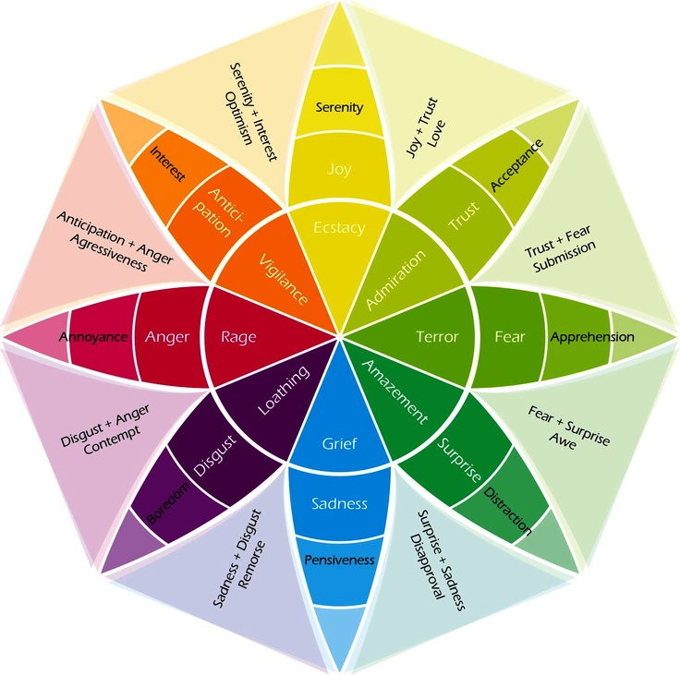
Question Focus
Plutchick’s Wheel of Emotions
“Being able to recognize emotions is more than simply having labels – students need to learn to apply those labels accurately to themselves and others”
All Learning is Social and Emotional: Helping Students Develop Essential Skills for the Classroom and Beyond
Source: Plutchick’s Wheel of Emotions
https://www.6seconds.org/2017/04/27/plutchiks-model-of-emotions/

Slide 16
Questions Produced
Who is Plutchick? (C) → Why should I believe Plutchick? (O)
Why is serenity and interest the only second tier emotion that is combined?
Are the extremes opposite of one another?
What is the significance of the colors?
How can we apply this in classrooms?
Are you always in one of these at all times?
What are the potential dangers of labels (O)→ are labels dangerous? (C)
Can rage ever be a productive emotion? (C) → When might rage be productive? (O)
What value is there to teaching this at a young age vs. older?
Are these related to the zones of regulation?
Do these emotions look different over time and individually?
Why is it important to label your emotions? (O)→ Is it important to label your emotions? (C)
Are the most intense emotions in the middle?
Why are the most intense emotions in the middle?
What research has been done to arrive at these emotions?
Why are there plus signs but no equals signs?
How are students supposed to recognize the difference between sadness and grief?
How do you label accurately when you’ve never experienced it?
Is this an exhaustive list of emotions?
What additional emotions should be added?

Slide 17
Professional Learning Example
Facilitator: Erin Horne, Preschool/Kindergarten principal
Setting: Team meeting with kindergarten teachers in Chicago, IL
Purpose: Address concerns, and come to a shared understanding and agreement on students’ play at recess

Slide 18
Question Focus
When on the playground, children need big body play

Slide 19
Questions Produced
What does consensual play look like?
What is the teachers’ role?
What does big body play look like? Sound like? Feel like?
Can big body play be on the playground structure?
How do we teach students to recognize body language and boundaries?
Can adults stop big body play?
What is the role of trees on the playground?
What are procedures for using the bathroom, going to the nurse, forgotten items?
What are appropriate games for big body play?
What equipment do we need to support this play?
What are storage options for the play equipment?
What is empowering language students can use during this play?
How do we support the need for big body play and communicate with all constituents meaning parents, supervisors, teachers, subs?
How can we support big body play when we cannot go outside?
What is expected noise level when outside and then when transitioning back into the school?
Should there be a transition between the play and next activity?
How can we help kids when their play has gone too far?
What does restorative justice look like when play has broken down with kids?
Does “Stop” “No” and “Ow” suffice for the language we want to teach the kids?
Does the child’s awareness of peers change with the age of the children and how does that impact play?

Slide 20
Outcomes
“I've had the experiences of using QFT with faculty and just like with children the process is so worthwhile. My colleagues feel they're part of the discussion and decision. They feel heard. We can come to a shared agreement about decisions that are made because of this process. We will continue the Big Body play discussion, produce a written understanding that we can all follow when supervising and share with the students and parents.”

Slide 21
Professional Learning Example
Facilitator: Kendall Evans, Director of Diversity and Inclusion
Setting: Start of the year conversation with faculty at an independent school in Austin, TX
Purpose: To open up dialogue among teachers about equity and inclusion needs and goals at the school

Slide 22
Question Focus
Diversity, Equity, and Inclusion at St. Andrew’s

Slide 23
Questions Produced
What education and actions do we need to be an inclusive community?
What spaces on our campus create further separation for students? How can we change spaces where students of color may feel marginalized?
How do we repair relationships when we mess up?
How do I know how much my students of color want to take on in any space? (advisory, class, etc.)
Where are our opportunities to build trust and community with students and parents?
How can we be more on point when speaking with white friends, co-workers, etc. about these important topics?
How do we define what needs to be addressed on this campus?
Where are we as a school on what teachers can say about race? (i.e. naming white privilege)
How do we reach the highest level of development in regards to race conversations? How do we remove shame from these conversations?
How do we handle these conversations when certain stake holders are not there?
How do we invite more people of color into our community?
How do we genuinely become a community that supports and celebrates a multicultural group/gathering?

Slide 24
Questions Produced
What untouchable questions are we not asking?
How does shared culture of some teacher/student relationships create inequality in the classroom?
To what extent is the school open to changing to accommodate values/beliefs of ALL families who comprise the school?
How do we educate parents about these issues?
Can we change the tendency to stay color mute?
How can our community learn to be more forthright but forgiving?
Is anyone else uncomfortable to be named white with a capital 'W'?
How can we undo the normalization of whiteness?
What role do administrators (development/marketing office) have to play in creating an anti-racist school? Calling families “clients”: how does our vocab contribute to privileging certain groups/their expectations?
Higher level classes = racial inequality? How can we disrupt? What changes have we made to help address this? What else could we do to affect change?
When we have very few kids of a certain identity in the room, how can we create a thoughtful/safe multicultural curriculum?
How do the white racial identities of teachers contribute to the system of inequality?
Can ignoring race contribute to racism/white supremacy?
Should we ask how whiteness plays a role in this story? (i.e. assuming white texts are not about race)
How do we disrupt binary thinking to move forward at SAS?

Slide 25
Next Steps
They did another round of the QFT when author, Ali Michael (Raising Race Questions: Whiteness, Inquiry and Education), came to visit later in the year, this time with the entire school community present: students, teachers, parents, alumni, parents of alumni and trustees
They worked in mixed groups to to decide together which questions the school should prioritize in the form of a viable action plan for the rest of the year

Slide 26
Outcomes
“It was probably one of the healthier conversations I've been involved in with my upper school faculty and colleagues since I've been here given that it was about diversity and inclusion and involved topics that have in the past led to less than ideal outcomes. I was surprisingly pleased by the outcomes this time around."

Slide 27

Virtual Professional Learning Examples
Topic: Plans for the 2020-2021 School Year
Purpose: Engaging school and district staff in contingency planning around COVID-19 and the start of the school year via ZOOM and GoogleDocs

Slide 28
Question Focus
The 2020-2021 school year will begin with a blended learning environment.

Slide 29
Selected Participant Questions
What are our options?
What are the advantages of having students alternating days with eLearning on the other days?
Would we do a staggered start?
What role would eLearning play?
How will the model we choose impact our community if parents are also going back to work?
How much time do we need to allow for cleaning?
How could we utilize our buildings differently?
How do we work with parents who do not want to send their student to school?
How can we continue to support parents?
What if the Health Dept. makes decisions around closing our district?
How do we need to adjust our supply lists to account for students learning at home/school?
How can we minimize costs to families?
How do we ensure every family has the technology they need for their child to e-learn?
How do we consider courses we can offer?
How do we look at vertical alignment to account for incomplete learning?
How do we continue to integrate the strengths we have discovered in eLearning?
How do we maximize face to face time?
How do we shift eLearning time to fit this blended approach?
Do we need to continue an eLearning plan for possible future closure?
What would it look like if we continued our team lesson planning and shared teaching responsibilities to help with sharing the load?

Slide 30
Next Steps with Questions
Participants suggested action steps as they were able and began to populate a shared google doc with questions, action steps, and information gathering
Several small groups formed to focus on different areas and report back
The principal reported: “It changed how I am approaching the problem. It doesn’t put all the pressure on one person. People aren’t worried about answers rather than just getting questions out there. Questions also create more questions which makes for a better decision making outcome.”

Slide 31
More Examples
Facilitator: Staff Development Specialist in Birmingham, AL
Setting: Orientation for new teachers
QFocus: The school’s purpose statement
Facilitator: Lecturer at a School of Education in Madison, WI
Setting: Intensive summer professional development institute
Purpose: For participating teachers to reflect on what is “intriguing, troubling, rewarding” about teaching writing and pick a question to pursue for their own practice
QFocus: Teaching Writing

Slide 32
More Examples
Facilitator: Library/Media Specialist and member of a district professional development committee in Delano, MN
Setting: Committee Meeting
Purpose: Explore a new idea with stakeholders (teachers) to address their feeling of being burdened to give personal time for their own professional growth in order to achieve the district's goals
QFocus: “Delano schools will implement an early release/late start schedule monthly to facilitate professional development activities in support of the District’s strategic plan”

Slide 33
Further Reading
5 Reasons Why the QFT Can Support Your Professional Learning Work by Matt Parilli
Leveraging the Question Formulation Technique for Professional Growth by Sandy Seufert
Coaching Through Questions: An Instructional Coach’s Experience with the QFT by Monique Almendarez

Slide 34


This resource may be reproduced or adapted, for noncommercial purposes, as long as it includes this reference:
“Source: The Right Question Institute - www.rightquestion.org. The Question Formulation Technique (QFT) was created by the Right Question Institute. Visit www.rightquestion.org for more information and free resources.”

