Slide 1
The Art and Science of the Question Formulation Technique
Notes:
Add RQI

Slide 2

QFT: An ART and a SCIENCE
The Science:
A rigorous protocol, with specific steps and sequence, that produces consistent results
The QFT
Discuss the rules
Present a Question Focus
Improve questions
Prioritize questions
Discuss next steps
Reflect

Slide 3

QFT: An ART and a SCIENCE
The Art:
Tailoring the QFT process to the specific content and students you are teaching.
Tailor the QFT through:
Design of the Qfocus
Instructions for prioritizing
Next steps for using the questions
Reflection questions
Facilitation

Slide 4
Notes:
Planning to teach using the QFT.

Slide 5
Five Areas Related to the Art of the QFT
Linking the QFT to Teaching and Learning Goals
QFocus Design
Prioritization Instructions
Reflection Questions
Facilitation

Slide 6
Various Teaching Purposes
  Engagement
  Knowledge acquisition
  Formative assessment
  Summative assessment

Slide 7
Five Areas Related to the Art of the QFT
Linking the QFT to Teaching and Learning Goals
QFocus Design
Prioritization Instructions
Reflection Questions
Facilitation

Slide 8
Question Focus Design:
Moving From Complicated to Simple

Slide 9

Initial Question Focus:

Slide 10
Revising the Question Focus:

Slide 11
Revised Question Focus:
“Good fiction creates its own reality.”
- Nora Roberts

Slide 12
Before reading Albert Camus’ The Plague

Slide 13
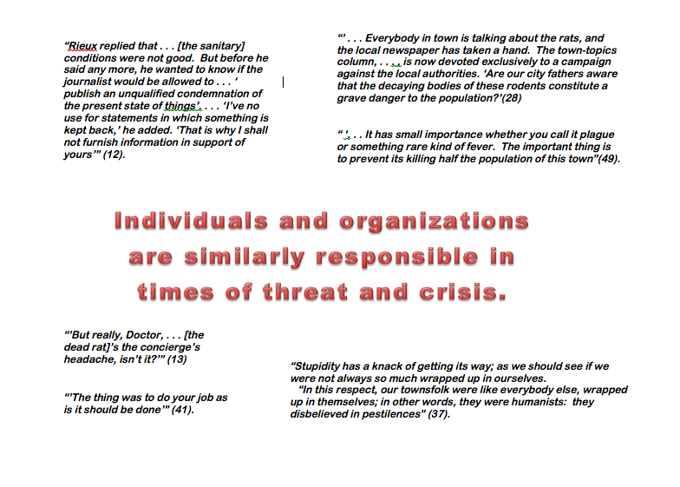
Initial Question Focus:

Slide 14
Revised Question Focus:
The city fathers were aware that the decaying bodies of these rodents were making people sick. (page 28)

Slide 15
Five Areas Related to the Art of the QFT
Linking the QFT to Teaching and Learning Goals
QFocus Design
Prioritization Instructions
Reflection Questions
Facilitation

Slide 16
Prioritization Instructions
Review your list of questions
Choose the three questions you consider most important.
While prioritizing, think about your Question Focus:
Some students are not asking questions.

Slide 17
Prioritization Instructions
Choose the three questions you consider most important.
Choose the three most important questions

Slide 18
Categories of Prioritization Instructions
Choose three questions…
General Instructions:
  that you consider most important
Specific Purposes:
  that you need to research further
  to help you solve the problem
  that you need to answer first
Comprehension:
  that will help you understand the text
  that require analyzing data

Slide 19
From Prioritization to Reflection
After prioritizing consider…
  Why did you choose those three questions?
  Where are your priority questions in the sequence of your entire list of questions?

Slide 20
Five Areas Related to the Art of the QFT
Linking the QFT to Teaching and Learning Goals
QFocus Design
Prioritization Instructions
Reflection Questions
Facilitation

Slide 21
Examples of Reflection Questions
QFT Process
Content Specific
What did you learn about asking questions?
How did you learn it?
What do you understand differently now about asking questions?
How can you use what you learned about asking questions?
How do you feel about asking questions?
What did you learn about the (content)?
How did the QFT process help you think about…
  key concept
  specific assignment
  overarching topic
  theme in the unit
  chapter you just read

Slide 22
Five Areas Related to the Art of the QFT
Linking the QFT to Teaching and Learning Goals
QFocus Design
Prioritization Instructions
Reflection Questions
Facilitation

Slide 23
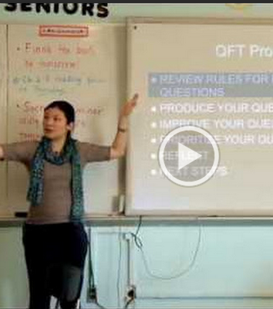
High School, Humanities
Teacher: Ling-Se Chesnakas
While watching observe:
What the teacher is doing.
What the students are doing.

Slide 24
High School, Humanities
http://rightquestion.org/qft-in-action/

Slide 25
Four Principles of Facilitation
Monitor student adherence to the process
Do not give examples
Do not get pulled into group discussion
Acknowledge all contributions equally
Notes:
Two recommendations to keep in mind while facilitating:
The QFT is not the time to correct grammar
The QFT is not the time to correct spelling
… this may come later, after the QFT.

Slide 26
Helpful Facilitation Tips
Avoid answering any questions while students are in the process of producing questions.
If a group slows down or gets stuck in their questioning, you may direct them to the QFocus again. For example, “Look at your QFocus and think about if there’s anything else you would like to know about it.”
If they’re really stuck, you may ask them to look at just one word of the QFocus and ask new questions about that.
The QFT is not a competition to ask the most questions. Some groups will produce more questions than others. As long as students have more than three questions, they will be able to complete the process.
Students who may ask only a few questions the first time may be absorbing the process and thinking about the content. Next time, they may ask more questions.

Slide 27
The Science of the QFT: a protocol
The Art of the QFT: You

Slide 28
The Key Role of the Teacher
Behind the scenes as lesson planner
Facilitate process according to the steps of the QFT and the five facilitation principles
Use student questions as part of next steps

Slide 29
Reflect
What do you understand differently now about the QFT?

Slide 30
The Skill of Asking Questions
For moving from ignorance to knowledge
For arriving at better answers
For increasing engagement and ownership
For demonstrating inquiry in the classroom
For a little more joy in a very demanding profession
And…

Slide 31
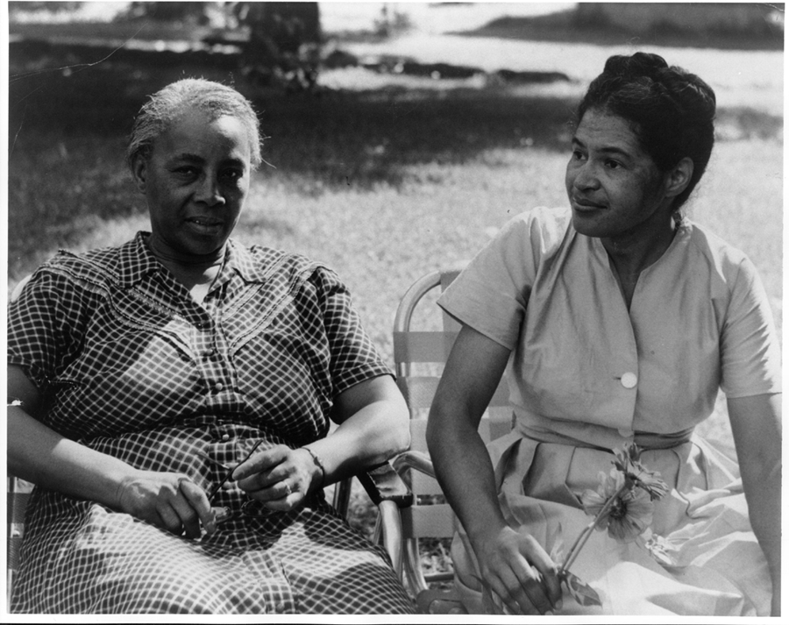
Education and Action
Image Courtesy of Highlander Research and Education Center
Notes:
Picture of Septima Clark (L) and Rosa Parks (r) at the Highlander Education and Research Center, Tennessee. 1958

Slide 32
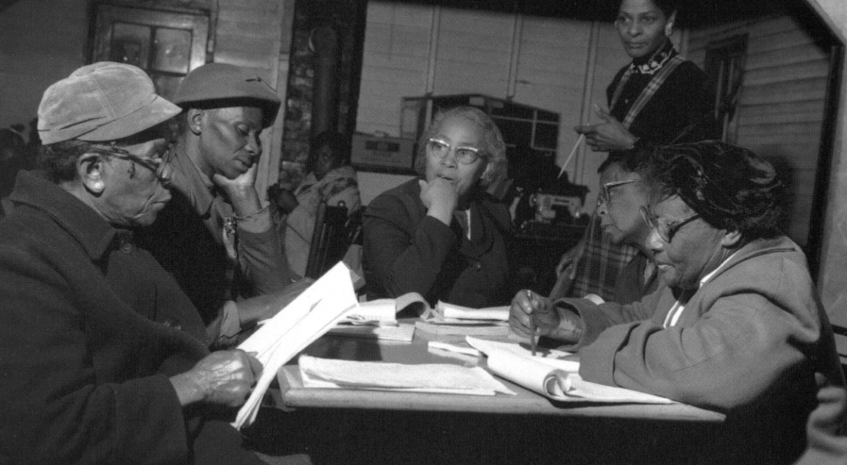
Democracy
“We need to be taught to study rather than to believe, to inquire rather than to affirm.” - Septima Clark
See Chapter 6 on Septima Clark in Freedom Road: Adult Education of African Americans (Peterson, 1996).

Slide 33
Resources
www.rightquestion.org/network

