Slide 1
Best Practices in the Question Formulation Technique (QFT)
Midwest Regional Seminar
Des Plaines, IL
June 28, 2018
Sarah Westbrook
Matt Parrilli
English Department Chair
Maine Township HS District
Director of Professional Learning
The Right Question Institute

Slide 2
Welcome
Jill Geocaris
Maine Township District 207
Innovative Adult Learning Coordinator

Slide 3
Acknowledgments
We are deeply grateful to the John Templeton Foundation and The Hummingbird Fund for their generous support of the Right Question Institute’s Million Classrooms Campaign.
We are grateful also to Jill Geocaris for her work behind the scenes and to all of our workshop facilitators who are joining us today.
#QFT #QFTCon

Slide 4
Who is in the room?
#QFT #QFTCon

Slide 5
We shall not cease from exploration
And the end of all our exploring
Will be to arrive where we started
And know the place
For the first time.
--T.S. Eliot

Slide 6
Today’s Agenda
Welcome and Community Building
Collaborative Learning with the
Question Formulation Technique (QFT)
Classroom Examples
The Art and Science of the QFT: A Deep Dive into Planning, Design, and Facilitation
Lunch
Workshop #1
Workshop #2
Informal Conversation & Reflection (optional)
#QFT #QFTCon
Notes:
There will be a scheduled break at 10:45. Lunch will be at about 12 noon.
Made#2 two lines and move optional to the end of #8.
Messed around a little with the Twitter info at bottom. – Eliminate it because of Slide 8?

Slide 7
To Access Today’s Materials:
http://rightquestion.org/educators/
seminar-resources/
Join our Educator Network for:
Templates you can use tomorrow in class
Classroom Examples
Instructional Videos
Forums and Discussions with other Educators

Slide 8
We’re Tweeting…
@RightQuestion
@MattParrilli
#QFT #QFTCon
Notes:
Do you want to add Luz or Dan to this slide?

Slide 9
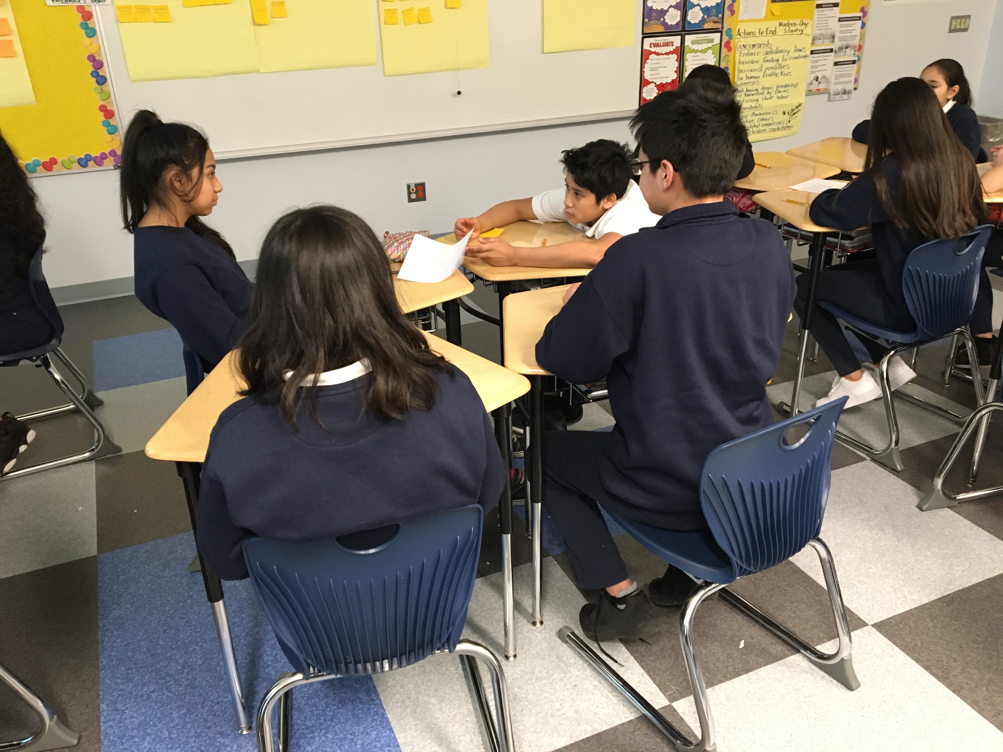
Why spend time teaching the skill of question formulation?

Slide 10
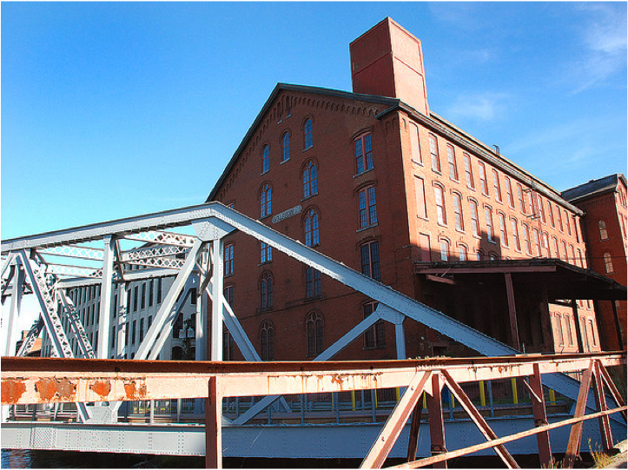
LAWRENCE, MA, 1990
“We don’t go to the school because we don’t even know what to ask.”

Slide 11
"There is no learning without having to pose a question."
- Richard Feynman
Nobel prize winning physicist
Notes:
Fixed punctuation of Nobel prize winning

Slide 12
“We must teach students how to think in questions, how to manage ignorance.”
- Stuart Firestein
Chairman of the Department of Biology at Columbia University

Slide 13
College Presidents on What Students Should Learn in College
“The primary skills should be analytical skills of interpretation and inquiry. In other words, know how to frame a question.”
- Leon Botstein, President of Bard College
“…the best we can do for students is have them ask the right questions.”
- Nancy Cantor, Chancellor of University of Illinois
The New York Times, August 4, 2002

Slide 14
Yet…only 27%of students believe college taught them to ask their own questions
Alison Head, Project Information Literacy at University of Washington, 2016

Slide 15
But, the problem begins long before college...

Slide 16
Percentage of Basic Skill Attainment
Sources
http://nces.ed.gov/nationsreportcard/pdf/main2009/2011455.pdf
http://nces.ed.gov/nationsreportcard/pubs/main2007/2008468.asp#section1
Data on question-asking based on parent and teacher feedback

Slide 17
Percentage of Basic Skill Attainment
Sources
http://nces.ed.gov/nationsreportcard/pdf/main2009/2011455.pdf
http://nces.ed.gov/nationsreportcard/pubs/main2007/2008468.asp#section1
Data on question-asking based on parent and teacher feedback
Notes:
Research that low income students ask fewer questions that middle and high income peers, academically low performing students ask fewer than middle and high performing peers
In class, teacher asks as much as 200 questions per 30 min; students ask 1-2. Students ask fewer than 4% of all questions in the average class.

Slide 18
We can work together on changing the direction of that slope.
Notes:
Added a period

Slide 19
We Are Not Alone
300,000 educators using the strategy all over the world

Slide 20
Now, Educators Lead the Work
The Right Question Institute offers materials through a Creative Commons License and we encourage you to make use of and/or share this resource. Please reference the Right Question Institute and rightquestion.org as the source on any materials you use.

Slide 21
What happens when students do learn to ask their own questions?

Slide 22
Research Confirms the Importance of Student Questioning
Self-questioning (metacognitive strategy):
Student formulation of their own questions is one of the most effective metacognitive strategies
Engaging in pre-lesson self-questioning improved students rate of learning by nearly 50% (Hattie, p.193)
John Hattie
Visible Learning: A Synthesis of Over 800
Meta-Analyses Relating to Achievement, 2008
Notes:
-UC Davis Research Linking Curiosity to Memory (UC Davis) 2014
-The Fullerton Longitudinal Study (FLS), a 30-plus year study of the development of giftedness across various points in time conducted by Adele and Allen Gottfried of California State University ”This finding has strong implications for the development of STEM considering that curiosity is a fundamental predictor of the aspiration to become a scientist.”
-S. von Stumm, B. Hell, T. Chamorro-Premuzic. The Hungry Mind: Intellectual Curiosity Is the Third Pillar of Academic Performance. Perspectives on Psychological Science, 2011 meta-analysis shows They found that curiosity did, indeed, influence academic performance. In fact, it had quite a large effect, about the same as conscientiousness. When put together, conscientiousness and curiosity had as big an effect on performance as intelligence.

Slide 23
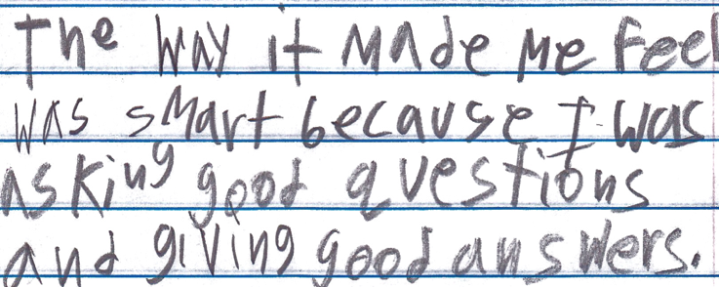
Student Reflection
“The way it made me feel was smart because I was asking good questions and giving good answers.”
-Boston 9th grade remedial summer school student

Slide 24
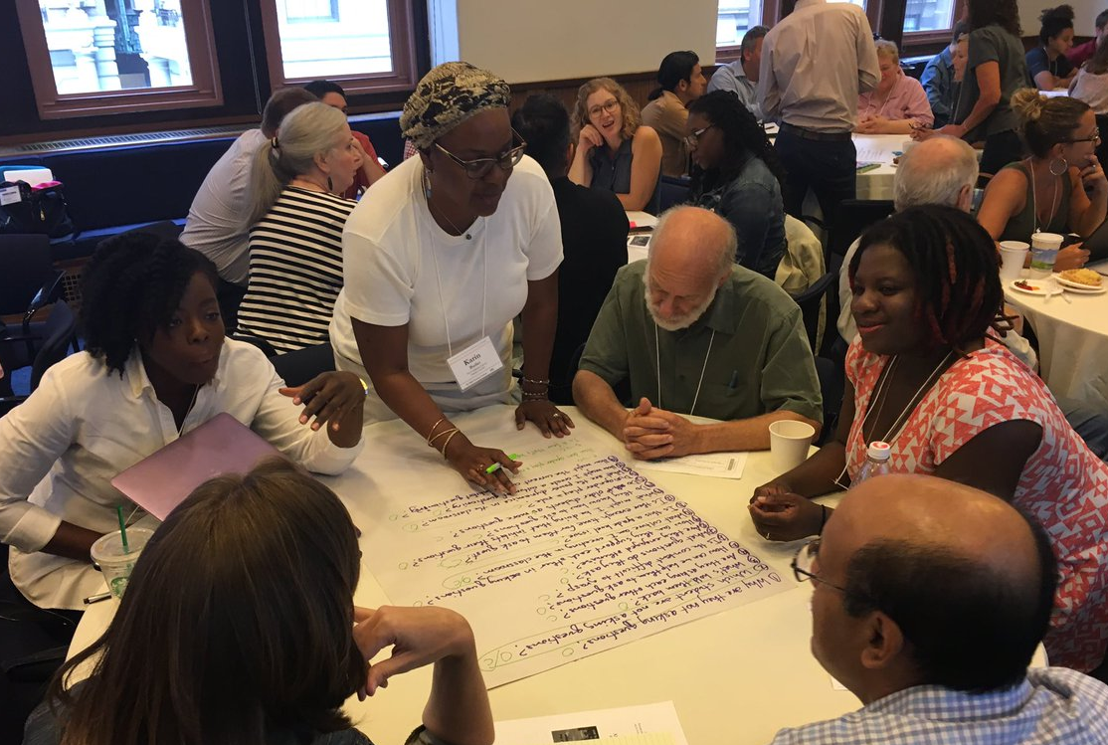
Collaborative Learning around a Common Problem with the Question Formulation Technique (QFT)

Slide 25
The Question Formulation Technique (QFT)
Students learn to:
Produce their own questions
Improve their questions
Strategize on how to use their questions
Reflect on what they have learned and how they learned it
#QFT #QFTCon

Slide 26
Rules for Producing Questions
1. Ask as many questions as you can
2. Do not stop to answer, judge, or discuss
3. Write down every question exactly as stated
4. Change any statements into questions

Slide 27
Produce Questions
Ask Questions
Follow the Rules
Ask as many questions as you can.
Do not stop to answer, judge, or discuss.
Write down every question exactly as it was stated.
Change any statements into questions.
Number the Questions

Slide 28
Question Focus:
Some students are not asking questions.
→Please write this statement at the top of your paper.
→Remember: Number the questions. Follow the rules.

Slide 29
Categorize Questions: Closed/ Open
Definitions:
Closed-ended questions can be answered with a “yes” or “no” or with a one-word answer.
Open-ended questions require
more explanation.
Directions: Identify your questions as closed-ended or open-ended by marking them with a “C” or an “O.”

Slide 30
Discussion
Closed-ended Questions
Advantages
Disadvantages

Slide 31
Discussion
Open-ended Questions
Advantages
Disadvantages

Slide 32
Change Questions
Take one closed-ended question and change it into an open-ended question.
Take one open-ended question and change it into a closed-ended question.
Closed
Open
Open
Closed

Slide 33
Prioritizie Questions
Review your list of questions
Choose the three questions you consider most important.
While prioritizing, think about your Question Focus: Some students are not asking questions.
After prioritizing consider…
Why did you choose those three questions?
Where are your priority questions in the sequence of your entire list of questions?

Slide 34
Strategize on How to Use Questions
From priority questions to action plan
In order to answer your priority questions:
What do you need to know? Information
What do you need to do? Tasks

Slide 35
Formulate an Action Plan
Information | Tasks

Slide 36
Share
Questions you changed from open/closed
Your three priority questions and their numbers in your original sequence
Rationale for choosing priority questions
Next steps

Slide 37
Reflection
What did you learn?
How did you learn it?
What do you understand differently now about some students not asking questions?

Slide 38
A Look Inside the Process
#QFT #QFTCon

Slide 39
The QFT, on one slide…
Question Focus
Produce Your Questions
Follow the rules
Number your questions
Improve Your Questions
Categorize questions as Closed or Open-ended
Change questions from one type to another
Prioritize Your Questions
Share & Discuss Next Steps
Reflect
Ask as many questions as you can
Do not stop to discuss, judge or answer
Record exactly as stated
Change statements into questions
Closed-Ended:
Answered with “yes,” “no” or one word
Open-Ended: Require longer explanation

Slide 40
Curiosity and Rigor
Three thinking abilities
with one process

Slide 41
Thinking in many different directions
DIVERGENT THINKING

Slide 42
Narrowing Down, Focusing
CONVERGENT
THINKING

Slide 43
The Importance of Questions
"Questions are the engines of intellect, the cerebral machines which convert energy to motion, and curiosity to controlled inquiry."
- David Hackett Fischer,
Historians' fallacies: Toward a logic of historical thought.
Routledge and Kegan Paul, 1971.
“[The QFT] helps me by getting me to think about questions on my own…it gets my mind in motion to think about the questions other people make."
- 8th grade student in James Brewster’s U.S. history class Gus Garcia Young Men’s Leadership Academy, Austin, TX, 2015
Notes:
This is why the QFT doesn’t stop at step 1; brainstorming, free-writing, etc, are different than what this process is doing—giving clarity and intention to curiosity.

Slide 44
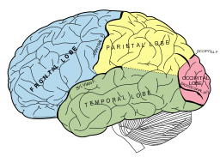
Thinking about Thinking
METACOGNITIVE
THINKING
Notes:
New slide

Slide 45
Exploring Classroom Examples

Slide 46
Classroom Example: Kindergarten
Teacher: Jennifer Shaffer, Walkersville, MD
Topic: Non-fiction literacy
Purpose: To engage students prior to reading a nonfiction text about alligators

Slide 47
Question Focus

Slide 48
Student Questions
Is the alligator camouflaged?
Why do the babies have stripes?
Are those baby crocodiles?
Is it a mom or dad crocodile?
What is the green stuff?
Why are they in the water so low?
Where are they going?
Why are the baby alligator’s eyes white and the mom’s black?
Why are baby alligators on top of the momma alligator?
Why does momma or daddy have bumps on them?

Slide 49
Classroom Example: 4th Grade
Teacher: Deirdre Brotherson, Hooksett, NH
Topic: Math unit on variables
Purpose: To engage students at the start of a unit on variables
Notes:
john

Slide 50
Question Focus
24 = ☺ + ☺ + ☺
Notes:
john

Slide 51
Student Questions
Why is the 24 first?
What do the smiley faces mean?
Why are there 3 smiley faces?
How am I suppose to figure this out?
Is the answer 12?
Can I put any number for a smiley face?
Do three faces mean something?
Do the numbers have to be the same because the smiley faces are the same?
What numbers will work here?
Does it mean 24 is a really happy number?
Can we replace each smiley face with an 8?
Do any other numbers work?
Can we do this for any number?
Does it always have to be smiley faces?
Do we always have to use three things?
Notes:
john

Slide 52
Next Steps with Student Questions
Questions posted on classroom walls.
Students cross off the questions they answer during subsequent lessons.
Teacher returns to student questions at the end of the unit to discuss with students what they learned and what they still want to know.
Notes:
john

Slide 53
Classroom Example: 7th Grade
Teacher: Nicole Bolduc, Ellington, CT
Topic: “The Universe and Its Stars” Unit
Purpose: To engage students in setting the learning agenda for the unit

Slide 54
Question Focus:
Students watched videos of dramatic tide change in Cape Cod, Alaska, and Canada
https://www.youtube.com/watch?v=mAYXZzKUAX4
https://www.youtube.com/watch?v=53EEDisloME

Slide 55
Selected Student Questions
Why does tide change?
How is tide created?
How does earth’s rotation cause the tide to change?
Does the sun have any part in the rise and retreat of tides?
Do tides occur because of the gravitational pull of the moon?
Do the phases of the moon come into play with the tides?
How do other planets affect it?
Are the tides opposite in Florida and Mexico? (b/c they share the Gulf of Mexico)
How come the tide changes greatly in some places but not others?
How far can high tide go?
How do tides affect people?
Can tide change be a problem in the future?
Does global warming affect tides?
Where does the water go to?
Does temperature have anything to do with tides?
Does tilt have anything to do with tides?
How do fish & wildlife survive when the tide is always changing?
If the moon disappeared, would there be no tides?
What would happen if the tide didn’t change?
Why are tides important to the earth?

Slide 56
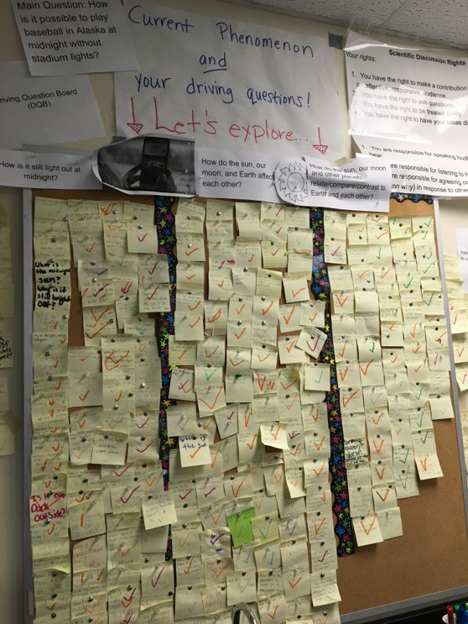
Next Steps:
The Driving Questions Board and the “Parking Lot”
Students draw initial models, give feedback, and make predictions.
Students experience a series of scientific investigations.
At the end of the unit, the Driving Question board is “published” in poster format.
Notes:
There is a whole prioritization process and practice identifying patterns and categories. And then…

Slide 57
Classroom Example:
High School
Teacher: Matt Parrilli, Park Ridge, IL
Topic: “The Room from Room 205” podcast
Purpose: To have students generate and prioritize questions to focus their listening and note taking

Slide 58
Question Focus
Notes:
Consider adding this slide?

Slide 59
Question Focus
Notes:
QFT
The View From Room 205
QFT
The View From Room 205
Priority Questions
The View From Room 205 Listening Guide

Slide 60
Selected Student Priority Questions
How does low or high income affect the chances of succeeding?
How does your community affect your chances of success?
What do public schools consider succeeding?
What is the comparison between teachers at public versus private/charter schools?
Is everyone really given an equal opportunity?
What will the school provide for a good learning environment?
Does income level dictate how well a student does?

Slide 61
Next Steps
After sharing and discussing each group’s priority questions as a class, students independently selected three questions that they were most interested in finding answers to from “The View from Room 205.”
Students took copous notes and wrote down evidence that they believed would help them to answer their selected priority questions. In addition to taking notes, students continued to ask questions raising new ones as they listened.
Students used their notes to compose a written response to one or more their selected priority questions.
Students discussed their responses with their original QFT groups and identified priority questions that were unanswered by “The View from Room 205.”
In the future, I would like to have students conduct independent research on a questions that is still unanswered or a new question that they generated while listening to the podcast.

Slide 62
Student Reflections
“Student hunger throughout the day affected their education.”
“I found out that it (success) is not about A’s and B’s. It is about standardized test scores. Schools were graded/examined based on standardized test scores, so that’s what they focused on.”
“Your community significantly affects your chances especially your home life. Kareem, for example, because his home life found it hard to focus at school and be successful.”
“Teachers do their best to help these children succeed, but it is hard for them to make it because of where they are from, a place where success isn’t common.”
Notes:
I think this slide could be CUT.

Slide 63
Professional Learning Example
Principal: Nat Vaughn, Medfield, MA
Setting: A schoolwide faculty meeting
Purpose: To build consensus around creating a schoolwide homework policy
Notes:
While the focus of this course is on using the QFT with students in the classroom, we are seeing many very effective applications of the QFT for working with adults in school and other settings.

Slide 64
Question Focus
“Homework practices vary at our school.”
“Homework practices are inconsistent at our school.”
Notes:
Which one is the Q Focus?

Slide 65
Outcomes
“The conversations that took place resulting from the process were rich, meaningful, and productive. The simple process provided a non-judgmental structure to address a significant ‘issue’ in our school and led us to a position of recognizing and embracing a need for change.”
Notes:
Fixed single quote next to issue

Slide 66
Why is question formulation so important now?

Slide 67
In the Age of Google…
“How should you respond when you get powerful new tools for finding answers?
Think of harder questions.”
Clive Thompson, Journalist and Technology Blogger
Notes:
Made Think of harder questions size 32.

Slide 68
The Skill of Asking Questions
For rewriting ignorance as weakness to ignorance as opportunity
For arriving at better answers (and more questions)
For increasing engagement and ownership
For a little more joy in a very demanding profession
And…

Slide 69
Democracy
“We need to be taught to study rather than to believe, to inquire rather than to affirm.”
- Septima Clark
See Chapter 6 on Septima Clark in Freedom Road: Adult Education of African Americans (Peterson, 1996).
Notes:
Moved name to a third line

Slide 70
Today’s Agenda
Welcome and Community Building
Collaborative Learning with the Question Formulation Technique (QFT)
Classroom Examples
The Art and Science of the QFT: A Deep Dive into Planning, Design, and Facilitation
Lunch
Workshop #1
Workshop #2
(optional) Informal Conversation & Reflection
#QFT #QFTCon
Notes:
There will be a scheduled break at 10:45. Lunch will be at about 12 noon.

Slide 71
QFT: An ART and a SCIENCE
The Science:
A rigorous protocol, with specific steps and sequence, that produces consistent results
The QFT
Discuss the rules
Present a Question Focus
Improve questions
Prioritize questions
Discuss next steps
Reflect

Slide 72
QFT: An ART and a SCIENCE
The Art:
Tailoring the QFT process to the specific content and students you are teaching.
Tailor the QFT through:
Design of the Question Focus (Qfocus)
Instructions for prioritizing
Next steps for using the questions
Reflection questions
Facilitation

Slide 73
Five Areas Related to the Art of the QFT
Facilitation
Starting at the End
QFocus Design
Prioritization Instructions
Reflection Questions

Slide 74
Classroom Example: High School
Teacher: Ling-Se Chesnakas, Boston, MA
Topic: 12th Grade Humanities unit on The Brief Wondrous Life of Oscar Wao by Junot Diaz
Purpose: To help students generate questions for a Socratic Seminar at the end of the unit

Slide 75
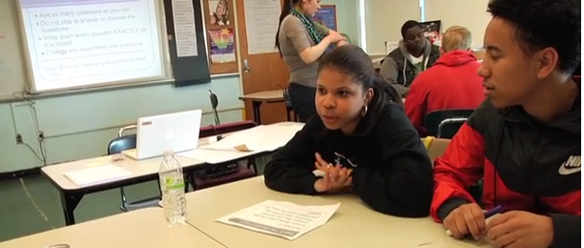
The Question Formulation Technique (QFT) in Action
http://rightquestion.org/qft-in-action/

Slide 76
Four Principles of Facilitation
Monitor student adherence to the process
Do not give examples
Do not get pulled into group discussion
Acknowledge all contributions equally
Discuss: What could be challenging about each principle? What might be important about each?

Slide 77
Five Areas Related to the Art of the QFT
Facilitation
Starting at the End
QFocus Design
Prioritization Instructions
Reflection Questions

Slide 78
The QFT , Not a Detour but a Shortcut
Notes:
Give a couple examples…ie Deirdre didn’t have to do a couple of the lessons she was planning, bc kids were further along than she thought and had figured out a couple things already!

Slide 79
Various Teaching Purposes
Engagement
Knowledge acquisition
Formative assessment
Summative assessment
Peer review
Skill development
Notes:
Put a space after each bullet.

Slide 80
Using the QFT for Engagement
Notes:
Teacher: Nicole Bolduc, Ellington, CT 7th Grade Science

Slide 81
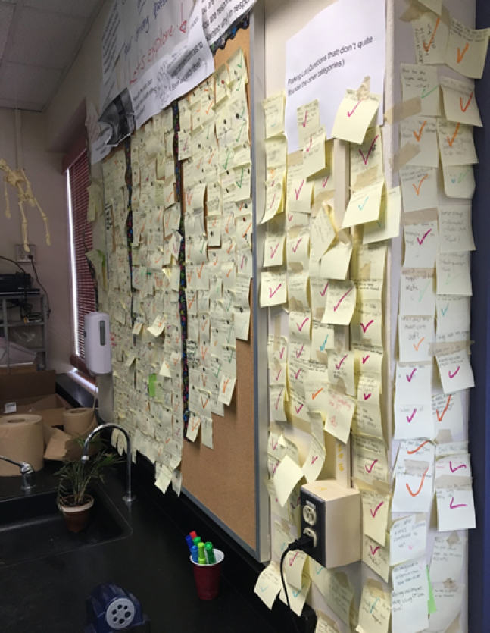
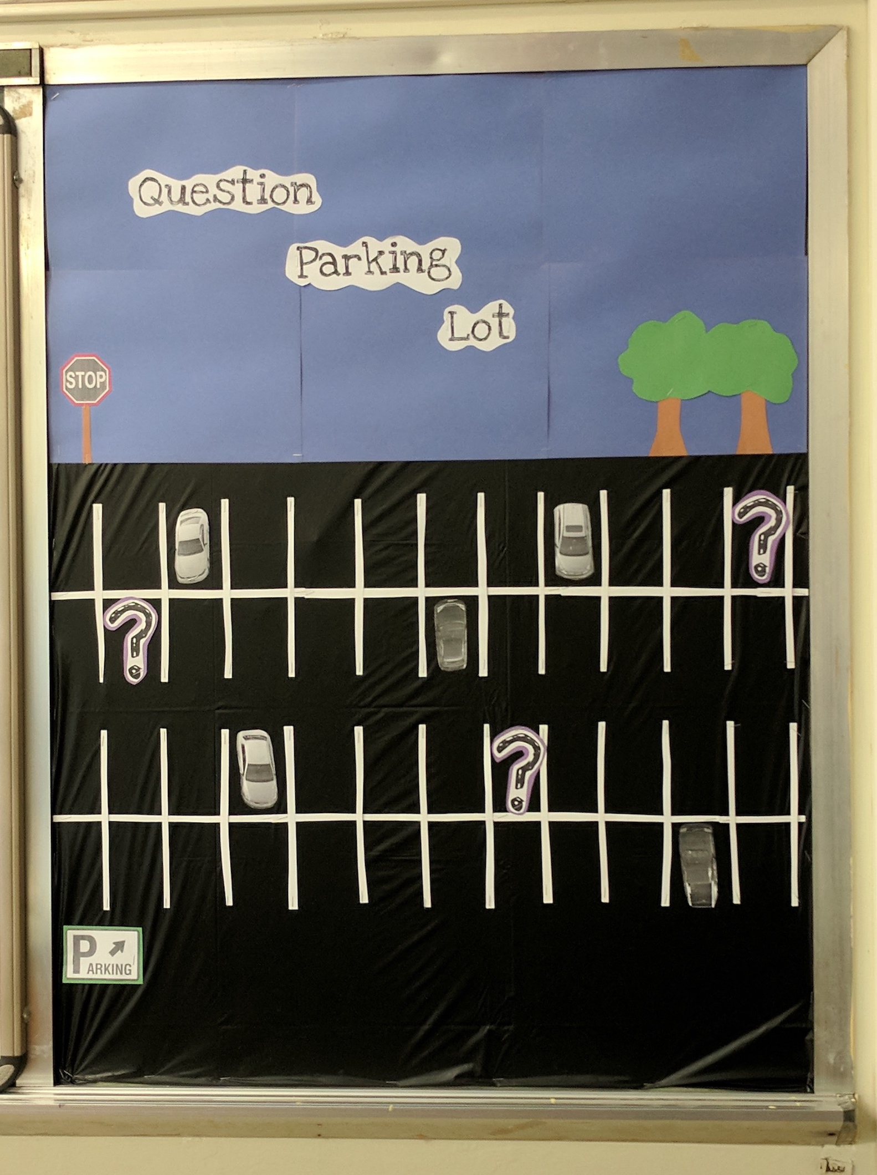
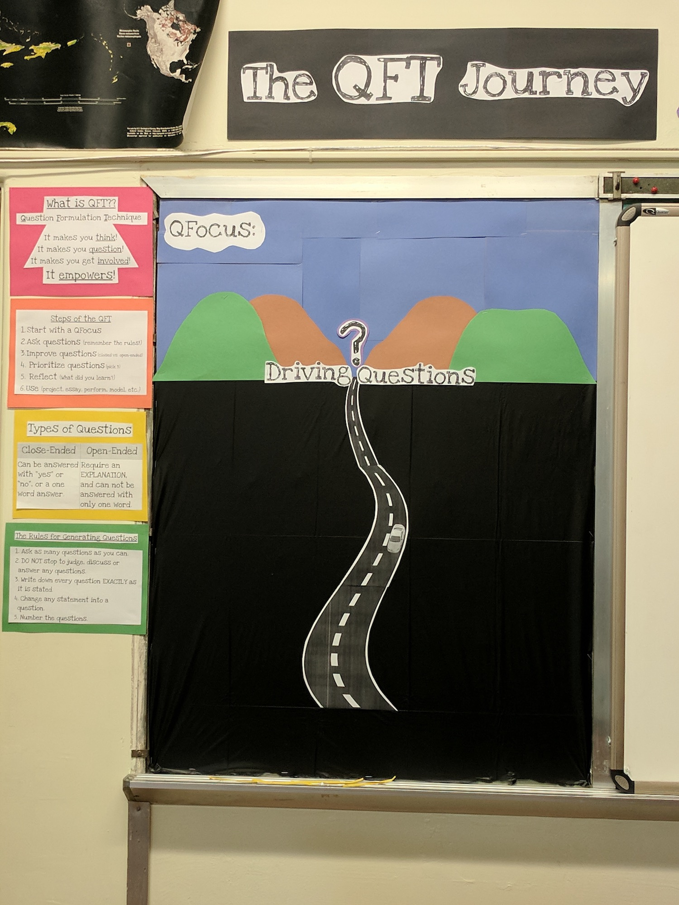
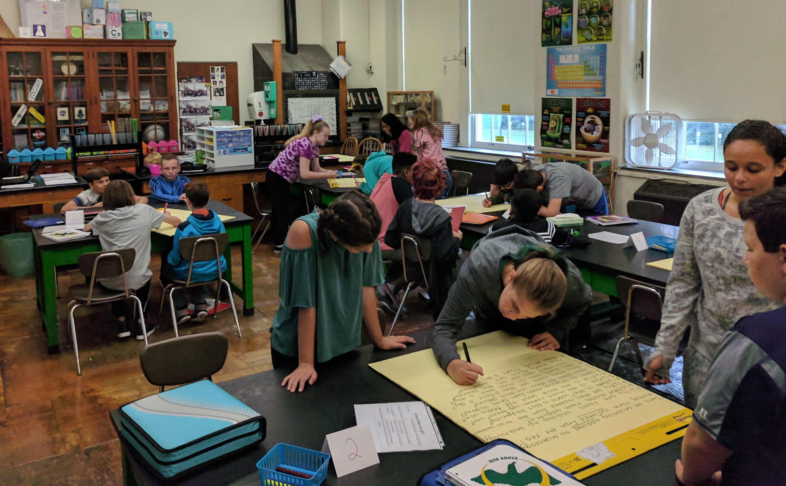
Next Steps with Student Questions
The Driving Question Board
The “Parking Lot”
Ongoing student choice projects

Slide 82
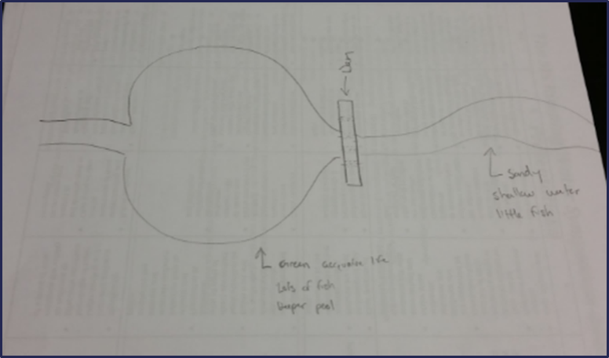
Using the QFT for Peer Review
Scientist’s claim:
“Adding a dam to a water system causes a decrease in aquatic life downstream.”
Student Design to test the claim:
Notes:
Teacher: Allison Gest, Park Ridge, IL
Topic: 11th & 12th Grade Geology
Purpose: To help students design a running water experiment and then refine their designs
*Note: teacher also used a QFT process first with the scientist’s claim as a Qfocus. Students designed their experiments based on their own questions (generated during the QFT about the scientist’s claim)

Slide 83
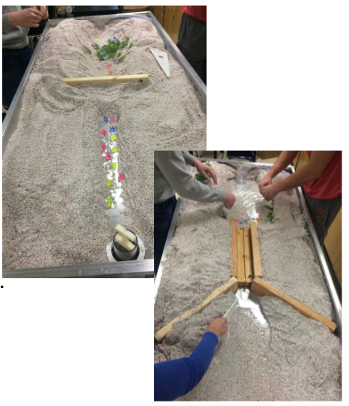
Next Steps with Student Questions:
Notes:
Students used the QFT on a different group’s design.
Students then revised their design informed by the questions from their peers.
Groups tested their final experiment design.

Slide 84
Using the QFT for Skill Development
(Students were assigned a complex molecular biology article)
QFocus: Ask as many questions as you can about the reading
Notes:
Teacher: Rachel Woodruff, Assistant Professor of Biology, Brandeis University, MA
Topic: Molecular Biology
Purpose: To build students’ research skills and prepare them to develop their own research proposal

Slide 85
Next Steps with Student Questions:
Students lead themselves through the QFT as homework and bring in their questions
In class, students discuss key attributes of a good biological research question and compare to other types of questions
Students improve their questions
Lists of questions are discarded or kept in notebooks (up to the student)
Students apply this skill to designing their own research project later in the semester

Slide 86
Putting it into Practice: Brainstorm 2-3 ways you might use the QFT in your context
Notes:
May not have time

Slide 87
Various Teaching Purposes
Engagement
Knowledge acquisition
Formative assessment
Summative assessment
Peer review
Skill development
Notes:
Same slide as 79?

Slide 88
Next Steps?
Pop Quiz or Reading Check
Debate Prep
Paper topic
Lab work & Experiments
Exit ticket or ”Do Now”
Hang on walls,
Check Off as Answered
Research
Projects
Test Prep
And sometimes…
Nothing!
Homework
Class discussion prompts
Presentations
Student Choice Projects
Socratic Seminar Prompts
Interview an Expert
Make Your Own Final Test
Journal Prompt
Guest speakers
Close Reading Protocol
Year-long or Unit-long Essential Questions
Tailoring Instruction
Service Action Projects

Slide 89
Five Areas Related to the Art of the QFT
Facilitation
Starting at the End
QFocus Design
Prioritization Instructions
Reflection Questions
Notes:
We’ve got to get them to work!

Slide 90
Question Focus (QFocus): A focus or prompt for student questions
A phrase or quotation
An image or video
A podcast or speech
A hands-on experience or experiment
An equation or data set
The QFocus is not a question!

Slide 91
Designing a Question Focus
An effective QFocus is
Simple…but not too simple
Directly tied to lesson’s main idea
Interesting or provocative to students…but not biased or leading

Slide 92
Initial Question Focus:
Notes:
Teacher: Joan Soble, Cambridge, MA
Topic: Albert Camus’s The Plague
Purpose: Pre-reading engagement and prediction of central themes going into the text
Cambridge, MA High School

Slide 93
Revised Question Focus:
The city fathers were aware that the decaying bodies of these rodents were making people sick. (page 28)

Slide 94
Initial Question Focus: “People, Animals, and Friends”
Do people exist?
Where do people live?
Why do animals live in the zoo?
Why do people go to the pool?
Why are friends fun?
Why do animals bite?
Why do people go to school?
Do people, animals, and friends play together?
Do animals make friends?
Why do I need friends?
Why do people want to be friends with animals?
Why are people making friends with animals?
Why do people, animal, and friends live in different countries?
Where did my dog and friend go?
Can my friend pet our new dog?
Why do I have eyes?
How do people smell?
Can animals speak?
Can people fly?
Where is my bunny? What happened?
Notes:
Let’s look at one more example of a Qfocus that needed some revision. This is from an elementary classroom in Hawaii.
The initial Qfocus was the phrase “people, animals, and friends,” and the teacher was engaging students at the start of a unit on “How can a pet be an important friend?”
I’m going to show you the questions that students asked in response to this Qfocus. As you read the questions, think about what do you notice? What do the questions tell you about the Q-Focus?
PAUSE.
Apart from noticing how adorable question #20 is, you may have noticed:
First (In orange), Most of the kids picked one of the three nouns (people, animals, OR friends) and zeroed in on it, asking questions that didn’t consider it in relationship to the other words in the prompt. These lines appear in purple. To me, this indicates that most kids just didn’t have enough direction, guidance from the Qfocus. They needed more hooks to go on, or maybe an image.
Second (Blue) : there is really good information here about what students care about and are interested in, in questions about their own pets and their own friends, which may be helpful to the teacher going forward or in re-designing a Qfocus
Third and finally (IN purple): some students are really thinking about the relationship b/w the 3 things listed and trying to connect the 3, so even in a batch of questions that are kind of off topic/not what the teacher expected, she could still have used #11 or #12 in her next steps.

Slide 95
Revising the Question Focus
“People, Animals, and Friends”
Your idea here!
Notes:
Activity: What would you do with this Q-Focus, now with the benefit of hindsight and having analyzed the student’s questions? What advice might you give to this teacher?
Discuss at tables, each table report back their best idea.
It may be helpful for participants to first review Marie’s initial list of Q-Focus ideas.
My ideas:
I wonder what they would ask about, for ex, "humans need animal friends" or "animals are very important friends to humans" or "friendship between people and animals"? Maybe even more provocative: "To survive, people need animal friends." This is where Dan and I sometimes go back and forth; adults/teens can sometimes benefit from a more open-ended, vague phrase; sometimes kids need more "hooks," more of a complete thought to guide their thinking.
Here's another thought. Say you kept the same Q-Focus and all the same questions--could you get kids, through prioritization, to your goal? (If you didn’t want to do the QFT all over again) What if the prioritization instructions were, "out of all our class questions, pick the 3 questions that you think would help us learn about friendships between pets and humans." Bingo—right back on track, no extra time, still honors their process.

Slide 96
Initial Question Focus Design Process
Topic: A unit on “How can a pet be an important friend?”
How can a pet be an important friend?
Collage of pictures: dogs, cats, guinea pigs, horses, other pets
Picture of a human and a service animal
Picture of a human and a service animal paired with a phrase like “people and animals”
“People and animals”
“People, animals, and friends”
Notes:
This is the process the teacher went through to come down to final QFocus. (some of the ideas she ruled out may actually have been better in retrospect) but there were reasons she made the choices she did. Mostly, she wanted to simplify and give kids the chance to name the relationship between people and animals themselves.
The Qfocus she used was “people, animals, and friends.”

Slide 97
Putting it into Practice

Slide 98
WANTED: Q Focus Guinea Pigs
Directions:
Work through the lesson planning workbook through page 5.
Try creating your own Q Focus! It’s ok if it is a bit rough.
Write it on an index card.
Trade cards with a partner.
Generate questions about your partner’s Q Focus.
Trade back and use their questions to guide revision of the QFocus.
Notes:
Directions:
They should be using/referencing the lesson planning workbook during this time.
Give people at least 15-20 minutes (more is better) to start coming up with their own Qfocus. Give time warnings. Circulate the room to help, try to turn as much as possible back over to participants when they ask questions. They’re the experts on their own subjects and kids!
After allotted time, call for guinea pigs to share.

Slide 99
Five Areas Related to the Art of the QFT
Facilitation
Starting at the End
QFocus Design
Prioritization Instructions
Reflection Questions

Slide 100
Prioritization Instructions
Choose the three most important questions
Choose the three questions you consider most important.

Slide 101
Categories of Prioritization Instructions
Choose three questions…
General Instructions:
that you consider most important
Specific Purposes:
that you need to research further
to help you solve the problem
that you need to answer first
that a scientist studying the earth might ask
that will help you understand the text
that require analyzing data
that are not “Googleable” and may be difficult to answer

Slide 102
QFocus: High School
“History, despite its wrenching pain, cannot be unlived, but if faced with courage, need not be lived again.”
– Maya Angelou
Troubleshooting Tips:
“Spend the next 2 minutes asking about just this word/phrase”
Change the Prioritization Instructions on the fly
Notes:
This is an example from a history classroom in Rhode Island. The teacher gave students this full quotation with the attribution to Maya Angelou. During the first step of producing questions, she noticed that most students were focusing their questions on Maya Angelou, rather than the content of the quotation—”who was Maya Angelou? Why would she say this? What in her history needed to be faced?” which are all great questions, but they didn’t suit the teacher’s purpose; she needed them to ask some overarching questions about history to guide their work all year.
Now, of course, the teacher could make a change to the Qfocus next year and just take out the words “Maya Angelou,” but what does she do now, in the middle of the lesson?
There are two easy fixes. First, as you facilitate the first step, producing questions, you could give students additional directions: READ slide.
Second, you could change the prioritization instructions on the fly: READ Slide
So, prioritization instructions are crucial for helping students narrow down, especially if there is a specific direction you have in mind.

Slide 103
Five Areas Related to the Art of the QFT
Facilitation
Starting at the End
QFocus Design
Prioritization Instructions
Reflection Questions

Slide 104
Examples of Reflection Questions
QFT Process
Content Specific
What did you learn about asking questions?
How did you learn it?
What do you understand differently now about asking questions?
How can you use what you learned about asking questions?
How do you feel about asking questions?
What did you learn about the (content)?
How did the QFT process help you think about…
key concept
specific assignment
overarching topic
theme in the unit
chapter you just read

Slide 105
One Last Thought about Reflection
“Reflection is the piece that keeps me coming back the next day…”
“The most profound reflections are almost always from the students who perhaps seemed disengaged in class. Quiet students often do a great deal of their thinking in the written reflection.”
-Ling-Se Chesnakas, Boston Public Schools

Slide 106
The Science of the QFT: a protocol
The Art of the QFT: You
Notes:
The key role of the teacher and YOU ARE sTILL In CONTROL:
Behind the scenes as lesson planner
Facilitate process according to the steps of the QFT and the five facilitation principles
Use student questions as part of next steps

Slide 107
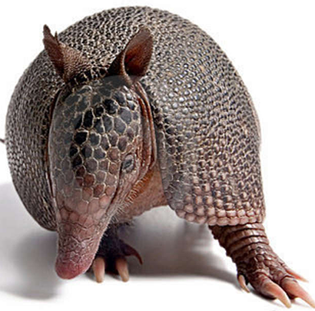
The one quality all excellent QFT designers share?
Thick Skin.
Notes:
Practice makes…more comfortable anyway.

Slide 108
Today’s Agenda
Welcome and Community Building
Collaborative Learning with the Question Formulation Technique (QFT)
Classroom Examples
The Art and Science of the QFT: A Deep Dive into Planning, Design, and Facilitation
Lunch
Workshop #1: 12:45 - 1:45
Workshop #2: 2:00 - 3:05
Informal Conversation & Reflection (optional)
#QFT #QFTCon
Notes:
Reiterate the invitation to join the conversation at the end is optional.
Ask each presenter to just sort of give a short intro or snapshot.
Remind that you must fill out eval at end of last session and come back to main room for credit sheet.

Slide 109
Workshop Sessions
Session #1: 12:45 - 1:45 pm | Room
Digital Tools to Support the QFT Jay Sorensen | Oxnard Union High School | B200
QFT as a Vehicle for Social Justice Erica Ferguson | Chicago Public Schools | 203
Using the QFT with Special Student Populations Nancy Cohen | Northwood Junior High School District | 205
What is Your QFT Destination? Dan Fouts| Maine Township | 201C
Notes:
Not sure which chart we will use yet

Slide 110
Workshop Sessions
Session #2: 2:00 - 3:05 pm | Room
Digital Tools to Support the QFT Jay Sorensen| Oxnard Union High School | B200
Roadmap to the Right Questions for Early Learners Cynthia Benoit| Chicago Public Schools | 205
Teaching Students How to Ask STEM Questions Allison Gest | Maine Township | 203
What is Your QFT Destination? Dan Fouts| Maine Township | 201C
Notes:
I like this one more.

Slide 111
Today’s Agenda
Welcome and Community Building
Collaborative Learning with the Question Formulation Technique (QFT)
Classroom Examples
The Art and Science of the QFT: A Deep Dive into Planning, Design, and Facilitation
Lunch
Workshop #1
Workshop #2
(optional) Informal Conversation & Reflection
#QFT #QFTCon
Notes:
Reiterate the invitation to join the conversation at the end is optional

Slide 112
Closing Reflections
We shall not cease from exploration
And the end of all our exploring
Will be to arrive where we started
And know the place
For the first time.
--T.S. Eliot
Notes:
To use during discussion possibly

Slide 113
Closing Reflections
What did you learn?
An “a-ha moment” or a meaningful take away from your experience today
A key question that will guide your work
What was new for you?
Notes:
To use during discussion usually

