Slide 1
A Simple and Powerful Strategy for Building School-Family Parnerships
The Right Question Strategy
Luz Santana
@rightquestion

Slide 2
- Your name - Where do you work and your position - Two things you wish the families you work with could do better “Travelers, there is no path, paths are made by walking.” ― Antonio Machado

Slide 3
Agenda
About the Right Question School-Family Partnership Strategy
Introduction to the Support, Monitor, and Advocate Model
Formulating Questions Using the Question Formulation Technique (QFT)
Asking Question about Decision: the Framework for Accountable Decision Making
Integrating the RQI Strategy
Practicing Using the Strategy
Lessons
Closing and Evaluation

Slide 4
About the Right Question School-Family Partnership Strategy

Slide 5
LAWRENCE, MA, 1990
“We don’t go to the school because we don’t even know what to ask.

Slide 6
A strategy that focuses on:
Sharing two skills:
Asking better questions
Participating more effectively in decisions
So that parents can play three roles:
Support
Monitor
Advocate

Slide 7
Lessons…
8 WORKSHOPS
How to Choose Your Child’s School
How to Use and Evaluate the Service: Communicating with the Teacher and Principal
When the School Evaluates Your Child , It Evaluates Itself
Who is Responsible for Discipline?
Discipline Leading to Evaluation
The School as a Part of the Political System
The School Committee
The School Budget

Slide 8
Family Engagement
Health Care
Innovation
The Classroom
Over 200,000 teachers using the strategy

Slide 9
Materials
The Right Question Institute offers many of our materials through a Creative Commons License and we encourage you to make use of and/or share this resource. Please reference the Right Question Institute as the source on any materials you use.
Source: www.rightquestion.org

Slide 10
The Right Question School-Family Partnership Strategy
ASCD Member Book, September, 2016

Slide 11
An integrated strategy
A Strategy, NOT a program
Complementary to existing programs

Slide 12
The Right Question Strategy
The Support, Monitor, and Advocate Model
Organizing parent participation into three main areas
The Question Formulation Technique (QFT)
Producing, improving and strategizing on how to use questions
The Framework for Accountable Decision Making
An analytical structure that allows parents to focus on decisions and ask questions about three key areas

Slide 13
Outcomes
Parents have foundational skills they can use to partner and advocate more effectively
Parents and school staff are resources for each other on behalf of children
Educators and school staff have tools and a strategy to engage and prepare parents to partner more effectively

Slide 14
The Build the foundation
Build the foundation first.
Teach parents:
about three roles they can play
how to ask their own questions
how to focus effectively on decisions

Slide 15
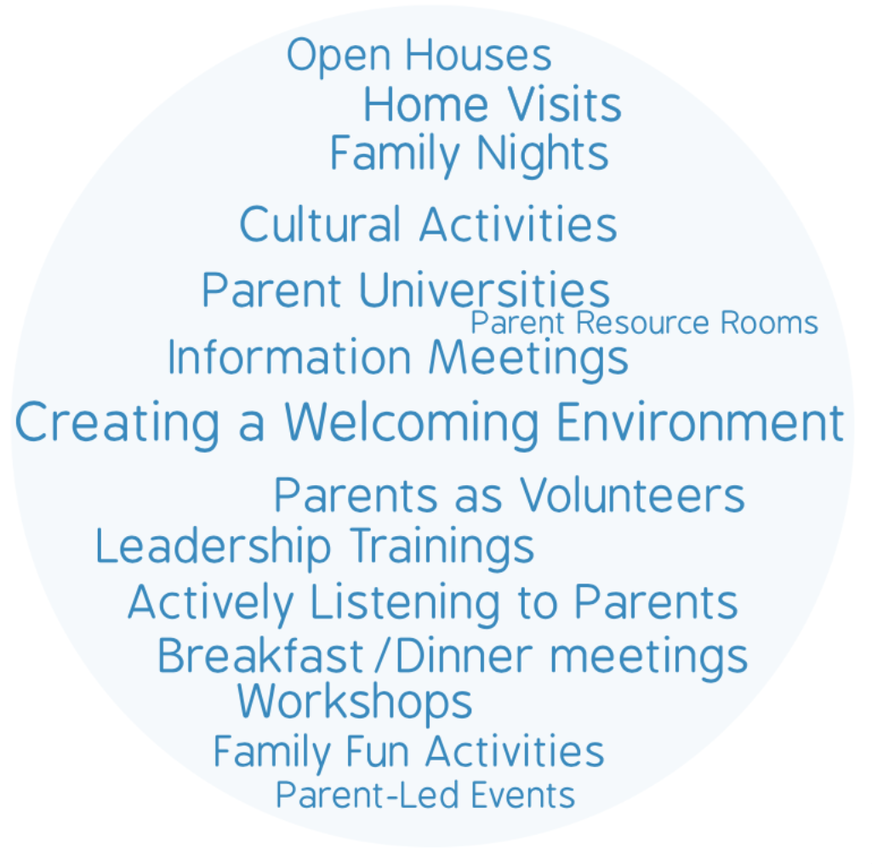
Parent Engagement Activities

Slide 16
Agenda
About the Right Question School-Family Partnership Strategy
Introduction to the Support, Monitor, and Advocate Model
Formulating Questions Using the Question Formulation Technique (QFT)
Asking Question about Decision: the Framework for Accountable Decision Making
Integrating the RQI Strategy
Practicing Using the Strategy
Lessons
Closing and Evaluation

Slide 17
Support, Monitor, and Advocate
Three Key Roles Parents Can Play:

Slide 18
Preparing to Work
Support Monitor Advocate

Slide 19
Parents as supporters
To help; to provide for;
to be available for
their children.
Name two things parents can do to support their child.

Slide 20
Parents as monitors
Watch / Keep track of:
their children’s progress
their children’s needs
Name two things parents can do to monitor their child.

Slide 21
Parents as advocates
Parents speak up and make specific requests on behalf of their children.
Name one situation in which parents should advocate for their child.

Slide 22
Share
What parents can do to support, monitor, and advocate

Slide 23
Reflection:
What could happen if parents support but don’t monitor or advocate?
And what could happen if they advocate, but don’t support or monitor?

Slide 24
Reflection:
What did you learn?
How can you use it?

Slide 25
The Support, Monitor and Advocate Model
Parents:
Name how they are supporting, monitoring and advocating
Identify other actions they can take to support, monitor and advocate
Name what they would like to learn to play the roles more effectively

Slide 26
Practice Facilitation

Slide 27
Preparing to Role Play
Decide in your group who will play the following roles:
Facilitator of the process
Parent
Observer

Slide 28
Support, Monitor, and Advocate
Introduce and define one role at a time
Ask parent to name two examples of how they are playing each role
Ask parent to think about other work they can do to support, monitor and advocate
Ask parent to think about what why would like to learn to support, monitor and advocate more effectively
Ask parent to reflect

Slide 29
Agenda
About the Right Question School-Family Partnership Strategy
Introduction to the Support, Monitor, and Advocate Model
Formulating Questions Using the Question Formulation Technique (QFT)
Asking Question about Decision: the Framework for Accountable Decision Making
Integrating the RQI Strategy
Practicing Using the Strategy
Lessons
Closing and Evaluation

Slide 30
An experience in the Question Formulation Technique (QFT)

Slide 31
Rules for Producing Questions
ASK AS MANY QUESTIONS AS YOU CAN
DO NOT STOP TO ANSWER, JUDGE OR DISCUSS
WRITE DOWN EVERY QUESTION EXACTLY AS STATED
CHANGE ANY STATEMENTS INTO QUESTIONS

Slide 32
Question Focus (QFocus)
Some parents are not asking questions

Slide 33
Some parents are not asking questions
QFocus:
Ask Questions
Follow the Rules
Ask as many questions as you can.
Do not stop to answer, judge, or discuss.
Write down every question exactly as it was stated.
Change any statements into questions.
Number the Questions

Slide 34
Improving questions: Identify closed and open-ended questions
Definitions:
Closed-ended questions can be answered with a “yes” or “no” or with a one-word answer.
Open-ended questions require
more explanation.
Identify your questions as closed-ended or open-ended by marking them with a “C” or an “O.”

Slide 35
Discussion
Closed-ended Questions
Advantages
Disadvantages

Slide 36
Discussion
Open-ended Questions
Advantages
Disadvantages

Slide 37
Improving questions: Change questions from one type to the other
Take one closed-ended question and change it into an open-ended question.
Take one open-ended question and change it into a closed-ended question.
Closed
Open
Open
Closed

Slide 38
Improving questions
Prioritize:
Review your list of questions
Choose the three questions you consider most important.
Keep in mind your QFocus: Some parents are not asking questions
After prioritizing consider…
Why did you choose those three questions?
Where are your priority questions in the sequence of your entire list of questions?

Slide 39
Strategizing on how to use questions
Next Steps:
What do you need to know? Information
What do you need to do? Tasks
Information Tasks

Slide 40
Share Your Work
Please share:
The questions you changed
Your three priority questions
Your rationale for selecting those three
The numbers of your priority questions
Your next steps (action plan)

Slide 41
Reflection:
What did you learn?
How can you use it?

Slide 42
Let’s peek inside the black box
The Question Formulation Technique (QFT)

Slide 43
The QFT, on one slide…
Question Focus
Produce Your Questions
Follow the rules
Number your questions
Improve Your Questions
Categorize questions as Closed or Open-ended
Change questions from one type to another
Prioritize Your Questions
Share & Discuss Next Steps
Reflect
Ask as many questions as you can
Do not stop to discuss, judge or answer
Record exactly as stated
Change statements into questions
Closed-Ended:
Answered with “yes,” “no” or one word
Open-Ended: Require longer explanation

Slide 44
The art and the science of the QFT
CONVERGENT
THINKING
DIVERGENT THINKING
METACOGNITIVE THINKING

Slide 45
Practice Facilitation

Slide 46
Discussion
What would be the value of parents asking questions?
What would be the value of parents practicing asking questions?
Why should the facilitator write down several questions before answering them?

Slide 47
A Question Focus (QFocus)
Question Focus Design Basics
Just one requirement for the QFocus:
It should not be a question
*Key Tip for Designing an Effective QFocus:
The simpler, the better.

Slide 48
Developing the Question Focus
Make a list of topics, issues, situations to discuss with parents
Choose one you would like to focus on
Turn the topic, issue, situation into a statement that will help parents easily produce questions

Slide 49
Share examples

Slide 50
Preparing to Role Play
Decide in your group who will play the following roles:
Facilitator of the process
Parent
Observer

Slide 51
Using the Question Formulation Technique
Roles: Facilitator, Parent, Observer
Process:
Facilitator will lead parent through the question formulation process.
Facilitator will cover as many steps as possible, making sure the parent is the one asking questions.
Observer will keep track of how the facilitation went and how the different steps were facilitated

Slide 53
Agenda
About the Right Question School-Family Partnership Strategy
Introduction to the Support, Monitor, and Advocate Model
Formulating Questions Using the Question Formulation Technique (QFT)
Asking Question about Decision: the Framework for Accountable Decision Making
Integrating the RQI Strategy
Practicing Using the Strategy
Lessons
Closing and Evaluation

Slide 54
The Framework for Accountable Decision-Making
DECISION:
A decision is the selection of one option from among two or more options.

Slide 55
We make decisions every day
Consider the REASONS, the PROCESS, and the ROLE you played in getting dressed this morning.

Slide 56
The Framework for Accountable Decision-Making
When decisions are made it is important to focus on:
REASONS - the basis for a decision.
PROCESS - the steps and actions taken, people involved, and information used in making the decision.
ROLE - the part you play/ the part the people affected by the decision play in the decision-making process.

Slide 57
Rules for Producing Questions
ASK AS MANY QUESTIONS AS YOU CAN
DO NOT STOP TO ANSWER, JUDGE OR DISCUSS
WRITE DOWN EVERY QUESTION EXACTLY AS STATED
CHANGE ANY STATEMENTS INTO QUESTIONS

Slide 58
Question Focus (QFocus)
Instructional practices will be changed to address the achievement gap throughout the school district next year

Slide 59
Find one question that will help you learn about the REASONS for the decision
The basis
Policies
Standards, regulations
Ask a new question if you don’t have one
Rationale: Why is the question you chose about the reasons?

Slide 60
Find One question that will help you learn about the PROCESS for making the decision
Information used
Steps taken; meetings held;
protocols used, place, time
People involved
Ask a new question if you don’t have one
Rationale: Why is the question you chose about the process?

Slide 61
Find one question that will help you learn about your ROLE/the ROLE of the people affected by the decision
What you/the people affected can do to influence the decision
What is expected of you/the people affected in this decision
Ask a new question if you don’t have one
Rationale: Why is the question you chose about your role/their role?

Slide 62
Share
Questions about REASONS, PROCESS and ROLE
Rationale for choosing each question

Slide 63
Reflection:
What did you learn?
How can you use it?

Slide 64
Decision-Making and Democratic Principles
Decisions should be are guided by the following criteria:
Legitimate reasons: The decisions are based on policies, standards, rules that are fairly applied.
Transparency: The process used to make the decision is visible to all.
Opportunities for participation: There is a role in the decision making process for the individual affected by the decision.

Slide 65
The three criteria correspond to key democratic principles:
Reason
Process
Role
Legitimacy
Transparency
Opportunities for participation

Slide 66
Practice Facilitation

Slide 67
Using the Framework for Accountable Decision Making
Give a brief overview of the process
the value of focusing on decisions,
the importance of asking questions about decisions
the importance of asking questions about reasons, process and role
Define the term “decision”
Provide an example of an everyday decision
Introduce and define REASON, PROCESS and ROLE

Slide 68
Using the Framework for Accountable Decision Making
Make parent aware that when they make decisions there are good reasons, a process and they have a role
Ask parent to ask questions
Ask parent to identify questions about reason, process and role
Give instructions on what to do if a question was not found quickly
Ask parent to reflect

Slide 69
Agenda
About the Right Question School-Family Partnership Strategy
Introduction to the Support, Monitor, and Advocate Model
Formulating Questions Using the Question Formulation Technique (QFT)
Asking Question about Decision: the Framework for Accountable Decision Making
Integrating the RQI Strategy
Practicing Using the Strategy
Lessons
Closing and Evaluation

Slide 70
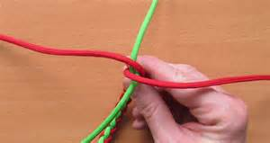
Integration Opportunities
”

Slide 71
Reflection
What did you learn?
How can you use what you learned here?

Slide 72
“Travelers, there is no path, paths are made by walking.” ― Antonio Machado

Slide 74
Democracy
“We need to be taught to study rather than to believe, to inquire rather than to affirm.”- Septima Clark
See Chapter 6 on Septima Clark in Freedom Road: Adult Education of African Americans (Peterson, 1996).

Slide 75
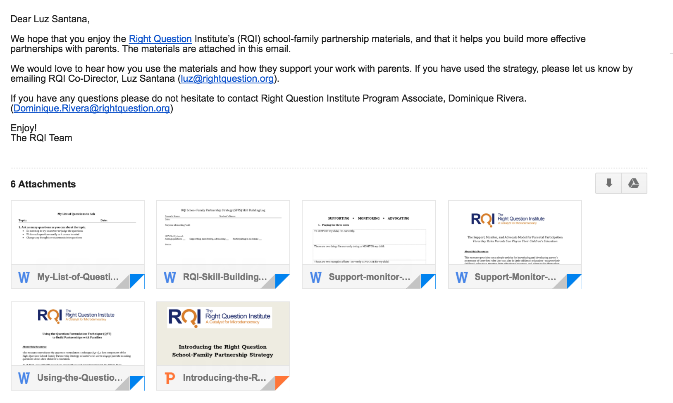
SCHOOL-FAMILY PARTNERSHIPS RESOURCES
@
WWW.RIGHTQUESTION.ORG

