Slide 1
Students Becoming Sophisticated Question-Askers and Thinkers
Day 1
Building Learning Communities
Boston, MA
July 22, 2018
Dan Rothstein & Luz Santana
The Right Question Institute
Cambridge, MA

Slide 2

Acknowledgments
We are deeply grateful to the John Templeton Foundation and The Hummingbird Fund for their generous support of the Right Question Institute’s Million Classrooms Campaign.
We are excited to be a part of BLC 18 and are thankful to Alan November for inviting us to participate and to Marcy Reed and Donna Lang for all the important behind the scenes work that makes this possible.
We are very grateful to Erin Kim, our 2017-18 Harvard Graduate School of Education intern, for her work in arranging this session.
#QFT

Slide 3
Who is in the room?
#QFT

Slide 4
We shall not cease from exploration
And the end of all our exploring
Will be to arrive where we started
And know the place
For the first time.
--T.S. Eliot

Slide 5
Today’s Agenda
Welcome and Community Building
Experience the Question Formulation Technique (QFT)
Explore the Process and Classroom Examples
Break
Video: Inside the Classroom and Discussion
A Taste of QFocus Design
Collaborative Work on Question Focus Design
Reflection
#QFT

Slide 6
To Access Today’s Materials:
http://rightquestion.org/educators/
seminar-resources/
Join our Educator Network for:
  Templates you can use tomorrow in class
  Classroom Examples
  Instructional Videos
  Forums and Discussions with other Educators

Slide 7

We’re Tweeting…
@RightQuestion
@RothsteinDan
@LuzSantana20
#QFT #BLC18

Slide 8
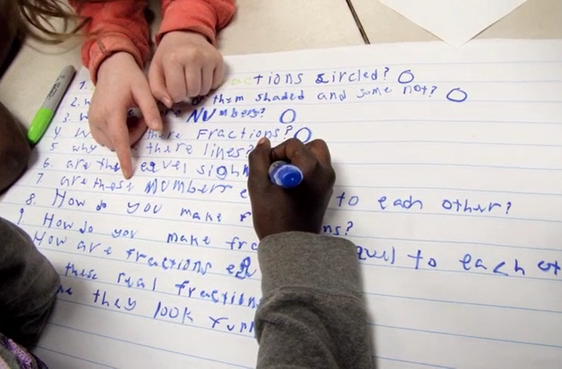
Why spend time teaching the skill of question formulation?

Slide 9


LAWRENCE, MA, 1990
“We don’t go to the school because we don’t even know what to ask.”

Slide 10
"There is no learning without having to pose a question."
- Richard Feynman
Nobel-Prizewinning physicist

Slide 11

“We must teach students how to think in questions, how to manage ignorance.”
- Stuart Firestein
Chairman of the Department of Biology at Columbia University

Slide 12
College Presidents on What Students Should Learn in College
“The primary skills should be analytical skills of interpretation and inquiry. In other words, know how to frame a question.”
- Leon Botstein, President of Bard College
“…the best we can do for students is have them ask the right questions.”
- Nancy Cantor, Chancellor of University of Illinois
The New York Times, August 4, 2002

Slide 13
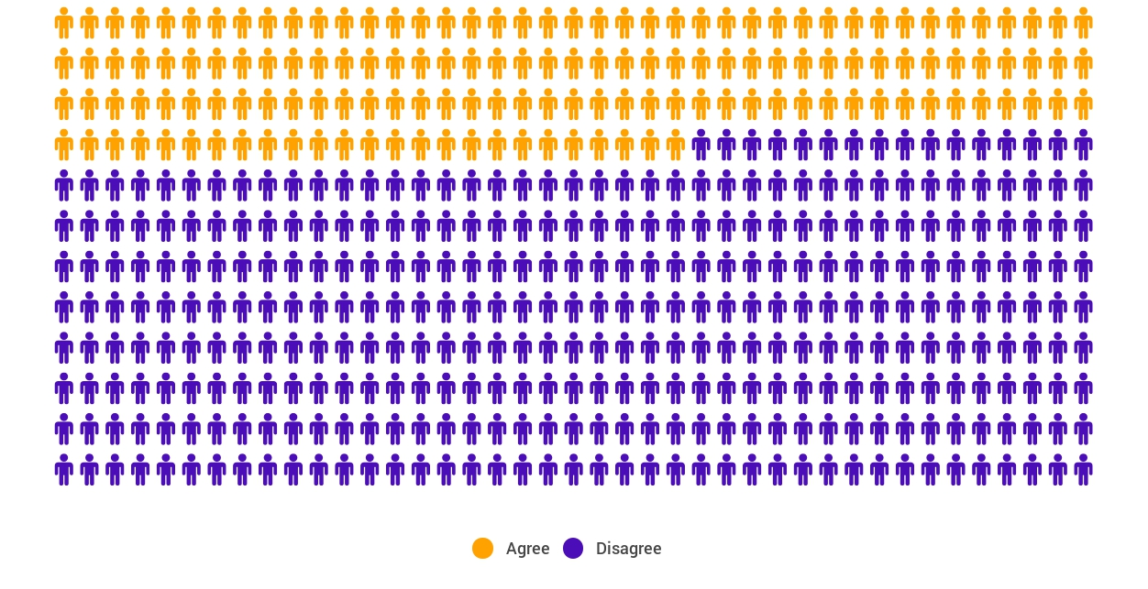
Yet…only 27%of students believe college taught them to ask their own questions
Alison Head, Project Information Literacy at University of Washington, 2016

Slide 14
But, the problem begins long before college...

Slide 15
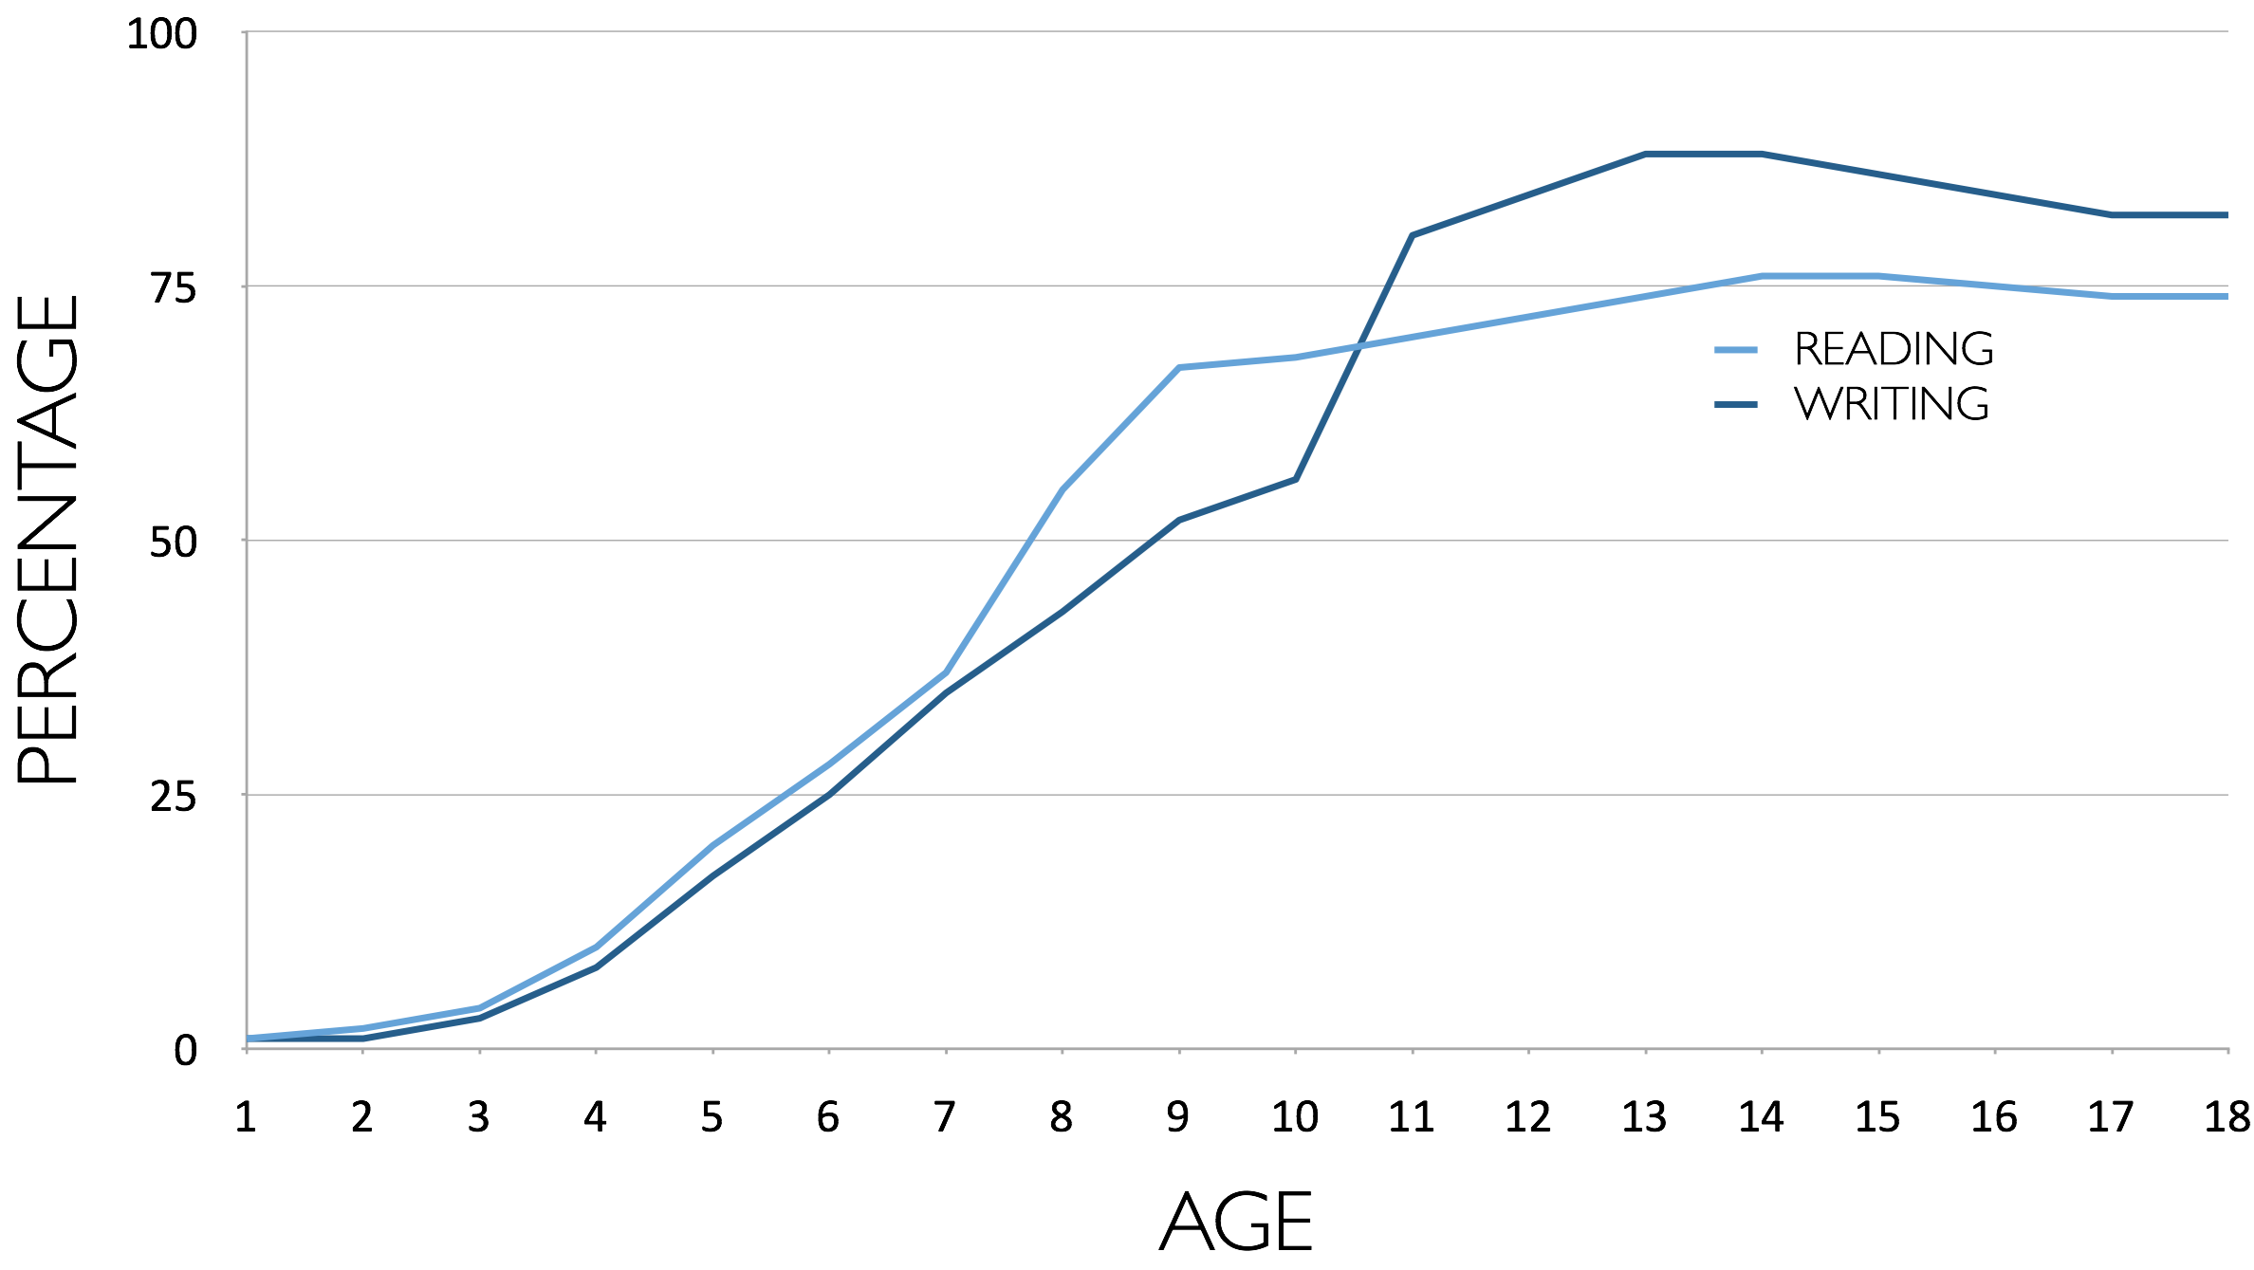
Percentage of Basic Skill Attainment
Sources
http://nces.ed.gov/nationsreportcard/pdf/main2009/2011455.pdf
http://nces.ed.gov/nationsreportcard/pubs/main2007/2008468.asp#section1
Data on question-asking based on parent and teacher feedback

Slide 16
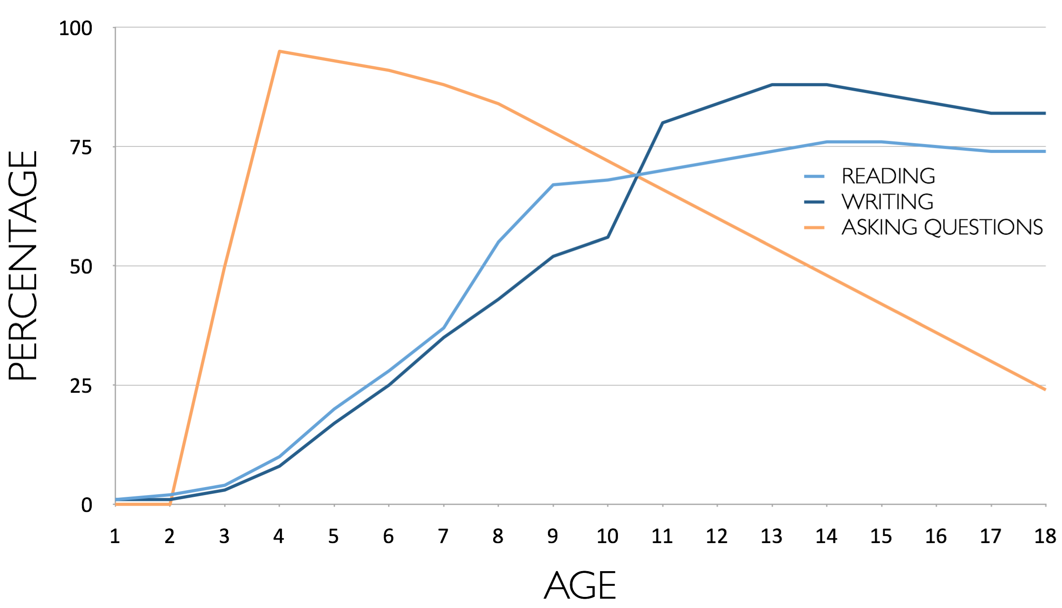
Percentage of Basic Skill Attainment
Sources
http://nces.ed.gov/nationsreportcard/pdf/main2009/2011455.pdf
http://nces.ed.gov/nationsreportcard/pubs/main2007/2008468.asp#section1
Data on question-asking based on parent and teacher feedback

Slide 17
We can work together on changing the direction of
that slope

Slide 18


We Are Not Alone
300,000 educators using the strategy all over the world

Slide 19

Now, Educators Lead the Work
The Right Question Institute offers materials through a Creative Commons License and we encourage you to make use of and/or share this resource. Please reference the Right Question Institute and rightquestion.org as the source on any materials you use.

Slide 20
What happens when students do learn to ask their own questions?

Slide 21
Moving from the exception…
In a 1912 study Romiett Stevens observed: “an unusual lesson because twenty-five of the thirty-four questions were asked by the pupils… The result was that the lesson developed an impetus born of real interest. I mention it because this lesson was unique in the series of one hundred.”
The Question as a Measure of Efficiency in Instruction: A critical study of classroom practice. Columbia University Contributions to Education, No. 48

Slide 22
Classroom Example:
Kindergarten
Teacher: Jennifer Shaffer, Walkersville, MD
Topic: Non-fiction literacy
Purpose: To engage students prior to reading a nonfiction text about alligators

Slide 23

Question Focus

Slide 24
Student Questions
Is the alligator camouflaged?
Why do the babies have stripes?
Are those baby crocodiles?
Is it a mom or dad crocodile?
What is the green stuff?
Why are they in the water so low?
Where are they going?
Why are the baby alligator’s eyes white and the mom’s black?
Why are baby alligators on top of the momma alligator?
Why does momma or daddy have bumps on them?

Slide 25
Classroom Example:
4th Grade
Teacher: Deirdre Brotherson, Hooksett, NH
Topic: Math unit on variables
Purpose: To engage students at the start of a unit on variables

Slide 26
Question Focus
24 = ☺ + ☺ + ☺

Slide 27
Student Questions
Why is the 24 first?
What do the smiley faces mean?
Why are there 3 smiley faces?
How am I suppose to figure this out?
Is the answer 12?
Can I put any number for a smiley face?
Do three faces mean something?
Do the numbers have to be the same because the smiley faces are the same?
What numbers will work here?
Does it mean 24 is a really happy number?
Can we replace each smiley face with an 8?
Do any other numbers work?
Can we do this for any number?
Does it always have to be smiley faces?
Do we always have to use three things?

Slide 28
Next Steps with Student Questions
Questions posted on classroom walls.
Students cross off the questions they answer during subsequent lessons.
Teacher returns to student questions at the end of the unit to discuss with students what they learned and what they still want to know.

Slide 29
Research Confirms the Importance of Student Questioning
Self-questioning (metacognitive strategy):
Student formulation of their own questions is one of the most effective metacognitive strategies
Engaging in pre-lesson self-questioning improved students rate of learning by nearly 50% (Hattie, p.193)
John Hattie
Visible Learning: A Synthesis of Over 800
meta-Analyses Relating to Achievement, 2008
Notes:
UC Davis Research Linking Curiosity to Memory (UC Davis) 2014
The Fullerton Longitudinal Study (FLS), a 30-plus year study of the development of giftedness across various points in time conducted by Adele and Allen Gottfried of California State University ”This finding has strong implications for the development of STEM considering that curiosity is a fundamental predictor of the aspiration to become a scientist.”
S. von Stumm, B. Hell, T. Chamorro-Premuzic. The Hungry Mind: Intellectual Curiosity Is the Third Pillar of Academic Performance. Perspectives on Psychological Science, 2011 meta-analysis shows They found that curiosity did, indeed, influence academic performance. In fact, it had quite a large effect, about the same as conscientiousness. When put together, conscientiousness and curiosity had as big an effect on performance as intelligence.

Slide 30
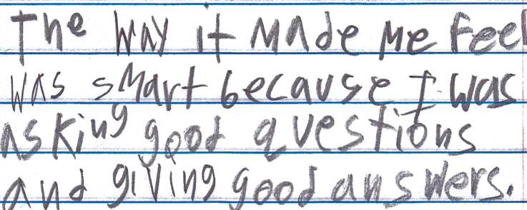
Student Reflection
“The way it made me feel was smart because I was asking good questions and giving good answers.”
-Boston 9th grade remedial summer school student

Slide 31

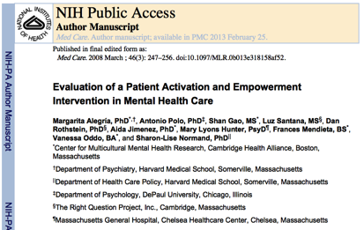


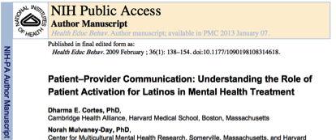





Slide 32
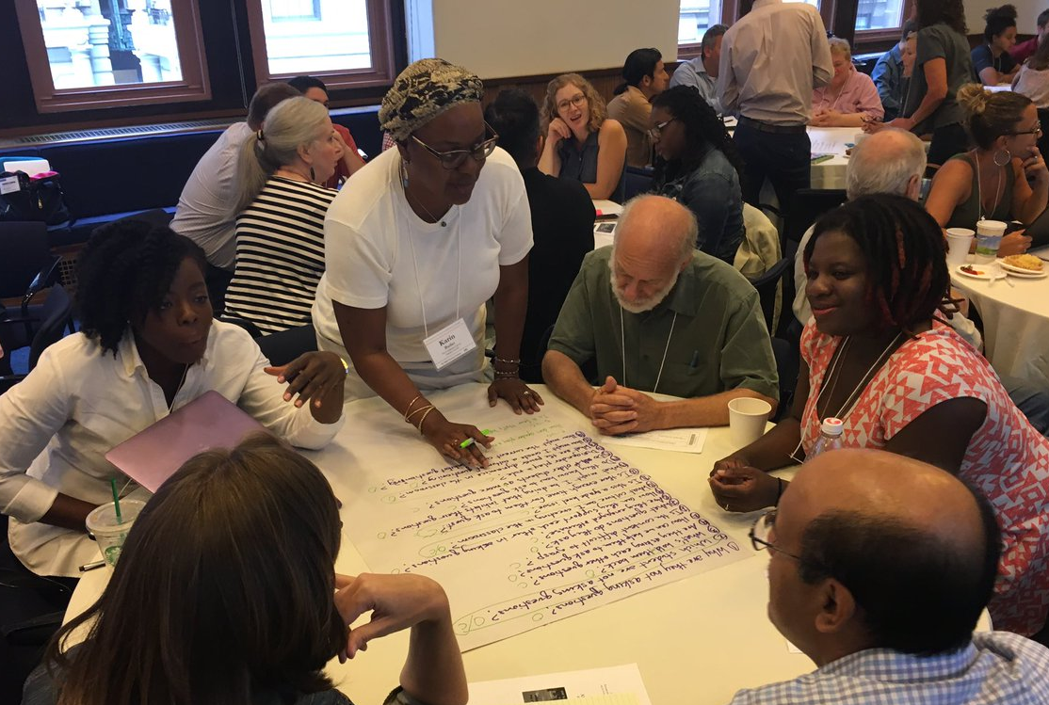
Collaborative Learning around a Common Problem with the Question Formulation Technique (QFT)

Slide 33
The Question Formulation Technique (QFT)
  Students learn to:
  Produce their own questions
  Change their questions
  Strategize on how to use their questions
  Reflect on what they have learned and how they learned it
#QFT

Slide 34
Rules for Producing Questions
1. Ask as many questions as you can
2. Do not stop to answer, judge, or discuss
3. Write down every question exactly as stated
4. Change any statements into questions

Slide 35
Produce Questions
Ask Questions
Follow the Rules
      Ask as many questions as you can.
      Do not stop to answer, judge, or discuss.
      Write down every question exactly as it was stated.
      Change any statements into questions.
Number the Questions

Slide 36
Question Focus:
When teachers model how to ask questions, students do not learn how to ask their own questions.
→Please write this statement at the top of your paper.
→Remember: Number the questions. Follow the rules.

Slide 37
Categorize Questions:
Closed/ Open
Definitions:
  Closed-ended questions can be answered with a “yes” or “no” or with a one-word answer.
  Open-ended questions require
  more explanation.
Directions: Identify your questions as closed-ended or open-ended by marking them with a “C” or an “O.”

Slide 38
Discussion
Closed-ended Questions
Advantages
Disadvantages

Slide 39
Discussion
Open-ended Questions
Advantages
Disadvantages

Slide 40
Change Questions
Take one closed-ended question and change it into an open-ended question.
Take one open-ended question and change it into a closed-ended question.
Closed
Open
Open
Closed

Slide 41
Prioritize Questions
Review your list of questions
  Choose the three questions you consider most important.
  While prioritizing, think about your Question Focus: When teachers model how to ask questions, students do not learn how to ask their own questions.
After prioritizing consider…
  Why did you choose those three questions?
  Where are your priority questions in the sequence of your entire list of questions?

Slide 42
Strategize on How to Use Questions
From priority questions to action plan
In order to answer your priority questions:
    What do you need to know? Information
    What do you need to do? Tasks

Slide 43
Formulate an Action Plan
Information | Tasks

Slide 44
Share
Questions you changed from open/closed
Your three priority questions and their numbers in your original sequence
Rationale for choosing priority questions
Next steps

Slide 45
Reflection
What did you learn?
How did you learn it?
What do you understand differently now about when teachers model how to ask questions, students do not learn how to ask their own questions?

Slide 46

A Look Inside the Process
#QFT

Slide 47
The QFT, on one slide…
Question Focus
Produce Your Questions
    Follow the rules
    Number your questions
Improve Your Questions
    Categorize questions as Closed or Open-ended
    Change questions from one type to another
Prioritize Your Questions
Share & Discuss Next Steps
Reflect
Ask as many questions as you can
Do not stop to discuss, judge or answer
Record exactly as stated
Change statements into questions
Closed-Ended:
Answered with “yes,” “no” or one word
Open-Ended: Require longer explanation

Slide 48
Curiosity and Rigor
  Three thinking abilities
  with one process

Slide 49
Thinking in many different directions
DIVERGENT
THINKING

Slide 50
Narrowing Down, Focusing
CONVERGENT
THINKING

Slide 51
The Importance of Questions
"Questions are the engines of intellect, the cerebral machines which convert energy to motion, and curiosity to controlled inquiry."
- David Hackett Fischer,
Historians' fallacies: Toward a logic of historical thought.
Routledge and Kegan Paul, 1971.
“[The QFT] helps me by getting me to think about questions on my own…it gets my mind
in motion to think about the questions other people make."
- 8th grade student in James Brewster’s U.S. history class
Gus Garcia Young Men’s Leadership Academy, Austin, TX, 2015

Slide 52
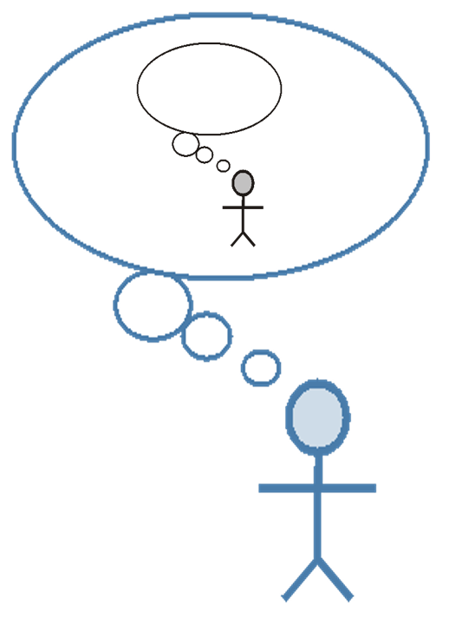
Thinking about Thinking
METACOGNITION

Slide 53
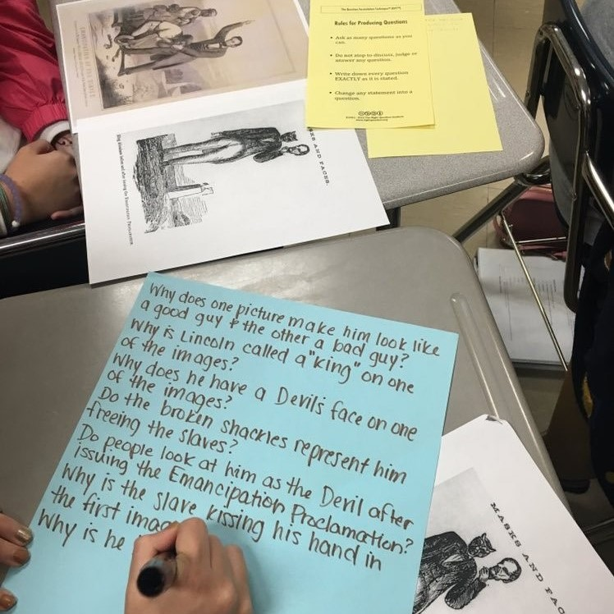
Exploring Classroom Examples

Slide 54
Classroom Example:
High School
Teacher: Ling-Se Chesnakas, Boston, MA
Topic: 12th Grade Humanities unit on The Brief Wondrous Life of Oscar Wao by Junot Diaz
Purpose: To help students generate questions for a Socratic Seminar at the end of the unit

Slide 55
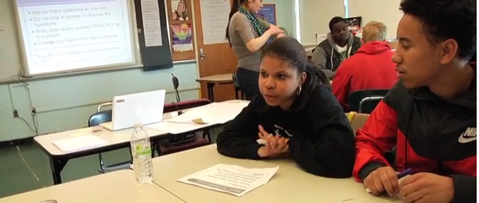
The Question Formulation Technique (QFT) in Action
http://rightquestion.org/qft-in-action/

Slide 56
Classroom Example:
Middle school
Teacher: Megan Harvell, Boston, MA
Topic: The Civil War
Purpose: Pre-reading activity to engage students

Slide 57
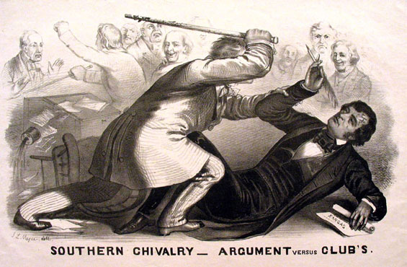
Question Focus
Image by John L. Magee, 1856

Slide 58
Student questions
Why are they fighting?
Are they fighting?
Are they part of the government?
Where were they?
Who are they?
Were they signing anything?
Who else was there?
Why are you hitting him?
Why didn’t they call 911?
Was this related to slavery?
Why is he hitting him with a bat?
11. Why are you taking a pen?
12. Why are they in court?
13. Who hit who first?
Who died?
Why are they smiling?

Slide 59
Classroom Example:
7th Grade
Teacher: Nicole Bolduc, Ellington, CT
Topic: “The Universe and Its Stars” Unit
Purpose: To engage students in setting the learning agenda for the unit

Slide 60
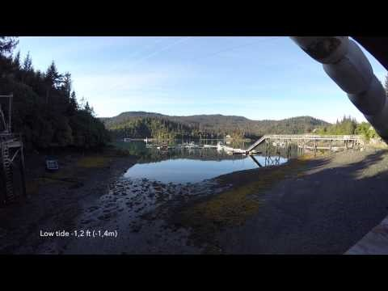
Question Focus:
Students watched videos of dramatic tide change in Cape Cod, Alaska, and Canada
https://www.youtube.com/watch?v=mAYXZzKUAX4
https://www.youtube.com/watch?v=53EEDisloME

Slide 61
Selected Student Questions
Why does tide change?
How is tide created?
How does earth’s rotation cause the tide to change?
Does the sun have any part in the rise and retreat of tides?
Do tides occur because of the gravitational pull of the moon?
Do the phases of the moon come into play with the tides?
How do other planets affect it?
Are the tides opposite in Florida and Mexico? (b/c they share the Gulf of Mexico)
How come the tide changes greatly in some places but not others?
How far can high tide go?
How do tides affect people?
Can tide change be a problem in the future?
Does global warming affect tides?
Where does the water go to?
Does temperature have anything to do with tides?
Does tilt have anything to do with tides?
Does this happen on other planets?
How do fish & wildlife survive when the tide is always changing?
If the moon disappeared, would there be no tides?
What would happen if the tide didn’t change?
Why are tides important to the earth?

Slide 62
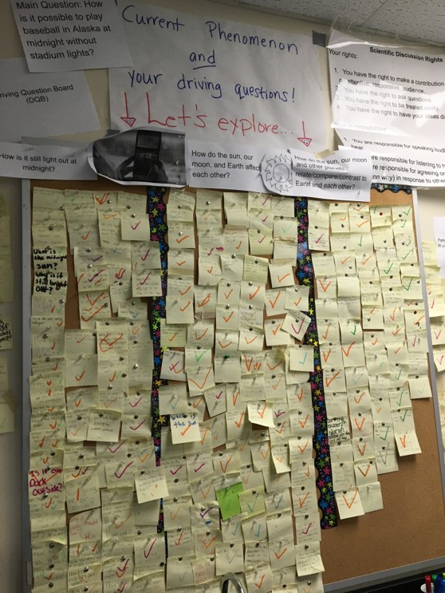
Next Steps:
The Driving Questions Board and the “Parking Lot”
Students draw initial models, give feedback, and make predictions.
Students experience a series of scientific investigations.
At the end of the unit, the Driving Question board is “published” in poster format.

Slide 63
Classroom Example:
High School
Teacher: Isabel Morales, Los Angeles, CA
Topic: Social Justice
Purpose: Engage students in thinking about systemic injustice ahead of several fiction and nonfiction texts in the semester

Slide 64

Question Focus
“The disciplinary policies of our society perpetuate injustice.”

Slide 65
Student Questions
Why are student of color targeted the most?
Do teachers nationwide take notice of these stats?
How can teachers develop better & effective disciplinary policies?
Why do people see the stats & data as a coincidence?
What does a kid learn about the system once in jail?
What do teachers believe expulsion will teach the students?
Does going to jury have a long-term effect on younger students about education?
When will it get better?
What are some ways to improve behavior?
What type of training will teachers go through that’ll bring justice to classrooms?
Shouldn’t school police officers be trained like teachers?
What is considered a criminal offense in school?
Isn’t it the teacher’s job to keep the students “in line”?
How should disruption in class be handled?
Shouldn’t school officers be punished as well?
What is the difference between a school officer and a regular police officer?
How come there aren’t any policies keeping students out of prison?

Slide 66
Next Steps
Students decided to research statistics and poll students and teachers.
Students met with the school administration to ask questions and address their concerns.
School principal founded a student advisory council, which many students joined, to give students a voice in new policies.

Slide 67
Student Reflections
“Asking questions is important because it opens up discussions and debate about issues.”
- Leslie S., 12th grader
“Asking questions is a step in creating change.”
- Jonathan S., 11th grader
“Questions can help focus on a problem and think of solutions.”
- Jason S., 11th grader

Slide 68
Why is question formulation so important now?

Slide 69

In the Age of Google…
“How should you respond when you get powerful new tools for finding answers?
Think of harder questions.”
Clive Thompson, Journalist and Technology Blogger

Slide 70
The Skill of Asking Questions
For moving from ignorance as weakness to ignorance as opportunity
For arriving at better answers (and more questions)
For increasing engagement and ownership
For a little more joy in a very demanding profession
And…

Slide 71
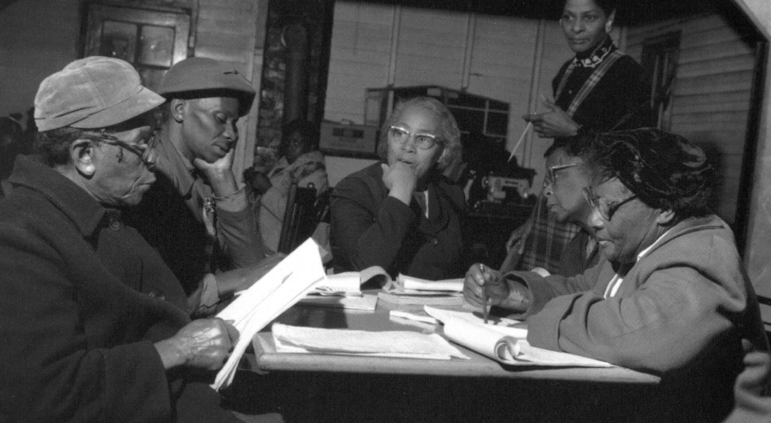
Democracy
“We need to be taught to study rather than to believe, to inquire rather than to affirm.” - Septima Clark
See Chapter 6 on Septima Clark in Freedom Road: Adult Education of African Americans (Peterson, 1996).

Slide 72
Today’s Agenda
Welcome and Community Building
Experience the Question Formulation Technique (QFT)
Explore the Process and Classroom Examples
Break
Video: Inside the Classroom and Discussion
A Taste of the QFocus Design
Collaborative Work on Question Focus Design
Reflection
#QFT

Slide 73
Today’s Agenda
Welcome and Community Building
Experience the Question Formulation Technique (QFT)
Explore the Process and Classroom Examples
Break
Video: Inside the Classroom and Discussion
A Taste of the QFocus Design
Collaborative Work on Question Focus Design
Reflection
#QFT

Slide 74
Inside the Classroom
What do you observe the teacher doing throughout this video?

Slide 75
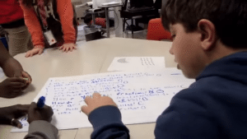
Video
Teacher: Lucy Canotas, Manchester, NH
Topic: 4th Grade Math
Purpose: For formative assessment in the middle of a unit on fractions
https://www.youtube.com/watch?v=Mox0WRGGk0Y

Slide 76
Today’s Agenda
Welcome and Community Building
Experience the Question Formulation Technique (QFT)
Explore the Process and Classroom Examples
Break
Video: Inside the Classroom and Discussion
A Taste of the QFocus Design
Collaborative Work on Question Focus Design
Reflection
#QFT

Slide 77
Question Focus (QFocus):
A focus or prompt for student questions
A phrase or quotation
An image or video
A podcast or speech
A hands-on experience or experiment
An equation or data set
The QFocus is not a question!

Slide 78
Designing a Question Focus
(a focus or prompt for student questions)
An effective QFocus is
A phrase, image, video, quotation, equation, experiment, data set…but NOT a Question!
Simple…but not too simple
Directly tied to lesson’s main idea
Interesting or provocative to students…but not biased or leading

Slide 79
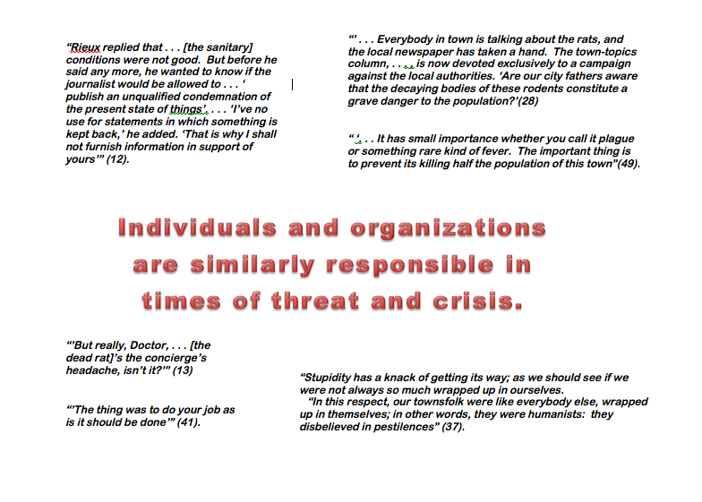
Initial Question Focus:
Notes:
Topic: Albert Camus’s The Plague
Purpose: Pre-reading engagement and prediction of central themes going into the text
Cambridge, MA High School

Slide 80
Revised Question Focus:
The city fathers were aware that the decaying bodies of these rodents were making people sick. (page 28)

Slide 81
Initial Question Focus:
“People, Animals, and Friends”
Do people exist?
Where do people live?
Why do animals live in the zoo?
Why do people go to the pool?
Why are friends fun?
Why do animals bite?
Why do people go to school?
Do people, animals, and friends play together?
Do animals make friends?
Why do I need friends?
Why do people want to be friends with animals?
Why are people making friends with animals?
Why do people, animal, and friends live in different countries?
Where did my dog and friend go?
Can my friend pet our new dog?
Why do I have eyes?
How do people smell?
Can animals speak?
Can people fly?
Where is my bunny? What happened?
Notes:
Teacher: Marie Romero, Lanai, Hawaii
Topic: A unit on “How can a pet be an important friend?”
Purpose: Let students generate their own key question for the week, assess how well students are able to ask questions
Elementary School
Activity: Think, Share
Read the student questions as a lens into diagnosing problems with the Qfocus. What do you notice in this list of student questions? What do the questions tell you about the Q-Focus?
An Answer:
First bold lines to appear: some students are really thinking about the relationship b/w the 3 things listed and trying to connect the 3, so even in a batch of questions that are kind of off topic/not what the teacher expected, she could still have used #11 or #12 in her next steps.
But, that type of creating connection between different words, is kind of sophisticated thinking. Most of the kids picked one of the three nouns and zeroed in on it, asking questions that had the word in it, but didn’t consider it in relationship to the other words in the prompt. These lines appear in purple. To me, this indicates that most kids just didn’t have enough direction, guidance from the Qfocus. They needed more hooks to go on, or maybe an image. Little kids in particular probably need more complete sentences, images perhaps, need more to go on than older kids or adults.
The last thing to point out---pets come up over and over again. We learn that kids have experience with pets and emotional attachments to pets. See #14, 15, 20. So, that might be a fruitful background knowledge connection to take into consideration in the unit, or in a redesigned Q-Focus.
And of course, the teacher did learn that her students were able to ask questions, which was a major objective for doing QFT in the first place. She gained insight into their skill level with question formulation.

Slide 82
Initial Question Focus Design Process
Topic: A unit on “How can a pet be an important friend?”
How can a pet be an important friend?
Collage of pictures: dogs, cats, guinea pigs, horses, other pets
Picture of a human and a service animal
Picture of a human and a service animal paired with a phrase like “people and animals”
“People and animals”
“People, animals, and friends”
Notes:
This is the process the teacher went through to come down to final QFocus. (some of the ideas she ruled out may actually have been better in retrospect) but there were reasons she made the choices she did. Mostly, she wanted to simplify and give kids the chance to name the relationship between people and animals themselves.
The Qfocus she used was “people, animals, and friends.”

Slide 83
Revising the Question Focus
“People, Animals, and Friends”
Your idea here!

Slide 84
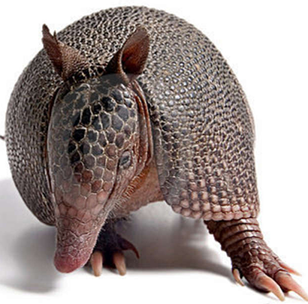
The one quality all excellent QFT designers share?
Thick Skin.

Slide 85
Today’s Agenda
Welcome and Community Building
Experience the Question Formulation Technique (QFT)
Explore the Process and Classroom Examples
Break
Video: Inside the Classroom and Discussion
A Taste of the QFocus Design
Collaborative Work on Question Focus Design
Work with a Lesson Planning Workbook
Reflection
#QFT

Slide 86
WANTED: Q Focus Guinea Pigs
Directions:
Try creating your own Q Focus! It’s ok if it is a bit rough.
Write it on an index card.
Trade cards with a partner.
Generate questions about your partner’s Q Focus.
Trade back and use their questions to guide revision of the QFocus.
Notes:
Have individuals share out after this practice

Slide 87
Today’s Agenda
Welcome and Community Building
Experience the Question Formulation Technique (QFT)
Explore the Process and Classroom Examples
Break
Video: Inside the Classroom and Discussion
A Taste of the QFocus Design
Collaborative Work on Question Focus Design
Work with a Lesson Planning Workbook
Reflection
#QFT

Slide 88
Reflection
What do you now know about Students Becoming Sophisticated Question-Askers and Thinkers that is different from when you first came in?
What are some takeaways from today’s session?

