Slide 1
Students Becoming Sophisticated Question-Askers and Thinkers
Day 2
Building Learning Communities 18
Boston, MA
July 23, 2018
Dan Rothstein & Luz Santana
The Right Question Institute
Cambridge, MA

Slide 2
To Access Today’s Materials:
http://rightquestion.org/educators/
seminar-resources/
Join our Educator Network for:
Templates you can use tomorrow in class
Classroom Examples
Instructional Videos
Forums and Discussions with other Educators

Slide 3
Today’s Agenda
Quick QFT
The Art and the Science
Break
Work on Lesson Plans
Building a Community of Practice
Reflections and Evaluations
#QFT

Slide 4
The Question Formulation Technique (QFT)
Students learn to:
Produce their own questions
Change their questions
Strategize on how to use their questions
Reflect on what they have learned and how they learned it
#QFT

Slide 5
Rules for Producing Questions
1. Ask as many questions as you can
2. Do not stop to answer, judge, or discuss
3. Write down every question exactly as stated
4. Change any statements into questions

Slide 6
Produce Questions
Ask Questions
Follow the Rules
Ask as many questions as you can.
Do not stop to answer, judge, or discuss.
Write down every question exactly as it was stated.
Change any statements into questions.
Number the Questions

Slide 7
Question Focus
I still want to know more about using the QFT.
→Please write this statement at the top of your paper.
→Remember: Number the questions. Follow the rules.

Slide 8
Categorize Questions: Closed/ Open
Identify your questions as closed-ended or open-ended by marking them with a “C” or an “O.”
Change one open-ended question to close-ended question
Change one close-ended question to open-ended question

Slide 9
Prioritize Questions
Review your list of questions
Choose the three questions you consider most important.
While prioritizing, think about your Question Focus: I still want to know more about using the QFT.
After prioritizing consider…
Why did you choose those three questions?
Where are your priority questions in the sequence of your entire list of questions?

Slide 10
Share
Questions you changed from open/closed
Your three priority questions and their numbers in your original sequence
Rationale for choosing priority questions
Next steps

Slide 11
Reflection
What did you learn?

Slide 12
Today’s Agenda
Quick QFT
The Art and the Science
Break
Work on Lesson Plans
Building a Community of Practice
Reflections and Evaluations
#QFT

Slide 13
QFT: An ART and a SCIENCE
The Science:
A rigorous protocol, with specific steps and sequence, that produces consistent results
The QFT
Discuss the rules
Present a Question Focus
Improve questions
Prioritize questions
Discuss next steps
Reflect

Slide 14
QFT: An ART and a SCIENCE
The Art:
Tailoring the QFT process to the specific content and students you are teaching.
Tailor the QFT through:
Design of the Question Focus (Qfocus)
Instructions for prioritizing
Next steps for using the questions
Reflection questions
Facilitation

Slide 15
Five Areas Related to the Art of the QFT
Facilitation
Starting at the End
QFocus Design
Prioritization Instructions
Reflection Questions

Slide 16
Classroom Example: 8th Grade Middle School
Teacher: Joshua Beer, Lempster, NH
Topic: American History, Imperialism unit
Purpose: To conclude unit and use student questions to create a summative assessment
Notes:
How do you notice the teacher facilitating the QFT?

Slide 17
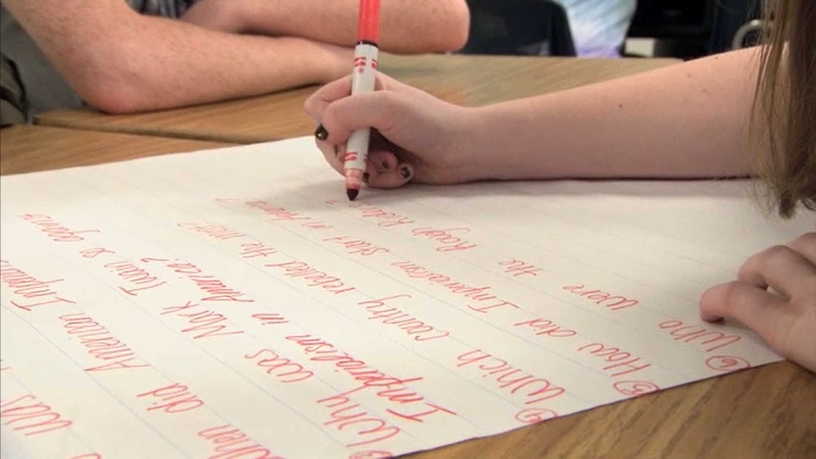
The Question Formulation Technique (QFT) in Action
https://www.youtube.com/watch?v=lfXEf0nG51I

Slide 18
Four Principles of Facilitation
Monitor student adherence to the process
Do not give examples
Do not get pulled into group discussion
Acknowledge all contributions equally
Discuss and Note on Lesson Plan Workbook: What could be challenging about each principle? What might be important about each?
Notes:
Back of the lesson plan workbook

Slide 19
Five Areas Related to the Art of the QFT
Facilitation
Starting at the End
QFocus Design
Prioritization Instructions
Reflection Questions

Slide 20
The QFT as a Shortcut, Not a Detour

Slide 21
Various Teaching Purposes
Engagement
Knowledge acquisition
Formative assessment
Summative assessment
Peer review
Skill development

Slide 22
Using the QFT for Engagement
Good fiction creates its own reality.

Slide 23
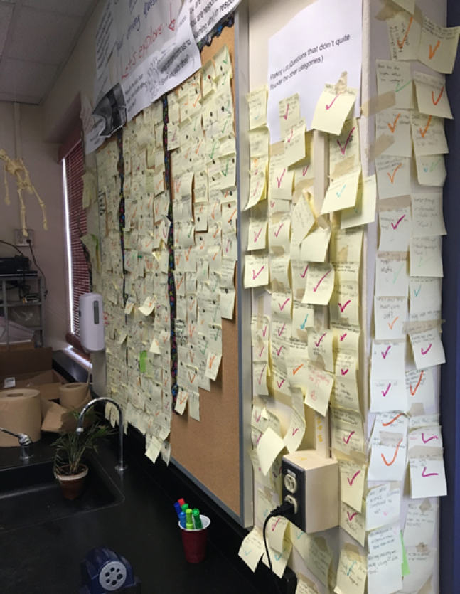
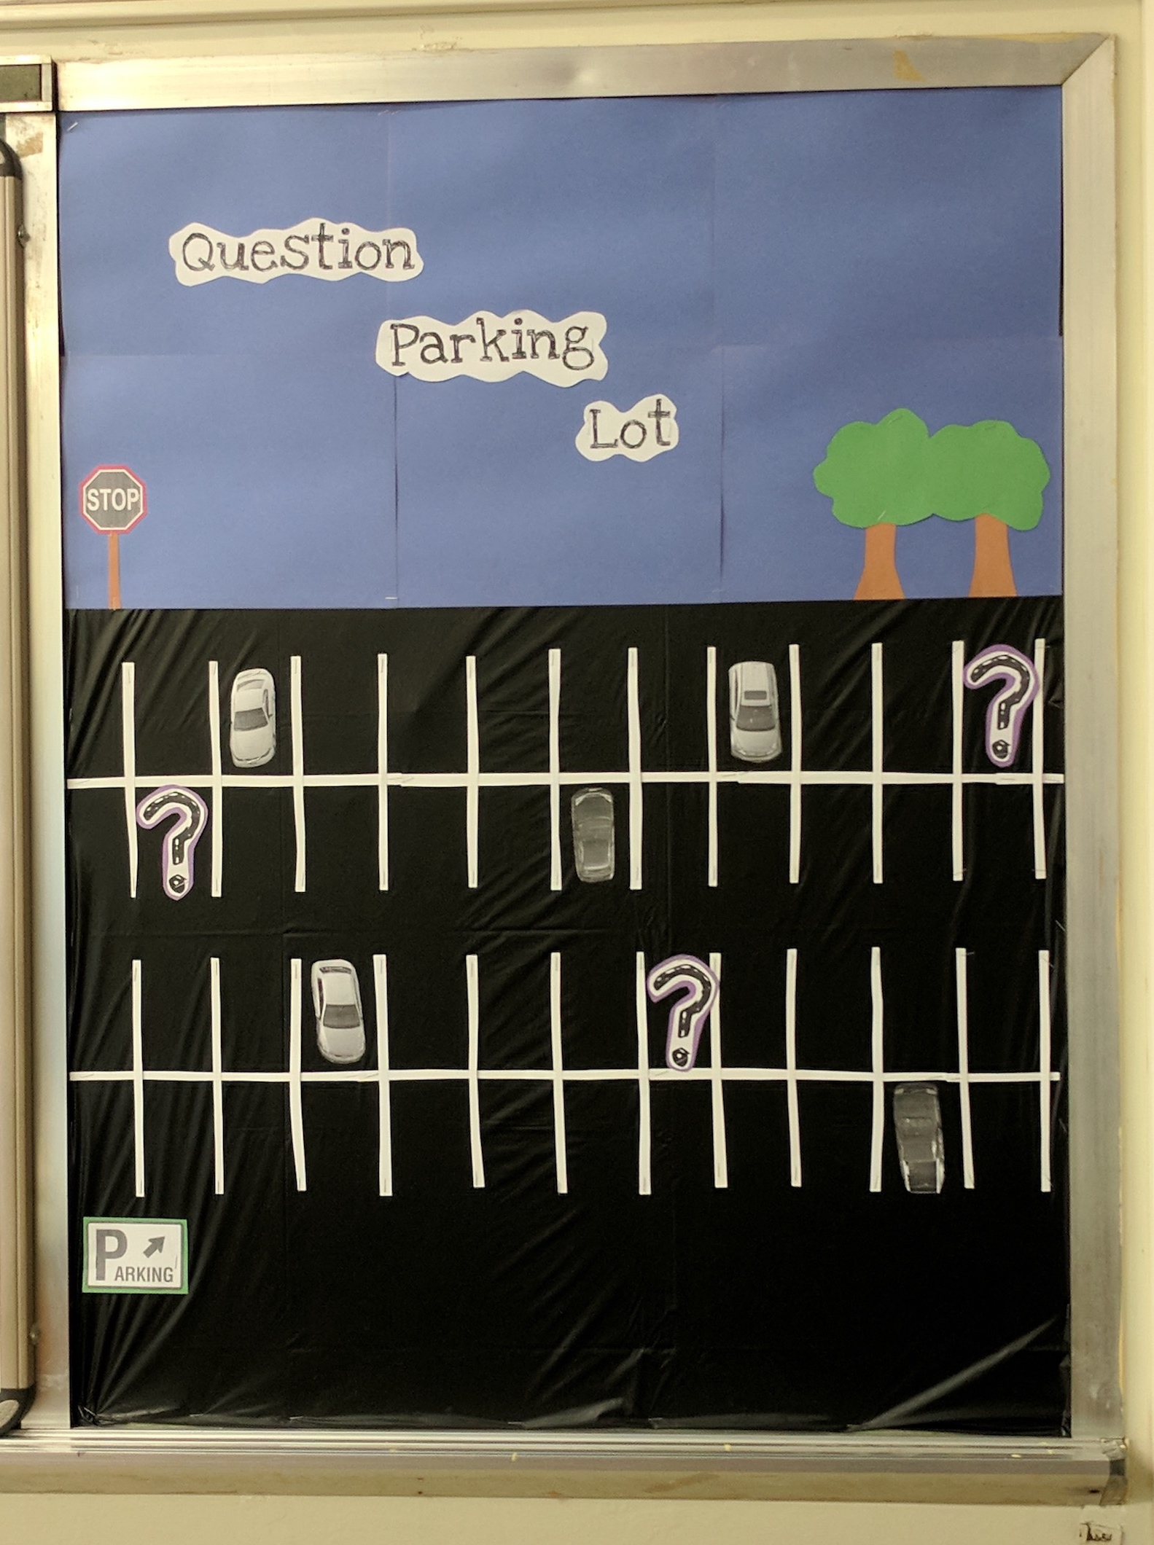
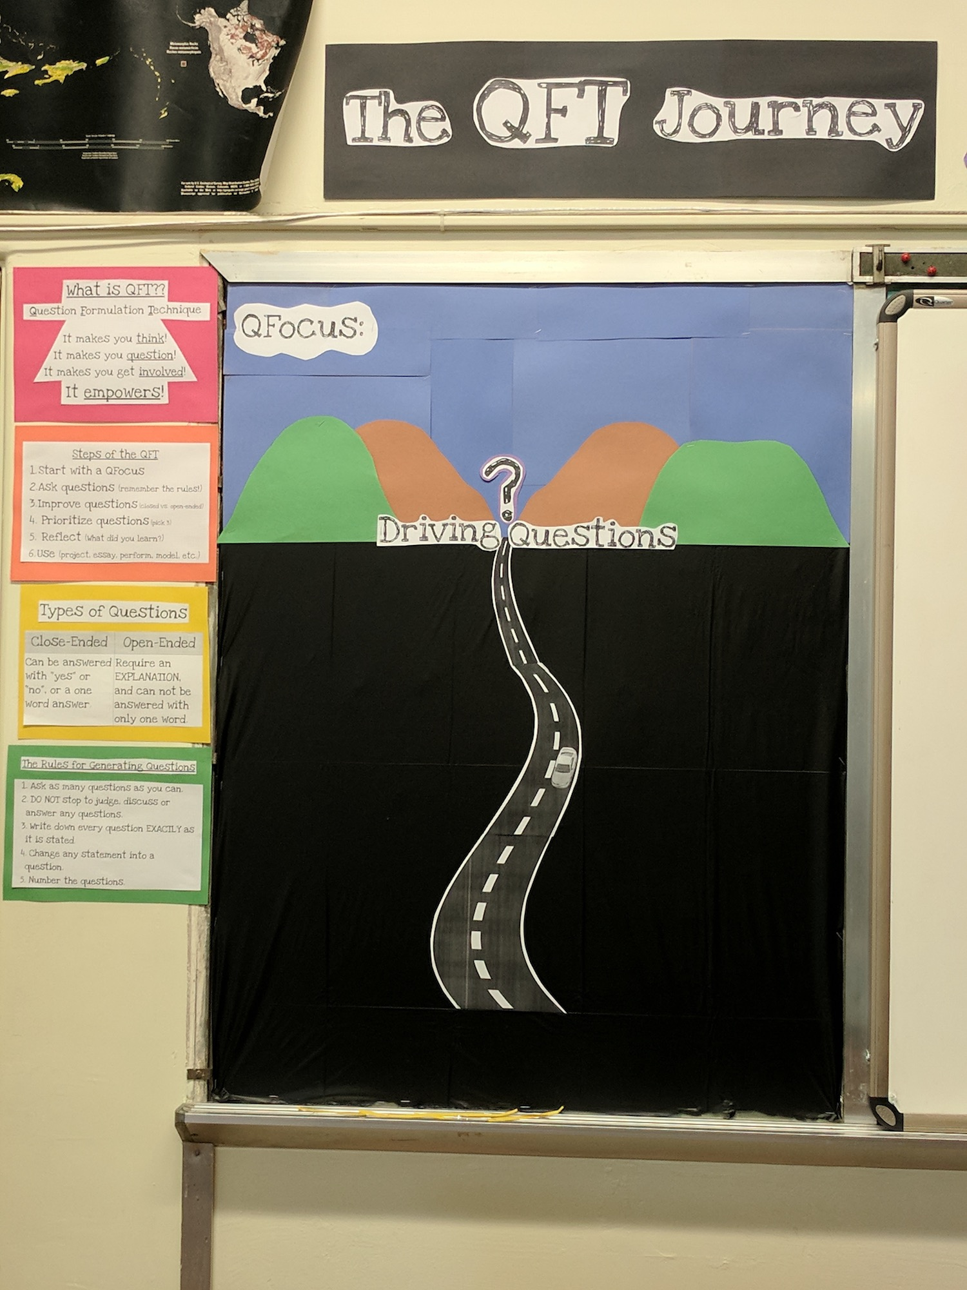
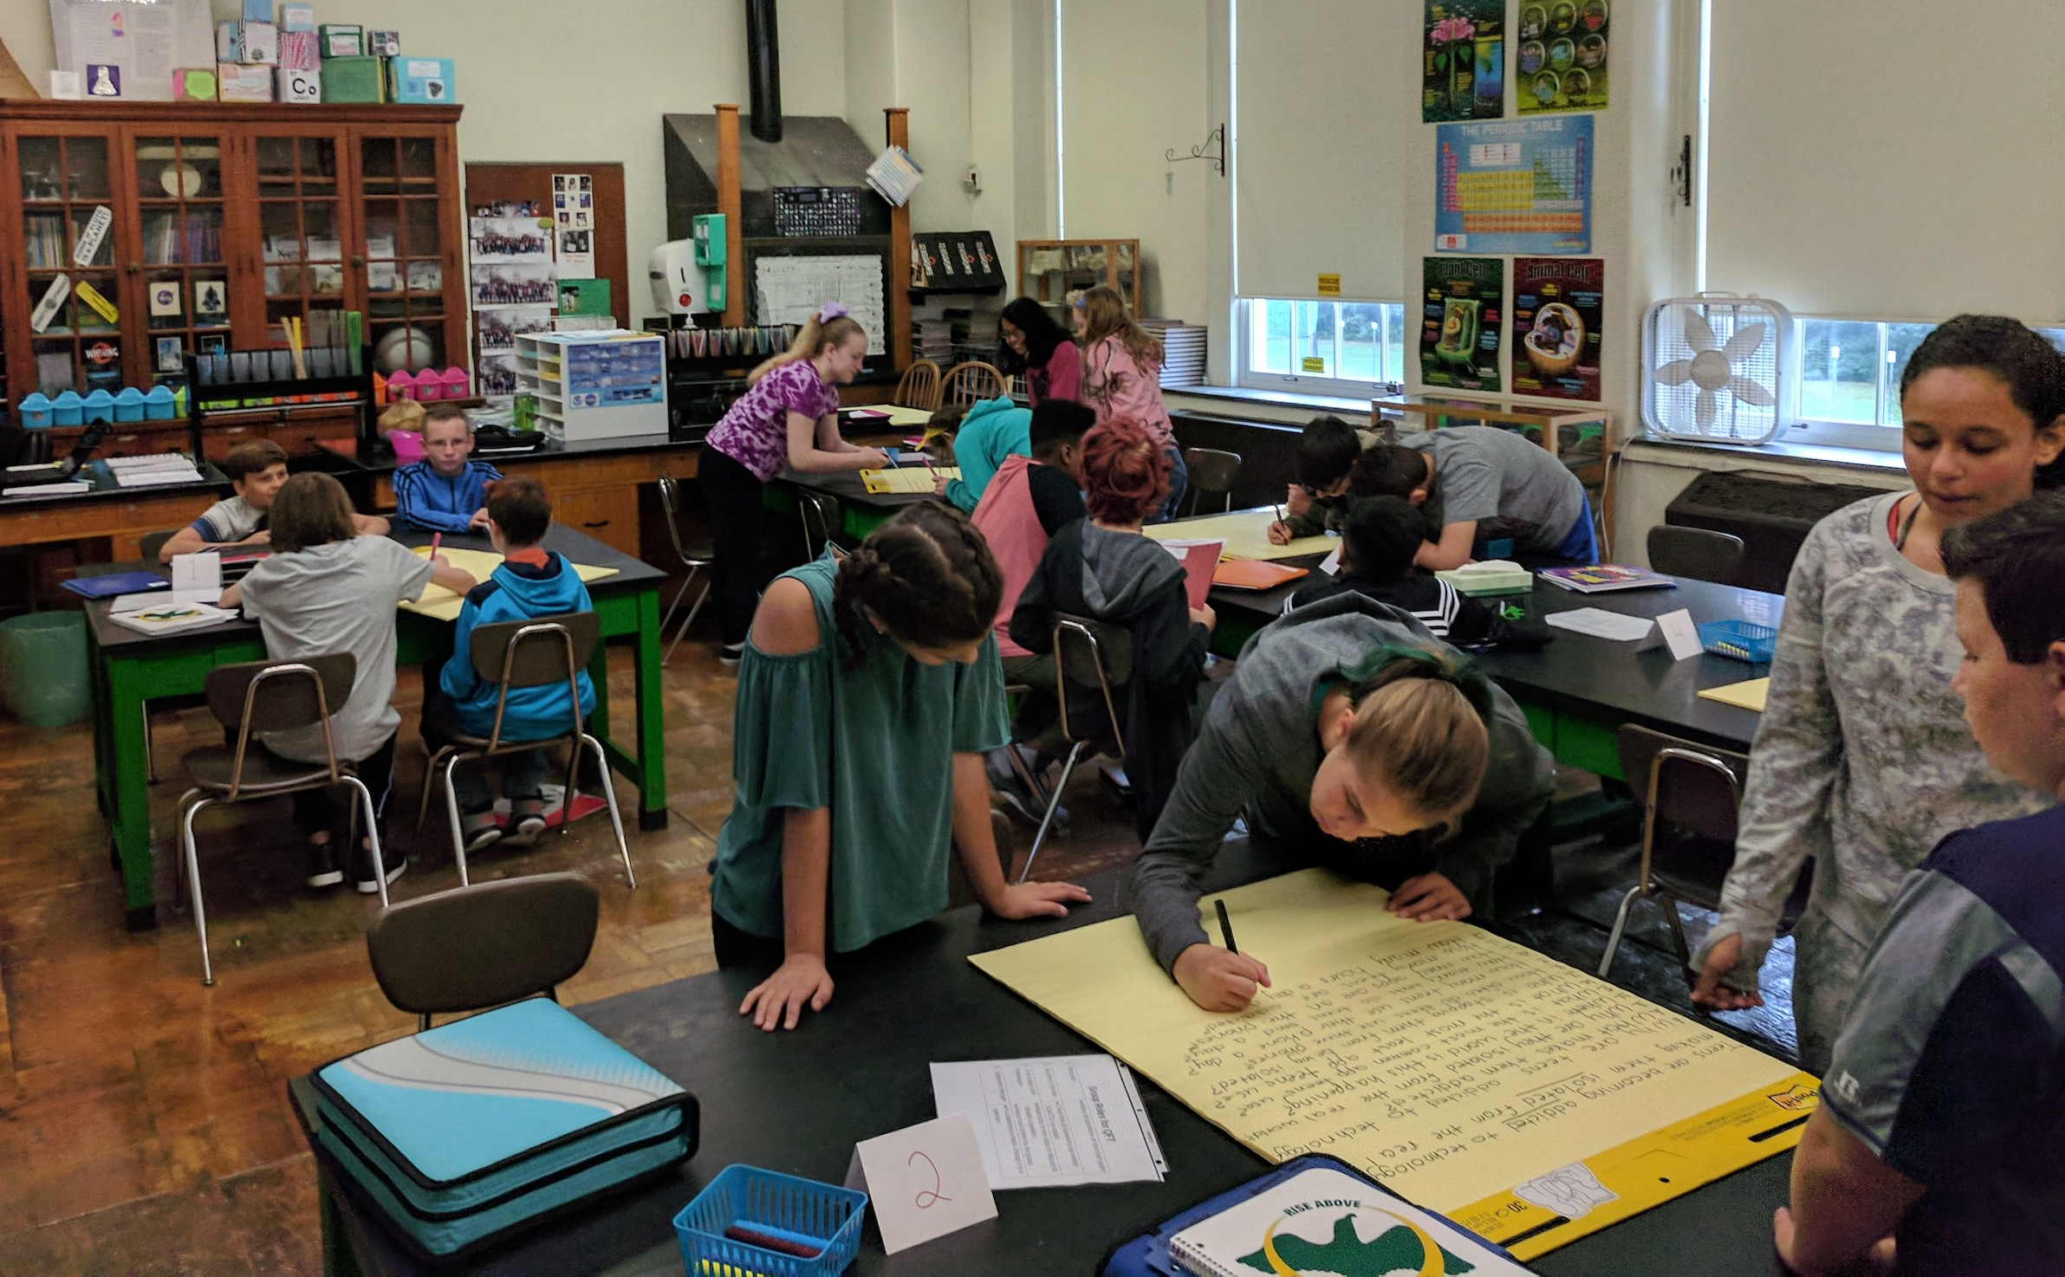
Next Steps with Student Questions
Post Questions around the room
Create a “Parking Lot” for fun, slightly off-topic questions
Ongoing student choice projects
“Do Nows” or extra credit

Slide 24
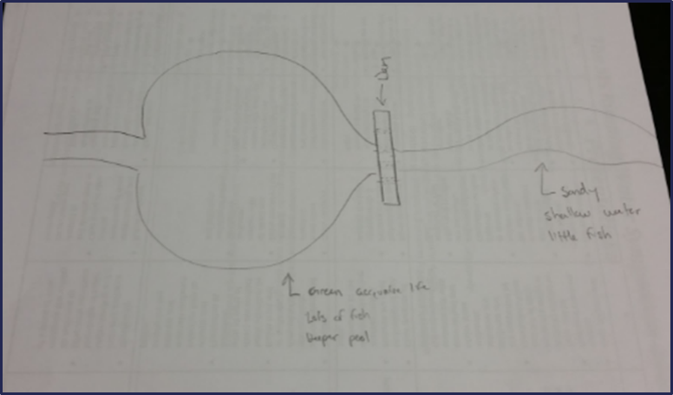
Using the QFT for Peer Review
Scientist’s claim:
“Adding a dam to a water system causes a decrease in aquatic life downstream.”
Student Design to test the claim:
Notes:
Teacher: Allison Gest, Park Ridge, IL
Topic: 11th & 12th Grade Geology
Purpose: To help students design a running water experiment and then refine their designs
*Note: teacher also used a QFT process first with the scientist’s claim as a Qfocus. Students designed their experiments based on their own questions (generated during the QFT about the scientist’s claim)

Slide 25
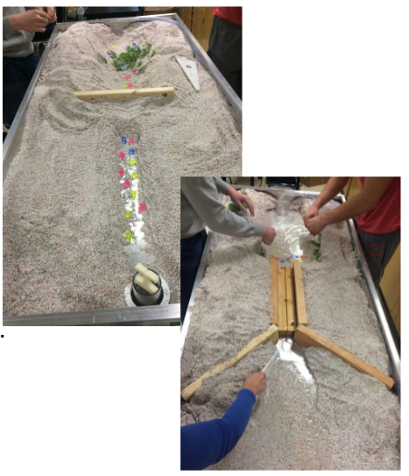
Next Steps with Student Questions:
Notes:
Students used the QFT on a different group’s design.
Students then revised their design informed by the questions from their peers.
Groups tested their final experiment design.

Slide 26
Using the QFT for Skill Development
(Students were assigned a complex molecular biology article)
QFocus: Ask as many questions as you can about the reading
Notes:
Teacher: Rachel Woodruff, Assistant Professor of Biology, Brandeis University, MA
Topic: Molecular Biology
Purpose: To build students’ research skills and prepare them to develop their own research proposal

Slide 27
Next Steps with Student Questions:
Students generate questions as homework then bring in to class
Students discuss key attributes of a good biological research question and compare to other types of questions
Students form groups and improve their questions, based on these attributes
These questions are discarded or kept in notebooks (up to the student)
Students apply this skill to designing their own research project later in the semester

Slide 28
Depending on your Teaching Purpose
Engagement
Knowledge acquisition
Formative assessment
Summative assessment
Peer review
Skill development

Slide 29
Consider Next Steps
Pop Quiz or Reading Check
Debate Prep
Paper topic
Lab work & Experiments
Exit ticket or ”Do Now”
Hang on walls,
Check Off as Answered
Research
Projects
Test Prep
And sometimes…
Nothing!
Homework
Class discussion prompts
Presentations
Student Choice Projects
Socratic Seminar Prompts
Interview an Expert
Make Your Own Final Test
Journal Prompt
Guest speakers
Close Reading Protocol
Year-long or Unit-long Essential Questions
Tailoring Instruction
Service Action Projects

Slide 30
Five Areas Related to the Art of the QFT
Facilitation
Starting at the End
QFocus Design
Prioritization Instructions
Reflection Questions

Slide 31
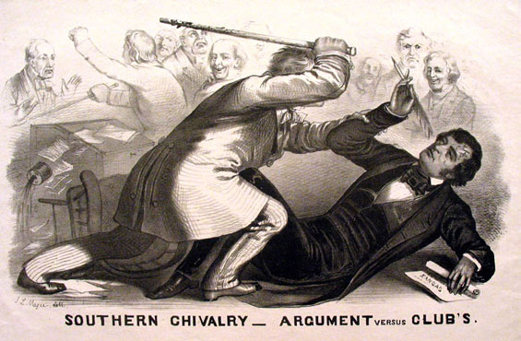
QFocus Design
24 = ☺ + ☺ + ☺
What do you understand differently now about QFocus Design?

Slide 32
Initial QFocus: Middle School

Slide 33
Revising the Question Focus
Picture of the School Building
“As a member of the Haviland Middle School 6th grade, you will have numerous opportunities to grow and learn.”
Notes:
Activity: Here’s how Doreen revised it and here’s the effect. If we were going to revise for next year, what would you do with this Q-Focus, now with the benefit of hindsight and having analyzed the student’s questions? What advice might you give to this teacher?
Think and share out to the whole group.

Slide 34
Five Areas Related to the Art of the QFT
Facilitation
Starting at the End
QFocus Design
Prioritization Instructions
Reflection Questions

Slide 35
Prioritization Instructions
Choose the three most important questions
Choose the three questions you consider most important.

Slide 36
Categories of Prioritization Instructions
Choose three questions…
General Instructions:
that you consider most important
Specific Purposes:
that you need to research further
to help you solve the problem
that you need to answer first
that a scientist studying the earth might ask
that will help you understand the text
that require analyzing data
that are not “Googleable” and may be difficult to answer
Notes:
QUESTION: What do you learn about prioritization instructions by looking at this list?
-Answer: different ways to do it, the prioritization instructions impacts what students are thinking about, having it tie back to your objective

Slide 37
Adjusting the Prioritization Instructions: High School
“History, despite its wrenching pain, cannot be unlived, but if faced with courage, need not be lived again.”
– Maya Angelou
Troubleshooting Tips:
“Spend the next 2 minutes asking about just this word/phrase”
Change the Prioritization Instructions on the fly
Notes:
Students started asking about Maya Angelou instead of the quotation. Teacher needed more general questions about history to use as the essential question for the rest of the year. So, what do you do in this situation? (short of changing the Qfocus for the next class) Providence Country Day School, AP US History,

Slide 38
Five Areas Related to the Art of the QFT
Facilitation
Starting at the End
QFocus Design
Prioritization Instructions
Reflection Questions

Slide 39
Examples of Reflection Questions
QFT Process
Content Specific
What did you learn about asking questions?
How did you learn it?
What do you understand differently now about asking questions?
How can you use what you learned about asking questions?
How do you feel about asking questions?
What did you learn about the (content)?
How did the QFT process help you think about…
key concept
specific assignment
overarching topic
theme in the unit
chapter you just read

Slide 40
The Science of the QFT: a protocol
The Art of the QFT: You
Notes:
The key role of the teacher:
Behind the scenes as lesson planner
Facilitate process according to the steps of the QFT and the five facilitation principles
Use student questions as part of next steps

Slide 41
Today’s Agenda
Quick QFT
The Art and the Science
Break
Work on Lesson Plans
Building a Community of Practice
Reflections and Evaluations
#QFT

Slide 42
Today’s Agenda
Quick QFT
The Art and the Science
Break
Work on Lesson Plans
Building a Community of Practice
Reflections and Evaluations
#QFT

Slide 43
Work with a Lesson Planning Workbook
As you begin work, consider:
What seems helpful or useful about this planning tool?
What parts of the QFT process need further clarification or support?
What questions do you have?

Slide 44
Putting it into Practice

Slide 45
Today’s Agenda
Quick QFT
The Art and the Science
Break
Work on Lesson Plans
Building a Community of Practice
Reflections and Evaluations
#QFT

Slide 46
So, where do we go from here?

Slide 47
Now, Educators Lead the Work
The Right Question Institute offers materials through a Creative Commons License and we encourage you to make use of and/or share this resource. Please reference the Right Question Institute and rightquestion.org as the source on any materials you use.

Slide 48
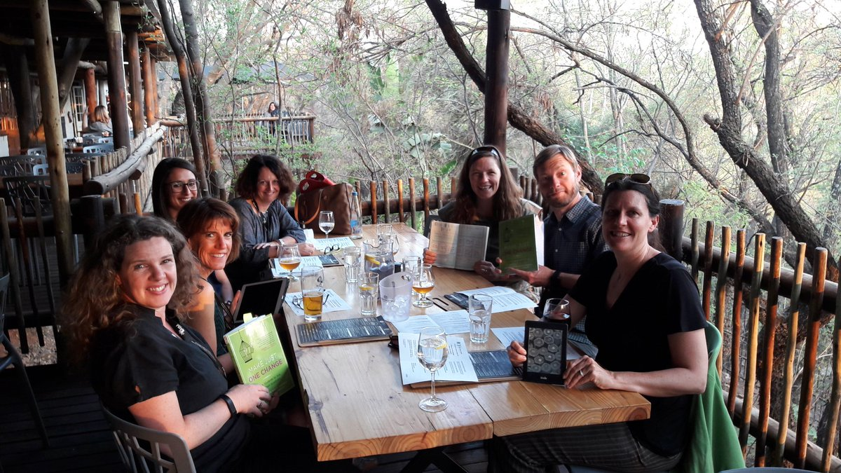
Facilitating book clubs with Make Just One Change

Slide 49
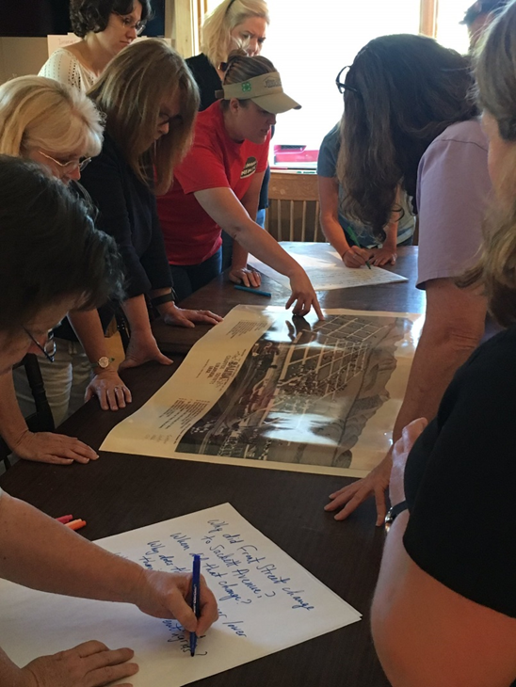
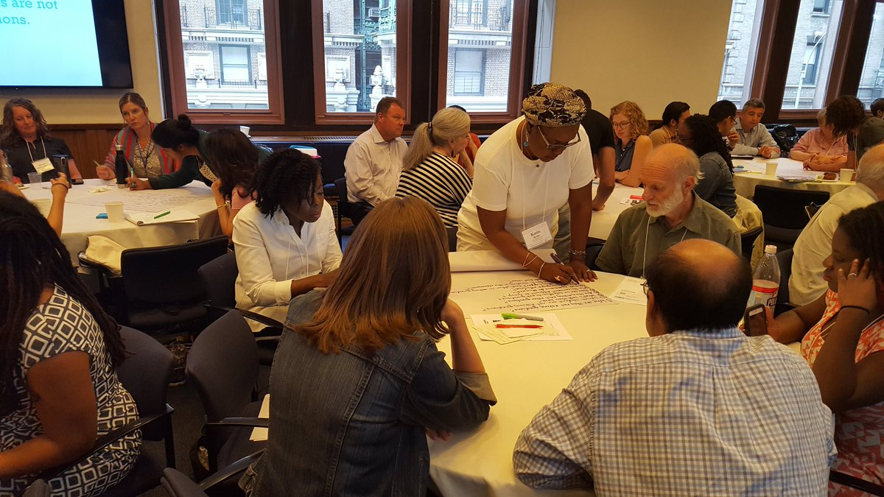
Delivering PD in their departments, schools, and districts
Knee deep in @RightQuestion on a Sunday learning together so that historic places are in the classroom
@TPSMSUDenver @TeachingLC

Slide 50
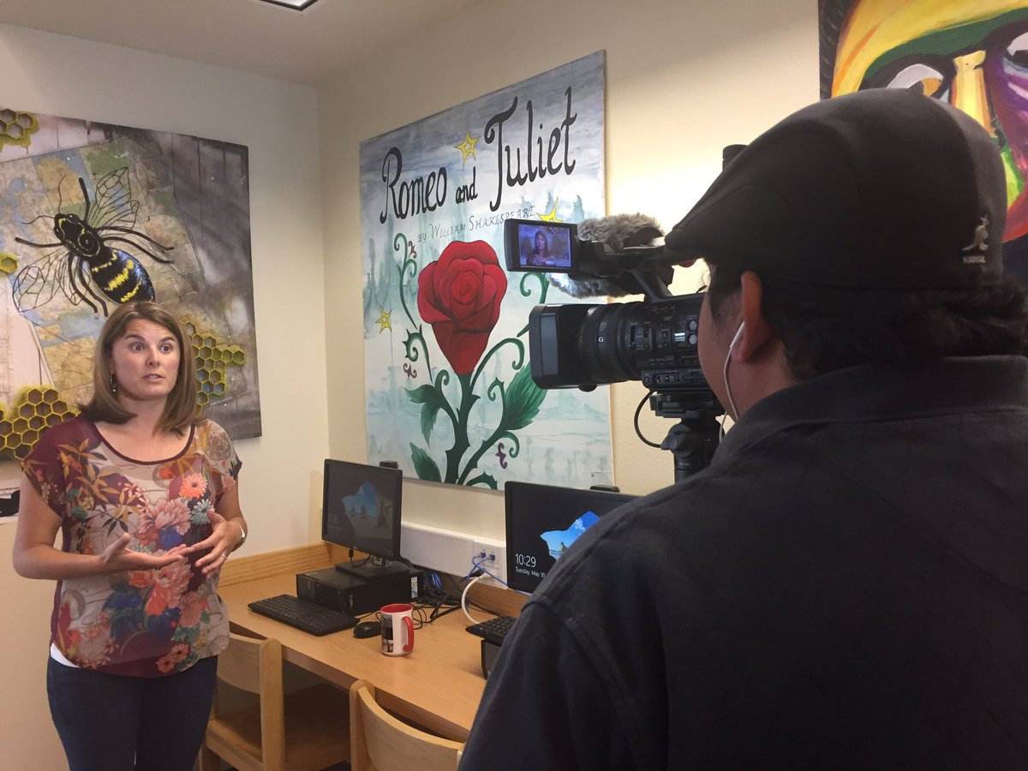
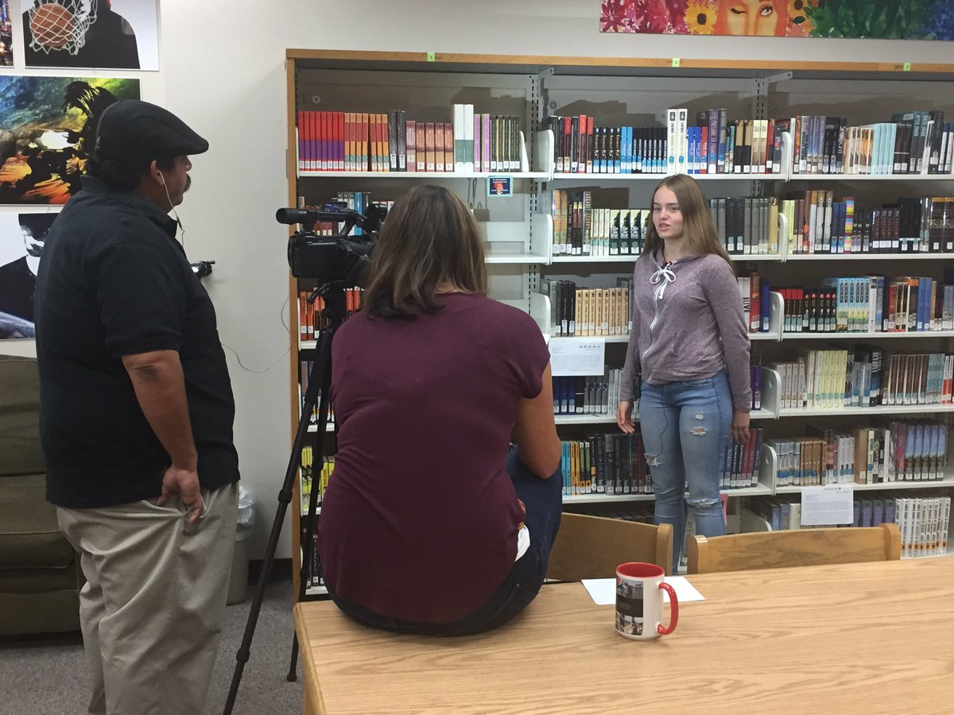
Filming instructional videos & creating online resources ‘[‘;//
That's a wrap! Ss & Ts at @ohs_jackets filmed by @GodoyStudios and interviewed on their experience w/ the #QFT

Slide 51
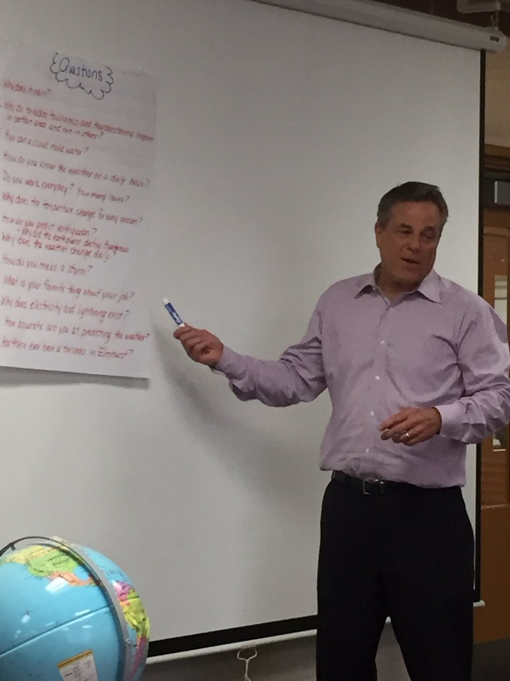
Tweeting QFT examples to school leaders, reporters, authors, and industry leaders…and getting their attention!
Thank you Phil Schwartz from @ABC7Chicago for answering our #QFT questions this morning. @Fischerspirit #d205learns
S. E. Hinton Retweeted Right Question
One of the reasons why teachers are my heroes.
Hi @BillNye As a 7th grade science teacher, I encourage young scientists to question and figure out phenomena! #BillMeetScienceTwitter

Slide 52
And continuing to do innovative, creative work with students

Slide 53
…as a two-way street
RQI’s Vision of Professional Learning
RQI’s design of professional learning experiences
Professional implementation & learning
#QFTCon #QFT

Slide 54
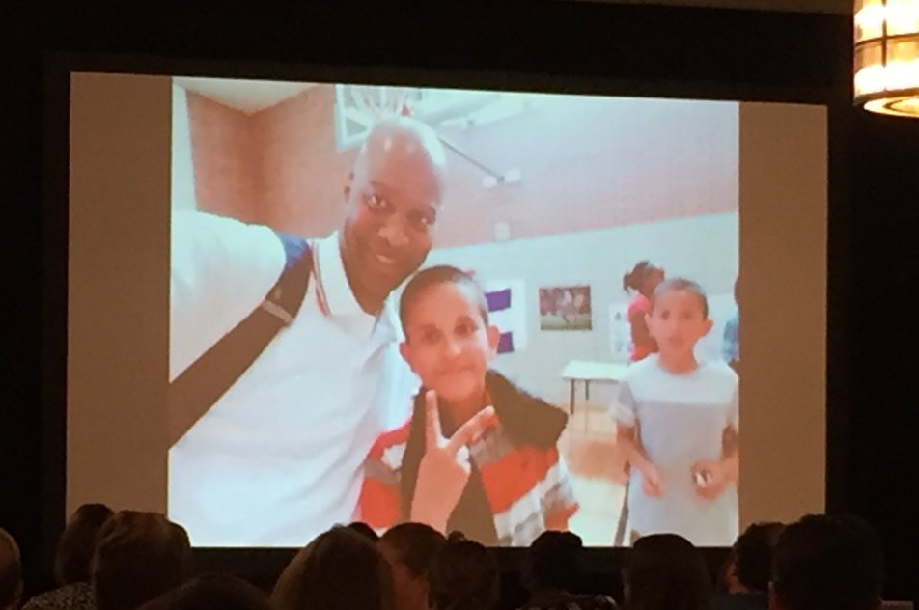
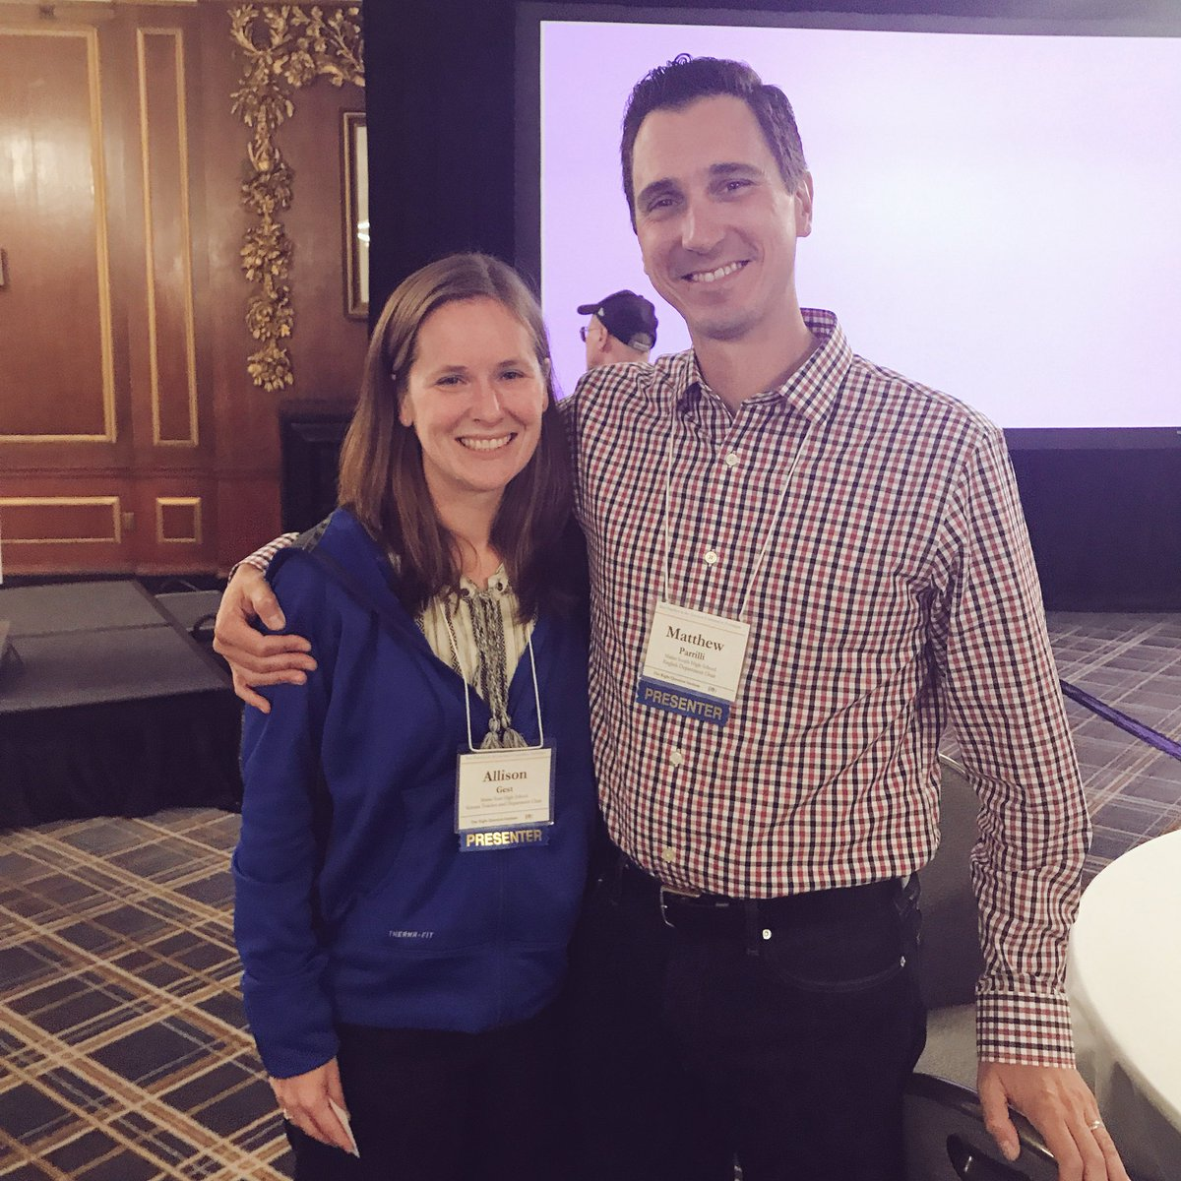
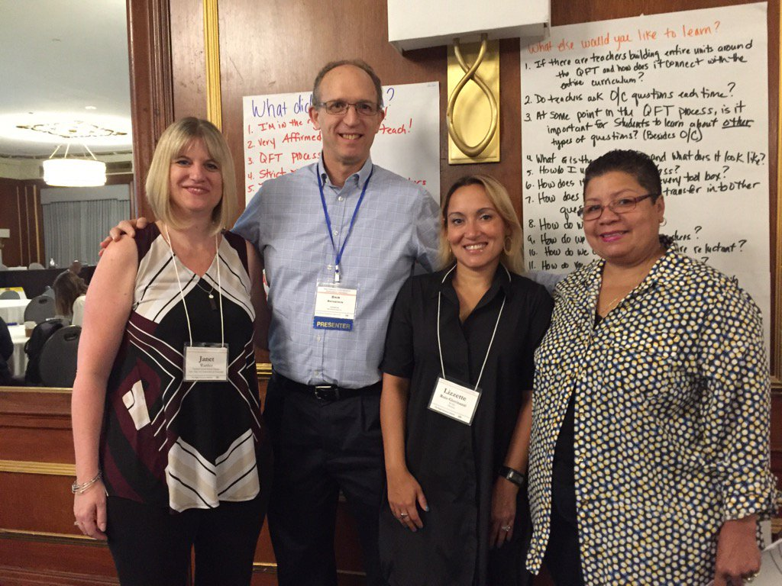
A Growing Community of Practice

Slide 55
Educator Network and RQI Resources
Templates you can use tomorrow in class
Classroom Examples
Instructional Videos
Forums and Discussions with other Educators
Seminar Resources

Slide 56
Today’s Agenda
Quick QFT
The Art and the Science
Break
Work on Lesson Plans
Building a Community of Practice
Reflections and Evaluations
#QFT

Slide 57
Closing Reflections
We shall not cease from exploration
And the end of all our exploring
Will be to arrive where we started
And know the place
For the first time.
--T.S. Eliot

Slide 58
Closing Reflections
What did you learn?
An “a-ha moment” or a meaningful take away from your experience today
A key question that will guide your work

Slide 59
Making a Contribution to Democracy
“We need to be taught to study rather than to believe, to inquire rather than to affirm.” - Septima Clark
See Chapter 6 on Septima Clark in Freedom Road: Adult Education of African Americans (Peterson, 1996).

