Slide 1
Today’s Agenda
Welcome and Community Building
Collaborative Learning with the Question Formulation Technique (QFT)
The Art and Science of the QFT: A Deep Dive into Planning and Designing
Lunch
Workshop #1
Workshop #2
(optional) Informal Conversation & Reflection
#QFT #QFTCon

Slide 2
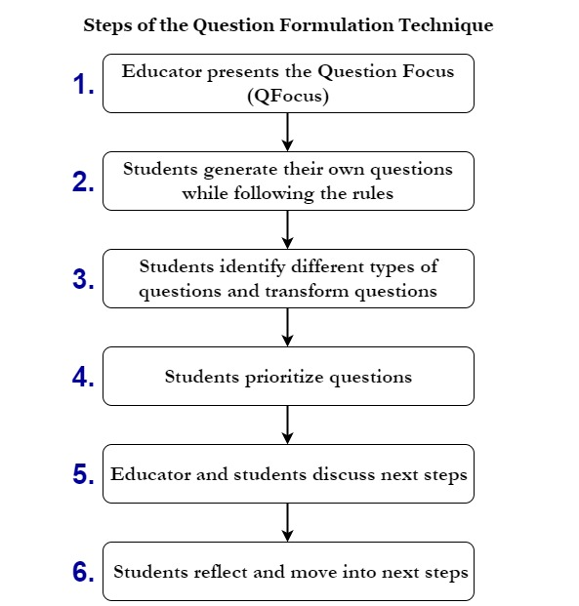
An Art and a Science
The Science
The QFT is a rigorous protocol, with specific steps and sequence, that produces consistent results.

Slide 3
An Art and a Science
The Art
You can tailor the QFT for your students to further enhance your teaching objectives.
Tailor the QFT through:
How students will make use of their questions
Question Focus design
Prioritization instructions
Reflection questions
Facilitation and scaffolding

Slide 4
The Art
Identify teaching & learning goals
Consider how students’ questions will be used
Design a Question Focus
Develop prioritization instructions
Create reflection questions
Facilitate

Slide 5
Not a Detour but a Shortcut

Slide 6
Various Teaching Purposes
Engagement
Knowledge acquisition
Formative assessment
Summative assessment
Collaboration
Skill development

Slide 7
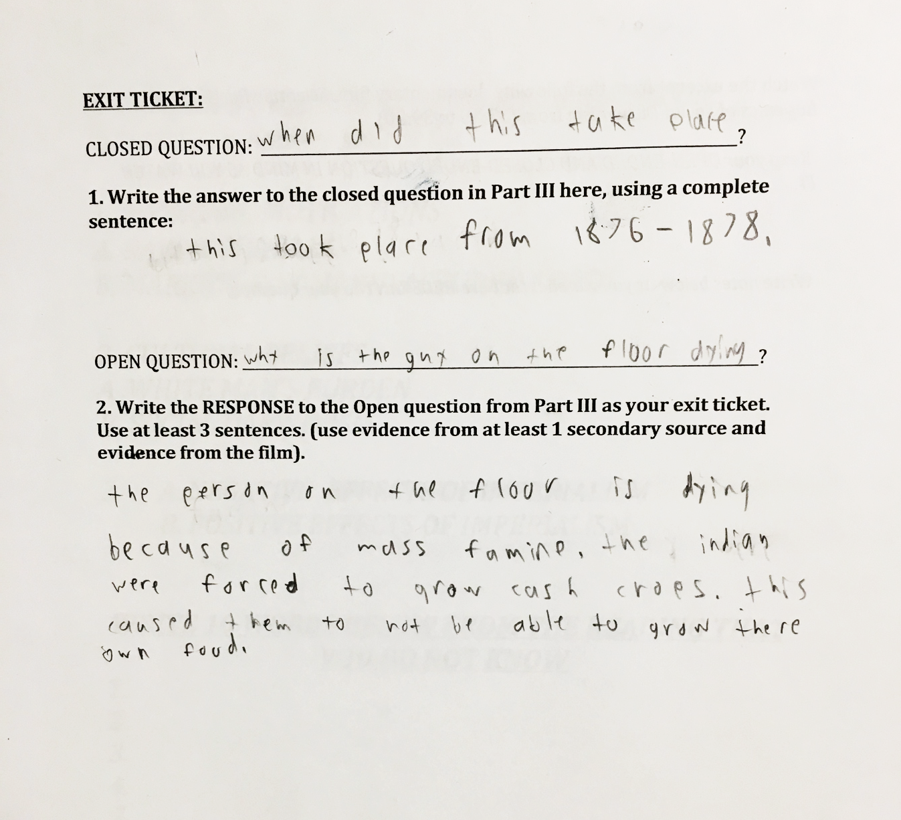
Using the QFT for Formative Assessment

Slide 8
Using the QFT for Engagement

Slide 9
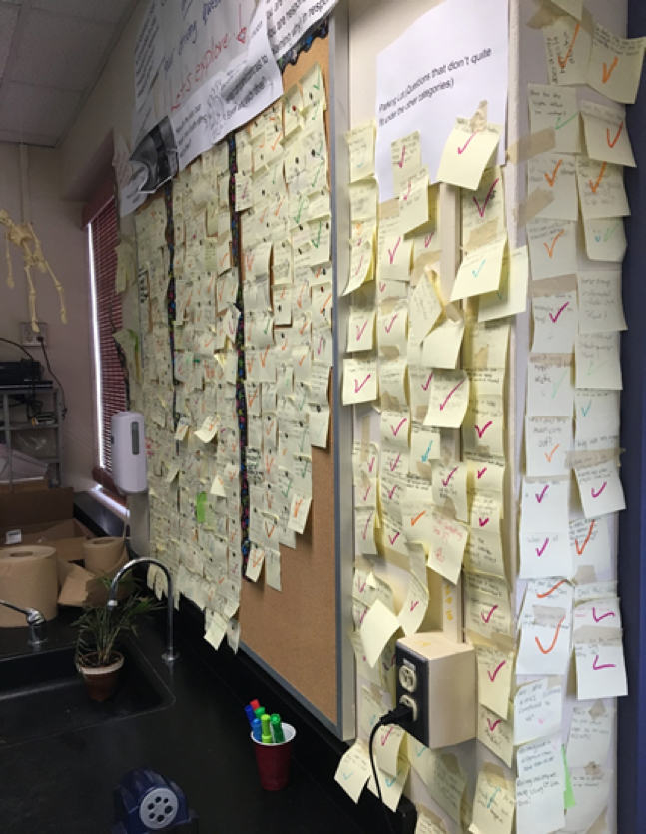
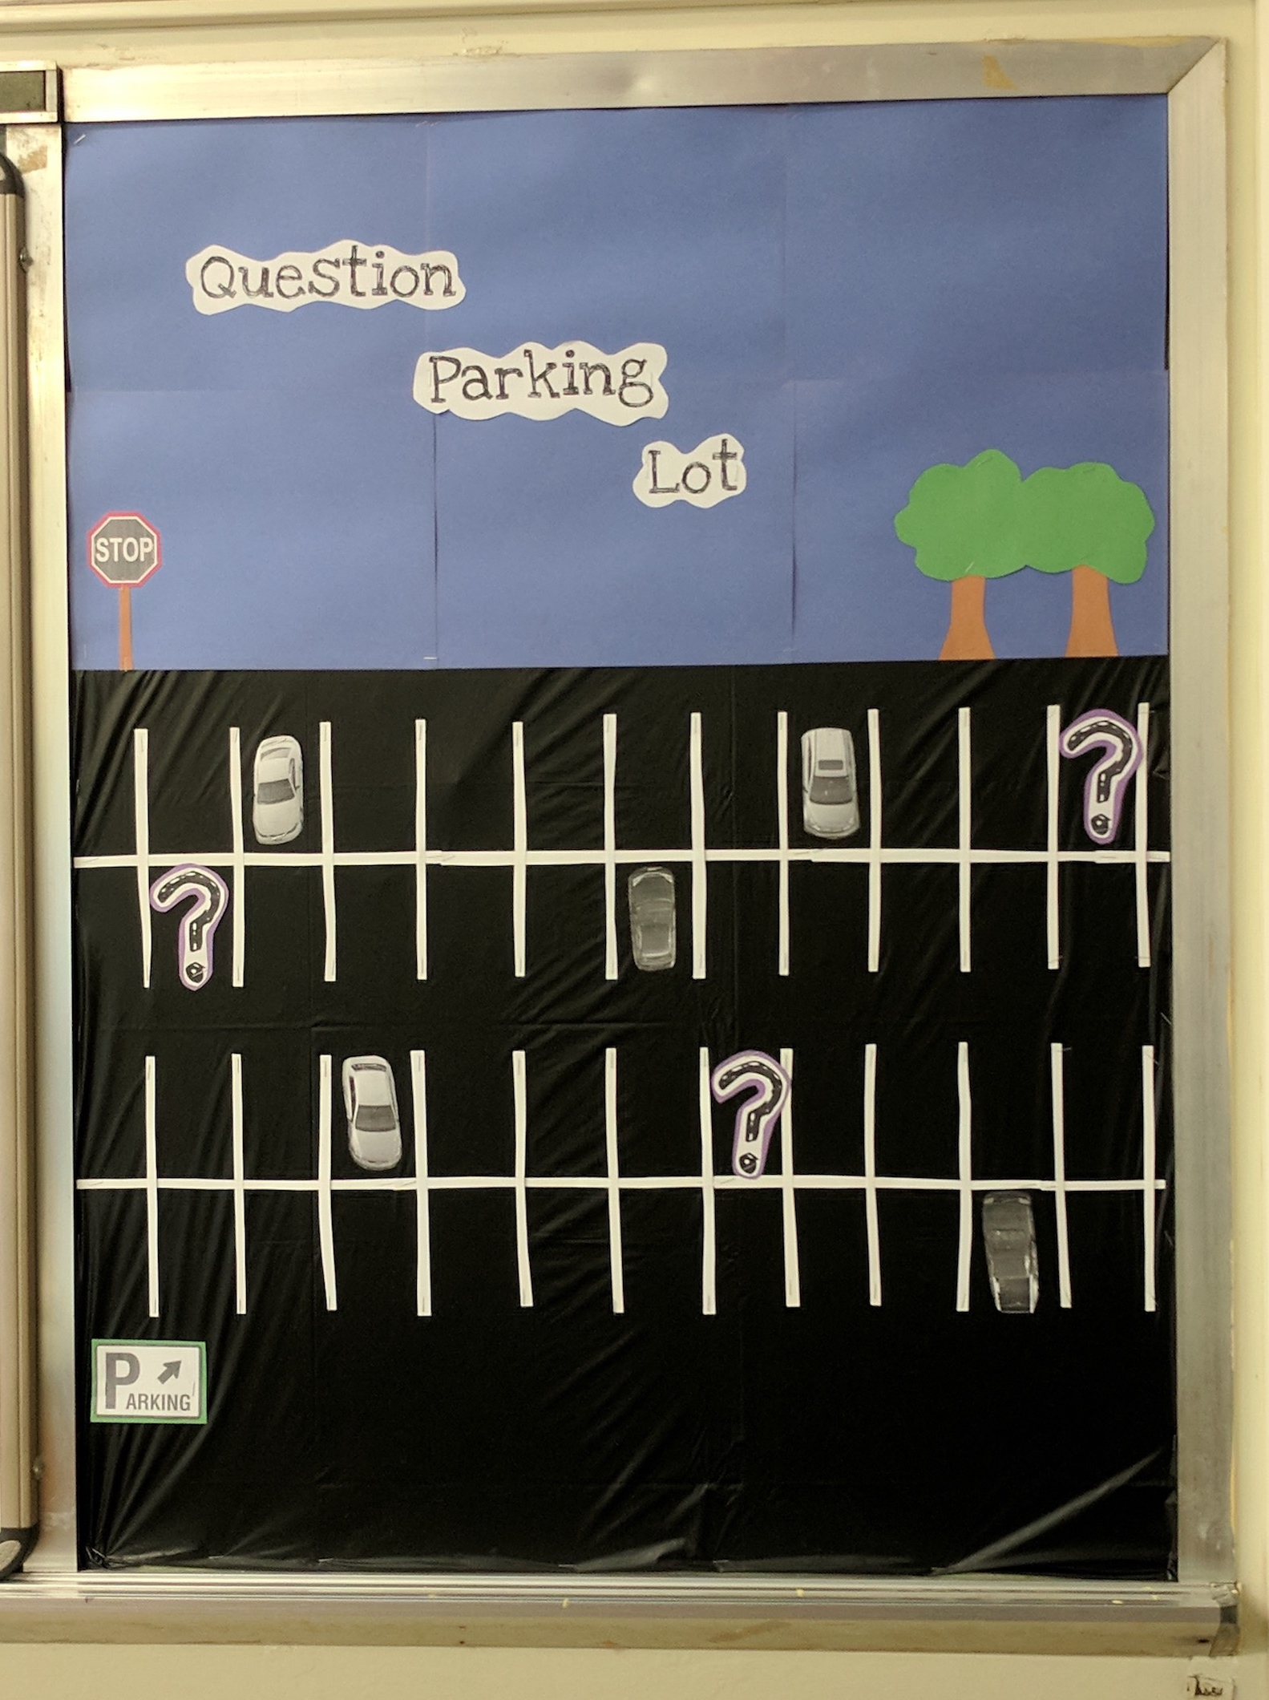
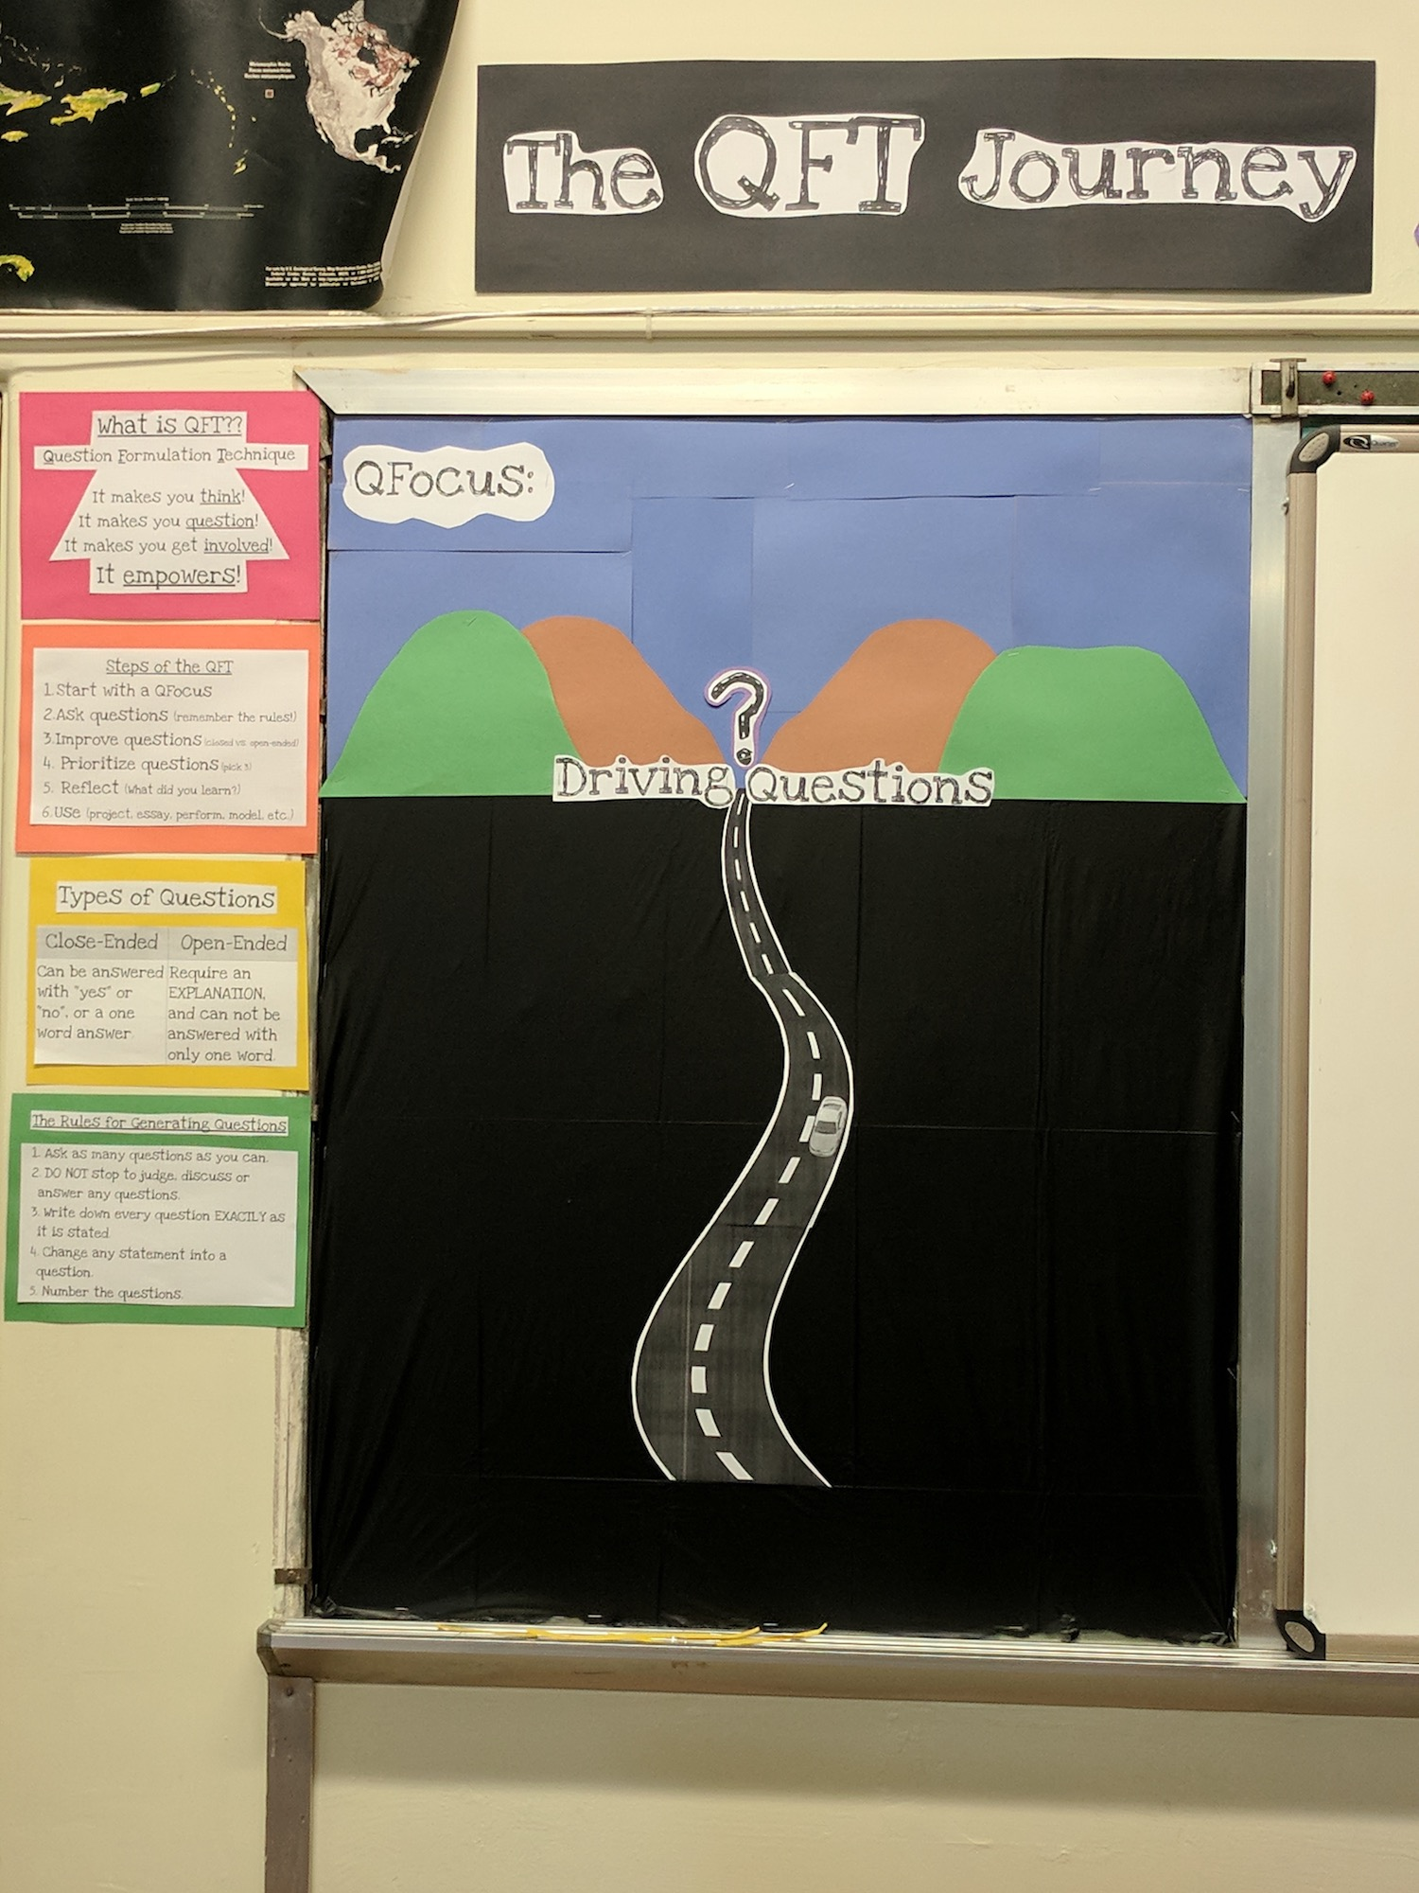
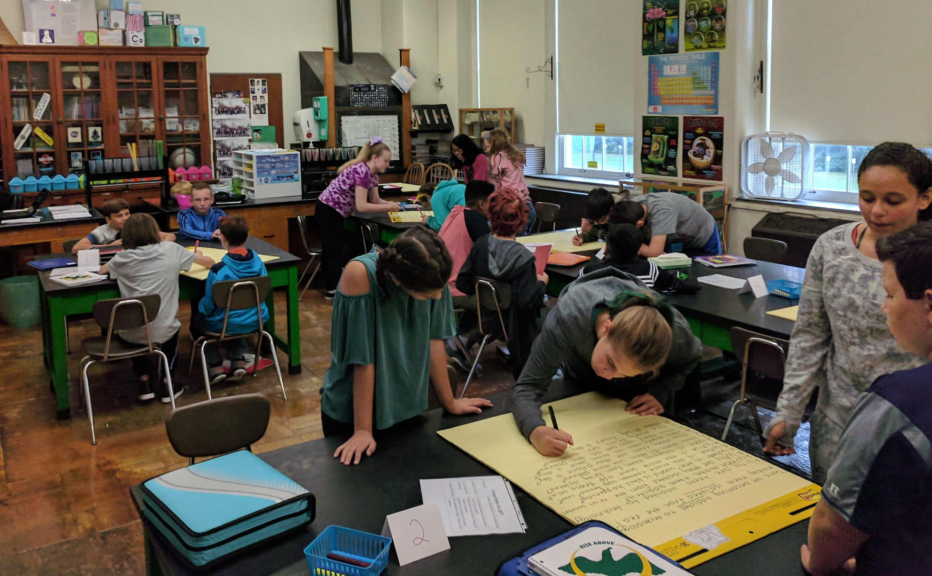
Next Steps with Student Questions
The Driving Question Board
The “Parking Lot”
Ongoing student choice projects

Slide 10
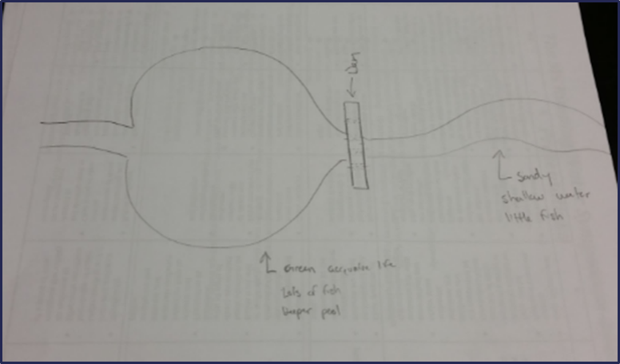
Using the QFT for Peer Review
Scientist’s claim:
“Adding a dam to a water system causes a decrease in aquatic life downstream.”
Student Design to test the claim:

Slide 11
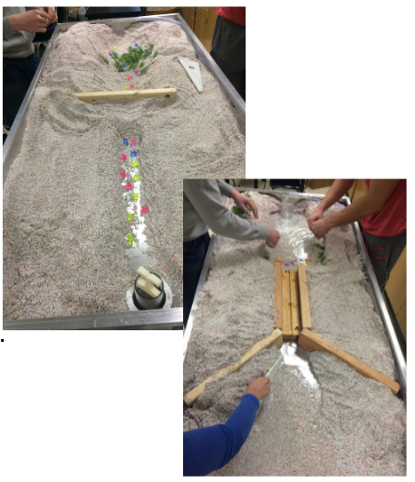
Next Steps with Student Questions:

Slide 12
Pop Quiz or Reading Check
Paper topic
Debate Prep
Lab work & Experiments
Exit ticket or ”Do Now”
Hang on walls,
Check Off as Answered
Research
Projects
And sometimes…
Nothing!
Test Prep
Homework
Presentations
Interview an Expert
Student Choice Projects
Socratic Seminar Prompts
Make Your Own Final Test
Guest speakers
Journal Prompt
Close Reading Protocol
Year-long or Unit-long Essential Questions
Tailoring Instruction
Service Action Projects

Slide 13
Think of a few ways you might integrate the QFT into your work
Keep in mind:
Your overarching teaching objectives
How students will use their own questions or how you will use their questions as the lesson progresses

Slide 14
Various Teaching Purposes
Engagement
Knowledge acquisition
Formative assessment
Summative assessment
Collaboration
Skill development
And many more…

Slide 15
The Art
Identify teaching & learning goals
Consider how students’ questions will be used
Design a Question Focus
Develop prioritization instructions
Create reflection questions
Facilitate

Slide 16
Question Focus (QFocus): A focus or prompt for students to ask questions about
Phrase or quotation
Image or video
Podcast or speech
Hands-on experience or experiment
Equation or data set
The QFocus is not a question!

Slide 17
Designing a QFocus
An effective QFocus should be:
directly tied to the objectives of a lesson or unit
simple, but not too simple
interesting or provocative to students, but not biased or leading

Slide 18
Initial QFocus

Slide 19
Revised QFocus
The city fathers were aware that the decaying bodies of these rodents were making people sick. (page 28)

Slide 20
Initial QFocus
Topic: A unit on “How can a pet be an important friend?”
QFocus:
People, animals, and friends

Slide 21
Initial Question Focus: People, Animals, and Friends
Do people exist?
Where do people live?
Why do animals live in the zoo?
Why do people go to the pool?
Why are friends fun?
Why do animals bite?
Why do people go to school?
Do people, animals, and friends play together?
Do animals make friends?
Why do I need friends?
Why do people want to be friends with animals?
Why are people making friends with animals?
Why do people, animal, and friends live in different countries?
Where did my dog and friend go?
Can my friend pet our new dog?
Why do I have eyes?
How do people smell?
Can animals speak?
Can people fly?
Where is my bunny? What happened?

Slide 22
Rather Than Thinking About This Relationship
People, animals, and friends

Slide 23
Students Were Hyper-focused on the Individual Parts of the Whole
People, animals, and friends

Slide 24
Lesson Planning Workbook
Directions:
Work on the lesson planning workbook through page 5.
Try creating your own QFocus. (It’s ok if it is a bit rough.)Write it on an index card.
Trade cards with a partner.
Generate questions about your partner’s QFocus.
Trade back and use their questions to guide revision of the QFocus.

Slide 25
The Art
Identify teaching & learning goals
Consider how students’ questions will be used
Design a Question Focus
Develop prioritization instructions
Create reflection questions
Facilitate

Slide 26
Prioritization Instructions
Choose the three most important questions
Choose the three questions you consider most important.

Slide 27
Categories of Prioritization Instructions
Choose three questions…
General Instructions:
that you consider most important
Specific Purposes:
that you need to research further
to help you solve the problem
that you need to answer first
that a scientist studying the earth might ask
that will help you understand the text
that require analyzing data
that are not “Googleable” and may be difficult to answer

Slide 28
QFocus: High School
“History, despite its wrenching pain, cannot be unlived, but if faced with courage, need not be lived again.”
– Maya Angelou
Troubleshooting Tips:
“Spend the next 2 minutes asking about just this word/phrase”
Change the prioritization instructions on the fly

Slide 29
The Art
Identify teaching & learning goals
Consider how students’ questions will be used
Design a Question Focus
Develop prioritization instructions
Create reflection questions
Facilitate

Slide 30
Examples of Reflection Questions
QFT Process
Content Specific
What did you learn about asking questions?
How did you learn it?
What do you understand differently now about asking questions?
How can you use what you learned about asking questions?
How do you feel about asking questions?
What did you learn about the (content)?
How did the QFT process help you think about…
key concept
specific assignment
overarching topic
theme in the unit
chapter you just read

Slide 31
One Last Thought about Reflection
“Reflection is the piece that keeps me coming back the next day…”
“The most profound reflections are almost always from the students who perhaps seemed disengaged in class. Quiet students often do a great deal of their thinking in the written reflection.”
- Ling-Se Chesnakas, Boston Public Schools

Slide 32
The Art
Identify teaching & learning goals
Consider how students’ questions will be used
Design a Question Focus
Develop prioritization instructions
Create reflection questions
Facilitate

Slide 33
Four Principles of Facilitation
Monitor student adherence to the process
Do not give examples
Do not get pulled into group discussion
Acknowledge all contributions equally
Discuss:
What could be challenging about each principle? What might be important about each?

Slide 34
The Science of the QFT:
a protocol
The Art of the QFT:
You

Slide 35
The one quality all excellent QFT designers share?
Thick skin.

Slide 36
Today’s Agenda
Welcome and Community Building
Collaborative Learning with the Question Formulation Technique (QFT)
The Art and Science of the QFT: A Deep Dive into Planning and Designing
Lunch
Workshop #1: 12:45 - 1:45
Workshop #2: 2:00 - 3:05
Informal Conversation & Reflection (optional)
#QFT #QFTCon

Slide 37
Workshop Sessions
Session #1: 12:45 - 1:45 pm | Room
Build Math Skills and Excitement with the QFT Jaime Brookman| Chesterfield County Public Schools | D108
Create an Inquiry Mindset Culture Wave in Your School: Using QFT in Collaboration with Your School Librarians Lori Donovan| Chesterfield County Public Schools | D107
It’s Elementary! Using the QFT with Primary Students Laurie Surles| Chesterfield County Public Schools | D109

Slide 38
Workshop Sessions
Session #2: 2:00 - 3:05 pm | Room
Facilitate Change with the Question Formulation Technique Lynne Bland| Chesterfield County Public Schools | D108
Inquiry Beyond the Question Peyton Anderson| Chesterfield County Public Schools | D107
Lessons from the Field: The QFT with Special Student Populations Andrew Minigan| Right Question Institute | D109

Slide 39
Agenda
Welcome and Community Building
Collaborative Learning with the Question Formulation Technique (QFT)
The Art and Science of the QFT: A Deep Dive into Planning and Designing
Lunch
Workshop #1
Workshop #2
(optional) Informal Conversation & Reflection
#QFT #QFTCon

Slide 40
Closing Reflections
We shall not cease from exploration
And the end of all our exploring
Will be to arrive where we started
And know the place
For the first time.
- T.S. Eliot

Slide 41
Closing Reflections
What did you learn?
An “a-ha moment” or a meaningful take away from your experience today
A key question that will guide your work
What was new for you?

