Slide 1
Advancing the Work: From Seminar to Action
Teachers College Columbia University
August 15, 2017
Dan Rothstein | Andrew Minigan | Sarah Westbrook
The Right Question Institute

Slide 2
Today’s Agenda
Welcome
Introduction to the Question Formulation Technique (QFT)
Unpacking the QFT & Classroom Examples
Preview of a QFT Lesson Planning Workbook
Art and Science of the QFT & Facilitation Principles
Lunch (on your own)
Using the QFT to Engage Learners of All Ages
Reflection, Evaluation, & Next Steps
#QFTCon #QFT

Slide 3
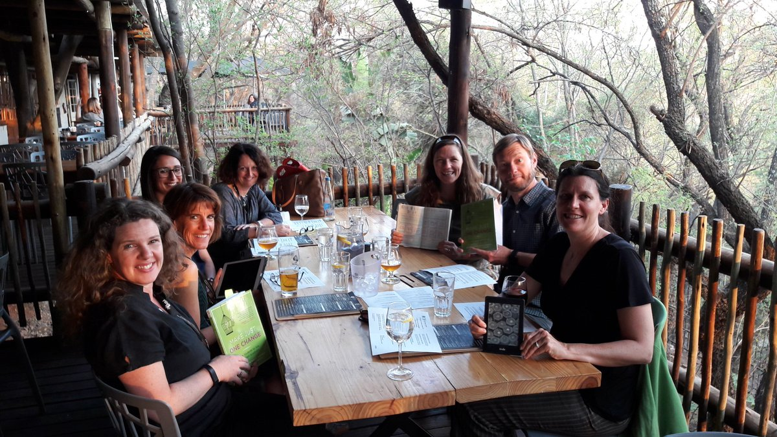
Facilitating book clubs with Make Just One Change

Slide 4
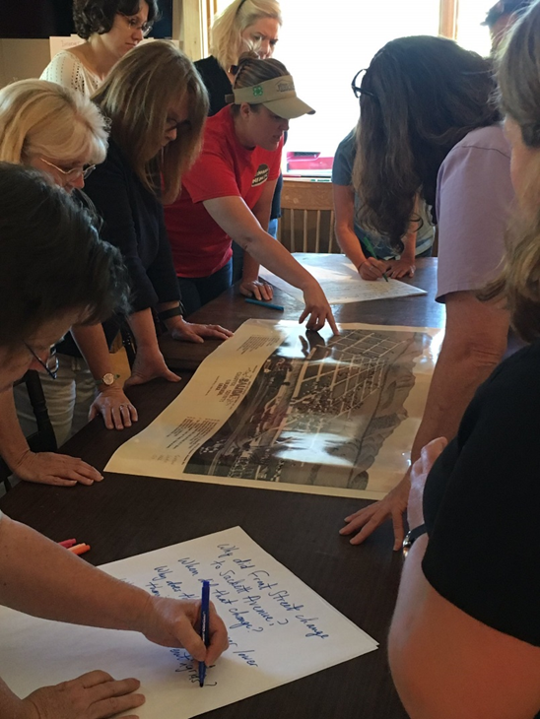
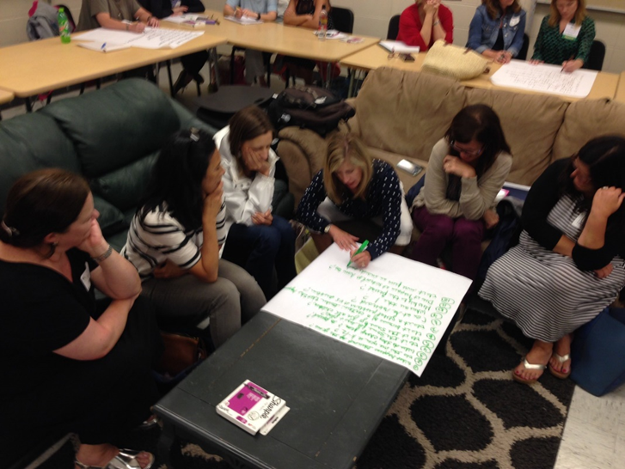
Delivering PD in their departments, schools, and districts
Knee deep in @RightQuestion on a Sunday learning together so that historic places are in the classroom
@TPSMSUDenver @TeachingLC

Slide 5
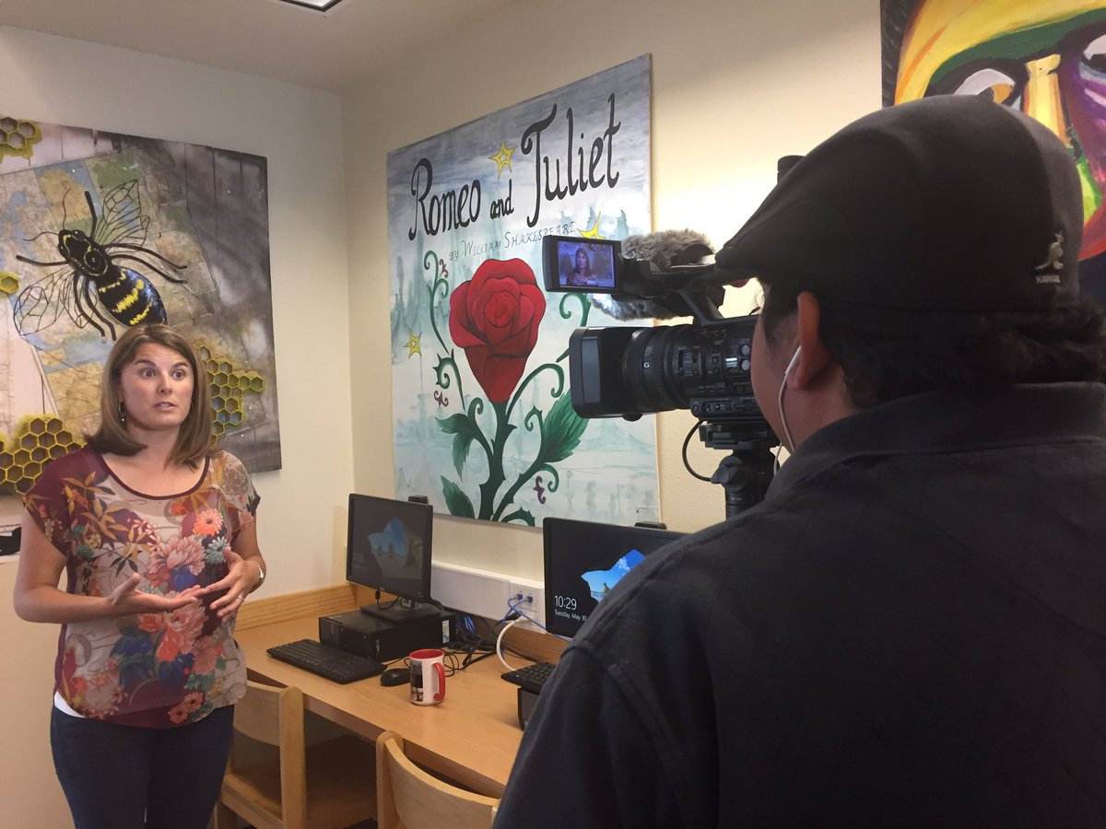
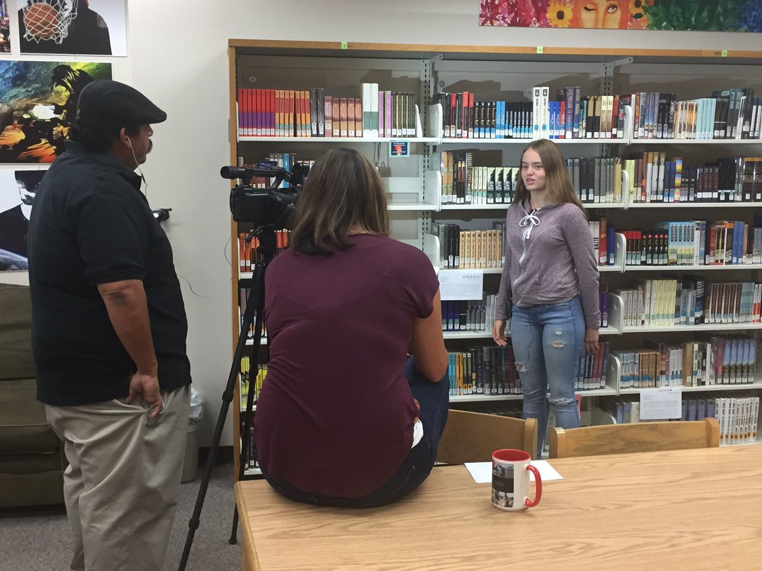
Filming instructional videos & creating online resources ‘[‘;//
That's a wrap! Ss & Ts at @ohs_jackets filmed by @GodoyStudios and interviewed on their experience w/ the #QFT

Slide 6
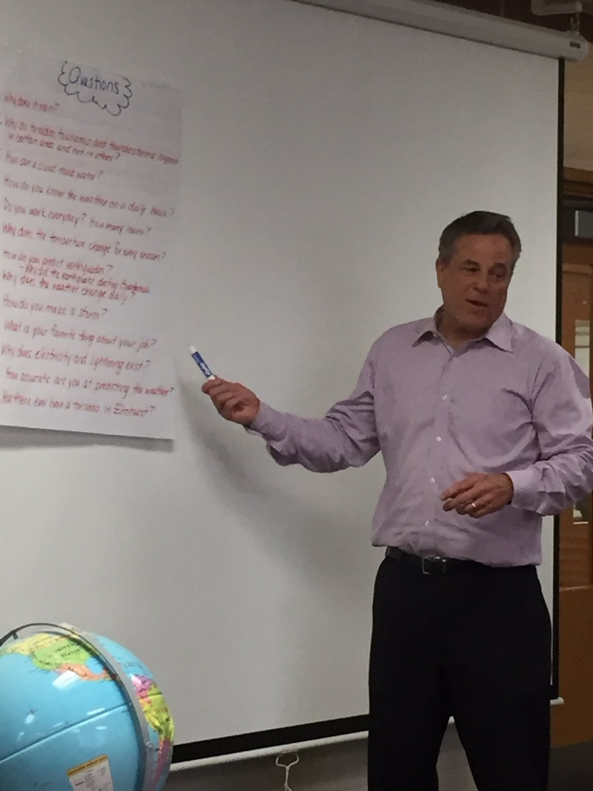
Tweeting QFT examples to school leaders, reporters, authors, and industry leaders…and getting their attention!
Thank you Phil Schwartz from @ABC7Chicago for answering our #QFT questions this morning. @Fischerspirit #d205learns
S. E. Hinton Retweeted Right Question
One of the reasons why teachers are my heroes.
Hi @BillNye As a 7th grade science teacher, I encourage young scientists to question and figure out phenomena! #BillMeetScienceTwitter

Slide 7
Ways to partner with RQI and join a growing community of practice
Here’s what past participants are up to this year:
Sharing lessons and student questions
Writing articles for EdWeek, Teaching Channel, Educational Leadership, ASCA…or creating their own blogs
Presenting at local, state, and national conferences—
Taking on new leadership positions and launching new initiatives
Working to change education policy and re-write standards
Collaborating with RQI on new proposals, projects, articles, grants, and presentations
And…

Slide 8
And most importantly, continuing to do innovative, creative work with students in the classroom

Slide 9
…as a two-way street
RQI’s Vision of Professional Learning
RQI’s design of professional learning experiences
Professional implementation & learning
#QFTCon #QFT

Slide 10
Closing Reflections
We shall not cease from exploration
And the end of all our exploring
Will be to arrive where we started
And know the place
For the first time.
--T.S. Eliot

Slide 11
Closing Reflections
“We need to be taught to study rather than to believe, to inquire rather than to affirm.” - Septima Clark
See Chapter 6 on Septima Clark in Freedom Road: Adult Education of African Americans (Peterson, 1996).

