Slide 1
Building Strong School-Family Partnerships with the Right Question School-Family Partnership Strategy
Luz Santana
@rightquestion

Slide 2
Materials
The Right Question Institute offers many of our materials through a Creative Commons License and we encourage you to make use of and/or share this resource. Please reference the Right Question Institute as the source on any materials you use.
Source: www.rightquestion.org

Slide 3
Agenda
About the Right Question School-Family Partnership Strategy
Integrating the RQI Strategy: Examples of Integration
Practice Using the Strategy

Slide 4
LAWRENCE, MA, 1990
“We don’t go to the school because we don’t even know what to ask.

Slide 5
Lessons…
8 WORKSHOPS
How to Choose Your Child’s School
How to Use and Evaluate the Service: Communicating with the Teacher and Principal
When the School Evaluates Your Child , It Evaluates Itself
Who is Responsible for Discipline?
Discipline Leading to Evaluation
The School as a Part of the Political System
The School Committee
The School Budget

Slide 6
Family Engagement
Health Care
Innovation
The Classroom
Over 200,000 teachers using the strategy

Slide 7
The Right Question School-Family Partnership Strategy
ASCD Member Book, September, 2016

Slide 8
A strategy that focuses on:
Sharing two skills:
Asking better questions
Participating more effectively in decisions
So that parents can play three roles:
Support
Monitor
Advocate

Slide 9
The Foundation
Questions are the foundation
Build the foundation first
Teach parents how to ask their own questions

Slide 10
Strengthen the foundation
Set aside time for parents to ask questions
Begin all interactions by setting time aside for parents to ask questions

Slide 11
An integrated strategy
A Strategy, NOT a program
Complementary to existing programs

Slide 12
Parent Engagement Activities

Slide 13
Components of the Strategy
The Question Formulation Technique
The Framework for Accountable Decision Making
The Support, Monitor, and Advocate Model

Slide 14
Integration Examples
”

Slide 15
The Question Focus (QFocus)
The QFocus is what parents are asking questions
The QFocus can be:
A statement or phrase
A picture
A simple problem

Slide 16
Integration examples…
Open House
A school principal and teachers engage parents to think about the issue of bullying
Question Focus: Creating a caring
environment.

Slide 17
Question Focus: Creating a caring environment
O
C
C
O
C
O
O
O
O
C
C
C
O
What do they mean by caring?
Is there a problem?
Is this about a caring environment in the school?
What about after school?
Is this about the fight that happened last year?
What fight?
Who’s creating it?
What does a caring environment mean?
Does it mean just keep the kids from fighting?
Do the kids know what’s expected of them?
Are parents part of this?
Is there something we can do to help?
What should the school be doing?
12. 14. What can we do to help?

Slide 18
Integration examples…
Parent-Teacher Conference
A teacher helps a mother
generate questions to address
an issue
Question Focus:
Sam seems to be having trouble
doing his homework.

Slide 19
The Questions:
Is he behaving?
Is he causing problems?
Is he doing his homework?
What do you mean by “trouble”?
How do you know he’s having trouble?
When did this start?
Did he do his homework before?
Is he getting punished for not doing his homework?
What’s going to happen to him?
Why do you think he’s having trouble? X
What should I do to make sure he does his homework? X
What happens when he doesn’t do his homework?
Will he be held back? X

Slide 20
Parent Liaison generated change
Individual Education Plan (IEP)
A parent liaison works with a parent in preparation for an IEP meeting
Support, monitor, and advocate
Ask questions
Prioritizes questions about decisions
QFocus: The school recommends and IEP
to help your child.

Slide 21
How’s it going to help?
Why does he need it?
Is the IEP the same for all kids?
Why are they saying he needs it now?
What’s different this year?
Is this going to make him feel stupid?
What can I do to help him?
What will the school do so he doesn't feel bad about himself?
Can’t his teacher help him more?
Is there something they can do instead of an IEP?
Reason
Process
Role

Slide 22
Integration Opportunities…
Open House
Progress Reports
Problem Solving Meetings
PTO Meetings
Workshops
Information Meetings
Title I Meetings
…

Slide 23
Discussion
What would be the value of parents asking questions?
What would be the value of parents practicing asking questions?
Why should the facilitator write down several questions before answering them?

Slide 24
Using the Question Formulation Technique
Roles: Teacher, Parent, Observer
Process:
Teacher will lead parent through the question formulation process.
Cover as many steps as possible, making sure parent is asking questions.
Observer will keep track of how the facilitation went, and how the different steps were facilitated

Slide 25
You will need to:
1. Share with parent(s) why would it be important to:
ask questions
practice asking questions
write down the questions before answering them
2. Give instructions on how to ask questions.
3. Write down the questions.

Slide 26
Question Focus (QFocus)
Your child might be held back in the same grade for one more year

Slide 27
Your child might be held back in the same grade for one more year
QFocus:
Ask Questions
Follow the Rules
Ask as many questions as you can.
Do not stop to answer, judge, or discuss.
Write down every question exactly as it was stated.
Change any statements into questions.
Number the Questions

Slide 28
Outcomes
Parents have foundational skills they can use to partner more effectively with the school
Parents and educators are resources for each other on behalf of the student
Educators have tools and a strategy to engage and prepare parents to partner more effectively

Slide 29
Parents Comments
Ask the right questions to be sure I understand the standards expected of my child.
Communicate better with my child’s teachers.
Have a plan of action when it comes to my child’s education.
Monitor my child’s education more closely and ask questions to obtain answers.

Slide 31
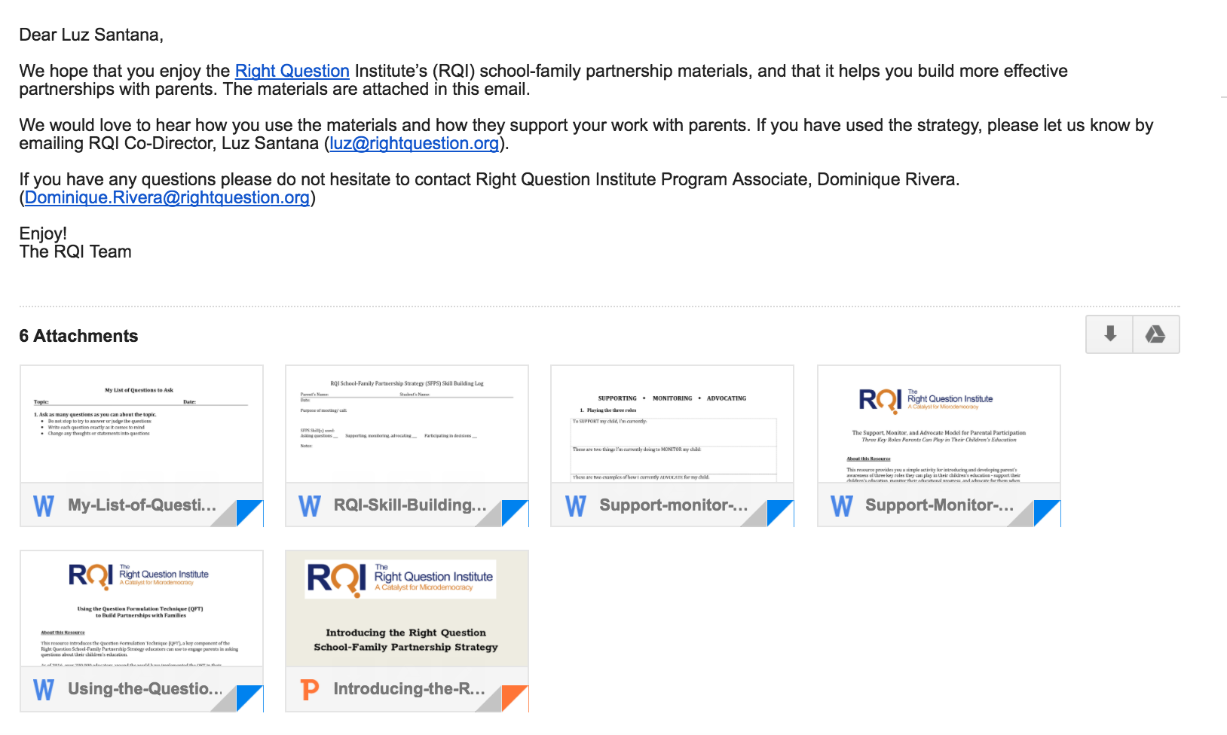
SCHOOL-FAMILY PARTNERSHIPS RESOURCES
@
WWW.RIGHTQUESTION.ORG

Slide 32
Reflection
What did you learn?
What is an “a-ha” or a meaningful take away from your experience today?

