Slide 1
Seminar on Best Practices with the QFT: Closing Reflections
Kailua Kalaheo Complex Area
Kailua, HI
August 29, 2017
Luz Santana
Co-Director
The Right Question Institute
Sarah Westbrook
Director of Professional Learning
The Right Question Institute

Slide 2
Today’s Agenda
Welcome and Community Building
Collaborative Learning with the Question Formulation Technique (QFT)
The Art and Science of the QFT
Lunch
Workshop Session #1
Workshop Session #2
Closing Reflections, Q&A, & Evaluations
#QFTCon #QFT

Slide 3
To Access Today’s Materials:
http://rightquestion.org/educators/
seminar-resources/
Join our Educator Network for:
Templates you can use tomorrow in class
Classroom Examples
Instructional Videos
Forums and Discussions with other Educators

Slide 4
Closing Reflections
What did you learn?
An “a-ha moment” or a meaningful take away from your experience today

Slide 5
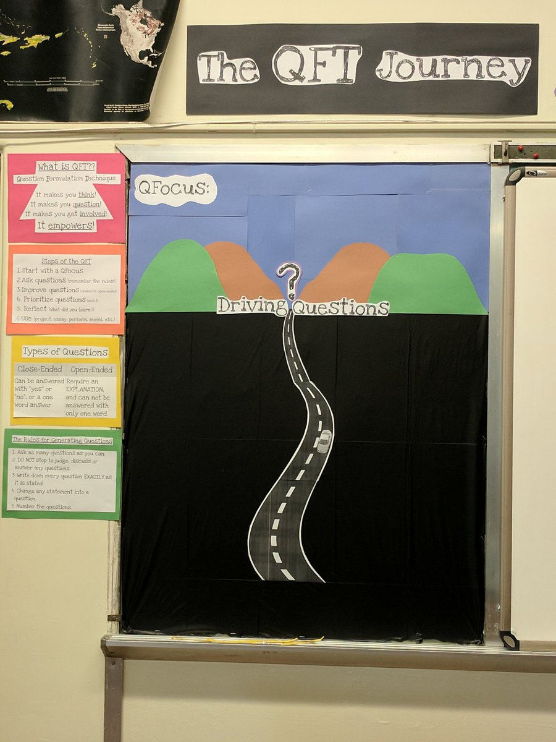
So, where do we go from here?

Slide 6
…as a two-way street
RQI’s Vision of Professional Learning
RQI’s design of professional learning experiences
Professional implementation & learning
#QFTCon #QFT

Slide 7
Closing Reflections
We shall not cease from exploration
And the end of all our exploring
Will be to arrive where we started
And know the place
For the first time.
--T.S. Eliot

