Slide 1
Using the QFT for Consensus-Building & Decision-Making in School Settings
Hawaii
Department of
Education
Kailua, HI
August 29, 2017
Luz Santana, Co-Director
The Right Question Institute
Cambridge, MA

Slide 2
We’re Tweeting…
@RightQuestion
@LuzSantana20
#QFTCon #QFT

Slide 3
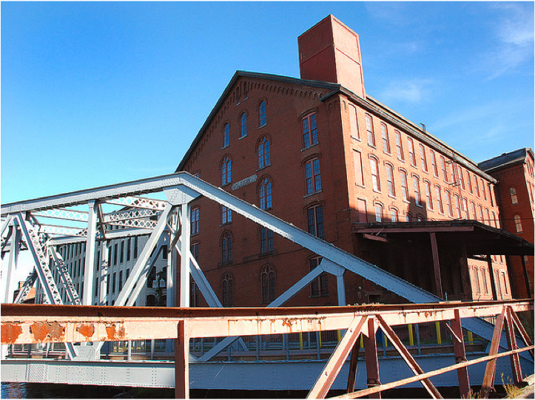
Lawrence, MA, 1990
“We don’t go to the school because we don’t even know what to ask.”

Slide 4
Agenda
Session Overview
Unpacking the Right Question Strategy
Example of the Right Question Strategy Used for School Change
Final Thoughts

Slide 5
Imagine you just have been to a seminar and you want your district, school, department, colleagues to make a change based on a practice you learned at the seminar.

Slide 6
Why spend time asking questions when introducing a change?
Because when you introduce a change the questions are going to be asked anyways, but you just may not hear them.

Slide 7
The Right Question Strategy
Core components of the strategy:
The Question Formulation Technique (QFT)
The Framework for Accountable Decision-Making

Slide 8
The QFT
A rigorous step-by-step process to:
Produce many questions
Improve the questions
Strategize on how to use the questions

Slide 9
The Framework For Accountable Decision Making
Identifying decisions and using a set of criteria to participate more effectively in decisions.

Slide 10
Definition of a Decision
The selection of one option from among two or more options.

Slide 11
What are examples of decisions embedded in this statement?
Student discipline practices at the high school will be reviewed by a committee appointed by the superintendent.

Slide 12
Examples of Decisions
Student discipline practices at the high school will be reviewed by a committee appointed by the superintendent.

Slide 13
The Framework for Accountable Decision-Making
When decisions are made it is important to ask questions about:
REASON: the basis for a decision.
PROCESS: the steps and actions taken, people involved, information used in making the decision.
ROLE: the part you play in the decision-making process.

Slide 14
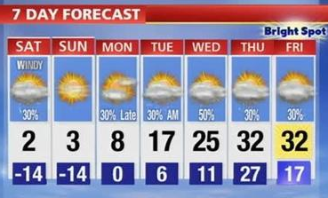
We make decisions every day
Consider the REASONS, the PROCESS and the ROLE you played in getting dressed this morning.

Slide 15
Experiencing the Right Question Strategy

Slide 16
Rules for Producing Questions
ASK AS MANY QUESTIONS AS YOU CAN
DO NOT STOP TO ANSWER, JUDGE OR DISCUSS
WRITE DOWN EVERY QUESTION EXACTLY AS STATED
CHANGE ANY STATEMENTS INTO QUESTIONS

Slide 17
QFocus:
Ask Questions
Follow the Rules
Ask as many questions as you can.
Do not stop to answer, judge, or discuss.
Write down every question exactly as it was stated.
Change any statements into questions.
Number the Questions

Slide 18
Question Focus (QFocus)
Instructional practices may be changed throughout the district next year in order to address the achievement gap.

Slide 19
REASON
REASON
REASON: the basis for a decision.
Identify one question about the REASONS by marking it with “REASONS”.
Ask a question about the reasons if you don’t have one.

Slide 20
PROCESS
PROCESS
PROCESS: the steps and actions taken, people involved, and information used in making the decision.
Identify one question about the PROCESS by marking it with “PROCESS”.
Ask a question about the process if you don’t have one.

Slide 21
ROLE
ROLE
ROLE: the part people affected by the decision play in the decision-making process.
Identify one question about the ROLE of the people affected by the decision by marking it with “ROLE.”
Ask a question about role if you don’t have one.

Slide 22
Prioritizing Questions
Review your list of questions
Choose three questions you think teachers would like answered immediately:
Instructional practices may be changed throughout the district next year in order to address the achievement gap.

Slide 23
Prioritizing Questions
After prioritizing, consider…
Why did you choose those three questions?
Where are your priority questions in the sequence of your entire list of questions?

Slide 24
Next Steps
From priority questions to action plan
In order to answer your priority questions:
what do you need to know? INFORMATION
what do you need to do? TASKS

Slide 25
Share
SHARE
Your three priority questions.
What you will do with the questions?

Slide 26
Reflection
What did you learn?
How did you learn it?
How can you use what you learned?

Slide 27
Agenda
Session Overview
Unpacking the Right Question Strategy
Example of the Right Question Strategy Used for School Change
Final Thoughts

Slide 28
The Right Question Strategy
Core components of the strategy:
a collaborative thinking, problem-solving, and decision-making tool.
The Question Formulation Technique
The Framework for Accountable Decision-Making

Slide 29
Summary of the Right Question Strategy
The Question Formulation Technique (QFT)
1. A Question Focus
2. Rules for Producing Questions
3. Producing Questions
4. Categorizing and Changing Questions-Open/Closed
5. Prioritizing Questions
6. Next Steps
7. Reflection
The Framework for Accountable Decision-Making (FADM)
1. Identifying Decisions
2. Asking Questions About Reason, Process, and Role

Slide 30
Accountable Decision-Making and Democratic Principles
In a democracy, we should expect and require that all decisions are guided by the following criteria.
Legitimacy: The decisions are based on policies, standards, rules that are fairly applied.
Transparency: The process used to make the decision is visible to all.
Opportunities for participation: There is a role in the decision making process for the individual affected by the decision.

Slide 31
The three criteria correspond to key democratic principles:
Reason
Process
Role
Legitimacy
Transparency
Opportunities for participation

Slide 32
Agenda
Session Overview
Unpacking the Right Question Strategy
Example of the Right Question Strategy Used for School Change
Final Thoughts

Slide 33
Middle School - Medfield, MA
Overview
Outcomes
“The conversations that took place resulting from the process were rich, meaningful, and productive. The simple process provided a non-judgmental structure to address a significant ‘issue' in our school and led us to a position of recognizing and embracing a need for change.”
~ Nat Vaughn, Principal
Purpose:
Use QFT to step back and analyze with staff the problem of student homework, which they had a focus group working on
QFocus:
Homework practices are inconsistent at Blake
Homework practices vary at Blake

Slide 34
Agenda
Session Overview
Unpacking the Right Question Strategy
Example of the Right Question Strategy Used for School Change
Final Thoughts

Slide 35
Reflection
REFLECTION
What did you learn?
What did you learn about the RQ Strategy for consensus building?
How can you use it?

Slide 36
Final Thoughts

Slide 37
The Right Question Institute offers many of our materials through a Creative Commons License and we encourage you to make use of and/or share this resource. Please reference the Right Question Institute as the source on any materials you use.
Source: www.rightquestion.org

