Slide 1
The Art and Science of the QFT:
Next Steps and Advancing the Work
Providence Country Day School
Providence, RI
October 16, 2017
Sarah Westbrook
Andrew Minigan and Tomoko Ouchi
The Right Question Institute, Cambridge, MA

Slide 2
Welcome
Vince Watchhorn
Head of School,
Providence Country Day School

Slide 3
Acknowledgements
We are deeply grateful to the Sir John Templeton Foundation and The Hummingbird Fund for their generous support of the Million Classrooms Campaign.
Thank you also to Mark McLaughlin, Jen Aikin, and Vince Watchhorn for their work behind the scenes supporting the planning for today’s program. A huge thanks to Mark for his ongoing support of and documentation of classroom work at PCD with the QFT.

Slide 4
Join the Conversation Online
PCD Document here!
Shortened Guide to Resources here!

Slide 5
We’re Tweeting…
@RightQuestion
#QFTCon #QFT

Slide 6
To Access Today’s Materials:
http://rightquestion.org/educators/
seminar-resources/
Join our Educator Network for:
Templates you can use tomorrow in class
Classroom Examples
Instructional Videos
Forums and Discussions with other Educators

Slide 7
Today’s Agenda
Welcome and Community Building
Setting a Collaborative Learning Agenda with the QFT
The Art and Science of the QFT
Breakout Groups: Discussion, Collaboration, and Active Work Time
Closing Reflections, Q&A, & Next Steps
Lunch
@RightQuestion#QFTCon #QFT

Slide 8
Rules for Producing Questions
1. Ask as many questions as you can
2. Do not stop to answer, judge, or discuss
3. Write down every question exactly as stated
4. Change any statements into questions

Slide 9
Producing Questions
Ask Questions
Follow the Rules
Ask as many questions as you can.
Do not stop to answer, judge, or discuss.
Write down every question exactly as it was stated.
Change any statements into questions.
Number the Questions

Slide 10
Question Focus:
The QFT at Providence Country Day School in fall 2018
→Please write this statement at the top of your paper.
→Follow the rules.
→Number the questions.

Slide 11
Improving Questions
Take one closed-ended question and change it into an open-ended question.
Take one open-ended question and change it into a closed-ended question.
Closed
Open
Open
Closed

Slide 12
Strategize: Prioritizing Questions
Review your list of questions
Choose the three questions you’re most interested to work on with colleagues today.
While prioritizing, think about your Question Focus: The QFT at Providence Country Day School in fall 2018
After prioritizing consider…
Why did you choose those three questions?
Where are your priority questions in the sequence of your entire list of questions?
What steps could you take to answer those three questions? What information do you need? What do you need to do or work on, individually or with others?

Slide 13
Share & Discuss
Your three priority questions and their numbers in your original sequence
Rationale for choosing priority questions
The next steps you discussed
Add your priority questions to our online collaboration tool: PCD’s Google Doc

Slide 14
Reflection
What did you learn?
How did you learn it?
What do you understand differently now about the QFT at Providence Country Day School?

Slide 15
The QFT, on one slide…
Question Focus
Produce Your Questions
Follow the rules
Number your questions
Improve Your Questions
Categorize questions as Closed or Open-ended
Change questions from one type to another
Prioritize Your Questions
Share & Discuss Next Steps
Reflect
Ask as many questions as you can
Do not stop to discuss, judge or answer
Record exactly as stated
Change statements into questions
Closed-Ended:
Answered with “yes,” “no” or one word
Open-Ended: Require longer explanation

Slide 16
Today’s Agenda
Welcome and Community Building
Setting a Collaborative Learning Agenda with the QFT
The Art and Science of the QFT
Breakout Groups: Discussion, Collaboration, and Active Work Time
Closing Reflections, Q&A, & Next Steps
Lunch
@RightQuestion#QFTCon #QFT

Slide 17
QFT: An ART and a SCIENCE
The Science:
A rigorous protocol, with specific steps and sequence, that produces consistent results
The QFT
Discuss the rules
Present a Question Focus
Improve questions
Prioritize questions
Discuss next steps
Reflect

Slide 18
QFT: An ART and a SCIENCE
The Art:
Tailoring the QFT process to the specific content and students you are teaching.
Tailor the QFT through:
Design of the Question Focus (Qfocus)
Instructions for prioritizing
Next steps for using the questions
Reflection questions
Facilitation

Slide 19
Five Areas Related to the Art of the QFT
Linking the QFT to Teaching and Learning Goals…& next steps
QFocus Design
Prioritization Instructions
Reflection Questions
Facilitation

Slide 20
The QFT as a Shortcut, Not a Detour

Slide 21
Various Teaching Purposes
Engagement
Knowledge acquisition
Formative assessment
Summative assessment
Peer review
Skill development
Larger inquiry or PBL cycles

Slide 22
Using the QFT for Engagement
24 = ☺ + ☺ + ☺

Slide 23
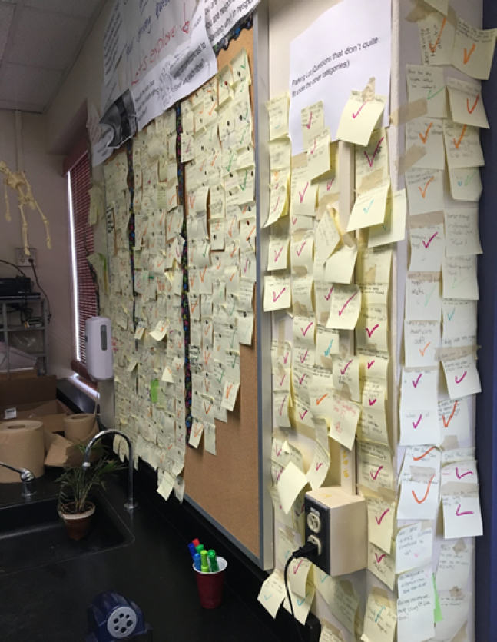
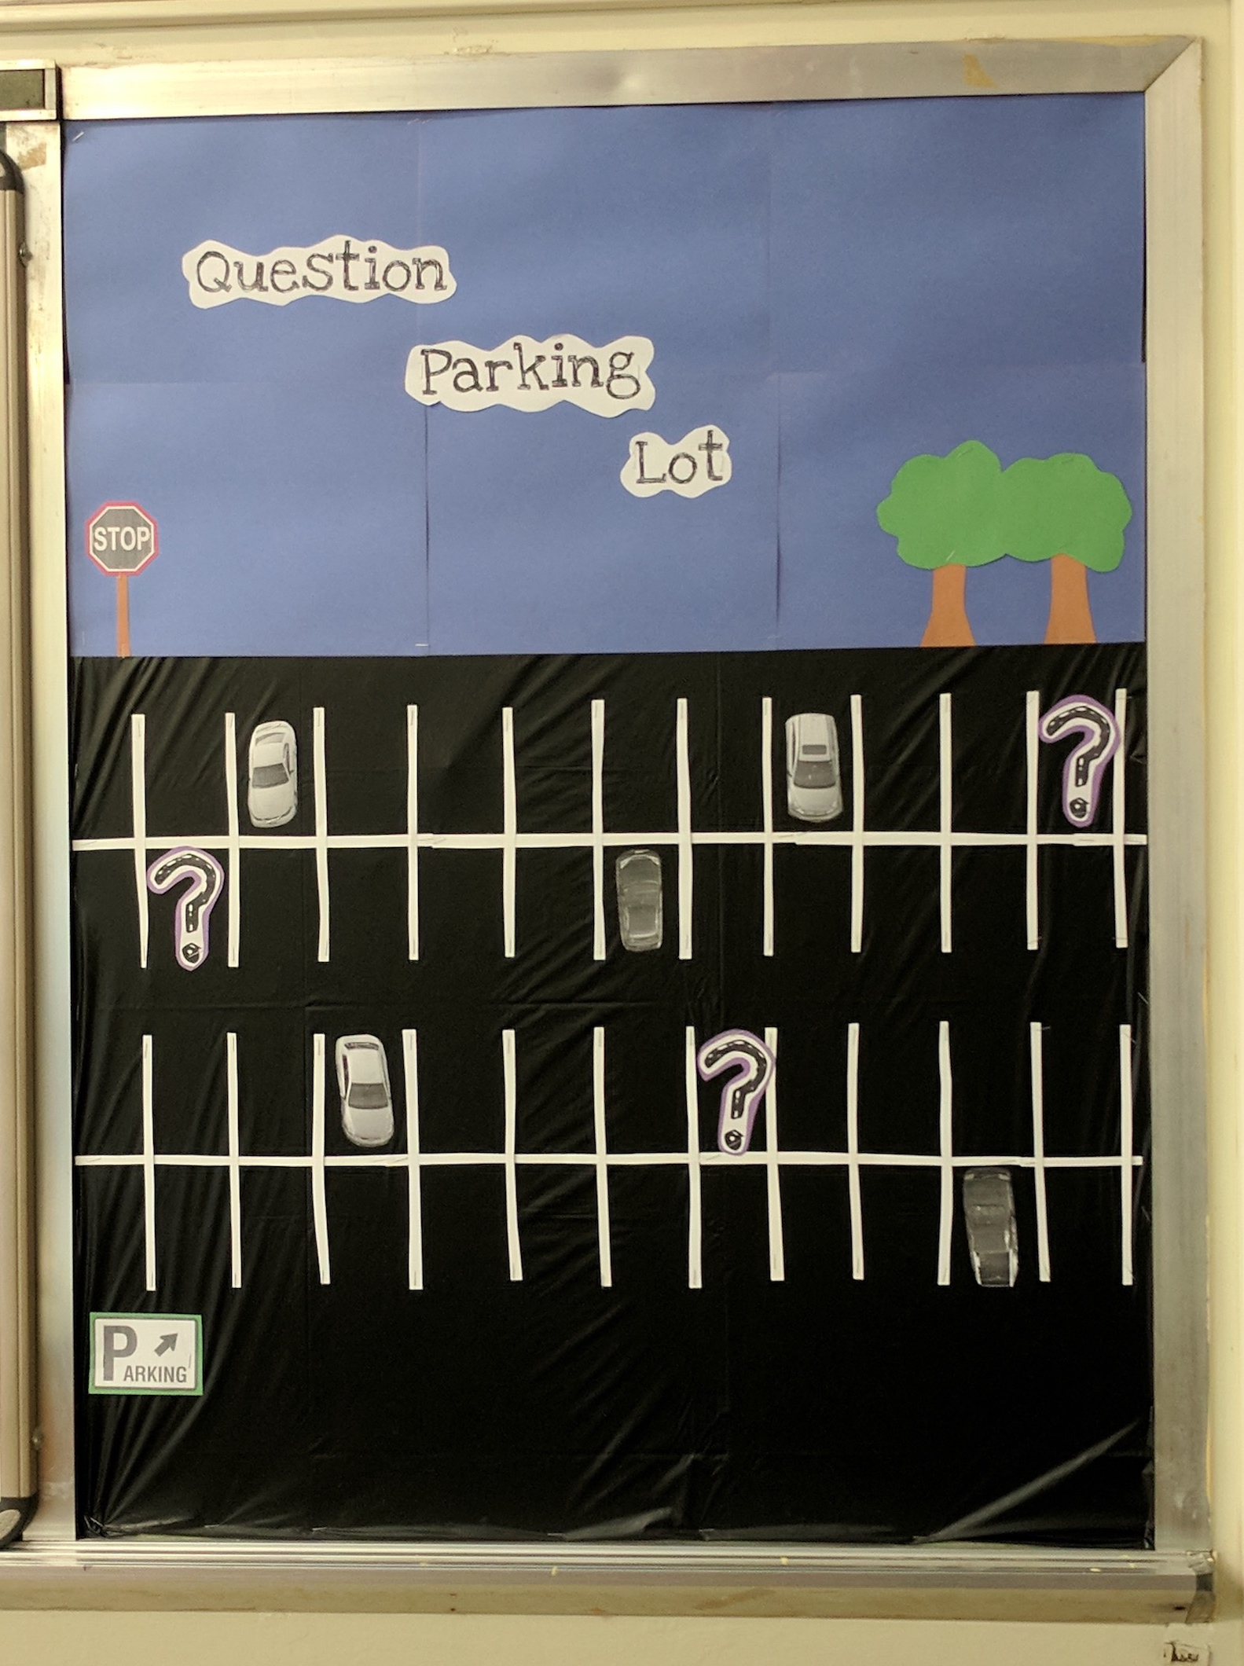
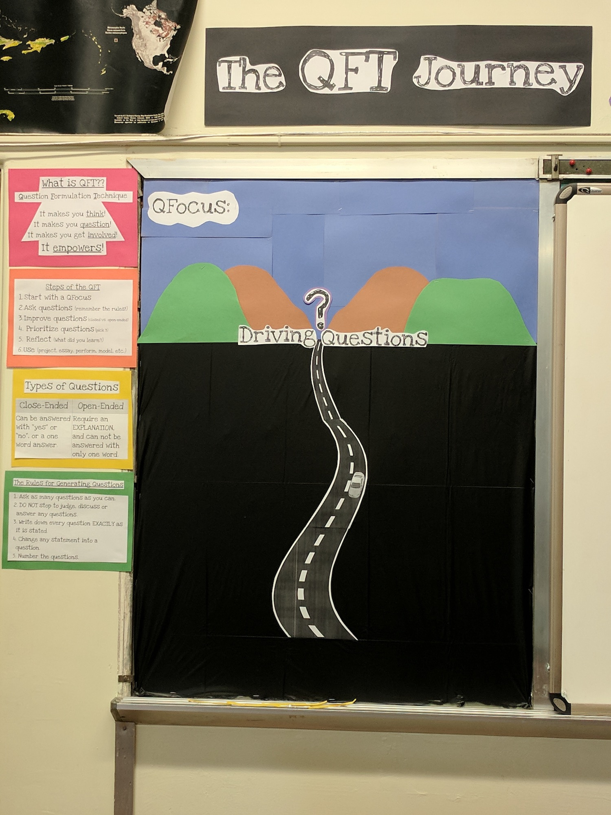
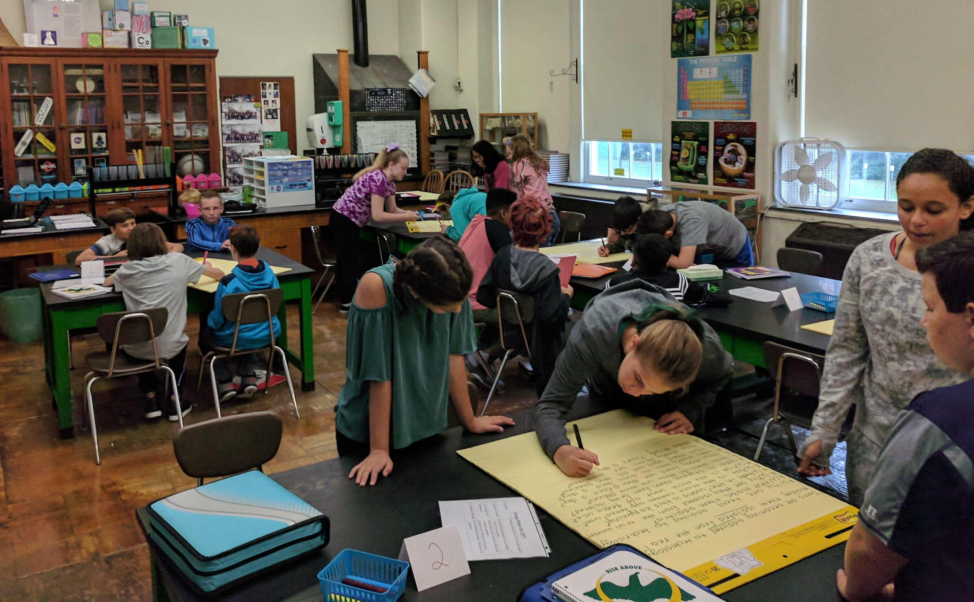
Next Steps with Student Questions
The Driving Question Board
The “Parking Lot”
Ongoing student choice projects

Slide 24
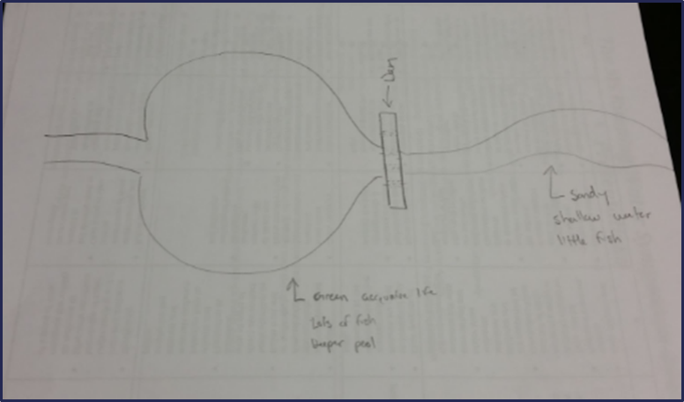
Using the QFT for Peer Review:
Scientist’s claim:
“Adding a dam to a water system causes a decrease in aquatic life downstream.”
Student Design to test the claim:

Slide 25
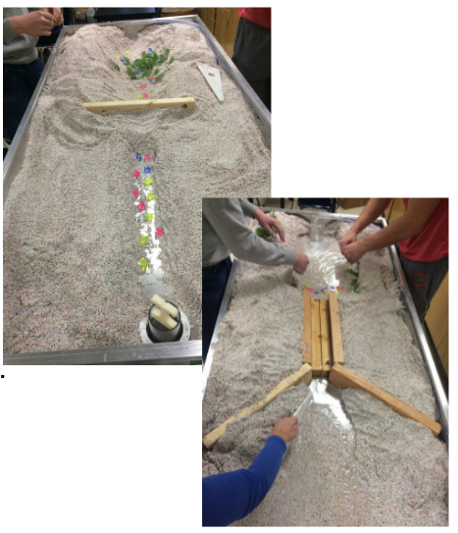
Next Steps with Student Questions:

Slide 26
Using the QFT for Skill Development
(Students were assigned a complex molecular biology article)
QFocus: Ask as many questions as you can about the reading

Slide 27
Next Steps with Student Questions:
Students generate questions for homework then bring in to class
Students discuss key attributes of a good biological research question and compare to other types of questions
Students form groups and improve their questions, based on these attributes
These questions are discarded or kept in notebooks (up to the student)
Students apply this skill to designing their own research project later in the semester

Slide 28
Using the QFT for Knowledge Acquisition
QFocus:
Debate Resolve:
Doctors should be able to do what they want with human tissue after the patient gives consent for removal of the tissue.

Slide 29
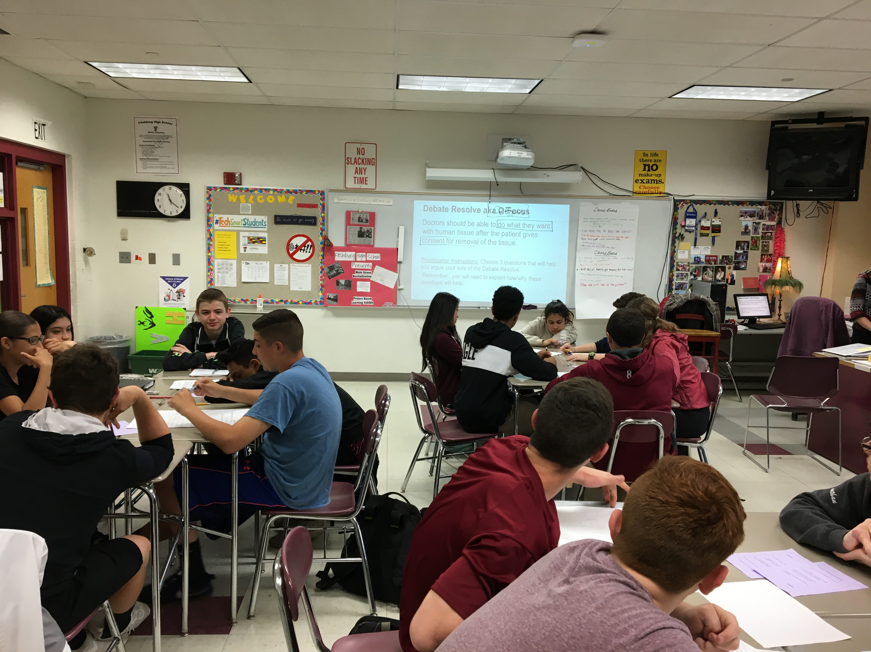
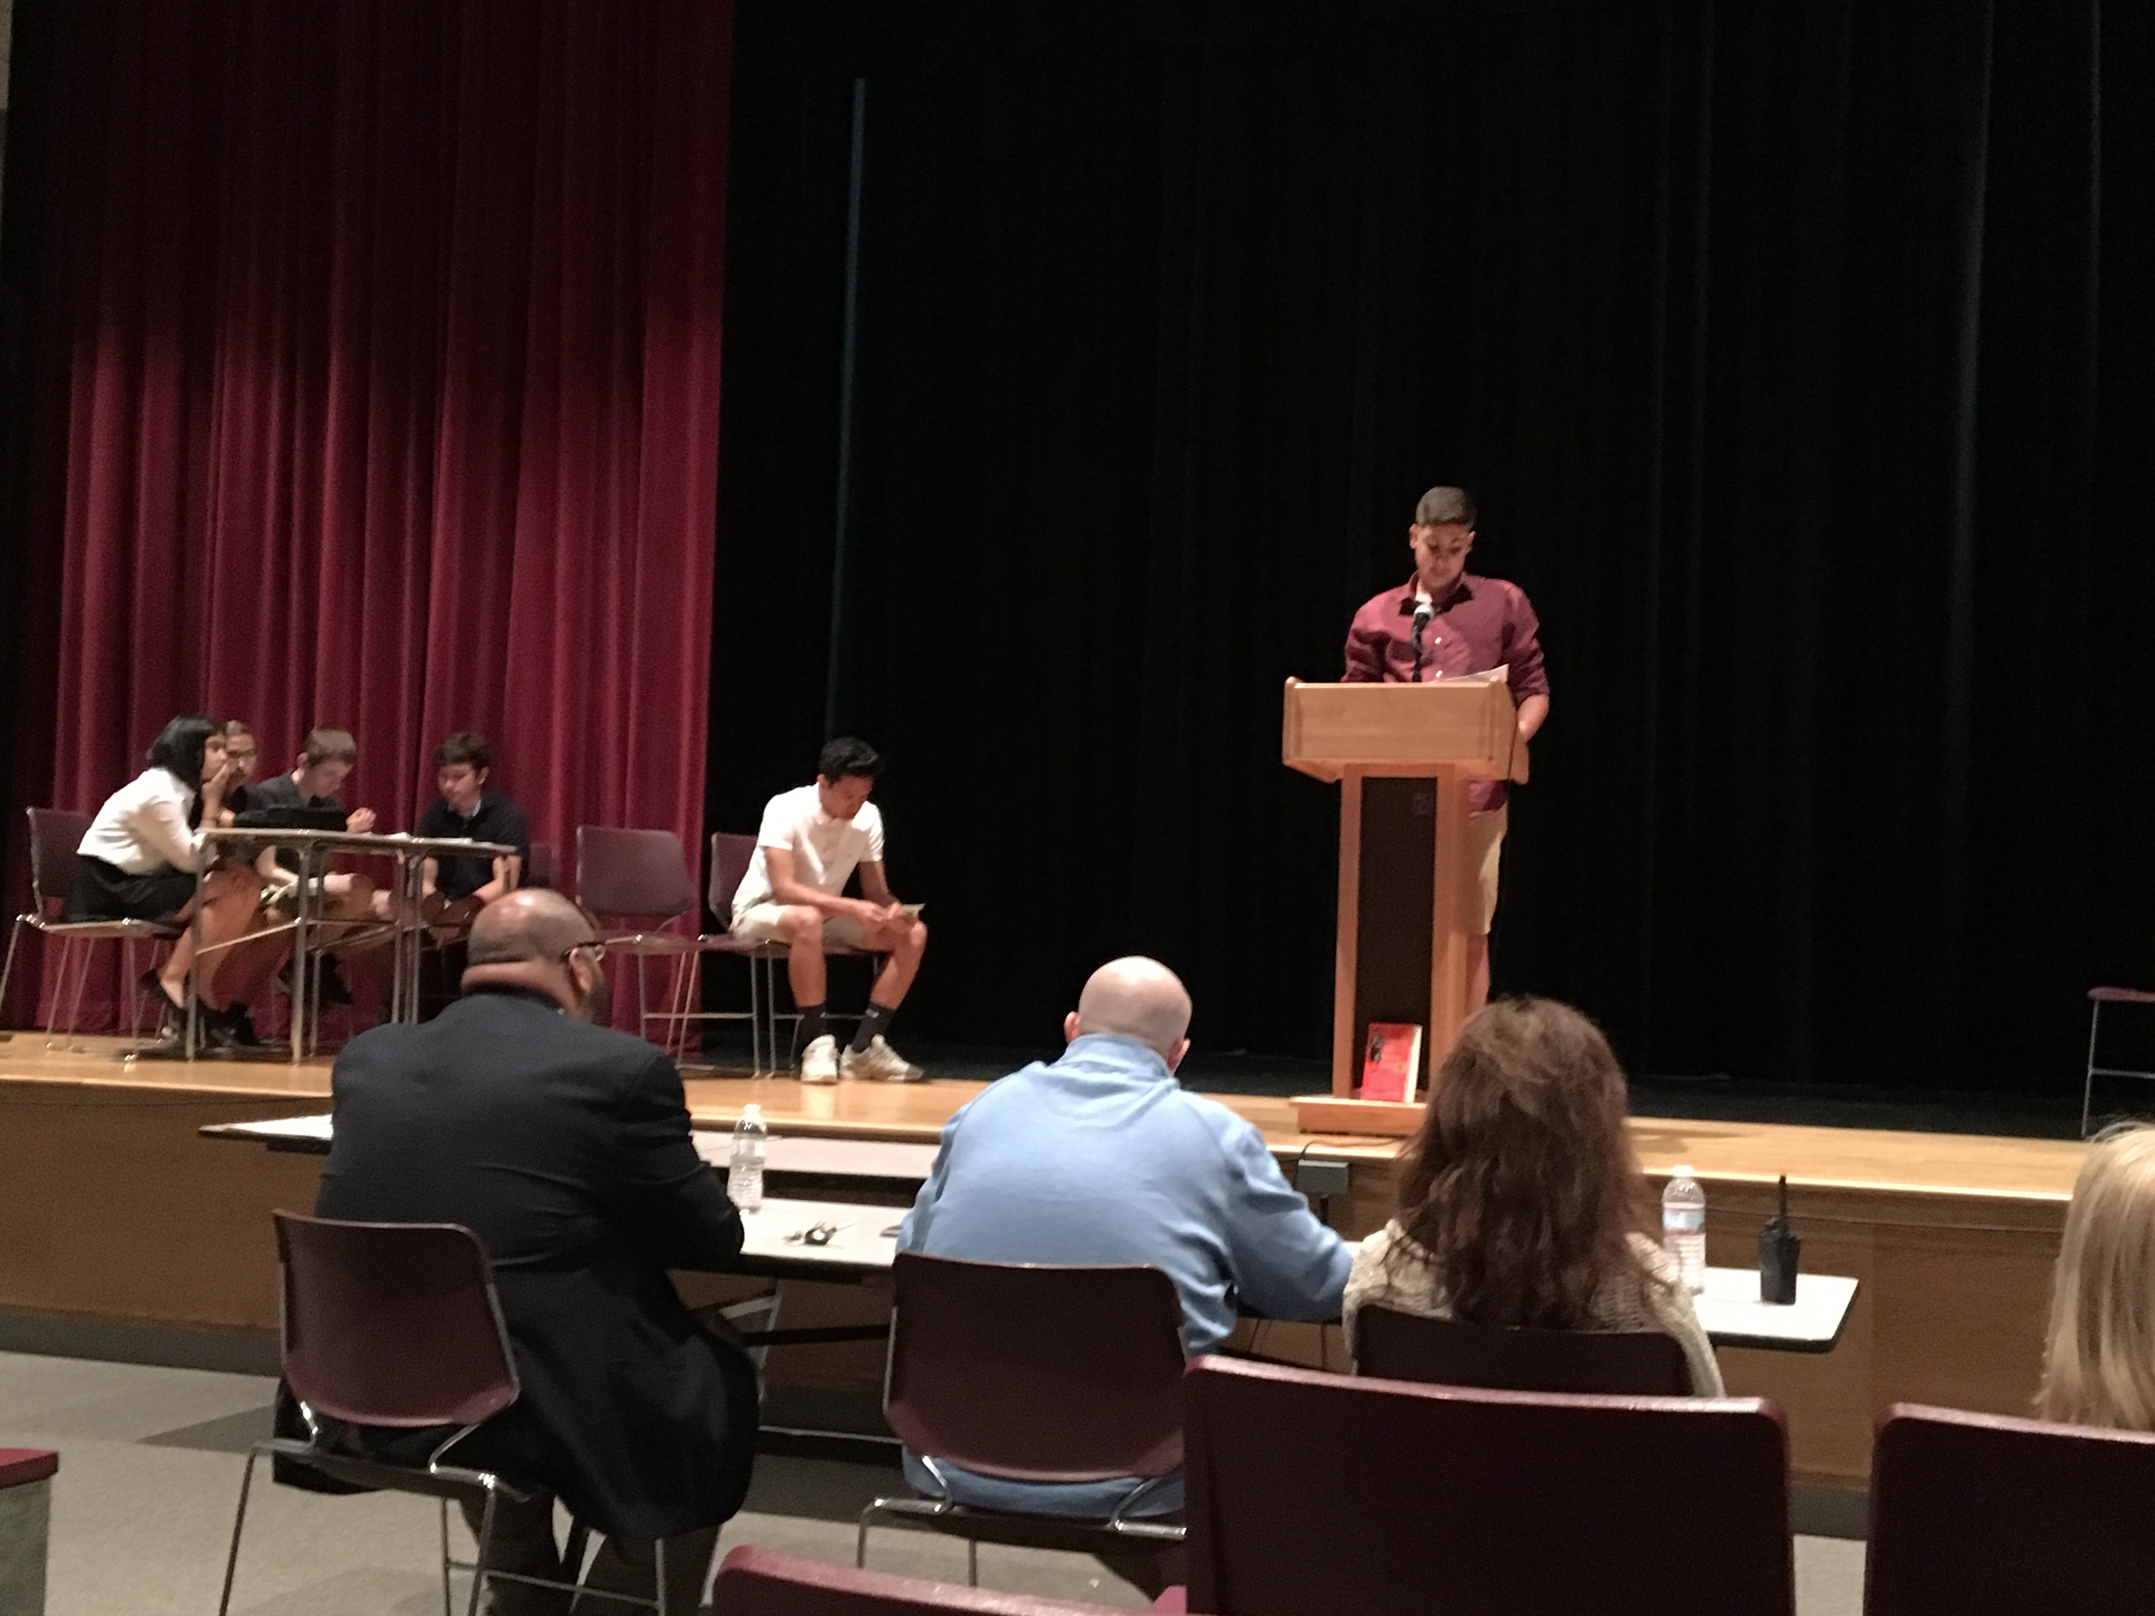
Next Steps with Student Questions

Slide 30
Various Teaching Purposes
Engagement
Knowledge acquisition
Formative assessment
Summative assessment
Peer review
Skill development
Larger inquiry or PBL cycles

Slide 31
Next Steps?
Pop Quiz or Reading Check
Debate Prep
Paper topic
Lab work & Experiments
Exit ticket or ”Do Now”
Hang on walls,
Check Off as Answered
Research
Projects
Test Prep
And sometimes…
Nothing!
Homework
Class discussion prompts
Presentations
Student Choice Projects
Socratic Seminar Prompts
Interview an Expert
Make Your Own Final Test
Journal Prompt
Guest speakers
Close Reading Protocol
Year-long or Unit-long Essential Questions
Tailoring Instruction
Service Action Projects

Slide 32
Five Areas Related to the Art of the QFT
Linking the QFT to Teaching and Learning Goals…& next steps
QFocus Design
Prioritization Instructions
Reflection Questions
Facilitation

Slide 33
Classroom Example: High School
Teacher: Joan Soble, Cambridge, MA
Topic: Albert Camus’s The Plague
Purpose: Pre-reading engagement and prediction of central themes going into the text

Slide 34
Initial Question Focus:

Slide 35
Revised Question Focus:
The city fathers were aware that the decaying bodies of these rodents were making people sick. (page 28)

Slide 36
Classroom Example: 2nd Grade
Teacher: Marie Romero, Lanai, Hawaii
Topic: A unit on “How can a pet be an important friend?”
Purpose: Let students generate their own key question for the week, assess how well students are able to ask questions

Slide 37
Initial Question Focus Design Process
How can a pet be an important friend?
Collage of pictures: dogs, cats, guinea pigs, horses, other pets
Picture of a human and a service animal
Picture of a human and a service animal paired with a phrase like “people and animals”
“People and animals”
“People, animals, and friends”

Slide 38
Student Questions: “People, Animals, and Friends”
Do people exist?
Where do people live?
Why do animals live in the zoo?
Why do people go to the pool?
Why are friends fun?
Why do animals bite?
Why do people go to school?
Do people, animals, and friends play together?
Do animals make friends?
Why do I need friends?
Why do people want to be friends with animals?
Why are people making friends with animals?
Why do people, animal, and friends live in different countries?
Where did my dog and friend go?
Can my friend pet our new dog?
Why do I have eyes?
How do people smell?
Can animals speak?
Can people fly?
Where is my bunny? What happened?

Slide 39
Revising the Question Focus
“People, Animals, and Friends”
Your idea here!

Slide 40
A Lesson from Luz
“Your child will be held back.”
“Your child might be held back.”

Slide 41
A Lesson from PCD
“History, despite its wrenching pain, cannot be unlived, but if faced with courage, need not be lived again.”
– Maya Angelou
Troubleshooting Tips:
“Spend the next 2 minutes asking about just this word/phrase”
Change the Prioritization Instructions on the fly

Slide 42
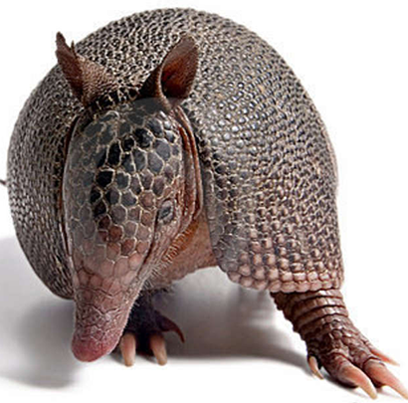
The one quality all excellent QFT designers share?
Thick Skin.

Slide 43
Five Areas Related to the Art of the QFT
Linking the QFT to Teaching and Learning Goals… & next steps
QFocus Design
Prioritization Instructions
Reflection Questions
Facilitation

Slide 44
Prioritization Instructions
Choose the three most important questions
Choose the three questions you consider most important.

Slide 45
Categories of Prioritization Instructions
Choose three questions…
General Instructions:
that you consider most important
Specific Purposes:
that you need to research further
to help you solve the problem
that you need to answer first
that a scientist studying the earth might ask
that will help you understand the text
that require analyzing data
that are not “Googleable” and may be difficult to answer

Slide 46
Five Areas Related to the Art of the QFT
Linking the QFT to Teaching and Learning Goals…& next steps
QFocus Design
Prioritization Instructions
Reflection Questions
Facilitation

Slide 47
Examples of Reflection Questions
QFT Process
Content Specific
What did you learn about asking questions?
How did you learn it?
What do you understand differently now about asking questions?
How can you use what you learned about asking questions?
How do you feel about asking questions?
What did you learn about the (content)?
How did the QFT process help you think about…
key concept
specific assignment
overarching topic
theme in the unit
chapter you just read

Slide 48
Five Areas Related to the Art of the QFT
Linking the QFT to Teaching and Learning Goals…& next steps
QFocus Design
Prioritization Instructions
Reflection Questions
Facilitation

Slide 49
Four Principles of Facilitation
Monitor student adherence to the process
Do not give examples
Do not get pulled into group discussion
Acknowledge all contributions equally
Pair & Share: What could be challenging about each principle? What might be important about each?

Slide 50
The Science of the QFT: a protocol
The Art of the QFT: You

Slide 51
Today’s Agenda
Welcome and Community Building
Setting a Collaborative Learning Agenda with the QFT
The Art and Science of the QFT
Breakout Groups: Discussion, Collaboration, and Active Work Time
Closing Reflections, Q&A, & Next Steps
Lunch
@RightQuestion#QFTCon #QFT

Slide 52
Small Group Breakout Sessions
9:50 - 10:50 am | Room
Humanities
Science
Math
Languages
Arts

Slide 53
Today’s Agenda
Welcome and Community Building
Setting a Collaborative Learning Agenda with the QFT
The Art and Science of the QFT
Breakout Groups: Discussion, Collaboration, and Active Work Time
Closing Reflections, Q&A, & Next Steps
Lunch
@RightQuestion#QFTCon #QFT

Slide 54
Closing Reflections
What did you learn?
An “a-ha moment” or a meaningful take away from your experience today
A key question that will guide your work this year
A key insight or idea from your department meeting that could translate to other content areas

Slide 55
So, where do we go from here?

Slide 56
Ways to partner with RQI and join a growing community of practice
Hosting classroom observations
Sharing lesson and student questions
Writing articles for EdWeek, Teaching Channel, Educational Leadership…or creating their own blogs
Presenting at local, state, and national conferences—
Taking on new leadership positions at their schools
And…

Slide 57
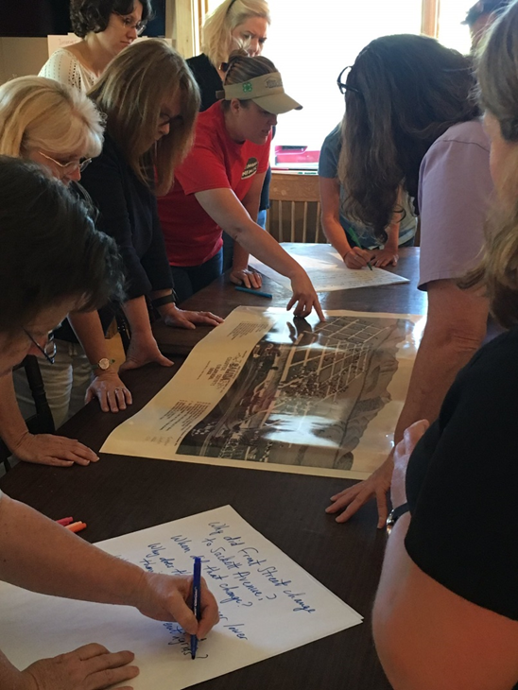
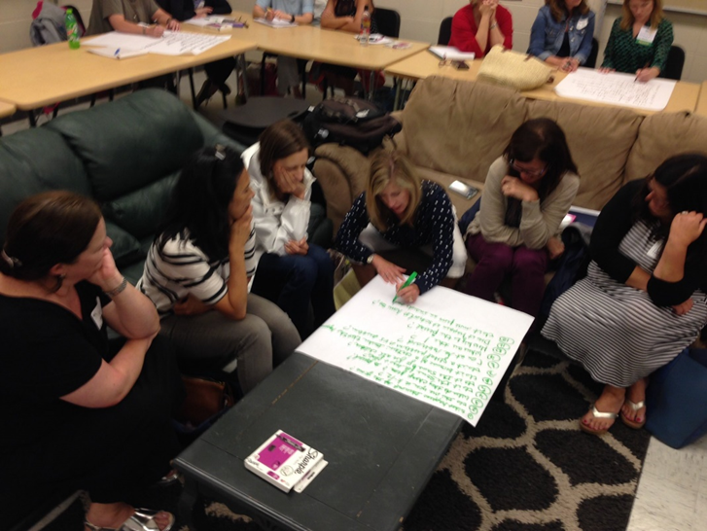
Delivering PD in departments, surrounding schools, and regions
Knee deep in @RightQuestion on a Sunday learning together so that historic places are in the classroom
@TPSMSUDenver @TeachingLC

Slide 58
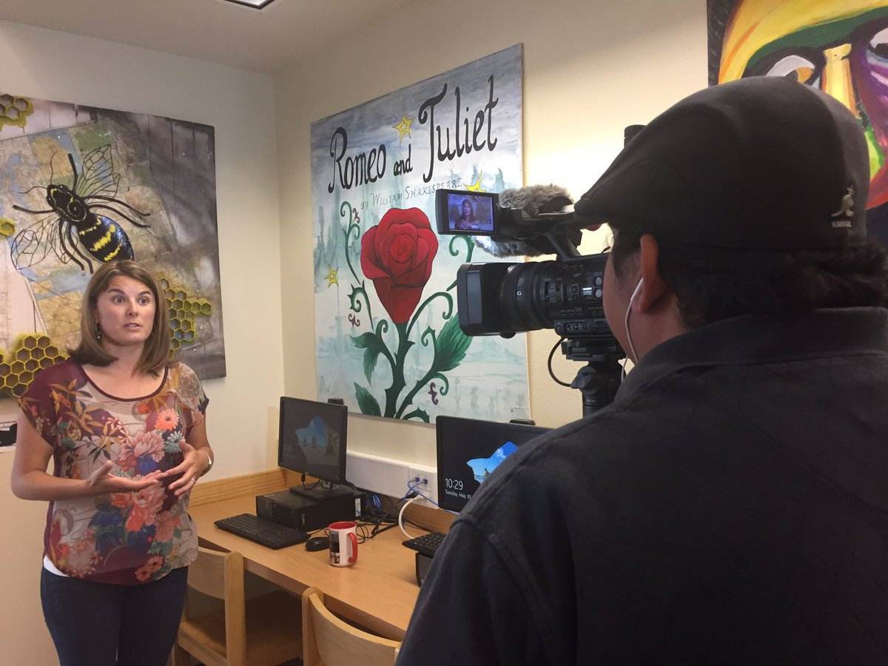
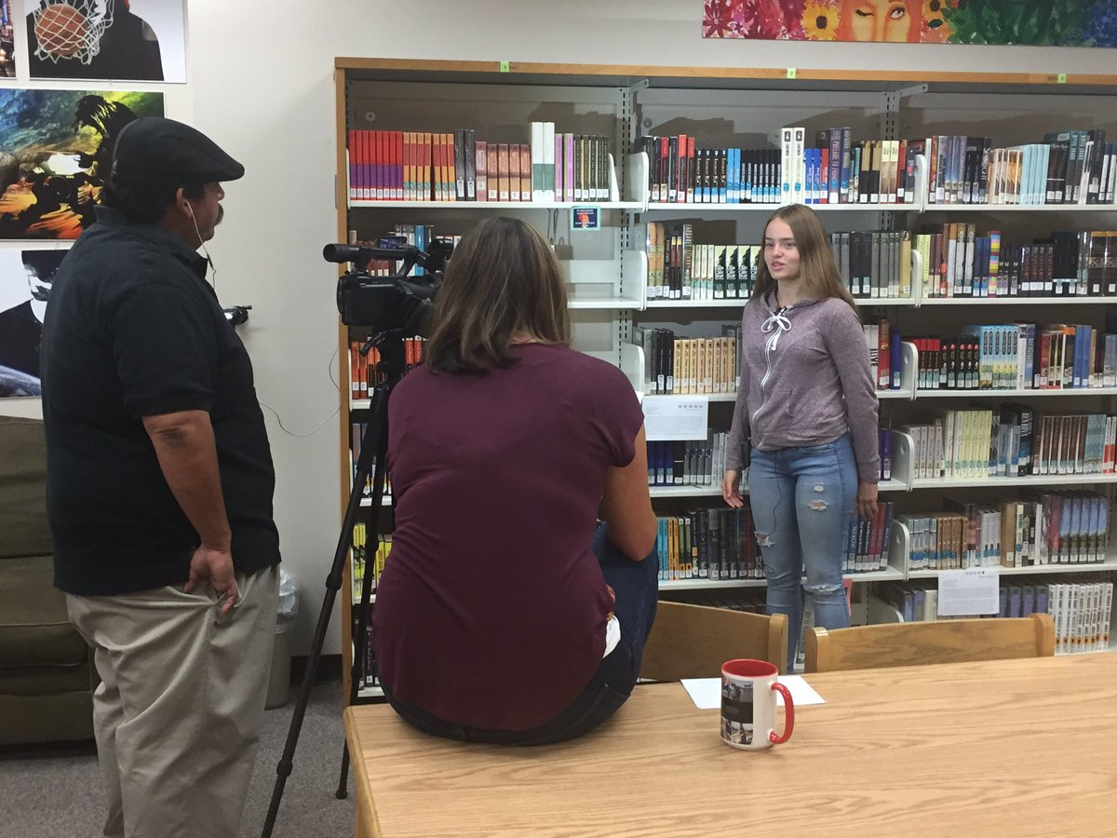
Filming instructional videos & creating online resources ‘[‘;//
That's a wrap! Ss & Ts at @ohs_jackets filmed by @GodoyStudios and interviewed on their experience w/ the #QFT

Slide 59
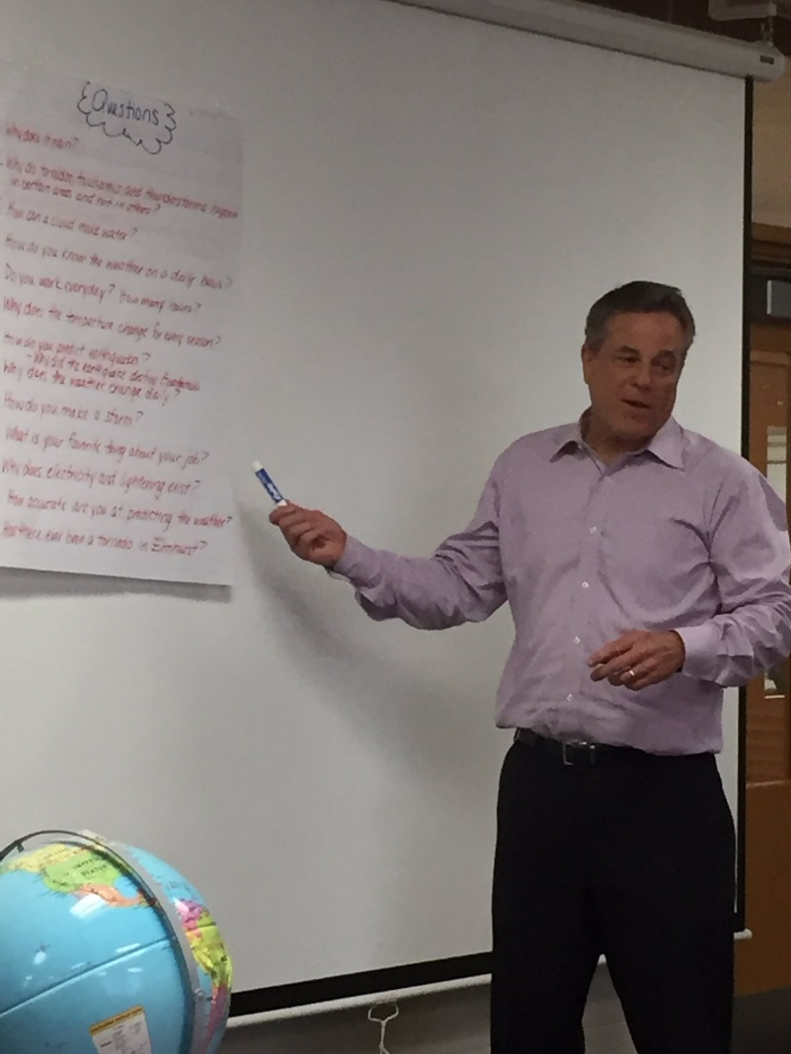
Tweeting QFT examples to school leaders, reporters, authors, and industry leaders…and getting their attention!
Thank you Phil Schwartz from @ABC7Chicago for answering our #QFT questions this morning. @Fischerspirit #d205learns
S. E. Hinton Retweeted Right Question
One of the reasons why teachers are my heroes.
Hi @BillNye As a 7th grade science teacher, I encourage young scientists to question and figure out phenomena! #BillMeetScienceTwitter

Slide 60
And continuing to do innovative, creative work with students

Slide 61
…as a two-way street
RQI’s Vision of Professional Learning
RQI’s design of professional learning experiences
Professional implementation & learning
#QFTCon #QFT

Slide 62
Evaluation
Please take a moment to fill out this brief evaluation and reflection:
http://bit.ly/2yI4XqV
We value your feedback and work hard to continuously revise our resources to best support the work of educators in the field. Let us know too if you’re open to a continuing collaboration with RQI.
Thank you!

Slide 63
Some Final Thoughts…
Greater Knowledge
Greater Curiosity
No Small Matter
There is something significant afoot in education, and beyond…

Slide 65
Why is student question formulation so important today?

Slide 66
In the Age of Google…
“How should you respond when you get powerful new tools for finding answers?
Think of harder questions.”
Clive Thompson, Journalist and Technology Blogger

Slide 67
The Skill of Asking Questions
For moving from ignorance as weakness to ignorance as opportunity
For arriving at better answers (and more questions)
For increasing engagement and ownership
For a little more joy in a very demanding profession
And…

Slide 68
Democracy
“We need to be taught to study rather than to believe, to inquire rather than to affirm.” - Septima Clark
See Chapter 6 on Septima Clark in Freedom Road: Adult Education of African Americans (Peterson, 1996).

Slide 69
Closing Reflections
We shall not cease from exploration
And the end of all our exploring
Will be to arrive where we started
And know the place
For the first time.
--T.S. Eliot

Slide 70
Evaluation
Please take a moment to fill out this brief evaluation and reflection:
http://bit.ly/2yI4XqV
We value your feedback and work hard to continuously revise to best support the work of educators in the field. Thank you!

