Slide 1
Teaching, Learning, and the Question Formulation Technique (QFT)
PNW BOCES
Yorktown Heights, NY
October 19, 2017
Dan Rothstein
Co-Director
|
Siyi Chu
Program Associate
The Right Question Institute

Slide 2

Acknowledgments
We are deeply grateful to the Sir John Templeton Foundation and The Hummingbird Fund for their generous support of the Right Question Institute’s Million Classrooms Campaign.
We thank Marla Gardner, Gregory Brown, Fred Ende, and Jennifer DelVelcchio for all the work that they have done to make today’s seminar possible. We appreciate the contribution Gregory Brown, Lizette Ruiz-Giovinazzi, and advid Jacob will be making to the session today.
We are grateful also to Sarah Westbrook for her help in preparing today’s session.
@RothsteinDan

Slide 3
Session Agenda
Why Work on Teaching Students to Ask their Own Questions?
Working on a Challenge by Using the Question Formulation Technique (QFT)
Peeking into the “Black Box”: Three Thinking Abilities
A PNW Example of QFT in the Classroom, Presented by Gregory Brown

Slide 4
In the beginning…
INQUIRY

Slide 5
We shall not cease from exploration
And the end of all our exploring
Will be to arrive where we started
And know the place
For the first time.
--T.S. Eliot

Slide 6
"There is no learning without having to pose a question."
- Richard Feynman
Nobel-Prizewinning physicist

Slide 7
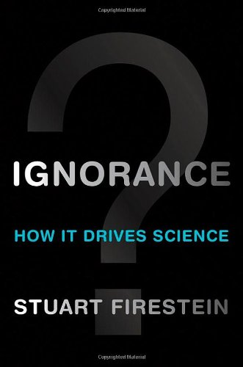
“We must teach students how to think in questions, how to manage ignorance.”
- Stuart Firestein
Chairman of the Department of Biology at Columbia University

Slide 8
College Presidents on What Students Should Learn in College
“The primary skills should be analytical skills of interpretation and inquiry. In other words, know how to frame a question.”
- Leon Botstein, President of Bard College
“…the best we can do for students is have them ask the right questions.”
- Nancy Cantor, Chancellor of University of Illinois
The New York Times, August 4, 2002

Slide 9
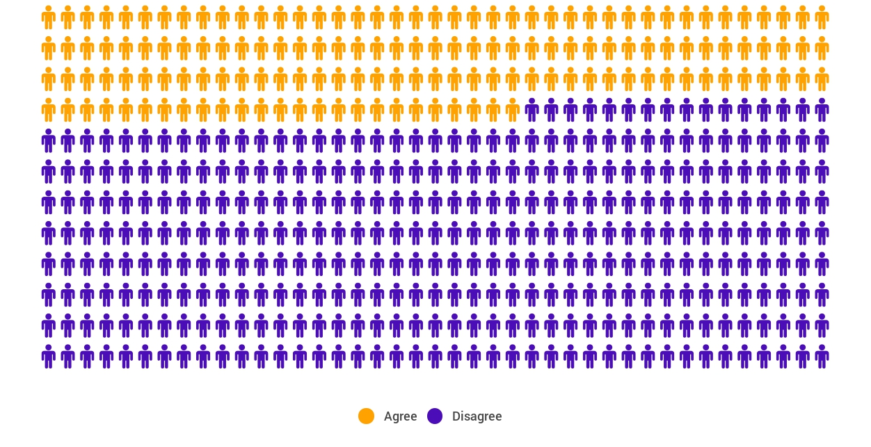
Yet…only 27%of students believe college taught them to ask their own questions
Alison Head, Project Information Literacy at University of Washington, 2016

Slide 10
But, the problem begins long before college...

Slide 11
A 1912 Study
Romiett Stevens, 1912
The Question as a Measure of Efficiency in Instruction: A critical study of classroom practice. Columbia University Contributions to Education, No. 48
“An unusual lesson because twenty-five of the thirty-four questions were asked by the pupils.…The result was that the lesson developed an impetus born of real interest. I mention it because this lesson was unique in the series of one hundred.”

Slide 12
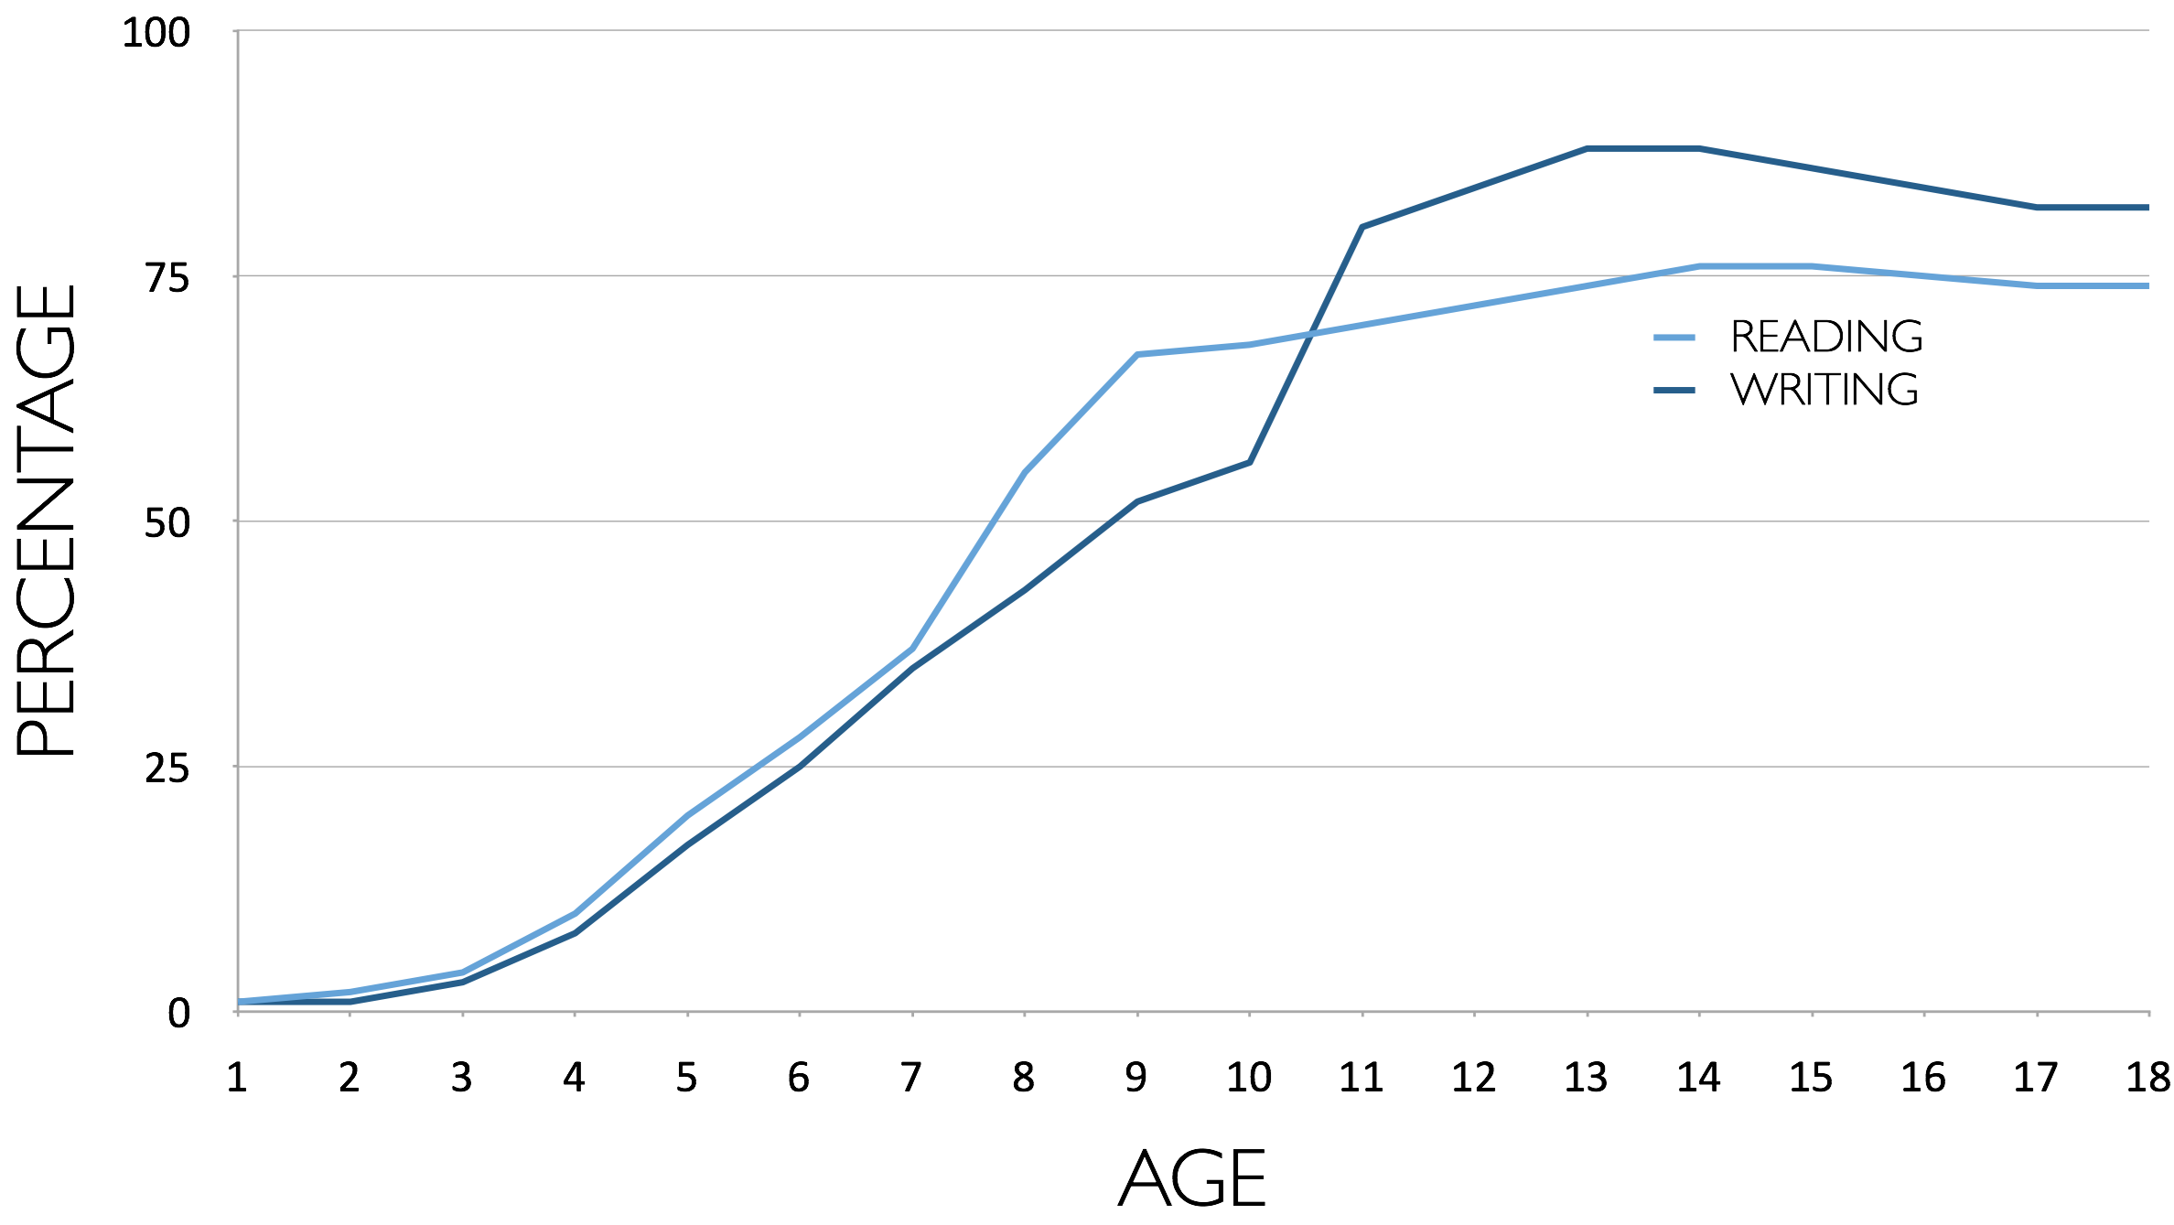
Percentage of Basic Skill Attainment
Sources
http://nces.ed.gov/nationsreportcard/pdf/main2009/2011455.pdf
http://nces.ed.gov/nationsreportcard/pubs/main2007/2008468.asp#section1
Data on question-asking based on parent and teacher feedback

Slide 13
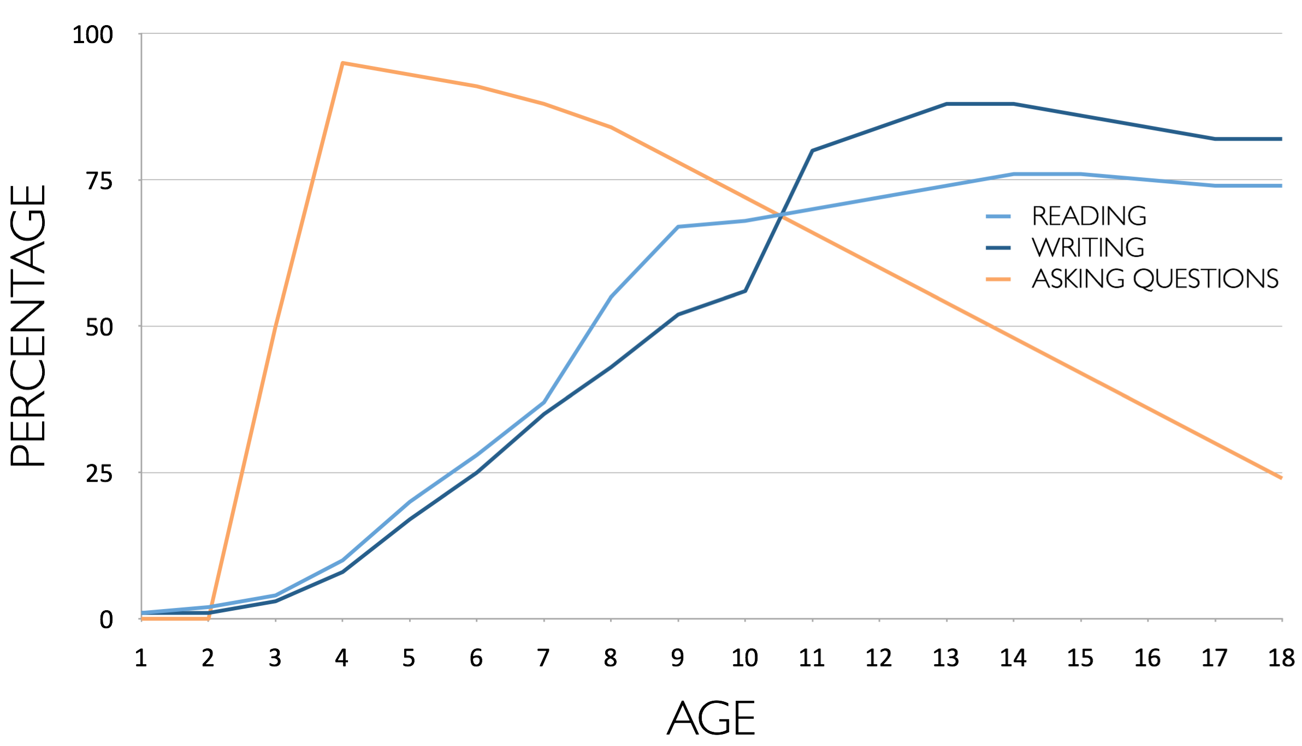
Percentage of Basic Skill Attainment
Sources
http://nces.ed.gov/nationsreportcard/pdf/main2009/2011455.pdf
http://nces.ed.gov/nationsreportcard/pubs/main2007/2008468.asp#section1
Data on question-asking based on parent and teacher feedback

Slide 14
The challenge of promoting inquiry in the classroom…
Maybe, don’t start with the word…

Slide 15
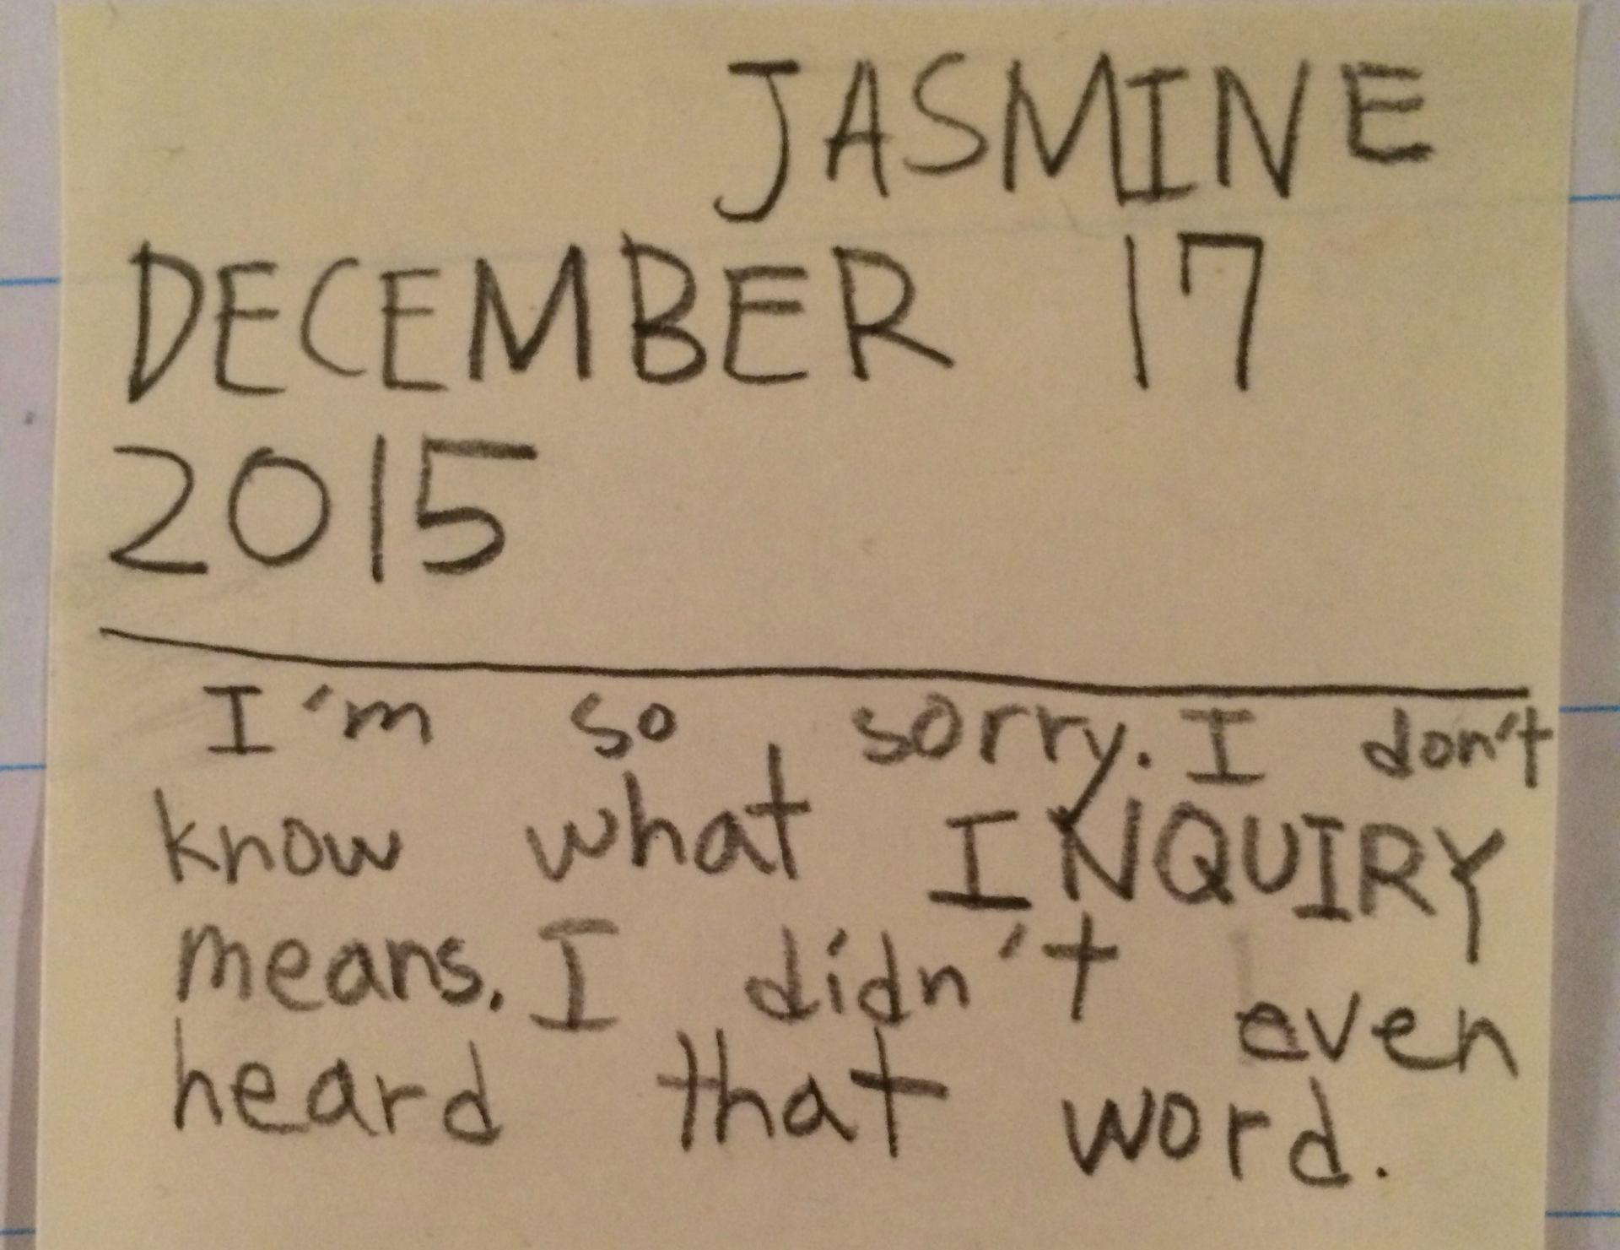

Slide 16
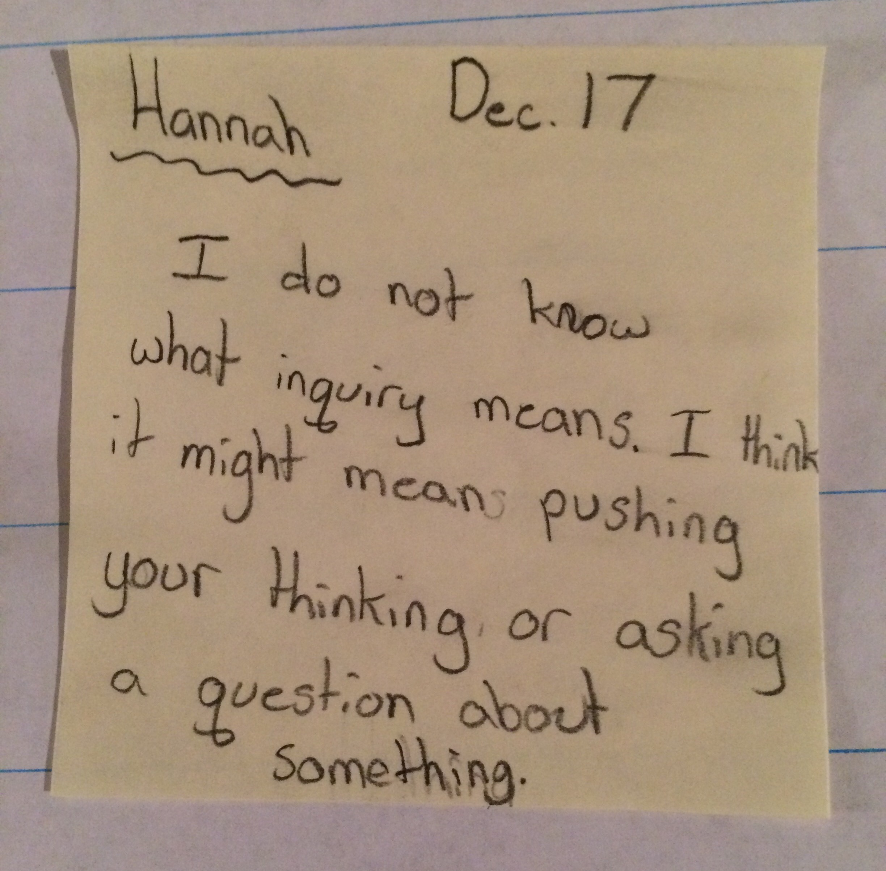

Slide 17
Classroom Example:
Kindergarten
Teacher: Jennifer Shaffer, Walkersville, MD
Topic: Non-fiction literacy
Purpose: To engage students prior to reading a nonfiction text about alligators

Slide 18
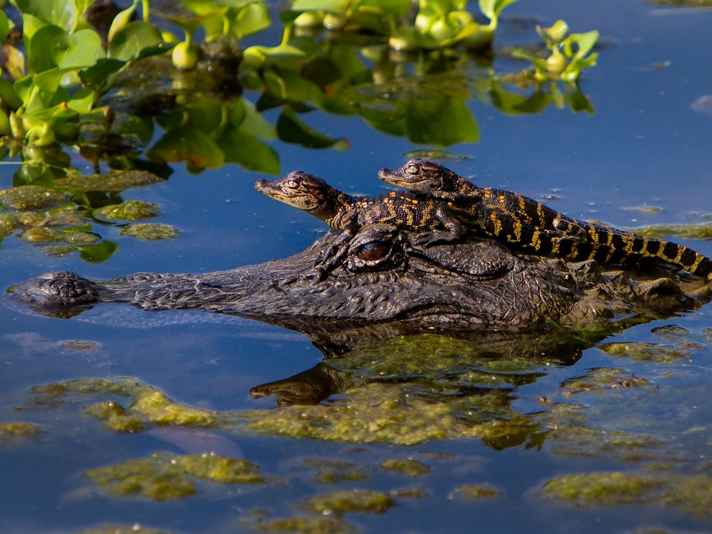
Question Focus
Photograph by Nuwan Samaranayake, 2013

Slide 19
Student Questions
Is the alligator camouflaged?
Why do the babies have stripes?
Are those baby crocodiles?
Is it a mom or dad crocodile?
What is the green stuff?
Why are they in the water so low?
Where are they going?
Why are the baby alligator’s eyes white and the mom’s black?
Why are baby alligators on top of the momma alligator?
Why does momma or daddy have bumps on them?

Slide 20
Classroom Example:
4th Grade
Teacher: Deirdre Brotherson, Hooksett, NH
Topic: Math unit on variables
Purpose: To engage students at the start of a unit on variables

Slide 21
Question Focus
24 = ☺ + ☺ + ☺

Slide 22
Student Questions
Why is the 24 first?
What do the smiley faces mean?
Why are there 3 smiley faces?
How am I suppose to figure this out?
Is the answer 12?
Can I put any number for a smiley face?
Do three faces mean something?
Do the numbers have to be the same because the smiley faces are the same?
What numbers will work here?
Does it mean 24 is a really happy number?
Can we replace each smiley face with an 8?
Do any other numbers work?
Can we do this for any number?
Does it always have to be smiley faces?
Do we always have to use three things?

Slide 23
Next Steps with Student Questions
Questions posted on classroom walls.
Students cross off the questions they answer during subsequent lessons.
Teacher returns to student questions at the end of the unit to discuss with students what they learned and what they still want to know.

Slide 24
Classroom Example:
Middle School
Teacher: Megan Harvell, Boston, MA
Topic: American History –The Civil War
Purpose: Pre-reading activity to engage students

Slide 25
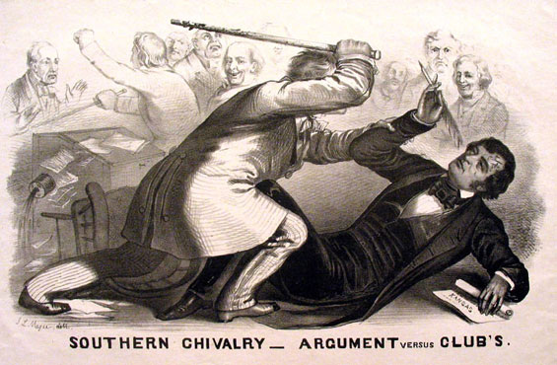
Question Focus
Image by John L. Magee, 1856

Slide 26
Student Questions
Why are they fighting?
Are they fighting?
Are they part of the government?
Where were they?
Who are they?
Were they signing anything?
Who else was there?
Why are you hitting him?
Why didn’t they call 911?
Was this related to slavery?
Why is he hitting him with a bat?
11. Why are you taking a pen?
12. Why are they in court?
13. Who hit who first?
Who died?
Why are they smiling?

Slide 27
Classroom Example:
High School
Teacher: Ling-Se Chesnakas, Boston, MA
Topic: 12th Grade Humanities unit on The Brief Wondrous Life of Oscar Wao by Junot Diaz
Purpose: To help students generate questions for a Socratic Seminar at the end of the unit

Slide 28
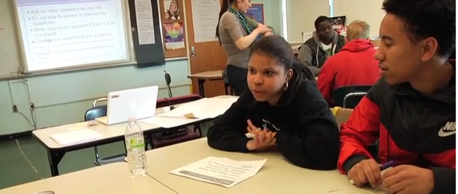
The Question Formulation Technique (QFT) in Action
http://rightquestion.org/qft-in-action/

Slide 29
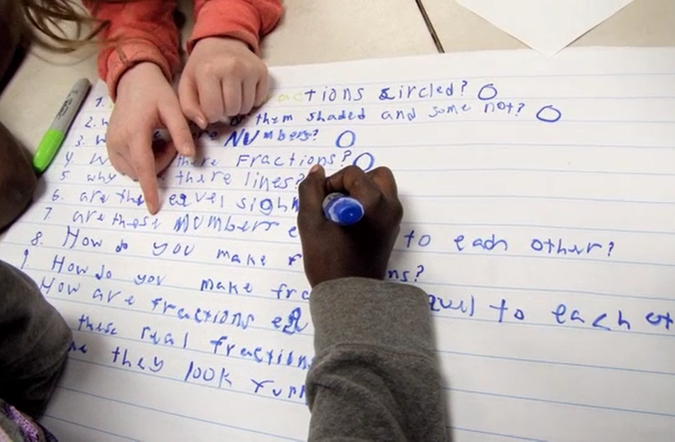
Working on a Challenge by Using the Question Formulation Technique (QFT)

Slide 30
Rules for Producing Questions
1. Ask as many questions as you can
2. Do not stop to answer, judge, or discuss
3. Write down every question exactly as stated
4. Change any statements into questions

Slide 31
Producing Questions
Ask Questions
Follow the Rules
      Ask as many questions as you can.
      Do not stop to answer, judge, or discuss.
      Write down every question exactly as it was stated.
      Change any statements into questions.
Number the Questions

Slide 32
Question Focus:
Some students are not asking questions.

Slide 33
Categorizing Questions:
Closed/ Open
Definitions:
  Closed-ended questions can be answered with a “yes” or “no” or with a one-word answer.
  Open-ended questions require
  more explanation.
Directions: Identify your questions as closed-ended or open-ended by marking them with a “C” or an “O.”

Slide 34
Discussion
Closed-ended Questions
Advantages
Disadvantages

Slide 35
Discussion
Open-ended Questions
Advantages
Disadvantages

Slide 36
Improving Questions
Take one closed-ended question and change it into an open-ended question.
Take one open-ended question and change it into a closed-ended question.
Closed
Open
Open
Closed

Slide 37
Strategize: Prioritizing Questions
Review your list of questions
  Choose the three questions you are most curious to explore further.
  While prioritizing, think about your Question Focus: Some students are not asking questions.
After prioritizing consider…
  Why did you choose those three questions?
  Where are your priority questions in the sequence of your entire list of questions?

Slide 38
Strategize: Next Steps
From priority questions to action plan
In order to answer your priority questions:
    What do you need to know? Information
    What do you need to do? Tasks

Slide 39
Share
Questions you changed from open/closed
Your three priority questions and their numbers in your original sequence
Rationale for choosing priority questions
Next steps

Slide 40
Reflection
What did you learn?
How did you learn it?
What do you understand differently now about Some students not asking questions?

Slide 41

Let’s peek inside the black box
#QFTCon #QFT

Slide 42
“Modern science is a technique...it is a practice that allows us to learn reliable things about the world. [Science] is a technique that was waiting for people to discover it.”
- Steven Weinberg, Nobel laureate in Physics
To Explain the World, 2015

Slide 43
The QFT, on one slide…
Question Focus
Produce Your Questions
    Follow the rules
    Number your questions
Improve Your Questions
    Categorize questions as Closed or Open-ended
    Change questions from one type to another
Prioritize Your Questions
Share & Discuss Next Steps
Reflect
Ask as many questions as you can
Do not stop to discuss, judge or answer
Record exactly as stated
Change statements into questions
Closed-Ended:
Answered with “yes,” “no” or one word
Open-Ended: Require longer explanation

Slide 44
Curiosity and Rigor
  Three thinking abilities
  with one process

Slide 45
Thinking in many different directions
DIVERGENT
THINKING

Slide 46
Narrowing Down, Focusing
CONVERGENT
THINKING

Slide 47
The Importance of Questions
"Questions are the engines of intellect, the cerebral machines which convert energy to motion, and curiosity to controlled inquiry."
- David Hackett Fischer,
Historians' fallacies: Toward a logic of historical thought.
Routledge and Kegan Paul, 1971.
“[The QFT] helps me by getting me to think about questions on my own…it gets my mind
in motion to think about the questions other people make."
- 8th grade student in James Brewster’s U.S. history class
Gus Garcia Young Men’s Leadership Academy, Austin, TX, 2015

Slide 48

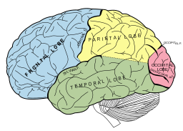
Thinking about Thinking
METACOGNITIVE
THINKING

Slide 49
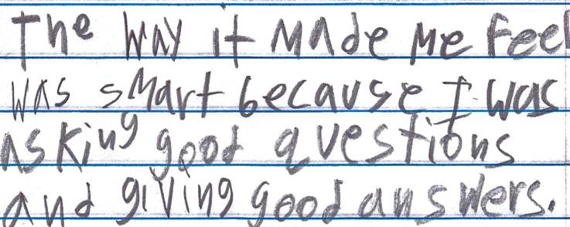
Student Reflection
“The way it made me feel was smart because I was asking good questions and giving good answers.”
-Boston 9th grade remedial summer school student

Slide 50
A PNW Examples of QFT in the Classroom
Gregory Brown
Regional Coordinator
Social Studies and Blended Learning
Putnam North Westchester BOCES

Slide 51
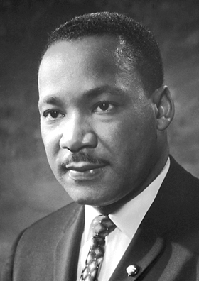
The QFT in an Elementary Setting
Grade 2: First Try
“Quick question! I did my first QFT today...it was amazing...what do you do when a child asks a question that isn't accurate? I wrote it but then I wasn't sure what happens. The question was, ‘When was Martin Luther King Jr. president?’”
Q-Focus:

Slide 52
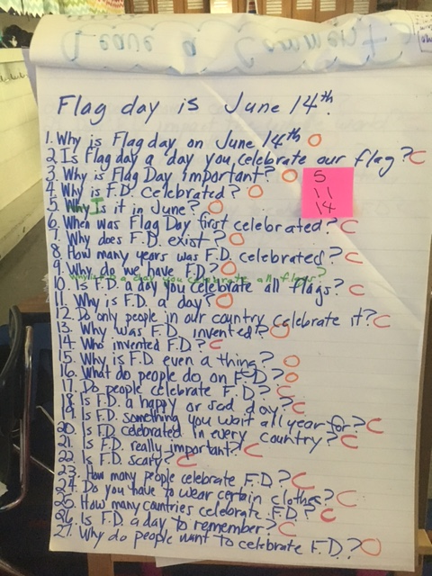
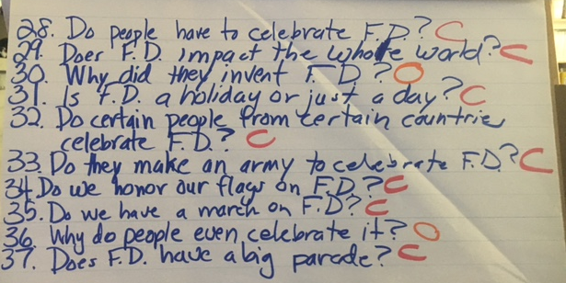
The QFT in an Elementary Setting
Grade 2: Second Try
“Instead of just reading a book I decided to do this for Flag Day! The green writing shows the questions they changed. The post it is what they prioritized. Then they decided what we should do to find the answers! We chose to use News-o-matric. News-O-Matic had a painting of Betsy Ross giving George Washington a flag so we tried to source it and determine if it was an accurate depiction! they were so thoughtful. We also had a great conversation about asking the same questions in a different way...Lol!!! It was so much more meaningful than just reading a book”!

Slide 53
The QFT in a Secondary Setting
“The attachment here is the culmination of my 3rd period class's group work. They are my largest class (31) and can get off task easily. This activity went wonderfully and produced some really exciting questions--and the best list by far came from the group where I would least expect it…Tomorrow the plan is to get them writing/responding, then we will read a short story and apply those same concepts/questions to the characters. This was an excellent PD and truly gave me materials to hit the ground running. Thank you for the valuable opportunity!”

Slide 54
The QFT in a Secondary Setting
The Q-Focus: “All of us have a hero and a villain in us.”
When are we villains?
When are we heroes?
Are villains always bad, and are heroes always good?
What do heroes and villains have in common?
Why does someone need to be a villain or a hero?
How do we have enough in our hearts to be a villain and a hero?
Is it always both?
Which one am I?

