Slide 1
The Art and Science of the QFT
PNW BOCES
Yorktown Heights, NY
October 19, 2017
Dan Rothstein
Co-Director
|
Siyi Chu
Program Associate
The Right Question Institute

Slide 2
Today’s Agenda
Welcome
Collaborative Learning with the Question Formulation Technique (QFT)
The Art and Science of the QFT
Lunch
Building Consensus for Change by Using the Right Question Strategy
Planning to Bring the QFT Back
Closing Remarks, Q&A, & Evaluations
@RightQuestion
@RothsteinDan #QFT

Slide 3
To Access Today’s Materials:
http://rightquestion.org/educators/
seminar-resources/
Join our Educator Network for:
Templates you can use tomorrow in class
Classroom Examples
Instructional Videos
Forums and Discussions with other Educators

Slide 4
To Access Today’s Materials:
The Right Question Institute offers our materials through a Creative Commons License and we encourage you to make use of and/or share this resource. Please reference the Right Question Institute and rightquestion.org as the source on any materials you use.

Slide 5
Review a Lesson Planning Workbook
Name some of the challenges of planning a lesson or session with the QFT. What part or pieces seems particularly tricky?
Look at how the workbook is structured. What do you notice? What seems helpful or useful about this planning tool?
What questions do you have about planning so far?

Slide 6
A PNW Examples of Using the QFT in Science and Engineering
David Jacob
Regional Science Coordinator
Putnam North Westchester BOCES

Slide 7
QFT and the New Science Standards
Science and Engineering Practice
Practice the Practice: Asking Questions and Defining Problems
“Students at any grade level should be able to ask questions of each other about the texts they read, the features of the phenomena they observe, and the conclusions they draw from their models or scientific investigations. For engineering, they should ask questions to define the problem to be solved and to elicit ideas that lead to the constraints and specifications for its solution.” (NRC Framework 2012, p. 56)

Slide 8
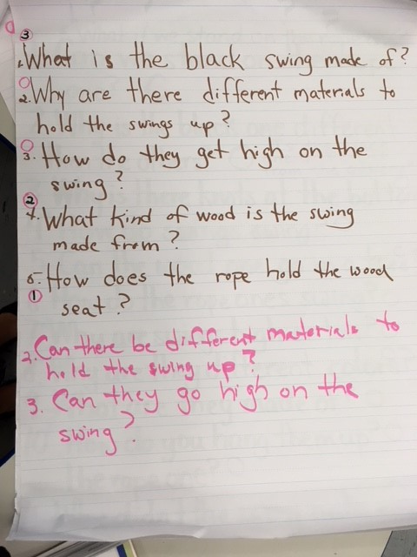
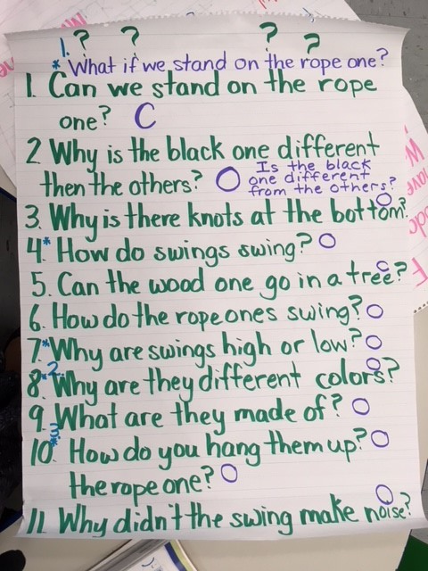
Grade 2 – QFT about Playground Equipment

Slide 9
Science 21 and Grade 2 Curriculum
Teacher Comments:
“We had great results doing it in our class with dividing the class into 3 groups where teachers could record questions and work in smaller groups with the students”
“The share outs after each part of the QFT process helped the kids see the similarities in their thinking and also different questions that were raised”

Slide 10
QFT: An ART and a SCIENCE
The Science:
A rigorous protocol, with specific steps and sequence, that produces consistent results
The QFT
Discuss the rules
Present a Question Focus
Improve questions
Prioritize questions
Discuss next steps
Reflect

Slide 11
QFT: An ART and a SCIENCE
The Art:
Tailoring the QFT process to the specific content and students you are teaching.
Tailor the QFT through:
Design of the Question Focus (Qfocus)
Instructions for prioritizing
Next steps for using the questions
Reflection questions
Facilitation

Slide 12
Five Areas Related to the Art of the QFT
Linking the QFT to Teaching and Learning Goals
QFocus Design
Prioritization Instructions
Reflection Questions
Facilitation

Slide 13
The QFT as a Shortcut, Not a Detour

Slide 14
Various Teaching Purposes
Engagement
Knowledge acquisition
Formative assessment
Summative assessment
Peer review
Skill development

Slide 15
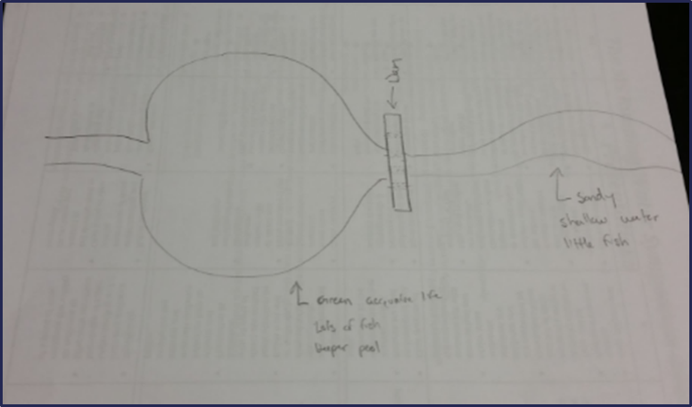
Using the QFT for Peer Review:
Scientist’s claim:
“Adding a dam to a water system causes a decrease in aquatic life downstream.”
Student Design to test the claim:

Slide 16
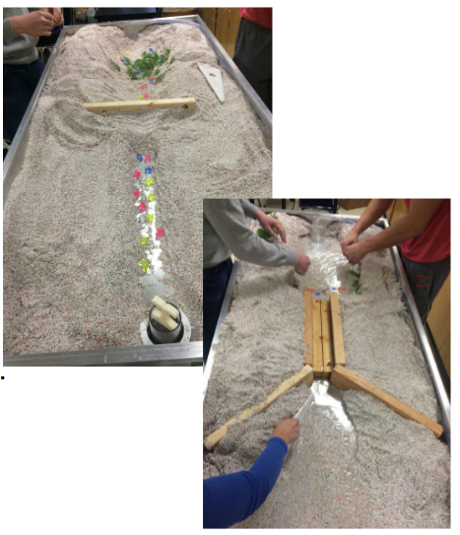
Next Steps with Student Questions:

Slide 17
Using the QFT for Skill Development
(Students were assigned a complex molecular biology article)
QFocus: Ask as many questions as you can about the reading

Slide 18
Next Steps with Student Questions:
Students generate questions for homework then bring in to class
Students discuss key attributes of a good biological research question and compare to other types of questions
Students form groups and improve their questions, based on these attributes
These questions are discarded or kept in notebooks (up to the student)
Students apply this skill to designing their own research project later in the semester

Slide 19
Next Steps?
Pop Quiz or Reading Check
Debate Prep
Paper topic
Lab work & Experiments
Exit ticket or ”Do Now”
Hang on walls,
Check Off as Answered
Research
Projects
Test Prep
And sometimes…
Nothing!
Homework
Class discussion prompts
Presentations
Student Choice Projects
Socratic Seminar Prompts
Interview an Expert
Make Your Own Final Test
Journal Prompt
Guest speakers
Close Reading Protocol
Year-long or Unit-long Essential Questions
Tailoring Instruction
Service Action Projects

Slide 20
Five Areas Related to the Art of the QFT
Linking the QFT to Teaching and Learning Goals
QFocus Design
Prioritization Instructions
Reflection Questions
Facilitation

Slide 21
Classroom Example: High School
Teacher: Joan Soble, Cambridge, MA
Topic: Albert Camus’s The Plague
Purpose: Pre-reading engagement and prediction of central themes going into the text

Slide 22
Initial Question Focus:

Slide 23
Revised Question Focus:
The city fathers were aware that the decaying bodies of these rodents were making people sick. (page 28)

Slide 24
Question Focus Design:
Moving From Complicated to Simple

Slide 25
Classroom Example: 2nd Grade
Teacher: Marie Romero, Lanai, Hawaii
Topic: A unit on “How can a pet be an important friend?”
Purpose: Let students generate their own key question for the week, assess how well students are able to ask questions

Slide 26
Initial Question Focus Design Process
How can a pet be an important friend?
Collage of pictures: dogs, cats, guinea pigs, horses, other pets
Picture of a human and a service animal
Picture of a human and a service animal paired with a phrase like “people and animals”
“People and animals”
“People, animals, and friends”

Slide 27
Student Questions: “People, Animals, and Friends”
Do people exist?
Where do people live?
Why do animals live in the zoo?
Why do people go to the pool?
Why are friends fun?
Why do animals bite?
Why do people go to school?
Do people, animals, and friends play together?
Do animals make friends?
Why do I need friends?
Why do people want to be friends with animals?
Why are people making friends with animals?
Why do people, animal, and friends live in different countries?
Where did my dog and friend go?
Can my friend pet our new dog?
Why do I have eyes?
How do people smell?
Can animals speak?
Can people fly?
Where is my bunny? What happened?

Slide 28
Revising the Question Focus
“People, Animals, and Friends”
Your idea here!

Slide 29
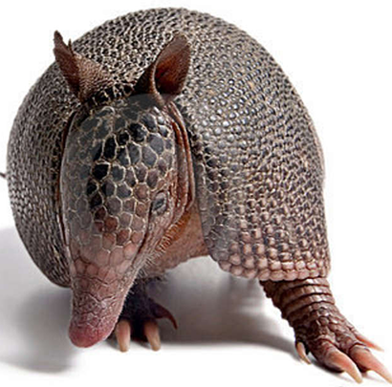
The one quality all excellent QFT designers share?
Thick Skin.

Slide 30
Five Areas Related to the Art of the QFT
Linking the QFT to Teaching and Learning Goals
QFocus Design
Prioritization Instructions
Reflection Questions
Facilitation

Slide 31
Prioritization Instructions
Choose the three most important questions
Choose the three questions you consider most important.

Slide 32
Categories of Prioritization Instructions
Choose three questions…
General Instructions:
that you consider most important
Specific Purposes:
that you need to research further
to help you solve the problem
that you need to answer first
that a scientist studying the earth might ask
that will help you understand the text
that require analyzing data
that are not “Googleable” and may be difficult to answer

Slide 33
Five Areas Related to the Art of the QFT
Linking the QFT to Teaching and Learning Goals
QFocus Design
Prioritization Instructions
Reflection Questions
Facilitation

Slide 34
Examples of Reflection Questions
QFT Process
Content Specific
What did you learn about asking questions?
How did you learn it?
What do you understand differently now about asking questions?
How can you use what you learned about asking questions?
How do you feel about asking questions?
What did you learn about the (content)?
How did the QFT process help you think about…
key concept
specific assignment
overarching topic
theme in the unit
chapter you just read

Slide 35
Five Areas Related to the Art of the QFT
Linking the QFT to Teaching and Learning Goals
QFocus Design
Prioritization Instructions
Reflection Questions
Facilitation

Slide 36
Four Principles of Facilitation
Monitor student adherence to the process
Do not give examples
Do not get pulled into group discussion
Acknowledge all contributions equally
Pair & Share: What could be challenging about each principle? What might be important about each?

Slide 37
The Science of the QFT: a protocol
The Art of the QFT: You

Slide 38
Today’s Agenda
Welcome
Collaborative Learning with the Question Formulation Technique (QFT)
The Art and Science of the QFT
Lunch
Building Consensus for Change by Using the Right Question Strategy
Planning to Bring the QFT Back
Closing Remarks, Q&A, & Evaluations
@RightQuestion#QFTCon #QFT

Slide 39
Today’s Agenda
Welcome
Collaborative Learning with the Question Formulation Technique (QFT)
The Art and Science of the QFT
Lunch
Building Consensus for Change by Using the Right Question Strategy
Planning to Bring the QFT Back
Closing Remarks, Q&A, & Evaluations
@RightQuestion#QFTCon #QFT

