Slide 1
A Work in Progress: New Ideas about Questions and Learning
PNW BOCES
Yorktown Heights, NY
October 19, 2017
Dan Rothstein
Co-Director
|
Siyi Chu
Program Associate
The Right Question Institute

Slide 2
What happened when you looked at the problem of some students not asking questions?
You focused intently on this problem for a limited period of time
You inquired. You asked questions
You worked with your questions
You selected questions you were most curious to explore

Slide 3
What happened to the students when they looked at the Caning of Sumner?
They focused intently on the image for a limited period of time
They inquired. They asked questions
They worked with their questions
They selected questions they were most curious to explore

Slide 4
Thinking a Little Differently about Curiosity
Curiosity is often seen as the catalyst for questions.
Curiosity can also be the result of students asking and working with their own questions.
Curiosity can deliberately be stimulated by using three distinct thinking abilities when working with one’s own questions.
Notes:
Many teachers try to stimulate curiosity by asking questions of students. It’s a time-honored method

Slide 5
Stimulating Curiosity and Enhancing Learning
The Emergence of a
“Working with One’s Own Questions” Model of Learning

Slide 6
How We Define “Working"
Produce
Categorize
Improve
Prioritize
Strategize on use of questions
Reflect
The “working” also requires using three thinking abilities:
Divergent
Convergent
Metacognitive

Slide 7
The Model Consistently Produces Two Outcomes
Greater Knowledge
Greater Curiosity

Slide 8
Evidence of Greater Knowledge
Discovery of new ways of thinking/ ideas
More clarity about content
More clarity about what they don’t know and what they need to know
New/ Expanded understanding of complexity

Slide 9
Teacher Reflections
“Knowing how to ask the right questions when faced with a dilemma is a fundamental process…[It can] provide students with the knowledge needed to achieve at high levels both in their educational endeavors and in the world that awaits them after graduation”
- Mitch Justice, High School Social Studies Teacher, Belfry, KY
Notes:
“I’m amazed at the level of questioning students can create using a QFT even at a first grade level!”
- Melissa Sanger, 1st Grade Teacher, Belfry, KY
I want to reference the work in E. KY. Place them after the ‘evidence of knowledge’ slide.
For now..

Slide 10
Evidence of Greater Curiosity
Want to Know More
Express New Interest
Take Ownership for Getting Answers
Set a Learning Agenda
Notes:
The working with one’s own questions produces these consistent outcomes

Slide 11
Greater Knowledge
Greater Curiosity
No Small Matter
There is something significant afoot in education, and beyond, relevant to our “Working with One’s Own Questions” Model of Learning

Slide 12
Research Confirms the Importance of Student Questioning
Self-questioning (metacognitive strategy):
Student formulation of their own questions is one of the most effective metacognitive strategies
Engaging in pre-lesson self-questioning improved students rate of learning by nearly 50% (Hattie, p.193)
John Hattie
Visible Learning: A Synthesis of Over 800
meta-Analyses Relating to Achievement, 2008

Slide 13
Student Questioning Across Disciplines
“Students at any grade level should be able to ask questions of each other about the texts they read, the features of the phenomena they observe, and the conclusions they draw from their models or scientific investigations. For engineering, they should ask questions to define the problem to be solved and to elicit ideas that lead to the constraints and specifications for its solution. (NRC Framework 2012, p. 56)” (p. 1)
National Research Council. (2013). APPENDIX F – Science and Engineering Practices in the NGSS. Next generation science standards: For states, by states.

Slide 14
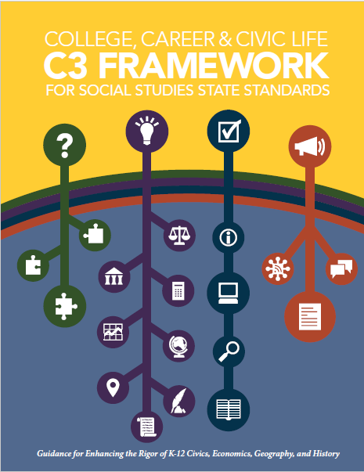
Student Questioning Across Disciplines
“Questioning is key to student learning.” (p.17)
“Central to a rich social studies experience is the capability for developing questions that can frame and advance an inquiry. ” (p. 24)
National Council for the Social Studies, The College, Career, and Civic Life (C3) Framework for Social Studies State Standards: Guidance for Enhancing the Rigor of K-12 Civics, Economics, Geography, and History (Silver Spring, MD: National Council for the Social Studies, 2013).

Slide 15
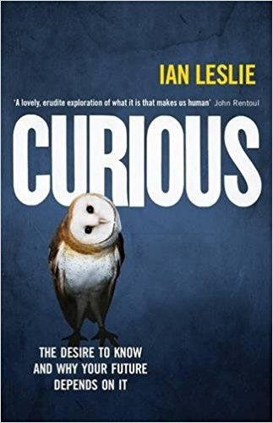
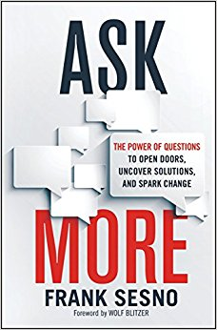
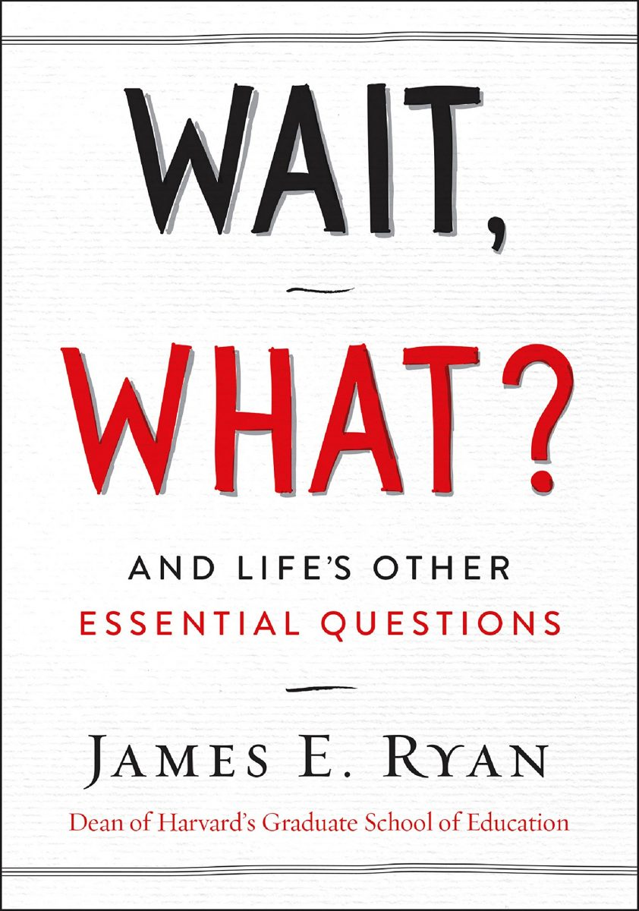
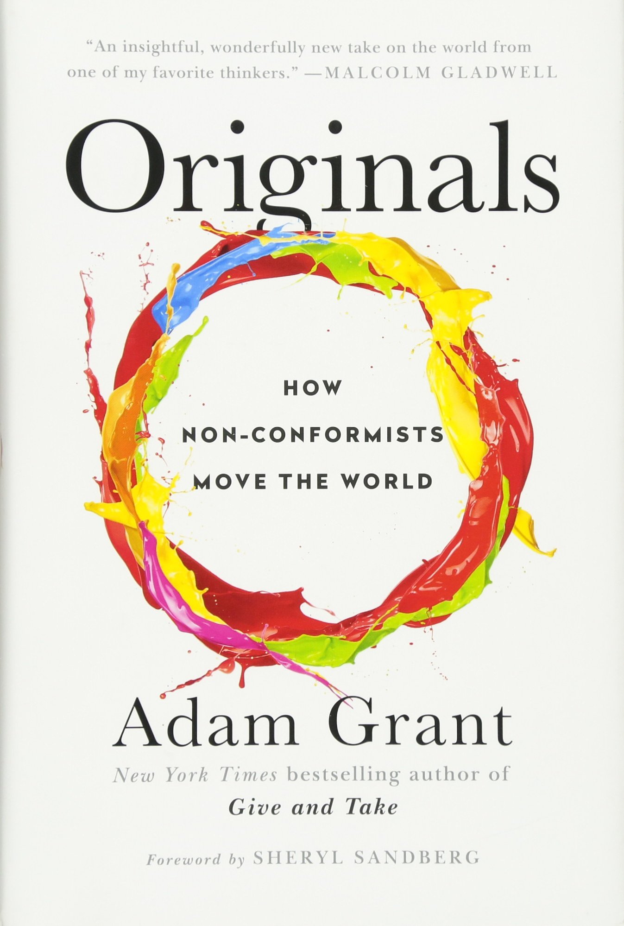
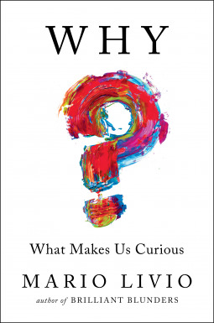
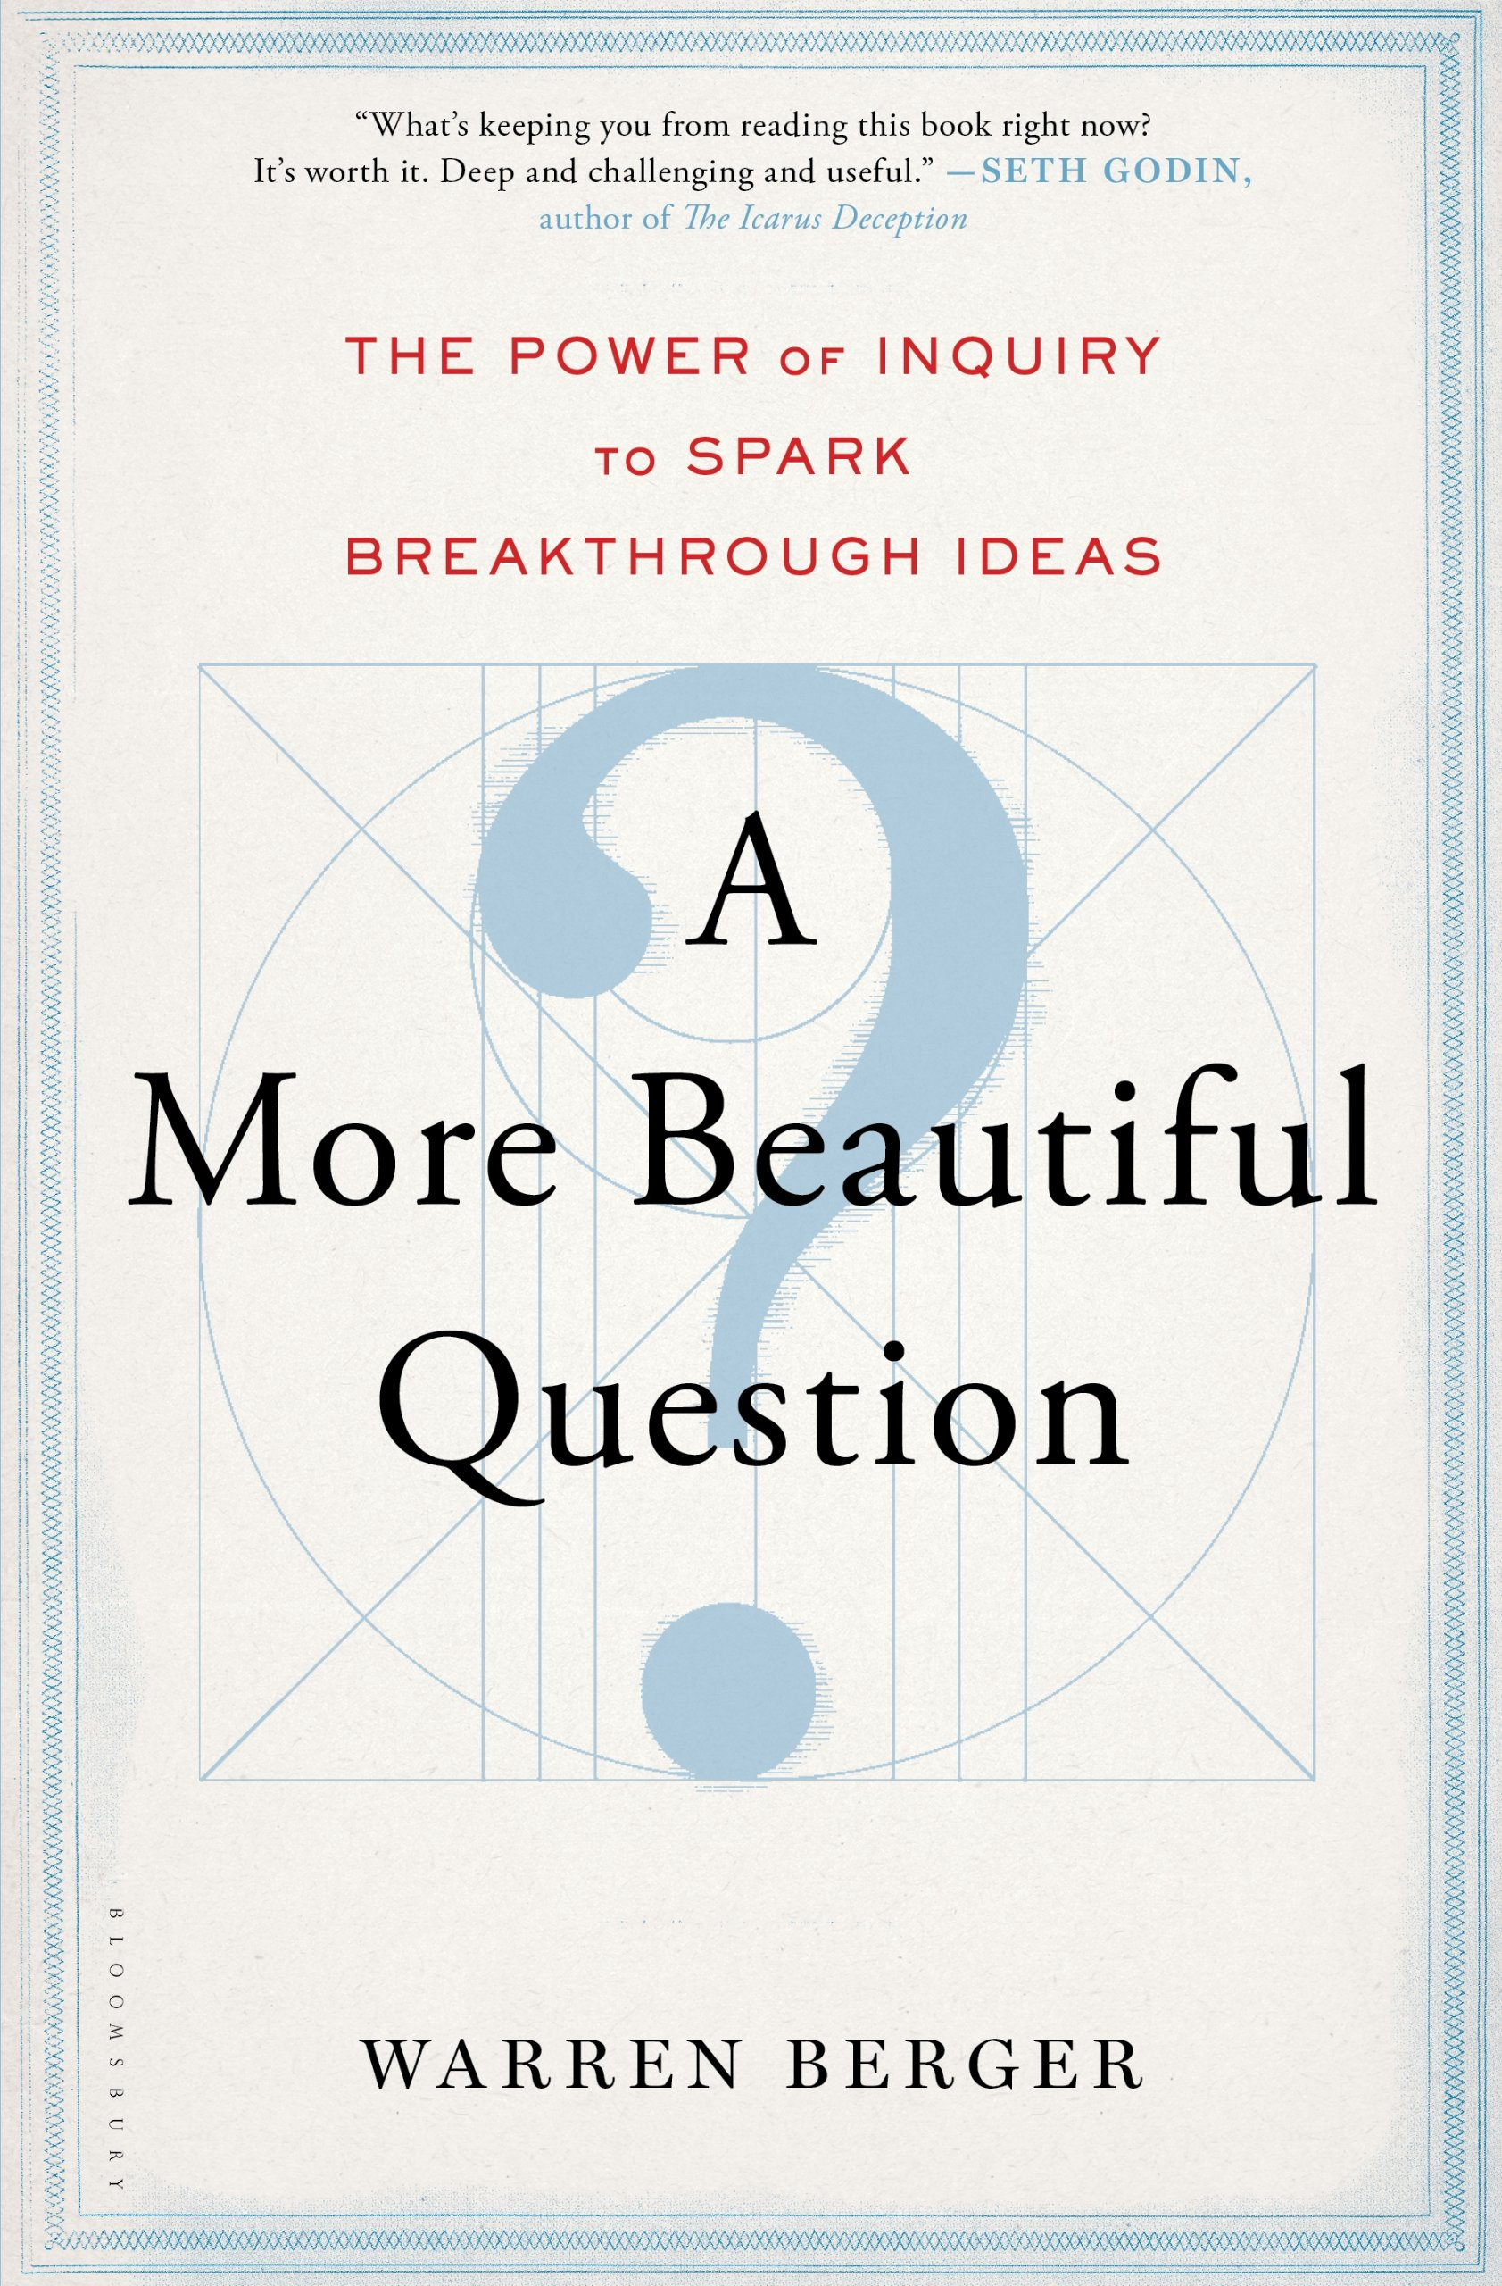
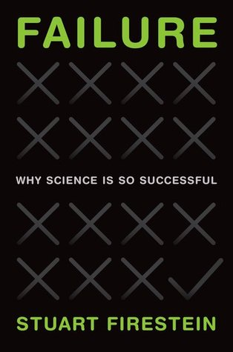

Slide 16
From Technique to Model
We figured out a technique for getting students to formulate their own questions.
In the last five years, educators have used the simple technique in creative and ingenious ways that consistently stimulate curiosity and advance student learning.
Educators’ work with the technique leads us to see more clearly a replicable model of learning that is based on combining student question formulation with teacher creativity.
Notes:
Flows from the recent recognition of the importance of students learning to ask questions

Slide 17
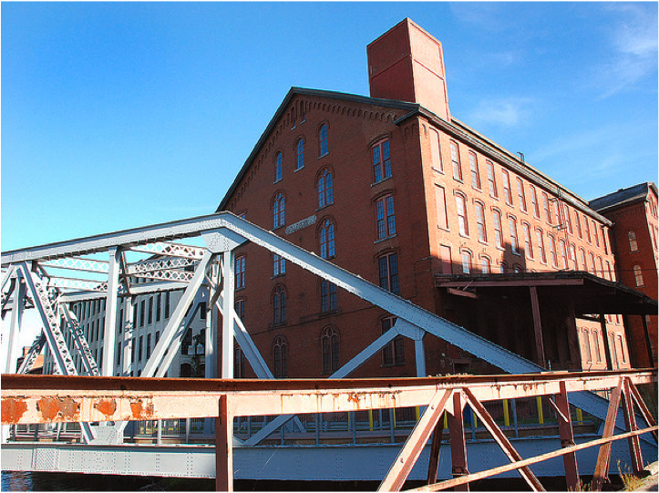
Honoring three sources of this model
LAWRENCE, MA, 1990
“We don’t go to the school because we don’t even know what to ask.”

Slide 18
Honoring the Sources (II)
250,000 Teachers around the world

Slide 19
Honoring the Sources (III)
Millions of students
"Asking questions may not always lead to answers, but it leads to curiosity. Curiosity is what drives children and teens to want to learn, even when they don't realize it...Question asking helps us guide our own adventure and helps us find new interests. Everything starts with a question, even if you don't realize it.”
- Abriana Fusco, 9th Grader, Fitchburg, MA
“When you ask the question, you feel like it’s your job to get the answer.”
- High School student, Boston, MA
“Just when you think you know all you need to know, you ask another question and discover how much more there is to learn.”
- 6th grader, Palo Alto, CA
In response to "why do you think we ask questions?”
“So we can be curious about what we are learning and want to
know more." - Ayaka, 1st Grader, Novi, Michigan

Slide 20
Lessons in Progress
Asking Questions vs. Question Formulation
Curiosity and Question Formulation
Working with one’s own questions
The three thinking abilities
Curiosity as a stimulus for questions (commonly perceived)
Curiosity as an outcome of working with questions
The three thinking abilities complemented by curiosity (multiplier)

Slide 21
Can we give the model a more scientific name?
, and Ah Ha!
“Working with One’s Own Questions”
Model of Learning
Hmm
, Oomph

Slide 22
Hmm, Oomph, and Ah Ha!
Why is a model for learning that emphasizes student question formulation so important today?

Slide 23
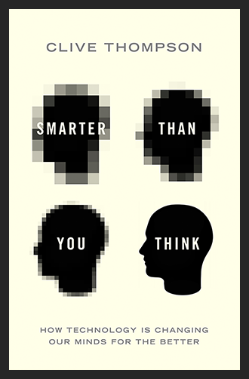
In the Age of Google…
“How should you respond when you get powerful new tools for finding answers?
Think of harder questions.”
Clive Thompson, Journalist and Technology Blogger

Slide 24
Democracy
“We need to be taught to study rather than to believe, to inquire rather than to affirm.” - Septima Clark
See Chapter 6 on Septima Clark in Freedom Road: Adult Education of African Americans (Peterson, 1996).

Slide 25
And now, at the end…
INQUIRY

Slide 26
From the beginning to the end…
We shall not cease from exploration
And the end of all our exploring
Will be to arrive where we started
And know the place
For the first time.
--T.S. Eliot

Slide 27
Q & A

Slide 28
Reflection and Evaluation

