Slide 1
Best Practices in the Question Formulation Technique (QFT)
Chicago Public Schools
Chicago, IL
November 4, 2017
Dan Rothstein
Co-Director
|
Sarah Westbrook
Director of Professional Learning
The Right Question Institute

Slide 2

Acknowledgments
We are deeply grateful to the Sir John Templeton Foundation and The Hummingbird Fund for their generous support of the Right Question Institute’s Million Classrooms Campaign.
We are grateful also to Heather Van Benthuysen for all her work in arranging this session to our own Siyi Chu for all her support back at the office.
#QFTCon #QFT

Slide 3
Today’s Agenda
Welcome and Community Building
Collaborative Learning with the Question Formulation Technique (QFT)
The Art and Science of the QFT
Lunch
Question Focus Design Workshop
Self-Organized Working Groups
The QFT in Action
#QFTCon #QFT

Slide 4
To Access Today’s Materials:
http://rightquestion.org/educators/
seminar-resources/
Join our Educator Network for:
  Templates you can use tomorrow in class
  Classroom Examples
  Instructional Videos
  Forums and Discussions with other Educators

Slide 5

We’re Tweeting…
@RightQuestion
@RothsteinDan
#QFTCON #QFT

Slide 6
We shall not cease from exploration
And the end of all our exploring
Will be to arrive where we started
And know the place
For the first time.
--T.S. Eliot
Notes:
For the beginning of our exploration, some lines of poetry

Slide 7
In the beginning…
INQUIRY

Slide 8
"There is no learning without having to pose a question."
- Richard Feynman
Nobel-Prizewinning physicist

Slide 9

“We must teach students how to think in questions, how to manage ignorance.”
- Stuart Firestein
Chairman of the Department of Biology at Columbia University

Slide 10
College Presidents on What Students Should Learn in College
“The primary skills should be analytical skills of interpretation and inquiry. In other words, know how to frame a question.”
- Leon Botstein, President of Bard College
“…the best we can do for students is have them ask the right questions.”
- Nancy Cantor, Chancellor of University of Illinois
The New York Times, August 4, 2002

Slide 11
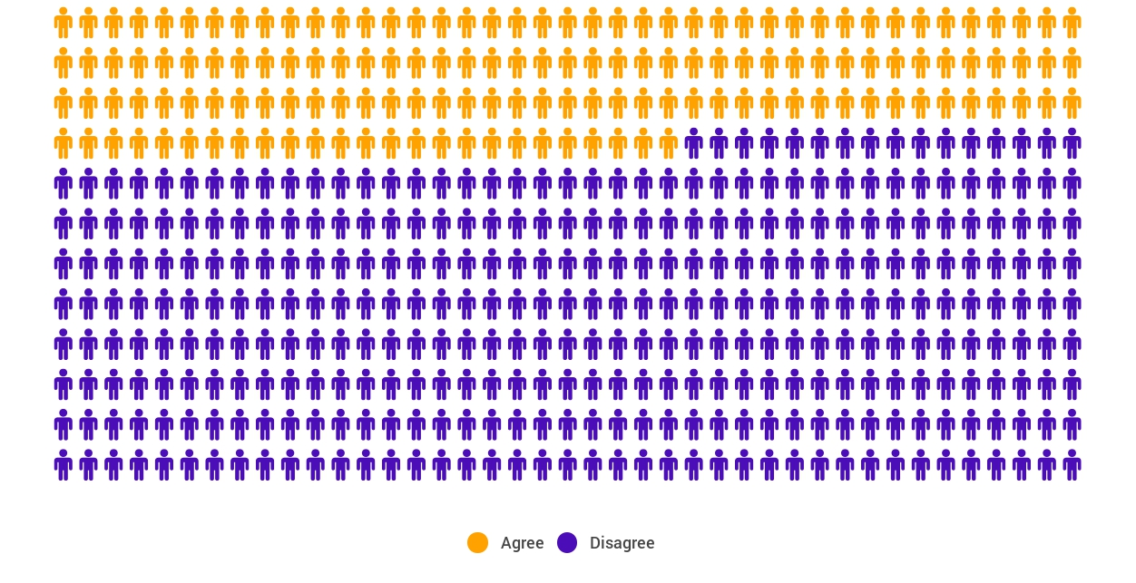
Yet…only 27%of students believe college taught them to ask their own questions
Alison Head, Project Information Literacy at University of Washington, 2016

Slide 12
But, the problem begins long before college...

Slide 13
A 1912 Study
Romiett Stevens, 1912
The Question as a Measure of Efficiency in Instruction: A critical study of classroom practice. Columbia University Contributions to Education, No. 48
“An unusual lesson because twenty-five of the thirty-four questions were asked by the pupils.…The result was that the lesson developed an impetus born of real interest. I mention it because this lesson was unique in the series of one hundred.”

Slide 14
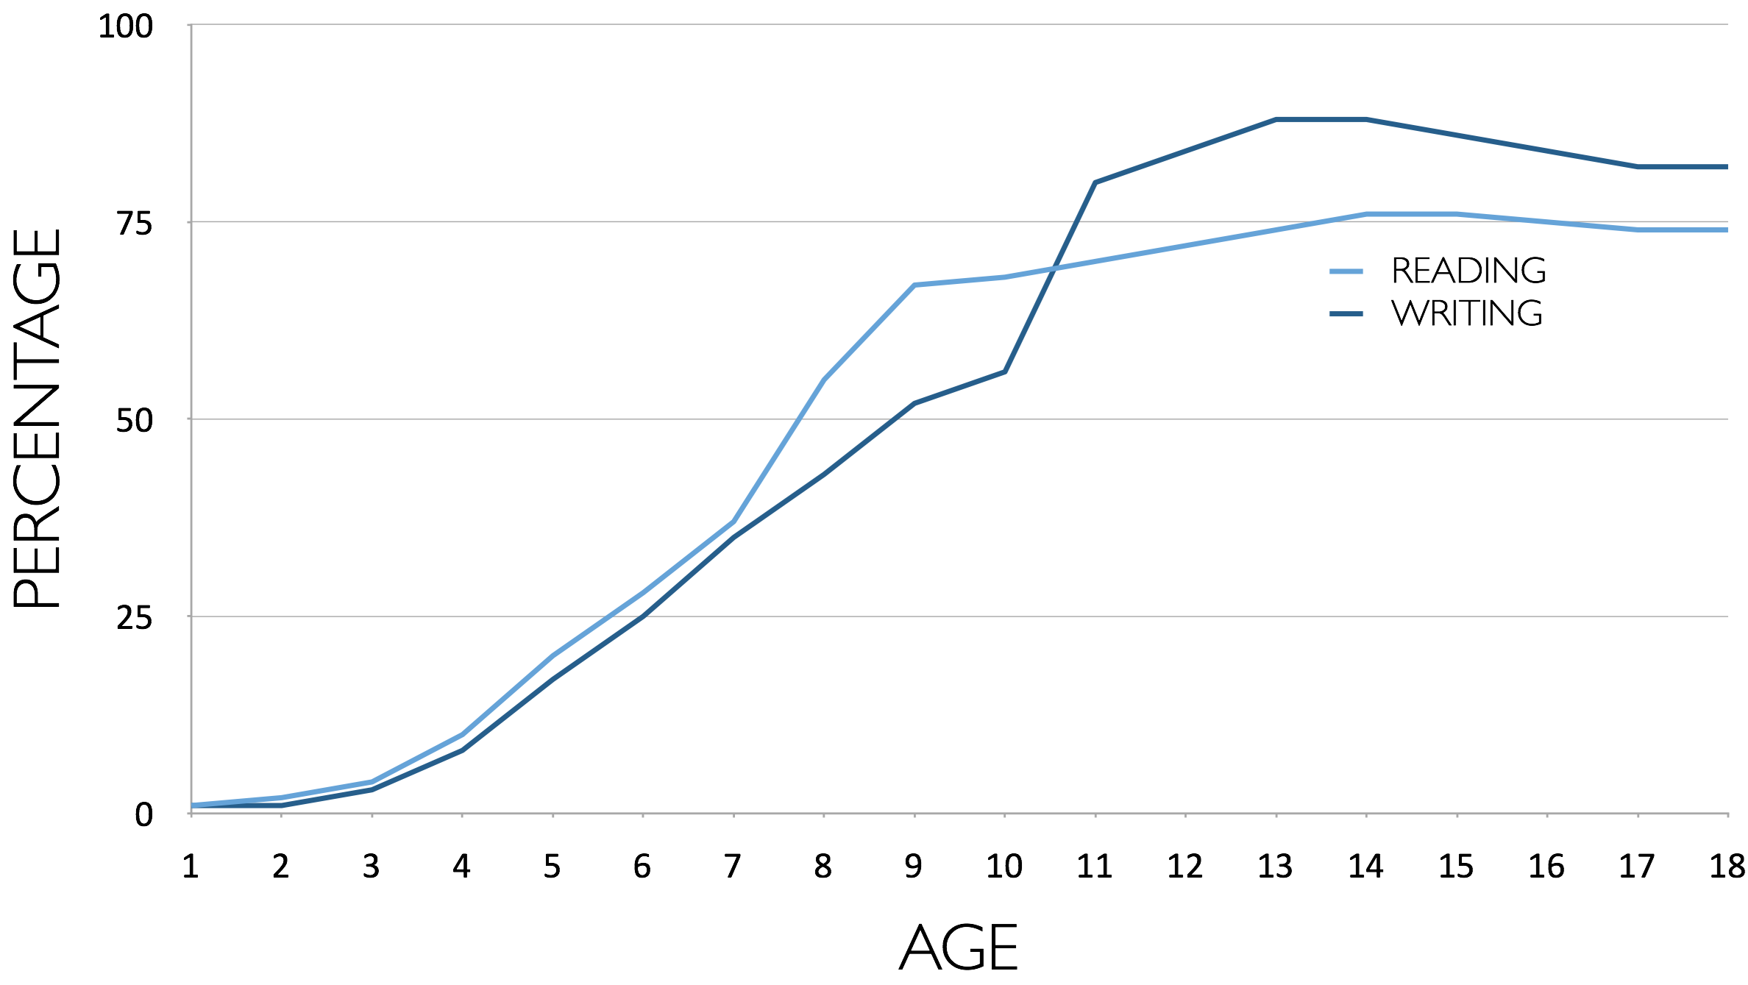
Percentage of Basic Skill Attainment
Sources
http://nces.ed.gov/nationsreportcard/pdf/main2009/2011455.pdf
http://nces.ed.gov/nationsreportcard/pubs/main2007/2008468.asp#section1
Data on question-asking based on parent and teacher feedback

Slide 15
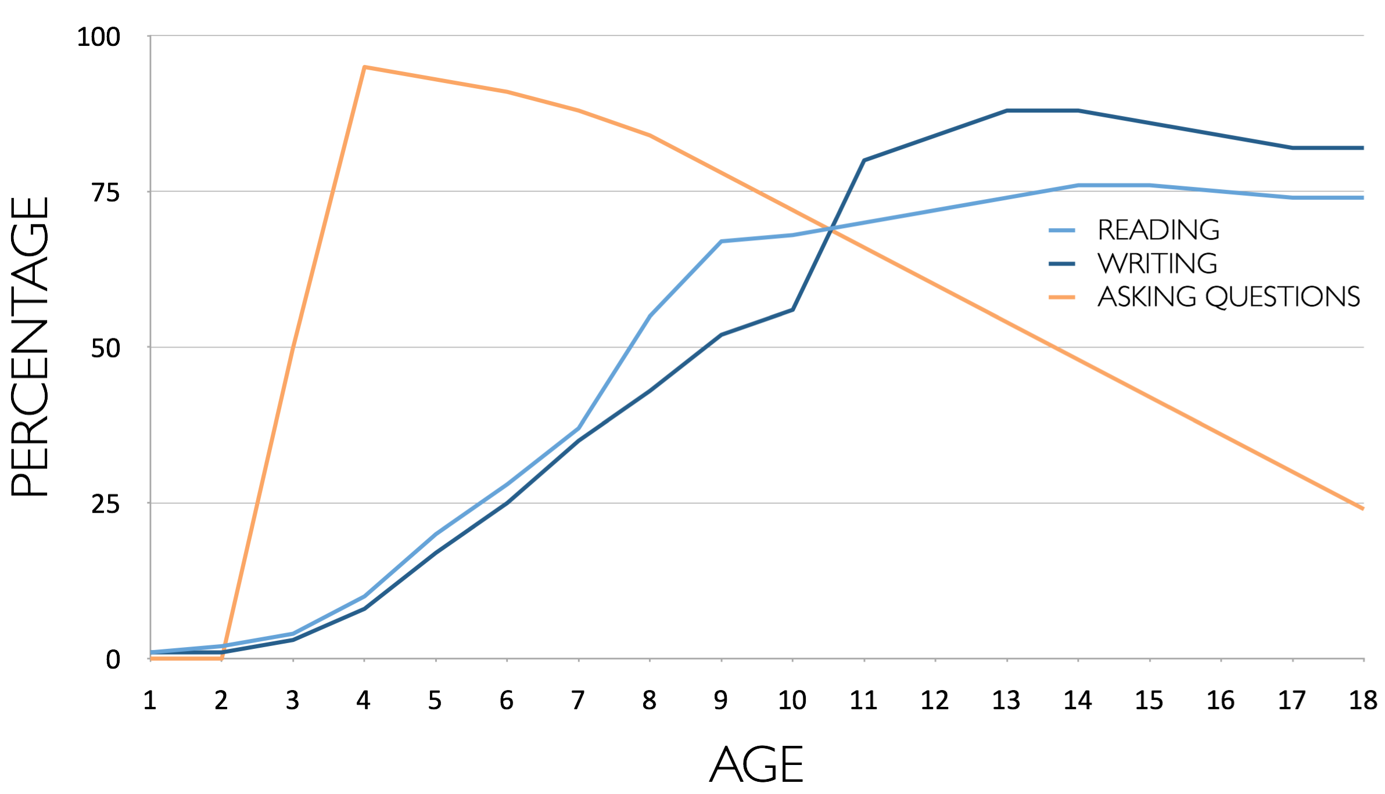
Percentage of Basic Skill Attainment
Sources
http://nces.ed.gov/nationsreportcard/pdf/main2009/2011455.pdf
http://nces.ed.gov/nationsreportcard/pubs/main2007/2008468.asp#section1
Data on question-asking based on parent and teacher feedback

Slide 16
The challenge of promoting inquiry in the classroom…
Maybe, don’t start with the word…

Slide 17
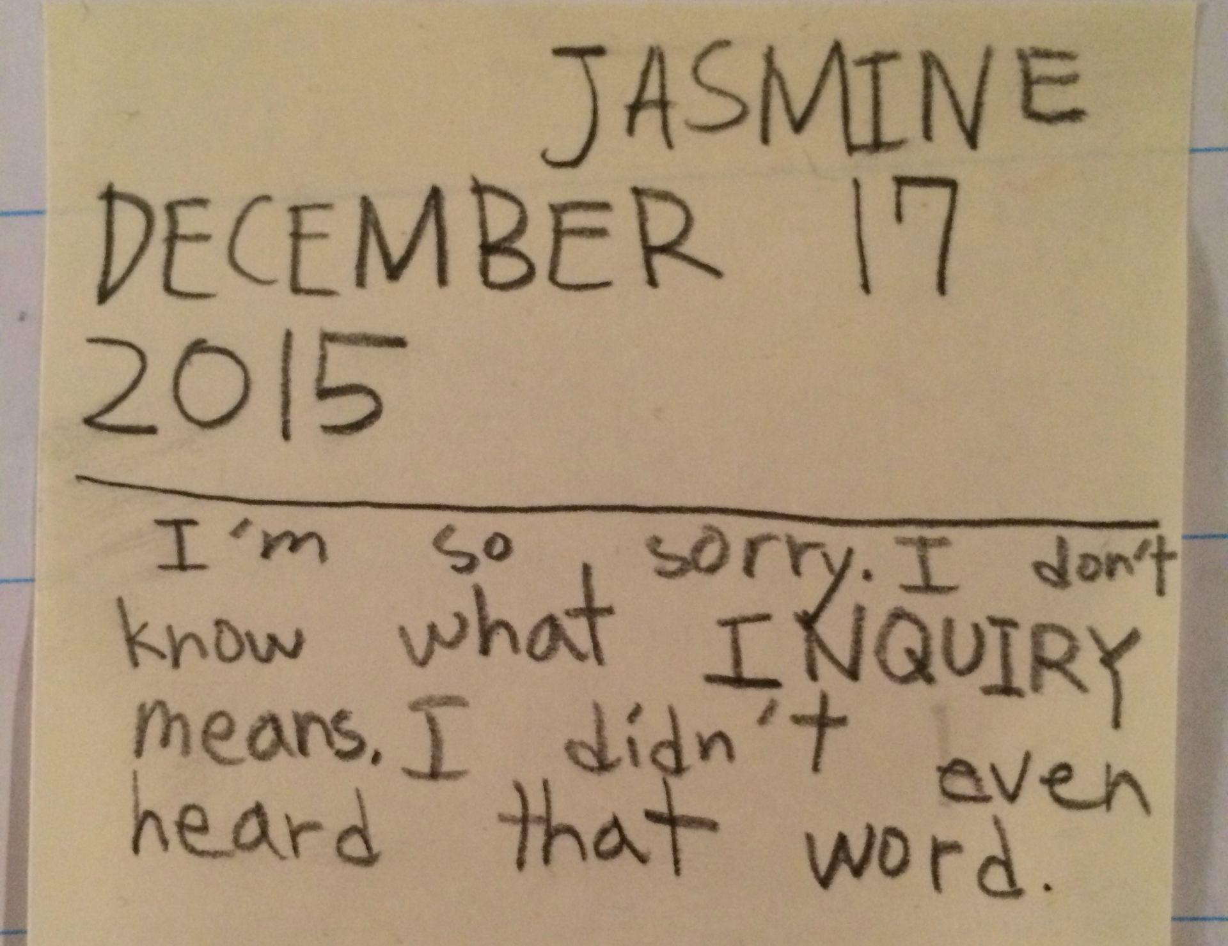

Slide 18
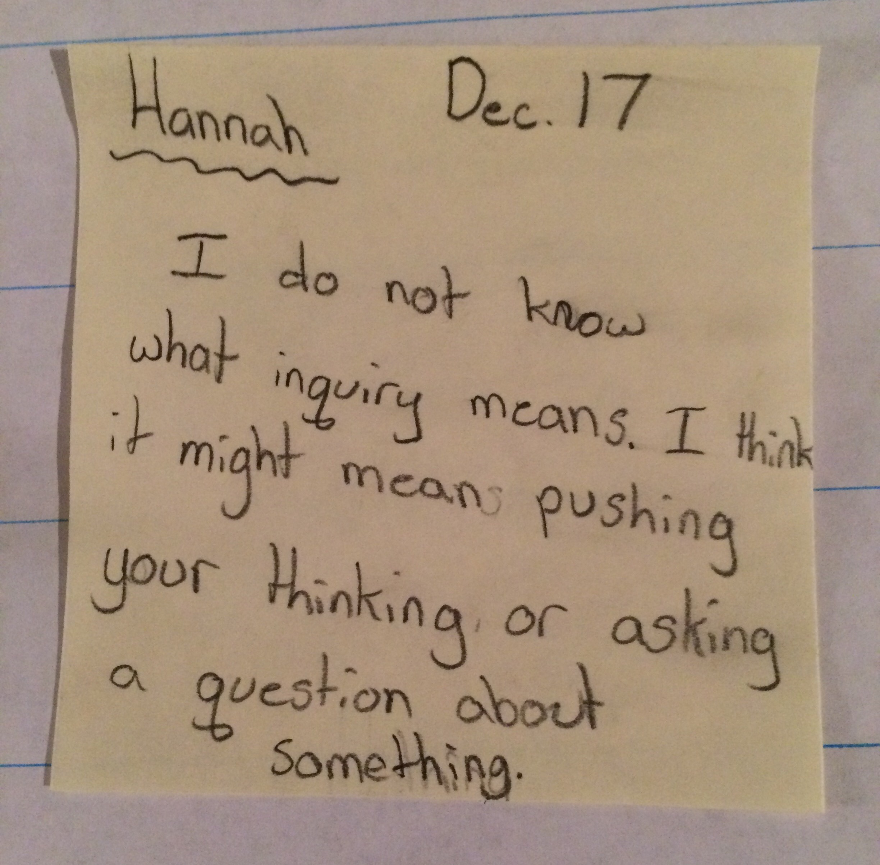
Notes:
Most of the teachers with whom we have worked tackle the challenge of promoting inquiry without using the word

Slide 19
Classroom Example:
Kindergarten
Teacher: Jennifer Shaffer, Walkersville, MD
Topic: Non-fiction literacy
Purpose: To engage students prior to reading a nonfiction text about alligators

Slide 20
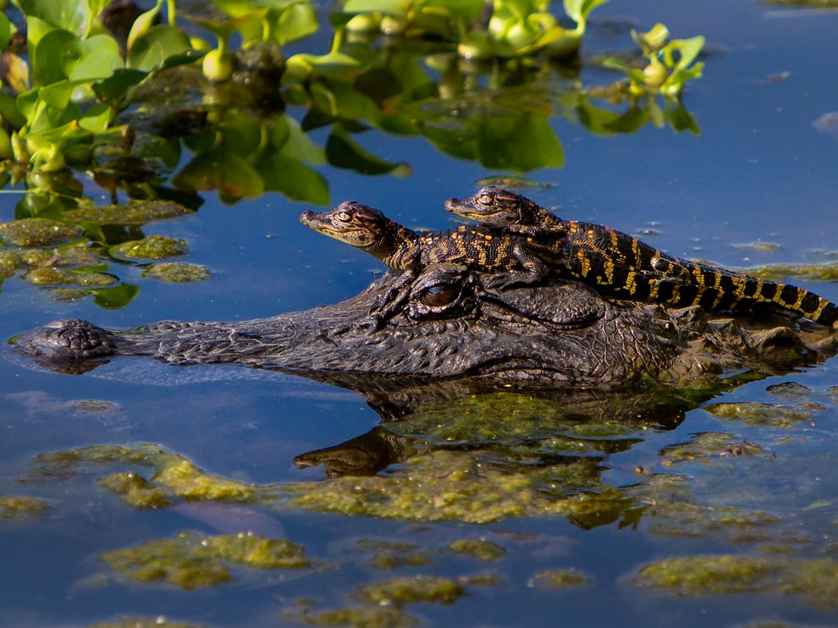
Question Focus
Photograph by Nuwan Samaranayake, 2013

Slide 21
Student Questions
Is the alligator camouflaged?
Why do the babies have stripes?
Are those baby crocodiles?
Is it a mom or dad crocodile?
What is the green stuff?
Why are they in the water so low?
Where are they going?
Why are the baby alligator’s eyes white and the mom’s black?
Why are baby alligators on top of the momma alligator?
Why does momma or daddy have bumps on them?

Slide 22
Classroom Example:
4th Grade
Teacher: Deirdre Brotherson, Hooksett, NH
Topic: Math unit on variables
Purpose: To engage students at the start of a unit on variables

Slide 23
Question Focus
24 = ☺ + ☺ + ☺

Slide 24
Student Questions
Why is the 24 first?
What do the smiley faces mean?
Why are there 3 smiley faces?
How am I suppose to figure this out?
Is the answer 12?
Can I put any number for a smiley face?
Do three faces mean something?
Do the numbers have to be the same because the smiley faces are the same?
What numbers will work here?
Does it mean 24 is a really happy number?
Can we replace each smiley face with an 8?
Do any other numbers work?
Can we do this for any number?
Does it always have to be smiley faces?
Do we always have to use three things?

Slide 25
Next Steps with Student Questions
Questions posted on classroom walls.
Students cross off the questions they answer during subsequent lessons.
Teacher returns to student questions at the end of the unit to discuss with students what they learned and what they still want to know.

Slide 26
Classroom Example:
Middle School
Teacher: Megan Harvell, Boston, MA
Topic: American History –The Civil War
Purpose: Pre-reading activity to engage students

Slide 27
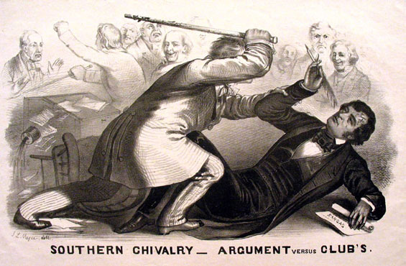
Question Focus
Image by John L. Magee, 1856

Slide 28
Student Questions
Why are they fighting?
Are they fighting?
Are they part of the government?
Where were they?
Who are they?
Were they signing anything?
Who else was there?
Why are you hitting him?
Why didn’t they call 911?
Was this related to slavery?
Why is he hitting him with a bat?
11. Why are you taking a pen?
12. Why are they in court?
13. Who hit who first?
Who died?
Why are they smiling?

Slide 29
Classroom Example:
High School
Teacher: Ling-Se Chesnakas, Boston, MA
Topic: 12th Grade Humanities unit on The Brief Wondrous Life of Oscar Wao by Junot Diaz
Purpose: To help students generate questions for a Socratic Seminar at the end of the unit

Slide 30
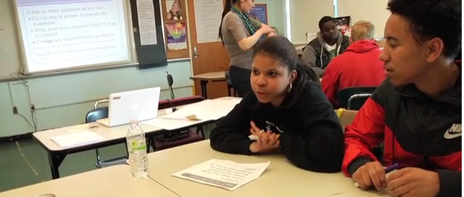
The Question Formulation Technique (QFT) in Action
http://rightquestion.org/qft-in-action/

Slide 31
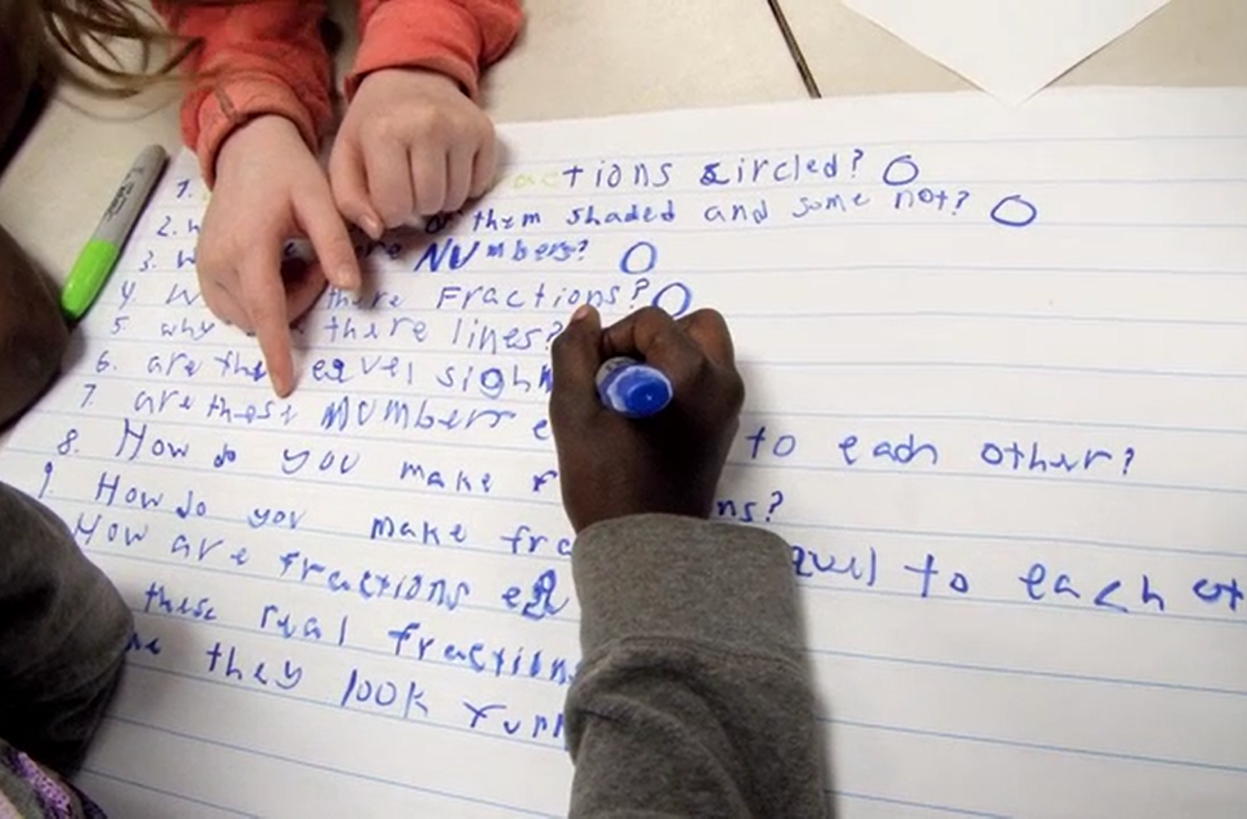
Working on a Challenge by Using the Question Formulation Technique (QFT)

Slide 32
Rules for Producing Questions
1. Ask as many questions as you can
2. Do not stop to answer, judge, or discuss
3. Write down every question exactly as stated
4. Change any statements into questions

Slide 33
Producing Questions
Ask Questions
Follow the Rules
      Ask as many questions as you can.
      Do not stop to answer, judge, or discuss.
      Write down every question exactly as it was stated.
      Change any statements into questions.
Number the Questions

Slide 34
Question Focus:
Some students are not asking questions.
→Please write this statement at the top of your paper.
→Remember to number the questions & follow the rules.

Slide 35
Categorizing Questions:
Closed/ Open
Definitions:
  Closed-ended questions can be answered with a “yes” or “no” or with a one-word answer.
  Open-ended questions require
  more explanation.
Directions: Identify your questions as closed-ended or open-ended by marking them with a “C” or an “O.”

Slide 36
Discussion
Closed-ended Questions
Advantages
Disadvantages

Slide 37
Discussion
Open-ended Questions
Advantages
Disadvantages

Slide 38
Improving Questions
Take one closed-ended question and change it into an open-ended question.
Take one open-ended question and change it into a closed-ended question.
Closed
Open
Open
Closed

Slide 39
Strategize: Prioritizing Questions
Review your list of questions
  Choose the three questions you are most curious to explore further.
  While prioritizing, think about your Question Focus: Some students are not asking questions.
After prioritizing consider…
  Why did you choose those three questions?
  Where are your priority questions in the sequence of your entire list of questions?

Slide 40
Strategize: Next Steps
From priority questions to action plan
In order to answer your priority questions:
    What do you need to know? Information
    What do you need to do? Tasks

Slide 41
Share
Questions you changed from open/closed
Your three priority questions and their numbers in your original sequence
Rationale for choosing priority questions
Next steps

Slide 42
Reflection
What did you learn?
How did you learn it?
What do you understand differently now about some students not asking questions?

Slide 43

Let’s peek inside the black box
#QFTCon #QFT

Slide 44
“Modern science is a technique...it is a practice that allows us to learn reliable things about the world. [Science] is a technique that was waiting for people to discover it.”
- Steven Weinberg, Nobel laureate in Physics
To Explain the World, 2015

Slide 45
The QFT, on one slide…
Question Focus
Produce Your Questions
    Follow the rules
    Number your questions
Improve Your Questions
    Categorize questions as Closed or Open-ended
    Change questions from one type to another
Prioritize Your Questions
Share & Discuss Next Steps
Reflect
Ask as many questions as you can
Do not stop to discuss, judge or answer
Record exactly as stated
Change statements into questions
Closed-Ended:
Answered with “yes,” “no” or one word
Open-Ended: Require longer explanation

Slide 46
Curiosity and Rigor
  Three thinking abilities
  with one process

Slide 47
Thinking in many different directions
DIVERGENT
THINKING

Slide 48
Narrowing Down, Focusing
CONVERGENT
THINKING

Slide 49
The Importance of Questions
"Questions are the engines of intellect, the cerebral machines which convert energy to motion, and curiosity to controlled inquiry."
- David Hackett Fischer,
Historians' fallacies: Toward a logic of historical thought.
Routledge and Kegan Paul, 1971.
“[The QFT] helps me by getting me to think about questions on my own…it gets my mind
in motion to think about the questions other people make."
- 8th grade student in James Brewster’s U.S. history class
Gus Garcia Young Men’s Leadership Academy, Austin, TX, 2015

Slide 50

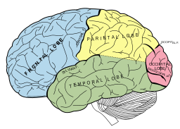
Thinking about Thinking
METACOGNITIVE
THINKING

Slide 51
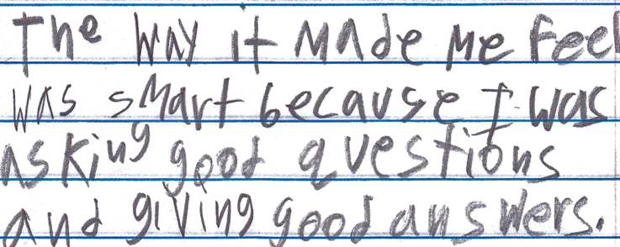
Student Reflection
“The way it made me feel was smart because I was asking good questions and giving good answers.”
-Boston 9th grade remedial summer school student

Slide 52
To Access Today’s Materials:
http://rightquestion.org/educators/
seminar-resources/
Join our Educator Network for:
  Templates you can use tomorrow in class
  Classroom Examples
  Instructional Videos
  Forums and Discussions with other Educators

Slide 53

Now, Educators Lead the Work
The Right Question Institute offers materials through a Creative Commons License and we encourage you to make use of and/or share this resource. Please reference the Right Question Institute and rightquestion.org as the source on any materials you use.

Slide 54
Today’s Agenda
Welcome and Community Building
Collaborative Learning with the Question Formulation Technique (QFT)
The Art and Science of the QFT
Lunch
Question Focus Design Workshop
Self-Organized Working Groups
The QFT in Action
#QFTCon #QFT

