Slide 1
The QFT in Action: New Ideas about Questions and Learning
Chicago Public Schools
Chicago, IL
November 4, 2017
Dan Rothstein
Co-Director
|
Sarah Westbrook
Director of Professional Learning
The Right Question Institute

Slide 2
Today’s Agenda
Welcome and Community Building
Collaborative Learning with the Question Formulation Technique (QFT)
The Art and Science of the QFT
Lunch
Question Focus Design Workshop
Self-Organized Working Groups
The QFT in Action
#QFTCon #QFT

Slide 3
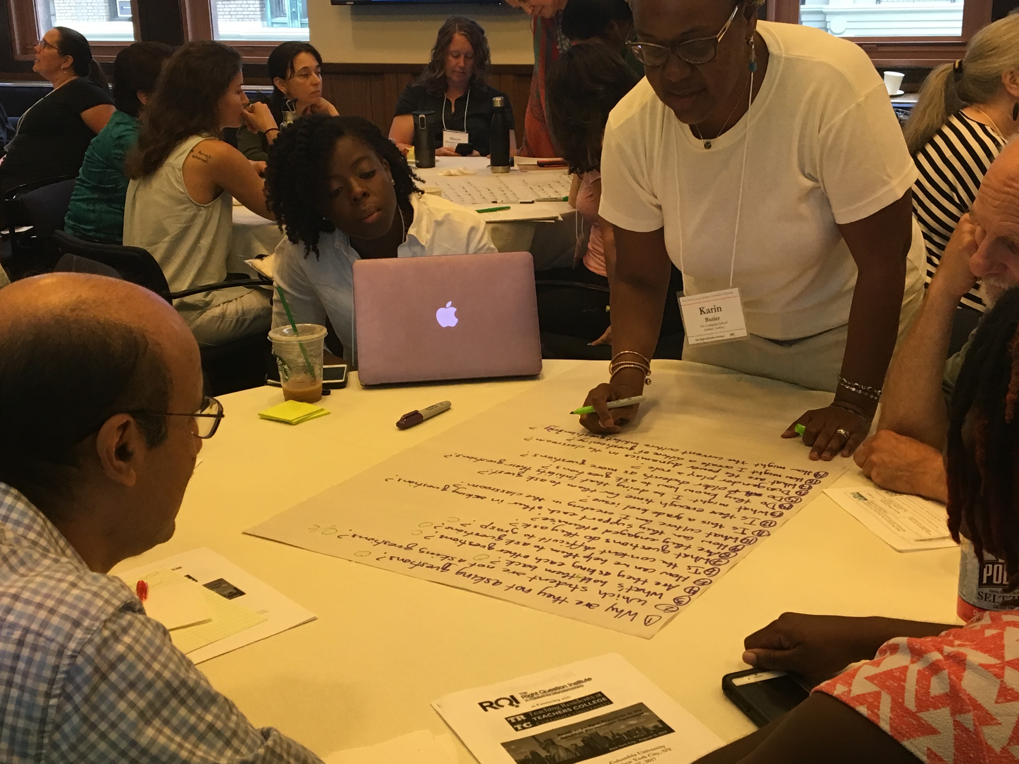
Designing and Revising a QFocus

Slide 4
Classroom Example: 2nd Grade
Teacher: Marie Romero, Lanai, Hawaii
Topic: A unit on “How can a pet be an important friend?”
Purpose: Let students generate their own key question for the week, assess how well students are able to ask questions

Slide 5
Initial Question Focus Design Process
How can a pet be an important friend?
Collage of pictures: dogs, cats, guinea pigs, horses, other pets
Picture of a human and a service animal
Picture of a human and a service animal paired with a phrase like “people and animals”
“People and animals”
“People, animals, and friends”
Notes:
This is the process the teacher went through to come down to final QFocus. (some of the ideas she ruled out may actually have been better in retrospect) but there were reasons she made the choices she did. Mostly, she wanted to simplify and give kids the chance to name the relationship between people and animals themselves.
The Qfocus she used was “people, animals, and friends.”

Slide 6
Student Questions: “People, Animals, and Friends”
Do people exist?
Where do people live?
Why do animals live in the zoo?
Why do people go to the pool?
Why are friends fun?
Why do animals bite?
Why do people go to school?
Do people, animals, and friends play together?
Do animals make friends?
Why do I need friends?
Why do people want to be friends with animals?
Why are people making friends with animals?
Where did my dog and friend go?
Can my friend pet our new dog?
Why do I have eyes?
How do people smell?
Can animals speak?
Can people fly?
Where is my bunny? What happened?
Notes:
Activity: Think, Share
Read the student questions as a lens into diagnosing problems with the Qfocus. What do you notice in this list of student questions? What do the questions tell you about the Q-Focus?
An Answer:
First bold lines to appear: some students are really thinking about the relationship b/w the 3 things listed and trying to connect the 3, so even in a batch of questions that are kind of off topic/not what the teacher expected, she could still have used #11 or #12 in her next steps.
But, that type of creating connection between different words, is kind of sophisticated thinking. Most of the kids picked one of the three nouns and zeroed in on it, asking questions that had the word in it, but didn’t consider it in relationship to the other words in the prompt. These lines appear in purple. To me, this indicates that most kids just didn’t have enough direction, guidance from the Qfocus. They needed more hooks to go on, or maybe an image. Little kids in particular probably need more complete sentences, images perhaps, need more to go on than older kids or adults.
The last thing to point out---pets come up over and over again. We learn that kids have experience with pets and emotional attachments to pets. See #14, 15, 20. So, that might be a fruitful background knowledge connection to take into consideration in the unit, or in a redesigned Q-Focus.
And of course, the teacher did learn that her students were able to ask questions, which was a major objective for doing QFT in the first place. She gained insight into their skill level with question formulation.

Slide 7
Revising the Question Focus
“People, Animals, and Friends”
Your idea here!
Notes:
Activity: What would you do with this Q-Focus, now with the benefit of hindsight and having analyzed the student’s questions? What advice might you give to this teacher?
Discuss at tables, each table report back their best idea.
It may be helpful for participants to first review Marie’s initial list of Q-Focus ideas.
My ideas:
I wonder what they would ask about, for ex, "humans need animal friends" or "animals are very important friends to humans" or "friendship between people and animals"? Maybe even more provocative: "To survive, people need animal friends." This is where Dan and I sometimes go back and forth; adults/teens can sometimes benefit from a more open-ended, vague phrase; sometimes kids need more "hooks," more of a complete thought to guide their thinking.
Here's another thought. Say you kept the same Q-Focus and all the same questions--could you get kids, through prioritization, to your goal? (If you didn’t want to do the QFT all over again) What if the prioritization instructions were, "out of all our class questions, pick the 3 questions that you think would help us learn about friendships between pets and humans." Bingo—right back on track, no extra time, still honors their process.

Slide 8
Classroom Example: 6th Grade
Teacher: Doreen Boone-Pitcher, Hyde Park, NY
Topic: Class culture at the start of the year
Purpose: To learn what the newest middle schoolers (6th graders) were concerned and/or curious about on their 5th day of school

Slide 9
Initial Question Focus

Slide 10
Student Questions
Why does it look so old?
Why does the school have a Fallout Zone?
Why is there a flag hanging upside down?
How old is the building?
Why are the classrooms numbered?
How many acres does it take up?
Why are there so many windows?
Why is there 4 big pillars at the front?
What is the big tower at the top?
Why are we being fit into one building?
When was the school made?
How much money did it cost to build it?
Why does it look like so many parts put together?
What is that white thing on top?
Why does it have 2 chimneys?
What is the point of lockers?
Who was the first principal?
Who is the boss of the superintendents?
Notes:
Activity: Think, Share
Read the student questions as a lens into diagnosing problems with the Q-focus. What do you notice in this list of student questions? What do the questions tell you about the Q-Focus?
An Answer:

Slide 11
Revising the Question Focus
Picture of the School Building
“As a member of the Haviland Middle School 6th grade, you will have numerous opportunities to grow and learn.”
Your idea here!
Notes:
Activity: Here’s how Doreen revised it and here’s the effect. If we were going to revise for next year, what would you do with this Q-Focus, now with the benefit of hindsight and having analyzed the student’s questions? What advice might you give to this teacher?
Think and share out to the whole group.

Slide 12
Classroom Example: High School
“History, despite its wrenching pain, cannot be unlived, but if faced with courage, need not be lived again.”
– Maya Angelou
Troubleshooting Tips:
“Spend the next 2 minutes asking about just this word/phrase”
Change the Prioritization Instructions on the fly
Notes:
Providence Country Day School, AP US History, Brady

Slide 13
A Lesson from Luz
“Your child will be held back.”
“Your child might be held back.”
Notes:
One word matters a great deal. Parents she works with really liked #1. How do you think teachers, special educators responded to #1? What’s the strength of #2? What difference does that one word make?

Slide 14
Our Takeaways
What do you understand differently now about designing a Q Focus?
What RQI has learned from educators:
practice, practice, practice
thick skin
get feedback from others, preferably students, in the form of questions
the most direct route is often the best route
each word matters
images are useful, but kids will ask about exactly what is pictured; will zero in on visual details
younger students need more hooks, more direction; weigh the cost/benefit complete statements vs. phrases
Your thoughts here!
Notes:
FIRST Hear out from participants, what they wrote down during the previous reflect slide. Type their responses directly on this slide or write on board, somehow notetake or record what they said.
THEN, click and add some of our takeaways.

Slide 15
Putting it into Practice

Slide 16
WANTED: Q Focus Guinea Pigs
Directions:
Try creating your own Q Focus!
Write it on an index card.
Be prepared to share with a partner.
Use the QFT to give feedback on your partner’s Q Focus.
If you finish a Q Focus, move on to the rest of the Lesson Planning Workbook.
Notes:
Directions:
They should be using/referencing the lesson planning workbook during this time.
Give people at least 15-20 minutes (more is better) to start coming up with their own Qfocus. Give time warnings. Circulate the room to help, try to turn as much as possible back over to participants when they ask questions. They’re the experts on their own subjects and kids!
After allotted time, call for guinea pigs.
Hand out guinea pig’s Qfocus cards to other groups/a partner (depending on how many volunteer and how you decide to structure it).
Put up the next slide and ask groups to work at their own pace through either steps #2-#4 or just step #2 (depending on how much time you have). They should record questions on an index card or hard piece of paper, not electronically.
Their list of questions will then be handed back

Slide 17
As you ask questions, remember:
Question Focus
Produce Your Questions
Follow the rules
Number your questions
Improve Your Questions
Categorize questions as Closed or Open-ended
Change questions from one type to another
Prioritize Your Questions
Share & Discuss Next Steps
Reflect
Ask as many questions as you can
Do not stop to discuss, judge or answer
Record exactly as stated
Change statements into questions
Closed-Ended:
Answered with “yes,” “no” or one word
Open-Ended: Require longer explanation

Slide 18
Today’s Agenda
Welcome and Community Building
Collaborative Learning with the Question Formulation Technique (QFT)
The Art and Science of the QFT
Lunch
Question Focus Design Workshop
Self-Organized Working Groups
The QFT in Action
#QFTCon #QFT

Slide 19
Today’s Agenda
Welcome and Community Building
Collaborative Learning with the Question Formulation Technique (QFT)
The Art and Science of the QFT
Lunch
Using the QFT to Address a Shared Professional Development Challenge
Active Work with a Lesson Planning Tool
The QFT in Action
#QFTCon #QFT

Slide 20
Q & A

Slide 21
So, where do we go from here?

Slide 22
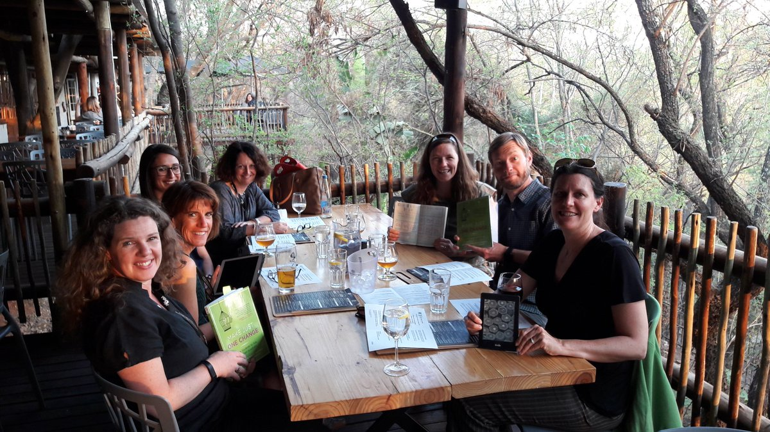
Facilitating book clubs with Make Just One Change

Slide 23
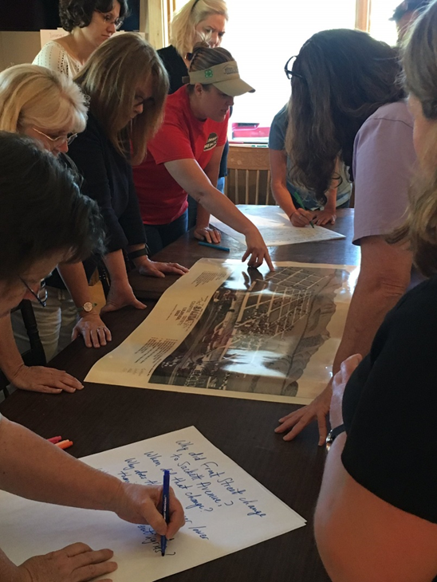
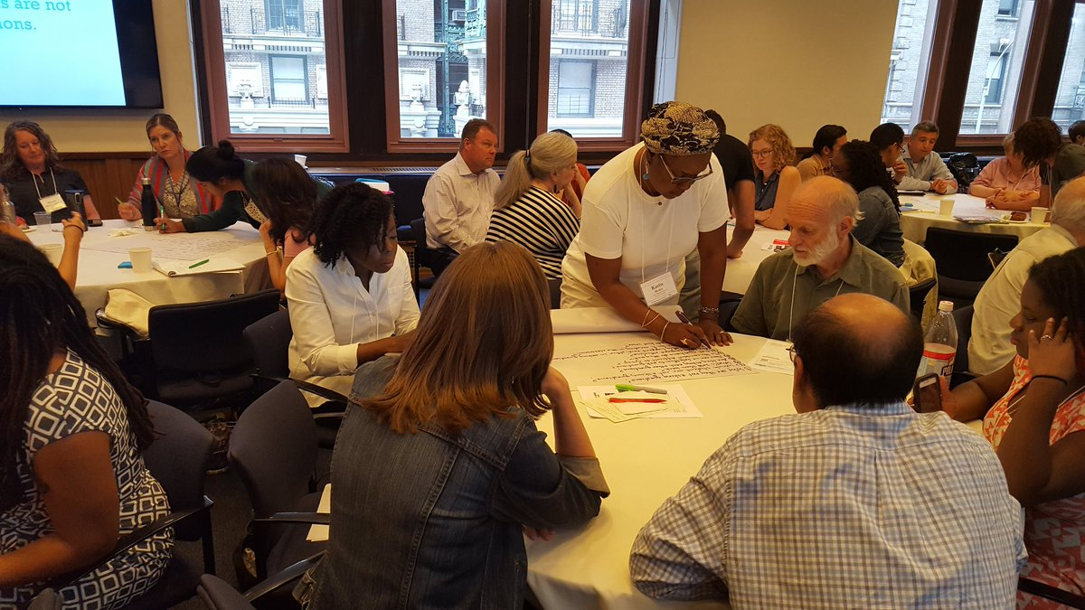
Delivering PD in their departments, schools, and districts
Knee deep in @RightQuestion on a Sunday learning together so that historic places are in the classroom
@TPSMSUDenver @TeachingLC

Slide 24
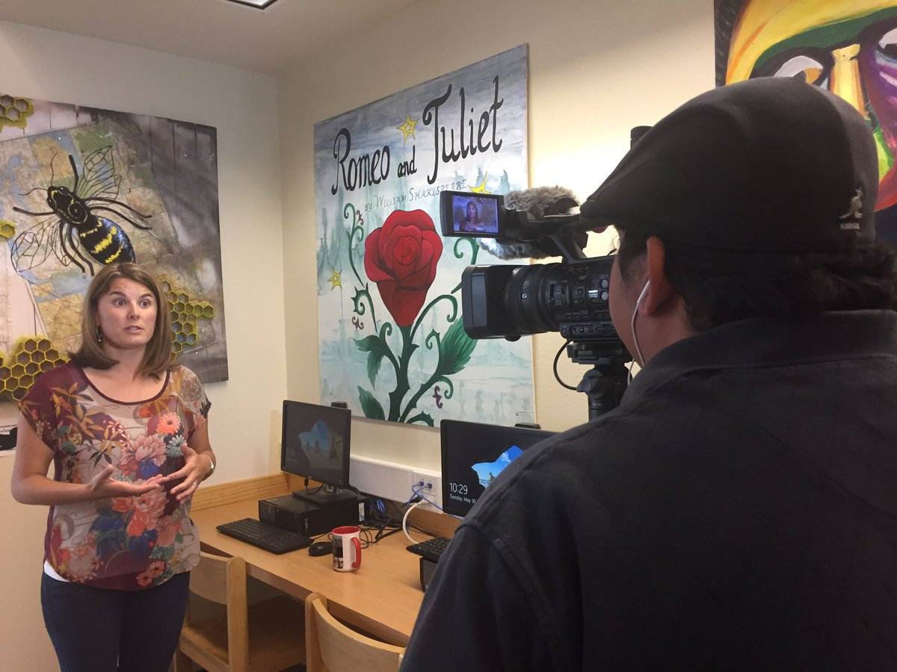
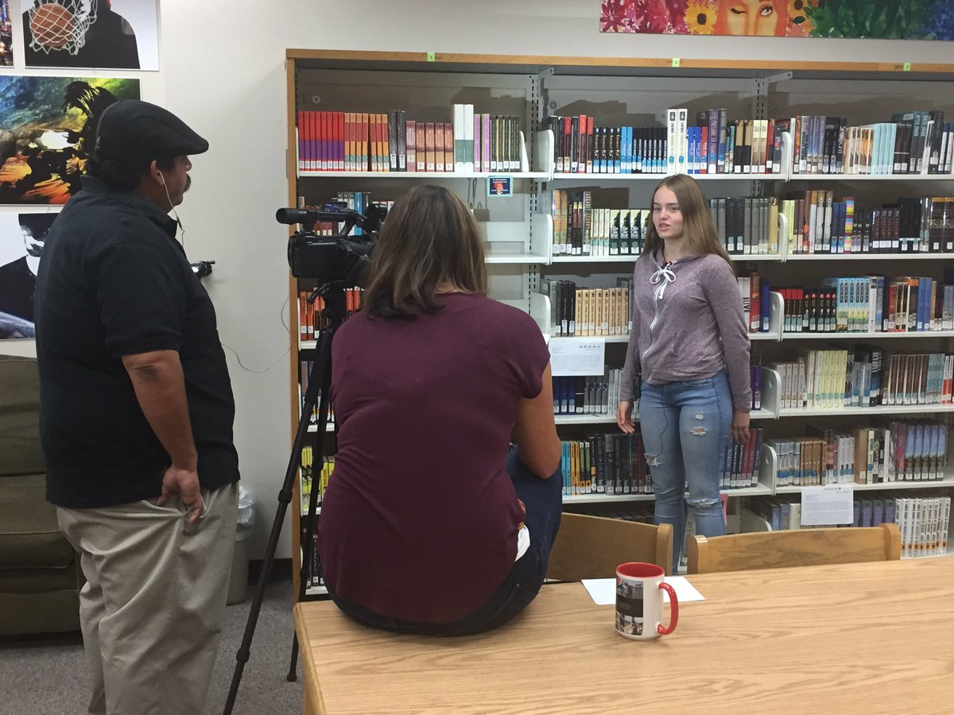
Filming instructional videos & creating online resources ‘[‘;//
That's a wrap! Ss & Ts at @ohs_jackets filmed by @GodoyStudios and interviewed on their experience w/ the #QFT

Slide 25
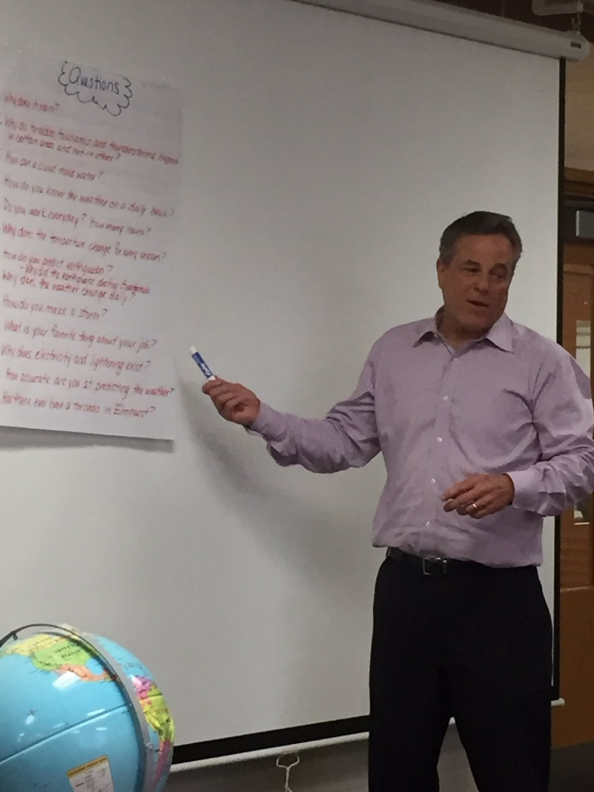
Tweeting QFT examples to school leaders, reporters, authors, and industry leaders…and getting their attention!
Thank you Phil Schwartz from @ABC7Chicago for answering our #QFT questions this morning. @Fischerspirit #d205learns
S. E. Hinton Retweeted Right Question
One of the reasons why teachers are my heroes.
Hi @BillNye As a 7th grade science teacher, I encourage young scientists to question and figure out phenomena! #BillMeetScienceTwitter

Slide 26
Ways to partner with RQI and join a growing community of practice
Here’s what past participants are up to this year:
Sharing lesson and student questions
Writing articles for EdWeek, Teaching Channel, Educational Leadership, ASCA…or creating their own blogs
Presenting at local, state, and national conferences—
Taking on new leadership positions and launching new initiatives
Working to change education policy and re-write standards
Collaborating with RQI on new proposals, projects, articles, grants, and presentations
And…

Slide 27
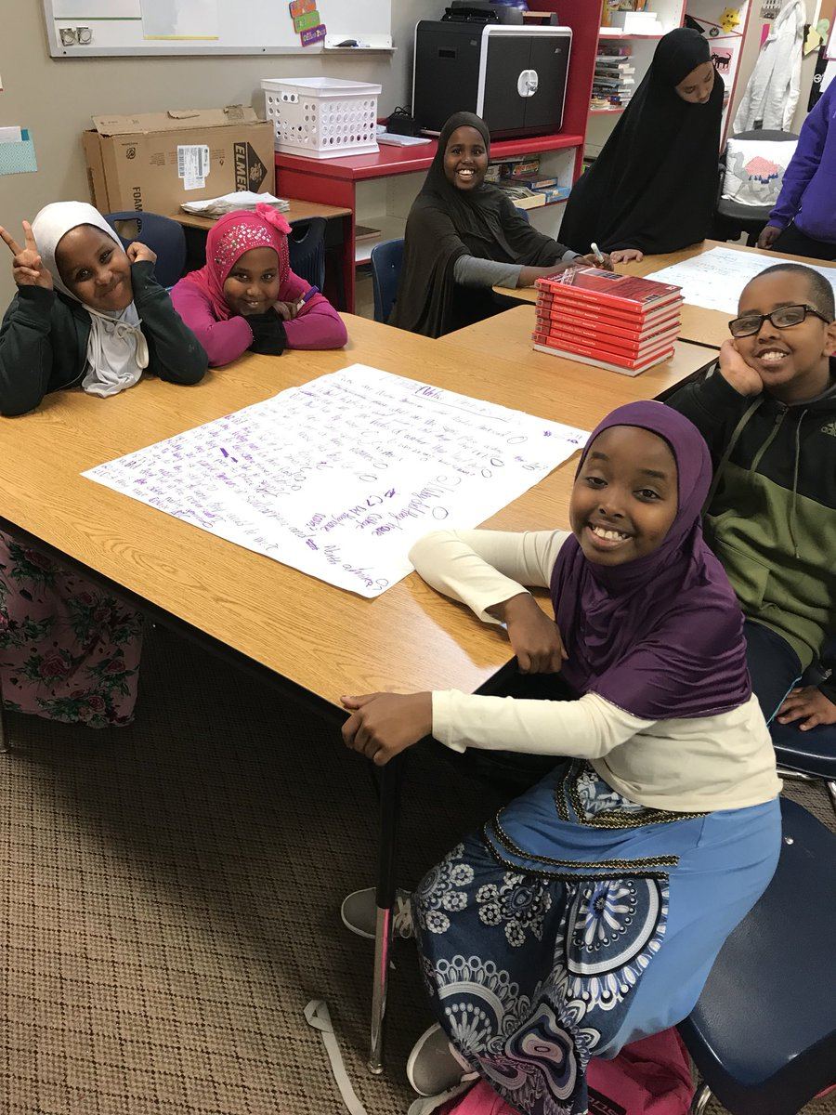
And continuing to do innovative, creative work with students

Slide 28
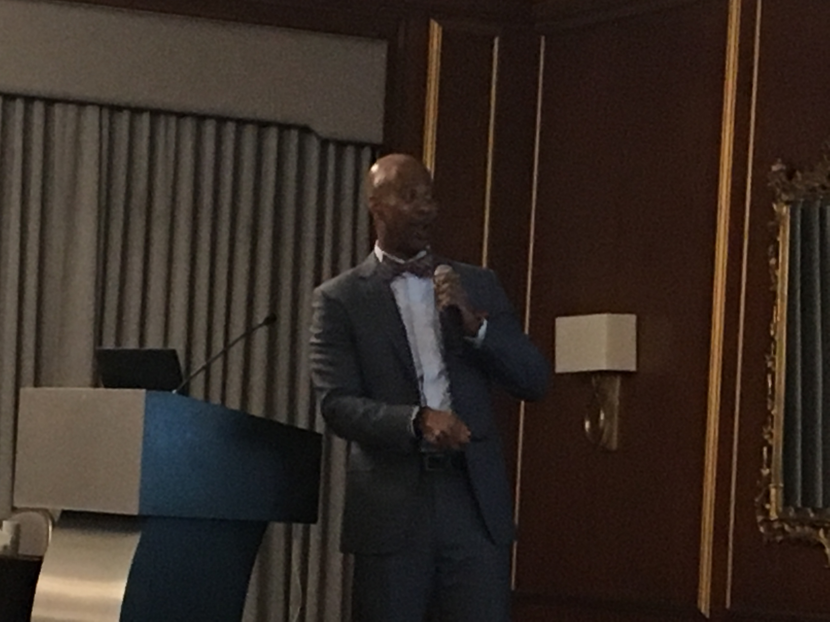
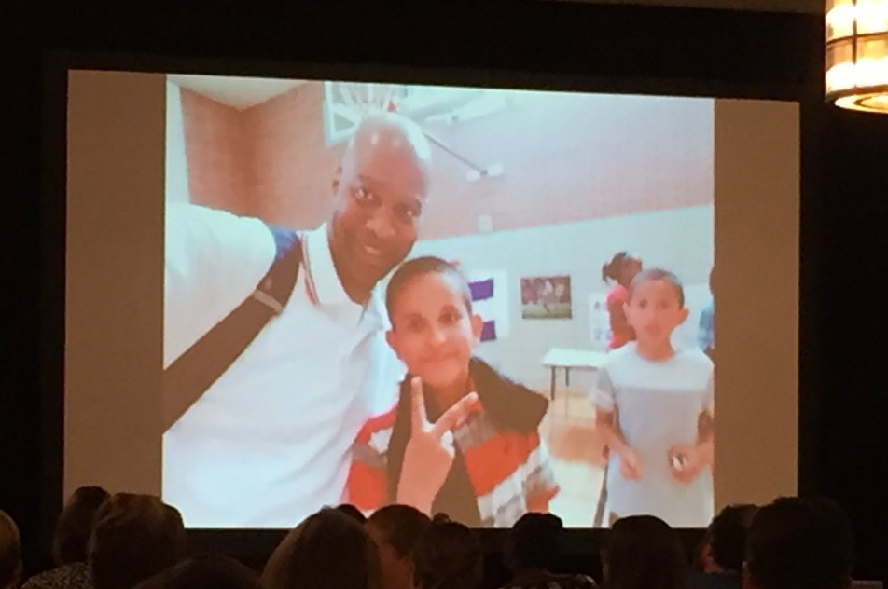
A Growing Community of Practice
The QFT in Action: New Ideas about Questions and Learning

Slide 29
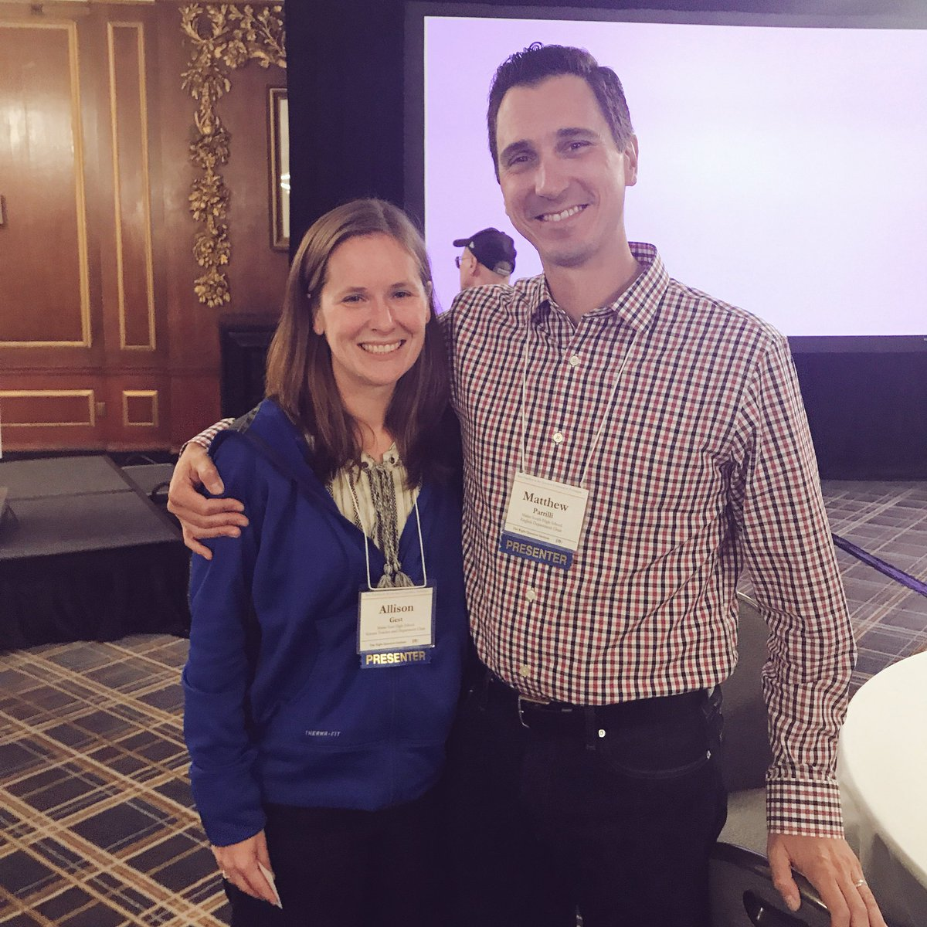
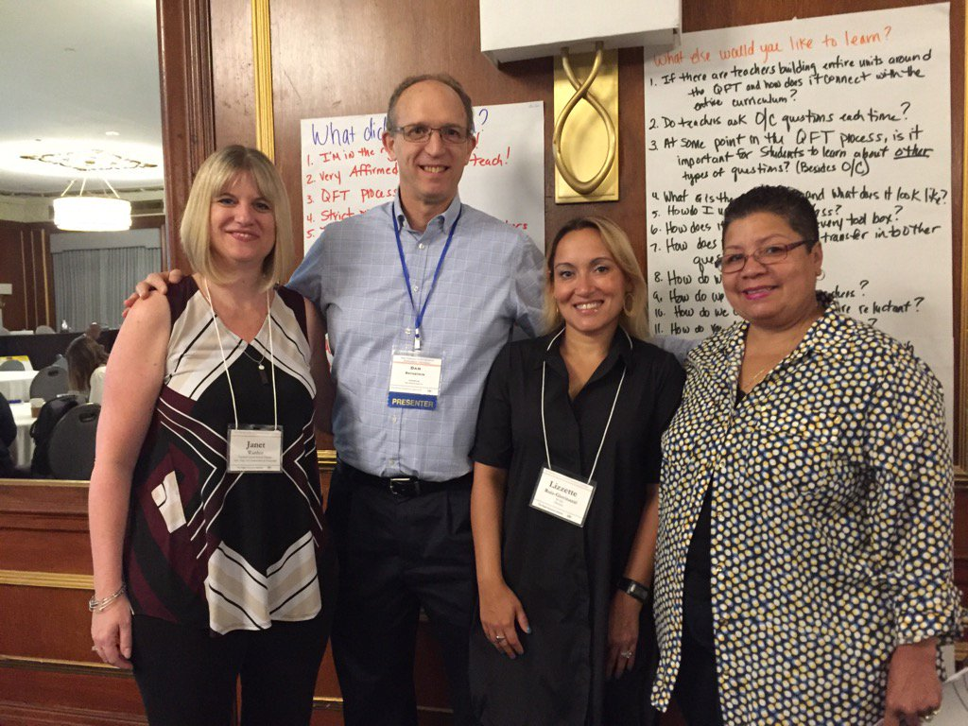
A Growing Community of Practice

Slide 30
…as a two-way street
RQI’s Vision of Professional Learning
RQI’s design of professional learning experiences
Professional implementation & learning
#QFTCon #QFT

Slide 31
Now, Educators Lead the Work
The Right Question Institute offers materials through a Creative Commons License and we encourage you to make use of and/or share this resource. Please reference the Right Question Institute and rightquestion.org as the source on any materials you use.

Slide 32
Planning Your Next Steps
Plan the 3 next steps you will take with the QFT after your work here today.
Pair and Share with someone you haven’t yet worked with today.

Slide 33
Closing Thoughts about a New Model of Learning

Slide 34
Stimulating Curiosity and Enhancing Learning
The Emergence of a
“Working with One’s Own Questions” Model of Learning

Slide 35
How We Define “Working"
Produce
Categorize
Improve
Prioritize
Strategize on use of questions
Reflect
The “working” also requires using three thinking abilities:
Divergent
Convergent
Metacognitive

Slide 36
The Model Consistently Produces Two Outcomes
Greater Knowledge
Greater Curiosity

Slide 37
Greater Knowledge
Greater Curiosity
No Small Matter
There is something significant afoot in education, and beyond, relevant to our “Working with One’s Own Questions” Model of Learning

Slide 38
Research Confirms the Importance of Student Questioning
Self-questioning (metacognitive strategy):
Student formulation of their own questions is one of the most effective metacognitive strategies
Engaging in pre-lesson self-questioning improved students rate of learning by nearly 50% (Hattie, p.193)
John Hattie
Visible Learning: A Synthesis of Over 800
meta-Analyses Relating to Achievement, 2008

Slide 39
Student Questioning Across Disciplines
“Students at any grade level should be able to ask questions of each other about the texts they read, the features of the phenomena they observe, and the conclusions they draw from their models or scientific investigations. For engineering, they should ask questions to define the problem to be solved and to elicit ideas that lead to the constraints and specifications for its solution. (NRC Framework 2012, p. 56)” (p. 1)
National Research Council. (2013). APPENDIX F – Science and Engineering Practices in the NGSS. Next generation science standards: For states, by states.

Slide 40
Student Questioning Across Disciplines
“Questioning is key to student learning.” (p.17)
“Central to a rich social studies experience is the capability for developing questions that can frame and advance an inquiry. ” (p. 24)
National Council for the Social Studies, The College, Career, and Civic Life (C3) Framework for Social Studies State Standards: Guidance for Enhancing the Rigor of K-12 Civics, Economics, Geography, and History (Silver Spring, MD: National Council for the Social Studies, 2013).

Slide 41
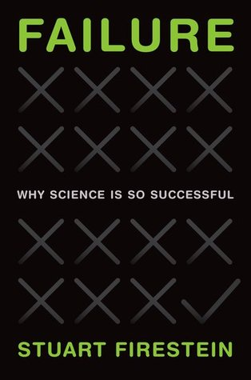

Slide 42
From Technique to Model
We figured out a technique for getting students to formulate their own questions.
In the last five years, educators have used the simple technique in creative and ingenious ways that consistently stimulate curiosity and advance student learning.
Educators’ work with the technique leads us to see more clearly a replicable model of learning that is based on combining student question formulation with teacher creativity.
Notes:
Flows from the recent recognition of the importance of students learning to ask questions

Slide 43
Honoring three sources of this model
LAWRENCE, MA, 1990
“We don’t go to the school because we don’t even know what to ask.”

Slide 44
Honoring the Sources (II)
250,000 Teachers around the world

Slide 45
Honoring the Sources (III)
Millions of students
"Asking questions may not always lead to answers, but it leads to curiosity. Curiosity is what drives children and teens to want to learn, even when they don't realize it...Question asking helps us guide our own adventure and helps us find new interests. Everything starts with a question, even if you don't realize it.”
- Abriana Fusco, 9th Grader, Fitchburg, MA
“When you ask the question, you feel like it’s your job to get the answer.”
- High School student, Boston, MA
“Just when you think you know all you need to know, you ask another question and discover how much more there is to learn.”
- 6th grader, Palo Alto, CA
In response to "why do you think we ask questions?”
“So we can be curious about what we are learning and want to
know more." - Ayaka, 1st Grader, Novi, Michigan

Slide 46
Can we give the model a more scientific name?
, and Ah Ha!
“Working with One’s Own Questions”
Model of Learning
Hmm
, Oomph

Slide 47
Hmm, Oomph, and Ah Ha!
Why is a model for learning that emphasizes student question formulation so important today?

Slide 48
In the Age of Google…
“How should you respond when you get powerful new tools for finding answers?
Think of harder questions.”
Clive Thompson, Journalist and Technology Blogger

Slide 49
Democracy
“We need to be taught to study rather than to believe, to inquire rather than to affirm.” - Septima Clark
See Chapter 6 on Septima Clark in Freedom Road: Adult Education of African Americans (Peterson, 1996).

Slide 50
And now, at the end…
INQUIRY

Slide 51
From the beginning to the end…
We shall not cease from exploration
And the end of all our exploring
Will be to arrive where we started
And know the place
For the first time.
--T.S. Eliot

