Slide 1
Better Questions, Better Decisions:
Building Consensus with the Right Question Strategy
The Asia Society
Global Cities Education Network Symposium
Denver, CO
November 06, 2017
Dan Rothstein
Co-Director
The Right Question Institute

Slide 2

Acknowledgments
We are deeply grateful to the Sir John Templeton Foundation and The Hummingbird Fund for their generous support of the Right Question Institute’s Million Classrooms Campaign.
Thank you to Jessica Kehayes, Heather Singmaster and Heather Loewecke for all the work done to make today’s seminar possible. Thanks especially to Siyi Chu for all the help in preparing the materials for today. And thanks to Andrew Minigan and Tomoko Ouchi for additional support.
@RothsteinDan

Slide 3
"There is no learning without having to pose a question."
- Richard Feynman
Nobel-Prizewinning physicist

Slide 4
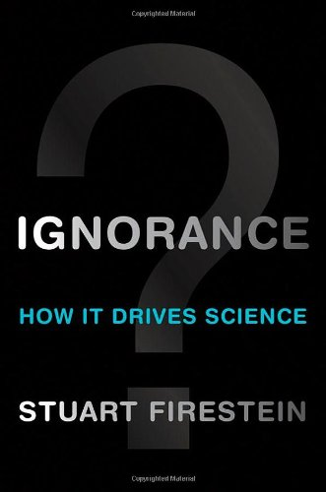
“We must teach students how to think in questions, how to manage ignorance.”
- Stuart Firestein
Chairman of the Department of Biology at Columbia University

Slide 5
College Presidents on What Students Should Learn in College
“The primary skills should be analytical skills of interpretation and inquiry. In other words, know how to frame a question.”
- Leon Botstein, President of Bard College
“…the best we can do for students is have them ask the right questions.”
- Nancy Cantor, Chancellor of University of Illinois
The New York Times, August 4, 2002

Slide 6
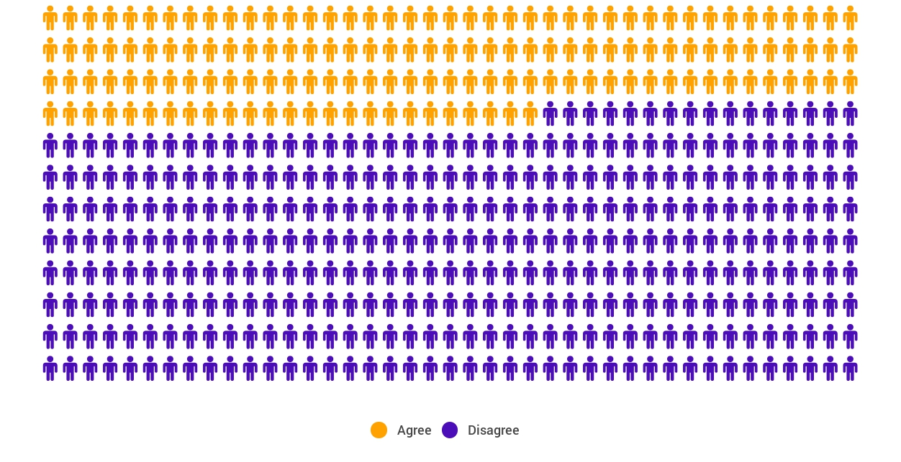
Yet…only 27%of students believe college taught them to ask their own questions
Alison Head, Project Information Literacy at University of Washington, 2016

Slide 7
But, the problem begins long before college...

Slide 8
A 1912 Study
Romiett Stevens, 1912
The Question as a Measure of Efficiency in Instruction: A critical study of classroom practice. Columbia University Contributions to Education, No. 48
“An unusual lesson because twenty-five of the thirty-four questions were asked by the pupils.…The result was that the lesson developed an impetus born of real interest. I mention it because this lesson was unique in the series of one hundred.”

Slide 9
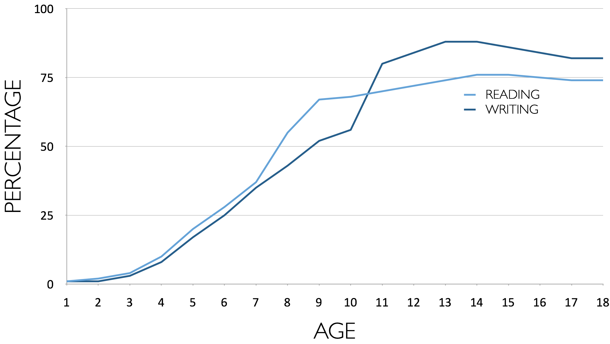
Percentage of Basic Skill Attainment
Sources
http://nces.ed.gov/nationsreportcard/pdf/main2009/2011455.pdf
http://nces.ed.gov/nationsreportcard/pubs/main2007/2008468.asp#section1
Data on question-asking based on parent and teacher feedback

Slide 10
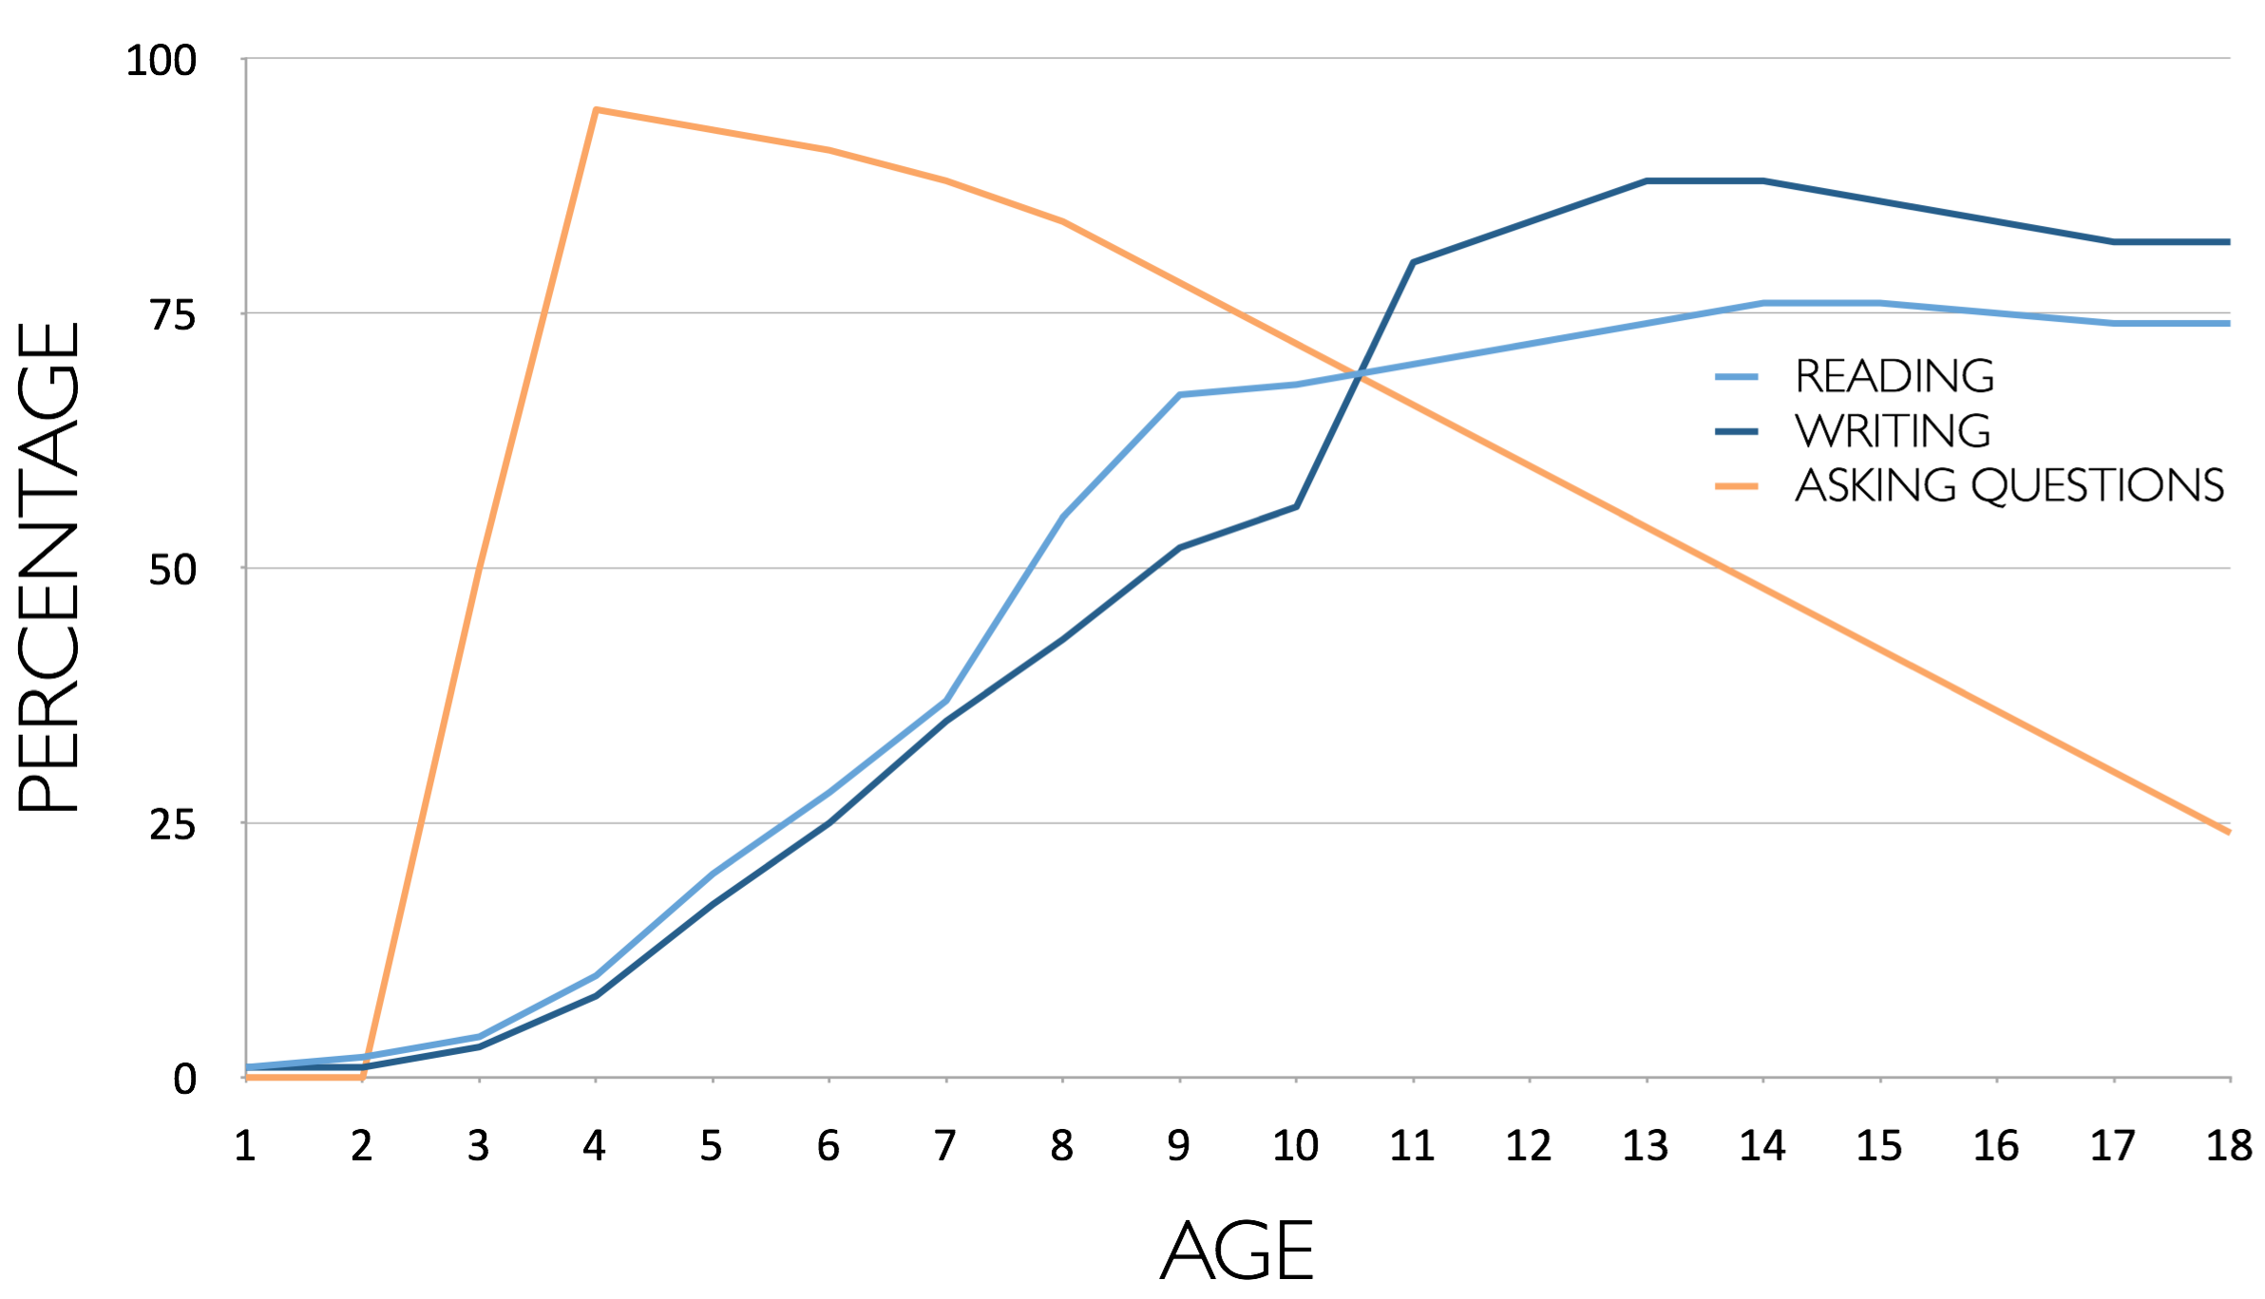
Percentage of Basic Skill Attainment
Sources
http://nces.ed.gov/nationsreportcard/pdf/main2009/2011455.pdf
http://nces.ed.gov/nationsreportcard/pubs/main2007/2008468.asp#section1
Data on question-asking based on parent and teacher feedback

Slide 11
Using Questions to Build Consensus

Slide 12
Imagine you just have been to a conference and you want your district, school, department, colleagues to make a change based on a practice you learned at the conference.

Slide 13
Why spend time asking questions when introducing a change?
Because when you introduce a change the questions are going to be asked anyways, but you just may not hear them.

Slide 14
The Right Question Strategy
Core components of the strategy:
  The Question Formulation Technique (QFT)
  The Framework for Accountable Decision-Making

Slide 15
The QFT
A rigorous step-by-step process to:
  Produce many questions
  Improve the questions
  Strategize on how to use the questions

Slide 16
The Framework For Accountable Decision Making
Identifying decisions and using a set of criteria to participate more effectively in decisions.

Slide 17
Definition of a Decision
The selection of one option from among two or more options.

Slide 18
What are examples of decisions embedded in this statement?
Student discipline practices at the high school will be reviewed by a committee appointed by the superintendent.
由区教委会长指定的委员会即将对高中学生纪律管理方式进行审查。
「高校生の学内での生活態度、規律の指導方法について、教育委員長が設置する委員会によって見直し、検討される。」

Slide 19
Examples of Decisions
Student discipline practices at the high school will be reviewed by a committee appointed by the superintendent.

Slide 20
The Framework for Accountable Decision-Making
When decisions are made it is important to focus on:
REASONS - the basis for a decision.
PROCESS - the steps and actions taken, people involved, and information used in making the decision.
ROLE - the part you play/ the part the people affected by the decision play in the decision-making process.

Slide 21


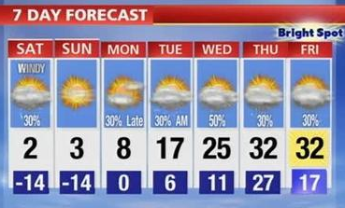

We make decisions every day
Consider the REASONS, the PROCESS and the ROLE you played in getting dressed this morning.

Slide 22
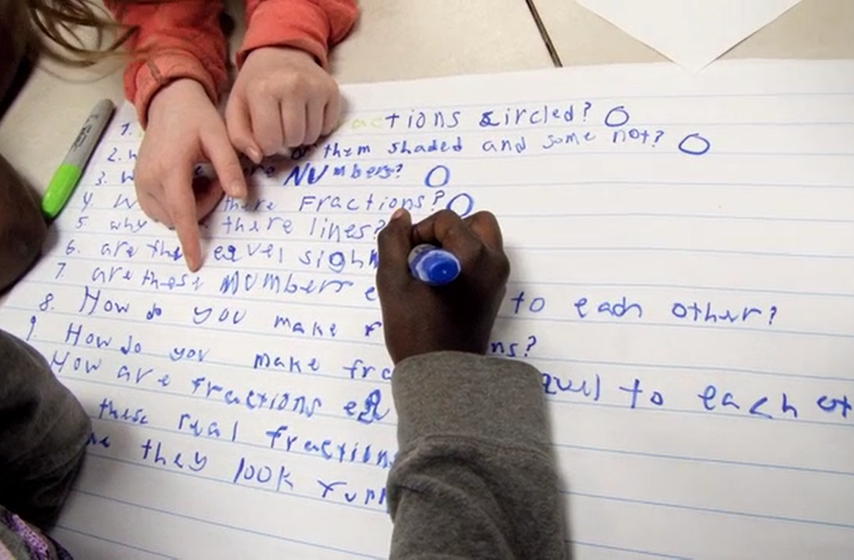
Working on a Challenge by Using the Right Question Strategy

Slide 23
Rules for Producing Questions
1. Ask as many questions as you can
2. Do not stop to answer, judge, or discuss
3. Write down every question exactly as stated
4. Change any statements into questions

Slide 24
Producing Questions
Ask Questions
Follow the Rules
      Ask as many questions as you can.
      Do not stop to answer, judge, or discuss.
      Write down every question exactly as it was stated.
      Change any statements into questions.
Number the Questions

Slide 25
Question Focus (QFocus)
Instructional practices in your school/district will be changed next year to improve educational outcomes.
为了改善教育成果，您所在学校/学区的教学实践方式将在明年被改变。
「教育の成果を向上するため、来年から学区/学校での教え方が変更される。」

Slide 26
Find two questions that will help you learn about the REASONS for the decision
  The basis
  Policies
  Standards, regulations
Ask a new question if you don’t have one
Rationale: Why is the question you chose about the reasons?

Slide 27
Find two questions that will help you learn about the Process for the decision
  Information used
  Steps taken; meetings held;
  protocols used, place, time
  People involved
Ask a new question if you don’t have one
Rationale: Why is the question you chose about the Process?

Slide 28
Find two questions that will help you learn about your ROLE/the ROLE of the people affected by the decision
  What you/the people
  affected can do to
  influence the decision
  What is expected of you/the people affected in this decision
Ask a new question if you don’t have one
Rationale: Why is the question you chose about the reasons?

Slide 29
Prioritizing Questions
Review your list of questions
Choose three questions you think teachers would like answered immediately:
Instructional practices in your school/district will be changed next year to improve educational outcomes.

Slide 30
Prioritizing Questions
After prioritizing, consider…
  Why did you choose those three questions?
  Where are your priority questions in the sequence of your entire list of questions?

Slide 31
Next Steps
From priority questions to action plan
In order to answer your priority questions:
    what do you need to know? INFORMATION
    what do you need to do? TASKS

Slide 32
Share
Your three priority questions.
What you will do with the questions?

Slide 33
Reflection
What did you learn?
How did you learn it?
How can you use what you learned?

Slide 34
The Right Question Strategy
The Question Formulation Technique (QFT)
Producing, improving and strategizing on how to use questions
The Framework for Accountable Decision-Making (FADM)
  Identifying decisions
  Asking questions about reasons, process, and role

Slide 35
Unpacking the
Right Question Strategy

Slide 36
Curiosity and Rigor
  Three thinking abilities
  with one process

Slide 37
Thinking in many different directions
DIVERGENT
THINKING

Slide 38
Narrowing Down, Focusing
CONVERGENT
THINKING

Slide 39
The Importance of Questions
"Questions are the engines of intellect, the cerebral machines which convert energy to motion, and curiosity to controlled inquiry."
- David Hackett Fischer,
Historians' fallacies: Toward a logic of historical thought.
Routledge and Kegan Paul, 1971.
“[The QFT] helps me by getting me to think about questions on my own…it gets my mind
in motion to think about the questions other people make."
- 8th grade student in James Brewster’s U.S. history class
Gus Garcia Young Men’s Leadership Academy, Austin, TX, 2015

Slide 40

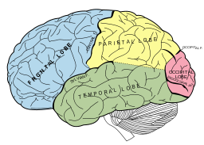
Thinking about Thinking
METACOGNITIVE
THINKING

Slide 41
Summary of the
Right Question Strategy
The Question Formulation Technique (QFT)
  1. A Question Focus
  2. Rules for Producing Questions
  3. Producing Questions
  4. Categorizing Questions
  5. Prioritizing Questions
  6. Next Steps
  7. Reflection
The Framework for Accountable Decision-Making (FADM)
  1. Identifying Decisions
  2. Asking Questions About Reason, Process, and Role

Slide 42
Accountable Decision-Making and Democratic Principles
In a democracy, we should expect and require that all decisions are guided by the following criteria.
  Legitimacy: The decisions are based on policies, standards, rules that are fairly applied.
  Transparency: The process used to make the decision is visible to all.
  Opportunities for participation: There is a role in the decision making process for the individual affected by the decision.

Slide 43
The Three Criteria Correspond to Key Democratic Principles:
Legitimacy
Transparency
Opportunities for participation
Reason
Process
Role

Slide 44
Example of the Right Question Strategy Used for School Change
Middle School - Medfield, MA
Overview
Outcomes
Purpose:
Use QFT to step back and analyze with staff the problem of student homework, which they had a focus group working
QFocus:
Homework practices are inconsistent at Blake
  Homework practices vary at Blake
“The conversations that took place resulting from the process were rich, meaningful, and productive. The simple process provided a non-judgmental structure to address a significant ‘issue' in our school and led us to a position of recognizing and embracing a need for change.”
~ Nat Vaughn, Principal

Slide 45
Final Thoughts

Slide 46

To Access Today’s Materials
http://rightquestion.org/educators/
seminar-resources/
The Right Question Institute offers our materials through a Creative Commons License and we encourage you to make use of and/or share this resource. Please reference the Right Question Institute and rightquestion.org as the source on any materials you use.

Slide 47
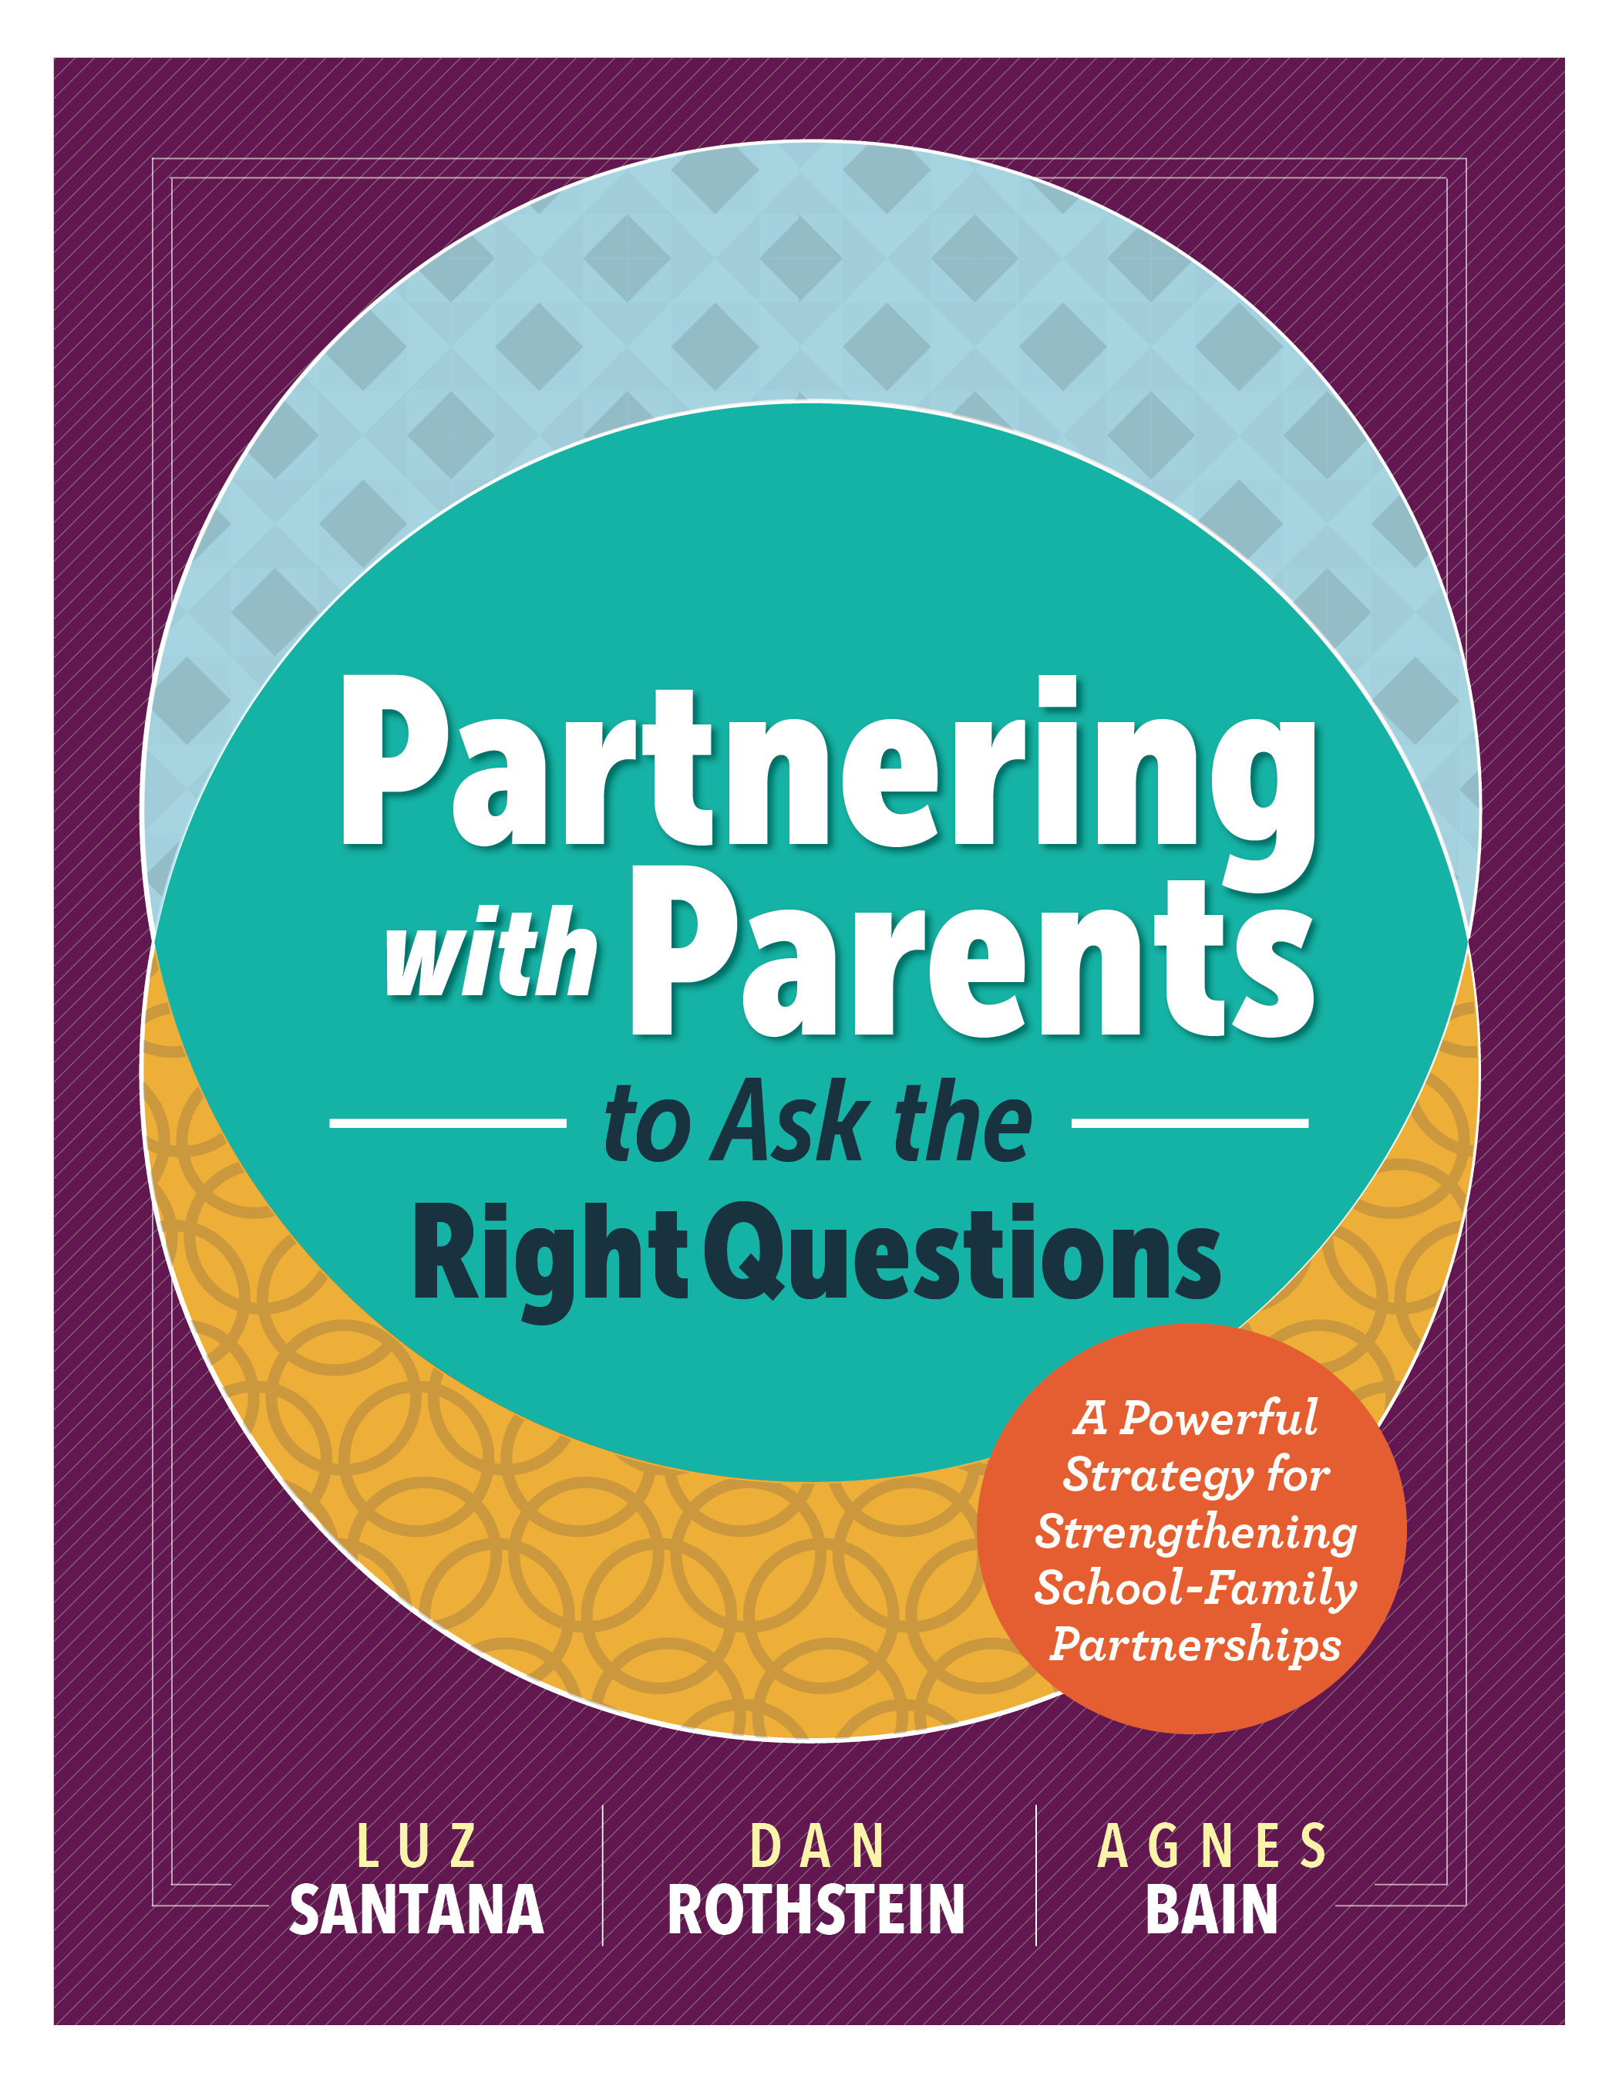
Some Additional Resources
Partnering with Parents to Ask the Right Questions, ASCD (2016)
See Chapter 5, Partnering to Increase Equity Through District-Initiated Change, for detailed examples of how the Right Questions Strategy engages parents to participate in decisions that affect them.

