Slide 1
Welcome to the Webinar: “Asking Questions in the Age of Google” Tuesday, November 14, 2017 3 p.m. ET / noon PT Presented by:

Slide 2
Presenters
John Sessler
Educator and Consultant
The Right Question Institute
Connie Williams
National Board Certified
Teacher Librarian

Slide 3
LAWRENCE, MA, 1990
“We don’t go to the school because we don’t even know what to ask.”

Slide 4
Educators Leading the Work
250,000 educators are using the strategy around the world.

Slide 5
Access Materials
The Right Question Institute offers materials through a Creative Commons License and we encourage you to make use of and/or share this resource. Access materials at rightquestion.org.
We are deeply grateful to the Sir John Templeton Foundation for their generous support of the Million Classrooms Campaign.

Slide 6
In the Age of Google…
“How should you respond when you get powerful new tools for finding answers?
Think of harder questions.”
Clive Thompson, Journalist and Technology Blogger

Slide 7
College Presidents on What Students Should Learn in College
“The primary skills should be analytical skills of interpretation and inquiry. In other words, know how to frame a question.”
- Leon Botstein, President of Bard College
“…the best we can do for students is have them ask the right questions.”
- Nancy Cantor, Chancellor of University of Illinois
The New York Times, August 4, 2002

Slide 8
Yet…only 27%of students believe college taught them to ask their own questions
Alison Head, Project Information Literacy at University of Washington, 2016

Slide 9
But, the problem begins long before college...

Slide 10
Percentage of Basic Skill Attainment
Sources
http://nces.ed.gov/nationsreportcard/pdf/main2009/2011455.pdf
http://nces.ed.gov/nationsreportcard/pubs/main2007/2008468.asp#section1
Data on question-asking based on parent and teacher feedback

Slide 11
Percentage of Basic Skill Attainment
Sources
http://nces.ed.gov/nationsreportcard/pdf/main2009/2011455.pdf
http://nces.ed.gov/nationsreportcard/pubs/main2007/2008468.asp#section1
Data on question-asking based on parent and teacher feedback

Slide 12
The Question Formulation Technique (QFT)
Students learn to:
Produce their own questions
Improve their questions
Strategize on how to use their questions
Reflect on what they have learned and how they learned it

Slide 13
Experience the Question Formulation Technique (QFT)

Slide 14
Rules for Producing Questions
1. Ask as many questions as you can
2. Do not stop to answer, judge, or discuss
3. Write down every question exactly as stated
4. Change any statements into questions

Slide 15
Question Focus:
In the digital age, some students are not asking questions.

Slide 16
Categorizing Questions: Closed/ Open
Definitions:
Closed-ended questions can be answered with a “yes” or “no” or with a one-word answer.
Open-ended questions require
more explanation.
Directions: Identify your questions as closed-ended or open-ended by marking them with a “C” or an “O.”

Slide 17
Discussion
Closed-ended Questions
Advantages
Disadvantages

Slide 18
Discussion
Open-ended Questions
Advantages
Disadvantages

Slide 19
Improving Questions
Take one closed-ended question and change it into an open-ended question.
Take one open-ended question and change it into a closed-ended question.
Closed
Open
Open
Closed

Slide 20
Strategize: Prioritizing Questions
Review your list of questions
Choose one question you consider most important.
While prioritizing, think about the Question Focus: In the digital age, some students are not asking questions.
After prioritizing consider…
Why did you choose the question?
Where is your priority question in the sequence of your entire list of questions?

Slide 21
Reflection
What did you learn?
How did you learn it?
What do you understand differently now about some students not asking questions in the digital age?

Slide 22
The QFT, on one slide…
Question Focus
Produce Your Questions
Follow the rules
Number your questions
Improve Your Questions
Categorize questions as Closed or Open-ended
Change questions from one type to another
Prioritize Your Questions
Share & Discuss Next Steps
Reflect
Ask as many questions as you can
Do not stop to discuss, judge or answer
Record exactly as stated
Change statements into questions
Closed-Ended:
Answered with “yes,” “no” or one word
Open-Ended: Require longer explanation

Slide 23
Curiosity and Rigor
Three thinking abilities
with one process

Slide 24
Thinking in Many Different Directions
DIVERGENT THINKING

Slide 25
Narrowing Down, Focusing
CONVERGENT
THINKING

Slide 26
Thinking about Thinking
METACOGNITIVE
THINKING

Slide 27
Research Confirms the Importance of Student Questioning
Self-questioning (metacognitive strategy):
Student formulation of their own questions is one of the most effective metacognitive strategies
Engaging in pre-lesson self-questioning improved students rate of learning by nearly 50% (Hattie, p.193)
John Hattie
Visible Learning: A Synthesis of Over 800
meta-Analyses Relating to Achievement, 2008

Slide 28
Student Reflections
“Just when you think you know all you need to know, you ask another question and discover how much more there is to learn.”
~ Sixth-grade student
“Asking questions is important because it opens up discussions and debate about issues.”
~ High School student

Slide 29
The QFT and Information Literacy

Slide 30
Inquiry asks a question – Research answers it
Research is a process –
to know and understand the steps needed to answer our questions.
NASA.gov

Slide 31
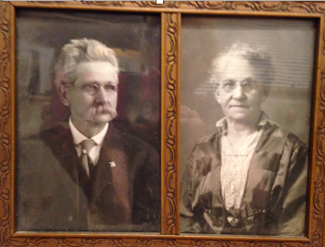
Common Core
Next Gen Science
ALL the standards address the
same two things:
A call to action/participation
Students asking questions
https://pixabay.com/p-2085589/?no_redirect
National School Library
Standards
C3 Framework

Slide 32
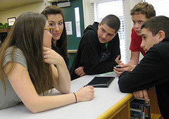
How do I incorporate
this into my classroom without impacting my curriculum?

Slide 33
Research Is a Process
Research comes out of an information need.
We encounter information needs all the time.
We research to a question not a statement.

Slide 34
Inquiry Is a Process
The only way to help kids want to complete the research questions you have assigned...
is to help them create their own compelling questions.
We utilize inquiry questions all the time:
What movie should we see today?
What computer [bike, phone] should I buy?
How will I complete all my homework on time?
What do I need to do in order to get to college?
Who are the 3 most influential authors of the 20th Century?
Turning information need statements:
I want to go to Iceland
into questions, allows us to take steps to
completing the task.

Slide 35
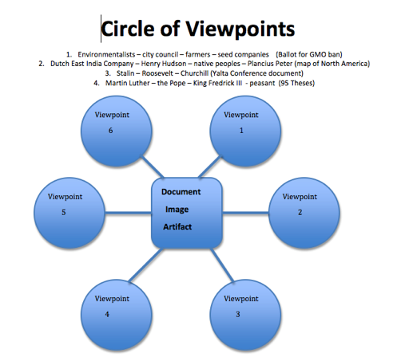
Researching and Interpreting Multiple Perspectives
Adapted from Visible Thinking: Harvard Project Zero

Slide 36
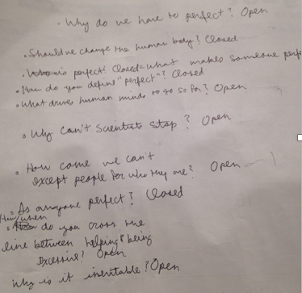
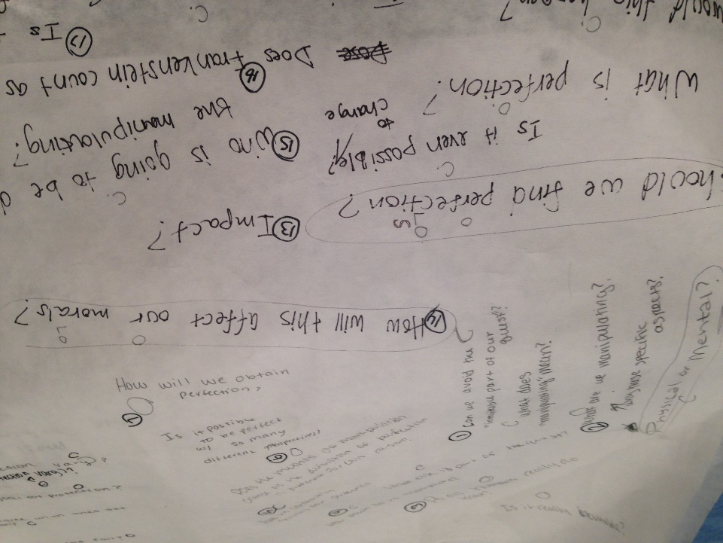
Beginning of a Unit
QFocus: Genetic engineering strives for perfection.
Purpose: Preparing students to read Frankenstein

Slide 37
Middle of a Unit
Working through a unit: Stop for a moment. Take stock. Make connections.
QFocus: Event A and Event G appear to be related.
1898 Seneca Falls Convention
1868 14th Amendment
1870 15th Amendment
1913 16th Amendment
1920 19th Amendment
1913 17th Amendment
1919 18th Amendment
A
B
C
D
E
F
G

Slide 38
End of a Unit
What questions should be on the test? Why?
Unpack a document or image: Ask questions then answer them using research skills.
Give students a task. Include the questioning process as part of the assessment.

Slide 39
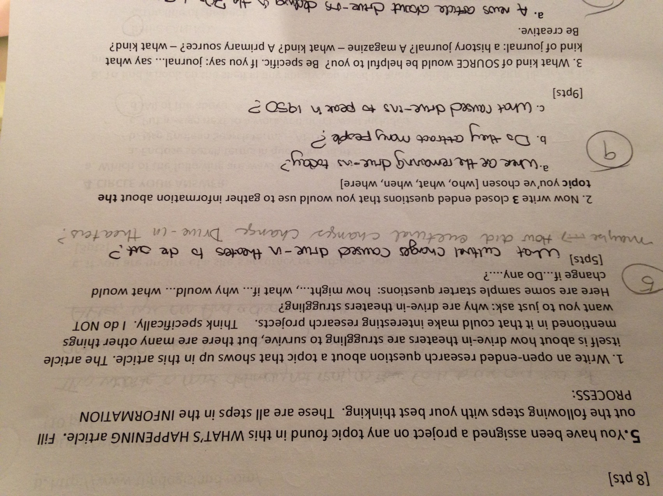
Quick Assessment

Slide 40
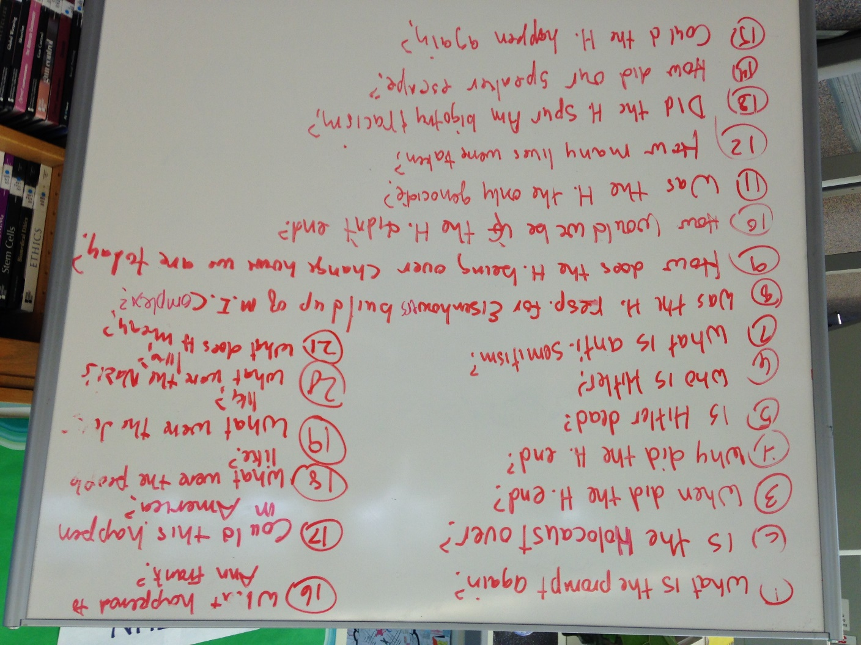
Question Building Before an Event (speakers, plays, field trips, etc.)
QFocus:
The Holocaust is still with us.
Learning Goal:
Besides filling unexpected time…
To create a series of questions in preparation
for our speaker on Surviving the Holocaust
QFT priority questions:
All are priority.

Slide 41
Classroom and Library Examples

Slide 42
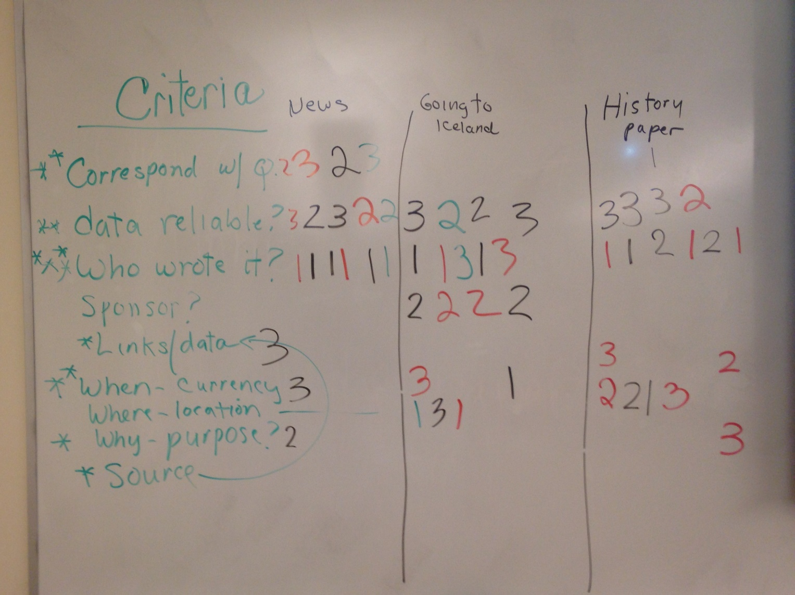
Classroom Example: High School/College Info Lit.
QFocus: I want to go to Iceland.
Learning Goal: To understand how different sources are used for different information needs.
Priority Questions: To develop the questions (criteria) that all could agree are the most important in determining which source to use when searching for information.

Slide 43
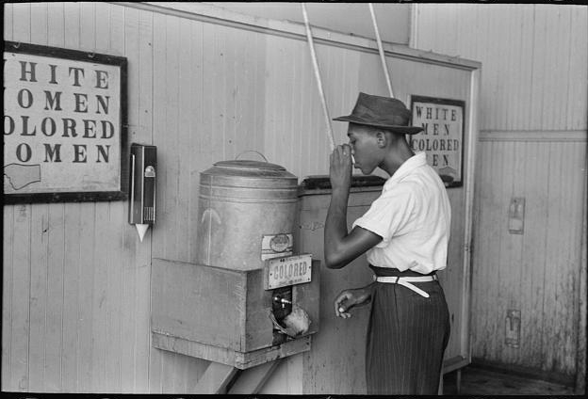
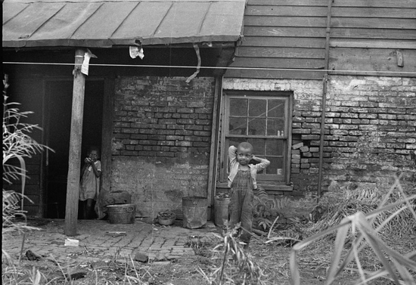
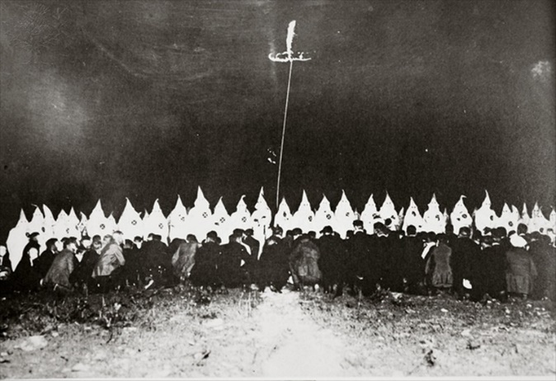
Classroom Example: High School English
QFocus: Choose an image.
Learning Goal: To create a context for the social background of To Kill a Mockingbird
Priority Questions: Choose the questions that interest you.

Slide 44
Classroom Example: High School Health Class
QFocus: Sending or receiving a sexually suggestive text or image under the age of 18 is considered child pornography and can result in criminal charges.
Learning Goal: To understand the many ramifications of sexting – legal, social, and personal.
Priority Questions: Choose a research question.
Task: Based on your research question, create a poster to hang in the health clinic for tweens and teens.

Slide 45
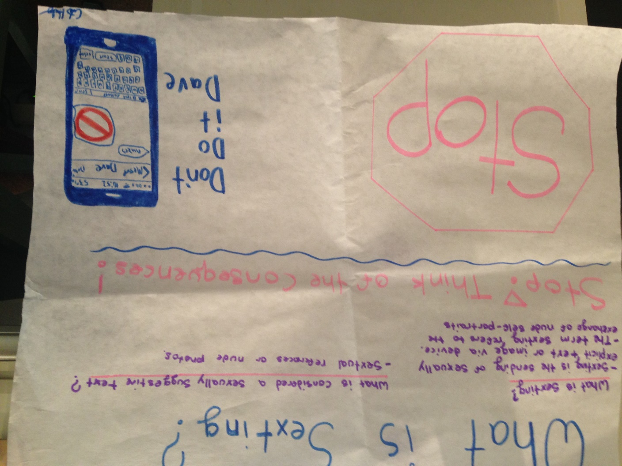
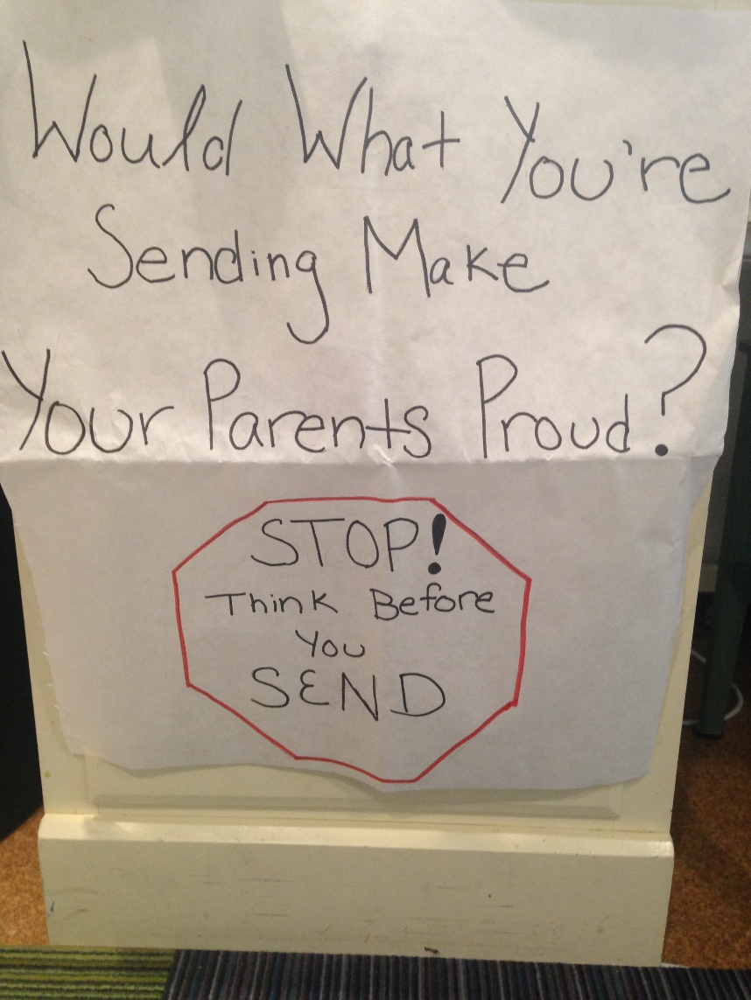
Student Posters

Slide 46
If you get stuck in your research…
Go back to your question

Slide 47
Teaching Students to Think in Questions
Post the QFT rules and use them as ‘touchstones.’
Create a place for questions to be written and answered. “Seed” it with your own questions.
Post question starters around the room:
How might…? I wonder…
What might have...? What if...?
Why did...? What is the importance of...?
If____, then....

Slide 48
The Skill of Asking Questions
For moving from ignorance as weakness to ignorance as opportunity
For arriving at better answers (and more questions)
For increasing engagement and ownership
For demonstrating inquiry in the classroom
For a little more joy in a very demanding profession
And…

Slide 49
Democracy
“We need to be taught to study rather than to believe, to inquire rather than to affirm.” - Septima Clark
See Chapter 6 on Septima Clark in Freedom Road: Adult Education of African Americans (Peterson, 1996).

Slide 50
Thank you!
Join the RQI Educator Network to access:
Templates you can use tomorrow in class
Classroom examples
Instructional videos
Forums and discussions with other educators
http://rightquestion.org/
http://rightquestion.org/educators/seminar-resources/

