Slide 1
Tomoko Ouchi International Program Specialist
Integrating the QFT into Your Work with STEM Students
2017 Massachusetts STEM Summit
DCU Center Worcester, MA
Sarah Westbrook
Director of Professional Learning
The Right Question Institute
Cambridge, MA
Kathy Shay
STEM teacher, Duxbury, MA

Slide 2
Who is in the room?

Slide 3
Our Objectives
Leave with new ideas and a better sense of:
Planning a lesson or session with the QFT
How you might use student questions
Trouble-shooting & revising QFocus Design
Begin planning your own lesson
Get feedback from others at your table
Ask questions & connect to additional resources

Slide 4
To Access Today’s Materials:
http://rightquestion.org/educators/
seminar-resources/
Join our Educator Network for:
Templates you can use tomorrow in class
Classroom Examples
Instructional Videos
Forums and Discussions with other Educators

Slide 5
We’re Tweeting…
@RightQuestion
#QFT #MASTEMSummit

Slide 6
The QFT, on one slide…
Question Focus
Produce Your Questions
Follow the rules
Number your questions
Improve Your Questions
Categorize questions as Closed or Open-ended
Change questions from one type to another
Prioritize Your Questions
Share & Discuss Next Steps
Reflect
Ask as many questions as you can
Do not stop to discuss, judge or answer
Record exactly as stated
Change statements into questions
Closed-Ended:
Answered with “yes,” “no” or one word
Open-Ended: Require longer explanation

Slide 7
QFT: An ART and a SCIENCE
The Science:
A rigorous protocol, with specific steps and sequence, that produces consistent results
The QFT
Discuss the rules
Present a Question Focus
Improve questions
Prioritize questions
Discuss next steps
Reflect

Slide 8
QFT: An ART and a SCIENCE
The Art:
Tailoring the QFT process to the specific content and students you are teaching.
Tailor the QFT through:
Design of the Question Focus (Qfocus)
Instructions for prioritizing
Next steps for using the questions
Reflection questions
Facilitation

Slide 9
Five Areas Related to the Art of the QFT
Linking the QFT to Teaching and Learning Goals
QFocus Design
Prioritization Instructions
Reflection Questions
Facilitation

Slide 10
The QFT as a Shortcut, Not a Detour

Slide 11
Various Teaching Purposes
Engagement
Knowledge acquisition
Formative assessment
Summative assessment
Peer review
Skill development

Slide 12
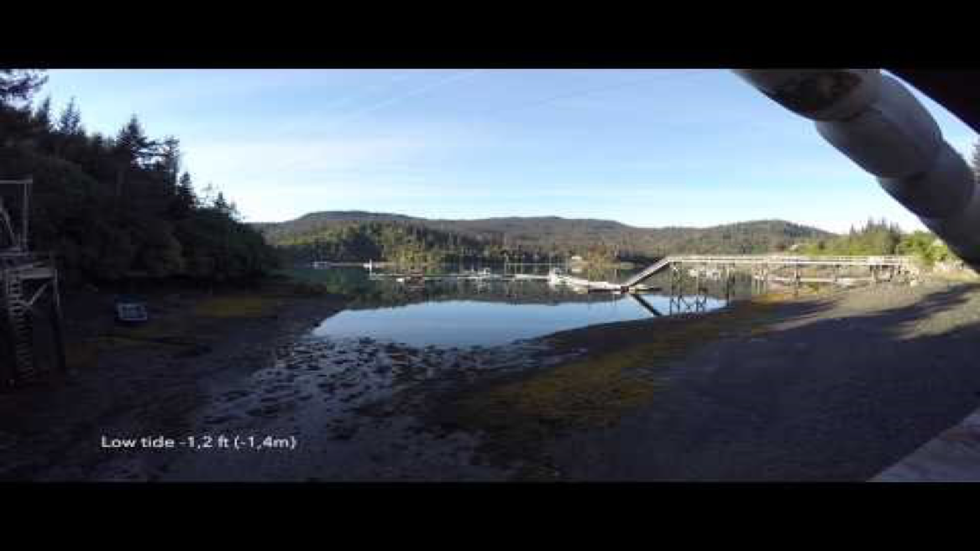
Using the QFT for Engagement
Nicole Bolduc, Ellington, CT

Slide 13
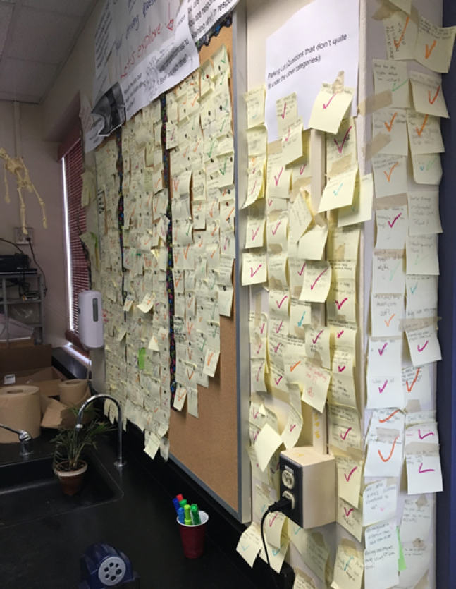
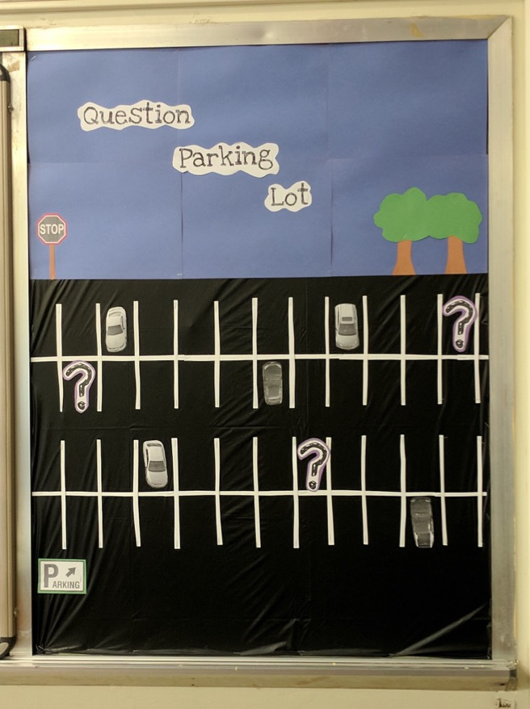
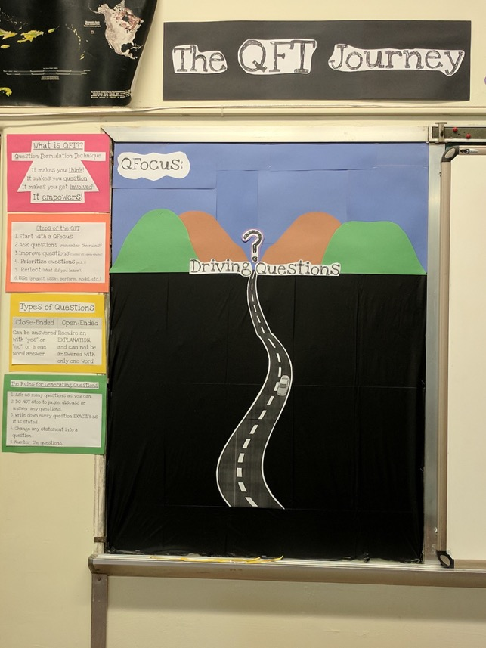
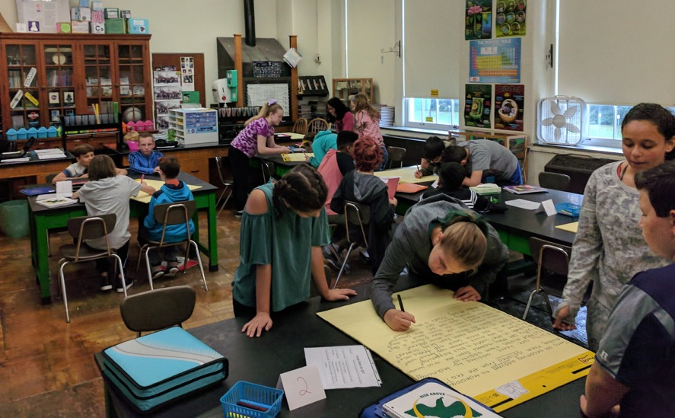
Next Steps with Student Questions
The Driving Question Board
The “Parking Lot”
Ongoing student choice projects

Slide 14
Using the QFT for Knowledge Acquisition
QFocus:
Debate Resolve:
Doctors should be able to do what they want with human tissue after the patient gives consent for removal of the tissue.
Ellen Gammel, Fitchburg, MA

Slide 15
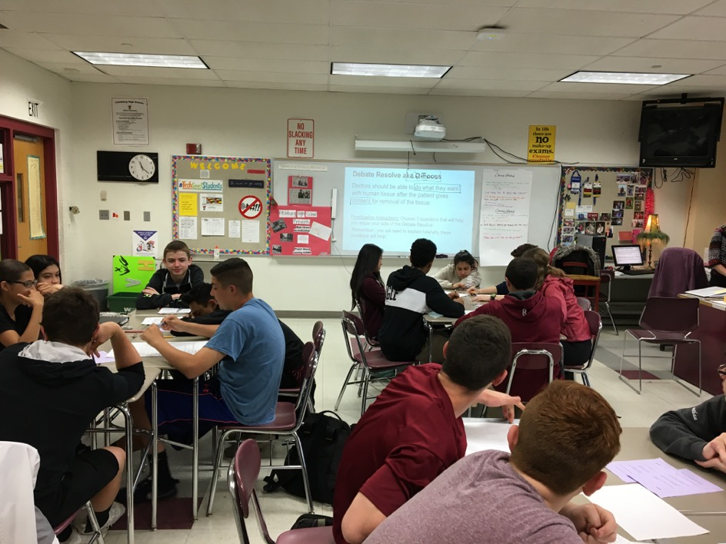
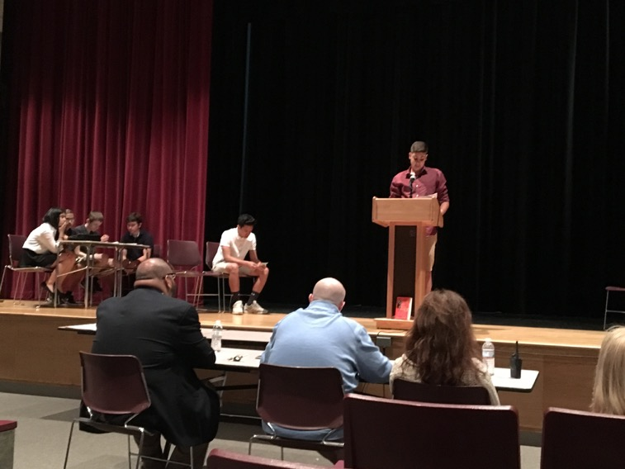
Next Steps with Student Questions

Slide 16
Using the QFT for Formative Assessment & Engagement
Kathy Shay, Duxbury, MA

Slide 17
Next Steps with Student Questions
Why is STEM important in the world?
What does STEM stand for?
Why are the letters color-coded?
What does each symbol represent?
What is the connection between science, technology, engineering and math?
What are we doing in STEM?
Does the symbol in the blue box represent an atom?
Why is STEM spelled STEM instead of something like METS?
Who invented the combination of Science, Tech, Engineering and Math
Do the letters have anything to do with the colors?
What does the purple sphere have to do with the T in STEM?
What is the sphere in the grid?

Slide 18
Using the QFT for a Guest Speaker
Kathy Shay, Duxbury, MA

Slide 19
Next Steps with Student Questions
Priority Questions:
How hard was it to build a real geodesic dome?
What kind of weather did you have in the arctic circle/South Pole?
How insulated were the clothes you had to wear while building it?
How does the dome not collapse in such harsh conditions?
What does a Navy civil engineer do?
How is it living in a geodesic dome?
What did you make the dome out of?
How long did you stay in the South Pole?
How difficult was it to be in the world’s coldest desert?
What was the hardest part of the build?
What made you want to do this?

Slide 20
Student Reflections
”The process’s value is that it teaches you to be creative”
“I learned through this activity that you should never judge a question and there is no wrong question to ask.”
“I would say I think it can help generate meaningful questions because it helps to specify and to make important and intelligent questions.”

Slide 21
Various Teaching Purposes
Engagement
Knowledge acquisition
Formative assessment
Summative assessment
Peer review
Skill development

Slide 22
Next Steps?
Pop Quiz or Reading Check
Debate Prep
Paper topic
Lab work & Experiments
Exit ticket or ”Do Now”
Hang on walls,
Check Off as Answered
Research
Projects
Test Prep
And sometimes…
Nothing!
Homework
Class discussion prompts
Presentations
Student Choice Projects
Socratic Seminar Prompts
Interview an Expert
Make Your Own Final Test
Journal Prompt
Guest speakers
Close Reading Protocol
Year-long or Unit-long Essential Questions
Tailoring Instruction
Service Action Projects

Slide 23
Five Areas Related to the Art of the QFT
Linking the QFT to Teaching and Learning Goals
QFocus Design
Prioritization Instructions
Reflection Questions
Facilitation

Slide 24
Classroom Example: High School
Teacher: Joan Soble, Cambridge, MA
Topic: Albert Camus’s The Plague
Purpose: Pre-reading engagement and prediction of central themes going into the text

Slide 25
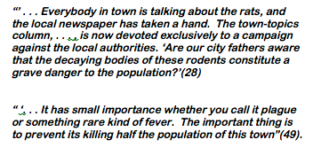
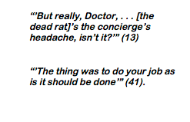
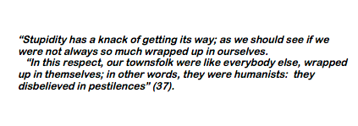
Initial Question Focus:

Slide 26
Revised Question Focus:
The city fathers were aware that the decaying bodies of these rodents were making people sick. (page 28)

Slide 27
Question Focus Design:
Keep it Simple!

Slide 28
Classroom Example: 2nd Grade
Teacher: Marie Romero, Lanai, Hawaii
Topic: A unit on “How can a pet be an important friend?”
Purpose: Let students generate their own key question for the week and assess how well students are able to ask questions

Slide 29
Initial Question Focus Design Process
How can a pet be an important friend?
Collage of pictures: dogs, cats, guinea pigs, horses, other pets
Picture of a human and a service animal
Picture of a human and a service animal paired with a phrase like “people and animals”
“People and animals”
“People, animals, and friends”

Slide 30
Student Questions: “People, Animals, and Friends”
Do people exist?
Where do people live?
Why do animals live in the zoo?
Why do people go to the pool?
Why are friends fun?
Why do animals bite?
Why do people go to school?
Do people, animals, and friends play together?
Do animals make friends?
Why do I need friends?
Why do people want to be friends with animals?
Why are people making friends with animals?
Why do people, animal, and friends live in different countries?
Where did my dog and friend go?
Can my friend pet our new dog?
Why do I have eyes?
How do people smell?
Can animals speak?
Can people fly?
Where is my bunny? What happened?

Slide 31
Revising the Question Focus
“People, Animals, and Friends”
Your idea here!

Slide 32
Classroom Example: 6th Grade
Teacher: Doreen Boone-Pitcher, Hyde Park, NY
Topic: Class culture at the start of the year
Purpose: To learn what the newest middle schoolers (6th graders) were concerned and/or curious about on their 5th day of school

Slide 33
Initial Question Focus

Slide 34
Student Questions
Why does it look so old?
Why does the school have a Fallout Zone?
Why is there a flag hanging upside down?
How old is the building?
Why are the classrooms numbered?
How many acres does it take up?
Why are there so many windows?
Why is there 4 big pillars at the front?
What is the big tower at the top?
Why are we being fit into one building?
When was the school made?
How much money did it cost to build it?
Why does it look like so many parts put together?
What is that white thing on top?
Why does it have 2 chimneys?
What is the point of lockers?
Who was the first principal?
Who is the boss of the superintendents?

Slide 35
Classroom Example: Providence Country Day School (RI)
“History, despite its wrenching pain, cannot be unlived, but if faced with courage, need not be lived again.”
– Maya Angelou
Troubleshooting Tips:
“Spend the next 2 minutes asking about just this word/phrase”
Change the Prioritization Instructions on the fly

Slide 36
Putting it into Practice

Slide 37
WANTED: Q Focus Guinea Pigs
Directions:
Try creating your own Q Focus!
Write it on an index card.
Be prepared to share with a partner.
If you finish early, move on to the rest of the resources on rightquestion.org/educators
Ask questions about your partner’s Q Focus. Follow the 4 rules!
Give your questions back to your partner.

Slide 38
Share and Reflect
What do you understand differently now about designing a QFT lesson?

Slide 39
The Science of the QFT: a protocol
The Art of the QFT: You

Slide 40
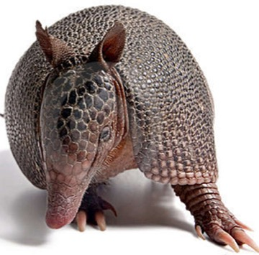
The one quality all excellent QFT designers share?
Thick Skin.

Slide 41
Evaluation
Please take a moment to fill out this brief evaluation and reflection:
http://bit.ly/2hwTraT
We value your feedback and work hard to continuously revise our resources to best support the work of educators in the field. Thank you!

Slide 42
To Access Today’s Materials:
http://rightquestion.org/educators/
seminar-resources/
Join our Educator Network for:
Templates you can use tomorrow in class
Classroom Examples
Instructional Videos
Forums and Discussions with other Educators

Slide 43
Five Areas Related to the Art of the QFT
Linking the QFT to Teaching and Learning Goals
QFocus Design
Prioritization Instructions
Reflection Questions
Facilitation

Slide 44
Prioritization Instructions
Choose the three most important questions
Choose the three questions you consider most important.

Slide 45
Categories of Prioritization Instructions
Choose three questions…
General Instructions:
that you consider most important
Specific Purposes:
that you need to research further
to help you solve the problem
that you need to answer first
that a scientist studying the earth might ask
that will help you understand the text
that require analyzing data
that are not “Googleable” and may be difficult to answer

Slide 46
Five Areas Related to the Art of the QFT
Linking the QFT to Teaching and Learning Goals
QFocus Design
Prioritization Instructions
Reflection Questions
Facilitation

Slide 47
Examples of Reflection Questions
QFT Process
Content Specific
What did you learn about asking questions?
How did you learn it?
What do you understand differently now about asking questions?
How can you use what you learned about asking questions?
How do you feel about asking questions?
What did you learn about the (content)?
How did the QFT process help you think about…
key concept
specific assignment
overarching topic
theme in the unit
chapter you just read

Slide 48
Five Areas Related to the Art of the QFT
Linking the QFT to Teaching and Learning Goals
QFocus Design
Prioritization Instructions
Reflection Questions
Facilitation

Slide 49
Four Principles of Facilitation
Monitor student adherence to the process
Do not give examples
Do not get pulled into group discussion
Acknowledge all contributions equally
Discuss: What could be challenging about each principle? What might be important about each?

