Slide 1
Dan Rothstein Co-Director
Teach Students to Ask Their Own STEM Questions:
Introduction to the Question Formulation Technique (QFT)
2017 Massachusetts STEM Summit
DCU Center Worcester, MA
Sarah Westbrook
Director of Professional Learning
The Right Question Institute
Cambridge, MA

Slide 2
Acknowledgments
We are deeply grateful to the Sir John Templeton Foundation and The Hummingbird Fund for their generous support of the Million Classrooms Campaign.

Slide 3
We’re Tweeting…
@RightQuestion
@RothsteinDan
#QFT

Slide 4
"There is no learning without having to pose a question."
-Richard Feynman, Nobel-Prize- winning physicist

Slide 5
LAWRENCE, MA, 1990
“We don’t go to the school because we don’t even know what to ask.”

Slide 6
“In both science and industry, the ability to ask the right questions is probably the greatest talent one can have.” (p. 22)
– Leonard Mlodinow,
Physicist & Screenwriter
* Emphasis added

Slide 7
“We must teach students how to think in questions, how to manage ignorance.”
-Stuart Firestein, Chairman of the Department of Biology at Columbia University

Slide 8
College Presidents on What Students Should Learn in College
“The primary skills should be analytical skills of interpretation and inquiry. In other words, know how to frame a question.”
- Leon Botstein, President of Bard College
“…the best we can do for students is have them ask the right questions.”
- Nancy Cantor, Chancellor of University of Illinois
The New York Times, August 4, 2002

Slide 9
Yet…only 27%of students believe college taught them to ask their own questions
Alison Head, Project Information Literacy at University of Washington, 2016

Slide 10
But, the problem begins long before college...

Slide 11
Percentage of Basic Skill Attainment
Sources
http://nces.ed.gov/nationsreportcard/pdf/main2009/2011455.pdf
http://nces.ed.gov/nationsreportcard/pubs/main2007/2008468.asp#section1
Data on question-asking based on parent and teacher feedback

Slide 12
Percentage of Basic Skill Attainment
Sources
http://nces.ed.gov/nationsreportcard/pdf/main2009/2011455.pdf
http://nces.ed.gov/nationsreportcard/pubs/main2007/2008468.asp#section1
Data on question-asking based on parent and teacher feedback

Slide 13
What happens when students do learn to ask their own questions?

Slide 14
Research Confirms the Importance of Student Questioning
Self-questioning (metacognitive strategy):
Student formulation of their own questions is one of the most effective metacognitive strategies
Engaging in pre-lesson self-questioning improved students rate of learning by nearly 50% (Hattie, p.193)
John Hattie
Visible Learning: A Synthesis of Over 800
meta-Analyses Relating to Achievement, 2008

Slide 15
Student Reflections
“Just when you think you know all you need to know, you ask another question and discover how much more there is to learn.”
~ Sixth-grade student, Palo Alto, CA
“When you ask the question, you feel like it’s your job to get the answer.”
~ High School student, Boston, MA

Slide 16
Classroom Example: Kindergarten
Teacher: Jennifer Shaffer, Walkersville, MD
Topic: Non-fiction literacy
Purpose: To engage students prior to reading a nonfiction text about alligators

Slide 17
Question Focus
Photograph by Nuwan Samaranayake, 2013

Slide 18
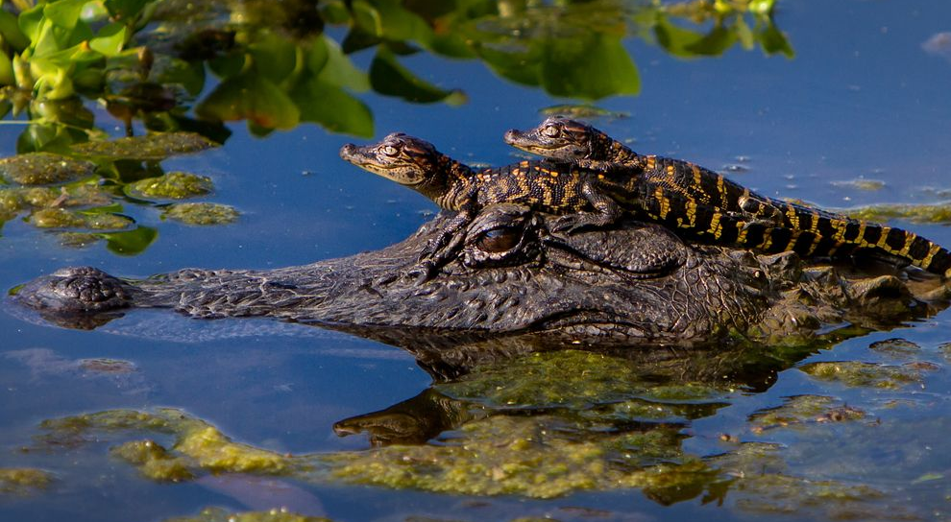
Student Questions
Is the alligator camouflaged?
Why do the babies have stripes?
Are those baby crocodiles?
Is it a mom or dad crocodile?
What is the green stuff?
Why are they in the water so low?
Where are they going?
Why are the baby alligator’s eyes white and the mom’s black?
Why are baby alligators on top of the momma alligator?
Why does momma or daddy have bumps on them?

Slide 19
Classroom Example: 4th Grade
Teacher: Deirdre Brotherson, Hooksett, NH
Topic: Math unit on variables
Purpose: To engage students at the start of a unit on variables

Slide 20
Question Focus
24 = ☺ + ☺ + ☺

Slide 21
Student Questions
Why is the 24 first?
What do the smiley faces mean?
Why are there 3 smiley faces?
How am I suppose to figure this out?
Is the answer 12?
Can I put any number for a smiley face?
Do three faces mean something?
Do the numbers have to be the same because the smiley faces are the same?
What numbers will work here?
Does it mean 24 is a really happy number?
Can we replace each smiley face with an 8?
Do any other numbers work?
Can we do this for any number?
Does it always have to be smiley faces?
Do we always have to use three things?

Slide 22
Next Steps with Student Questions
Questions posted on classroom walls.
Students cross off the questions they answer during subsequent lessons.
Teacher returns to student questions at the end of the unit to discuss with students what they learned and what they still want to know.

Slide 23
Working on a Challenge by Using the Question Formulation Technique (QFT)

Slide 24
Rules for Producing Questions
1. Ask as many questions as you can
2. Do not stop to answer, judge, or discuss
3. Write down every question exactly as stated
4. Change any statements into questions

Slide 25
Producing Questions
Ask Questions
Follow the Rules
Ask as many questions as you can.
Do not stop to answer, judge, or discuss.
Write down every question exactly as it was stated.
Change any statements into questions.
Number the Questions

Slide 26
Question Focus:
Some students are not asking questions.
→Please write this statement at the top of your paper.
→Remember to number the questions & follow the rules.

Slide 27
Categorizing Questions: Closed/ Open
Definitions:
Closed-ended questions can be answered with a “yes” or “no” or with a one-word answer.
Open-ended questions require
more explanation.
Directions: Identify your questions as closed-ended or open-ended by marking them with a “C” or an “O.”

Slide 28
Discussion
Closed-ended Questions
Advantages
Disadvantages

Slide 29
Discussion
Open-ended Questions
Advantages
Disadvantages

Slide 30
Improving Questions
Take one closed-ended question and change it into an open-ended question.
Take one open-ended question and change it into a closed-ended question.
Closed
Open
Open
Closed

Slide 31
Strategize: Prioritizing Questions
Review your list of questions
Choose the three questions you are most curious to explore further.
While prioritizing, think about your Question Focus: Some students are not asking questions.
After prioritizing consider…
Why did you choose those three questions?
Where are your priority questions in the sequence of your entire list of questions?

Slide 32
Strategize: Next Steps
From priority questions to action plan
In order to answer your priority questions:
What do you need to know? Information
What do you need to do? Tasks

Slide 33
Share
Questions you changed from open/closed
Your three priority questions and their numbers in your original sequence
Rationale for choosing priority questions
Next steps

Slide 34
Reflection
What did you learn?
How did you learn it?
What do you understand differently now about some students not asking questions?

Slide 35
Let’s peek inside the black box

Slide 36
“Modern science is a technique...it is a practice that allows us to learn reliable things about the world. [Science] is a technique that was waiting for people to discover it.”
- Steven Weinberg, Nobel laureate in Physics
To Explain the World, 2015

Slide 37
The QFT, on one slide…
Question Focus
Produce Your Questions
Follow the rules
Number your questions
Improve Your Questions
Categorize questions as Closed or Open-ended
Change questions from one type to another
Prioritize Your Questions
Share & Discuss Next Steps
Reflect
Ask as many questions as you can
Do not stop to discuss, judge or answer
Record exactly as stated
Change statements into questions
Closed-Ended:
Answered with “yes,” “no” or one word
Open-Ended: Require longer explanation

Slide 38
Curiosity and Rigor
Three thinking abilities
with one process

Slide 39
Thinking in many different directions
DIVERGENT THINKING

Slide 40
Narrowing Down, Focusing
CONVERGENT
THINKING

Slide 41
Thinking about Thinking
METACOGNITIVE
THINKING

Slide 42
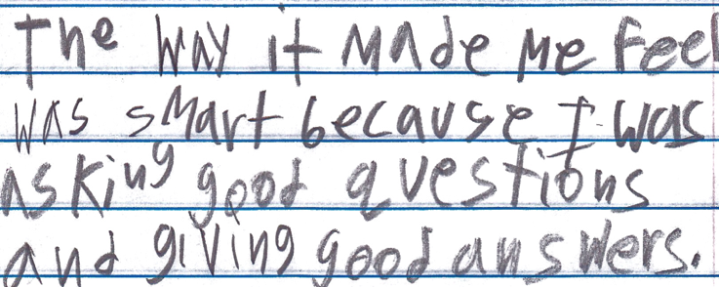
Student Reflection
“The way it made me feel was smart because I was asking good questions and giving good answers.”
-Boston 9th grade remedial summer school student

Slide 43
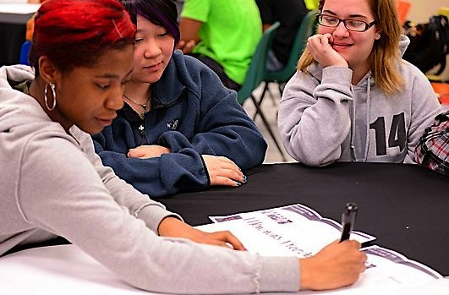
Exploring Classroom Examples

Slide 44
Classroom Example: 7th Grade
Teacher: Nicole Bolduc, Ellington, CT
Topic: “The Universe and Its Stars” Unit
Purpose: To engage students in setting the learning agenda for the unit

Slide 45
Question Focus:
Students watched videos of dramatic tide change in Cape Cod, Alaska, and Canada
https://www.youtube.com/watch?v=mAYXZzKUAX4
https://www.youtube.com/watch?v=53EEDisloME

Slide 46
Selected Student Questions
Why does tide change?
How is tide created?
How does earth’s rotation cause the tide to change?
Does the sun have any part in the rise and retreat of tides?
Do tides occur because of the gravitational pull of the moon?
Do the phases of the moon come into play with the tides?
How do other planets affect it?
Are the tides opposite in Florida and Mexico? (b/c they share the Gulf of Mexico)
How come the tide changes greatly in some places but not others?
How far can high tide go?
How do tides affect people?
Can tide change be a problem in the future?
Does global warming affect tides?
Where does the water go to?
Does temperature have anything to do with tides?
Does tilt have anything to do with tides?
Does this happen on other planets?
How do fish & wildlife survive when the tide is always changing?
If the moon disappeared, would there be no tides?
What would happen if the tide didn’t change?
Why are tides important to the earth?

Slide 47
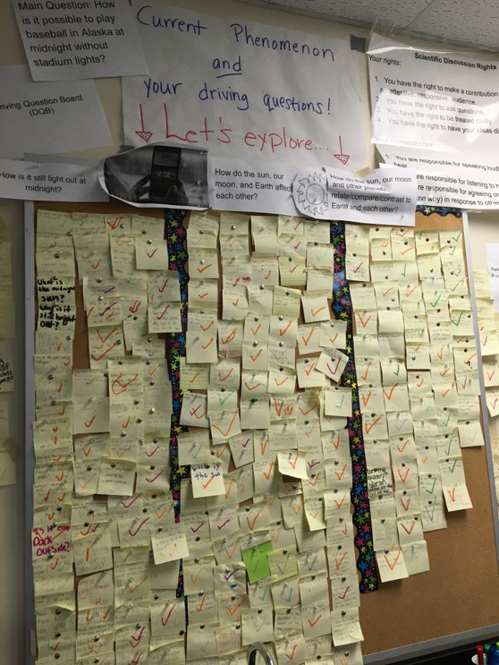
Next Steps:
The Driving Questions Board and the “Parking Lot”
Students draw initial models, give feedback, and make predictions.
Students experience a series of scientific investigations.
At the end of the unit, the Driving Question board is “published” in poster format.

Slide 48
Classroom Example:
High School
Teacher: Allison Gest, Park Ridge, IL
Topic: A unit on “Running Water”
Purpose: To give peer feedback and revise initial experiment designs

Slide 49
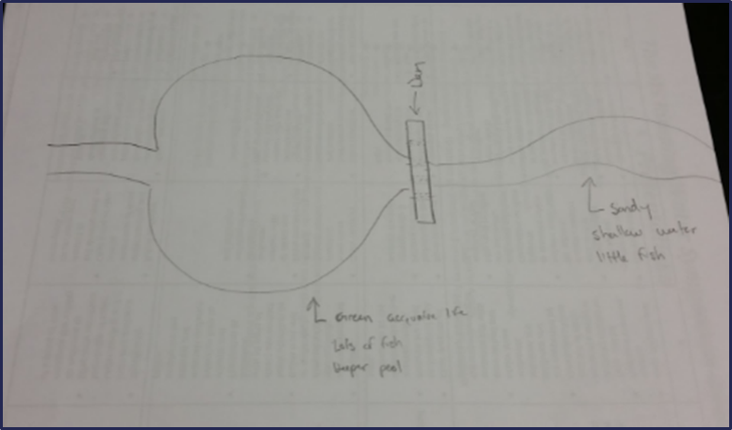
Question Focus:
Scientist’s claim:
“Adding a dam to a water system causes a decrease in aquatic life downstream.”
Student Design to test the claim:

Slide 50
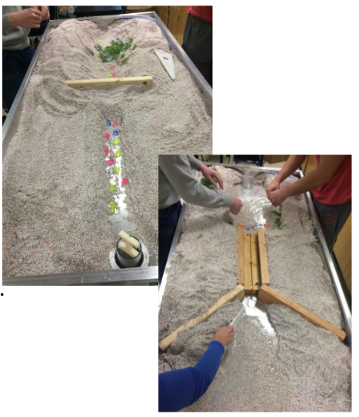
Next Steps:

Slide 51
Classroom Example: University
Teacher: Rachel Woodruff, Assistant Professor of Biology, Brandeis University, MA
Topic: Molecular Biology
Purpose: To build students’ research skills and prepare them to develop their own research proposal

Slide 52
Question Focus:
(Students were assigned a complex molecular biology article)
Ask as many questions as you can about the reading

Slide 53
Next Steps with Student Questions:
Students generate questions for homework
Students discuss key attributes of a good biological research question and compare to other types of questions
Students form groups and improve their questions
These questions are discarded or kept in notebooks (up to the student)
Students apply this skill to designing their own research project later in the semester

Slide 54
Classroom Example: High School Physics
Teacher: David Meshoulam, Newton, MA
Topic: Current and magnetism
Purpose: Transition from unit on Electricity to unit on Electricity and Magnetism

Slide 55
Question Focus:
Power lines from a power plant carry electricity at voltages of 345,000 Volts or more!
Transformers, like the one shown reduce that voltage to 120 Volts for home use.

Slide 56
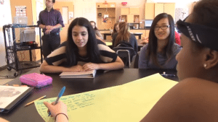
Classroom Example: High School
https://www.youtube.com/watch?v=9wrIIDNECUQ

Slide 57
Why is student question formulation so important today?

Slide 58
In the Age of Google…
“How should you respond when you get powerful new tools for finding answers?
Think of harder questions.”
- Clive Thompson, Journalist and Technology Blogger

Slide 59
The Skill of Asking Questions
For moving from ignorance as weakness to ignorance as opportunity
For arriving at better answers (and more questions)
For increasing engagement and ownership
For demonstrating inquiry in the classroom
For a little more joy in a very demanding profession
And…

Slide 60
Democracy
“We need to be taught to study rather than to believe, to inquire rather than to affirm.” - Septima Clark
See Chapter 6 on Septima Clark in Freedom Road: Adult Education of African Americans (Peterson, 1996).

Slide 61
Evaluation
Please take a moment to fill out this brief evaluation and reflection:
http://bit.ly/2zEfKlY
We value your feedback and work hard to continuously revise our resources to best support the work of educators in the field. Thank you!

Slide 62
To Access Today’s Materials:
http://rightquestion.org/educators/
seminar-resources/
Join our Educator Network for:
Templates you can use tomorrow in class
Classroom Examples
Instructional Videos
Forums and Discussions with other Educators

Slide 63
Now, Educators Lead the Work
The Right Question Institute offers materials through a Creative Commons License and we encourage you to make use of and/or share this resource. Please reference the Right Question Institute and rightquestion.org as the source on any materials you use.

