Slide 1
Make Your Job Easier: Teach Students to Ask Better Questions
NCSS 2017 National Conference
San Francisco, CA
November 19, 2017
Isabel Morales
CA Academy of Liberal Studies, CA
Ariela Rothstein
San Francisco Unified, CA
Connie Williams
Petaluma, CA
Dan Rothstein
Sarah Westbrook
|
The Right Question Institute
Cambridge, MA

Slide 2

Acknowledgments
We are deeply grateful to the Sir John Templeton Foundation and The Hummingbird Fund for their generous support of the Right Question Institute’s Million Classrooms Campaign.
#NCSS17 #QFT

Slide 3
Today’s Agenda
Welcome and Community Building
Collaborative Learning with the Question Formulation Technique (QFT)
Explore Classroom Examples & Applications
Emerging Ideas about a New Model of Learning
Work in Self-Organized Interest Groups
Reflection & Evaluation
#NCSS #QFT

Slide 4
To Access Today’s Materials:
http://rightquestion.org/educators/
seminar-resources/
Join our Educator Network for:
  Templates you can use tomorrow in class
  Classroom Examples
  Instructional Videos
  Forums and Discussions with other Educators

Slide 5

We’re Tweeting…
@RightQuestion
@RothsteinDan
#NCSS17 #QFT

Slide 6
"There is no learning without having to pose a question."
- Richard Feynman
Nobel-Prizewinning physicist

Slide 7

“We must teach students how to think in questions, how to manage ignorance.”
- Stuart Firestein
Chairman of the Department of Biology at Columbia University

Slide 8
Research Confirms the Importance of Student Questioning
Self-questioning (metacognitive strategy):
Student formulation of their own questions is one of the most effective metacognitive strategies
Engaging in pre-lesson self-questioning improved students rate of learning by nearly 50% (Hattie, p.193)
John Hattie
Visible Learning: A Synthesis of Over 800
meta-Analyses Relating to Achievement, 2008

Slide 9
College Presidents on What Students Should Learn in College
“The primary skills should be analytical skills of interpretation and inquiry. In other words, know how to frame a question.”
- Leon Botstein, President of Bard College
“…the best we can do for students is have them ask the right questions.”
- Nancy Cantor, Chancellor of University of Illinois
The New York Times, August 4, 2002

Slide 10
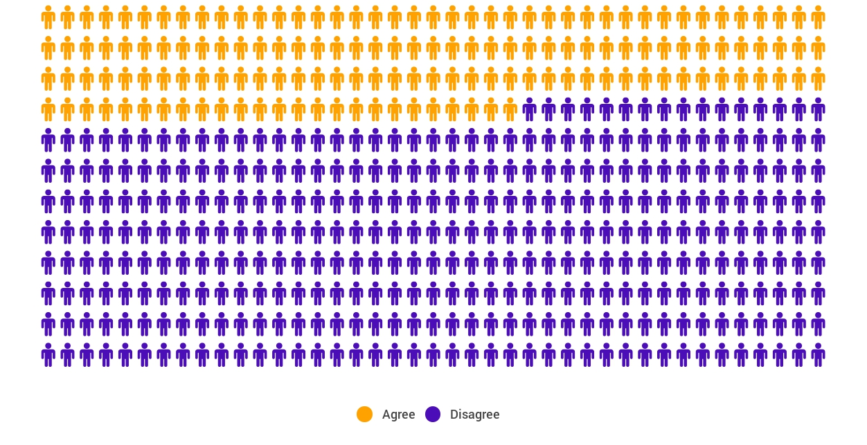
Yet…only 27%of students believe college taught them to ask their own questions
Alison Head, Project Information Literacy at University of Washington, 2016

Slide 11
But, the problem begins long before college...

Slide 12
A 1912 Study
Romiett Stevens, 1912
The Question as a Measure of Efficiency in Instruction: A critical study of classroom practice. Columbia University Contributions to Education, No. 48
“An unusual lesson because twenty-five of the thirty-four questions were asked by the pupils.…The result was that the lesson developed an impetus born of real interest. I mention it because this lesson was unique in the series of one hundred.”

Slide 13
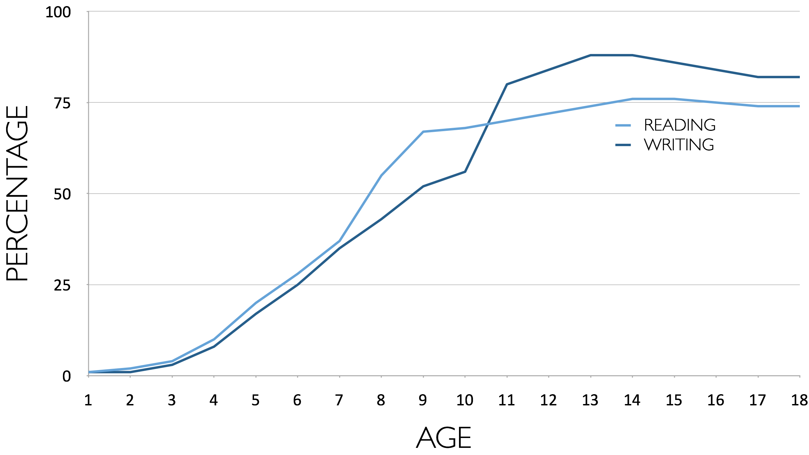
Percentage of Basic Skill Attainment
Sources
http://nces.ed.gov/nationsreportcard/pdf/main2009/2011455.pdf
http://nces.ed.gov/nationsreportcard/pubs/main2007/2008468.asp#section1
Data on question-asking based on parent and teacher feedback

Slide 14
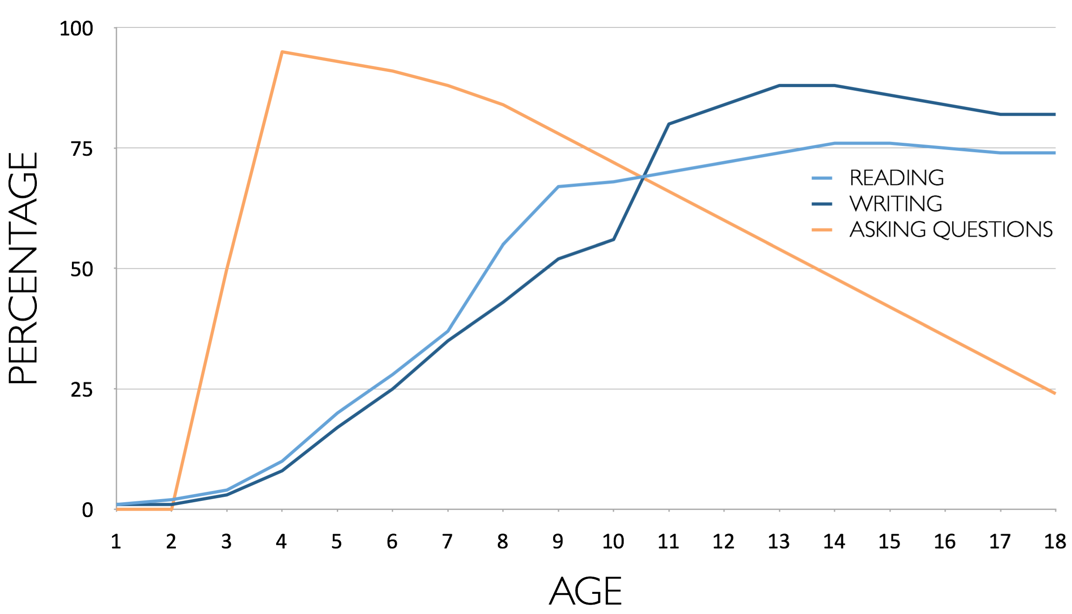
Percentage of Basic Skill Attainment
Sources
http://nces.ed.gov/nationsreportcard/pdf/main2009/2011455.pdf
http://nces.ed.gov/nationsreportcard/pubs/main2007/2008468.asp#section1
Data on question-asking based on parent and teacher feedback

Slide 15
The challenge of promoting inquiry in the classroom…
Maybe, don’t start with the word…

Slide 16
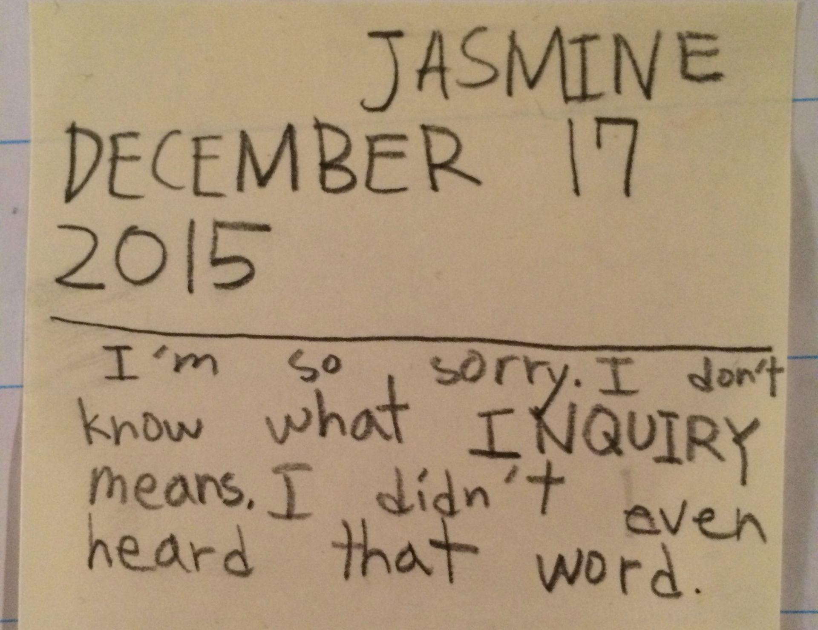

Slide 17
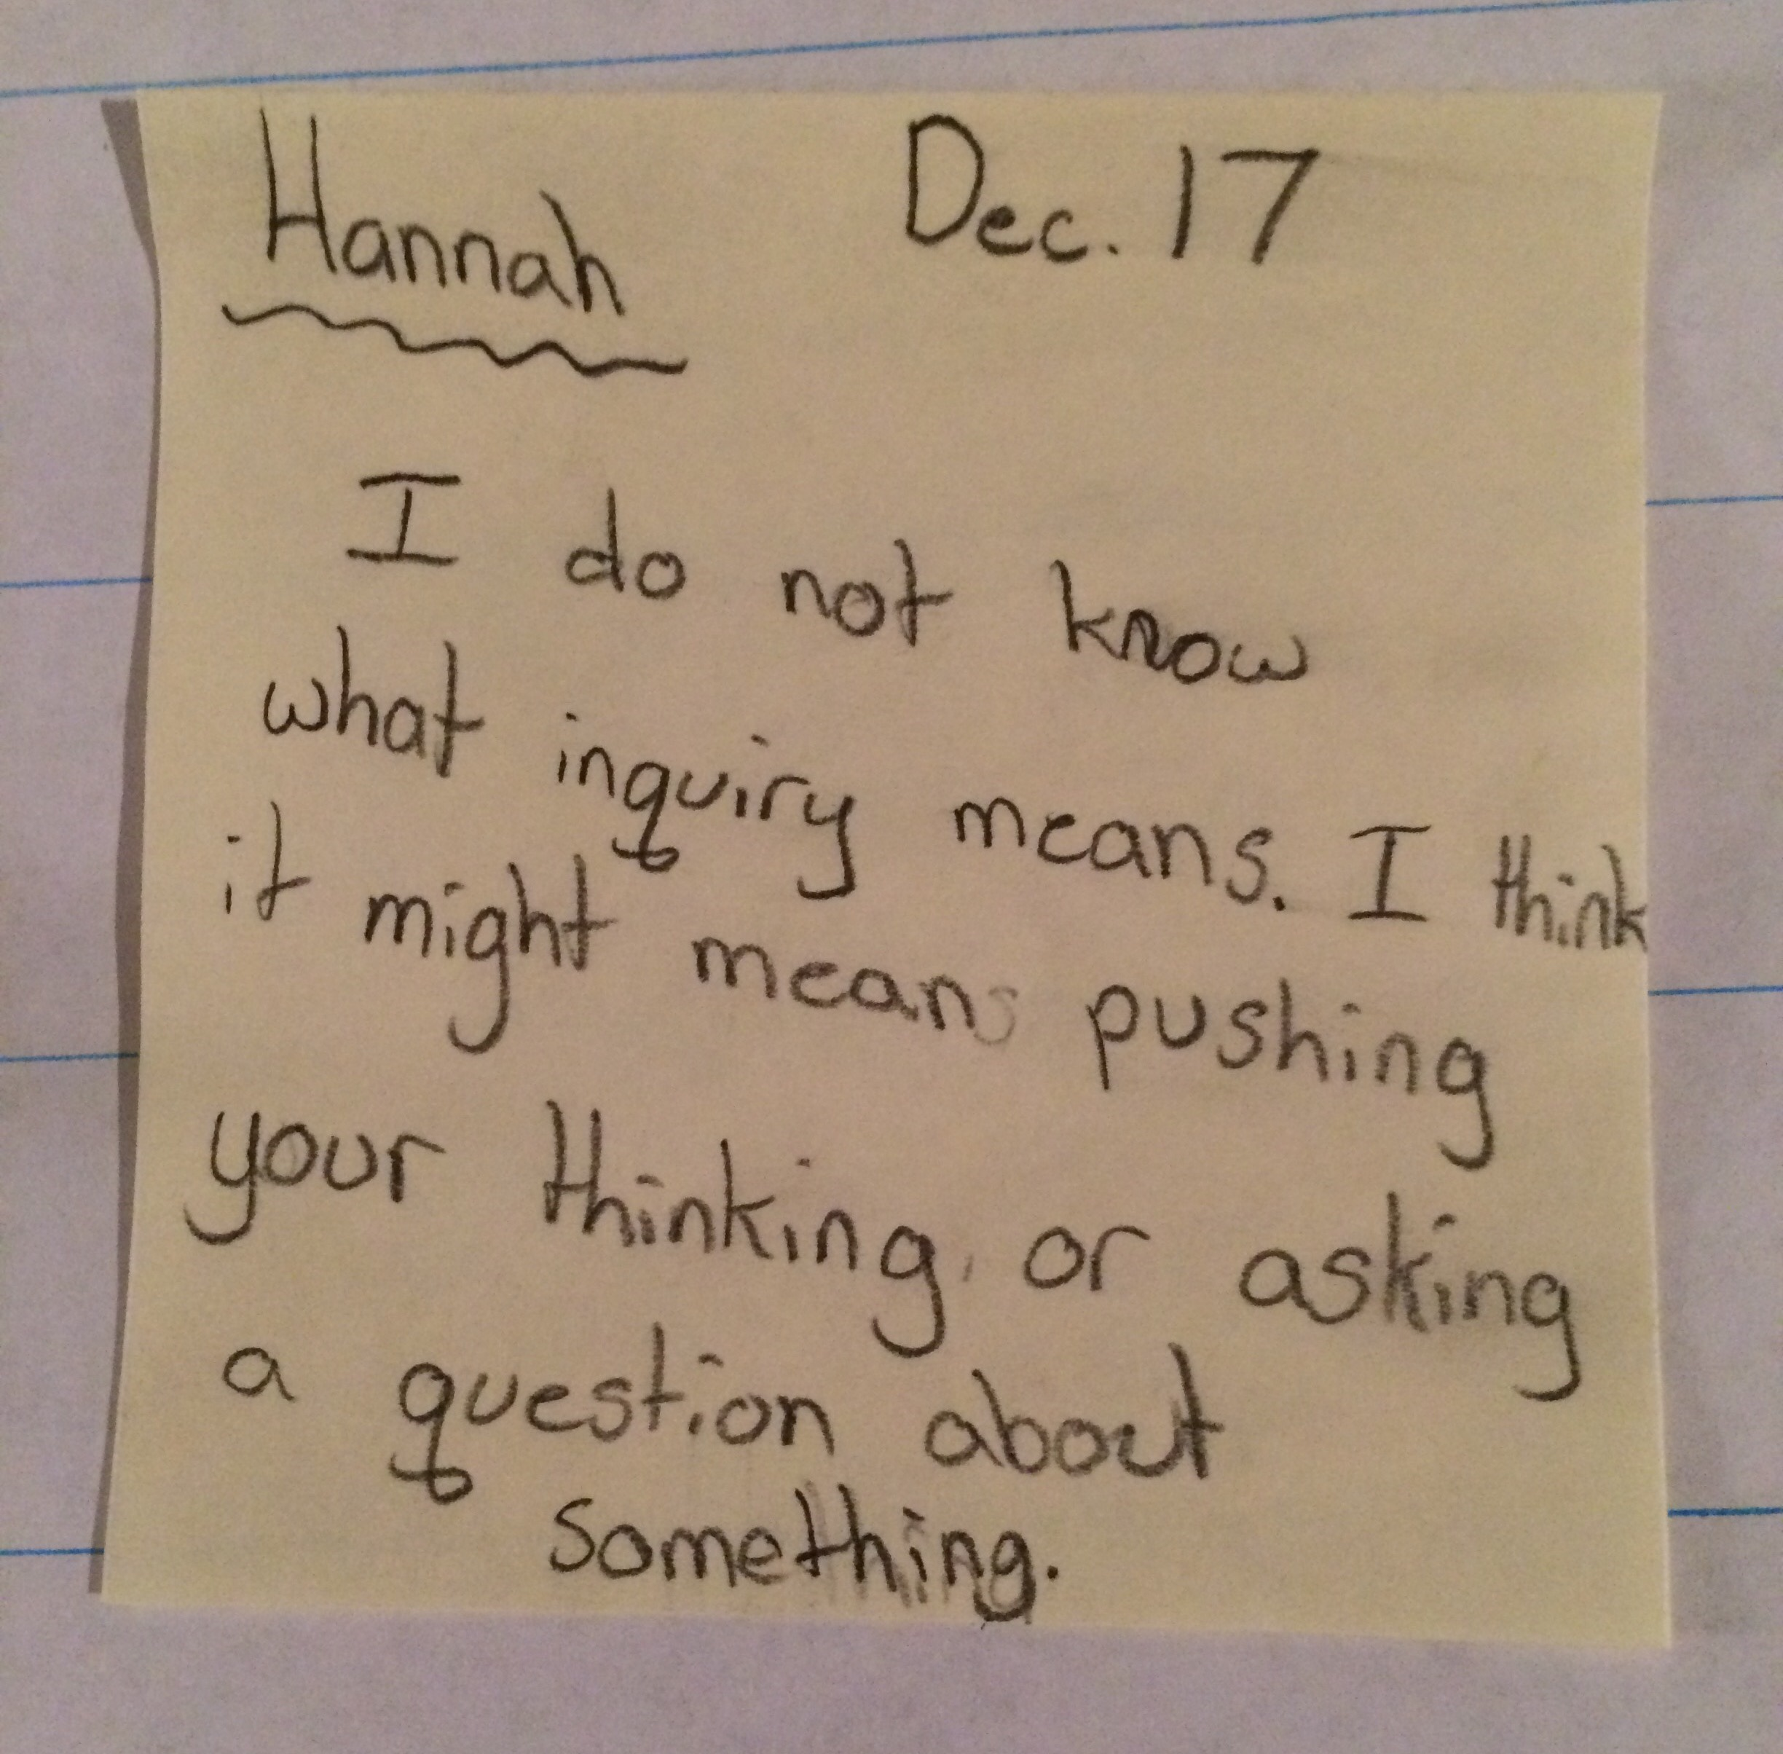
Notes:
Most of the teachers with whom we have worked tackle the challenge of promoting inquiry without using the word

Slide 18
Classroom Example:
Kindergarten
Teacher: Jennifer Shaffer, Walkersville, MD
Topic: Non-fiction literacy
Purpose: To engage students prior to reading a nonfiction text about alligators

Slide 19

Question Focus
Photograph by Nuwan Samaranayake, 2013

Slide 20
Student Questions
Is the alligator camouflaged?
Why do the babies have stripes?
Are those baby crocodiles?
Is it a mom or dad crocodile?
What is the green stuff?
Why are they in the water so low?
Where are they going?
Why are the baby alligator’s eyes white and the mom’s black?
Why are baby alligators on top of the momma alligator?
Why does momma or daddy have bumps on them?

Slide 21
Classroom Example:
4th Grade
Teacher: Deirdre Brotherson, Hooksett, NH
Topic: Math unit on variables
Purpose: To engage students at the start of a unit on variables

Slide 22
Question Focus
24 = ☺ + ☺ + ☺

Slide 23
Student Questions
Why is the 24 first?
What do the smiley faces mean?
Why are there 3 smiley faces?
How am I suppose to figure this out?
Is the answer 12?
Can I put any number for a smiley face?
Do three faces mean something?
Do the numbers have to be the same because the smiley faces are the same?
What numbers will work here?
Does it mean 24 is a really happy number?
Can we replace each smiley face with an 8?
Do any other numbers work?
Can we do this for any number?
Does it always have to be smiley faces?
Do we always have to use three things?

Slide 24
Next Steps with Student Questions
Questions posted on classroom walls.
Students cross off the questions they answer during subsequent lessons.
Teacher returns to student questions at the end of the unit to discuss with students what they learned and what they still want to know.

Slide 25
Classroom Example:
Middle School
Teacher: Megan Harvell, Boston, MA
Topic: American History –The Civil War
Purpose: Pre-reading activity to engage students

Slide 26
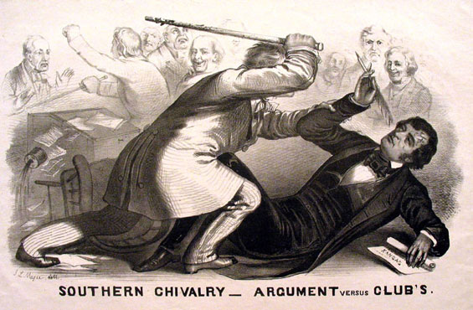
Question Focus
Image by John L. Magee, 1856

Slide 27
Student Questions
Why are they fighting?
Are they fighting?
Are they part of the government?
Where were they?
Who are they?
Were they signing anything?
Who else was there?
Why are you hitting him?
Why didn’t they call 911?
Was this related to slavery?
Why is he hitting him with a bat?
11. Why are you taking a pen?
12. Why are they in court?
13. Who hit who first?
Who died?
Why are they smiling?

Slide 28
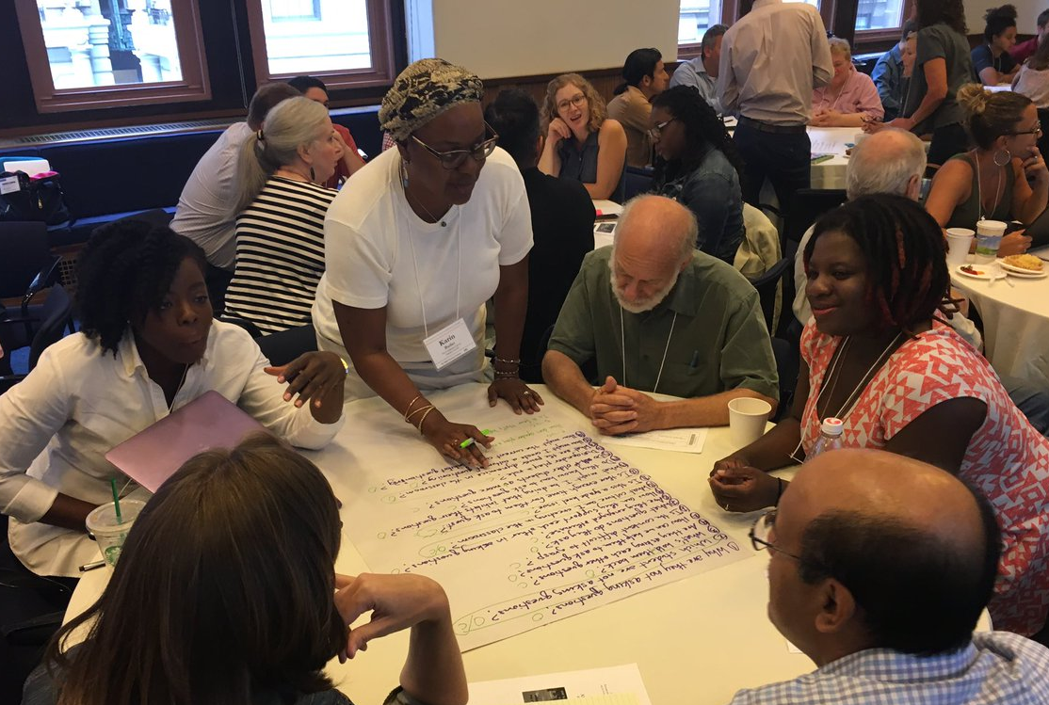
Working on a Challenge by Using the Question Formulation Technique (QFT)

Slide 29
Rules for Producing Questions
1. Ask as many questions as you can
2. Do not stop to answer, judge, or discuss
3. Write down every question exactly as stated
4. Change any statements into questions

Slide 30
Producing Questions
Ask Questions
Follow the Rules
      Ask as many questions as you can.
      Do not stop to answer, judge, or discuss.
      Write down every question exactly as it was stated.
      Change any statements into questions.
Number the Questions

Slide 31
Question Focus:
Some students are not asking questions.
→Please write this statement at the top of your paper.
→Remember: Number the questions. Follow the rules.

Slide 32
Categorizing Questions:
Closed/ Open
Definitions:
  Closed-ended questions can be answered with a “yes” or “no” or with a one-word answer.
  Open-ended questions require
  more explanation.
Directions: Identify your questions as closed-ended or open-ended by marking them with a “C” or an “O.”

Slide 33
Discussion
Closed-ended Questions
Advantages
Disadvantages

Slide 34
Discussion
Open-ended Questions
Advantages
Disadvantages

Slide 35
Improving Questions
Take one closed-ended question and change it into an open-ended question.
Take one open-ended question and change it into a closed-ended question.
Closed
Open
Open
Closed

Slide 36
Strategize: Prioritizing Questions
Review your list of questions
  Choose the three questions you consider most important.
  While prioritizing, think about your Question Focus: Some students are not asking questions.
After prioritizing consider…
  Why did you choose those three questions?
  Where are your priority questions in the sequence of your entire list of questions?

Slide 37
Strategize: Next Steps
From priority questions to action plan
In order to answer your priority questions:
    What do you need to know? Information
    What do you need to do? Tasks

Slide 38
Share
Questions you changed from open/closed
Your three priority questions and their numbers in your original sequence
Rationale for choosing priority questions
Next steps

Slide 39
Reflection
What did you learn?
How did you learn it?
What do you understand differently now about some students not asking questions?

Slide 40
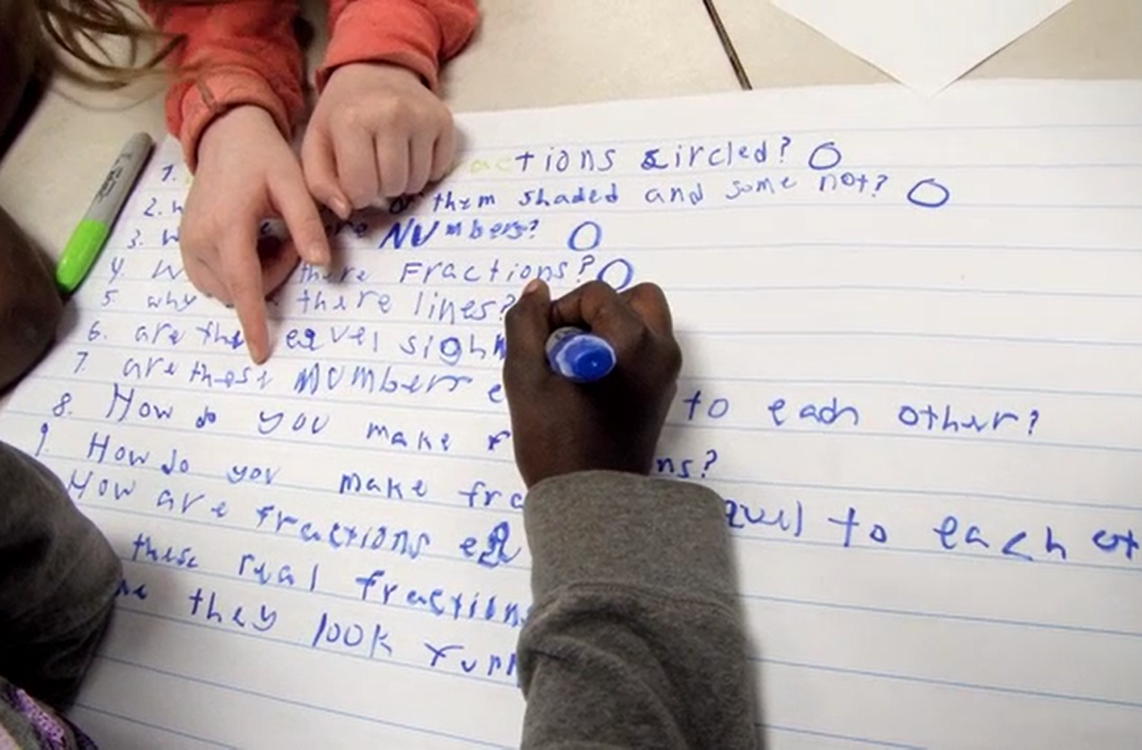
Exploring Classroom Examples

Slide 41
Classroom Example:
High School
Teacher: Ling-Se Chesnakas, Boston, MA
Topic: 12th Grade Humanities unit on The Brief Wondrous Life of Oscar Wao by Junot Diaz
Purpose: To help students generate questions for a Socratic Seminar at the end of the unit

Slide 42
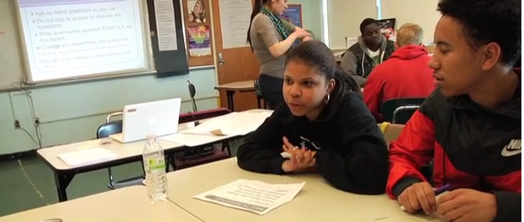
The Question Formulation Technique (QFT) in Action
http://rightquestion.org/qft-in-action/

Slide 43
The QFT, Information Literacy, and the Research Process
Connie Williams
National Board Certified Teacher Librarian
Petaluma, CA

Slide 44
Research is a Process
Research comes out of an information need.
We encounter information needs all the time.
No matter what our information need is: the process is the same
We utilize inquiry questions all the time:
What movie should we see today?
What computer [bike, phone] should I buy?
How will I complete all my homework on time?
What do I need to do in order to get to college?
Who are the 3 most influential authors of the 20th Century?
The only way to help kids want to complete the research you have assigned...is to help them create their own compelling questions.

Slide 45

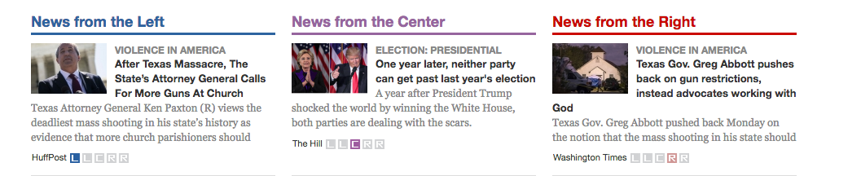
Teaching Information Literacy
Teaching Information literacy within a content area gives practice to the steps of the research process.
Our task: to teach those steps.
Turning information need statements:
I want to go to Iceland
Write an essay on the French Revolution
into questions, allows us to focus on what we consider to be important within that topic.
Dig & Dive into the topic to gather content information
Head out to the great beyond…and question your sources

Slide 46
Example: High School Debate Team
Context: Students are preparing to debate. They want authentic TRUE information. They want me to tell them Exactly. Where. That. is.
Question Focus: “Resolved that the United States screen immigrants for extremist ideological views.”
Student Questions:
•What are extremist views?
•How are we screening now?
•What kinds of extremist views are there?
•What about homegrown extremist views?
•How might we screen immigrants differently?
•What would happen if we didn’t let anyone in anymore?
•Don’t we already have a good system?
•Why are we re-building something that isn’t broken?
•How do we know if it’s broken or not?
Next Steps: Student questions for the evaluation of sources:
Who wrote this?
For what purpose was this written?
How do they want me to feel?
How do they want me to act?
What are the sources of their numbers, charts, or other evidence?
Can we trace them back to their creator?… and then question the purpose and authority of those numbers also.

Slide 47
QFT in the Classroom as a ‘Primer’ for Difficult Reading
Ariela Rothstein
Instructional and Professional Development Coach
San Francisco Unified School District, CA
Social Studies Teacher (2010-2017)
Brooklyn Public Transfer High School (NY)

Slide 48
Literacy Strategy: Priming Students to Read a Difficult Text
Why a pre-reading strategy?
Increasing background knowledge or assessing interest in the topic ahead of time increases engagement and perseverance prior to reading a difficult text
There’s a big focus in Common Core and state standards on reading grade-level appropriate materials - often not reflecting the reality of the reading level range in the classroom. Then, there’s pressure to differentiate to every student’s reading level - not reflecting the reality of a teacher’s workday
So What?
QFT is an excellent strategy for a differentiated, critical thinking method for priming students for a challenging reading

Slide 49

Classroom Example
Question Focus:
“Being Young, Muslim and Arab in America”

Slide 50
Student Questions
In 2013
Why do Arabs pray 7 times a day?
Why do Arabs own cornerstores?
[o->c] Do all Arabs own a corner store?
Why do female Muslims wear head scarves?
Why do Arabs have long hair?
Why do they come to the US?
[o->c]Do you find the US to have better opportunities?
Why do they have so many kids?
Why do they cut the little girls’ hair?
Why do Muslims believe in a different God?
Why don’t Muslims eat pork?
Why does everyone go to jail and become Muslim?
Why did they really blow up the World Trade Center?
In 2015
Did you know the US see you as terrorists?
Did you know Trump about to ban most of your beliefs?
What’s your side of the story about the terrorists attacks?
Do you have a side of the story?

Slide 51
In a small group, we will...
Look at examples of the QFT from my own classroom
Brainstorm examples with you for your upcoming units
We might also discuss:
QFT in Project Based Learning
QFT for adults: in organizing contexts (prioritizing goals/action steps/next steps)
The penultimate step: Creative ways for social studies teachers to ask students to prioritize their questions in order to…
  address multiple perspectives
  analyze their questions for biases
  learn skills about ‘thinking like a historian’
How to ‘grade’ the QFT , or strategies for getting admin support for QFT usage across classrooms
Want to go to another group, but still have questions? rothsteina@sfusd.edu

Slide 52
The QFT for Social Justice
Isabel Morales
California Academy of Liberal Studies
PUC Charter Schools
Los Angeles, CA

Slide 53
Classroom Example:
High School
Teacher: Isabel Morales, Los Angeles, CA
Topic: Social Justice
Purpose: Engage students in thinking about systemic injustice

Slide 54

Classroom Example
Question Focus
“The disciplinary policies of our society perpetuate injustice.”
Notes:
Note - this is an image I found online.

Slide 55
Student Questions
Why are student of color targeted the most?
Do teachers nationwide take notice of these stats?
How can teachers develop better & effective disciplinary policies?
Why do people see the stats & data as a coincidence?
What does a kid learn about the system once in jail?
What do teachers believe expulsion will teach the students?
Does going to jury have a long-term effect on younger students about education?
When will it get better?
What are some ways to improve behavior?
What type of training will teachers go through that’ll bring justice to classrooms?
Why is there a law?
Shouldn’t school police officers be trained like teachers?
What is considered a criminal offense in school?
Isn’t it the teacher’s job to keep the students “in line”?
How should disruption in class be handled?
Shouldn’t school officers be punished as well?
What is the difference between a school officer and a regular police officer?
How come there aren’t any policies keeping students out of prison?

Slide 56
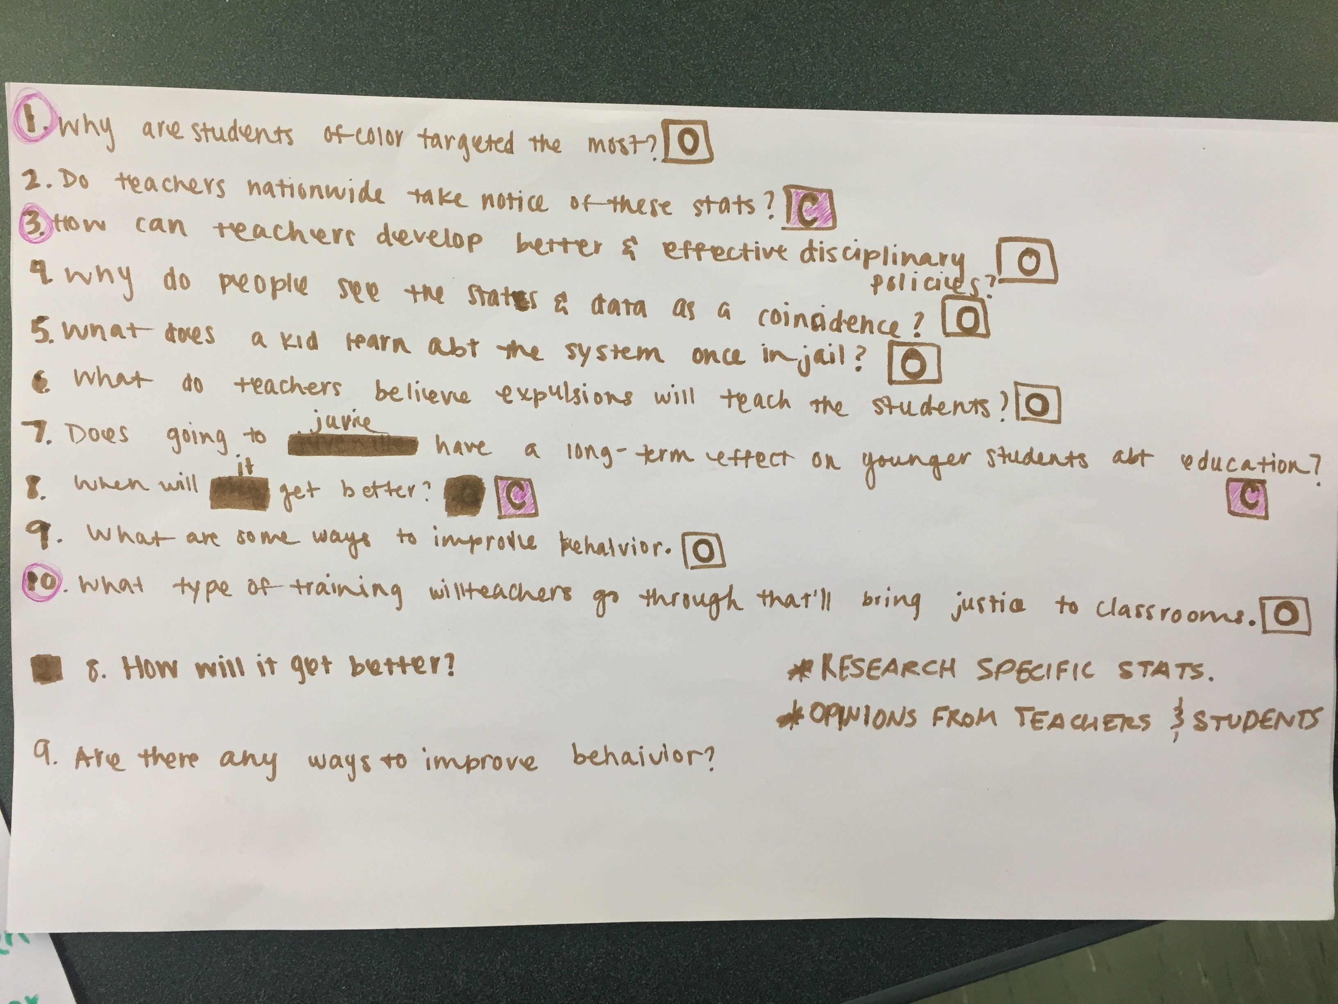
Notes:
Why are student of color targeted the most?
Do teachers nationwide take notice of these stats?
How can teachers develop better & effective disciplinary policies?
Why do people see the stats & data as a coincidence?
What does a kid learn about the system once in jail?
What do teachers believe expulsion will teach the students?
Does going to jury have a long-term effect on younger students about education?
When will it get better?
What are some ways to improve behavior?
What type of training will teachers go through that’ll bring justice to classrooms?

Slide 57
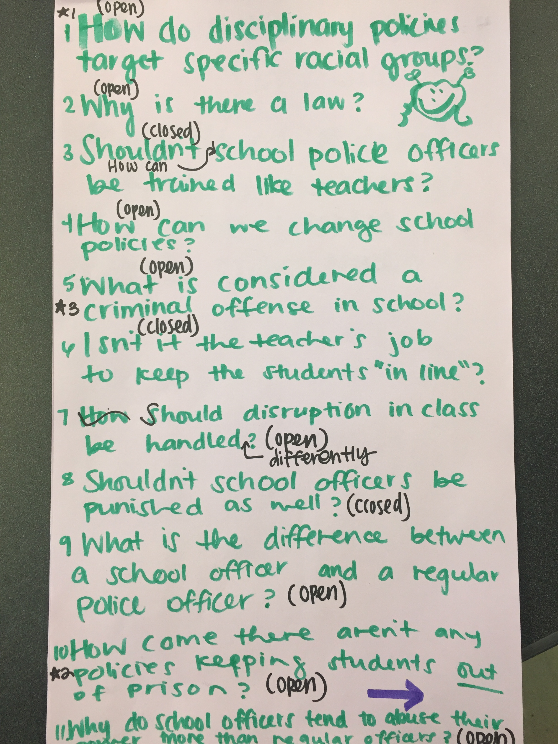
Notes:
How do disciplinary policies target specific racial groups
Why is there a law
Shouldn’t school police officers be trained like teachers?
How can we change school policies?
What is considered a criminal offense in school?
Isn’t it the teacher’s job to keep the students “in line”?
How should disruption in class be handled?
Shouldn’t school officers be punished as well?
What is the difference between a school officer and a regular police officer?
How come there aren’t any policies keeping students out of prison?

Slide 58
Student Reflections
“Asking questions is important because it opens up discussions and debate about issues.”
- Leslie S., 12th grader
“Asking questions is a step in creating change.”
- Jonathan S., 11th grader
“Questions can help focus on a problem and think of solutions.”
- Jason S., 11th grader

Slide 59

Let’s peek inside the black box
#QFT #NCSS17

Slide 60
“Modern science is a technique...it is a practice that allows us to learn reliable things about the world. [Science] is a technique that was waiting for people to discover it.”
- Steven Weinberg, Nobel laureate in Physics
To Explain the World, 2015

Slide 61
The QFT, on one slide…
Question Focus
Produce Your Questions
    Follow the rules
    Number your questions
Improve Your Questions
    Categorize questions as Closed or Open-ended
    Change questions from one type to another
Prioritize Your Questions
Share & Discuss Next Steps
Reflect
Ask as many questions as you can
Do not stop to discuss, judge or answer
Record exactly as stated
Change statements into questions
Closed-Ended:
Answered with “yes,” “no” or one word
Open-Ended: Require longer explanation

Slide 62
Curiosity and Rigor
  Three thinking abilities
  with one process

Slide 63
Thinking in many different directions
DIVERGENT
THINKING

Slide 64
Narrowing Down, Focusing
CONVERGENT
THINKING

Slide 65
The Importance of Questions
"Questions are the engines of intellect, the cerebral machines which convert energy to motion, and curiosity to controlled inquiry."
- David Hackett Fischer,
Historians' fallacies: Toward a logic of historical thought.
Routledge and Kegan Paul, 1971.
“[The QFT] helps me by getting me to think about questions on my own…it gets my mind
in motion to think about the questions other people make."
- 8th grade student in James Brewster’s U.S. history class
Gus Garcia Young Men’s Leadership Academy, Austin, TX, 2015

Slide 66

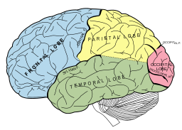
Thinking about Thinking
METACOGNITIVE
THINKING

Slide 67
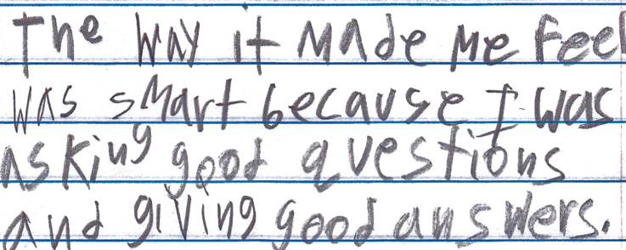
Student Reflection
“The way it made me feel was smart because I was asking good questions and giving good answers.”
-Boston 9th grade remedial summer school student

Slide 68
Emerging Ideas about a New Model of Learning

Slide 69
Stimulating Curiosity and Enhancing Learning
The Emergence of a
“Working with One’s Own Questions” Model of Learning

Slide 70
How We Define “Working"
  Produce
  Categorize
  Improve
  Prioritize
  Strategize on use of questions
  Reflect
The “working” also requires using three thinking abilities:
Divergent
Convergent
Metacognitive

Slide 71
The Model Consistently Produces Two Outcomes
Greater Knowledge
Greater Curiosity

Slide 72
Greater Knowledge
Greater Curiosity
No Small Matter
There is something significant afoot in education, and beyond, relevant to our “Working with One’s Own Questions” Model of Learning

Slide 73

Student Questioning Across Disciplines
“Questioning is key to student learning.” (p.17)
“Central to a rich social studies experience is the capability for developing questions that can frame and advance an inquiry. ” (p. 24)
National Council for the Social Studies, The College, Career, and Civic Life (C3) Framework for Social Studies State Standards: Guidance for Enhancing the Rigor of K-12 Civics, Economics, Geography, and History (Silver Spring, MD: National Council for the Social Studies, 2013).

Slide 74

Student Questioning Across Disciplines
“Students at any grade level should be able to ask questions of each other about the texts they read, the features of the phenomena they observe, and the conclusions they draw from their models or scientific investigations. For engineering, they should ask questions to define the problem to be solved and to elicit ideas that lead to the constraints and specifications for its solution. (NRC Framework 2012, p. 56)” (p. 1)
National Research Council. (2013). APPENDIX F – Science and Engineering Practices in the NGSS. Next generation science standards: For states, by states.
Notes:
x

Slide 75









Slide 76
From Technique to Model
We figured out a technique for getting students to formulate their own questions.
In the last five years, educators have used the simple technique in creative and ingenious ways that consistently stimulate curiosity and advance student learning.
Educators’ work with the technique leads us to see more clearly a replicable model of learning that is based on combining student question formulation with teacher creativity.
Notes:
X Flows from the recent recognition of the importance of students learning to ask questions

Slide 77


Honoring three sources of this model
LAWRENCE, MA, 1990
“We don’t go to the school because we don’t even know what to ask.”
Notes:
x

Slide 78
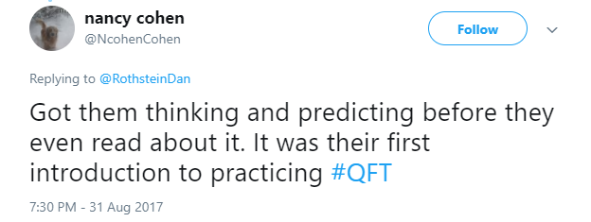
Honoring the Sources (II)
250,000 Teachers around the world
Notes:
x

Slide 79
Honoring the Sources (III)
Millions of students
  "Asking questions may not always lead to answers, but it leads to curiosity. Curiosity is what drives children and teens to want to learn, even when they don't realize it...Question asking helps us guide our own adventure and helps us find new interests. Everything starts with a question, even if you don't realize it.”
  - Abriana Fusco, 9th Grader, Fitchburg, MA
  “When you ask the question, you feel like it’s your job to get the answer.”
  - High School student, Boston, MA
  “Just when you think you know all you need to know, you ask another question and discover how much more there is to learn.”
  - 6th grader, Palo Alto, CA
  In response to "why do you think we ask questions?”
  “So we can be curious about what we are learning and want to
  know more."
  - Ayaka, 1st Grader, Novi, Michigan
Notes:
x

Slide 80
Can we give the model a more scientific name?
, and Ah Ha!
“Working with One’s Own Questions”
Model of Learning
Hmm
, Oomph

Slide 81
Hmm, Oomph, and Ah Ha!
Why is a model for learning that emphasizes student question formulation so important today?

Slide 82

In the Age of Google…
“How should you respond when you get powerful new tools for finding answers?
Think of harder questions.”
Clive Thompson, Journalist and Technology Blogger

Slide 83
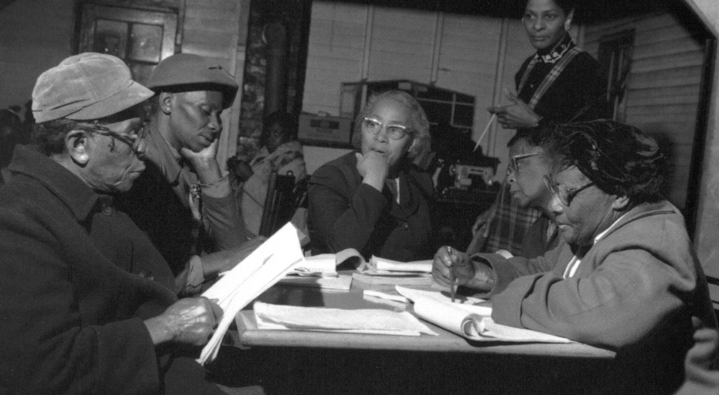
Democracy
“We need to be taught to study rather than to believe, to inquire rather than to affirm.” - Septima Clark
See Chapter 6 on Septima Clark in Freedom Road: Adult Education of African Americans (Peterson, 1996).

Slide 84

Now, Educators Lead the Work
The Right Question Institute offers materials through a Creative Commons License and we encourage you to make use of and/or share this resource. Please reference the Right Question Institute and rightquestion.org as the source on any materials you use.

Slide 85
To Access Today’s Materials:
http://rightquestion.org/educators/
seminar-resources/
Join our Educator Network for:
  Templates you can use tomorrow in class
  Classroom Examples
  Instructional Videos
  Forums and Discussions with other Educators

Slide 86
Today’s Agenda
Welcome and Community Building
Collaborative Learning with the Question Formulation Technique (QFT)
Explore Classroom Examples & Applications
Emerging Ideas about a New Model of Learning
Work in Self-Organized Interest Groups
Reflection & Evaluation

Slide 87
Evaluation
Please take a moment to fill out this brief evaluation and reflection:
https://tinyurl.com/NCSS17RQI
We value your feedback and work hard to continuously revise our resources to best support the work of educators in the field. Thank you!

