Slide 1
Making it Easier to Build Effective Partnerships with Families
Luz Santana
Co-Director
Right Question Institute
Deirdre Brotherson
5th Grade Teacher
Hooksett, NH

Slide 2
- Your name -Where do you work and your position -Two things you wish the families you work with could do better “Travelers, there is no path, paths are made by walking.” ― Antonio Machado

Slide 3
Agenda
About the Right Question School-Family Partnership Strategy
Formulating Questions Using the Question Formulation Technique (QFT)
Three Roles Parents Can Play: Support, Monitor, and Advocate
Unpacking the Strategy & Examples of Use
Practice Teaching
Developing Action Plans
Closing and Evaluation

Slide 4
We’re Tweeting…
@RightQuestion
@LuzSantana20

Slide 5
LAWRENCE, MA, 1990
“We don’t go to the school because we don’t even know what to ask.

Slide 6
Lessons…
8 WORKSHOPS
How to Choose Your Child’s School
How to Use and Evaluate the Service: Communicating with the Teacher and Principal
When the School Evaluates Your Child , It Evaluates Itself
Who is Responsible for Discipline?
Discipline Leading to Evaluation
The School as a Part of the Political System
The School Committee
The School Budget

Slide 7
Family Engagement
Health Care
Innovation
The Classroom
Over 200,000 teachers using the strategy

Slide 8
Materials
The Right Question Institute offers many of our materials through a Creative Commons License and we encourage you to make use of and/or share this resource. Please reference the Right Question Institute as the source on any materials you use.
Source: www.rightquestion.org

Slide 9
The Right Question School-Family Partnership Strategy
ASCD Member Book, September, 2016

Slide 10
A strategy that focuses on:
Sharing two skills:
Asking better questions
Participating more effectively in decisions
So that parents can play three roles:
Support
Monitor
Advocate

Slide 11
An Integrated Strategy
A Strategy, NOT a program
Complementary to existing programs

Slide 12
Components of the Strategy
The Question Formulation Technique
The Framework for Accountable Decision Making
The Support, Monitor, and Advocate Model

Slide 13
The Build the Foundation
Questions are the foundation
Build the foundation first
Teach parents how to ask their own questions

Slide 14
Strengthen the Foundation
Set aside time for parents to ask questions
Begin all interactions by setting time aside for parents to ask questions

Slide 15
Parent Engagement & Skill Building Activities
What are some examples of activities you are implementing at your school?

Slide 16
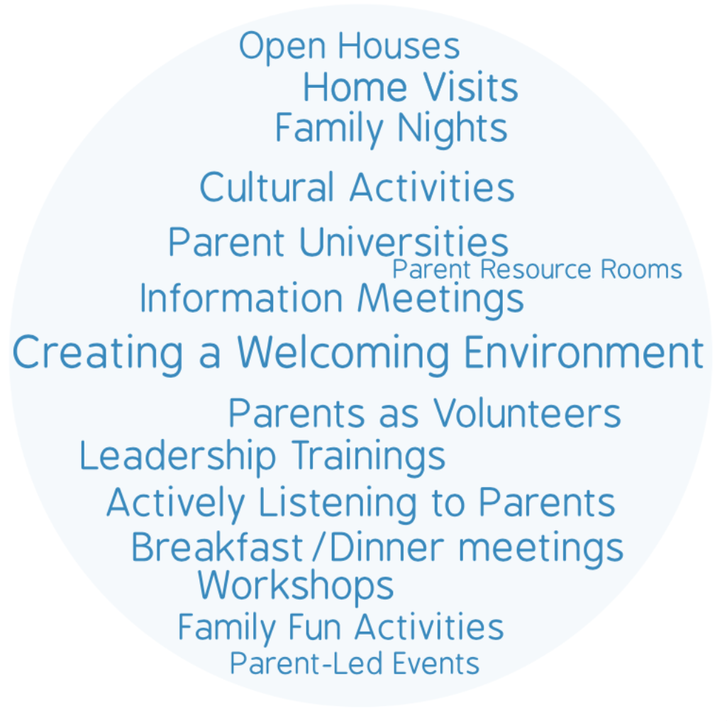
Parent Engagement Activities

Slide 17
Agenda
About the Right Question School-Family Partnership Strategy
Formulating Questions Using the Question Formulation Technique (QFT)
Three Roles Parents Can Play: Support, Monitor, and Advocate
Unpacking the Strategy & Examples of Use
Practice Teaching
Developing Action Plans
Closing and Evaluation

Slide 18
Imagine…

Slide 19
Parent Hat

Slide 20
An Experience in the Question Formulation Technique(QFT)

Slide 21
Rules for Producing Questions
ASK AS MANY QUESTIONS AS YOU CAN
DO NOT STOP TO ANSWER, JUDGE OR DISCUSS
WRITE DOWN EVERY QUESTION EXACTLY AS STATED
CHANGE ANY STATEMENTS INTO QUESTIONS

Slide 22
Question Focus (QFocus)
Your child might be held back in the same grade for another year.

Slide 23
Qfocus: Your child might be held back in the same grade for another year.
QFocus:
Ask Questions
Follow the Rules
Ask as many questions as you can.
Do not stop to answer, judge, or discuss.
Write down every question exactly as it was stated.
Change any statements into questions.
Number the Questions

Slide 24
Improving questions: Identify closed and open-ended questions
Definitions:
Closed-ended questions can be answered with a “yes” or “no” or with a one-word answer.
Open-ended questions require
more explanation.
Identify your questions as closed-ended or open-ended by marking them with a “C” or an “O.”

Slide 25
Discussion
Closed-ended Questions
Advantages
Disadvantages

Slide 26
Discussion
Open-ended Questions
Advantages
Disadvantages

Slide 27
Improving questions: Change questions from one type to the other
Take one closed-ended question and change it into an open-ended question.
Take one open-ended question and change it into a closed-ended question.
Closed
Open
Open
Closed

Slide 28
Improving questions
Prioritize:
Review your list of questions
Choose the three questions you consider most important.
Keep in mind your QFocus: Your child might be held back in the same grade for another year.
After prioritizing consider…
Why did you choose those three questions?
Where are your priority questions in the sequence of your entire list of questions?

Slide 29
Strategizing on how to use questions
Next Steps:
What do you need to know? Information
What do you need to do? Tasks

Slide 30
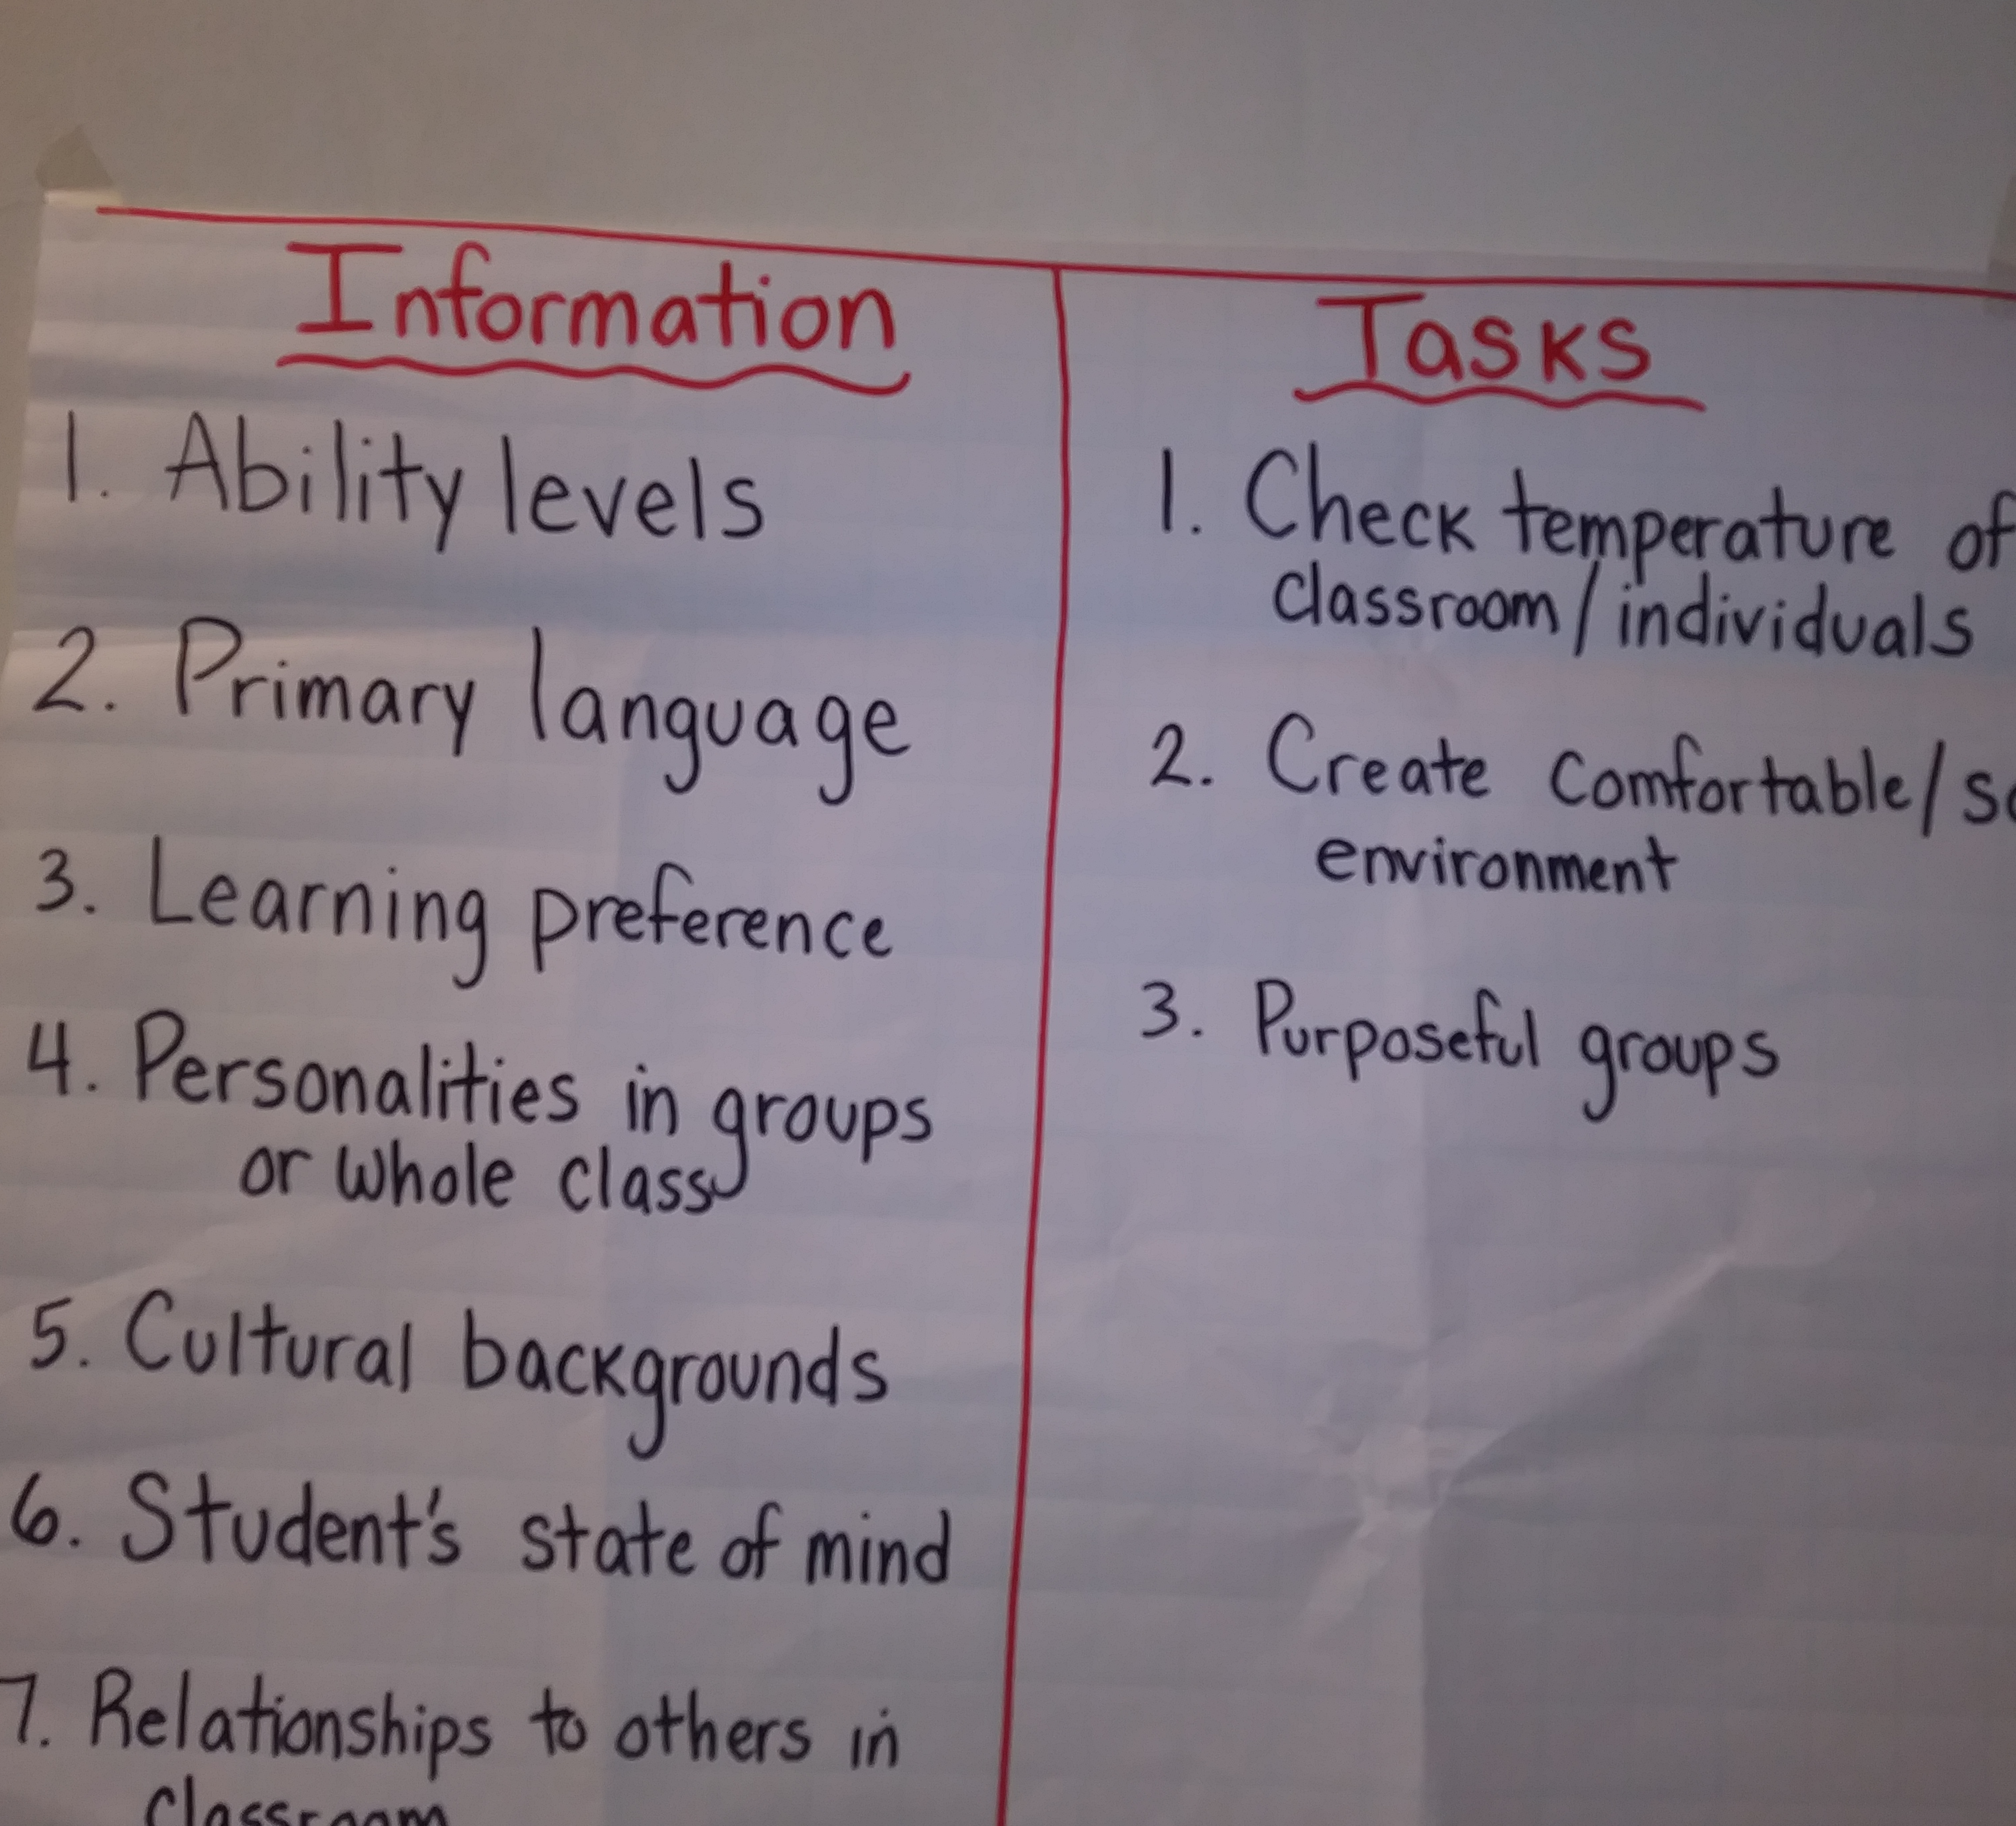
Strategizing on how to use questions
Next steps:

Slide 31
Share Your Work
Please share:
The questions you changed
Your three priority questions
Your rationale for selecting those three
The numbers of your priority questions
Your next steps

Slide 32
Reflection:
What did you learn?
How can you use it?

Slide 33
Agenda
About the Right Question School-Family Partnership Strategy
Formulating Questions Using the Question Formulation Technique (QFT)
Three Roles Parents Can Play: Support, Monitor, and Advocate
Unpacking the Strategy & Examples of Use
Practice Teaching
Developing Action Plans
Closing and Evaluation

Slide 34
Support, Monitor, and Advocate
Three Key Roles Parents Can Play:

Slide 35
Preparing to Work
Support Monitor Advocate

Slide 36
Parents as supporters
To help; to provide for;
to be available for
their children.
Name two things you are doing to support your child.

Slide 37
Parents as monitors
Watch / Keep track of:
their children’s progress
their children’s needs
Name two things you are doing to monitor your child.

Slide 38
Parents as advocates
Parents speak up and make specific requests on behalf of their children.
Name one situation in which you have advocated for your child.

Slide 39
Additional Activities…
To support my child I will:
To monitor my child I will:
To advocate for my child I will:

Slide 40
Supporting, Monitoring, Advocating
I would like to learn more about:

Slide 41
Share
What you are doing to support, monitor and advocate
Additional examples of activities you will do
What you would like to learn more about

Slide 42
Reflection:
What did you learn?
How can you use it?

Slide 43
Agenda
About the Right Question School-Family Partnership Strategy
Formulating Questions Using the Question Formulation Technique (QFT)
Three Roles Parents Can Play: Support, Monitor, and Advocate
Unpacking the Strategy & Examples of Use
Practice Teaching
Developing Action Plans
Closing and Evaluation

Slide 44
The Right Question Strategy
The Question Formulation Technique (QFT)
Producing, improving and strategizing on how to use questions
The Support, Monitor, Advocate Model
Organizing parent participation into three main areas
The Framework for Accountable Decision Making

Slide 45
Let’s peek inside the black box
The Question Formulation Technique (QFT)

Slide 46
The QFT, on one slide…
Question Focus
Produce Your Questions
Follow the rules
Number your questions
Improve Your Questions
Categorize questions as Closed or Open-ended
Change questions from one type to another
Prioritize Your Questions
Share & Discuss Next Steps
Reflect
Ask as many questions as you can
Do not stop to discuss, judge or answer
Record exactly as stated
Change statements into questions
Closed-Ended:
Answered with “yes,” “no” or one word
Open-Ended: Require longer explanation

Slide 47
The art and the science of the QFT
CONVERGENT
THINKING
DIVERGENT THINKING
METACOGNITIVE THINKING

Slide 48
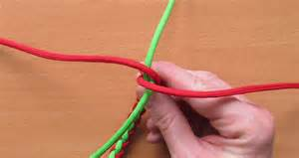
Integration Examples
”

Slide 49
The Question Focus (QFocus)
The QFocus is the springboard for asking questions. It is what parents are asking questions about.
The QFocus can be:
A statement or phrase
A picture
A simple problem

Slide 50
A Question Focus (QFocus)
Question Focus Design Basics
Just one requirement for the QFocus:
It should not be a question
*Key Tip for Designing an Effective QFocus:
The simpler, the better.
What are some QFoci you can use with the parents you work with?

Slide 51
Integration examples…
Parent-Teacher Conference
A teacher helps a mother
generate questions to address
an issue
Question Focus:
Sam seems to be having trouble
doing his homework.

Slide 52
The Questions:
Is he behaving?
Is he causing problems?
Is he doing his homework?
What do you mean by “trouble”?
How do you know he’s having trouble?
When did this start?
Did he do his homework before?
Is he getting punished for not doing his homework?
What’s going to happen to him?
Why do you think he’s having trouble? X
What should I do to make sure he does his homework? X
What happens when he doesn’t do his homework?
Will he be held back? X

Slide 53
Integration examples…
Open House
A school principal and teachers engage parents to think about the issue of bullying
Introduce 3 roles: Support,
Monitor and Advocate
Question Focus: Creating
a caring environment.

Slide 54
Question Focus: Creating a caring environment
O
C
C
O
C
O
O
O
O
C
C
C
O
What do they mean by caring?
Is there a problem?
Is this about a caring environment in the school?
What about after school?
Is this about the fight that happened last year?
What fight?
Who’s creating it?
What does a caring environment mean?
Does it mean just keep the kids from fighting?
Do the kids know what’s expected of them?
Are parents part of this?
Is there something we can do to help?
What should the school be doing?
12. 14. What can we do to help?

Slide 55
Parent Liaison generated change
Individual Education Plan (IEP)
A parent liaison works with a parent in preparation for an IEP meeting
Support, monitor, and advocate
Ask questions
Prioritizes questions about decisions
QFocus: The school recommends and IEP to help your child.

Slide 56
How’s it going to help?
Why does he need it?
Is the IEP the same for all kids?
Why are they saying he needs it now?
What’s different this year?
Is this going to make him feel stupid?
What can I do to help him?
What will the school do so he doesn't feel bad about himself?
Can’t his teacher help him more?
Is there something they can do instead of an IEP?
Reason
Process
Role

Slide 57
Integration Opportunities…
Problem Solving Meetings
Workshops
Information Meetings
Home Visits
…

Slide 58
Outcomes
Parents have foundational skills they can use to partner and advocate more effectively
Parents and school staff are resources for each other on behalf of children
Educators and school staff have tools and a strategy to engage and prepare parents to partner more effectively

Slide 59
Parents Comments
Ask the right questions to be sure I understand the standards expected of my child.
Communicate better with my child’s teachers.
Have a plan of action when it comes to my child’s education.
Monitor my child’s education more closely and ask questions to obtain answers.

Slide 60
Agenda
About the Right Question School-Family Partnership Strategy
Formulating Questions Using the Question Formulation Technique (QFT)
Three Roles Parents Can Play: Support, Monitor, and Advocate
Unpacking the Strategy & Examples of Use
Practice Teaching
Developing Action Plans
Closing and Evaluation

Slide 61
Practice Facilitation

Slide 62
Discussion
What would be the value of parents asking questions?
What would be the value of parents practicing asking questions?
Why should the facilitator write down several questions before answering them?

Slide 63
Using the Question Formulation Technique
Roles: Facilitator, Parent, Observer
Process:
Facilitator will lead parent through the question formulation process.
Facilitator will cover as many steps as possible, making sure parent is asking questions.
Observer will keep track of how the facilitation went and how the different steps were facilitated

Slide 64
Preparing to Role Play
Decide in your group who will play the following roles:
Facilitator of the process
Parent
Observer

Slide 65
You will need to:
Share with parent(s) why it would be important to:
ask questions
practice asking questions
write down the questions before answering them
Give instructions on how to ask questions.
Write down the questions.

Slide 66
Practice Round #1
Facilitator introduces the Question Focus
Share with parent(s) why it would be important to:
ask questions
practice asking questions
write down the questions before answering them
Give instructions on how to ask questions.
Write down the questions.

Slide 67
Practice Round #2
The parent chooses the Question Focus
Share with parent(s) why it would be important to:
ask questions
practice asking questions
write down the questions before answering them
Give instructions on how to ask questions.
Write down the questions.

Slide 68
Practice Round #3
The parent chooses the Question Focus
Share with parent(s) why it would be important to:
ask questions
practice asking questions
write down the questions before answering them
Give instructions on how to ask questions.
Write down the questions.

Slide 69
Reflection
What did you learn?
How can you use it?

Slide 70
Developing the Question Focus
Make a list of topics, issues, situations to discuss with parents
Choose one you would like to focus on
Turn the topic, issue, situation into a statement that will help parents easily produce questions

Slide 71
A Question Focus (QFocus)
Question Focus Design Basics
Just one requirement for the QFocus:
It should not be a question
*Key Tip for Designing an Effective QFocus:
The simpler, the better.

Slide 72
Share examples

Slide 73
Agenda
About the Right Question School-Family Partnership Strategy
Formulating Questions Using the Question Formulation Technique (QFT)
Three Roles Parents Can Play: Support, Monitor, and Advocate
Unpacking the Strategy & Examples of Use
Practice Teaching
Developing Action Plans
Closing and Evaluation

Slide 74
Planning to Use the RQI Strategy
How are you planning to use the Right Question Strategy?
Please be specific.

Slide 75
Outreaching Parents

Slide 76
Inviting Parents to Learn the Right Question Strategy
Develop a flyer to invite parents to learn to ask better questions and the 3 roles they can play.

Slide 77
Agenda
About the Right Question School-Family Partnership Strategy
Formulating Questions Using the Question Formulation Technique (QFT)
Three Roles Parents Can Play: Support, Monitor, and Advocate
Unpacking the Strategy & Examples of Use
Practice Teaching
Developing Action Plans
Closing and Evaluation

Slide 78
“Travelers, there is no path, paths are made by walking.” ― Antonio Machado

Slide 80
Democracy
“We need to be taught to study rather than to believe, to inquire rather than to affirm.”- Septima Clark
See Chapter 6 on Septima Clark in Freedom Road: Adult Education of African Americans (Peterson, 1996).

Slide 81
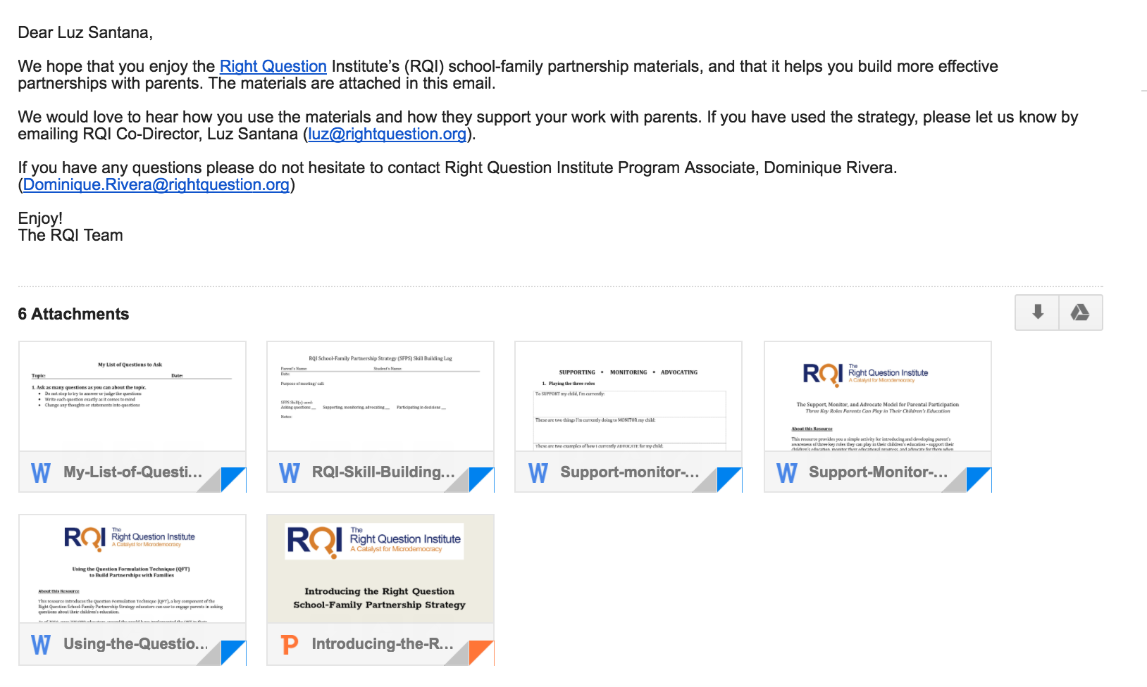
SCHOOL-FAMILY PARTNERSHIPS RESOURCES
@
WWW.RIGHTQUESTION.ORG

