Slide 1
Curiosity and Learning: Teach Students to Ask Better Questions
LEARNING FORWARD
Learning Beyond the Horizon
Orlando, FL
December 4, 2017
Deirdre Brotherson
5th Grade Teacher
Hooksett, New Hampshire
Luz Santana
Co-Director
The Right Question Institute

Slide 2
Acknowledgments
We are deeply grateful to the Sir John Templeton Foundation and The Hummingbird Fund for their generous support of the Million Classrooms Campaign.
#QFTCon #QFT

Slide 3
Who is in the room?
#QFTCon #QFT

Slide 4
Today’s Agenda
About the Right Question Institute
Collaborative Learning with the Question Formulation Technique (QFT)
The Art and Science of the QFT
Closing Reflections, Q&A, & Evaluations
#QFTCon #QFT

Slide 5
To Access Today’s Materials:
http://rightquestion.org/educators/
seminar-resources/
Join our Educator Network for:
Templates you can use tomorrow in class
Classroom Examples
Instructional Videos
Forums and Discussions with other Educators

Slide 6
We’re Tweeting…
@RightQuestion

Slide 7
LAWRENCE, MA, 1990
“We don’t go to the school because we don’t even know what to ask.”

Slide 8
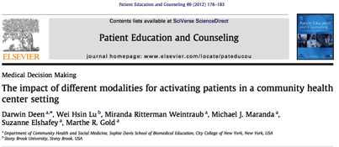
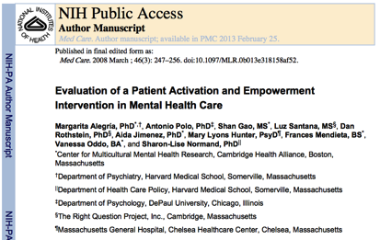
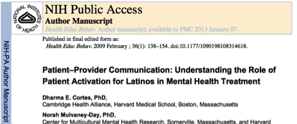
School-Family Partnership
Health Care
Innovation
Voter Engagement

Slide 9
“We must teach students how to think in questions, how to manage ignorance.”
- Stuart Firestein
Chairman of the Department of Biology at Columbia University

Slide 10
College Presidents on What Students Should Learn in College
“The primary skills should be analytical skills of interpretation and inquiry. In other words, know how to frame a question.”
- Leon Botstein, President of Bard College
“…the best we can do for students is have them ask the right questions.”
- Nancy Cantor, Chancellor of University of Illinois
The New York Times, August 4, 2002

Slide 11
Yet…only 27%of students believe college taught them to ask their own questions
Alison Head, Project Information Literacy at University of Washington, 2016

Slide 12
But, the problem begins long before college...

Slide 13
Percentage of Basic Skill Attainment
Sources
http://nces.ed.gov/nationsreportcard/pdf/main2009/2011455.pdf
http://nces.ed.gov/nationsreportcard/pubs/main2007/2008468.asp#section1
Data on question-asking based on parent and teacher feedback

Slide 14
Percentage of Basic Skill Attainment
Sources
http://nces.ed.gov/nationsreportcard/pdf/main2009/2011455.pdf
http://nces.ed.gov/nationsreportcard/pubs/main2007/2008468.asp#section1
Data on question-asking based on parent and teacher feedback

Slide 15
We can work together on changing the direction of that slope

Slide 16
We Are Not Alone
250,000 educators using the strategy all over the world

Slide 17
Now, Educators Lead the Work
The Right Question Institute offers materials through a Creative Commons License and we encourage you to make use of and/or share this resource. Please reference the Right Question Institute and rightquestion.org as the source on any materials you use.

Slide 18
What happens when students do learn to ask their own questions?

Slide 19
Research Confirms the Importance of Student Questioning
Self-questioning (metacognitive strategy):
Student formulation of their own questions is one of the most effective metacognitive strategies
Engaging in pre-lesson self-questioning improved students rate of learning by nearly 50% (Hattie, p.193)
John Hattie
Visible Learning: A Synthesis of Over 800
meta-Analyses Relating to Achievement, 2008

Slide 20
Student Reflections
“Just when you think you know all you need to know, you ask another question and discover how much more there is to learn.”
~ Sixth-grade student, Palo Alto, CA
“When you ask the question, you feel like it’s your job to get the answer.”
~ High School student, Boston, MA

Slide 21
The Question Formulation Technique (QFT)
Students learn to:
Produce their own questions
Improve their questions
Strategize on how to use their questions
Reflect on what they have learned and how they learned it
#QFTCon #QFT

Slide 22
Experience the Question Formulation Technique (QFT)

Slide 23
Rules for Producing Questions
1. Ask as many questions as you can
2. Do not stop to answer, judge, or discuss
3. Write down every question exactly as stated
4. Change any statements into questions

Slide 24
Producing Questions
Ask Questions
Follow the Rules
Ask as many questions as you can.
Do not stop to answer, judge, or discuss.
Write down every question exactly as it was stated.
Change any statements into questions.
Number the Questions

Slide 25
Question Focus:
Some students are not demonstrating curiosity.
→Please write this statement at the top of your paper.

Slide 26
Some students are not asking questions.
Ask Questions
Follow the Rules
Ask as many questions as you can.
Do not stop to answer, judge, or discuss.
Write down every question exactly as it was stated.
Change any statements into questions.
Number the Questions

Slide 27
Categorizing Questions: Closed/ Open
Definitions:
Closed-ended questions can be answered with a “yes” or “no” or with a one-word answer.
Open-ended questions require
more explanation.
Directions: Identify your questions as closed-ended or open-ended by marking them with a “C” or an “O.”

Slide 28
Discussion
Closed-ended Questions
Advantages
Disadvantages

Slide 29
Discussion
Open-ended Questions
Advantages
Disadvantages

Slide 30
Improving Questions
Take one closed-ended question and change it into an open-ended question.
Take one open-ended question and change it into a closed-ended question.
Closed
Open
Open
Closed

Slide 31
Strategize: Prioritizing Questions
Review your list of questions
Choose the three questions you consider most important.
While prioritizing, think about your Question Focus: Some students are not demonstrating curiosity.
After prioritizing consider…
Why did you choose those three questions?
Where are your priority questions in the sequence of your entire list of questions?

Slide 32
Strategize: Next Steps
From priority questions to action plan
In order to answer your priority questions:
What do you need to know? Information
What do you need to do? Tasks

Slide 33
Share
Questions you changed from open/closed
Your three priority questions and their numbers in your original sequence
Rationale for choosing priority questions
Next steps

Slide 34
Reflection
What did you learn?
How did you learn it?
What do you understand differently now about some students not demonstrating curiosity?

Slide 35
Classroom Example: High School
Teacher: Ling-Se Chesnakas, Boston, MA
Topic: 12th Grade Humanities unit on The Brief Wondrous Life of Oscar Wao by Junot Diaz
Purpose: To help students generate questions for a Socratic Seminar at the end of the unit

Slide 36
The QFT In Action
http://rightquestion.org/educators/videos/

Slide 37
Let’s peek inside the black box
#QFTCon #QFT

Slide 38
The QFT, on one slide…
Question Focus
Produce Your Questions
Follow the rules
Number your questions
Improve Your Questions
Categorize questions as Closed or Open-ended
Change questions from one type to another
Prioritize Your Questions
Share & Discuss Next Steps
Reflect
Ask as many questions as you can
Do not stop to discuss, judge or answer
Record exactly as stated
Change statements into questions
Closed-Ended:
Answered with “yes,” “no” or one word
Open-Ended: Require longer explanation

Slide 39
Curiosity and Rigor
Three thinking abilities
with one process

Slide 40
The art and the science of the QFT
CONVERGENT
THINKING
DIVERGENT THINKING
METACOGNITIVE THINKING

Slide 41
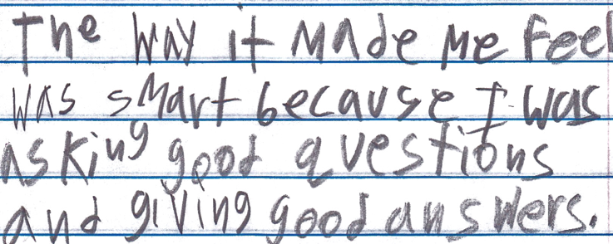
Student Reflection
“The way it made me feel was smart because I was asking good questions and giving good answers.”
-Boston 9th grade remedial summer school student

Slide 42
More Classroom Examples
#QFTCon #QFT

Slide 43
Question Focus

Slide 44
Student Questions
Is the alligator camouflaged?
Why do the babies have stripes?
Are those baby crocodiles?
Is it a mom or dad crocodile?
What is the green stuff?
Why are they in the water so low?
Where are they going?
Why are the baby alligator’s eyes white and the mom’s black?
Why are baby alligators on top of the momma alligator?
Why does momma or daddy have bumps on them?

Slide 45
Classroom Example: Kindergarten
Teacher: Jennifer Shaffer, Walkersville, MD
Topic: Non-fiction literacy
Purpose: To engage students prior to reading a nonfiction text about alligators

Slide 46
Classroom Example: 4th Grade
Teacher: Deirdre Brotherson, Hooksett, NH
Topic: Math unit on variables
Purpose: To engage students at the start of a unit on variables

Slide 47
Question Focus
24 = ☺ + ☺ + ☺

Slide 48
Student Questions
Why is the 24 first?
What do the smiley faces mean?
Why are there 3 smiley faces?
How am I suppose to figure this out?
Is the answer 12?
Can I put any number for a smiley face?
Do three faces mean something?
Do the numbers have to be the same because the smiley faces are the same?
What numbers will work here?
Does it mean 24 is a really happy number?
Can we replace each smiley face with an 8?
Do any other numbers work?
Can we do this for any number?
Does it always have to be smiley faces?
Do we always have to use three things?

Slide 49
Next Steps
Questions posted on classroom walls.
Students cross off the questions they answer during subsequent lessons.
Teacher returns to student questions at the end of the unit to discuss with students what they learned and what they still want to know.

Slide 50
Classroom Example: 4th Grade Novel Study
Teacher: Deirdre Brotherson
Topic: Out of My Mind by Sharon Draper, a book about a young girl with cerebral palsy
Purpose: Get students thinking about an extension project question
Introduced about 2/3rds of the way through the book
Assignment: Develop a question that you will be able to answer through research that will teach the class something about cerebral palsy we have not learned in the book.

Slide 51
Question Focus
Cerebral Palsy

Slide 52
Student Questions
Are wheelchairs expensive?
Are talk boxes expensive?
Are people making talk boxes better?
Do people use other things to help people?
Can robotics be used to help?
Do people adopt kids with cerebral palsy?
How long do people live?
Can it get better?
Do you always know if someone has cerebral palsy?
Can famous people have cerebral palsy?
Did a president have cerebral palsy?
Has there always been cerebral palsy in history?
Who discovered cerebral palsy?
Does Stephen Hawking have cerebral palsy?
Are people with cerebral palsy smarter?
How do I meet someone with cerebral palsy?
Are there other books about other people?
What is cerebral palsy?
Who can get cerebral palsy?
How do you get cerebral palsy?
Can we help someone with cerebral palsy?
How can we help someone with cerebral palsy?
Do all the kids in a family have cerebral palsy?
Is it always the oldest kid who gets cerebral palsy?
Is everyone with cerebral palsy like Melody?
Does everyone with cerebral palsy need a wheel chair and a talk box?
Are there different types of cerebral palsy?
Can people with cerebral palsy walk on their own?
Does anybody speak?
Can I play sports if I have cerebral palsy?
If twins are born do they both have cerebral palsy?
How many people have cerebral palsy?

Slide 53
Results: Student projects
Student projects covered many subjects:
Twins
Types
Robotics
Athletes
Beauty queen
Artist
Wheel chair improvements
Music therapy
Review of other books and movies
Lesson about how to treat people

Slide 54
Results: What I saw in the classroom…
Students got to work right away
No one struggled with what topic to do
Total engagement in project
Stronger students excelled
Students shared resources and talents with classmates
Struggling students also excelled with a different type of project
Presentations varied
Class was engaged during presentations
Questions asked of presenters were high quality
After presentation we all walked away with more

Slide 55
QFT: An ART and a SCIENCE
The Science:
A rigorous protocol, with specific steps and sequence, that produces consistent results
The QFT
Discuss the rules
Present a Question Focus
Improve questions
Prioritize questions
Discuss next steps
Reflect

Slide 56
QFT: An ART and a SCIENCE
The Art:
Tailoring the QFT process to the specific content and students you are teaching.
Tailor the QFT through:
Design of the Question Focus (Qfocus)
Instructions for prioritizing
Next steps for using the questions
Reflection questions
Facilitation

Slide 57
Five Areas Related to the Art of the QFT
Linking the QFT to Teaching and Learning Goals
QFocus Design
Prioritization Instructions
Reflection Questions
Facilitation

Slide 58
Various Teaching Purposes
Engagement
Knowledge acquisition
Formative assessment
Summative assessment
Peer review
Skill development

Slide 59
Five Areas Related to the Art of the QFT
Linking the QFT to Teaching and Learning Goals
QFocus Design
Prioritization Instructions
Reflection Questions
Facilitation

Slide 60
Classroom Example: High School
Teacher: Joan Soble, Cambridge, MA
Topic: Albert Camus’s The Plague
Purpose: Pre-reading engagement and prediction of central themes going into the text

Slide 61
Initial Question Focus:

Slide 62
Revised Question Focus:
The city fathers were aware that the decaying bodies of these rodents were making people sick. (page 28)

Slide 63
Next Steps with Student Questions
Pop Quiz or Reading Check
Debate Prep
Paper topic
Lab work & Experiments
Exit ticket or ”Do Now”
Hang on walls,
Check Off as Answered
Research
Projects
Test Prep
And sometimes…
Nothing!
Homework
Class discussion prompts
Presentations
Student Choice Projects
Socratic Seminar Prompts
Interview an Expert
Make Your Own Final Test
Journal Prompt
Guest speakers
Close Reading Protocol
Year-long or Unit-long Essential Questions
Tailoring Instruction
Service Action Projects

Slide 64
Closing Reflections
What did you learn?
An “a-ha moment” or a meaningful take away from your experience today

Slide 65
Final Words: Universal Relevance
#QFTCon #QFT

Slide 66
In the Age of Google…
“How should you respond when you get powerful new tools for finding answers?
Think of harder questions.”
Clive Thompson, Journalist and Technology Blogger

Slide 67
The Skill of Asking Questions
For moving from ignorance as weakness to ignorance as opportunity
For arriving at better answers (and more questions)
For increasing engagement and ownership
For demonstrating inquiry in the classroom
For a little more joy in a very demanding profession
And…

Slide 68
Democracy
“We need to be taught to study rather than to believe, to inquire rather than to affirm.” - Septima Clark
See Chapter 6 on Septima Clark in Freedom Road: Adult Education of African Americans (Peterson, 1996).

Slide 69
Join our Educator Network at RightQuestion.org for…
Templates you can use tomorrow in class
Lesson planning tools
Classroom examples
Instructional videos
Forums and discussions with other educators
Other free downloadable resources

