Slide 1
Best Practices in the Question Formulation Technique (QFT)
Cuyahoga County ESC
Independence, OH
January 10, 2018
Sarah Westbrook & John Sessler
The Right Question Institute
Cambridge, MA

Slide 2
Today’s Agenda
Welcome and Community Building
Collaborative Learning with the Question Formulation Technique (QFT)
Active Work with a Lesson Planning Tool
Lunch
Facilitation Principles & The Art and The Science of the QFT
Self-organized Working Groups
Moving into Action
Reflection & Evaluation
#QFT

Slide 3
To Access Today’s Materials:
http://rightquestion.org/educators/
seminar-resources/
Join our Educator Network for:
Templates you can use tomorrow in class
Classroom Examples
Instructional Videos
Forums and Discussions with other Educators

Slide 4
QFT: An ART and a SCIENCE
The Science:
A rigorous protocol, with specific steps and sequence, that produces consistent results
The QFT
Discuss the rules
Present a Question Focus
Improve questions
Prioritize questions
Discuss next steps
Reflect

Slide 5
QFT: An ART and a SCIENCE
The Art:
Tailoring the QFT process to the specific content and students you are teaching.
Tailor the QFT through:
Design of the Question Focus (Qfocus)
Instructions for prioritizing
Next steps for using the questions
Reflection questions
Facilitation

Slide 6
Five Areas Related to the Art of the QFT
Facilitation
Linking the QFT to Teaching and Learning Goals
QFocus Design
Prioritization Instructions
Reflection Questions

Slide 7
Four Principles of Facilitation
Monitor student adherence to the process
Do not give examples
Do not get pulled into group discussion
Acknowledge all contributions equally
Discuss: What could be challenging about each principle? What might be important about each?

Slide 8
Five Areas Related to the Art of the QFT
Facilitation
Linking the QFT to Teaching and Learning Goals
QFocus Design
Prioritization Instructions
Reflection Questions

Slide 9
The QFT as a Shortcut, Not a Detour

Slide 10
Various Teaching Purposes
Engagement
Knowledge acquisition
Formative assessment
Summative assessment
Peer review
Skill development

Slide 11
Using the QFT for Engagement

Slide 12
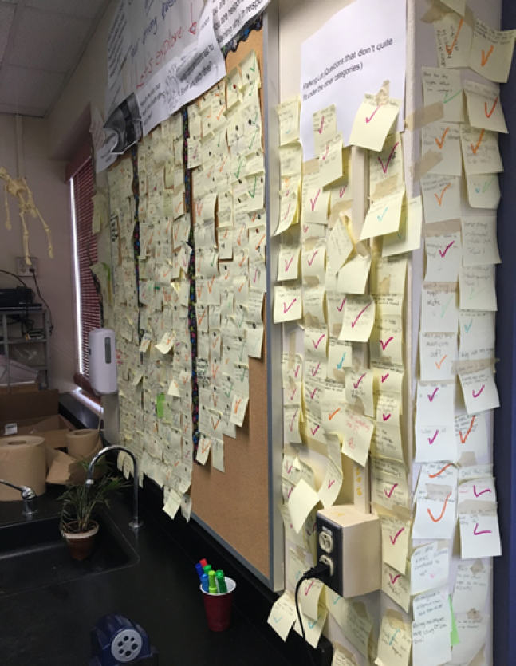
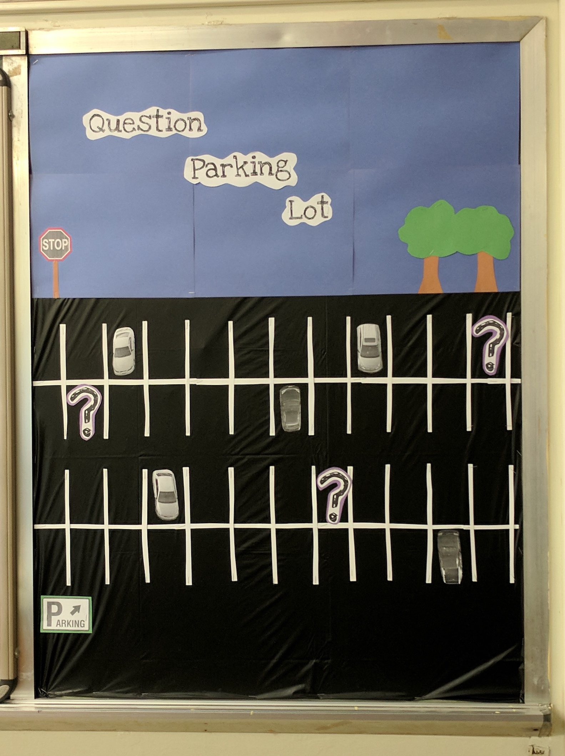
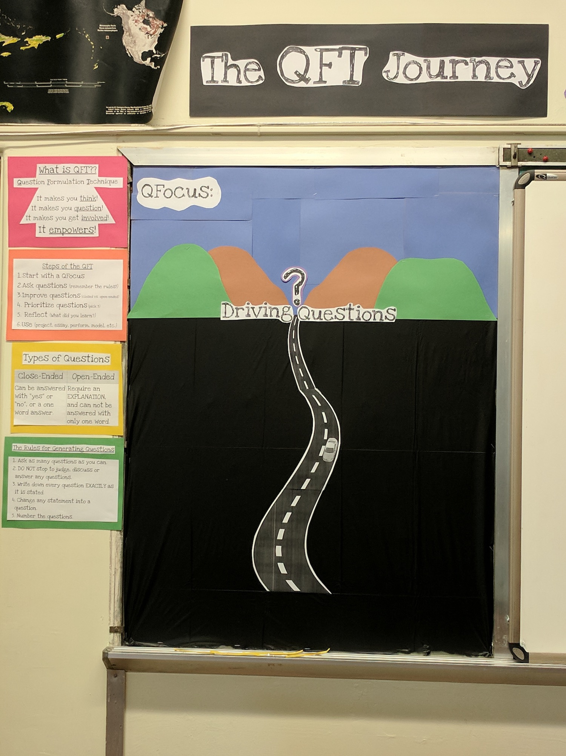
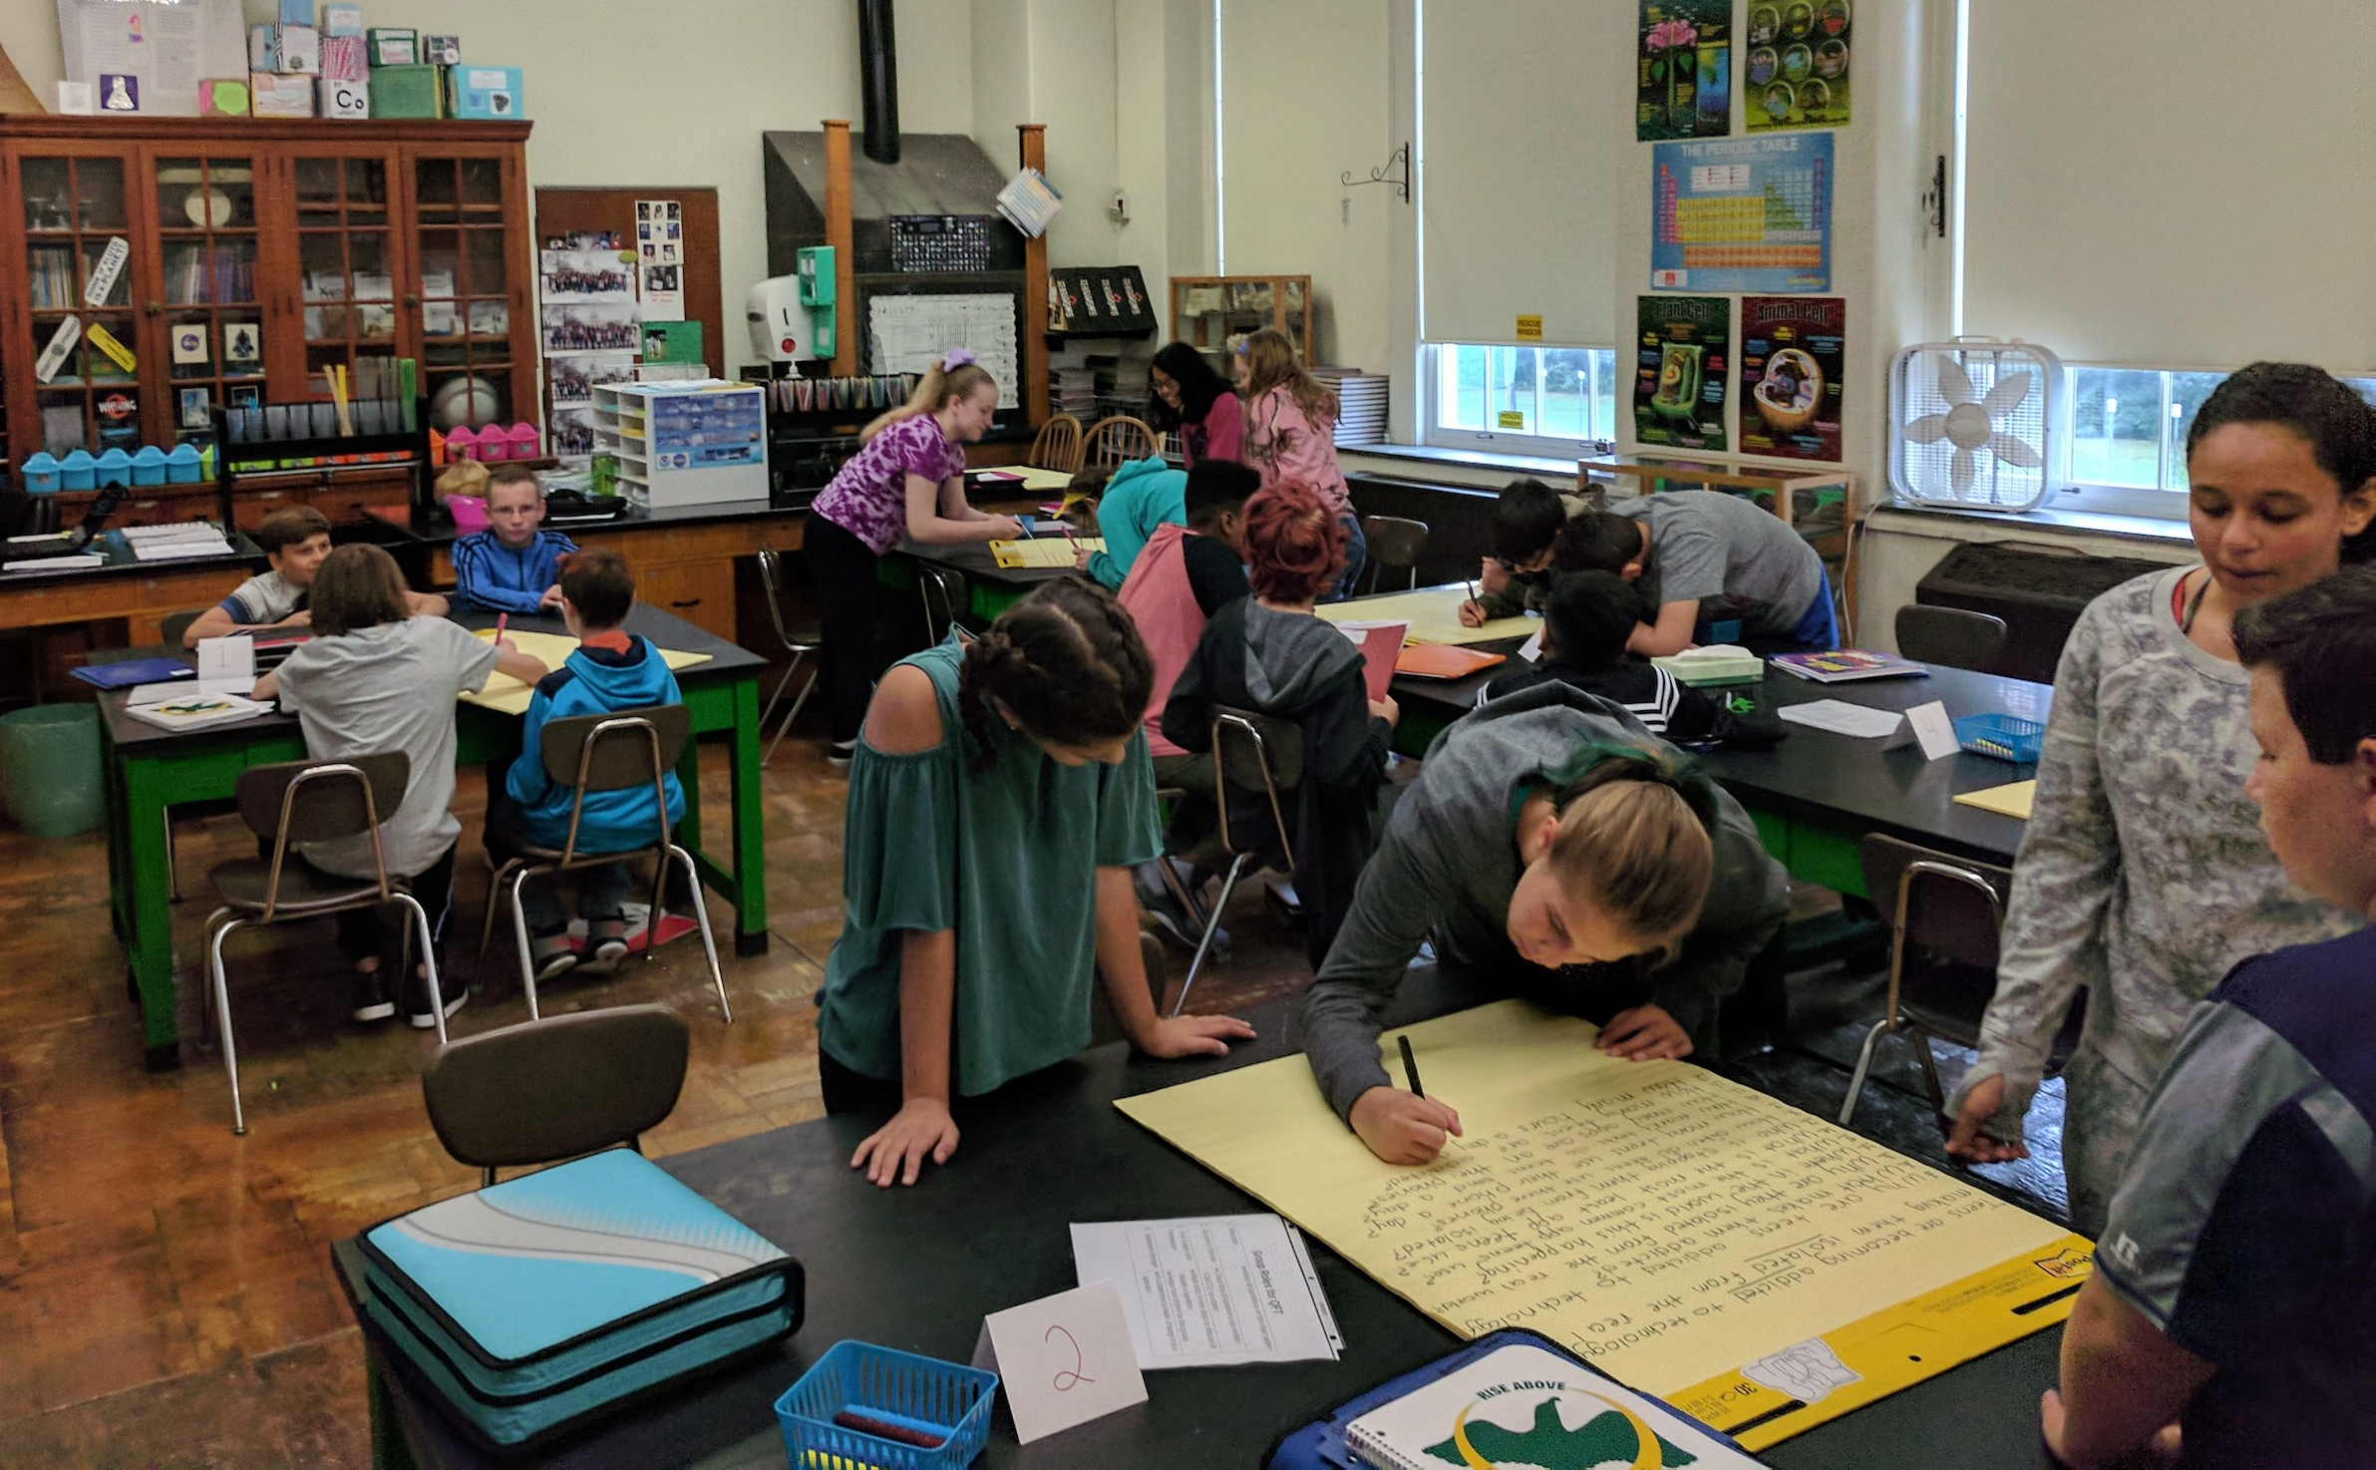
Next Steps with Student Questions
The Driving Question Board
The “Parking Lot”
Ongoing student choice projects

Slide 13
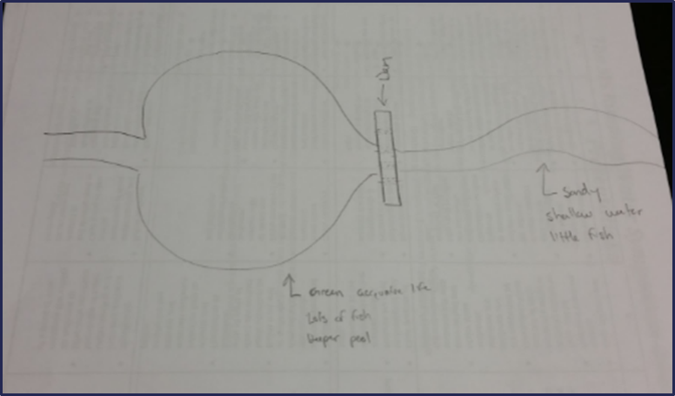
Using the QFT for Peer Review
Scientist’s claim:
“Adding a dam to a water system causes a decrease in aquatic life downstream.”
Student Design to test the claim:
Notes:
Teacher: Allison Gest, Park Ridge, IL
Topic: 11th & 12th Grade Geology
Purpose: To help students design a running water experiment and then refine their designs
*Note: teacher also used a QFT process first with the scientist’s claim as a Qfocus. Students designed their experiments based on their own questions (generated during the QFT about the scientist’s claim)

Slide 14
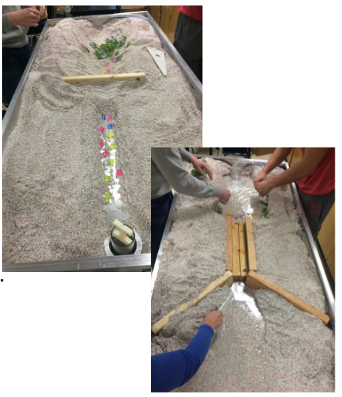
Next Steps with Student Questions:
Notes:
Students used the QFT on a different group’s design.
Students then revised their design informed by the questions from their peers.
Groups tested their final experiment design.

Slide 15
Using the QFT for Skill Development
(Students were assigned a complex molecular biology article)
QFocus: Ask as many questions as you can about the reading
Notes:
Teacher: Rachel Woodruff, Assistant Professor of Biology, Brandeis University, MA
Topic: Molecular Biology
Purpose: To build students’ research skills and prepare them to develop their own research proposal

Slide 16
Next Steps with Student Questions:
Students generate questions as homework then bring in to class
Students discuss key attributes of a good biological research question and compare to other types of questions
Students form groups and improve their questions, based on these attributes
These questions are discarded or kept in notebooks (up to the student)
Students apply this skill to designing their own research project later in the semester

Slide 17
Various Teaching Purposes
Engagement
Knowledge acquisition
Formative assessment
Summative assessment
Peer review
Skill development

Slide 18
Next Steps?
Pop Quiz or Reading Check
Debate Prep
Paper topic
Lab work & Experiments
Exit ticket or ”Do Now”
Hang on walls,
Check Off as Answered
Research
Projects
Test Prep
And sometimes…
Nothing!
Homework
Class discussion prompts
Presentations
Student Choice Projects
Socratic Seminar Prompts
Interview an Expert
Make Your Own Final Test
Journal Prompt
Guest speakers
Close Reading Protocol
Year-long or Unit-long Essential Questions
Tailoring Instruction
Service Action Projects

Slide 19
Five Areas Related to the Art of the QFT
Facilitation
Linking the QFT to Teaching and Learning Goals
QFocus Design
Prioritization Instructions
Reflection Questions

Slide 20
Initial Qfocus: Middle School

Slide 21
Initial QFocus: Middle School

Slide 22
Revising the Question Focus
Picture of the School Building
“As a member of the Haviland Middle School 6th grade, you will have numerous opportunities to grow and learn.”
Notes:
Activity: Here’s how Doreen revised it and here’s the effect. If we were going to revise for next year, what would you do with this Q-Focus, now with the benefit of hindsight and having analyzed the student’s questions? What advice might you give to this teacher?
Think and share out to the whole group.

Slide 23
Initial QFocus: High School
“History, despite its wrenching pain, cannot be unlived, but if faced with courage, need not be lived again.”
– Maya Angelou
Troubleshooting Tips:
“Spend the next 2 minutes asking about just this word/phrase”
Change the Prioritization Instructions on the fly
Notes:
Providence Country Day School, AP US History, Brady

Slide 24
Five Areas Related to the Art of the QFT
Facilitation
Linking the QFT to Teaching and Learning Goals
QFocus Design
Prioritization Instructions
Reflection Questions

Slide 25
Prioritization Instructions
Choose the three most important questions
Choose the three questions you consider most important.

Slide 26
Categories of Prioritization Instructions
Choose three questions…
General Instructions:
that you consider most important
Specific Purposes:
that you need to research further
to help you solve the problem
that you need to answer first
that a scientist studying the earth might ask
that will help you understand the text
that require analyzing data
that are not “Googleable” and may be difficult to answer

Slide 27
Five Areas Related to the Art of the QFT
Facilitation
Linking the QFT to Teaching and Learning Goals
QFocus Design
Prioritization Instructions
Reflection Questions

Slide 28
Examples of Reflection Questions
QFT Process
Content Specific
What did you learn about asking questions?
How did you learn it?
What do you understand differently now about asking questions?
How can you use what you learned about asking questions?
How do you feel about asking questions?
What did you learn about the (content)?
How did the QFT process help you think about…
key concept
specific assignment
overarching topic
theme in the unit
chapter you just read

Slide 29
The Science of the QFT: a protocol
The Art of the QFT: You
Notes:
The key role of the teacher:
Behind the scenes as lesson planner
Facilitate process according to the steps of the QFT and the five facilitation principles
Use student questions as part of next steps

Slide 30
Putting it into Practice

Slide 31
Today’s Agenda
Welcome and Community Building
Collaborative Learning with the Question Formulation Technique (QFT)
Active Work with a Lesson Planning Tool
Lunch
Facilitation Principles & The Art and The Science of the QFT
Self-organized Working Groups
Moving into Action
Reflection & Evaluation
#QFT

Slide 32
Today’s Agenda
Welcome and Community Building
Collaborative Learning with the Question Formulation Technique (QFT)
Active Work with a Lesson Planning Tool
Lunch
Facilitation Principles & The Art and The Science of the QFT
Self-organized Working Groups
Moving into Action
Reflection & Evaluation
#QFT

Slide 33
Planning Your Next Steps
With your group, plan the 3 next steps you will take with the QFT after your work here today.
Then, create a poster about your next steps with the QFT. Be as artistic and creative as possible! Be prepared to share.

Slide 34
Gallery Walk
As you read what other groups have written, consider which ideas might be useful to you. What most interests or surprises you about the ideas that come up? Why?
Be prepared to share out with the group.

Slide 35
So, where do we go from here?

Slide 36
Now, Educators Lead the Work
The Right Question Institute offers materials through a Creative Commons License and we encourage you to make use of and/or share this resource. Please reference the Right Question Institute and rightquestion.org as the source on any materials you use.

Slide 37
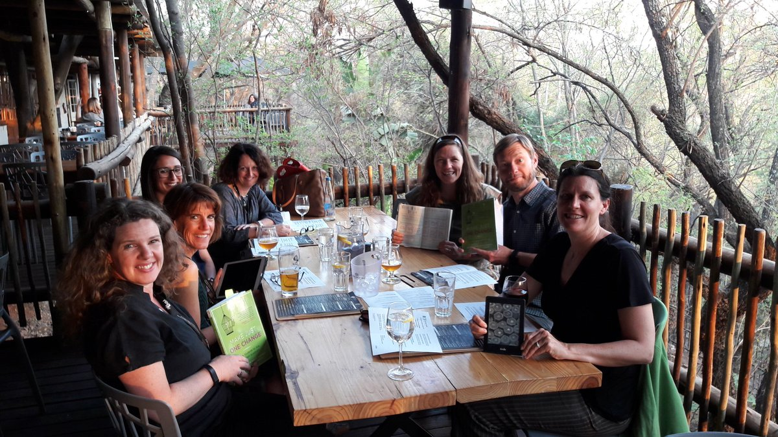
Facilitating book clubs with Make Just One Change

Slide 38
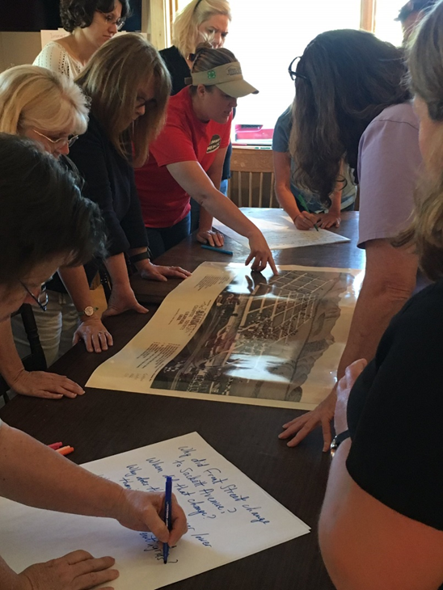
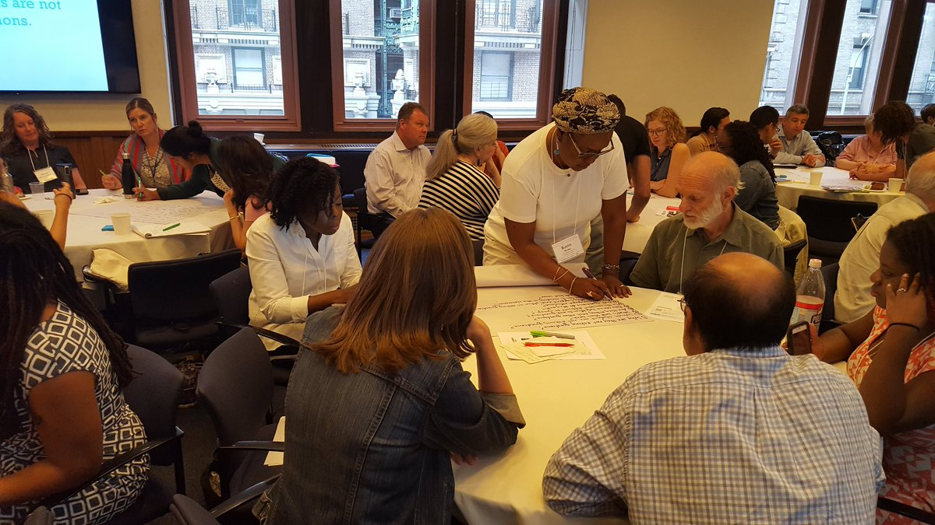
Delivering PD in their departments, schools, and districts
Knee deep in @RightQuestion on a Sunday learning together so that historic places are in the classroom
@TPSMSUDenver @TeachingLC

Slide 39
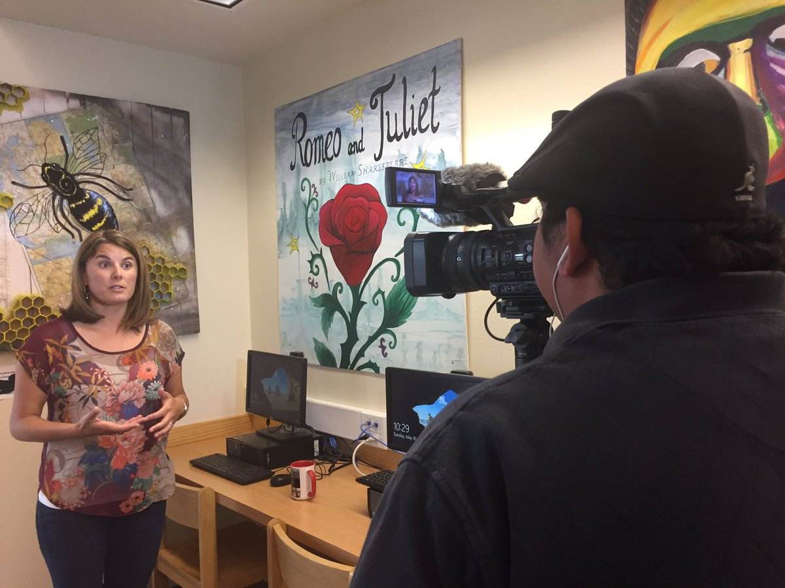
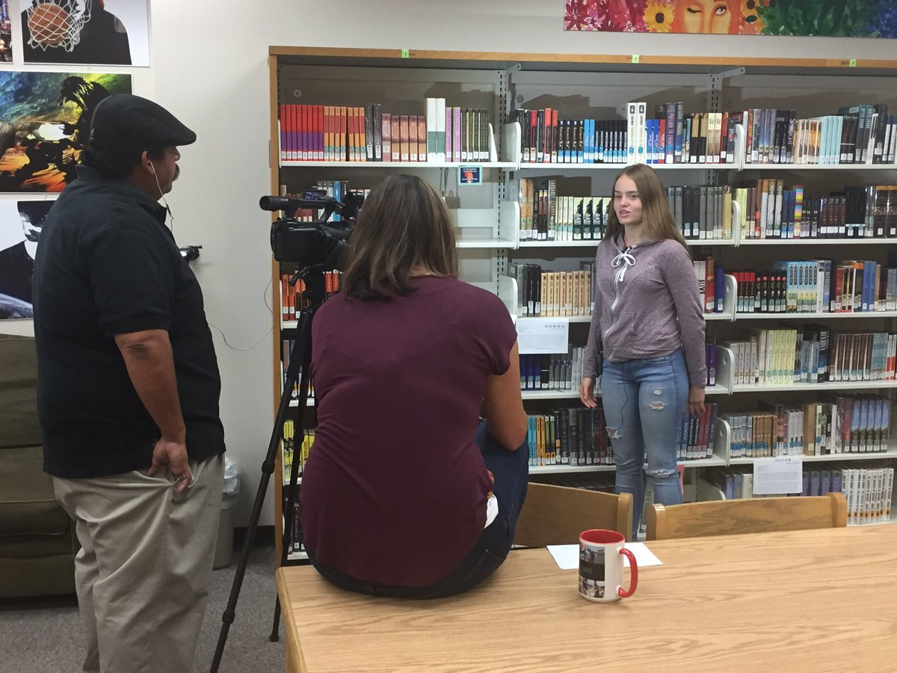
Filming instructional videos & creating online resources ‘[‘;//
That's a wrap! Ss & Ts at @ohs_jackets filmed by @GodoyStudios and interviewed on their experience w/ the #QFT

Slide 40
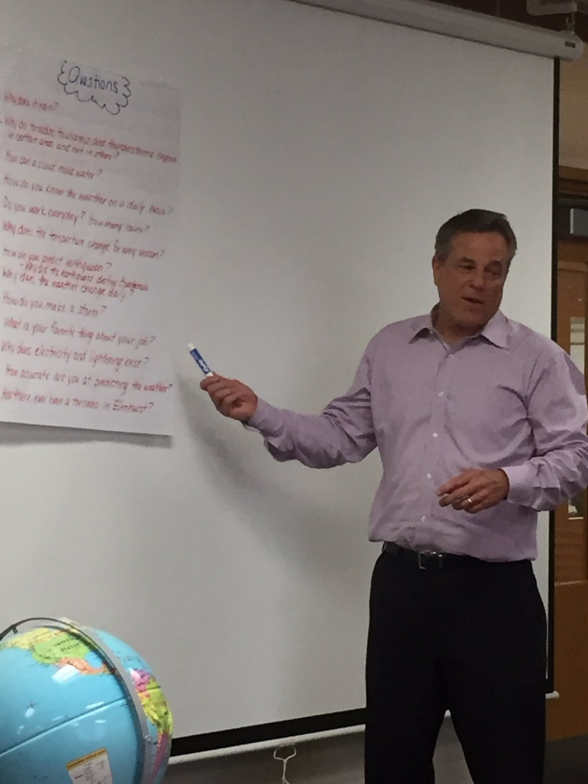
Tweeting QFT examples to school leaders, reporters, authors, and industry leaders…and getting their attention!
Thank you Phil Schwartz from @ABC7Chicago for answering our #QFT questions this morning. @Fischerspirit #d205learns
S. E. Hinton Retweeted Right Question
One of the reasons why teachers are my heroes.
Hi @BillNye As a 7th grade science teacher, I encourage young scientists to question and figure out phenomena! #BillMeetScienceTwitter

Slide 41
And continuing to do innovative, creative work with students

Slide 42
…as a two-way street
RQI’s Vision of Professional Learning
RQI’s design of professional learning experiences
Professional implementation & learning
#QFTCon #QFT

Slide 43
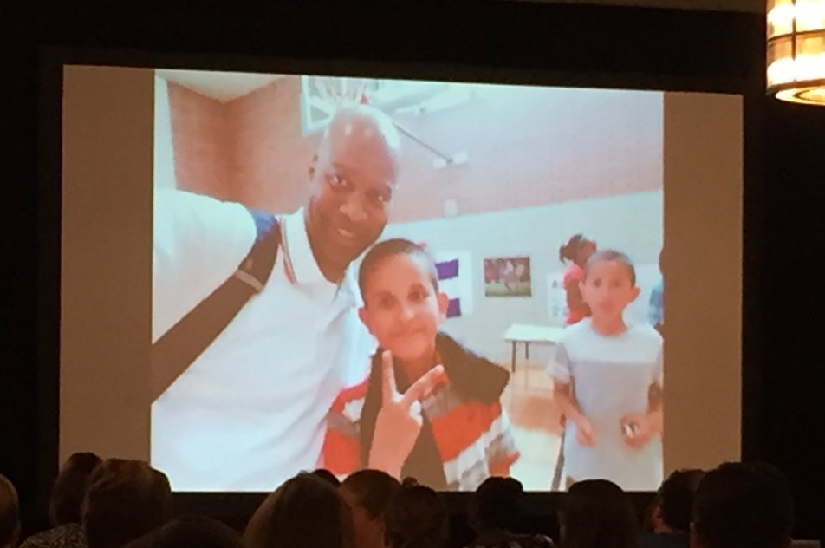
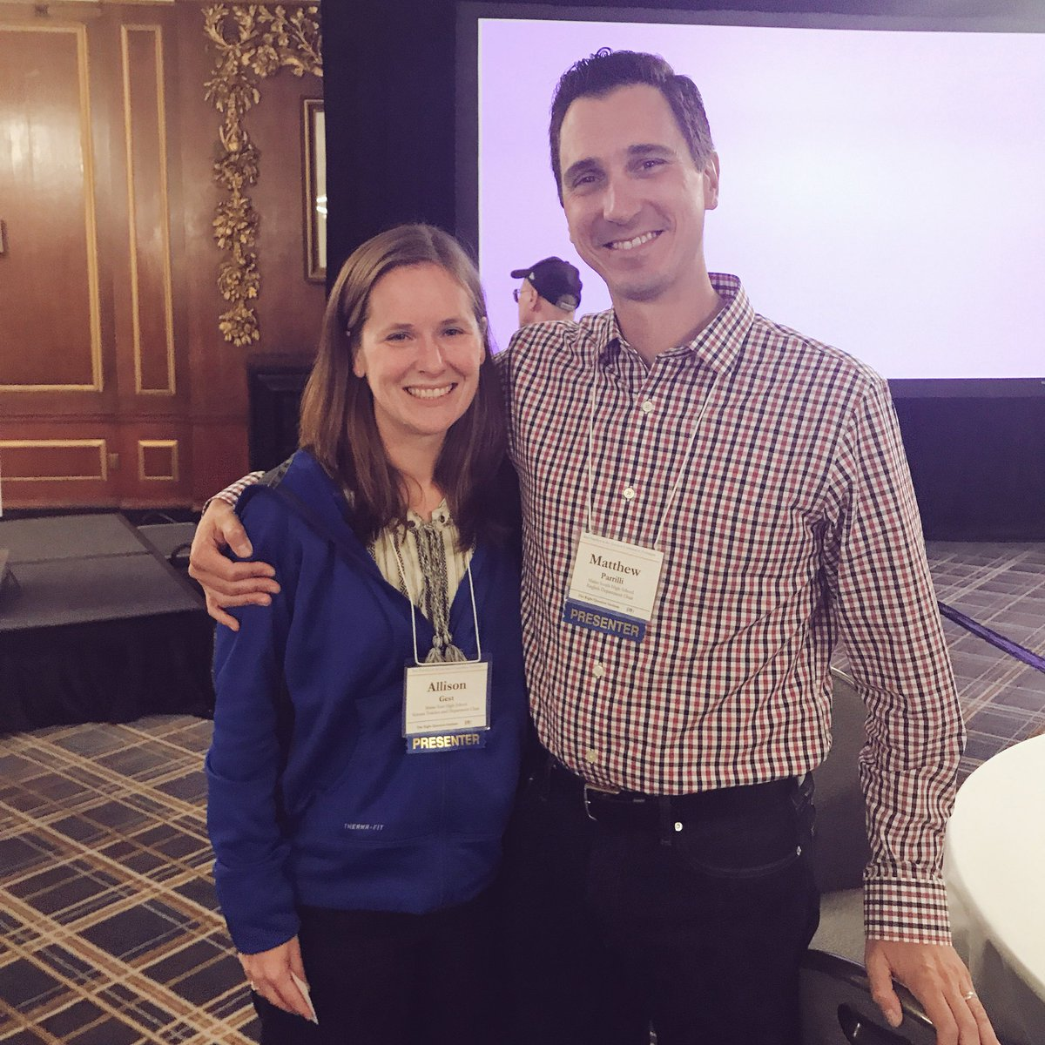
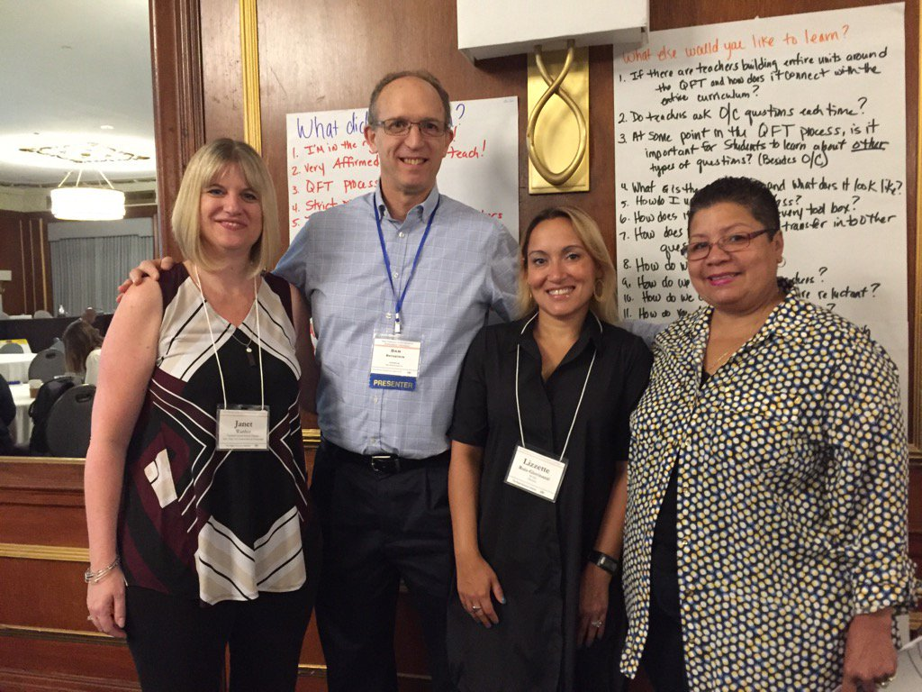
A Growing Community of Practice

Slide 44
Today’s Agenda
Welcome and Community Building
Collaborative Learning with the Question Formulation Technique (QFT)
Active Work with a Lesson Planning Tool
Lunch
Facilitation Principles & The Art and The Science of the QFT
Self-organized Working Groups
Moving into Action
Reflection & Evaluation
#QFT

Slide 45
Closing Reflections
We shall not cease from exploration
And the end of all our exploring
Will be to arrive where we started
And know the place
For the first time.
--T.S. Eliot

Slide 46
Closing Reflections
What did you learn?
An “a-ha moment” or a meaningful take away from your experience today
A key question that will guide your work

Slide 47
Making a Contribution to Democracy
“We need to be taught to study rather than to believe, to inquire rather than to affirm.” - Septima Clark
See Chapter 6 on Septima Clark in Freedom Road: Adult Education of African Americans (Peterson, 1996).

