Slide 1
ERN
2018
An introduction to the Question Formulation Technique (QFT)
Luz Santana
Co-Director
The Right Question Institute

Slide 2
Acknowledgments
We are deeply grateful to the John Templeton Foundation and The Hummingbird Fund for their generous support of the Right Question Institute’s Million Classrooms Campaign.

Slide 3
Tweet…
@RightQuestion

Slide 4
"There is no learning without having to pose a question."
- Richard Feynman
Nobel-Prizewinning physicist

Slide 5
LAWRENCE, MA, 1990
“We don’t go to the school because we don’t even know what to ask.”

Slide 6
“If you are a researcher you are trying to figure out what the question is as well as what the answer is.
“You want to find the question that is sufficiently easy that you might be able to answer it, and sufficiently hard that the answer is interesting.”
-- Edward Witten
Physicist, Institute of Advanced Study

Slide 7
“We must teach students how to think in questions, how to manage ignorance.”
Stuart Firestein
Former chairman of the Department of Biology at Columbia University

Slide 9
College Presidents on What Students Should Learn in College
“The primary skills should be analytical skills of interpretation and inquiry. In other words, know how to frame a question.”
- Leon Botstein, President of Bard College
“…the best we can do for students is have them ask the right questions.”
- Nancy Cantor, Chancellor of University of Illinois
The New York Times, August 4, 2002

Slide 10
Yet…only 27%of students believe college taught them to ask their own questions
Alison Head, Project Information Literacy at University of Washington, 2016

Slide 11
But, the problem begins long before college...

Slide 12
Percentage of Basic Skill Attainment
Sources
http://nces.ed.gov/nationsreportcard/pdf/main2009/2011455.pdf
http://nces.ed.gov/nationsreportcard/pubs/main2007/2008468.asp#section1
Data on question-asking based on parent and teacher feedback

Slide 13
Percentage of Basic Skill Attainment
Sources
http://nces.ed.gov/nationsreportcard/pdf/main2009/2011455.pdf
http://nces.ed.gov/nationsreportcard/pubs/main2007/2008468.asp#section1
Data on question-asking based on parent and teacher feedback

Slide 14
What happens when students learn to ask their own questions?

Slide 15
Student Reflections
“Just when you think you know all you need to know, you ask another question and discover how much more there is to learn.”
~ Sixth-grade student, Palo Alto, CA
“When you ask the question, you feel like it’s your job to get the answer.”
~ High School student, Boston, MA

Slide 16
The Question Formulation Technique (QFT)
Students learn to:
Produce their own questions
Improve their questions
Strategize on how to use their questions
Reflect on what they have learned and how they learned it
#QFTCon #QFT

Slide 17
Classroom Example: 4th Grade
Teacher: Deirdre Brotherson, Hooksett, NH
Topic: Math unit on variables
Purpose: To engage students at the start of a unit on variables

Slide 18
Question Focus
24 = ☺ + ☺ + ☺
Teacher: Deirdre Brotherson, 4th Grade in Hooksett, NH

Slide 19
Selected Student Questions
Why is the 24 first?
What do the smiley faces mean?
Why are there 3 smiley faces?
How am I suppose to figure this out?
Is the answer 12?
Can I put any number for a smiley face?
Do three faces mean something?
Do the numbers have to be the same because the smiley faces are the same?
What numbers will work here?
Does it mean 24 is a really happy number?
Can we replace each smiley face with an 8?
Do any other numbers work?
Can we do this for any number?
Does it always have to be smiley faces?
Do we always have to use three things?

Slide 20
Classroom Example: High School
Teacher: Daniel Fouts, Des Plaines, IL
Topic: 12th Grade Government unit on the American presidency at moments of crisis
Purpose: To engage students at the start of the unit and to help students select a topic for an independent project

Slide 21
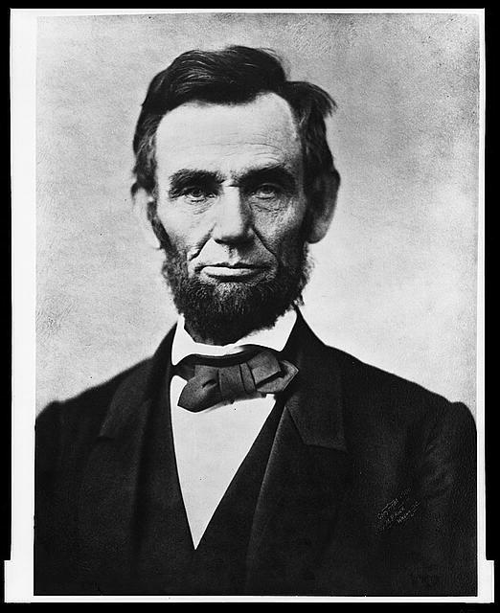
Question Focus
“Nearly all men can handle adversity; but if you really want to test a man’s character, give him power.”
Teacher: Dan Fouts, 12th Grade Park Ridge, IL

Slide 22
Selected Student Questions
How does power challenge one’s morality?
Should everyone have some type of power?
Does power make people corrupt?
What if the person who is qualified for power doesn’t attain it?
How is a man’s power tested?
What is considered power?
What defines good character?
How can we ensure that the good men get the power?
What kind of man can handle adversity?
What can power tell us about a man’s character?
How can power be obtained by adversity?
Why are some people affected by power differently?
If adversity supposedly makes you stronger, does that mean that power makes you weaker?

Slide 23
Classroom Example: College Biology
Teacher: Professor Dan Perlman, Ph.D. Associate Provost of Innovation in Education, Professor of Biology, Brandeis University
Topic: Evolutionary Ecology
Purpose: Introducing and concluding a course on evolutionary biology

Slide 24
Question Focus
Organisms
Andrewartha, H. G.

Slide 25
Classroom Example: College Biology
Through their questions [about The Distribution and Abundance of Organisms] at the start of the semester, students identified ALL of the sub-disciplines in ecology, which led them to create a course of study for the semester.
At the end of the semester, students compared their initial and final questions and saw how much more sophisticated their questions had become.

Slide 26
Examples of Student Growth
How do you measure species abundance?
→ How do you measure a species abundance if it has a naturally varying population size?
What are the typical pattern of abundance? Distribution?
→ When measuring distribution, how do we define a species when it gradually changes over space?

Slide 27
“The QFT is a way to organize your thinking, [even] around a topic you know nothing about.”
– Stephen Quatrano, Right Question Institute Board Member & Lexington resident

Slide 28
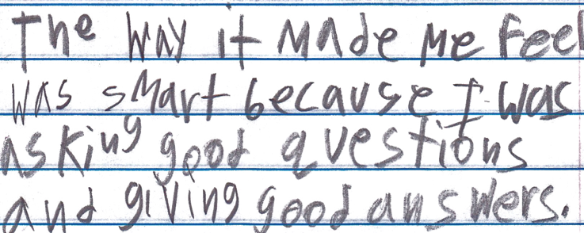
Student Reflections
“The way it made me feel was smart because I was asking good questions and giving good answers.”
--Boston 9th grade student in a remedial summer school program with teacher Ling-Se (Peet) Chesnakas

Slide 29
Student Reflections
“I learned that I need to think more seriously about the way you frame and ask a question, which influences not only the response you receive but also your own sense of role and empowerment.”
– Student, Harvard Law School
“The QFT really teaches a way of thinking so that students can be thinking critically every time they read, trying to connect the concepts and deciding whether to take facts and information at face value or to dig a little deeper.”
– Undergraduate Student, Brandeis University

Slide 30
An Opportunity to Think Together…
An Experience in the Question Formulation Technique

Slide 31
Rules for Producing Questions
1. Ask as many questions as you can
2. Do not stop to answer, judge, or discuss
3. Write down every question exactly as stated
4. Change any statements into questions

Slide 32
Question Focus:
Finding a mentor when I get
to a new career path

Slide 33
Categorizing Questions: Closed/ Open
Definitions:
Closed-ended questions can be answered with a “yes” or “no” or with a one-word answer.
Open-ended questions require
more explanation.
Directions: Identify your questions as closed-ended or open-ended by marking them with a “C” or an “O.”

Slide 34
Improving Questions
Take one closed-ended question and change it into an open-ended question.
Take one open-ended question and change it into a closed-ended question.
Closed
Open
Open
Closed

Slide 35
Prioritizing Questions
Review your list of questions
Choose the three questions you consider most important.
While prioritizing, think about your Question
Focus: Finding a mentor when I get to a new career path
After prioritizing consider…
Why did you choose those three questions?
Where are your priority questions in the sequence of your entire list of questions?

Slide 36
Share
Questions you changed from open/closed
Your three priority questions and their numbers in your original sequence
Rationale for choosing priority questions
Next steps

Slide 37
Reflection
What did you learn?
How did you learn it?
What do you understand differently now about some students not asking questions?

Slide 38
The QFT, on one slide…
Question Focus
Produce Your Questions
Follow the rules
Number your questions
Improve Your Questions
Categorize questions as Closed or Open-ended
Change questions from one type to another
Prioritize Your Questions
Share & Discuss Next Steps
Reflect
Ask as many questions as you can
Do not stop to discuss, judge or answer
Record exactly as stated
Change statements into questions
Closed-Ended:
Answered with “yes,” “no” or one word
Open-Ended: Require longer explanation

Slide 39
Let’s peek inside the black box
#QFTCon #QFT

Slide 40
Curiosity and Rigor
Three thinking abilities
with one process

Slide 41
The art and the science of the QFT
CONVERGENT
THINKING
DIVERGENT THINKING
METACOGNITIVE THINKING

Slide 42
Individual Skills and Democracy
Image Courtesy of Highlander Research and Education Center

Slide 43
Democracy
“We need to be taught to study rather than to believe, to inquire rather than to affirm.” - Septima Clark
See Chapter 6 on Septima Clark in Freedom Road: Adult Education of African Americans (Peterson, 1996).

