Slide 1
Making it Easier
to Foster Curiosity
Character LAB
Philadelphia, PA
March 6th, 2018
Dan Rothstein
Co-Director
The Right Question Institute

Slide 2

Acknowledgments
We are grateful to the Sir John Templeton Foundation and The Hummingbird Fund for their generous support of the Right Question Institute’s Million Classrooms Campaign. We appreciate Jeremy Steinberg’s work behind the scenes for this session.
I am very grateful to Tomoko Ouchi for her work with me in thinking and preparing for this session, Andrew Minigan for his research gems, Luz Santana and Sarah Westbrook for their on-going contributions to our current thinking.
@RothsteinDan

Slide 3
We shall not cease from exploration
And the end of all our exploring
Will be to arrive where we started
And know the place
For the first time.
-T.S. Eliot

Slide 4
The Question Formulation Technique (QFT) on one slide…
Question Focus
Produce Your Questions
    Follow the rules
    Number your questions
Improve Your Questions
    Categorize questions as Closed or Open-ended
    Change questions from one type to another
Prioritize Your Questions
Share & Discuss Next Steps
Reflect
Ask as many questions as you can
Do not stop to discuss, judge or answer
Record exactly as stated
Change statements into questions
Closed-Ended:
Answered with “yes,” “no” or one word
Open-Ended: Require longer explanation

Slide 5
Part Ⅰ: Beginning the Exploration Questions and Learning
?
Why focus on questions?

Slide 6
"There is no learning without having to pose a question."
- Richard Feynman
Nobel-Prizewinning physicist

Slide 7
A 1912 Study
Romiett Stevens, 1912
The Question as a Measure of Efficiency in Instruction: A critical study of classroom practice. Columbia University Contributions to Education, No. 48
“An unusual lesson because twenty-five of the thirty-four questions were asked by the pupils.…The result was that the lesson developed an impetus born of real interest. I mention it because this lesson was unique in the series of one hundred.”

Slide 8

“We must teach students how to think in questions, how to manage ignorance.”
- Stuart Firestein
Chairman of the Department of Biology at Columbia University

Slide 9
College Presidents on What Students Should Learn in College
“The primary skills should be analytical skills of interpretation and inquiry. In other words, know how to frame a question.”
- Leon Botstein, President of Bard College
“…the best we can do for students is have them ask the right questions.”
- Nancy Cantor, Chancellor of University of Illinois
The New York Times, August 4, 2002

Slide 10
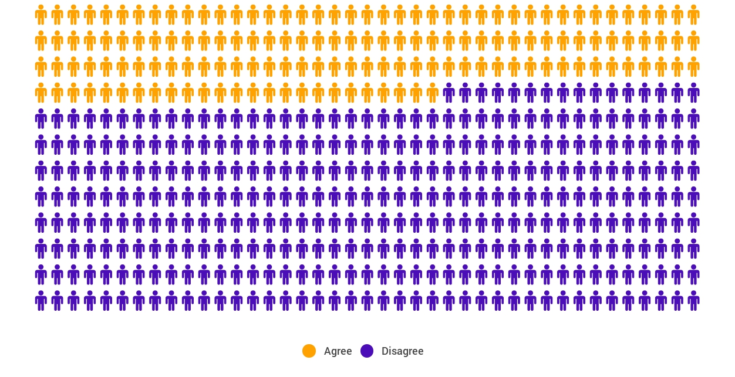
Yet…only 27%of students believe college taught them to ask their own questions
Alison Head, Project Information Literacy at University of Washington, 2016

Slide 11
But, the problem begins long before college...

Slide 12
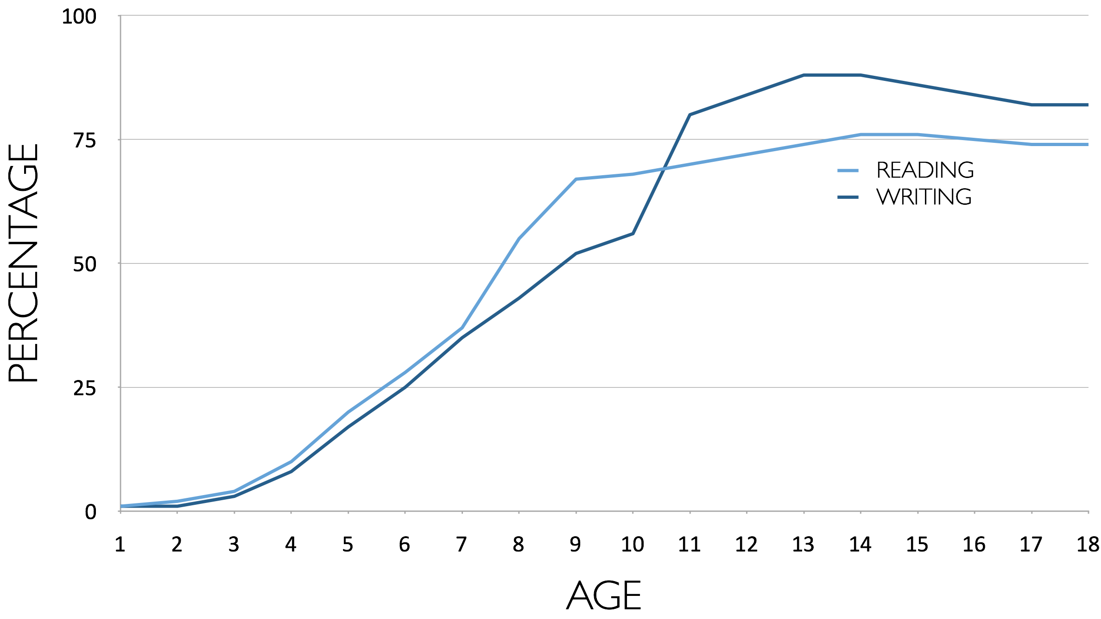
Percentage of Basic Skill Attainment
Sources
http://nces.ed.gov/nationsreportcard/pdf/main2009/2011455.pdf
http://nces.ed.gov/nationsreportcard/pubs/main2007/2008468.asp#section1
Data on question-asking based on parent and teacher feedback

Slide 13
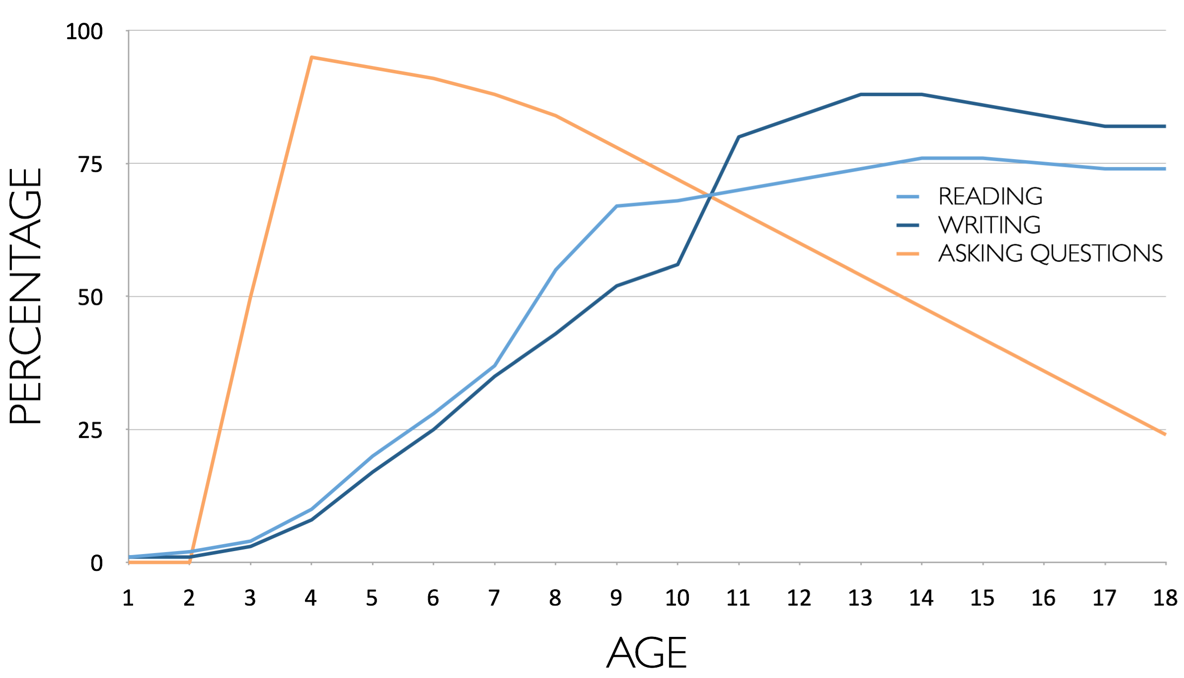
Percentage of Basic Skill Attainment
Sources
http://nces.ed.gov/nationsreportcard/pdf/main2009/2011455.pdf
http://nces.ed.gov/nationsreportcard/pubs/main2007/2008468.asp#section1
Data on question-asking based on parent and teacher feedback

Slide 14
Classroom Example:
Kindergarten
Teacher: Jennifer Shaffer, Walkersville, MD
Topic: Non-fiction literacy
Purpose: To engage students prior to reading a nonfiction text about alligators

Slide 15
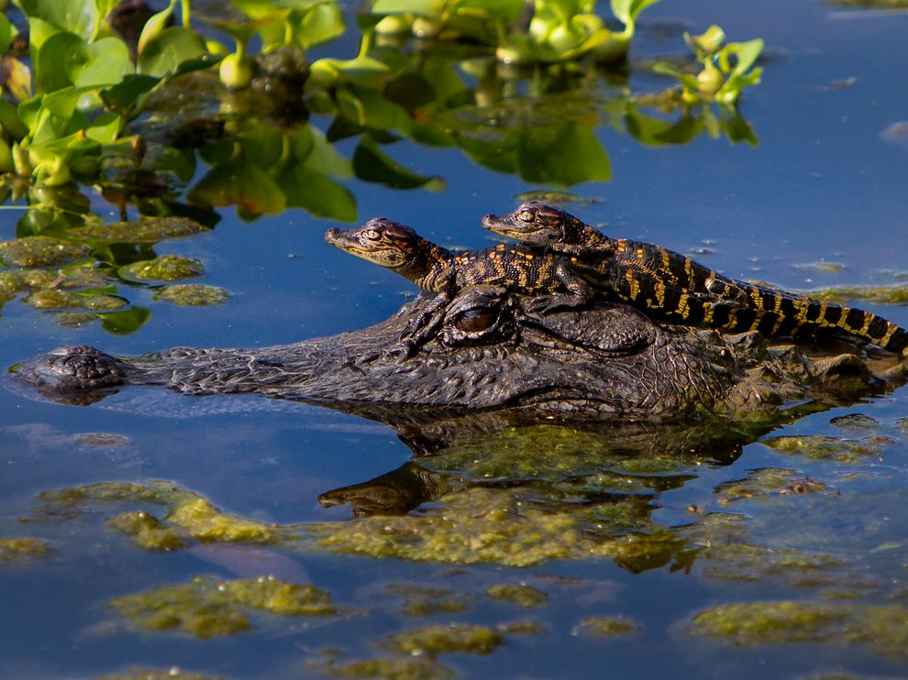
Question Focus
Photograph by Nuwan Samaranayake, 2013

Slide 16
Student Questions
Is the alligator camouflaged?
Why do the babies have stripes?
Are those baby crocodiles?
Is it a mom or dad crocodile?
What is the green stuff?
Why are they in the water so low?
Where are they going?
Why are the baby alligator’s eyes white and the mom’s black?
Why are baby alligators on top of the momma alligator?
Why does momma or daddy have bumps on them?

Slide 17
Classroom Example:
4th Grade
Teacher: Deirdre Brotherson, Hooksett, NH
Topic: Math unit on variables
Purpose: To engage students at the start of a unit on variables

Slide 18
Question Focus
24 = ☺ + ☺ + ☺

Slide 19
Student Questions
Why is the 24 first?
What do the smiley faces mean?
Why are there 3 smiley faces?
How am I suppose to figure this out?
Is the answer 12?
Can I put any number for a smiley face?
Do three faces mean something?
Do the numbers have to be the same because the smiley faces are the same?
What numbers will work here?
Does it mean 24 is a really happy number?
Can we replace each smiley face with an 8?
Do any other numbers work?
Can we do this for any number?
Does it always have to be smiley faces?
Do we always have to use three things?

Slide 20
Next Steps
Questions posted on classroom walls.
Students cross off the questions they answer during subsequent lessons.
Teacher returns to student questions at the end of the unit to discuss with students what they learned and what they still want to know.

Slide 21
Classroom Example:
High School
Teacher: Daniel Fouts, Des Plaines, IL
Topic: 12th Grade Government unit on the American presidency at moments of crisis
Purpose: To engage students at the start of the unit and to help students select a topic for an independent project

Slide 22
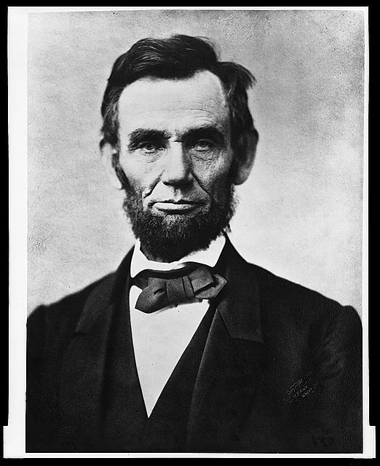
Question Focus
“Nearly all men can handle adversity; but if you really want to test a man’s character, give him power.”
https://www.loc.gov/pictures/item/96522529/

Slide 23
Student Questions
How does power challenge one’s morality?
Should everyone have some type of power?
Does power make people corrupt?
What if the person who is qualified for power doesn’t attain it?
How is a man’s power tested?
What is considered power?
What defines good character?
How can we ensure that the good men get the power?
What kind of man can handle adversity?
What can power tell us about a man’s character?
How can power be obtained by adversity?
Why are some people affected by power differently?
If adversity supposedly makes you stronger, does that mean that power makes you weaker?

Slide 24
Next Steps:
Each student selected l question from the class list to work on throughout the unit
Students answered their question using research and knowledge from the unit in a two-page reflection paper
Students shared their reflections in a class discussion on the final day of the unit

Slide 25
Classroom Example: College Biology
Teacher: Professor Dan Perlman, Ph.D. Associate Provost of Innovation in Education, Professor of Biology, Brandeis University
Topic: Evolutionary Ecology
Purpose: Introducing and concluding a course on evolutionary biology

Slide 26


Question Focus
Organisms
Andrewartha, H. G.

Slide 27
Classroom Example: College Biology
Through their questions [about The Distribution and Abundance of Organisms] at the start of the semester, students identified ALL of the sub-disciplines in ecology, which led them to create a course of study for the semester.
At the end of the semester, students compared their initial and final questions and saw how much more sophisticated their questions had become.

Slide 28
Examples of Student Growth
How do you measure species abundance?
→ How do you measure a species abundance if it has a naturally varying population size?
What are the typical pattern of abundance? Distribution?
→ When measuring distribution, how do we define a species when it gradually changes over space?

Slide 29
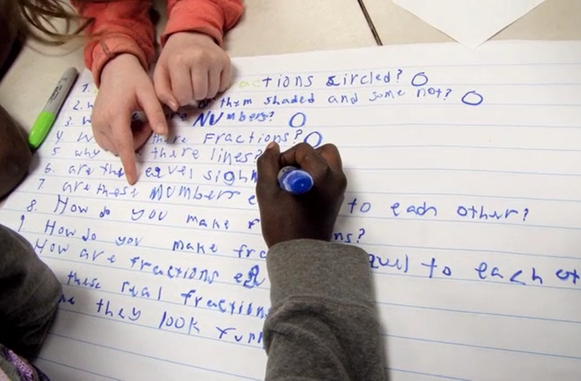
Part Ⅱ: Continuing the Exploration with the Question Formulation Technique (QFT)

Slide 30
Rules for Producing Questions
1. Ask as many questions as you can
2. Do not stop to answer, judge, or discuss
3. Write down every question exactly as stated
4. Change any statements into questions

Slide 31
  Making it Easier to Foster Curiosity
1. Ask as many questions as you can
2. Do not stop to answer, judge, or discuss
3. Write down every question exactly as stated
4. Change any statements into questions

Slide 32
Strategize: Prioritizing Questions
Review your list of questions
  Choose the three questions you are most curious to explore further.
  While prioritizing, think about your Question Focus: Making Easier to Foster Curiosity
  After prioritizing consider…
  Why did you choose those three questions?
  Where are your priority questions in the sequence of your entire list of questions?

Slide 33
Reflection
What did you learn?
How did you learn it?

Slide 34

Let’s peek inside the black box
#QFTCon #QFT

Slide 35
The QFT, on one slide…
Question Focus
Produce Your Questions
    Follow the rules
    Number your questions
Improve Your Questions
    Categorize questions as Closed or Open-ended
    Change questions from one type to another
Prioritize Your Questions
Share & Discuss Next Steps
Reflect
Ask as many questions as you can
Do not stop to discuss, judge or answer
Record exactly as stated
Change statements into questions
Closed-Ended:
Answered with “yes,” “no” or one word
Open-Ended: Require longer explanation

Slide 36
Thinking in many different directions
DIVERGENT
THINKING

Slide 37
Narrowing Down, Focusing
CONVERGENT
THINKING

Slide 38
The Importance of Questions
"Questions are the engines of intellect, the cerebral machines which convert energy to motion, and curiosity to controlled inquiry."
- David Hackett Fischer,
Historians' fallacies: Toward a logic of historical thought.
Routledge and Kegan Paul, 1971.
"[The QFT] helps me by getting me to think about questions on my own…it gets my mind in motion to think about the questions other people make."
- 8th grade student in James Brewster’s U.S. history class
Gus Garcia Young Men’s Leadership Academy, Austin, TX, 2015

Slide 39

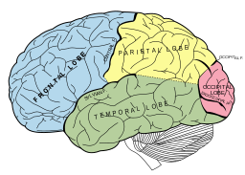
Thinking about Thinking
METACOGNITIVE
THINKING
Lucidish [CC-BY-SA-3.0], and Mysid [Public domain], via Wikimedia Commons

Slide 40
Research Confirms the Importance of Student Questioning
Self-questioning (metacognitive strategy):
Student formulation of their own questions is one of the most effective metacognitive strategies
Engaging in pre-lesson self-questioning improved students rate of learning by nearly 50% (Hattie, p.193)
John Hattie
Visible Learning: A Synthesis of Over 800
meta-Analyses Relating to Achievement, 2008

Slide 41
Teachers say
The QFT is a powerful instructional practice that inspires a curious habit of mind, as it invites students to share the responsibility of asking questions of themselves and one another. Melanie Meehan, CT
…it[the QFT] instilled in my students to be in a constant state of asking and answering their own questions. Curiosity is a quality that we must nurture at every stage of our lives. Matt Parrilli, IL
The engagement and curiosity from this just explodes into every other aspect of the classroom. Elementary School teacher, OH
Students don't care, you can hear crickets, but as soon as you bring in the QFT, students are sitting on the edge of their seats. Kim Sergent, KY
"The QFT is a powerful instructional practice that inspires a curious habit of mind, as it invites students to share the responsibility of asking questions of themselves and one another." | Curiosity＆Creativity | Curiosity | Melanie Meehan | Literacy teacher, Simsbury Public Schools | Elemetary School-5 | CT, Simsbury
"This QFT on a controversial, current event has been the most rewarding teaching I have done this year due to the desire it instilled in my students to be in a constant state of asking and answering their own questions. Curiosity is a quality that we must nurture at every stage of our lives, and the QFT is a proven way of doing so." | Curiosity＆Creativity | Curiosity | Matt Parrilli |  |  | IL. Park Ridge
The engagement and curiosity from this just explodes into every other aspect of the classroom. | Curiosity＆Creativity | Curiosity |  |  | Elementary School | OH, Northolmstead school district

Slide 42
Students say…
  In response to "why do you think we ask questions?”
  So we can be curious about what we are learning and want to know more.
  -Ayaka, 1st Grader, Novi, Michigan

Slide 43
Students say…
  Asking questions may not always lead to answers, but it leads to curiosity. Curiosity is what drives children and teens to want to learn, even when they don't realize it...Question asking helps us guide our own adventure and helps us find new interests. Everything starts with a question, even if you don't realize it.
  - Abriana Fusco, 9th Grader, Fitchburg, MA
"There is no learning without having to pose a question." - Richard Feynman
Nobel-Prizewinning physicist

Slide 44
Some Lessons about Curiosity
Curiosity is often seen as the catalyst for questions.
Curiosity can also be the result of students asking and working with their own questions.
Curiosity can deliberately be stimulated by using three distinct thinking abilities when working with one’s own questions.

Slide 45
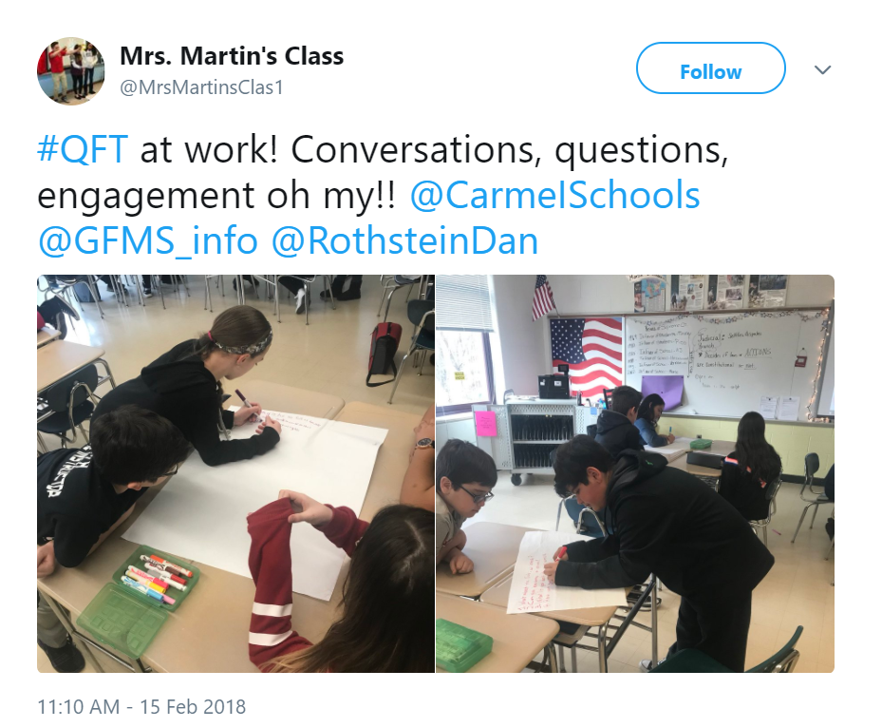
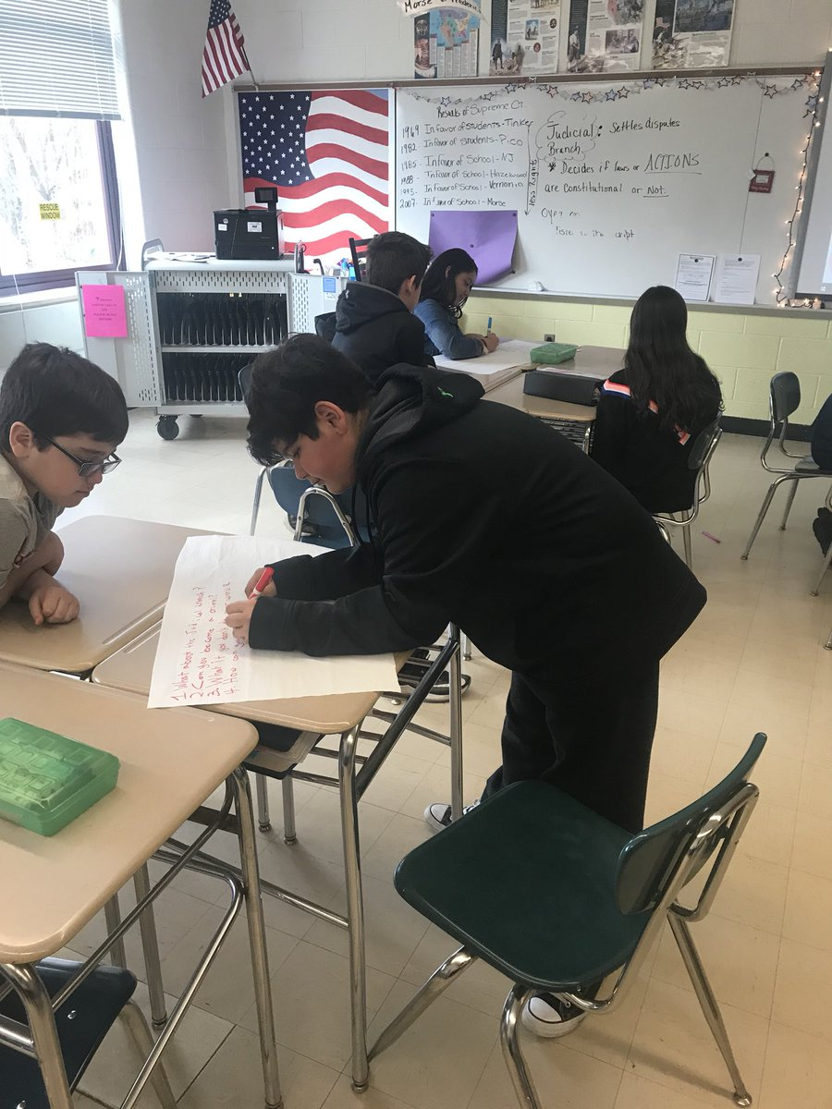
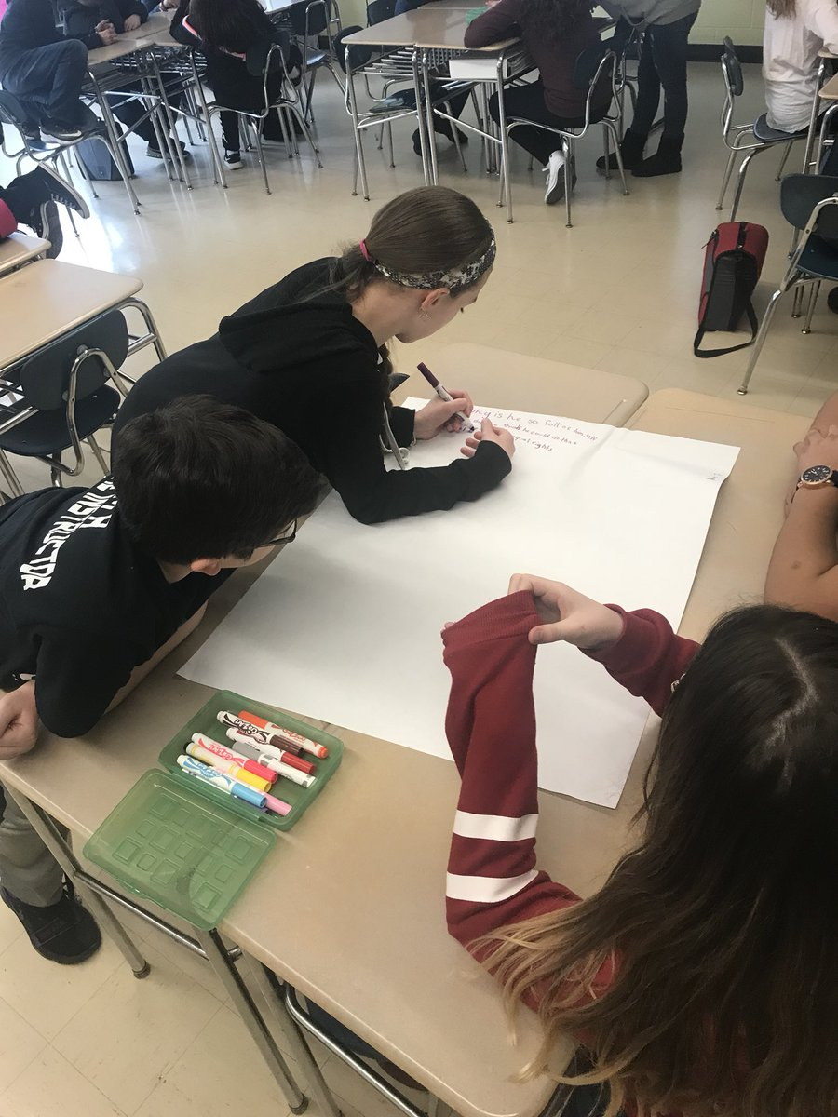
https://twitter.com/MrsMartinsClas1/status/964215453907390464
Mrs. Martin's Class‏ @MrsMartinsClas1
#QFT at work! Conversations, questions, engagement oh my!! @CarmeISchools @GFMS_info @RothsteinDan
11:10 AM - 15 Feb 2018

Slide 46
When is a technique not just a technique?
“Modern science is a technique...it is a practice that allows us to learn reliable things about the world. [Science] is a technique that was waiting for people to discover it.”
-Steven Weinberg, Nobel laureate in Physics
To Explain the World, 2015

Slide 47
The QFT in higher education
Brandeis graduate student comment from NSF
"Stimulating curiosity and the ability to formulate technical questions in an electric circuits course using the question formulation technique (QFT),"
          H. J. LeBlanc, K. Nepal and G. S. Mowry, 2017 IEEE Frontiers in Education Conference (FIE), Indianapolis, IN, USA, 2017, pp. 1-6.

Slide 48
Part III: Conclusion
“And the end of all our exploring”

Slide 49
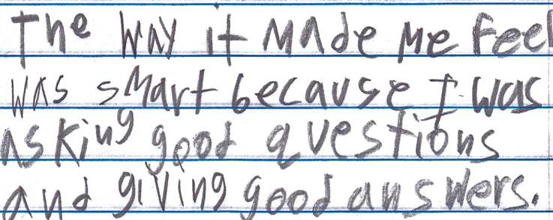
Cognitive, Affective and Behavioral Changes
“The way it made me feel was smart because I was asking good questions and giving good answers.”
-Boston 9th grade remedial summer school student

Slide 50
“Just when you think you know all you need to know , you ask another question and discover how much more there is to learn.”
  - 6th grade student, J.L. Stanford Middle School, Palo Alto

Slide 51

In the Age of Google…
“How should you respond when you get powerful new tools for finding answers?
Think of harder questions.”
Clive Thompson, Journalist and Technology Blogger

Slide 52


Honoring sources of this model
LAWRENCE, MA, 1990
“We don’t go to the school because we don’t even know what to ask.”

Slide 53
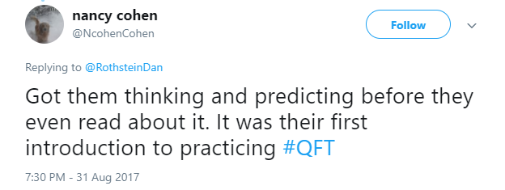
Honoring the Sources (II)
300,000 Teachers around the world

Slide 54
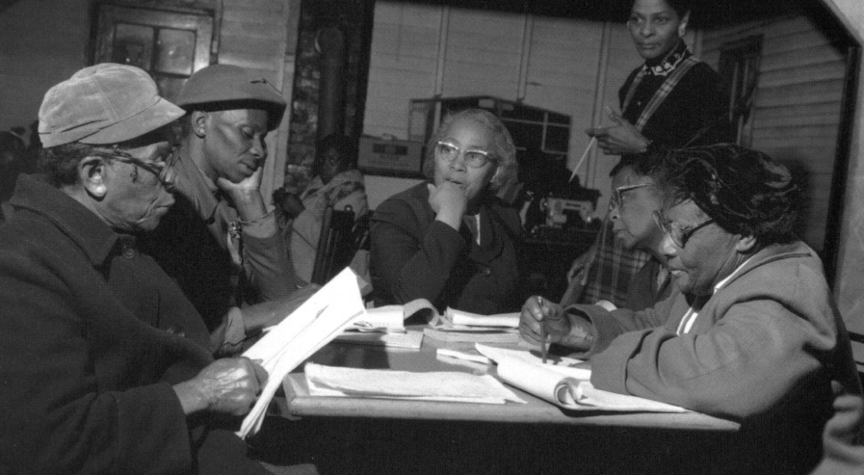
Democracy
“We need to be taught to study rather than to believe, to inquire rather than to affirm.” - Septima Clark
See Chapter 6 on Septima Clark in Freedom Road: Adult Education of African Americans (Peterson, 1996).

Slide 55
The QFT, on one slide…
Question Focus
Produce Your Questions
    Follow the rules
    Number your questions
Improve Your Questions
    Categorize questions as Closed or Open-ended
    Change questions from one type to another
Prioritize Your Questions
Share & Discuss Next Steps
Reflect
Ask as many questions as you can
Do not stop to discuss, judge or answer
Record exactly as stated
Change statements into questions
Closed-Ended:
Answered with “yes,” “no” or one word
Open-Ended: Require longer explanation

Slide 56
We shall not cease from exploration
And the end of all our exploring
Will be to arrive where we started
And know the place
For the first time.
-T.S. Eliot

