Slide 1
Luz Santana Co-Director
Catalyze Deeper Learning and Strengthen Democracy by Teaching Students to Ask Questions
CUE 2018
Palm Springs, CA
The Right Question Institute
Cambridge, MA

Slide 2
Acknowledgments
We are deeply grateful to the John Templeton Foundation and The Hummingbird Fund for their generous support of the Right Question Institute’s Million Classrooms Campaign.

Slide 3
We’re Tweeting…
@RightQuestion
#QFT

Slide 4
LAWRENCE, MA, 1990
“We don’t go to the school because we don’t even know what to ask.”

Slide 5
“In both science and industry, the ability to ask the right questions is probably the greatest talent one can have.” (p. 22)
– Leonard Mlodinow,
Physicist & Screenwriter
* Emphasis added

Slide 6
“We must teach students how to think in questions, how to manage ignorance.”
-Stuart Firestein, Chairman of the Department of Biology at Columbia University

Slide 8
What happens when students do learn to ask and work with their own questions?

Slide 9
Research Confirms the Importance of Student Questioning
Self-questioning (metacognitive strategy):
Student formulation of their own questions is one of the most effective metacognitive strategies
Engaging in pre-lesson self-questioning improved students rate of learning by nearly 50% (Hattie, p.193)
John Hattie
Visible Learning: A Synthesis of Over 800
meta-Analyses Relating to Achievement, 2008

Slide 10
Student Reflections
“Just when you think you know all you need to know, you ask another question and discover how much more there is to learn.”
~ Sixth-grade student, Palo Alto, CA
“When you ask the question, you feel like it’s your job to get the answer.”
~ High School student, Boston, MA

Slide 11
Asking questions…
… a habit of mind and NOT a discrete activity students do
Notes:
A democratic habit of mind that ALL students, citizens and workers should have. How can we easily build the skill?

Slide 12
The Question Formulation Technique (QFT)
Students learn to:
Produce their own questions
Improve their questions
Strategize on how to use their questions
Reflect on what they have learned and how they learned it
#QFTCon #QFT

Slide 13
The Question Formulation (QFT) on one slide…
Question Focus
Produce Your Questions
Follow the rules
Number your questions
Improve Your Questions
Categorize questions as Closed or Open-ended
Change questions from one type to another
Prioritize Your Questions
Share & Discuss Next Steps
Reflect
Ask as many questions as you can
Do not stop to discuss, judge or answer
Record exactly as stated
Change statements into questions
Closed-Ended:
Answered with “yes,” “no” or one word
Open-Ended: Require longer explanation

Slide 14
Classroom Example: Kindergarten
Teacher: Jennifer Shaffer, Walkersville, MD
Topic: Non-fiction literacy
Purpose: To engage students prior to reading a nonfiction text about alligators

Slide 15
Question Focus
Photograph by Nuwan Samaranayake, 2013

Slide 16
Student Questions
Is the alligator camouflaged?
Why do the babies have stripes?
Are those baby crocodiles?
Is it a mom or dad crocodile?
What is the green stuff?
Why are they in the water so low?
Where are they going?
Why are the baby alligator’s eyes white and the mom’s black?
Why are baby alligators on top of the momma alligator?
Why does momma or daddy have bumps on them?

Slide 17
Classroom Example: 4th Grade
Teacher: Deirdre Brotherson, Hooksett, NH
Topic: Math unit on variables
Purpose: To engage students at the start of a unit on variables

Slide 18
Question Focus
24 = ☺ + ☺ + ☺

Slide 19
Student Questions
Why is the 24 first?
What do the smiley faces mean?
Why are there 3 smiley faces?
How am I suppose to figure this out?
Is the answer 12?
Can I put any number for a smiley face?
Do three faces mean something?
Do the numbers have to be the same because the smiley faces are the same?
What numbers will work here?
Does it mean 24 is a really happy number?
Can we replace each smiley face with an 8?
Do any other numbers work?
Can we do this for any number?
Does it always have to be smiley faces?
Do we always have to use three things?
Notes:
Questions posted on classroom walls.
Students cross off the questions they answer during subsequent lessons.
Teacher returns to student questions at the end of the unit to discuss with students what they learned and what they still want to know.

Slide 20
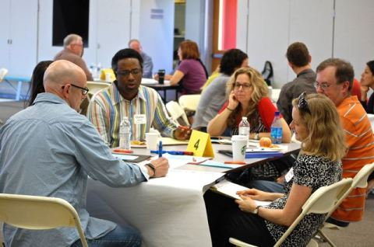
Working on a Challenge by Using the Question Formulation Technique (QFT)

Slide 21
Rules for Producing Questions
1. Ask as many questions as you can
2. Do not stop to answer, judge, or discuss
3. Write down every question exactly as stated
4. Change any statements into questions

Slide 22
Question Focus
Some students are not asking questions

Slide 23
Producing Questions
Some students are not
asking questions
Ask Questions
Follow the Rules
Ask as many questions as you can.
Do not stop to answer, judge, or discuss.
Write down every question exactly as it was stated.
Change any statements into questions.
Number the Questions

Slide 24
Categorizing Questions: Closed/Open
Definitions:
Closed-ended questions can be answered with a “yes” or “no” or with a one-word answer.
Open-ended questions require
more explanation.
Directions: Identify your questions as closed-ended or open-ended by marking them with a “C” or an “O”.

Slide 25
Discussion
Closed-ended Questions
Advantages
Disadvantages

Slide 26
Discussion
Open-ended Questions
Advantages
Disadvantages

Slide 27
Improve Questions
Take one closed-ended question and change it into an open-ended question.
Take one open-ended question and change it into a closed-ended question.
CLOSED
OPEN
OPEN
CLOSED
Notes:
Time on slide 3 min ( Time passed 25)

Slide 28
Prioritizing Questions
Review your list of questions
Choose the three questions you consider most important.
While prioritizing, think about your Question Focus:
Some students are not asking questions
After prioritizing consider…
Why did you choose those three questions?
Where are your priority questions in the sequence of your entire list of questions?

Slide 29
Next Steps
From priority questions to action plan
In order to answer your priority questions:
What do you need to know? INFORMATION
What do you need to do? TASKS

Slide 30
Share
Questions you changed from open/closed
Your three priority questions and their numbers in your original sequence
Rationale for choosing priority questions
What you will do with the questions

Slide 31
Reflection
What did you learn?
How did you learn it?

Slide 32
Let’s peek inside the black box

Slide 33
The Question Formulation (QFT) on one slide…
Question Focus
Produce Your Questions
Follow the rules
Number your questions
Improve Your Questions
Categorize questions as Closed or Open-ended
Change questions from one type to another
Prioritize Your Questions
Share & Discuss Next Steps
Reflect
Ask as many questions as you can
Do not stop to discuss, judge or answer
Record exactly as stated
Change statements into questions
Closed-Ended:
Answered with “yes,” “no” or one word
Open-Ended: Require longer explanation
Notes:
Three thinking abilities in one process

Slide 34
The art and the science of the QFT
CONVERGENT
THINKING
DIVERGENT THINKING
METACOGNITIVE THINKING

Slide 35
Changes
Cognitive
Affective
Behavioral
Notes:
Students know how to produce questions.
Students know the difference between open- and closed-ended questions and know how the questions can be changed to secure different kinds of information.
Cognitive changes - Students know how to use criteria to prioritize their questions.
Affective-Students feel more confident.
Students express greater interest and are more curious.
Students demonstrate a greater sense of urgency and responsibility to “get the answers.”
Behavioral -Students self-regulate more effectively.
Students collaborate and listen to each other’s questions.
Students negotiate and work on reaching consensus about group decisions.
Students become more self-aware and build positive relationships (SEL goals).

Slide 36
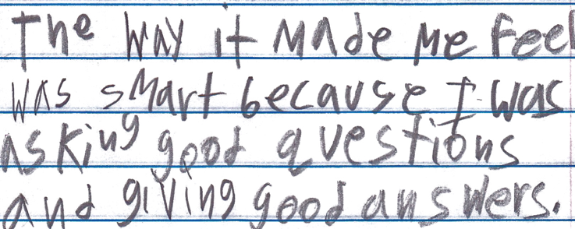
Student Reflection
“The way it made me feel was smart because I was asking good questions and giving good answers.”
-Boston 9th grade remedial summer school student

Slide 37
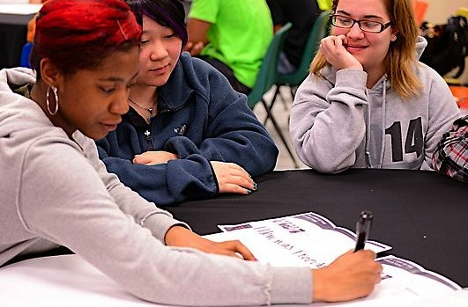
Exploring Classroom Examples

Slide 38
Building skills that connect to the real world
Notes:
These two examples are relevant to all of you but specially important for those of you who are working on elevating student voice.

Slide 39
Classroom Example:
Elementary School
Teacher: Esther Lee, New York, NY
Topic: ELA unit on Child Labor
Purpose: To engage students at the beginning of the unit
Notes:
Setting - small group special education setting with students with a range medium to severe of LDs (sub-separate small group education setting) + grade level

Slide 40
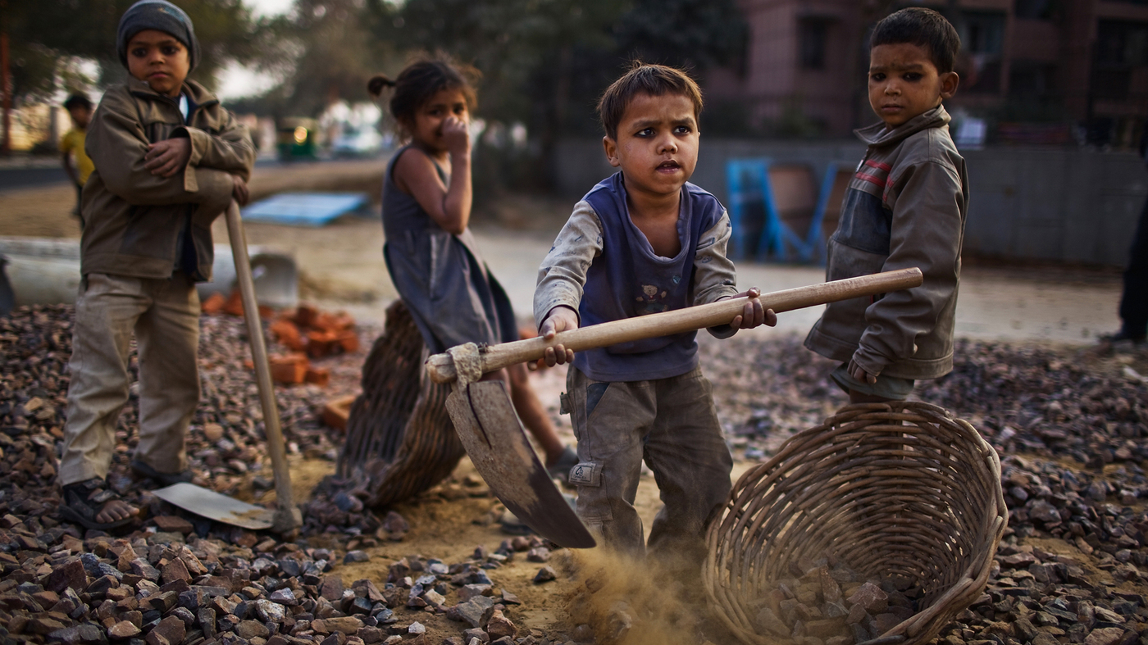
Question Focus
Daniel Berehulak/Getty Images
Notes:
.

Slide 41
Student Questions
Why are they so dirty?
Are they farming?
Where are their shoes?
Why are they sad?
Are they having fun?
Where are their parents?
Why are they farming?
Why are they holding that?
Are they in school?
Notes:
Questions about what they actually observed. Made assumptions based on their observations also took it beyond- where are their parents? Are they in school? but (Students who initially were described as struggling to maintain connections with their peers are empathizing with others)

Slide 42
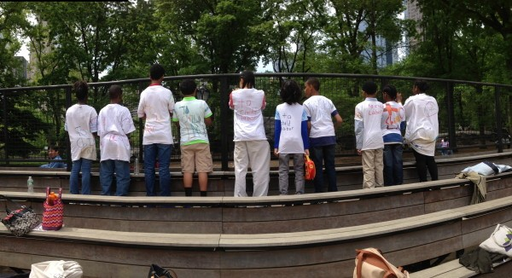
Next Steps
Students complete the exam and essay for the New York State mandated ELA curriculum
Students write speeches, make t-shirts, and organize a protest on the streets of NYC
Notes:
http://rightquestion.org/blog/student-engagement-special-education-classroom/

Slide 43
Classroom Example:
High School
Teacher: Isabel Morales, Los Angeles, CA
Topic: Social Justice
Purpose: Engage students in thinking about systemic injustice ahead of several fiction and nonfiction texts in the semester

Slide 44
Question Focus
“The disciplinary policies of our society perpetuate injustice.”
Notes:
Note - this is an image I found online.

Slide 45
Student Questions
Why are student of color targeted the most?
Do schools nationwide take notice of these stats?
How can we develop better & effective disciplinary policies?
Why do people see the stats & data as a coincidence?
What does a kid learn about the system once in jail?
What do people believe expulsion will teach the students?
Does going to jury have a long-term effect on younger students about education?
When will it get better?
What are some ways to improve behavior?
What type of training will teachers go through that’ll bring justice to classrooms?
Shouldn’t school police officers be trained like teachers?
What is considered a criminal offense in school?
Is it the teacher’s job to keep the students “in line”?
How should disruption in class be handled?
Shouldn’t school officers be punished as well?
What is the difference between a school officer and a regular police officer?
How come there aren’t any policies keeping students out of prison?

Slide 46
Next Steps
Students decided to research statistics and poll students and teachers.
Students met with the school administration to ask questions and address their concerns.
School principal founded a student advisory council, which many students joined, to give students a voice in new policies.

Slide 47
Why is the skill of question formulation so important now?

Slide 48
Question formulation is a foundational & transformative skill
Key for a healthy democracy
Notes:
Asking questions as a foundational skill- More CURIOSITY, ownership and learning more. IMPORTANT characteristics for the citizen of the future.

Slide 49
Student Reflections
“Asking questions is important because it opens up discussions and debate about issues.”
- Leslie S., 12th grader
“Asking questions is a step in creating change.”
- Jonathan S., 11th grader
“Questions can help focus on a problem and think of solutions.”
- Jason S., 11th grader

Slide 50
What are examples of decisions embedded in this statement?
Student discipline practices at the high school will be reviewed by a committee appointed by the superintendent.

Slide 51
Examples of Decisions
Student discipline practices at the high school will be reviewed by a committee appointed by the superintendent.

Slide 52
The Framework for Accountable Decision-Making
When decisions are made it is important to focus on:
REASONS - the basis for a decision.
PROCESS - the steps and actions taken, people involved, and information used in making the decision.
ROLE - the part you play/ the part the people affected by the decision play in the decision-making process.

Slide 53
Accountable Decision-Making and Democratic Principles
In a democracy, we should expect and require that all decisions are guided by the following criteria.
Legitimacy: The decisions are based on policies, standards, rules that are fairly applied.
Transparency: The process used to make the decision is visible to all.
Opportunities for participation: There is a role in the decision making process for the individual affected by the decision.

Slide 54
Asking Questions about::
Legitimacy
Transparency
Opportunities for participation
Reason
Process
Role

Slide 55
The Skill of Asking Questions
For moving from ignorance as weakness to ignorance as opportunity
For arriving at better answers (and more questions)
For increasing engagement and ownership
For demonstrating inquiry in the classroom
For a little more joy in a very demanding profession
And…

Slide 56
Individual Skills and Democracy
Image Courtesy of Highlander Research and Education Center
Notes:
Picture of Septima Clark (L) and Rosa Parks (r) at the Highlander Education and Research Center, Tennessee. 1958

Slide 57
Democracy
“We need to be taught to study rather than to believe, to inquire rather than to affirm.” - Septima Clark
See Chapter 6 on Septima Clark in Freedom Road: Adult Education of African Americans (Peterson, 1996).
Notes:
septima clark; she committed herself not just to teach literacy but to teach the illiterate adults to speak up, to participate, to have a voice. she was a gamechanger on a big scale, but she focused on the small picture, the people right in front of her.
http://www.scpcs.org/septima_clark.aspx

Slide 58
To Access Today’s Materials:
http://rightquestion.org/educators/
seminar-resources/
Join our Educator Network for:
Templates you can use tomorrow in class
Classroom Examples
Instructional Videos
Forums and Discussions with other Educators

Slide 59
Now, Educators Lead the Work
The Right Question Institute offers materials through a Creative Commons License and we encourage you to make use of and/or share this resource. Please reference the Right Question Institute and rightquestion.org as the source on any materials you use.

