Slide 1
Spark Curiosity,
Fuel Deeper Learning:
Engage All Students in Asking Their Own Questions
ASCD
Empower 18
Boston, MA
March 25, 2018
Dan Rothstein
The Right Question Institute
Sarah Westbrook
The Right Question Institute
Cambridge, MA
Nicole Bolduc
Ellington Middle School
Ellington, CT
Ellen Gammel
Montachusett Regional Vocational Technical School, Fitchburg, MA
Notes:
I’m a former teacher high school ELA in the Boston area, taught AP students and co-taught, academically struggling students

Slide 2
Acknowledgments
We are deeply grateful to the John Templeton Foundation and The Hummingbird Fund for their generous support of the Right Question Institute’s Million Classrooms Campaign.
#QFT

Slide 3
Who is in the room?
#QFT

Slide 4
Today’s Agenda
Why Spend Time on Teaching Question Formulation?
Collaborative Learning with the Question Formulation Technique (QFT)
Explore Classroom Examples & Applications
Planning How You Might Use the QFT
Reflection & Evaluation
#QFT

Slide 5
To Access Today’s Materials:
http://rightquestion.org/educators/
seminar-resources/
Join our Educator Network for:
Templates you can use tomorrow in class
Classroom Examples
Instructional Videos
Forums and Discussions with other Educators

Slide 6
We’re Tweeting…
@RightQuestion
@RothsteinDan
@ellengammel
@nicolejbolduc
#QFT

Slide 7
LAWRENCE, MA, 1990
“We don’t go to the school because we don’t even know what to ask.”

Slide 8
"There is no learning without having to pose a question."
- Richard Feynman
Nobel-Prizewinning physicist

Slide 9
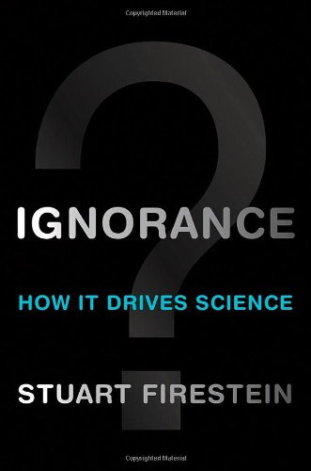
“We must teach students how to think in questions, how to manage ignorance.”
- Stuart Firestein
Chairman of the Department of Biology at Columbia University

Slide 10
College Presidents on What Students Should Learn in College
“The primary skills should be analytical skills of interpretation and inquiry. In other words, know how to frame a question.”
- Leon Botstein, President of Bard College
“…the best we can do for students is have them ask the right questions.”
- Nancy Cantor, Chancellor of University of Illinois
The New York Times, August 4, 2002

Slide 11
Yet…only 27%of students believe college taught them to ask their own questions
Alison Head, Project Information Literacy at University of Washington, 2016

Slide 12
But, the problem begins long before college...

Slide 13
Percentage of Basic Skill Attainment
Sources
http://nces.ed.gov/nationsreportcard/pdf/main2009/2011455.pdf
http://nces.ed.gov/nationsreportcard/pubs/main2007/2008468.asp#section1
Data on question-asking based on parent and teacher feedback

Slide 14
Percentage of Basic Skill Attainment
Sources
http://nces.ed.gov/nationsreportcard/pdf/main2009/2011455.pdf
http://nces.ed.gov/nationsreportcard/pubs/main2007/2008468.asp#section1
Data on question-asking based on parent and teacher feedback
Notes:
Research that low income students ask fewer questions that middle and high income peers, academically low performing students ask fewer than middle and high performing peers
In class, teacher asks as much as 200 questions per 30 min; students ask 1-2. Students ask fewer than 4% of all questions in the average class.

Slide 15
We can work together on changing the direction of that slope

Slide 16
We Are Not Alone
300,000 educators using the strategy all over the world

Slide 17
Now, Educators Lead the Work
The Right Question Institute offers materials through a Creative Commons License and we encourage you to make use of and/or share this resource. Please reference the Right Question Institute and rightquestion.org as the source on any materials you use.

Slide 18
What happens when students do learn to ask their own questions?

Slide 19
Research Confirms the Importance of Student Questioning
Self-questioning (metacognitive strategy):
Student formulation of their own questions is one of the most effective metacognitive strategies
Engaging in pre-lesson self-questioning improved students rate of learning by nearly 50% (Hattie, p.193)
John Hattie
Visible Learning: A Synthesis of Over 800
meta-Analyses Relating to Achievement, 2008
Notes:
UC Davis Research Linking Curiosity to Memory (UC Davis) 2014
The Fullerton Longitudinal Study (FLS), a 30-plus year study of the development of giftedness across various points in time conducted by Adele and Allen Gottfried of California State University ”This finding has strong implications for the development of STEM considering that curiosity is a fundamental predictor of the aspiration to become a scientist.”
S. von Stumm, B. Hell, T. Chamorro-Premuzic. The Hungry Mind: Intellectual Curiosity Is the Third Pillar of Academic Performance. Perspectives on Psychological Science, 2011 meta-analysis shows They found that curiosity did, indeed, influence academic performance. In fact, it had quite a large effect, about the same as conscientiousness. When put together, conscientiousness and curiosity had as big an effect on performance as intelligence.

Slide 20
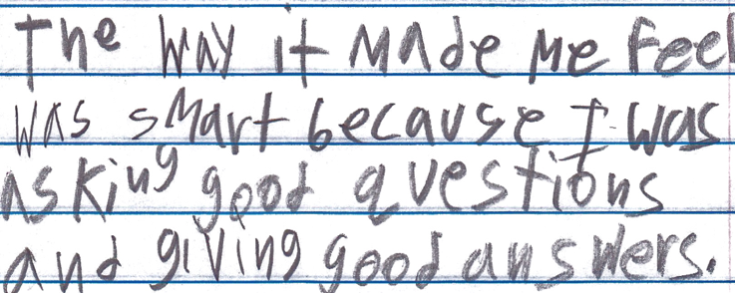
Student Reflection
“The way it made me feel was smart because I was asking good questions and giving good answers.”
-Boston 9th grade remedial summer school student

Slide 21
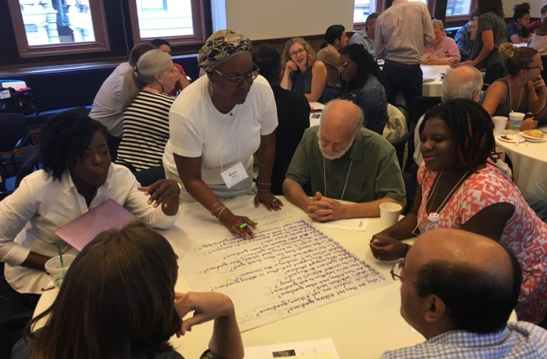
Collaborative Learning with the Question Formulation Technique (QFT)

Slide 22
The Question Formulation Technique (QFT)
Students learn to:
Produce their own questions
Improve their questions
Strategize on how to use their questions
Reflect on what they have learned and how they learned it
#QFT

Slide 23
Rules for Producing Questions
1. Ask as many questions as you can
2. Do not stop to answer, judge, or discuss
3. Write down every question exactly as stated
4. Change any statements into questions

Slide 24
Producing Questions
Ask Questions
Follow the Rules
Ask as many questions as you can.
Do not stop to answer, judge, or discuss.
Write down every question exactly as it was stated.
Change any statements into questions.
Number the Questions

Slide 25
Question Focus:
Some students are not asking questions.
→Please write this statement at the top of your paper.
→Remember: Number the questions. Follow the rules.

Slide 26
Categorizing Questions: Closed/ Open
Definitions:
Closed-ended questions can be answered with a “yes” or “no” or with a one-word answer.
Open-ended questions require
more explanation.
Directions: Identify your questions as closed-ended or open-ended by marking them with a “C” or an “O.”

Slide 27
Discussion
Closed-ended Questions
Advantages
Disadvantages

Slide 28
Discussion
Open-ended Questions
Advantages
Disadvantages

Slide 29
Improving Questions
Take one closed-ended question and change it into an open-ended question.
Take one open-ended question and change it into a closed-ended question.
Closed
Open
Open
Closed

Slide 30
Strategize: Prioritizing Questions
Review your list of questions
Choose the three questions you consider most important.
While prioritizing, think about your Question Focus: Some students are not asking questions.
After prioritizing consider…
Why did you choose those three questions?
Where are your priority questions in the sequence of your entire list of questions?

Slide 31
Strategize: Next Steps
From priority questions to action plan
In order to answer your priority questions:
What do you need to know? Information
What do you need to do? Tasks

Slide 32
Next Steps: Action Plan
Information | Tasks

Slide 33
Share
Questions you changed from open/closed
Your three priority questions and their numbers in your original sequence
Rationale for choosing priority questions
Next steps

Slide 34
Reflection
What did you learn?
How did you learn it?
What do you understand differently now about some students not asking questions?

Slide 35
A Look Inside the Process
#QFT

Slide 36
The QFT, on one slide…
Question Focus
Produce Your Questions
Follow the rules
Number your questions
Improve Your Questions
Categorize questions as Closed or Open-ended
Change questions from one type to another
Prioritize Your Questions
Share & Discuss Next Steps
Reflect
Ask as many questions as you can
Do not stop to discuss, judge or answer
Record exactly as stated
Change statements into questions
Closed-Ended:
Answered with “yes,” “no” or one word
Open-Ended: Require longer explanation

Slide 37
Curiosity and Rigor
Three thinking abilities
with one process

Slide 38
Thinking in many different directions
DIVERGENT THINKING

Slide 39
Narrowing Down, Focusing
CONVERGENT
THINKING

Slide 40
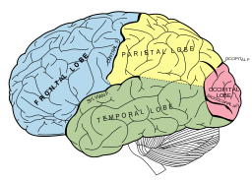
Thinking about Thinking
METACOGNITIVE
THINKING

Slide 41
Exploring Classroom Examples

Slide 42
Classroom Example: Kindergarten
Teacher: Jennifer Shaffer, Walkersville, MD
Topic: Non-fiction literacy
Purpose: To engage students prior to reading a nonfiction text about alligators

Slide 43
Question Focus

Slide 44
Student Questions
Is the alligator camouflaged?
Why do the babies have stripes?
Are those baby crocodiles?
Is it a mom or dad crocodile?
What is the green stuff?
Why are they in the water so low?
Where are they going?
Why are the baby alligator’s eyes white and the mom’s black?
Why are baby alligators on top of the momma alligator?
Why does momma or daddy have bumps on them?

Slide 45
Classroom Example: 4th Grade
Teacher: Deirdre Brotherson, Hooksett, NH
Topic: Math unit on variables
Purpose: To engage students at the start of a unit on variables and assess their current skill level

Slide 46
Question Focus
24 = ☺ + ☺ + ☺

Slide 47
Student Questions
Why is the 24 first?
What do the smiley faces mean?
Why are there 3 smiley faces?
How am I suppose to figure this out?
Is the answer 12?
Can I put any number for a smiley face?
Do three faces mean something?
Do the numbers have to be the same because the smiley faces are the same?
What numbers will work here?
Does it mean 24 is a really happy number?
Can we replace each smiley face with an 8?
Do any other numbers work?
Can we do this for any number?
Does it always have to be smiley faces?
Do we always have to use three things?

Slide 48
Higher Education Example?

Slide 49
Classroom Example:
High School
Teacher: Isabel Morales, Los Angeles, CA
Topic: Social Justice
Purpose: Engage students in thinking about systemic injustice ahead of several fiction and nonfiction texts in the semester

Slide 50
Question Focus
“The disciplinary policies of our society perpetuate injustice.”
Notes:
Note - this is an image I found online.

Slide 51
Student Questions
Why are student of color targeted the most?
Do schools nationwide take notice of these stats?
How can we develop better & effective disciplinary policies?
Why do people see the stats & data as a coincidence?
What does a kid learn about the system once in jail?
What do people believe expulsion will teach the students?
Does going to jury have a long-term effect on younger students about education?
When will it get better?
What are some ways to improve behavior?
What type of training will teachers go through that’ll bring justice to classrooms?
Shouldn’t school police officers be trained like teachers?
What is considered a criminal offense in school?
Is it the teacher’s job to keep the students “in line”?
How should disruption in class be handled?
Shouldn’t school officers be punished as well?
What is the difference between a school officer and a regular police officer?
How come there aren’t any policies keeping students out of prison?

Slide 52
Next Steps
Students decided to research statistics and poll students and teachers.
Students met with the school administration to ask questions and address their concerns.
School principal founded a student advisory council, which many students joined, to give students a voice in new policies.

Slide 53
Student Reflections
“Asking questions is important because it opens up discussions and debate about issues.”
- Leslie S., 12th grader
“Asking questions is a step in creating change.”
- Jonathan S., 11th grader
“Questions can help focus on a problem and think of solutions.”
- Jason S., 11th grader

Slide 54
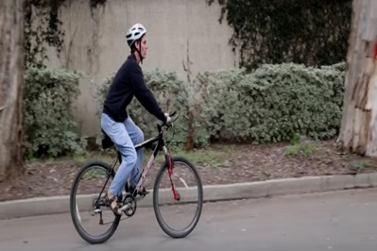
Classroom Example: Middle School
Teacher: Nicole Bolduc, Ellington, CT
Topic: The Science of Sound
Purpose: To engage students in setting the learning agenda for the unit.
Students watched video of Daniel Kish, a blind man who uses “Flash Sonar” to navigate the world.
They are instructed to ask questions as a scientist who wants to discover.
https://www.youtube.com/watch?v=PLPEcu6523Q

Slide 55
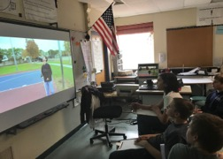
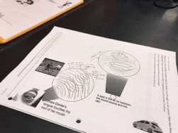
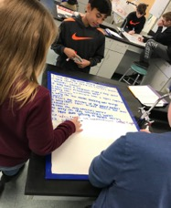
Before the QFT
Watched phenomenon twice and wrote down observations.
Came together to share observations.
Drew initial models of how phenomenon works scientifically.
Came together to share initial models and come up with an organized consensus model.
Made a list of other related phenomena.
QFT process based on Daniel Kish, our consensus model, and new list of related phenomena.

Slide 56
Selected Student Questions
(Category A) What causes different sounds
Does the clicking only work with special objects?
Why does fire make a “crackling” noise?
Why do different things make different sounds?
How can get something so loud?
Does loud or quiet sounds help you know where you are?
Does he have to make a louder noise is he is in a larger environment?
Do you have to click a certain way to “see?”
Could the use of snapping vs clicking make a difference?
Why do all the animals have different sounds?
How does the speed that they click effect what you are doing?
What makes up sound?
How is echolocation used? Humans and animals?
Why when we yell does it echo?
How does lightning make sound?
How does snapping your fingers make a noise?
Does the volume of the sound matter?
Why does a tennis racket maker a “whoosh” sound?
Can certain people hear dog whistles?
Cick here to see ALL of their cetegorized questions

Slide 57
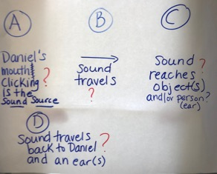
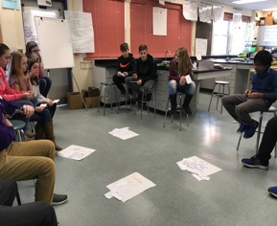
Next Steps After the QFT
1) Students chose the 3 most interesting questions from their list.
2) Students categorized their questions into following categories:
What causes different sounds?
How does sound move from a sound source to an object or someone’s ear?
How does sound interact with an object?
What affects how someone receives sound?
PARKING LOT

Slide 58
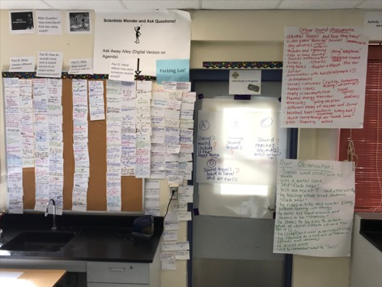
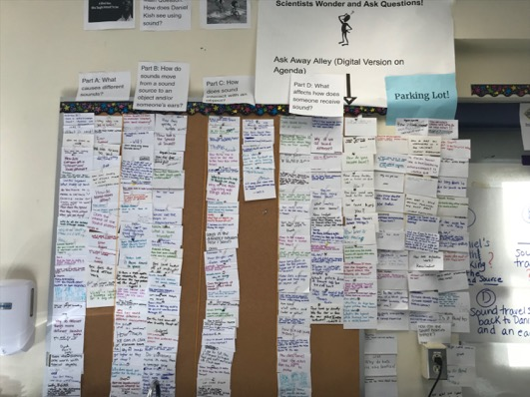
Next Steps: the Driving Question Board
Driving Question Board next to other student-generated ideas

Slide 59
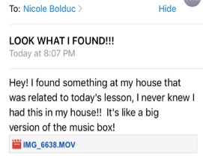
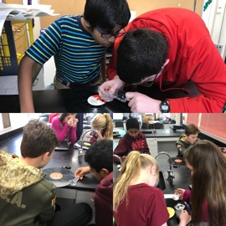
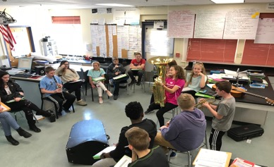
Next Steps: in the Days Following QFT
Students experience a series of scientific investigations that target figuring out specific parts of our consensus model.
Students encouraged to continuously ask questions throughout the process (Question Wall of Fame)
As we figure out parts of our model, we revisit the Driving Question Board and agree on questions we have answered and/or not answered.
From an inspired student!

Slide 60
Classroom Example: High School
Teacher: Ellen Gammel, Fitchburg, MA
Topic: An interdisciplinary unit on bioethics and a nonfiction text, The Immortal Life of Henrietta Lacks
Purpose: To help students begin preparation for a formal debate at the very end of the unit
Notes:
Ellen Gammel, 9th Grade, Fitchburg, MA
At the end of the unit on Henriette Lacks and bioethics, students are preparing for a debate, they’ve already chosen sides, their questions are intended to help propel their research and counter-arguments

Slide 61
Question Focus
Debate Resolve:
Doctors should be able to do what they want with human tissue after the patient gives consent for removal of the tissue.

Slide 62
Selected Student Questions
A Team Against Debate Resolve:
A Team For Debate Resolve
Are our bodies truly our property?
How much consent?
How much information should a patient receive in order for them to give informed consent?
Consent for removal or consent for research?
Should the patient be paid?
How should patients be paid? What for?
What counts as tissue?
Consent for removal of tissue or other body parts?
How about animals?
Are owners in charge of their pet’s tissue?
Are parents in charge of their kids’ tissue?
Can kids give informed consent?
Do gives give their parents consent?
How about teeth?
Do teeth count as bone donations?
What percent of compensation should patients receive?
How have tissue ownership laws changed over the years?
Is there a law?
Do doctors owns the tissue after patients give consent?
Should patients be able to perform their own research?
Do doctors come up with the idea? (A focus)
Do doctors need consent for tissue that doesn't belong to humans?
Can patients take back consent once they find out what the doctors are doing with their tissue?

Slide 63
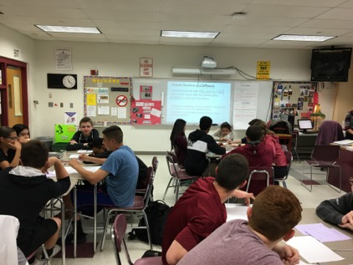
Next Steps
In teams, students research their priority questions
Students prepare their debate arguments and rebuttals, using research
Students practice public speaking and rhetorical skills

Slide 64
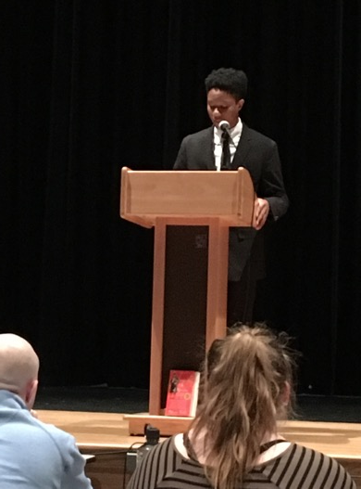
Next Steps: the Debate
The 3 Judges: administrators, teachers and a former student
The Audience: students, parents, teachers, school & district leaders

Slide 65
Why is the skill of question formulation so important now?

Slide 66
In the Age of Google…
“How should you respond when you get powerful new tools for finding answers?
Think of harder questions.”
Clive Thompson, Journalist and Technology Blogger

Slide 67
Democracy
“We need to be taught to study rather than to believe, to inquire rather than to affirm.” - Septima Clark
See Chapter 6 on Septima Clark in Freedom Road: Adult Education of African Americans (Peterson, 1996).

Slide 68
Today’s Agenda
Why Spend Time on Teaching Question Formulation?
Collaborative Learning with the Question Formulation Technique (QFT)
Explore Classroom Examples & Applications
Planning How You Might Use the QFT
Reflection & Evaluation
#QFT

Slide 69
To Access Today’s Materials:
http://rightquestion.org/educators/
seminar-resources/
Join our Educator Network for:
Templates you can use tomorrow in class
Classroom Examples
Instructional Videos
Forums and Discussions with other Educators

Slide 70
Now, Educators Lead the Work
The Right Question Institute offers materials through a Creative Commons License and we encourage you to make use of and/or share this resource. Please reference the Right Question Institute and rightquestion.org as the source on any materials you use.

Slide 71
Closing Reflection & Evaluation
https://tinyurl.com/QFTatASCD

Slide 72
Classroom Example: High School
Teacher: Ling-Se Chesnakas, Boston, MA
Topic: 12th Grade Humanities unit on The Brief Wondrous Life of Oscar Wao by Junot Diaz
Purpose: To help students generate questions for a Socratic Seminar at the end of the unit

Slide 73
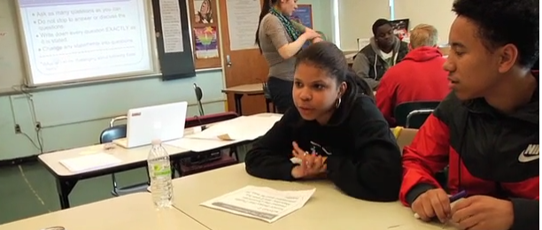
The Question Formulation Technique (QFT) in Action
http://rightquestion.org/qft-in-action/
Notes:
As you’re watching, pay attention to what do you see the teacher doing? What do you see the students doing? And we’ll share out at the end of the video.
So, what did you notice?

