Slide 1
Getting to the Right Questions:
Working Collaboratively with the Question Formulation Technique
Germination Workshop
The National Science Foundation
June 21, 2018
Dan Rothstein
Luz Santana
The Right Question Institute
Cambridge, MA

Slide 2
Acknowledgments
We are grateful to the National Science Foundation (grant #1745919), the John Templeton Foundation and the Hummingbird Fund for their generous support for our work in education.
We are very grateful to Professor Dan Perlman, Brandeis University, and Tomoko Ouchi and the whole team at the Right Question Institute for their valuable contributions to this session.

Slide 3
Our Agenda
The Role of Question Formulation in Learning
Collaborative Thinking with the Question Formulation Technique (QFT)
Universal Relevance
Asking Questions as a Pathway to Greater Inclusion

Slide 4
Who is in the room?
Break into small groups
Introduce yourselves

Slide 5
I. The Role of Question Formulation in Learning

Slide 6
"There is no learning without having to pose a question."
- Richard Feynman
Nobel-Prizewinning physicist

Slide 7
“I am happy just to be asking the right questions: "This is for the love of understanding how the world works - what it really is."
“You want to find the question that is sufficiently easy that you might be able to answer it, and sufficiently hard that the answer is interesting. You spend a lot of time thinking and you spend a lot of time floundering around."
Edward Witten The Institute for Advanced Study, Princeton, New Jersey

Slide 8
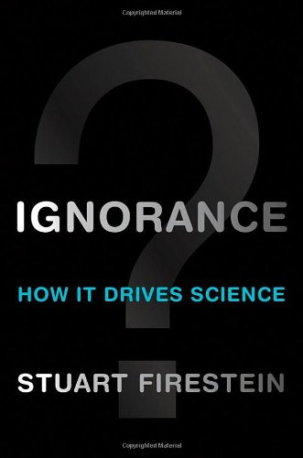
“We must teach students how to think in questions, how to manage ignorance.”
- Stuart Firestein
Chairman of the Department of Biology at Columbia University

Slide 9
College Presidents on What Students Should Learn in College
“The primary skills should be analytical skills of interpretation and inquiry. In other words, know how to frame a question.”
- Leon Botstein, President of Bard College
“…the best we can do for students is have them ask the right questions.”
- Nancy Cantor, Chancellor of University of Illinois
The New York Times, August 4, 2002

Slide 10
Yet…only 27%of students believe college taught them to ask their own questions
Alison Head, Project Information Literacy at University of Washington, 2016

Slide 11
Research Confirms the Importance of Student Questioning
Self-questioning (metacognitive strategy):
Student formulation of their own questions is one of the most effective metacognitive strategies
Engaging in pre-lesson self-questioning improved students rate of learning by nearly 50% (Hattie, p.193)
John Hattie
Visible Learning: A Synthesis of Over 800
meta-Analyses Relating to Achievement, 2008

Slide 12
Three Thinking Abilities
Divergent Thinking
Convergent Thinking
Meta-Cognitive Thinking

Slide 13
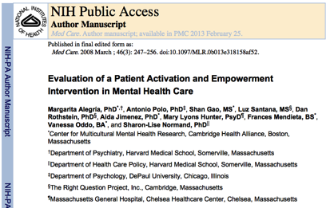
Right Question Institute

Slide 14
Classroom Examples

Slide 15
Classroom Example: Kindergarten
Teacher: Jennifer Shaffer, Walkersville, MD
Topic: Non-fiction literacy
Purpose: To engage students prior to reading a nonfiction text about alligators

Slide 16
Question Focus

Slide 17
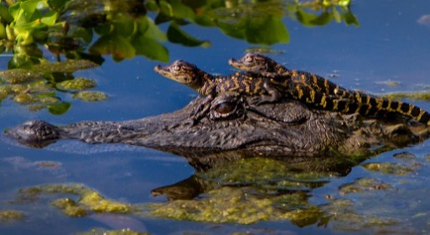
Student Questions
Is the alligator camouflaged?
Why do the babies have stripes?
Are those baby crocodiles?
Is it a mom or dad crocodile?
What is the green stuff?
Why are they in the water so low?
Where are they going?
Why are the baby alligator’s eyes white and the mom’s black?
Why are baby alligators on top of the momma alligator?
Why does momma or daddy have bumps on them?

Slide 18
Classroom Example: 4th Grade
Teacher: Deirdre Brotherson, Hooksett, NH
Topic: Math unit on variables
Purpose: To engage students at the start of a unit on variables and assess their current skill level

Slide 19
Question Focus
24 = ☺ + ☺ + ☺

Slide 20
Student Questions
Why is the 24 first?
What do the smiley faces mean?
Why are there 3 smiley faces?
How am I suppose to figure this out?
Is the answer 12?
Can I put any number for a smiley face?
Do three faces mean something?
Do the numbers have to be the same because the smiley faces are the same?
What numbers will work here?
Does it mean 24 is a really happy number?
Can we replace each smiley face with an 8?
Do any other numbers work?
Can we do this for any number?
Does it always have to be smiley faces?
Do we always have to use three things?

Slide 21
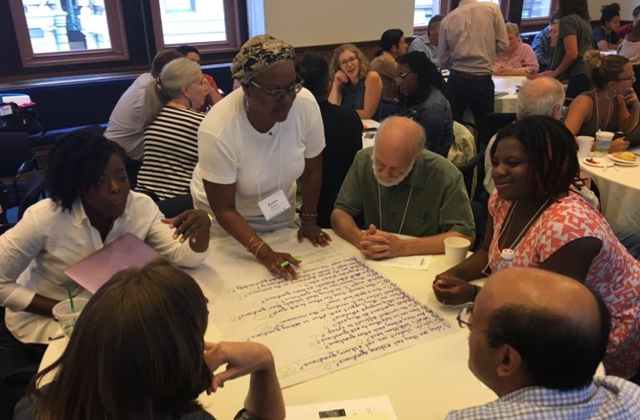
Ⅱ. Collaborative Thinking with the Question Formulation Technique (QFT)

Slide 22
Rules for Producing Questions
1. Ask as many questions as you can
2. Do not stop to answer, judge, or discuss
3. Write down every question exactly as stated
4. Change any statements into questions

Slide 23
Question Focus:
Motivating Impactful Research
→Please write this statement at the top of your paper.
→Remember: Number the questions. Follow the rules.

Slide 24
Categorizing Questions: Closed/ Open
Definitions:
Closed-ended questions can be answered with a “yes” or “no” or with a one-word answer.
Open-ended questions require
more explanation.
Directions: Identify your questions as closed-ended or open-ended by marking them with a “C” or an “O.”

Slide 25
Discussion
Closed-ended Questions
Advantages
Disadvantages

Slide 26
Discussion
Open-ended Questions
Advantages
Disadvantages

Slide 27
Improving Questions
Take one closed-ended question and change it into an open-ended question.
Take one open-ended question and change it into a closed-ended question.
Closed
Open
Open
Closed

Slide 28
Strategize: Prioritizing Questions
Review your list of questions
Choose the three questions that most interest you.
Keep in mind the Question Focus: Motivating Impactful Research.
After prioritizing consider…
Why did you choose those three questions?
Where are your priority questions in the sequence of your entire list of questions?

Slide 29
Share
Questions you changed from open/closed
Your three priority questions and their numbers in your original sequence
Rationale for choosing priority questions

Slide 30
Reflection
What did you learn?
What do you understand differently about the idea of motivating impactful research?

Slide 31
Ⅲ. Universal Relevance

Slide 32
The QFT, on one slide…
Question Focus
Produce Your Questions
Follow the rules
Number your questions
Improve Your Questions
Categorize questions as Closed or Open-ended
Change questions from one type to another
Prioritize Your Questions
Share & Discuss Next Steps
Reflect
Ask as many questions as you can
Do not stop to discuss, judge or answer
Record exactly as stated
Change statements into questions
Closed-Ended:
Answered with “yes,” “no” or one word
Open-Ended: Require longer explanation

Slide 33
Classroom Example: College Biology
Professor: Rachel Woodruff, Ph.D. Assistant Professor of Biology, Brandeis University
Topic: Molecular Biology
Purpose:
To build students’ research skills and prepare them to develop their own research proposal later in the semester

Slide 34
Question Focus:
Students read a complex molecular biology article
Task: Ask as many questions as you can about the reading

Slide 35
The Use of the Questions:
Students individually generated questions about the article.
In class, students discussed the key attributes of a good biological research question and compared it with other types of questions.
Students formed groups and worked to improve their questions based on these attributes.

Slide 36
Classroom Example: College Biology
Professor: Dan Perlman, Ph.D. Associate Provost of Innovation in Education, Professor of Biology, Brandeis University
Topic: Ecology
Purpose: Introducing and concluding a course on ecology

Slide 37
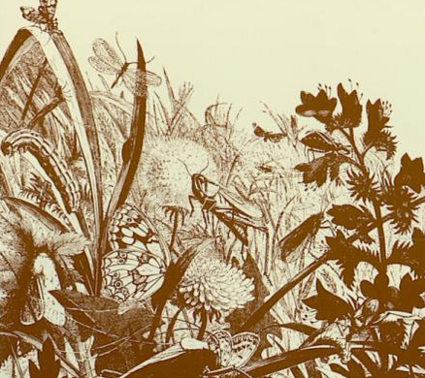
Question Focus
Organisms
Andrewartha, H. G.

Slide 38
Classroom Example: College Biology
Through their questions [about The Distribution and Abundance of Organisms] at the start of the semester, students identified ALL of the sub-disciplines in ecology, which led them to create a course of study for the semester.
At the end of the semester, students compared their initial and final questions and saw how much more sophisticated their questions had become.

Slide 39
Examples of Student Growth
Start and end of an Ecology Course
How do you measure species abundance? (start)
→ How do you measure a species abundance if it has a naturally varying population size? (end)
What are the typical patterns of abundance? Distribution? (start)
→ When measuring distribution, how do we define a species when it gradually changes over space? (end)

Slide 40
The Importance of Questions
"Questions are the engines of intellect, the cerebral machines which convert energy to motion, and curiosity to controlled inquiry."
- David Hackett Fischer,
Historians' fallacies: Toward a logic of historical thought.
Routledge and Kegan Paul, 1971.
“[The QFT] helps me by getting me to think about questions on my own…it gets my mind in motion to think about the questions other people make."
- 8th grade student in James Brewster’s U.S. history class Gus Garcia Young Men’s Leadership Academy, Austin, TX, 2015

Slide 41
In the Age of Google…
“How should you respond when you get powerful new tools for finding answers?
Think of harder questions.”

Slide 42
Ⅳ. Asking Questions as a Pathway to Greater Inclusion

Slide 43
Democracy
“We need to be taught to study rather than to believe, to inquire rather than to affirm.” - Septima Clark
See Chapter 6 on Septima Clark in Freedom Road: Adult Education of African Americans (Peterson, 1996).

Slide 44
LAWRENCE, MA, 1990
“We don’t go to the school because we don’t even know what to ask.”

