Slide 1
Nicole Bolduc Science Teacher Ellington Public Schools (CT)
2018
NSTA STEM Forum & Expo
Make Your Job Easier:
Teach Students to Ask Better Questions
Philadelphia, PA
Sarah Westbrook
Director of Professional Learning
The Right Question Institute (MA)
Access Today’s Materials:
http://rightquestion.org/educators/seminar-resources/

Slide 2
Acknowledgments
We are deeply grateful to the John Templeton Foundation and The Hummingbird Fund for their generous support of the Million Classrooms Campaign.

Slide 3
We’re Tweeting…
@RightQuestion
@SarahRQI
@NicolejBolduc
#QFT

Slide 4
Who is in the room?
#QFT

Slide 5
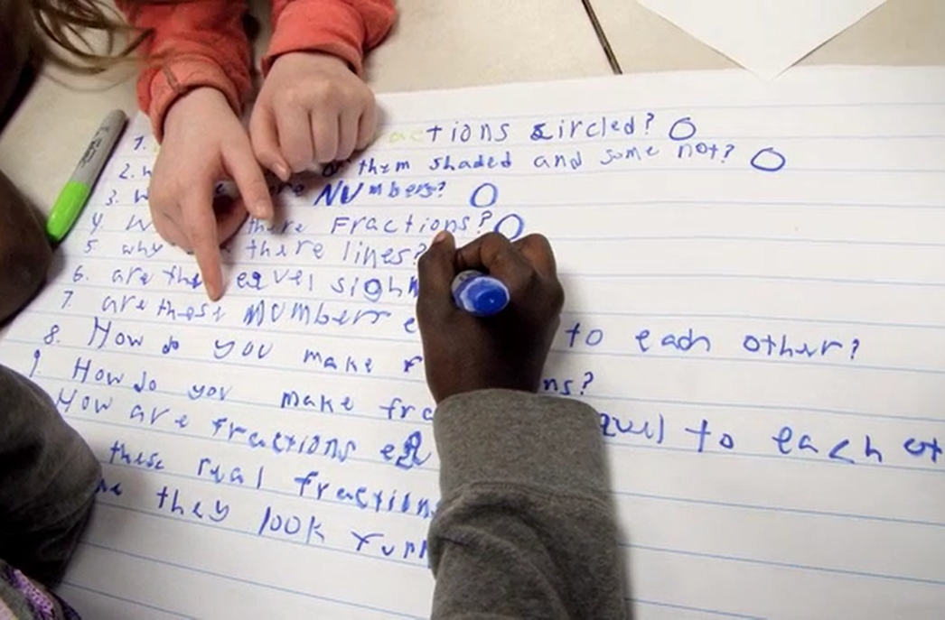
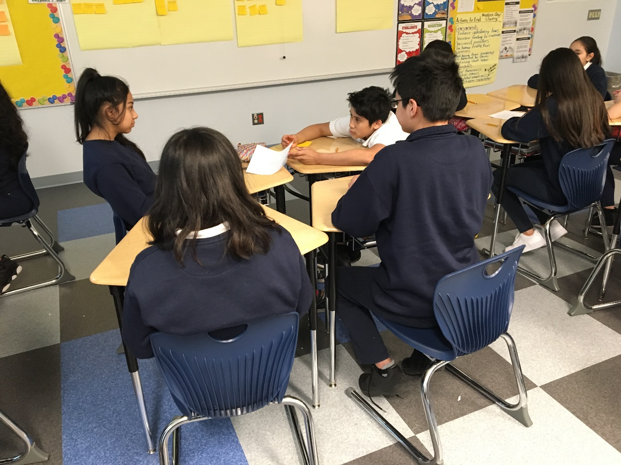
Why spend time teaching the skill of question formulation?

Slide 6
LAWRENCE, MA, 1990
“We don’t go to the school because we don’t even know what to ask.”

Slide 7
"There is no learning without having to pose a question."
-Richard Feynman, Nobel-Prize- winning physicist

Slide 8
“We must teach students how to think in questions, how to manage ignorance.”
-Stuart Firestein, Chairman of the Department of Biology at Columbia University

Slide 9
College Presidents on What Students Should Learn in College
“The primary skills should be analytical skills of interpretation and inquiry. In other words, know how to frame a question.”
- Leon Botstein, President of Bard College
“…the best we can do for students is have them ask the right questions.”
- Nancy Cantor, Chancellor of University of Illinois
The New York Times, August 4, 2002

Slide 10
Yet…only 27%of students believe college taught them to ask their own questions
Alison Head, Project Information Literacy at University of Washington, 2016

Slide 11
But, the problem begins long before college...

Slide 12
Percentage of Basic Skill Attainment
Sources
http://nces.ed.gov/nationsreportcard/pdf/main2009/2011455.pdf
http://nces.ed.gov/nationsreportcard/pubs/main2007/2008468.asp#section1
Data on question-asking based on parent and teacher feedback

Slide 13
Percentage of Basic Skill Attainment
Sources
http://nces.ed.gov/nationsreportcard/pdf/main2009/2011455.pdf
http://nces.ed.gov/nationsreportcard/pubs/main2007/2008468.asp#section1
Data on question-asking based on parent and teacher feedback

Slide 14
We can work together on changing the direction of that slope.
Notes:
Added a period

Slide 15
We Are Not Alone
300,000 educators using the strategy all over the world

Slide 16
Now, Educators Lead the Work
The Right Question Institute offers materials through a Creative Commons License and we encourage you to make use of and/or share this resource. Please reference the Right Question Institute and rightquestion.org as the source on any materials you use.

Slide 17
What happens when students do learn to ask their own questions?

Slide 18
Classroom Example: Kindergarten
Teacher: Jennifer Shaffer, Walkersville, MD
Topic: Non-fiction literacy
Purpose: To engage students prior to reading a nonfiction text about alligators

Slide 19
Question Focus
Photograph by Nuwan Samaranayake, 2013

Slide 20
Student Questions
Is the alligator camouflaged?
Why do the babies have stripes?
Are those baby crocodiles?
Is it a mom or dad crocodile?
What is the green stuff?
Why are they in the water so low?
Where are they going?
Why are the baby alligator’s eyes white and the mom’s black?
Why are baby alligators on top of the momma alligator?
Why does momma or daddy have bumps on them?

Slide 21
Research Confirms the Importance of Student Questioning
Self-questioning (metacognitive strategy):
Student formulation of their own questions is one of the most effective metacognitive strategies
Engaging in pre-lesson self-questioning improved students rate of learning by nearly 50% (Hattie, p.193)
John Hattie
Visible Learning: A Synthesis of Over 800
meta-Analyses Relating to Achievement, 2008

Slide 22
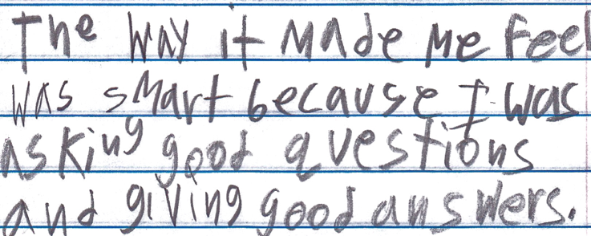
Student Reflection
“The way it made me feel was smart because I was asking good questions and giving good answers.”
-Boston 9th grade remedial summer school student

Slide 23
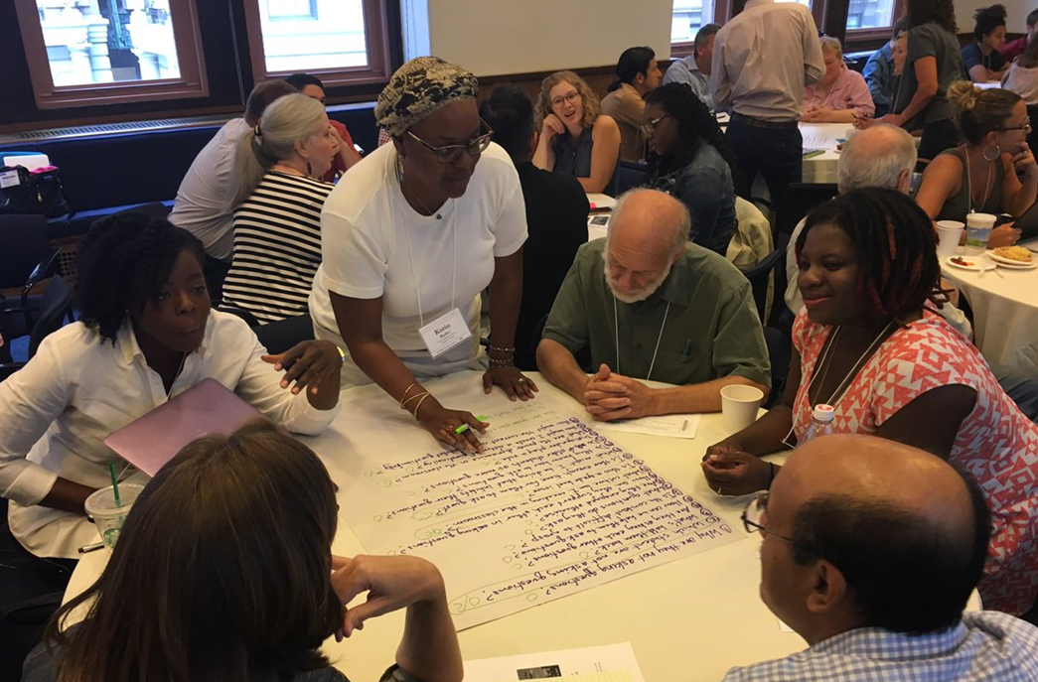
Working on a Shared Challenge Using the Question Formulation Technique (QFT)
Notes:
As yourself, approach an authentic problem that most of us share, work using the QFT, so you’re learning the process by experiencing it yourself.

Slide 24
The Question Formulation Technique (QFT)
Students learn to:
Produce their own questions
Improve their questions
Strategize on how to use their questions
Reflect on what they have learned and how they learned it
#QFT
Notes:
Before we start, give 1 minute to introduce selves, where you work, what age group, and pick one person as the recorder.
Warning: you may feel frustrated by the time constraints, it will be frustrating sometimes to stop just as you’ve started; we’ve made this choice because we think it is best to experience the whole process, at least a taste, this is an intro not a deep dive (you may hate the timer by the end of it)

Slide 25
Rules for Producing Questions
1. Ask as many questions as you can
2. Do not stop to answer, judge, or discuss
3. Write down every question exactly as stated
4. Change any statements into questions

Slide 26
Produce Questions
Ask Questions
Follow the Rules
Ask as many questions as you can.
Do not stop to answer, judge, or discuss.
Write down every question exactly as it was stated.
Change any statements into questions.
Number the Questions

Slide 27
Question Focus:
Some students are not asking questions.
→Please write this statement at the top of your paper.
→Remember to number the questions & follow the rules.

Slide 28
Categorize Questions: Closed/ Open
Definitions:
Closed-ended questions can be answered with a “yes” or “no” or with a one-word answer.
Open-ended questions require
more explanation.
Directions: Identify your questions as closed-ended or open-ended by marking them with a “C” or an “O.”

Slide 29
Discussion
Closed-ended Questions
Advantages
Disadvantages

Slide 30
Discussion
Open-ended Questions
Advantages
Disadvantages

Slide 31
Improve Questions
Take one closed-ended question and change it into an open-ended question.
Take one open-ended question and change it into a closed-ended question.
Closed
Open
Open
Closed

Slide 32
Prioritize Questions
Review your list of questions
Choose the three questions you are most curious to explore further.
While prioritizing, think about your Question Focus: Some students are not asking questions.
After prioritizing consider…
Why did you choose those three questions?
Where are your priority questions in the sequence of your entire list of questions?

Slide 33
Strategize on How to Use Questions
From priority questions to action plan
In order to answer your priority questions:
What do you need to know? Information
What do you need to do? Tasks

Slide 34
Share
Questions you changed from open/closed
Your three priority questions and their numbers in your original sequence
Rationale for choosing priority questions
Next steps

Slide 35
Reflection
What did you learn?
How did you learn it?
What do you understand differently now about some students not asking questions?

Slide 36
A Look Inside the Process
#QFT

Slide 37
The QFT, on one slide…
Question Focus
Produce Your Questions
Follow the rules
Number your questions
Improve Your Questions
Categorize questions as Closed or Open-ended
Change questions from one type to another
Prioritize Your Questions
Share & Discuss Next Steps
Reflect
Ask as many questions as you can
Do not stop to discuss, judge or answer
Record exactly as stated
Change statements into questions
Closed-Ended:
Answered with “yes,” “no” or one word
Open-Ended: Require longer explanation

Slide 38
Curiosity and Rigor
Three thinking abilities
with one process

Slide 39
Thinking in many different directions
DIVERGENT THINKING

Slide 40
Narrowing Down, Focusing
CONVERGENT
THINKING

Slide 41
Thinking about Thinking
METACOGNITIVE
THINKING

Slide 42
Exploring Classroom Examples
#QFT

Slide 43
Classroom Example: 4th Grade
Teacher: Deirdre Brotherson, Hooksett, NH
Topic: Math unit on variables
Purpose: To engage students at the start of a unit on variables

Slide 44
Question Focus
24 = ☺ + ☺ + ☺

Slide 45
Student Questions
Why is the 24 first?
What do the smiley faces mean?
Why are there 3 smiley faces?
How am I suppose to figure this out?
Is the answer 12?
Can I put any number for a smiley face?
Do three faces mean something?
Do the numbers have to be the same because the smiley faces are the same?
What numbers will work here?
Does it mean 24 is a really happy number?
Can we replace each smiley face with an 8?
Do any other numbers work?
Can we do this for any number?
Does it always have to be smiley faces?
Do we always have to use three things?

Slide 46
Next Steps with Student Questions
Questions posted on classroom walls.
Students cross off the questions they answer during subsequent lessons.
Teacher returns to student questions at the end of the unit to discuss with students what they learned and what they still want to know.

Slide 47
Classroom Example: Middle School
Teacher: Nicole Bolduc, Ellington, CT
Topic: Living organisms (DCI)
Purpose: To engage students in setting the learning agenda for the unit. Students figure out the phenomenon of some eggs hatching into chicks.
Case 1
Case 2

Slide 48
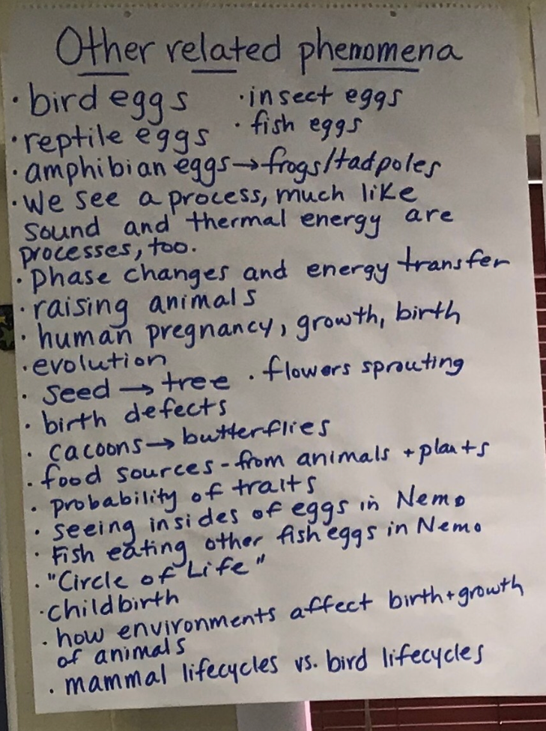
Before the QFT, we…
1) Watched videos of people raising chickens, harvesting eggs, and chicks hatching.
2) Discussed observations and why people raise chickens.
3) Made a list of items we needed in our classroom to raise chickens.
5) Drew initial models of phenomenon.
6) Discussed our initial models and came up with one consensus model.
7) Made a list of other related phenomena.

Slide 49
Question Focus:
“Some eggs hatch into chicks while others do not.”
(Class consensus model)
Case 1
Case 2

Slide 50
Selected Student Questions (there were over 200!)
What happens when the egg is not in a certain environment?
Can other eggs relate to the same process?
Do both of the eggs in both cases start the same way?
How are the shells formed?
Do different eggs need different temp?
How is the egg made in the chicken?
Why do eggs hatch at certain time?
Do female chickens lay eggs or also male?
What does fertilization have to do with the way the egg hatches?
Do the eggs change anyway during hatching?
How are eggs fertilized?
How are other animals’ eggs relate to the chicken eggs?
How do chicken eggs start off edible on the inside?
Does Kinetic Energy/Potential Energy/Thermal energy relate to eggs in any way?

Slide 51
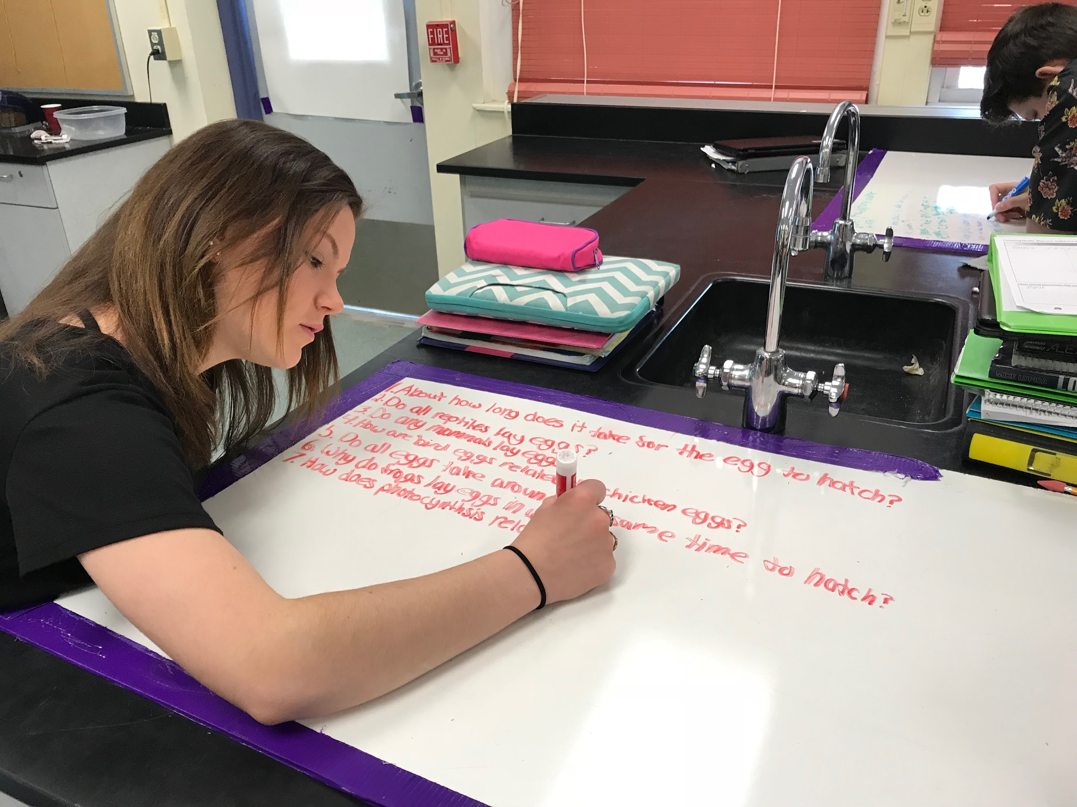
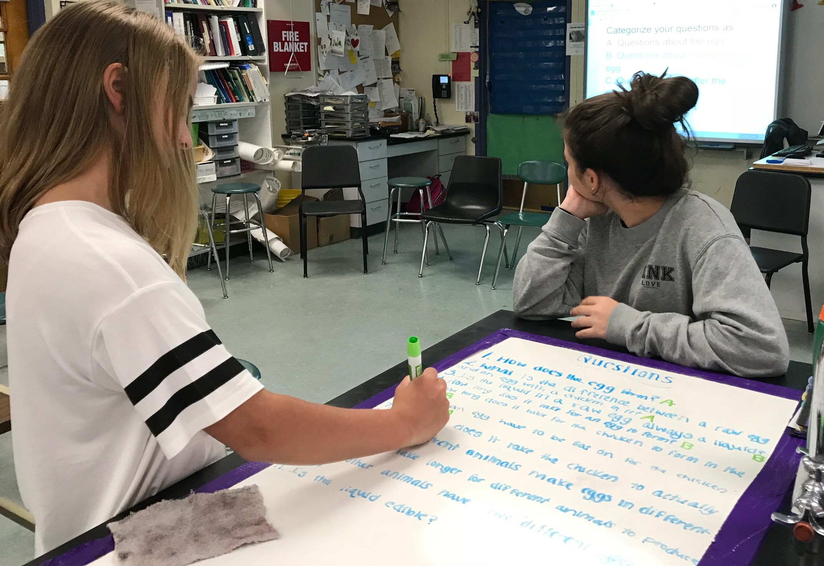
Categorization & Prioritization
1) Students categorized their questions into following categories:
A) The egg at first
B) Inside the egg over time
C) The egg after a period of time has passed
D) *PARKING LOT
2) Continue to improve and add questions.
3) Students choose 4 questions they believe will best help them figure out the phenomenon and/or related phenomena.
Notes:
2) Revise and Improve questions by changing a “thin” question to “thick” and adding at least one question required for categories A, B, and C.
Is it really after the QFT?

Slide 52
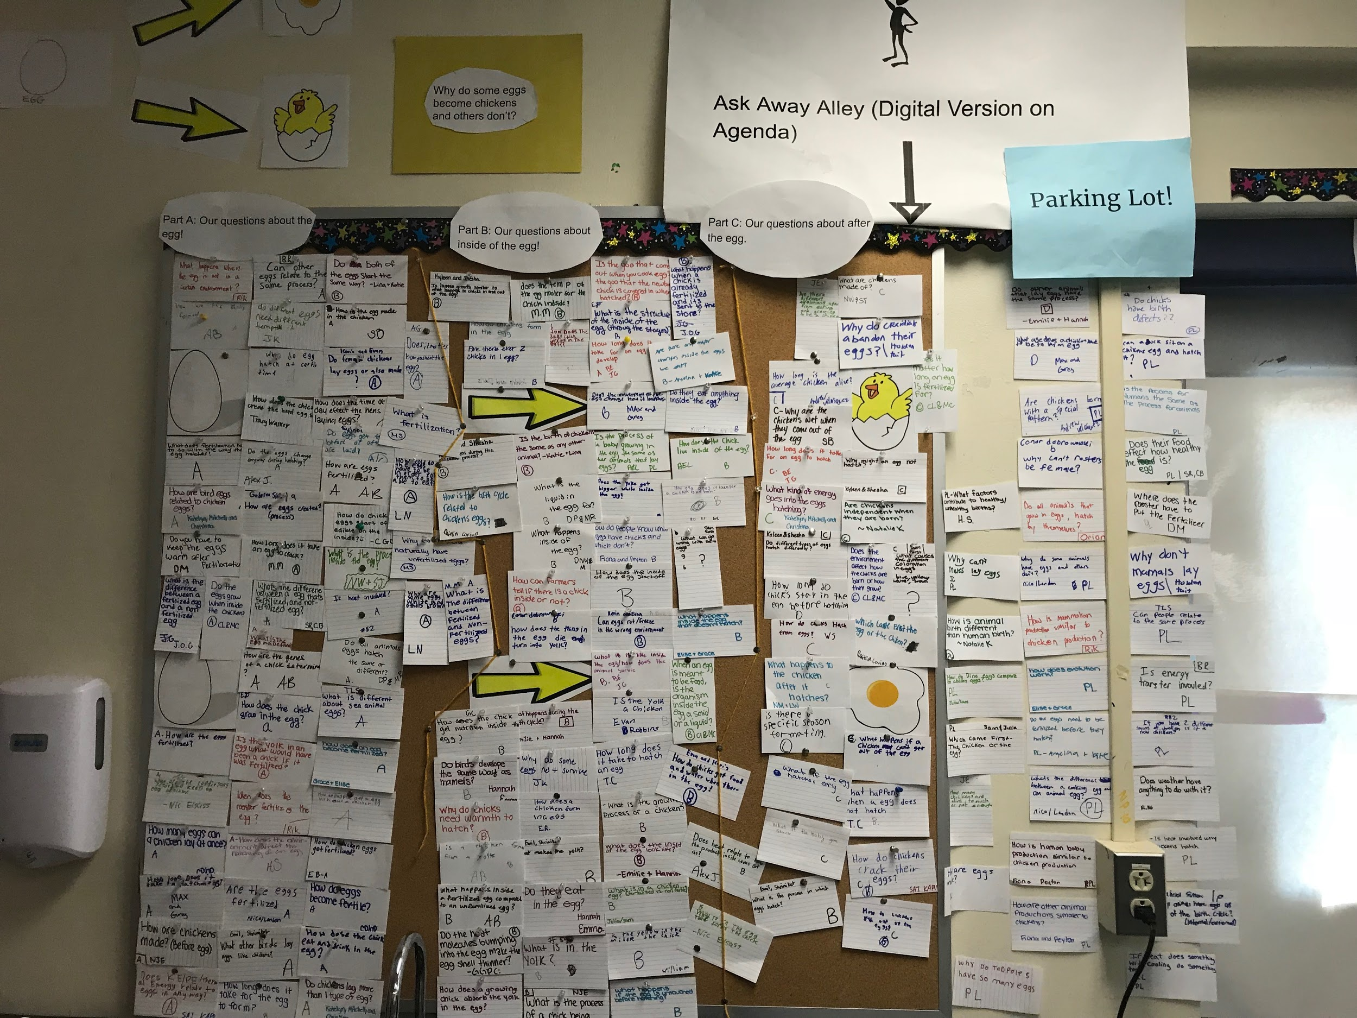
Next steps after the QFT
The Driving Question Board (DQB)

Slide 53
Next steps after the QFT
List your 4 questions below | This question best relates to the following part of our consensus model: A, B, C or Parking Lot | Sources of evidence we need in order to answer the question | Ideas for class investigations
1. 2. 3. 4.
Reflect: I chose these 4 questions because...
Students reflect and help plan next steps with their questions

Slide 54
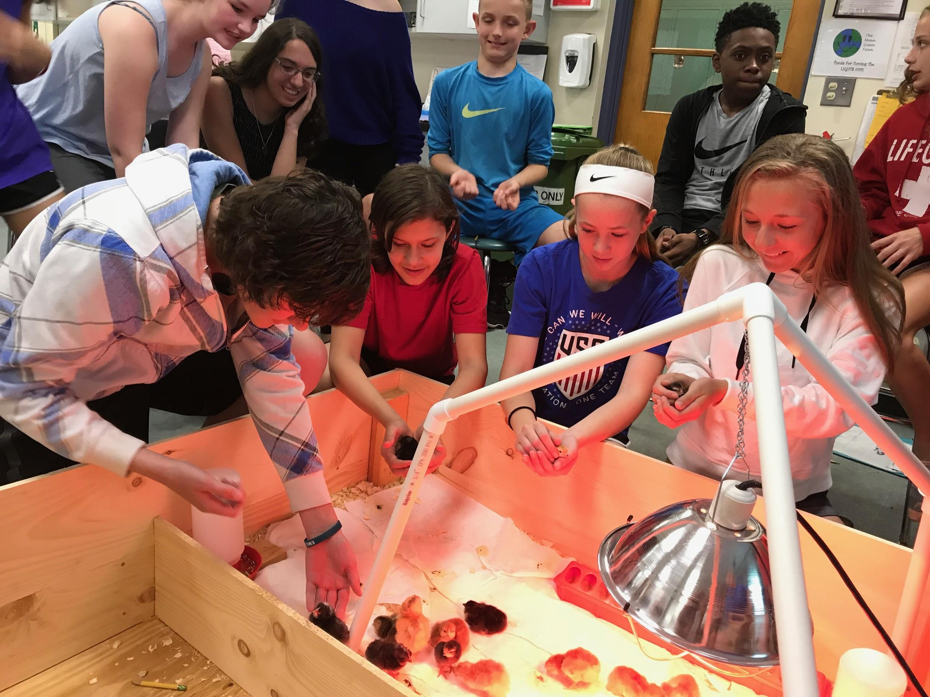
Next Steps: in the Days Following QFT
Students raise chicks and conduct other investigations

Slide 55
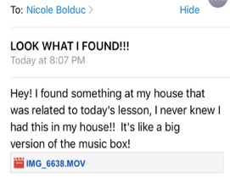
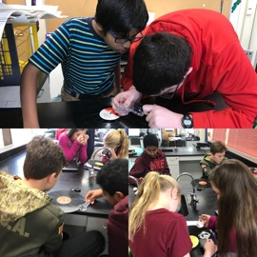
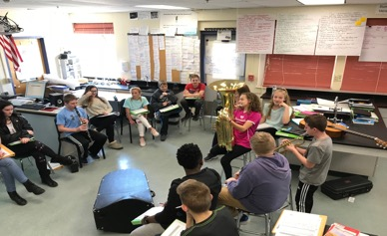
Next Steps: in the Days Following QFT
Students experience a series of scientific investigations that target figuring out specific parts of our consensus model.
Students encouraged to continuously ask questions throughout the process (Question Wall of Fame)
As we figure out parts of our model, we revisit the Driving Question Board and agree on questions we have answered and/or not answered.
From an inspired student!

Slide 56
To See More of Nicole’s Work:
http://rightquestion.org/educators/seminar-resources/

Slide 57
Classroom Example:
High School
Teacher: Allison Gest, Park Ridge, IL
Topic: A unit on “Running Water”
Purpose: To give peer feedback and revise initial experiment designs

Slide 58
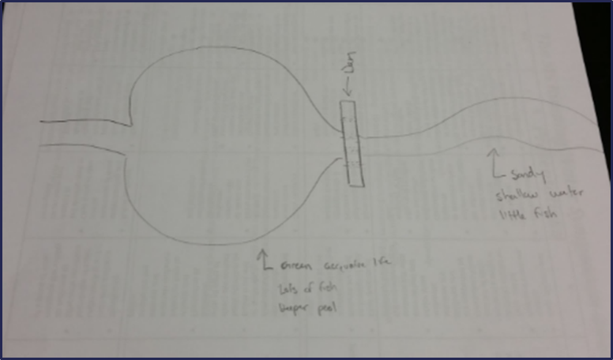
Question Focus:
Scientist’s claim:
“Adding a dam to a water system causes a decrease in aquatic life downstream.”
Student Design to test the claim:

Slide 59
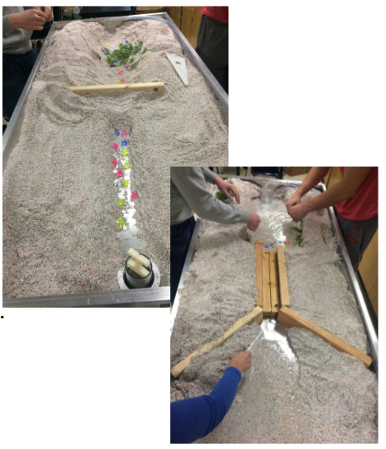
Next Steps:

Slide 60
Classroom Example: University
Teacher: Rachel Woodruff, Assistant Professor of Biology, Brandeis University, MA
Topic: Molecular Biology
Purpose: To build students’ research skills and prepare them to develop their own research proposal

Slide 61
Question Focus:
(Students were assigned a complex molecular biology article)
Ask as many questions as you can about the reading

Slide 62
Next Steps with Student Questions:
Students generate questions for homework
Students discuss key attributes of a good biological research question and compare to other types of questions
Students form groups and improve their questions
These questions are discarded or kept in notebooks (up to the student)
Students apply this skill to designing their own research project later in the semester

Slide 63
Why is student question formulation so important today?

Slide 64
In the Age of Google…
“How should you respond when you get powerful new tools for finding answers?
Think of harder questions.”
- Clive Thompson, Journalist and Technology Blogger

Slide 65
The Skill of Asking Questions
For moving from ignorance as weakness to ignorance as opportunity
For arriving at better answers (and more questions)
For increasing engagement and ownership
For jump-starting inquiry in the classroom
For a little more joy in a very demanding profession
And…

Slide 66
Democracy
“We need to be taught to study rather than to believe, to inquire rather than to affirm.” - Septima Clark
See Chapter 6 on Septima Clark in Freedom Road: Adult Education of African Americans (Peterson, 1996).

Slide 67
Evaluation
Please take a moment to fill out this brief evaluation and reflection:
https://tinyurl.com/QFTSTEMexpo
We value your feedback and work hard to continuously revise our resources to best support the work of educators in the field. Thank you!
Leave us your email & we’ll enter you in a book raffle for Make Just One Change!

Slide 68
To Access Today’s Materials:
http://rightquestion.org/educators/
seminar-resources/
Join our Free Educator Network for:
Templates you can use tomorrow in class
Classroom Examples
Instructional Videos
Forums and Discussions with other Educators

Slide 69
Now, Educators Lead the Work
The Right Question Institute offers materials through a Creative Commons License which means that we encourage you to make use of and/or share this resource. Please just be sure to reference the Right Question Institute and rightquestion.org as the source on any materials you use.

Slide 70
To Learn More About How to Use the QFT in Your Context
Check out our online course hosted by the Harvard Graduate School of Education:
https://www.gse.harvard.edu/ppe/program/teaching-students-ask-their-own-questions-best-practices-question-formulation-technique
October 15, 2018 – November 2, 2018

Slide 71
A Sample of What’s on Rightquestion.org…

Slide 72
Classroom Example: High School Physics
Teacher: David Meshoulam, Newton, MA
Topic: Current and magnetism
Purpose: Transition from unit on Electricity to unit on Electricity and Magnetism

Slide 73
Question Focus:
Power lines from a power plant carry electricity at voltages of 345,000 Volts or more!
Transformers, like the one shown reduce that voltage to 120 Volts for home use.

Slide 74
Classroom Example: High School
https://www.youtube.com/watch?v=9wrIIDNECUQ

