Slide 1
QFT Examples from Nicole Bolduc’s 7th Grade Classroom
To find out more or ask questions, please reach out to Nicole: nbolduc@ellingtonschools.net

Slide 2
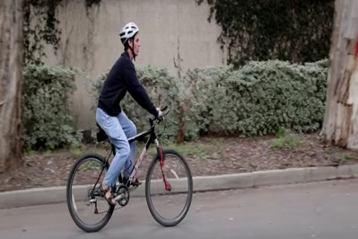
Classroom Example: Middle School
Teacher: Nicole Bolduc, Ellington, CT
Topic: The Science of Sound
Purpose: To engage students in setting the learning agenda for the unit.
Students watched video of Daniel Kish, a blind man who uses “Flash Sonar” to navigate the world.
They are instructed to ask questions as a scientist who wants to discover.
https://www.youtube.com/watch?v=PLPEcu6523Q

Slide 3
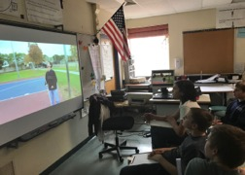
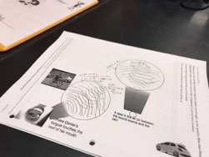
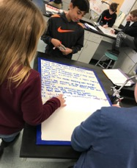
Before the QFT
Watched phenomenon twice and wrote down observations.
Came together to share observations.
Drew initial models of how phenomenon works scientifically.
Came together to share initial models and come up with an organized consensus model.
Made a list of other related phenomena.
QFT process based on Daniel Kish, our consensus model, and new list of related phenomena.

Slide 4
Selected Student Questions
(Category A) What causes different sounds
Does the clicking only work with special objects?
Why does fire make a “crackling” noise?
Why do different things make different sounds?
How can get something so loud?
Does loud or quiet sounds help you know where you are?
Does he have to make a louder noise is he is in a larger environment?
Do you have to click a certain way to “see?”
Could the use of snapping vs clicking make a difference?
Why do all the animals have different sounds?
How does the speed that they click effect what you are doing?
What makes up sound?
How is echolocation used? Humans and animals?
Why when we yell does it echo?
How does lightning make sound?
How does snapping your fingers make a noise?
Does the volume of the sound matter?
Why does a tennis racket maker a “whoosh” sound?
Can certain people hear dog whistles?
Cick here to see ALL of their cetegorized questions

Slide 5
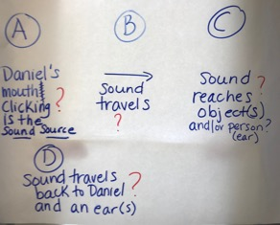
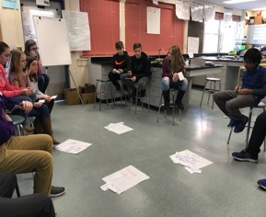
Next Steps After the QFT
1) Students chose the 3 most interesting questions from their list.
2) Students categorized their questions into following categories:
What causes different sounds?
How does sound move from a sound source to an object or someone’s ear?
How does sound interact with an object?
What affects how someone receives sound?
PARKING LOT

Slide 6
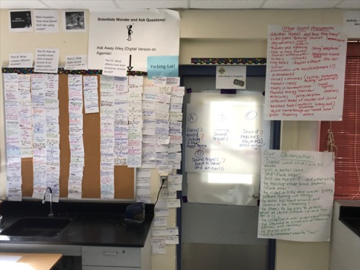
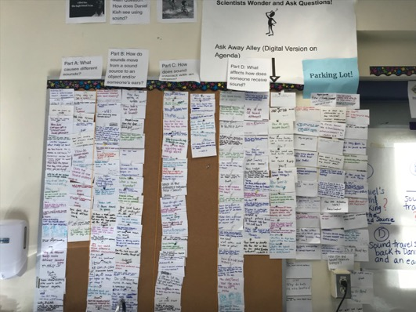
Next Steps: the Driving Question Board
Driving Question Board next to other student-generated ideas

Slide 7
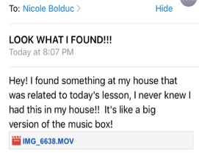
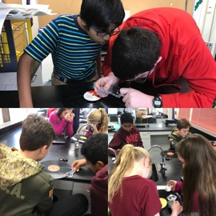
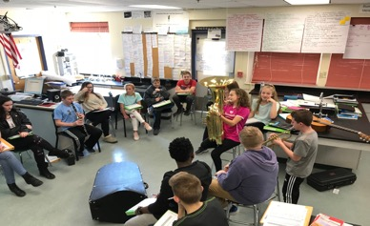
Next Steps: in the Days Following QFT
Students experience a series of scientific investigations that target figuring out specific parts of our consensus model.
Students encouraged to continuously ask questions throughout the process (Question Wall of Fame)
As we figure out parts of our model, we revisit the Driving Question Board and agree on questions we have answered and/or not answered.
From an inspired student!

Slide 8
Classroom Example: 7th Grade
Teacher: Nicole Bolduc, Ellington, CT
Topic: “The Universe and Its Stars” Unit
Purpose: To engage students in setting the learning agenda for the unit

Slide 9
Question Focus:
Students watched videos of dramatic tide change in Cape Cod, Alaska, and Canada
https://www.youtube.com/watch?v=mAYXZzKUAX4
https://www.youtube.com/watch?v=53EEDisloME

Slide 10
Selected Student Questions
Why does tide change?
How is tide created?
How does earth’s rotation cause the tide to change?
Does the sun have any part in the rise and retreat of tides?
Do tides occur because of the gravitational pull of the moon?
Do the phases of the moon come into play with the tides?
How do other planets affect it?
Are the tides opposite in Florida and Mexico? (b/c they share the Gulf of Mexico)
How come the tide changes greatly in some places but not others?
How far can high tide go?
How do tides affect people?
Can tide change be a problem in the future?
Does global warming affect tides?
Where does the water go to?
Does temperature have anything to do with tides?
Does tilt have anything to do with tides?
How do fish & wildlife survive when the tide is always changing?
If the moon disappeared, would there be no tides?
What would happen if the tide didn’t change?
Why are tides important to the earth?

Slide 11
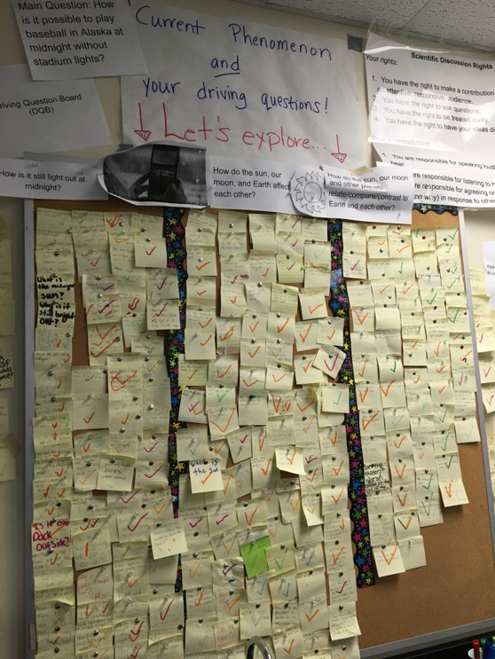
Next Steps:
The Driving Questions Board and the “Parking Lot”
Students draw initial models, give feedback, and make predictions.
Students experience a series of scientific investigations.
At the end of the unit, the Driving Question board is “published” in poster format.

Slide 12
Classroom Example:
Middle School
Topic (DCI’s?): Living organisms
Phenomenon: Some eggs hatch into chicks while others do not.
Case 1
Case 2

Slide 13
Before the QFT
1) Watched videos of people raising chickens, harvesting eggs, and chicks hatching while writing observations.
2) Discussed observations.
3) Discussed reasons why people raise chickens.
4) Discussed list of items we need in our classroom to raise chickens. I suggested that I go to the grocery store to pick up eggs.
5) Drew initial models of phenomenon.
Case 1
Case 2

Slide 14
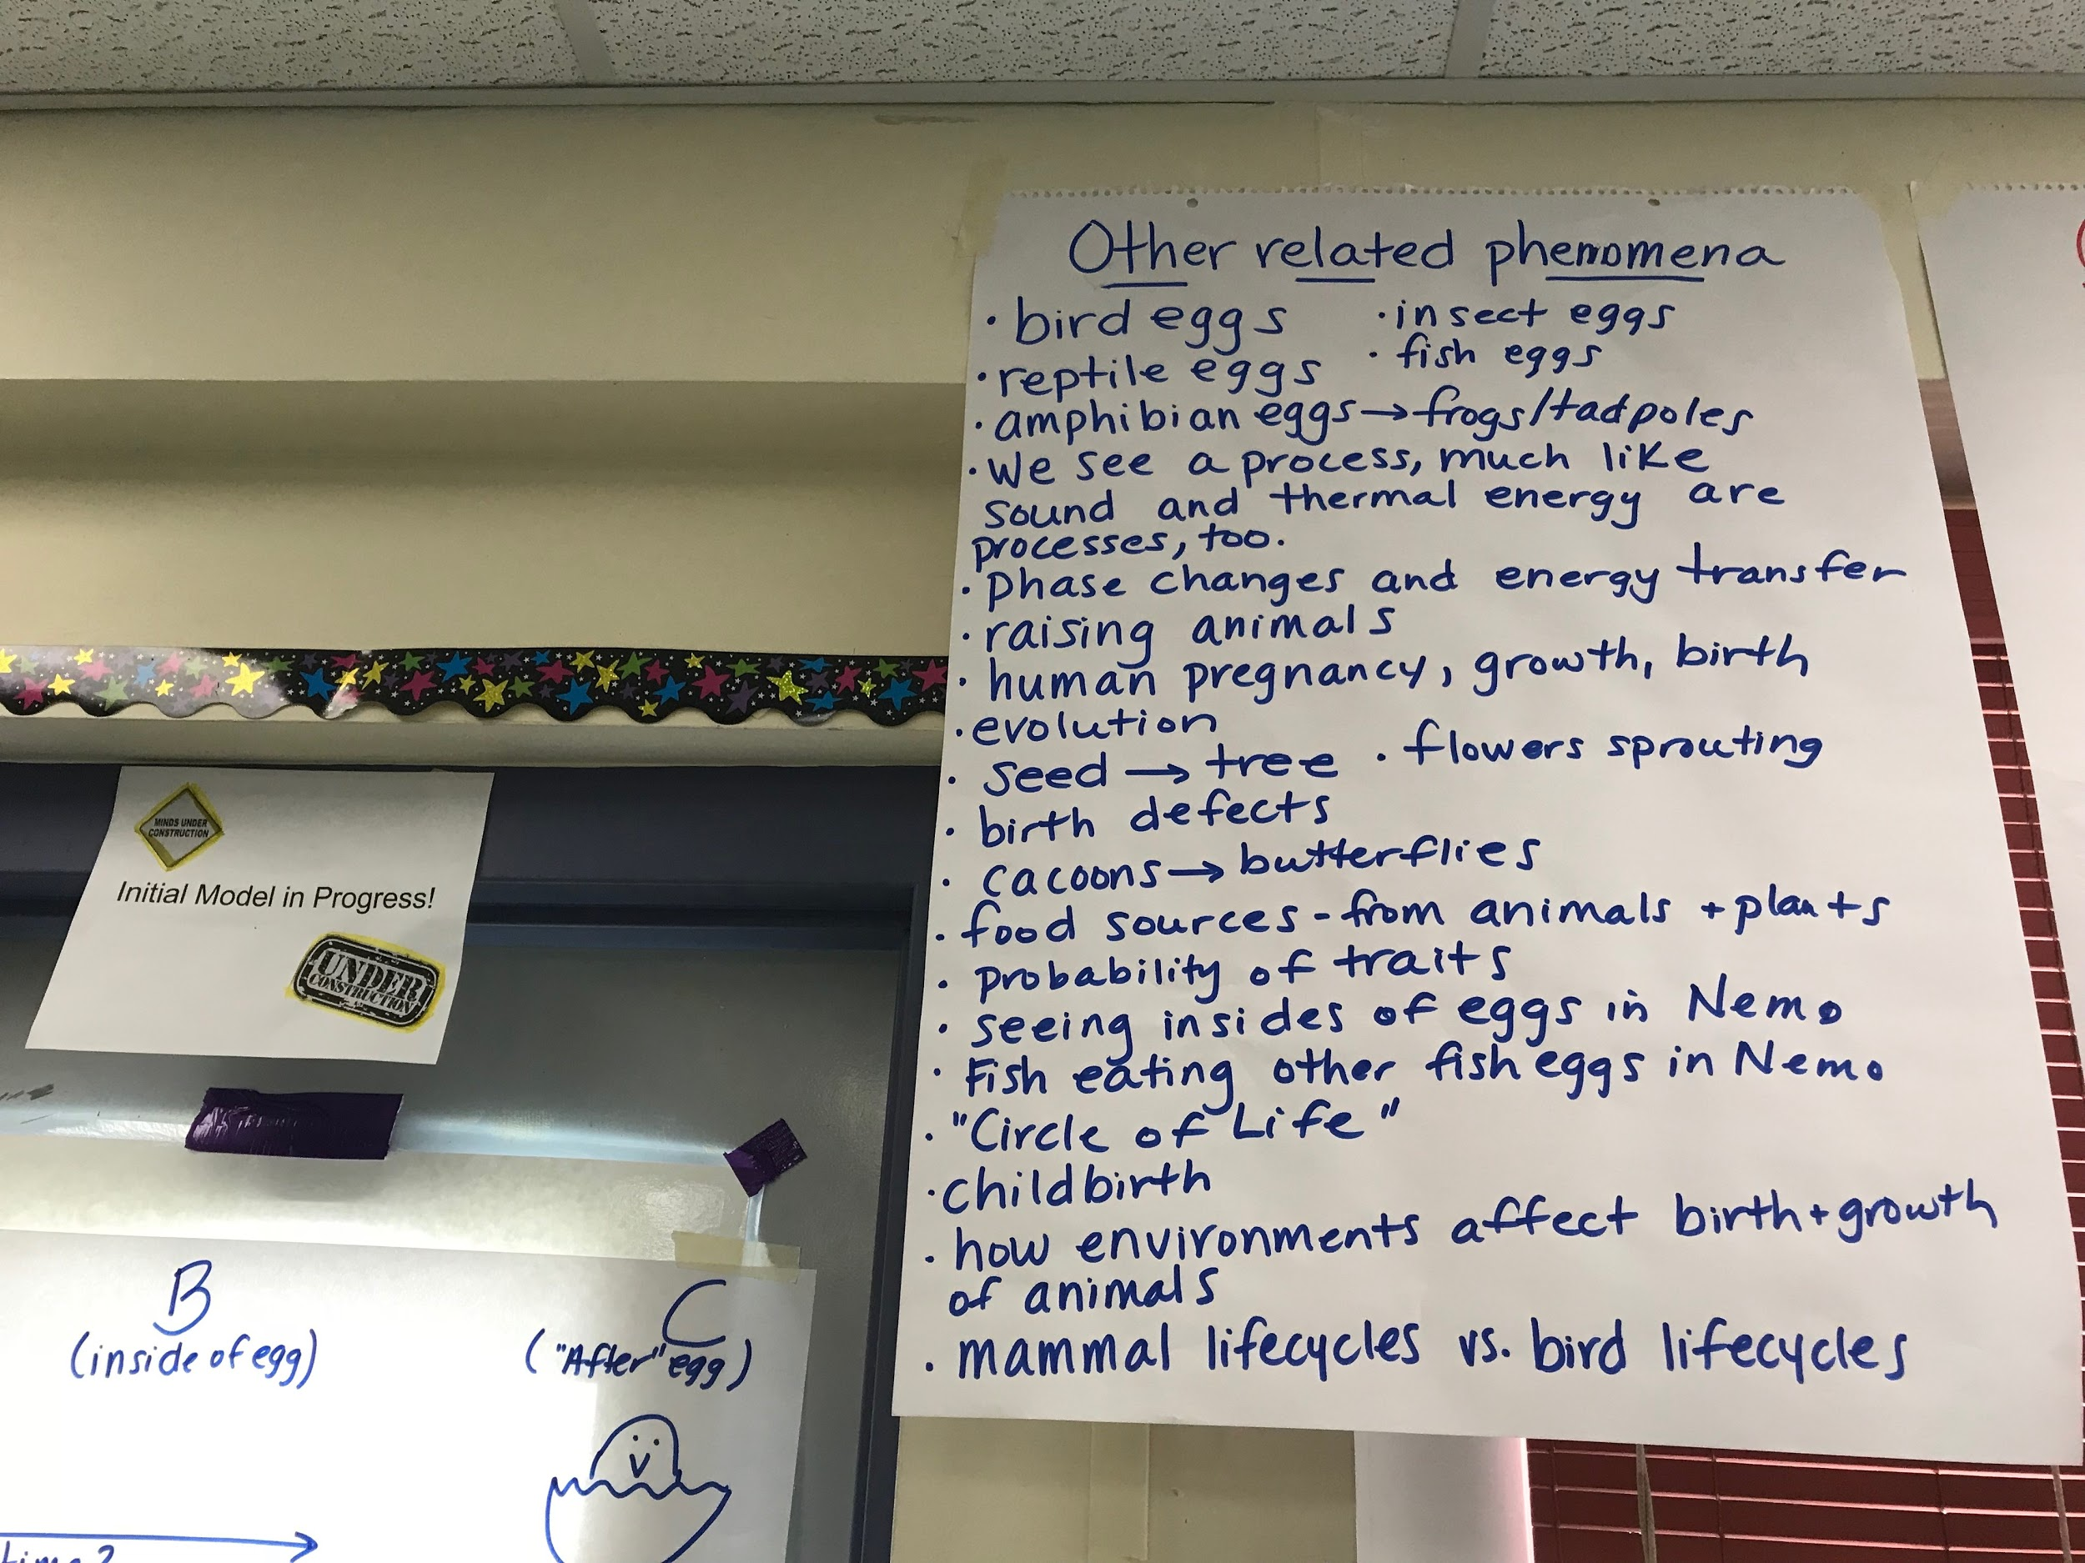
Before the QFT
7) Shared/discussed initial models and come up with an organized consensus model.
8) Made a list of other related phenomena.

Slide 15
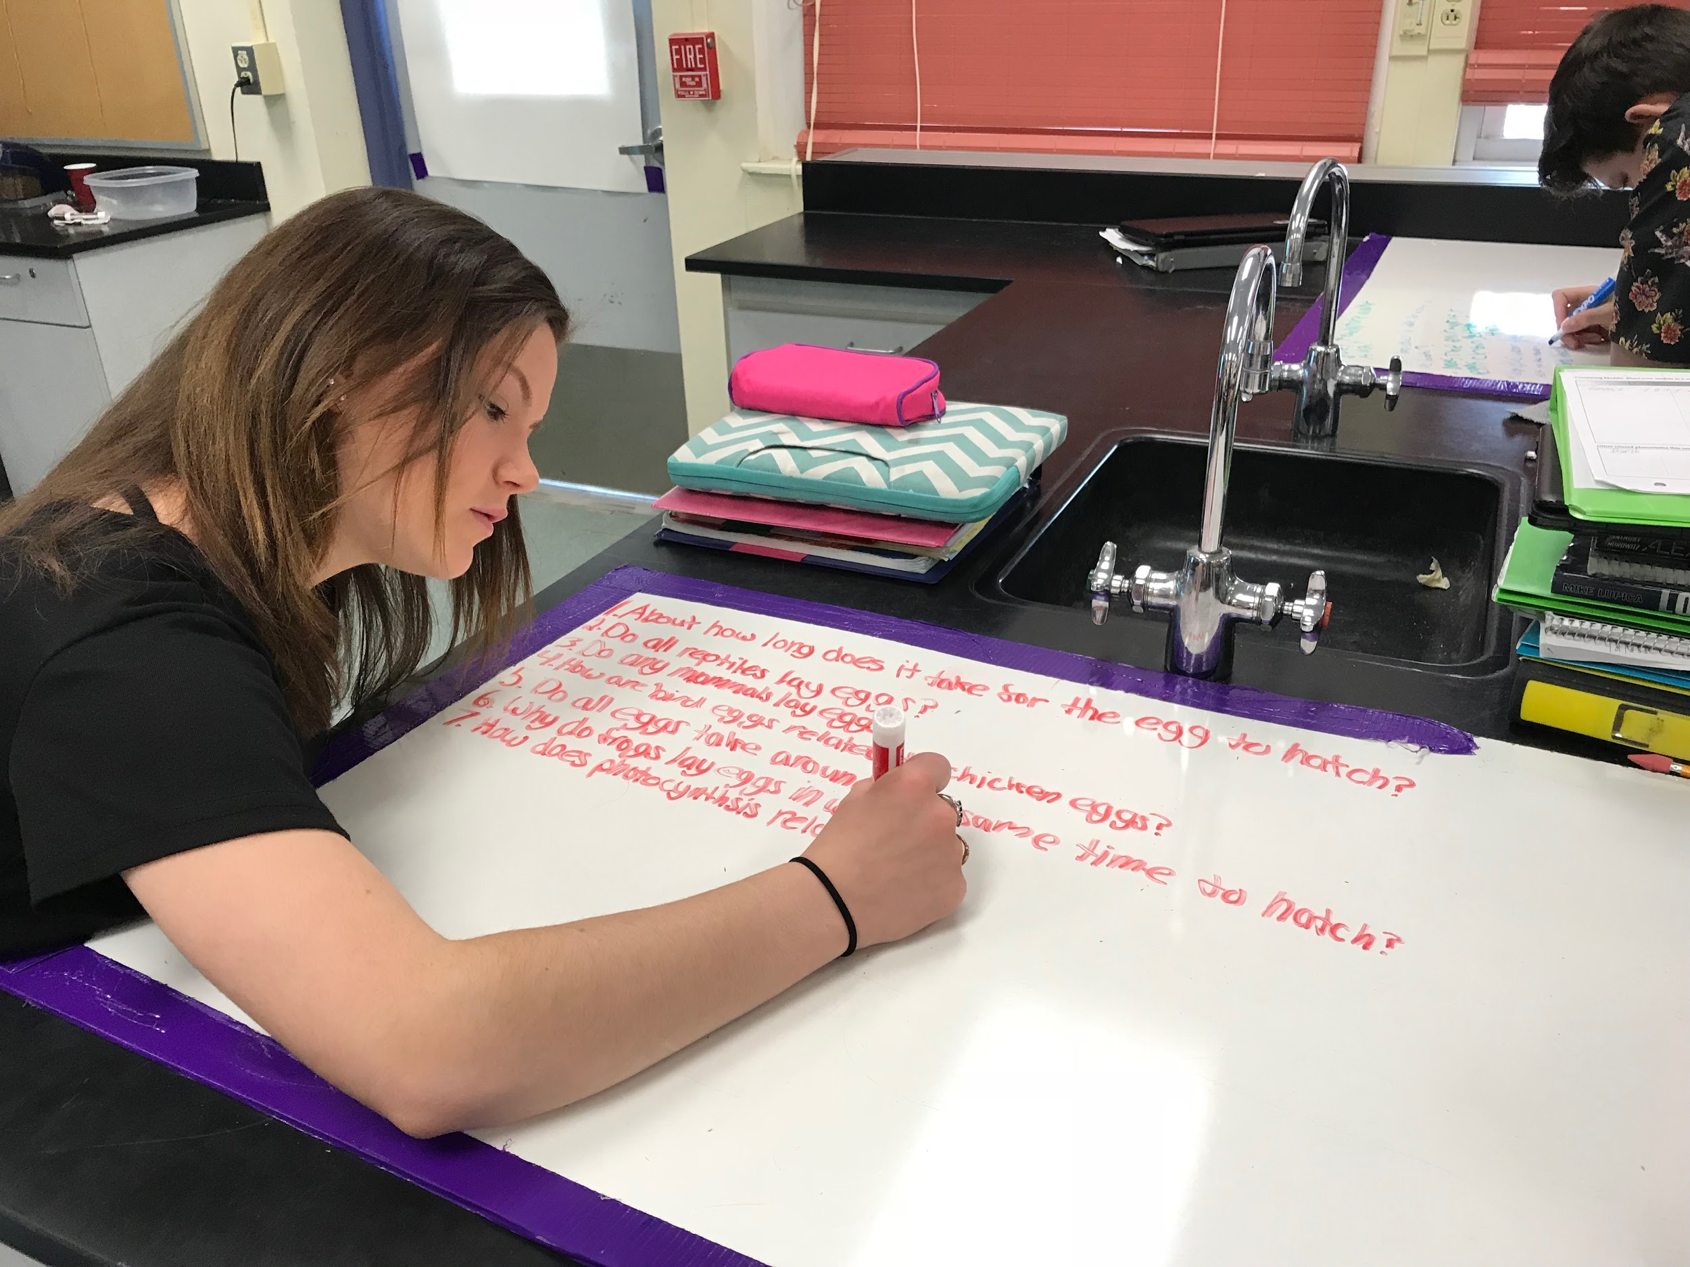
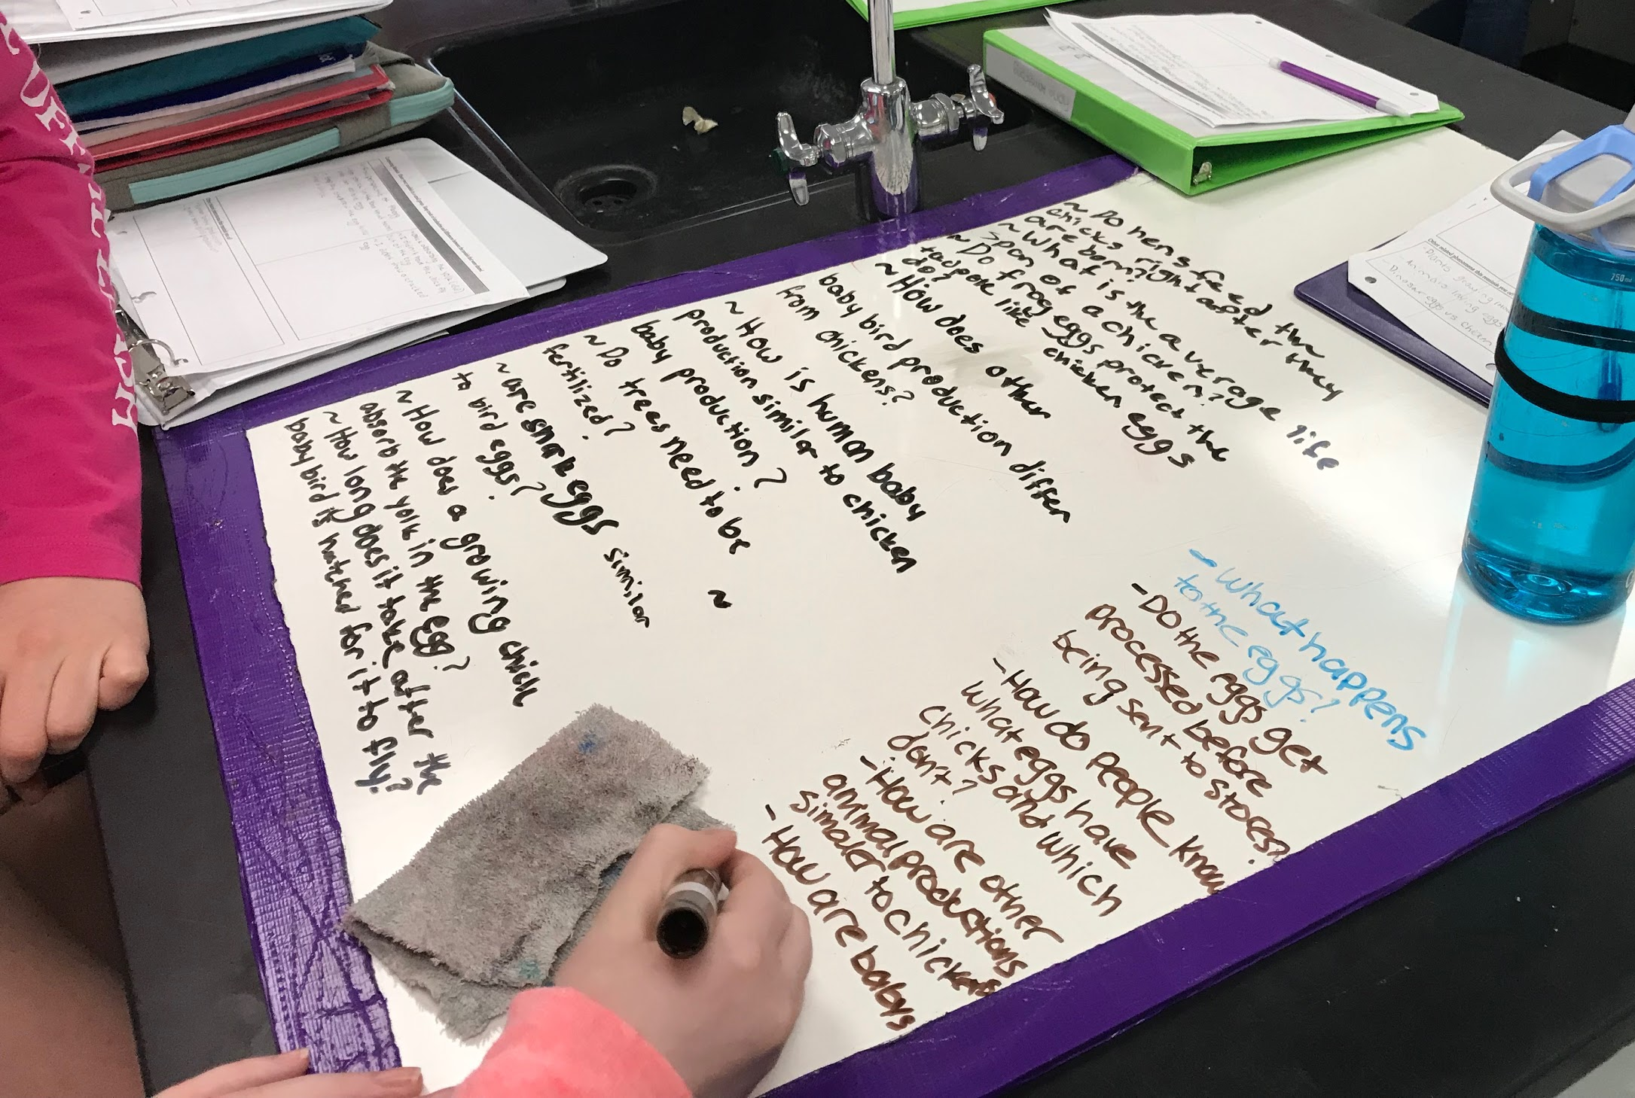
During the QFT
Students generate “scientific” questions based on their initial models, our class consensus model, and our list of related phenomena.

Slide 16
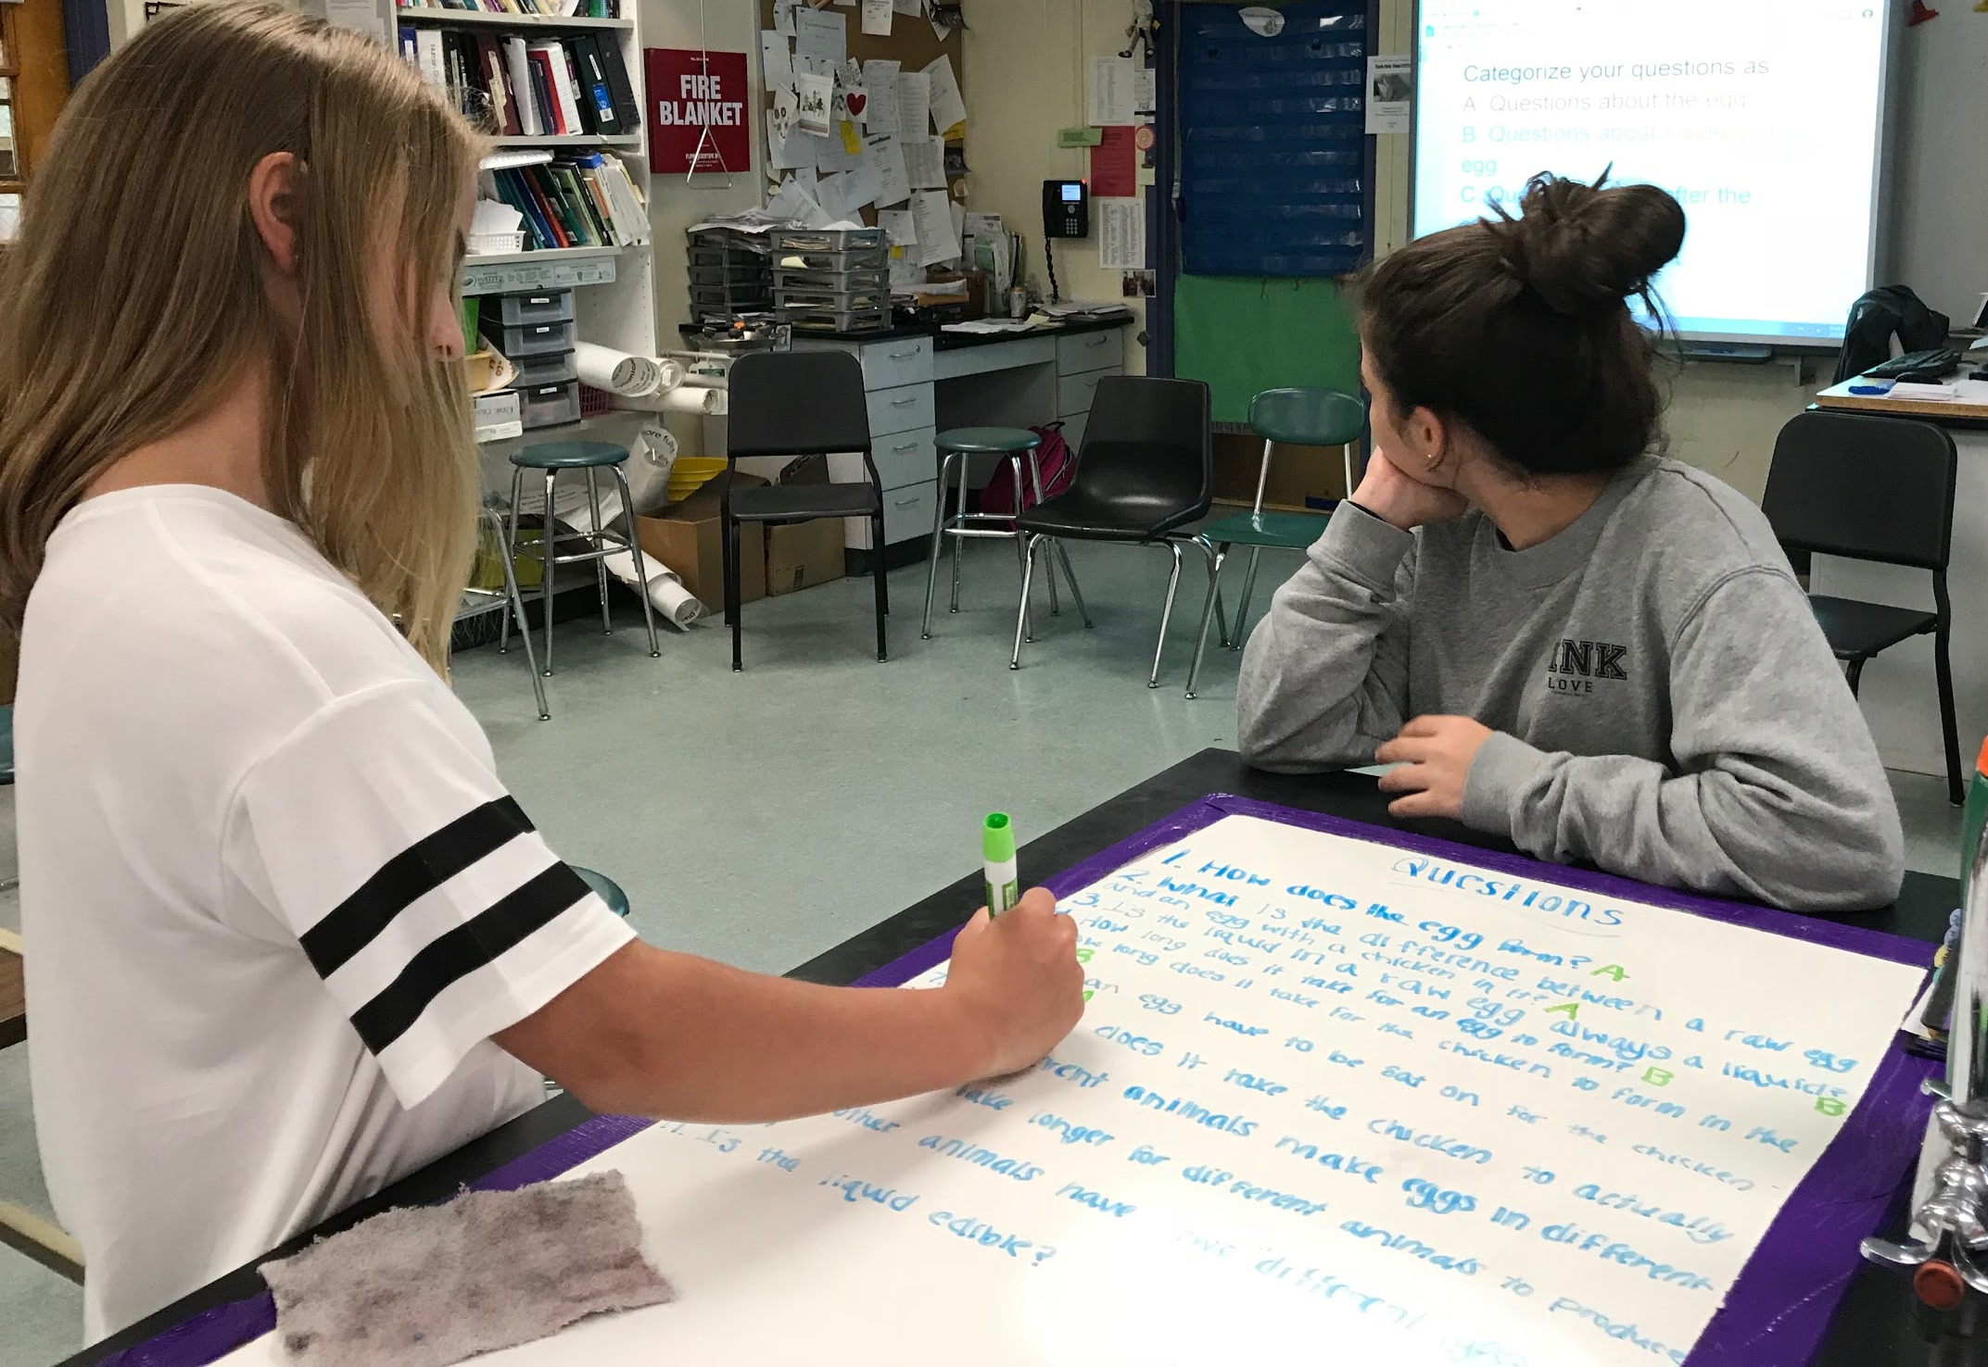
Next steps after the QFT
1) Students categorized their questions into following categories:
A) The egg at first
B) Inside the egg over time
C) The egg after a period of time has passed
*PARKING LOT
2) Revise/Improve questions by changing a “thin” question to “thick” and at least one question required for categories A, B, and C. Generate more questions if needed.

Slide 17
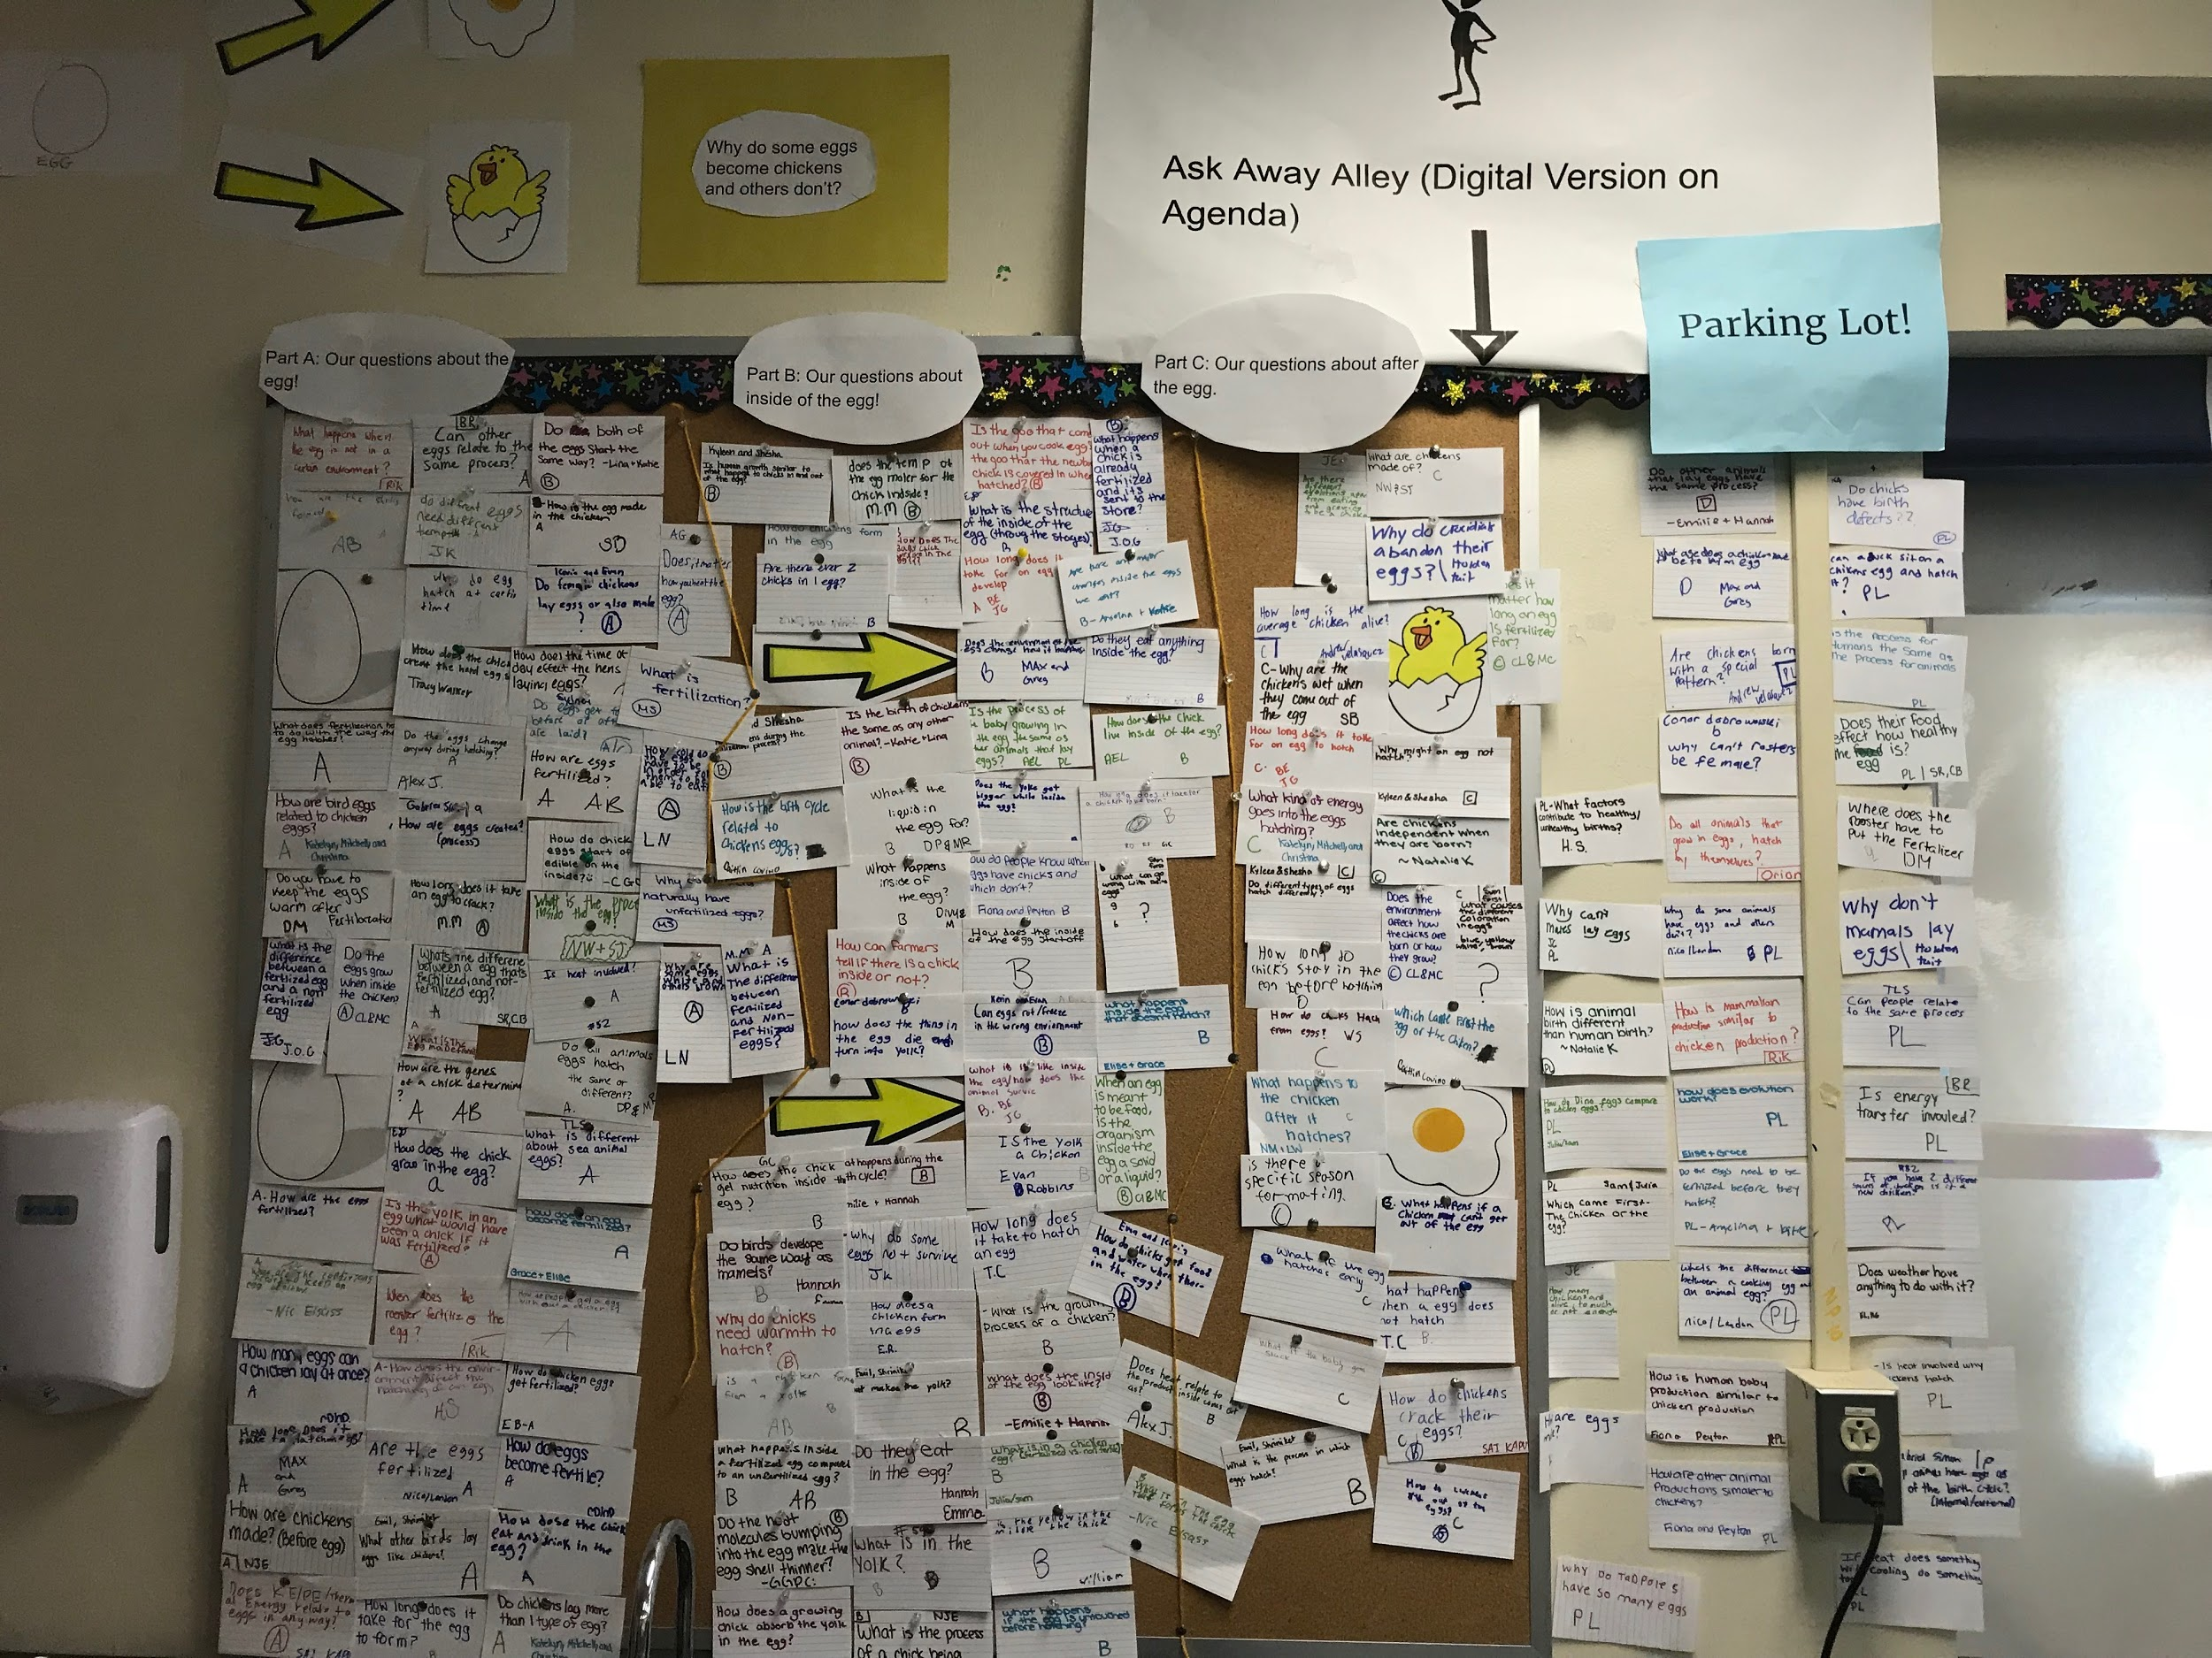
Next steps after the QFT
-Students choose 4 questions they believe will best help them figure out the phenomenon and/or related phenomena.
-Create Driving Question Board (DQB)

Slide 18
Sample Student Questions (there were over 200!)
Overall Question: Why do some eggs become chickens but others don’t?
A: Questions we have about the egg and “beginning” of process.
What happens when the egg is not in a certain environment?
Can other eggs relate to the same process?
Do both of the eggs in both cases start the same way?
How are the shells formed?
Do different eggs need different temp?
How is the egg made in the chicken?
Why do eggs hatch at certain time?
Do female chickens lay eggs or also male?
What does fertizalition have to do with the way the egg hatches?
Do the eggs change anyway during hatching?
How are eggs fertilized?
How are other animals’ eggs relate to the chicken eggs?
How do chicken eggs start off edible on the inside?
Does Kinetic Energy/Potential Energy/Thermal energy relate to eggs in any way?

Slide 19
Next steps after the QFT
List your 4 questions below | This question best relates to the following part of our consensus model: A, B, C or Parking Lot | Sources of evidence we need in order to answer the question | Ideas for class investigations
1. 2. 3. 4.
Reflect: I chose these 4 questions because...

Slide 20
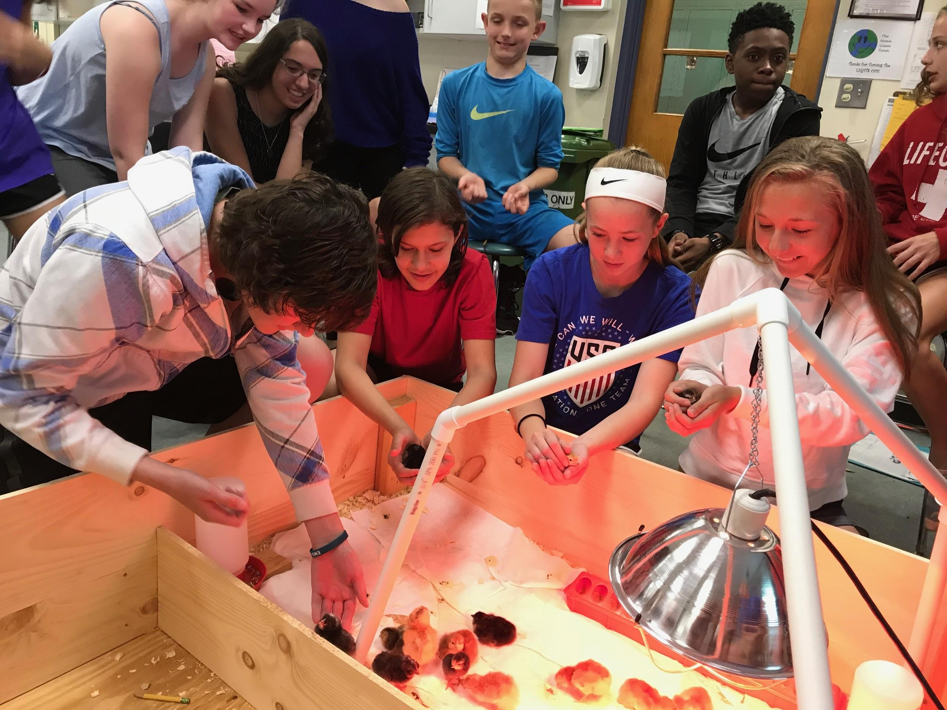
Next steps after QFT

