Slide 1
Teaching Undergraduate, Graduate, and Doctoral Students How to Ask Better Questions
Andrew P. Minigan
Director of Strategy, Education Program

Slide 2
Acknowledgments
We are deeply grateful to The National Science Foundation and The Hummingbird Fund for their generous support of the Right Question Institute’s work in education.
Thank you to Dr. Stacey L. MacKinnon and Dr. Beth Archer-Kuhn for their support and making possible this conference.

Slide 3
Overview
The skill of question formulation and students not asking questions
Examples of how educators have used the Question Formulation Technique (QFT)
A glimpse of some research on the QFT for developing research questions

Slide 4
“There can be no thinking without questioning—no purposeful study of the past, nor any serious planning
for the future.”
- David Hackett Fischer
University Professor Emeritus of History at Brandeis University

Slide 5
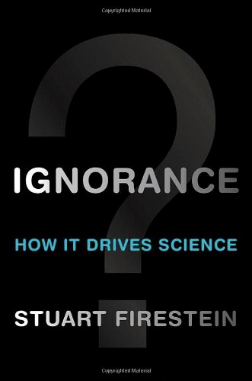
“We must teach students how to think in questions, how to manage ignorance.”
– Stuart Firestein
Chairman of the Department of Biology, Columbia University

Slide 6
College Presidents on What College Students Should Learn
“The primary skills should be analytical skills of interpretation and inquiry. In other words, know how to frame a question.”
- Leon Botstein, President of Bard College
“…the best we can do for students is have them ask the right questions.”
- Nancy Cantor, Chancellor of University of Illinois
The New York Times, August 4, 2002

Slide 7
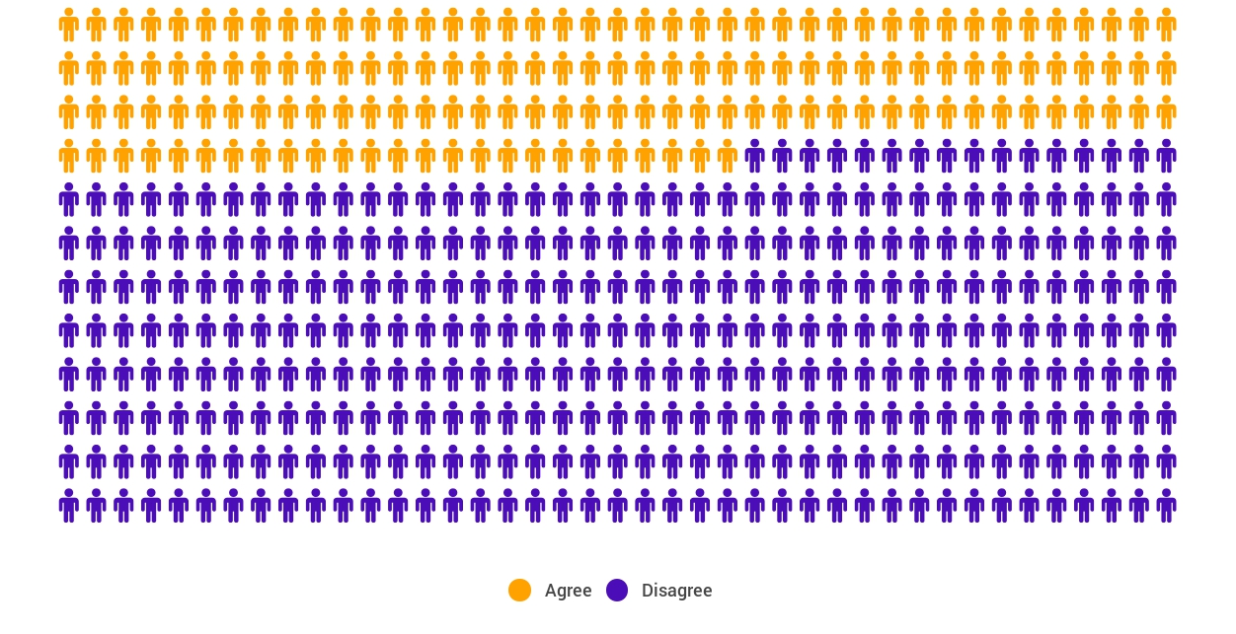
Yet, Only 27% of Graduates Believe College Taught Them How to Ask Their Own Questions
Alison Head
Project Information Literacy
at University of Washington, 2016

Slide 8
But, the problem begins long before college...
But, the problem begins long before college…

Slide 9
Age Four: “The true age of inquisitiveness”
James Sully dubbed age four, “the true age of inquisitiveness when question after question is fired off with wondrous rapidity and pertinacity.”
Young children ask 10,000 questions per year before they begin formal schooling.
Sully, 1896
Harris, 2012

Slide 10
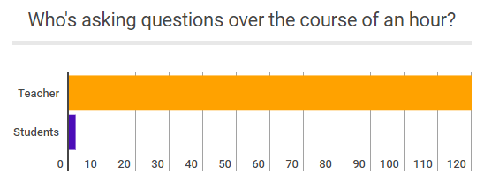
Question Formulation by Adolescence
Dillon, 1988, p. 199

Slide 11
Educators Recognize the Problem
Teachers report that getting students to ask questions feels like, “pulling teeth.”
Students ask less than 1/5th the questions educators estimated would be elicited and deemed desirable.
Susskind, 1979

Slide 12
How can teaching students to ask questions go from a feeling of “pulling teeth” to a feeling of excitement for both teachers and learners?

Slide 13
Moving from the exception…
In a 1912 study Romiett Stevens observed: “an unusual lesson because twenty-five of the thirty-four questions were asked by the pupils… The result was that the lesson developed an impetus born of real interest. I mention it because this lesson was unique in the series of one hundred.”
The Question as a Measure of Efficiency in Instruction: A critical study of classroom practice. Columbia University Contributions to Education, No. 48

Slide 14


…to the norm

Slide 15
The Question Formulation Technique (QFT)
A strategy educators can use to teach students how to:
formulate their own questions
work with and improve their questions
prioritize questions
strategize on how to use questions
reflect on their questions and the process
use their questions to drive learning

Slide 16
What does it look like when students learn to ask their own questions?

Slide 17
Classroom example: Kindergarten
Teacher: Jennifer Shaffer, Walkersville, MD
Topic: Nonfiction literacy
Purpose: To engage students prior to reading a nonfiction text about alligators

Slide 18

Question Focus

Slide 19
Students’ Questions
Is the alligator camouflaged?
Why do the babies have stripes?
Are those baby crocodiles?
Is it a mom or dad crocodile?
What is the green stuff?
Why are they in the water so low?
Where are they going?
Why are the baby alligator’s eyes white and the mom’s black?
Why are baby alligators on top of the momma alligator?
Why does momma or daddy have bumps on them?

Slide 20
Classroom Example: College Biology
Professor: Rachel Woodruff, Ph.D. Assistant Professor of Biology, Brandeis University
Topic: Molecular Biology
Purpose: To build students’ research skills and prepare them to develop their own a proposal later in the semester

Slide 21
Question Focus
Students were assigned a complex molecular biology article
Ask as many questions as you can about the reading

Slide 22
Next Steps
Students generate questions about a complex article on their own
Students discuss the key attributes of a good biological research question and compare to other types of questions
Students form groups and improve their questions, based on these attributes

Slide 23
Classroom Example: College Biology
Professor: Emily Westover, Ph.D., Brandeis University
Topic: Post-Exam Review
Purpose: To assess what the students were not understanding about the content. They had performed poorly on a particular question on an exam.

Slide 24
Question Focus
Ask as many questions as you can about [the exam question]

Slide 25
Educator Reflections
Students were thinking more deeply about the exam question
Professor Westover was able to gather insight into why they may have had difficulty with the exam question

Slide 26
Classroom Example: Writing Fundamentals
Professor: Professor Sun Ezzell, Mt. San Antonio College
Topic: Grades
Purpose:
Students use their questions to spark discussion on the article & write a response to article.
Students consider whether they should switch from letter grade to pass/no pass.

Slide 27
Question Foci
“the case against grades” (for students who read the article)
or
“grades” (for students who did not read)

Slide 28
Students’ Questions
Why are students intimidated against grades?
Is the grading process needed?
How does the grading system affect students?
Why do we have a grading system?
Does the grading system need improvement?
Why is it challenging to get good grades?
Why do students think school is challenging?
Why do students focus more on grading than learning?
Does the grading system help students in life?
What are your thoughts on our grading system?
Do students focus more on grading than learning?

Slide 29
Next Steps
After the activity, some students decided to switch from letter grades to pass/no pass
Led to discussion about feedback and how they can use/ share feedback for learning.
Sun gained insight into student thinking

Slide 30
Students’ Reflections
“I discovered that by asking questions about the article it was easier to understand the article and the meaning behind it.”
“I learned that by doing the question exploration it can help you not be stuck when you do not understand the material.”
“The [QFT] was an amazing group activity...I loved that no one was excluded...”
“I learned I can come up with questions very quickly which is good because it means thinking and creativity is improving and growing.”
“When we come up with our own questions, we think more deeply.”

Slide 31
The Question Formulation Technique for Developing Research Questions

Slide 32
Agreement on having strategies
In considering what research questions…
to pursue, I have specific strategies that allow me to generate good questions.***
to investigate, I have specific strategies that allow me to prioritize which questions are the best to pursue.***
***p < .001
** p <.01
* p < .05

Slide 33
In considering what research questions to pursue, I have specific strategies that allow me to generate good questions.
1 = Strongly Disagree
2 = Disagree
3 = Slightly Disagree
4 = Slightly Agree
5 = Agree
6 = Strongly Agree

Slide 34
Beliefs about question formulation behavior
In the process of developing a research study, it is important to spend time considering what research questions are the most valuable to ask.*
In considering the research process, I believe that it is best to quickly move into the research process rather than to spend time generating a list of questions.**
In trying to develop my ideas about a research project, I find that asking many questions can be more counterproductive than useful.**
Once I have a set of questions before me, I believe that it is worthwhile to take the time to revise and improve them.***
I am able to efficiently formulate research questions.***

Slide 35
In trying to develop my ideas about a research project, I find that asking many questions can be more counterproductive than useful.
1 = Strongly Disagree
2 = Disagree
3 = Slightly Disagree
4 = Slightly Agree
5 = Agree
6 = Strongly Agree

Slide 36
Confidence in question formulation skills
I am confident in my ability to formulate quality research questions.***
In developing research questions, I believe that my skills are superior to most other graduate students.***
In developing research questions, I believe that my skills are at a high level.***
It is easy to formulate quality research questions.***

Slide 37
I am confident in my ability to formulate quality research questions.
1 = Strongly Disagree
2 = Disagree
3 = Slightly Disagree
4 = Slightly Agree
5 = Agree
6 = Strongly Agree

Slide 38
What did you notice about the quality of your questions?
Improved the quality, testability, and impact.
Improved the quality and the quantity [of my questions.]
It made them more specific and allowed me to pick the best from among several similar questions.
Reworking my questions made my questions better and more complex.
Improved the quality of the question but more importantly lead to new questions.

Slide 39

In the Age of Google
“How should you respond when you get powerful new tools for finding answers?
Think of harder questions.”
– Clive Thompson
Journalist and Technology Blogger

Slide 40
Thank you.
Now some time for your questions.

Slide 41

C3 Framework
“Questioning is key to student learning.” (p.17)
“Central to a rich social studies experience is the capability for developing questions that can frame and advance an inquiry. ” (p. 24)
National Council for the Social Studies, The College, Career, and Civic Life (C3) Framework for Social Studies State Standards: Guidance for Enhancing the Rigor of K-12 Civics, Economics, Geography, and History (Silver Spring, MD: National Council for the Social Studies, 2013).

Slide 42

AASL Standards Framework for Learners
Learners display curiosity by “Formulating questions about a personal interest or a curricular topic.”
Learners gather information by “Systematically questioning and assessing the validity and accuracy of information.”
https://standards.aasl.org/wp-content/uploads/2017/11/AASL-Standards-Framework-for-Learners-pamphlet.pdf

