Slide 1
Introduction to the
Question Formulation Technique (QFT)
Andrew P. Minigan
Director of Strategy, Education Program
Katy Connolly
Program Associate

Slide 2
Who is in the room?

Slide 3
Acknowledgments
We are deeply grateful to The National Science Foundation and The Hummingbird Fund for their generous support of the Right Question Institute’s work in education.

Slide 4
Access Today’s Resources
http://rightquestion.org/educators/seminar-resources/

Slide 5
We Tweet
Share your thinking and learning from today:
@RightQuestion
@AndrewRQI
#QFT

Slide 6
Overview
Questions & learning
An experience in the Question Formulation Technique
Unpacking the QFT
Examples of the QFT in the classroom
Lesson planning and exploring resources
Reflection & Q&A

Slide 7
Questions & Learning

Slide 8

Honoring the Original Source:
Parents in Lawrence, MA 1990
“We don’t go to the school because we don’t even know what to ask.”

Slide 9
“All learning must begin with the posing of a question.”
– Richard Feynman
Nobel Laureate, Physicist

Slide 10
“There can be no thinking without questioning—no purposeful study of the past, nor any serious planning
for the future.”
- David Hackett Fischer
University Professor Emeritus of History at Brandeis University

Slide 11
“In mathematics, the art of posing a question must be held of higher value than solving it.”
- Georg Cantor, Creator of Set Theory (1867)

Slide 12

“We must teach students how to think in questions, how to manage ignorance.”
– Stuart Firestein
Chairman of the Department of Biology, Columbia University

Slide 13

C3 Framework
“Questioning is key to student learning.” (p.17)
“Central to a rich social studies experience is the capability for developing questions that can frame and advance an inquiry. ” (p. 24)
National Council for the Social Studies, The College, Career, and Civic Life (C3) Framework for Social Studies State Standards: Guidance for Enhancing the Rigor of K-12 Civics, Economics, Geography, and History (Silver Spring, MD: National Council for the Social Studies, 2013).

Slide 14

AASL Standards Framework for Learners
Learners display curiosity by “Formulating questions about a personal interest or a curricular topic.”
Learners gather information by “Systematically questioning and assessing the validity and accuracy of information.”
https://standards.aasl.org/wp-content/uploads/2017/11/AASL-Standards-Framework-for-Learners-pamphlet.pdf

Slide 15
College Presidents on What College Students Should Learn
“The primary skills should be analytical skills of interpretation and inquiry. In other words, know how to frame a question.”
- Leon Botstein, President of Bard College
“…the best we can do for students is have them ask the right questions.”
- Nancy Cantor, Chancellor of University of Illinois
The New York Times, August 4, 2002

Slide 16
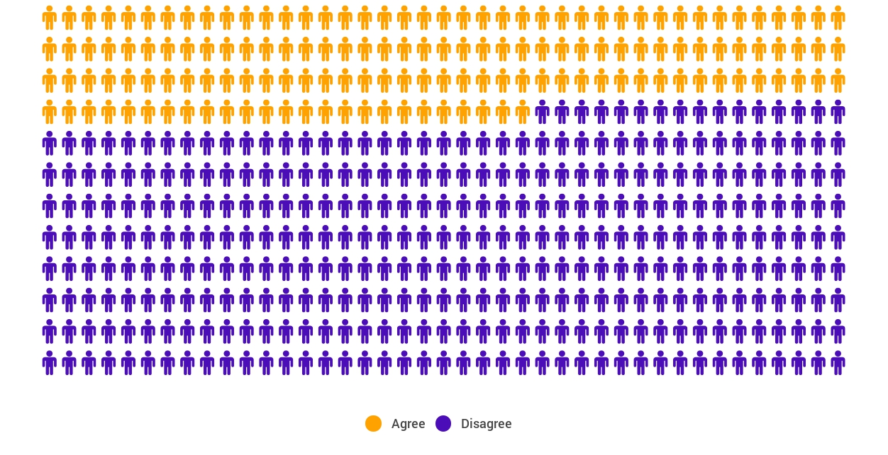
Yet, Only 27% of Graduates Believe College Taught Them How to Ask Their Own Questions
Alison Head
Project Information Literacy
at University of Washington, 2016

Slide 17
But, the problem begins long before college...
But, the problem begins long before college…

Slide 18
Age Four: “The true age of inquisitiveness”
James Sully dubbed age four, “the true age of inquisitiveness when question after question is fired off with wondrous rapidity and pertinacity.”
Young children ask 10,000 questions per year before they begin formal schooling.
Sully, 1896
Harris, 2012

Slide 19
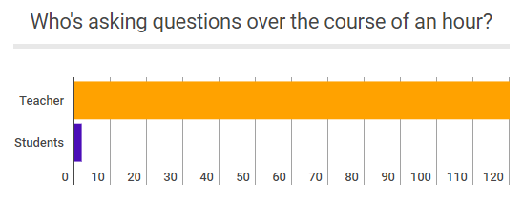
Question Formulation by Adolescence
Dillon, 1988, p. 199

Slide 20
Educators Recognize the Problem
Teachers report that getting students to ask questions feels like, “pulling teeth.”
Students ask less than 1/5th the questions educators estimated would be elicited and deemed desirable.
Susskind, 1979

Slide 21
How can teaching students to ask questions go from a feeling of “pulling teeth” to a feeling of excitement for both teachers and learners?

Slide 22
Moving from the exception…
In a 1912 study Romiett Stevens observed: “an unusual lesson because twenty-five of the thirty-four questions were asked by the pupils… The result was that the lesson developed an impetus born of real interest. I mention it because this lesson was unique in the series of one hundred.”
The Question as a Measure of Efficiency in Instruction: A critical study of classroom practice. Columbia University Contributions to Education, No. 48

Slide 23


…to the norm

Slide 24
But, the problem begins long before college...
What happens when students learn how to ask their own questions?

Slide 25
Research Links Question Formulation & Learning Outcomes
Student question formulation is one of the most effective metacognitive strategies
Engaging in pre-lesson self-questioning improved students rate of learning by nearly 50% (p.193)
John Hattie
Visible Learning: A Synthesis of Over 800
meta-Analyses Relating to Achievement, 2008

Slide 26
Student Reflections
“Asking questions may not always lead to answers, but it leads to curiosity… Question asking helps us guide our own adventure and helps us find new interests. Everything starts with a question, even if you don't realize it.”
- 9th Grader, Fitchburg, MA

Slide 27
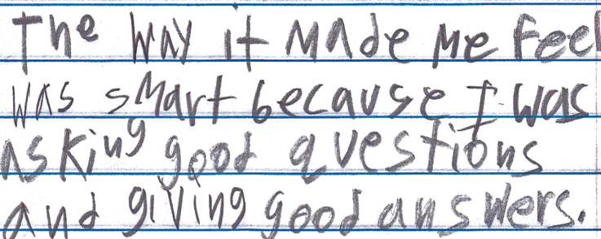
Student Reflections
“The way it made me feel was smart because I was asking good questions and giving good answers.”
- 9th Grader, Boston, MA
Summer remedial Program

Slide 28
The Question Formulation Technique (QFT)
A strategy educators can use to teach students how to:
formulate their own questions
work with and improve their questions
prioritize questions
strategize on how to use questions
reflect on their questions and the process
use their questions to drive learning

Slide 29
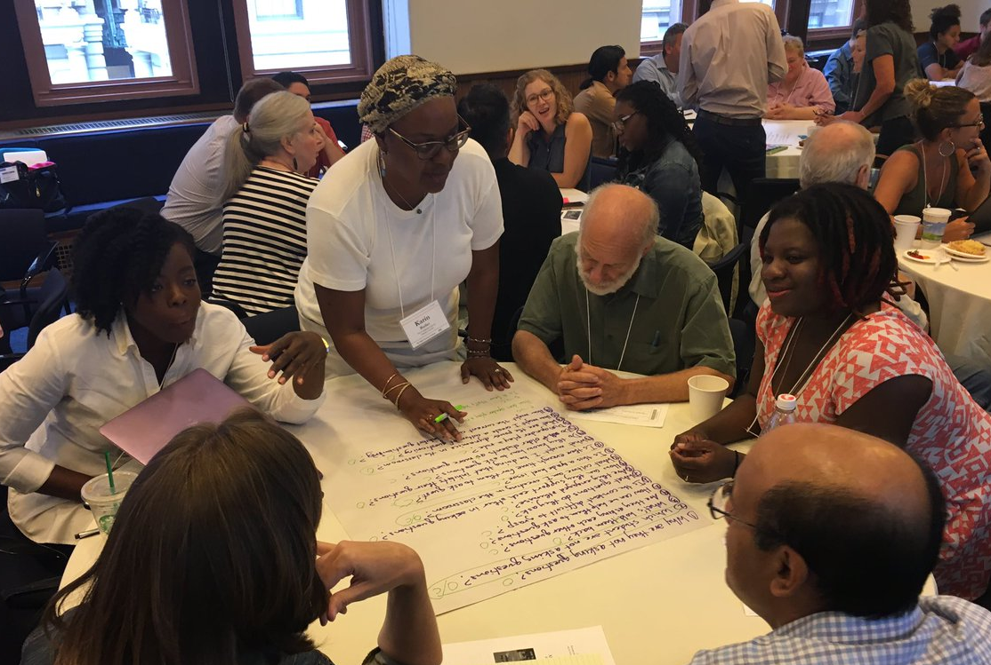
An Experience in the Question Formulation Technique

Slide 30
Rules for Producing Questions
1. Ask as many questions as you can
2. Do not stop to answer, judge, or discuss
3. Write down every question exactly as stated
4. Change any statements into questions

Slide 31
Produce Questions
Ask questions
Follow the rules
      Ask as many questions as you can
      Do not stop to answer, judge, or discuss
      Write down every question exactly as it was stated
      Change any statements into questions
Number the questions

Slide 32
Question Focus
Some students are not asking questions.

Slide 33
Categorize Questions: Closed/Open
Definitions:
  Closed-ended questions can be answered with a “yes” or “no” or with a one-word answer.
  Open-ended questions require more explanation.
Directions:
Identify your questions as closed-ended or open-ended by marking them with a “C” or an “O.”

Slide 34
Discuss
Closed-ended questions
Advantages
Disadvantages

Slide 35
Discuss
Open-ended questions
Advantages
Disadvantages

Slide 36
Change Questions
Take one closed-ended question and change it into an open-ended question.
Take one open-ended question and change it into a closed-ended question.
Closed
Open
Open
Closed

Slide 37
Prioritize Questions
Review your list of questions:
  Choose your three most important questions.
  While prioritizing, think about your Question Focus: Some students are not asking questions.
After prioritizing consider:
  Why did you choose those three questions?
  Where are your priority questions in the sequence of your entire list of questions?

Slide 38
Create an Action Plan
In order to answer your priority questions:
What do you need to know? Information
What do you need to do? Tasks
Information | Tasks

Slide 39
Share
Questions you changed from open/closed
Your three priority questions and their numbers in your original sequence
Rationale for choosing priority questions
Next steps

Slide 40
Reflect
What did you learn?
How did you learn it?
What do you understand differently now about some students not asking questions?

Slide 41
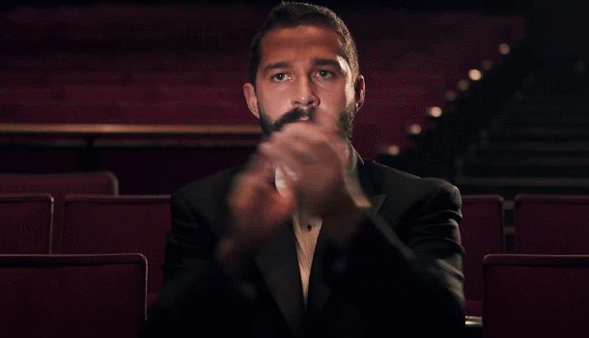
A Round of Applause

Slide 42

Unpacking the QFT

Slide 43
The Question Formulation Technique (QFT)
A strategy educators can use to teach students how to:
formulate their own questions
work with and improve their questions
prioritize questions
strategize on how to use questions
reflect on their questions and the process
use their questions to drive learning

Slide 44
Three thinking abilities, one strategy.

Slide 45
Thinking in many different directions
Divergent
Thinking

Slide 46
Narrowing down, focusing
Convergent
Thinking

Slide 47
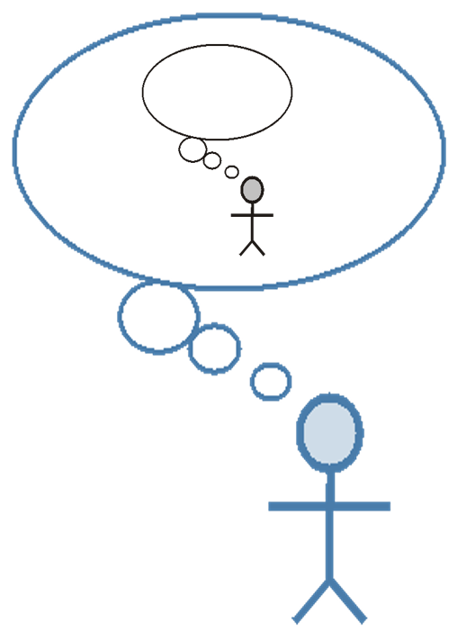
Thinking about thinking
Metacognition

Slide 48
Consistent Outcomes
Greater knowledge
Greater ownership
Greater intellectual rigor
Greater curiosity

Slide 49
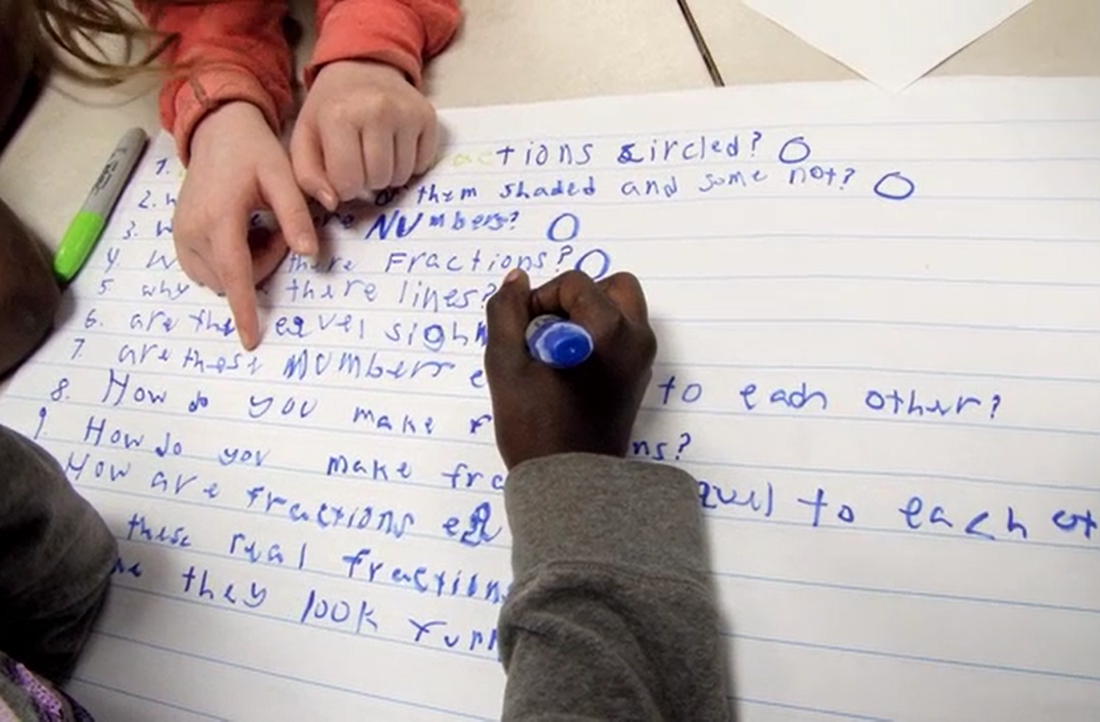
Examples of the QFT in the Classroom
What does it look like when students learn to ask their own questions?

Slide 50
Classroom Example: High School English
https://vimeo.com/116974103

Slide 51
What did you notice?

Slide 52
Classroom Example: Elementary Math
Teacher: Deirdre Brotherson, Hooksett, NH
Topic: Math unit on variables
Purpose: To engage students at the start of a unit on variables

Slide 53
Question Focus
24 = ☺ + ☺ + ☺

Slide 54
Student Questions
Why is the 24 first?
What do the smiley faces mean?
Why are there 3 smiley faces?
How am I suppose to figure this out?
Is the answer 12?
Can I put any number for a smiley face?
Do three faces mean something?
Do the numbers have to be the same because the smiley faces are the same?
What numbers will work here?
Does it mean 24 is a really happy number?
Can we replace each smiley face with an 8?
Do any other numbers work?
Can we do this for any number?
Does it always have to be smiley faces?
Do we always have to use three things?

Slide 55
Next Steps with Student Questions
Questions posted on classroom walls.
Students cross off the questions they answer during subsequent lessons.
Teacher returns to student questions at the end of the unit to discuss with students what they learned and what they still want to know.

Slide 56
Classroom Example: High School Social Studies
Teacher: Kelly Grotrian, East Brunswick, NJ
Subject: 11th Grade U.S. History II
Topic: The end of World War II
Purpose: Leads into a discussion about whether the United States was justified in dropping the atomic bomb. Students’ questions were also used for a homework assignment on Google classroom.

Slide 57
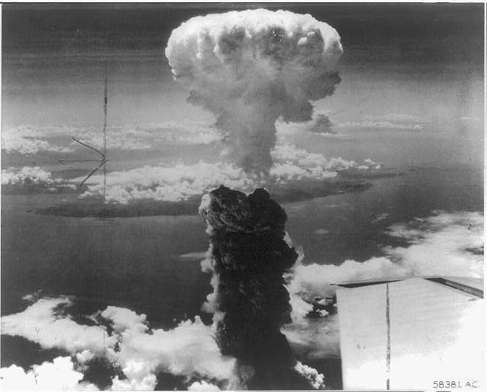
Question Focus
http://www.loc.gov/pictures/item/98506956/

Slide 58
Student Questions
What is this?
Who did this?
How did this affect people?
What were the environmental & economic implications of dropping the bomb?
How many people were hurt?
Is that a plane wing in the bottom right?
Did the people in that plane drop the bomb?
Did the people dropping the bomb know what they were doing?
Did they make the bomb?
Who was responsible for dropping the bomb?
What led to this event?
What happened as a result of dropping the bomb?
Where was the bomb dropped?
Had people been given warning?
How long did it take to notice effects of the bomb?
When did this happen (at what point in the war)?
How many lives were lost as a result?

Slide 59
Classroom Example: High School Science
Teacher: Allison Gest, Park Ridge, IL
Topic: A unit on “Running Water”
Purpose: To give peer feedback and revise initial experiment designs

Slide 60
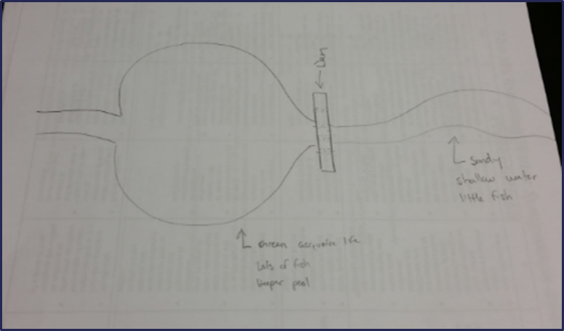
Question Focus
Scientist’s claim:
“Adding a dam to a water system causes a decrease in aquatic life downstream.”
Student Design to test the claim:

Slide 61
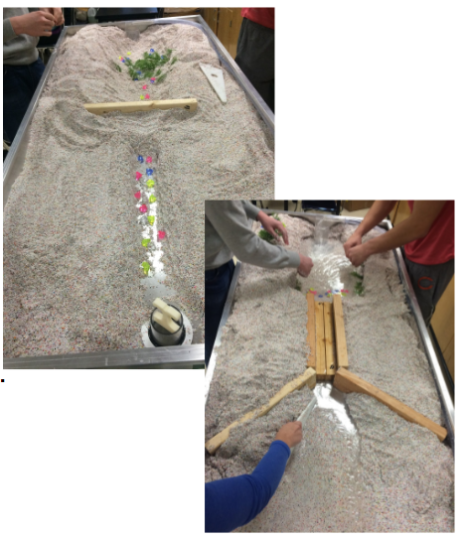
Next Steps

Slide 62
Classroom Example: High School Math
Teacher: Rick Barlow, San Jose, CA
Topic: Algebra 1: Quadratics
Purpose: To introduce the quadratics unit by having students explore modelling data with a function.

Slide 63




Before the Question Focus
8
Find how many bingo chips that fit into a 23 X 23 inch square
Square Size | # of Bingo Chips that Fit
2
3
4
6
8
3
3
6
6
Notes:
Then I gave each group a few squares and a lot of bingo chips. I had squares of side length 1, 2, 3, 4, 5, 6, 7 and 8 inches. Each group got 2 or 3 squares. Students collected the data. We put the data into a class data table (averaging the number of bingo chips for a given side length as needed). I then asked students to tell me what type of function would best model the data in the table. I gave them like 3 minutes to discuss this. The goal WAS NOT that they have a definitive answer. The goal was to get them to explore the data in the table or graph (some groups also graphed the data).

Slide 64
Question Focus
Square Size | # of Bingo Chips that Fit
2
3
4
6
8
23
The function that best models this data:
Notes:
Then I gave each group a few squares and a lot of bingo chips. I had squares of side length 1, 2, 3, 4, 5, 6, 7 and 8 inches. Each group got 2 or 3 squares. Students collected the data. We put the data into a class data table (averaging the number of bingo chips for a given side length as needed). I then asked students to tell me what type of function would best model the data in the table. I gave them like 3 minutes to discuss this. The goal WAS NOT that they have a definitive answer. The goal was to get them to explore the data in the table or graph (some groups also graphed the data).

Slide 65
Student Questions
Is this related to polynomial?
What would you call a function that is neither linear or exponential?
Will this graph give us the exact # of how many chips will fit in the square?
Does size of chips matter?
Can it be exponential on a graph and not on a table?
Why is the line on the graph curved and then out of nowhere it goes straight?
How could you find what the table is multiplying by?
Why does it increase rapidly then slow down?
What would the slope look like?
What type of function is the graph if it is not a J, L, or linear?
If we were to find the amount of chips found in an 11 in a square could we double that and find the answer for a 22 inch square?
Does the graph cross zero?
What kind of math did people use to get these solutions?

Slide 66
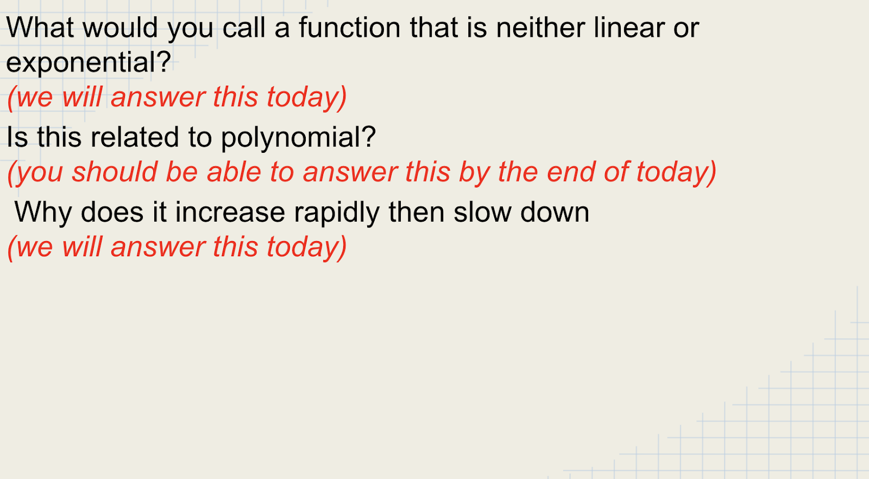
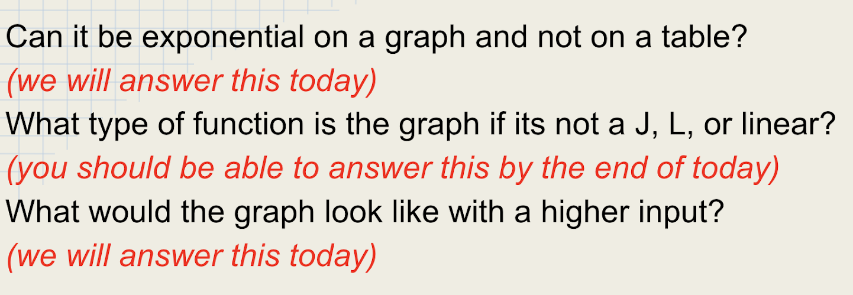
Next Steps with Student Questions
Questions used as opening slides for the next day’s lesson
Revisited at the end as a debrief

Slide 67
Teacher Reflection
“QFT also pushes students to be curious. Sometimes learning can feel prescriptive or rigid. While the structure of QFT is somewhat prescriptive, the process creates a safe, encouraging space that supports students in the process of taking intellectual risks and asking really good questions.”

Slide 68
Classroom Example: High School Spanish
Teacher: Judy Wilson, Staten Island, NY
Topic: A unit on “personal identification”
Purpose: To connect unit to the “Culture” strand of the World-Readiness Standards for Learning Languages; to prepare students for a trip to the MET

Slide 69
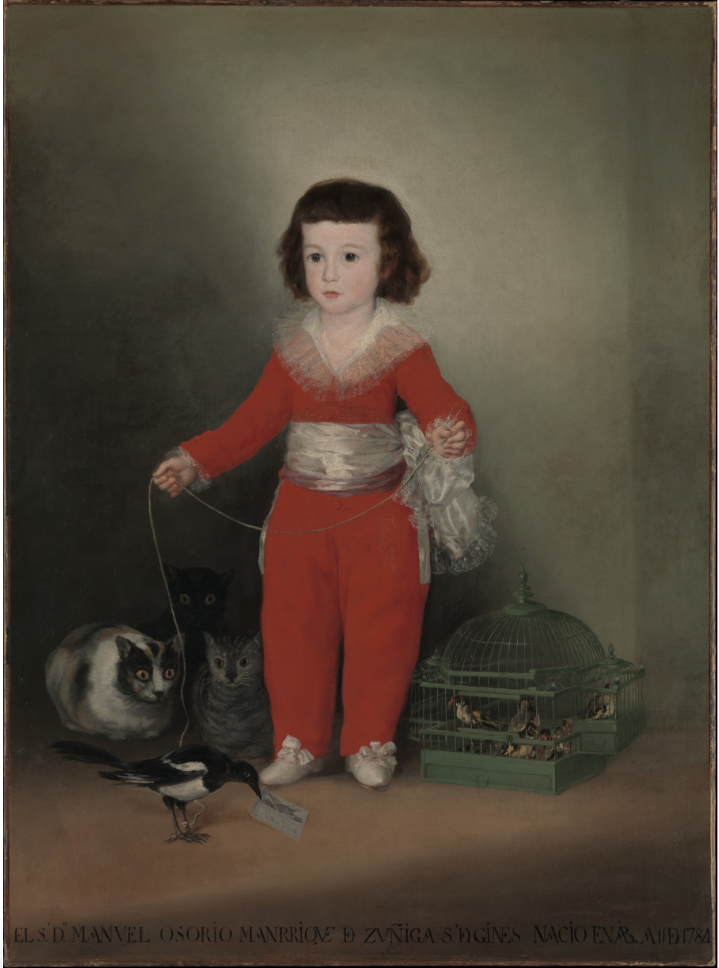
Question Focus
Notes:
Before the question focus, Judy introduces: “Portraits of children accompanied by animals have a long tradition in Spanish painting”
Goya

Slide 70
Student Questions
¿Qué artista pinto la pintura?
¿Como se siente el niño?
¿Es niño o niña?
¿Por qué es tan pálido?
¿Por qué está triste?
¿Dónde está?
¿Qué celebra?
¿Por qué hay animals?
¿Por qué los gatos no comen el pajaro?
¿En que piensan los gatos?
¿Por qué tiene una correa en la boca el pájaro?
¿Es una pintura famosa o importante?
¿Quándo pintó?
What artist painted the picture?
How does the little boy feel?
Is it a little boy or girl?
Why is he so pale?
Why is he sad?
Where is he?
What is he celebrating?
Why are there animals?
Why aren’t the cats eating the bird?
What are the cats thinking?
Why does the bird have a letter in his mouth?
Is this a famous or important painting?
When was it painted?

Slide 71
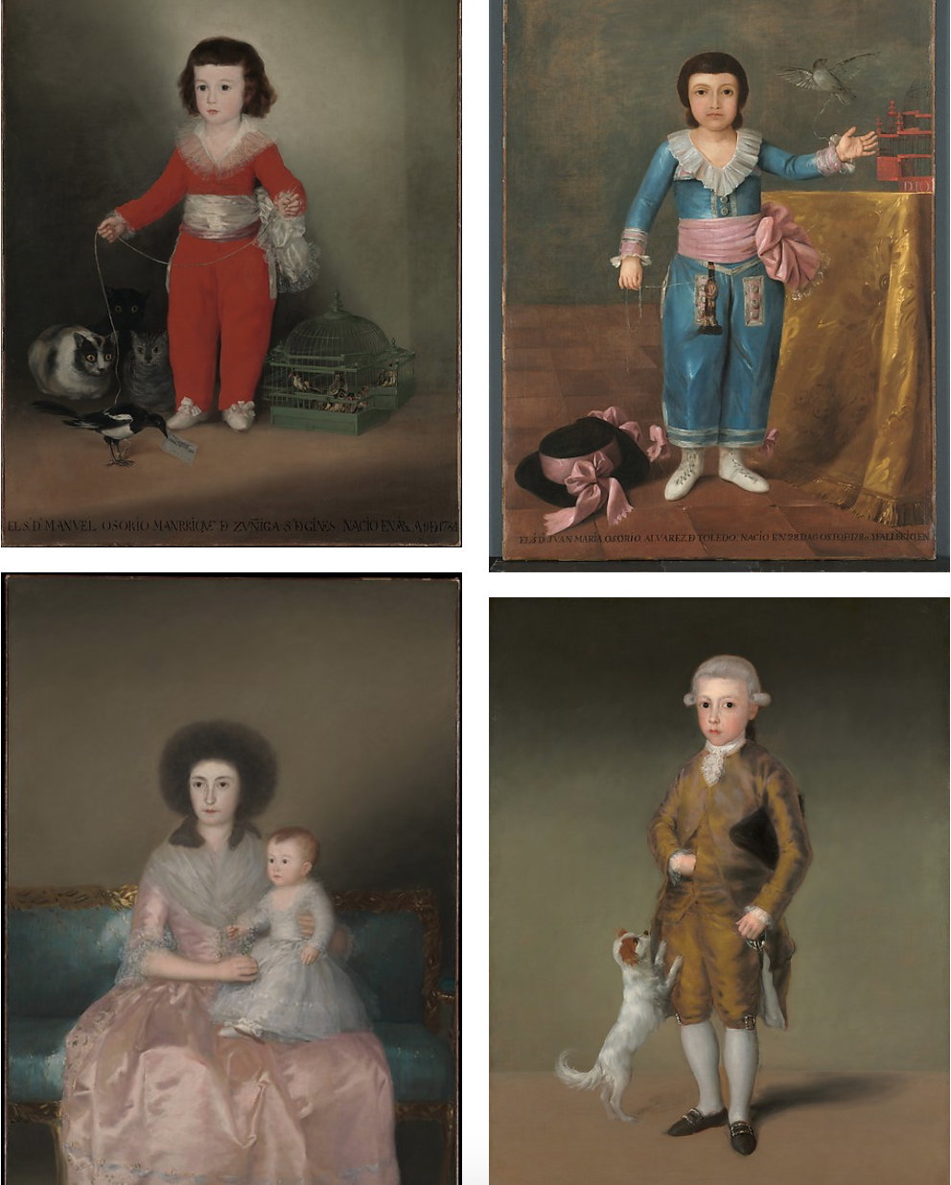
Next Steps
Students answered questions by listening to the curator’s recording on the MET museum website
Students did online research to find the answers to their other questions, and found the rest of the Altamira family
They visited the MET museum to see the rest of Goya’s paintings

Slide 72
Classroom Example: College Biology
Professor: Rachel Woodruff, Ph.D. Assistant Professor of Biology, Brandeis University
Topic: Molecular Biology
Purpose: To build students’ research skills and prepare them to develop their own a proposal later in the semester

Slide 73
Question Focus
Students were assigned a complex molecular biology article
Ask as many questions as you can about the reading

Slide 74
Next Steps
Students generate questions about a complex article on their own
Students discuss the key attributes of a good biological research question and compare to other types of questions
Students form groups and improve their questions, based on these attributes

Slide 75
Classroom Example: College Biology
Professor: Emily Westover, Ph.D., Brandeis University
Topic: Post-Exam Review
Purpose: To assess what the students were not understanding about the content. They had performed poorly on a particular question on an exam.

Slide 76
Question Focus
Ask as many questions as you can about [the exam question]

Slide 77
Educator Reflections
Students were thinking more deeply about the exam question
Professor Westover was able to gather insight into why they may have had difficulty with the exam question

Slide 78
Students’ Reflections
“I discovered that by asking questions about the article it was easier to understand the article and the meaning behind it.”
“I learned that by doing the question exploration it can help you not be stuck when you do not understand the material.”
“The [QFT] was an amazing group activity...I loved that no one was excluded...”
“I learned I can come up with questions very quickly which is good because it means thinking and creativity is improving and growing.”
“When we come up with our own questions, we think more deeply.”

Slide 79
The Skill of Question Formulation
For reframing the perception of ignorance: not a weakness, but an opportunity
For arriving at better answers (and more questions)
For increasing engagement and ownership
For a little more joy in a very demanding profession
And…

Slide 80
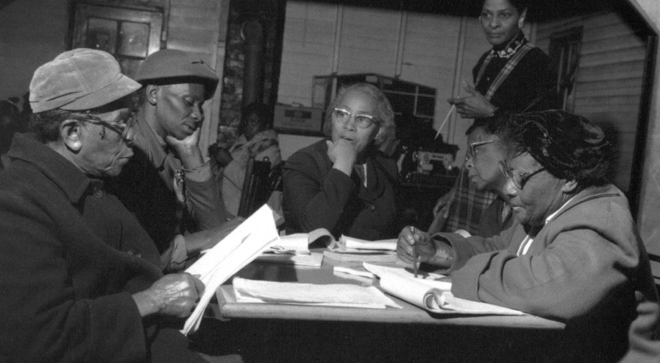
Democracy
“We need to be taught to study rather than to believe, to inquire rather than to affirm.”
- Septima Clark
See Chapter 6 on Septima Clark in Freedom Road: Adult Education of African Americans (Peterson, 1996).
Notes:
We have learned a lot from people with limited education, far from power, who were parents in a low-income Massachusetts city. They
were not participating in their children’s education because “they did not even know what questions to ask.” These parents were the
individuals who first named the problem and made the critical insight into the importance of questions for thinking, learning, and
participating. We have worked on this problem for nearly 30 years since.
Yet, we are not the first people to say question formulation is critical. We see our work connecting back to the work of someone who
you probably have never heard of but is one of the greatest educators of the 20th century.
Septima Clark was a civil rights activist and an African American educator who worked alongside Rosa Parks. After having her
teaching license revoked after decades or teaching service for her activism with a civil rights organization (NAACP), Clark, with her
cousin Bernice Robinson, established citizenship schools in South Carolina. Clark began working with low people with low literacy, first
to make sure they could vote and were not cheated out of wages, but as a part of a larger effort for people to become more effective
participants in democracy.
She said, “we need to be taught to study rather than to believe, to inquire rather than to affirm.” Clark saw inquiry and questioning as a
foundational part of learning, civic participation, and advocacy. By honing this fundamental skill one is able to advance research, think
and learn in new ways, and also to integrate this skill democratic habit of mind into their daily life.
Septima Clark, seated center, and her cousin Bernice Robinson standing to the right.
21

Slide 81
Overview
Questions & learning
An experience in the Question Formulation Technique
Unpacking the QFT
Examples of the QFT in the classroom
Lesson planning and exploring resources
Reflection & Q&A

Slide 82
Two Keys to Planning a Lesson with the QFT
Starting at the End
QFocus Design

Slide 83


Not a detour, a shortcut
Notes:
For example…Deirdre didn’t have to do a couple of the lessons she was planning, bc kids were further along than she thought and had figured out a couple things already! A formative assessment that quickly, effectively actually shows what kids are thinking? The QFT

Slide 84
Various Teaching Purposes
  Engagement
  Knowledge acquisition
  Formative assessment
  Summative assessment
  Peer review
  Skill development
Notes:
Put a space after each bullet.

Slide 85
Next Steps?
Lab work & Experiments
Exit ticket or “Do Now”
Debate Prep
Pop Quiz or Reading Check
Hang on walls,
Check Off as Answered
Research
Projects
Test Prep
And sometimes…
Nothing!
Homework
Class discussion prompts
Presentations
Socratic Seminar Prompts
Student Choice Projects
Paper topic
Interview an Expert
Tailoring Instruction
Make Your Own Final Test
Journal Prompt
Guest speakers
Service Action Projects
Year-long or Unit-long Essential Questions
Close Reading Protocol
Notes:
Ok to change your mind once you see what you get; but try to be transparent with students, show them how/why their questions matter (rather than one off activity)

Slide 86
Two Keys to Planning a Lesson with the QFT
Starting at the End
QFocus Design

Slide 87
Question Focus (QFocus):
A focus or prompt for student questions
A phrase or quotation
An image or video
A podcast or speech
A hands-on experience or experiment
An equation or data set
The QFocus is not a question!

Slide 88
Designing a Question Focus
An effective QFocus should be
Directly tied to lesson’s main idea
Simple…but not too simple
Interesting or provocative to students…but not biased or leading

Slide 89
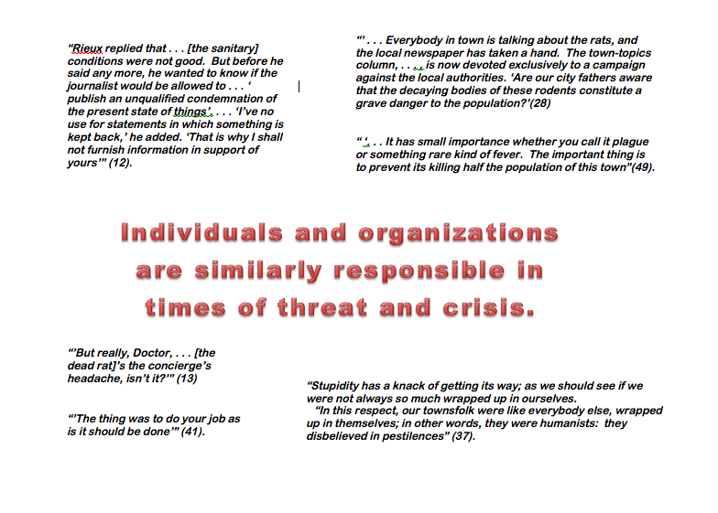
Initial Question Focus
Notes:
Topic: Albert Camus’s The Plague
Purpose: Pre-reading engagement and prediction of central themes going into the text

Slide 90
Revised Question Focus
The city fathers were aware that the decaying bodies of these rodents were making people sick. (p. 28)

Slide 91
Initial Question Focus:
“People, Animals, and Friends”
Do people exist?
Where do people live?
Why do animals live in the zoo?
Why do people go to the pool?
Why are friends fun?
Why do animals bite?
Why do people go to school?
Do people, animals, and friends play together?
Do animals make friends?
Why do I need friends?
Why do people want to be friends with animals?
Why are people making friends with animals?
Why do people, animal, and friends live in different countries?
Where did my dog and friend go?
Can my friend pet our new dog?
Why do I have eyes?
How do people smell?
Can animals speak?
Can people fly?
Where is my bunny? What happened?
Notes:
Let’s look at one more example of a Qfocus that needed some revision. This is from an elementary classroom in Hawaii.
The initial Qfocus was the phrase “people, animals, and friends,” and the teacher was engaging students at the start of a unit on “How can a pet be an important friend?”
Apart from noticing how adorable question #20 is, you may have noticed:
First (In orange), Most of the kids picked one of the three nouns (people, animals, OR friends) and zeroed in on it, asking questions that didn’t consider it in relationship to the other words in the prompt. These lines appear in purple. To me, this indicates that most kids just didn’t have enough direction, guidance from the Qfocus. They needed more hooks to go on, or maybe an image.
Second (Blue) : there is really good information here about what students care about and are interested in, in questions about their own pets and their own friends, which may be helpful to the teacher going forward or in re-designing a Qfocus
Third and finally (IN purple): some students are really thinking about the relationship b/w the 3 things listed and trying to connect the 3, so even in a batch of questions that are kind of off topic/not what the teacher expected, she could still have used #11 or #12 in her next steps.

Slide 92
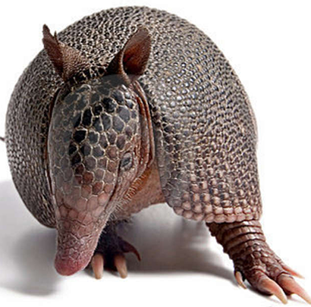
The one quality all excellent QFT designers share?
The key ingredient to QFocus design?
Thick Skin.
Notes:
Practice makes…more comfortable anyway.

Slide 93
Putting it into practice.

Slide 94
Self-Organized Work & Planning Time
Work on the lesson planning workbook through page 5.
Try creating your own QFocus. (It’s ok if it is a bit rough.)

Slide 95
Wanted: QFocus Guinea Pigs
Who is willing to share the QFocus you were working on?

Slide 96
Overview
Questions & learning
An experience in the Question Formulation Technique
Unpacking the QFT
Examples of the QFT in the classroom
Lesson planning and exploring resources
Reflection & Q&A

Slide 97
Closing Reflections
What did you learn?
How can you use what you learned?
An “a-ha moment” or a meaningful take away from your experience today.
Notes:
To use during discussion usually

Slide 98
Thank you.
Now, some time for your questions.
We are eager to connect with you and explore how we can support your work:
Andrew.Minigan@rightquestion.org
Katy.Connolly@rightquestion.org
Register to access free resources over at: www.rightquestion.org

