Slide 1
How Asking the Right Questions
Can Improve Learning and
Build Civic Participation
Andrew P. Minigan
Director of Strategy, Education Program
The Right Question Institute

Slide 2
Who is in the room?

Slide 3
Acknowledgments
We are deeply grateful to The National Science Foundation, The Library of Congress, and The Hummingbird Fund for their generous support of the Right Question Institute’s work in education.
I would like to thank the RQI board of directors, and my colleagues Katy Connolly, Tomoko Ouchi, and Sarah Westbrook for all they do to make possible our work in education.
And, I would like to thank Dr. Eliza Reilly for all of her work in making today’s experience possible, SENCER, and Case Western Reserve University.

Slide 4
Access Free Resources
Visit to find resources from today’s experience:
rightquestion.org/events
You can also find
Easy-to-use templates and downloadable resources
Classroom examples, articles, and blogs
Instructional videos

Slide 5
We Tweet
Share your thinking and learning from today:
@AndrewRQI
@RightQuestion
#QFT

Slide 6
Overview
Questions & learning
An experience in the Question Formulation Technique (QFT)
Unpacking the QFT
Examples of the QFT in the classroom
Question formulation in the 21st century
Reflection & Q&A

Slide 7
Questions & Learning

Slide 8

Honoring the Original Source:
Parents in Lawrence, MA 1990
“We don’t go to the school because we don’t even know what to ask.”

Slide 9













The Right Question Institute

Slide 10
“There is no learning without having to pose a question.”
– Richard Feynman
Nobel Laureate, Physicist

Slide 11
“If you are a researcher you are trying to figure out what the question is as well as what the answer is.”
“You want to find the question that is sufficiently easy that you might be able to answer it, and sufficiently hard that the answer is interesting.”
– Edward Witten
Physicist, Institute of Advanced Study

Slide 12
“Today, the modern classicist begins to focus on an unanswered question or a group of related questions and spends time in libraries, museums, and archaeological sites in an attempt to find answers. This practice of inquiry—looking into and trying to answer a question—is the heart of research.”
– Roger B. Ulrich
Professor of Classical Studies, Dartmouth College

Slide 13
“The study of biology is about asking good questions about life and figuring out clever ways to find the answers.”
– Amy Gladfelter
Associate Professor, University of North Carolina

Slide 14
“There can be no thinking without questioning—no purposeful study of the past, nor any serious planning
for the future.”
– David Hackett Fischer
University Professor Emeritus of History, Brandeis University

Slide 15
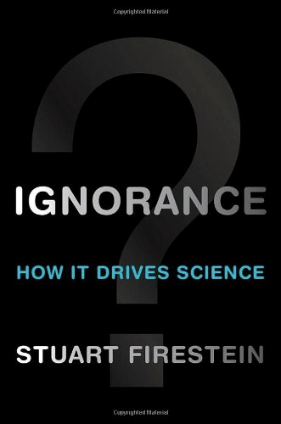
“We must teach students how to think in questions, how to manage ignorance.”
– Stuart Firestein
Professor, Department of Biology, Columbia University

Slide 16
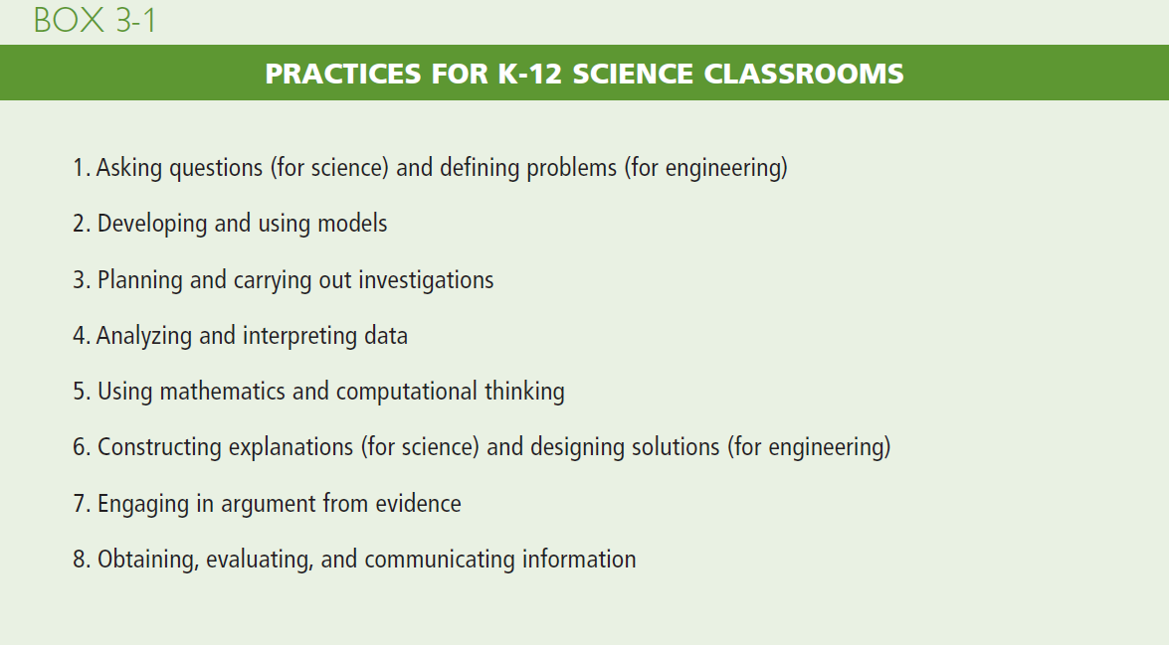
NGSS
https://www.nap.edu/catalog/13165/a-framework-for-k-12-science-education-practices-crosscutting-concepts#

Slide 17
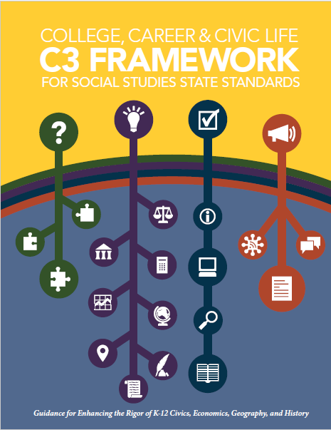
C3 Framework
“Questioning is key to student learning.” (p.17)
“Central to a rich social studies experience is the capability for developing questions that can frame and advance an inquiry. ” (p. 24)
National Council for the Social Studies, The College, Career, and Civic Life (C3) Framework for Social Studies State Standards: Guidance for Enhancing the Rigor of K-12 Civics, Economics, Geography, and History (Silver Spring, MD: National Council for the Social Studies, 2013).

Slide 18

AASL Standards Framework for Learners
Learners display curiosity by “Formulating questions about a personal interest or a curricular topic.”
Learners gather information by “Systematically questioning and assessing the validity and accuracy of information.”
https://standards.aasl.org/wp-content/uploads/2017/11/AASL-Standards-Framework-for-Learners-pamphlet.pdf

Slide 19
College Presidents on What College Students Should Learn in the 21st Century
“The primary skills should be analytical skills of interpretation and inquiry. In other words, know how to frame a question.”
- Leon Botstein, President of Bard College
“…the best we can do for students is have them ask the right questions.”
- Nancy Cantor, Chancellor of University of Illinois
The New York Times, August 4, 2002

Slide 20
19th Century Public Intellectuals on
College Students’ Skills
Someone with a college education, “is able to converse…is able to listen…can ask a question pertinently.”
Aoun, 2017

Slide 21
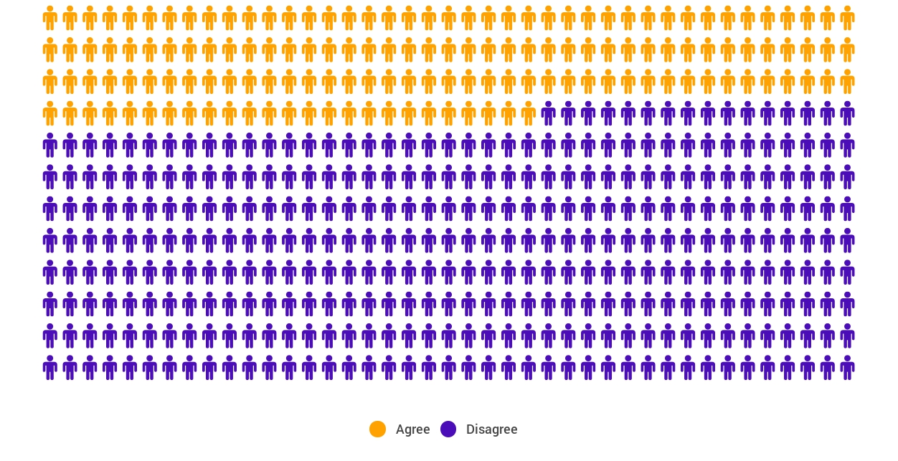
Yet, Only 27% of Graduates Believe College Taught Them How to Ask Their Own Questions
Alison Head
Project Information Literacy
at University of Washington, 2016

Slide 22
But, the problem begins long before college...
But, the problem begins long before college…

Slide 23
Age Four: “The true age of inquisitiveness”
James Sully dubbed age four, “the true age of inquisitiveness when question after question is fired off with wondrous rapidity and pertinacity.”
Young children ask 10,000 questions per year before they begin formal schooling.
Sully, 1896
Harris, 2012

Slide 24
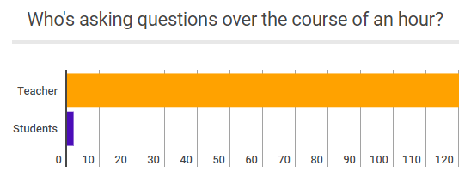
Question Formulation by Adolescence
Dillon, 1988, p. 199

Slide 25
Educators Recognize the Problem
Teachers report that getting students to ask questions feels like, “pulling teeth.”
Students ask less than 1/5th the questions educators estimated would be elicited and deemed desirable.
Susskind, 1979

Slide 26
First Year Students’ Engagement
Students engage in behaviors consistent with their high school behaviors.
Students who reported frequently asking questions in high school also reported doing the same in their first year of college.
Students who tended to not ask questions in high school tended to not do so during their first year at college.
National Survey of Student Engagement, 2008

Slide 27
How can teaching students to ask questions go from a feeling of “pulling teeth” to a feeling of excitement for both teachers and learners?

Slide 28
Moving from the exception…
In a 1912 study Romiett Stevens observed: “an unusual lesson because twenty-five of the thirty-four questions were asked by the pupils… The result was that the lesson developed an impetus born of real interest. I mention it because this lesson was unique in the series of one hundred.”
The question as a measure of efficiency in instruction: A critical study of classroom practice. Columbia University Contributions to Education, No. 48

Slide 29
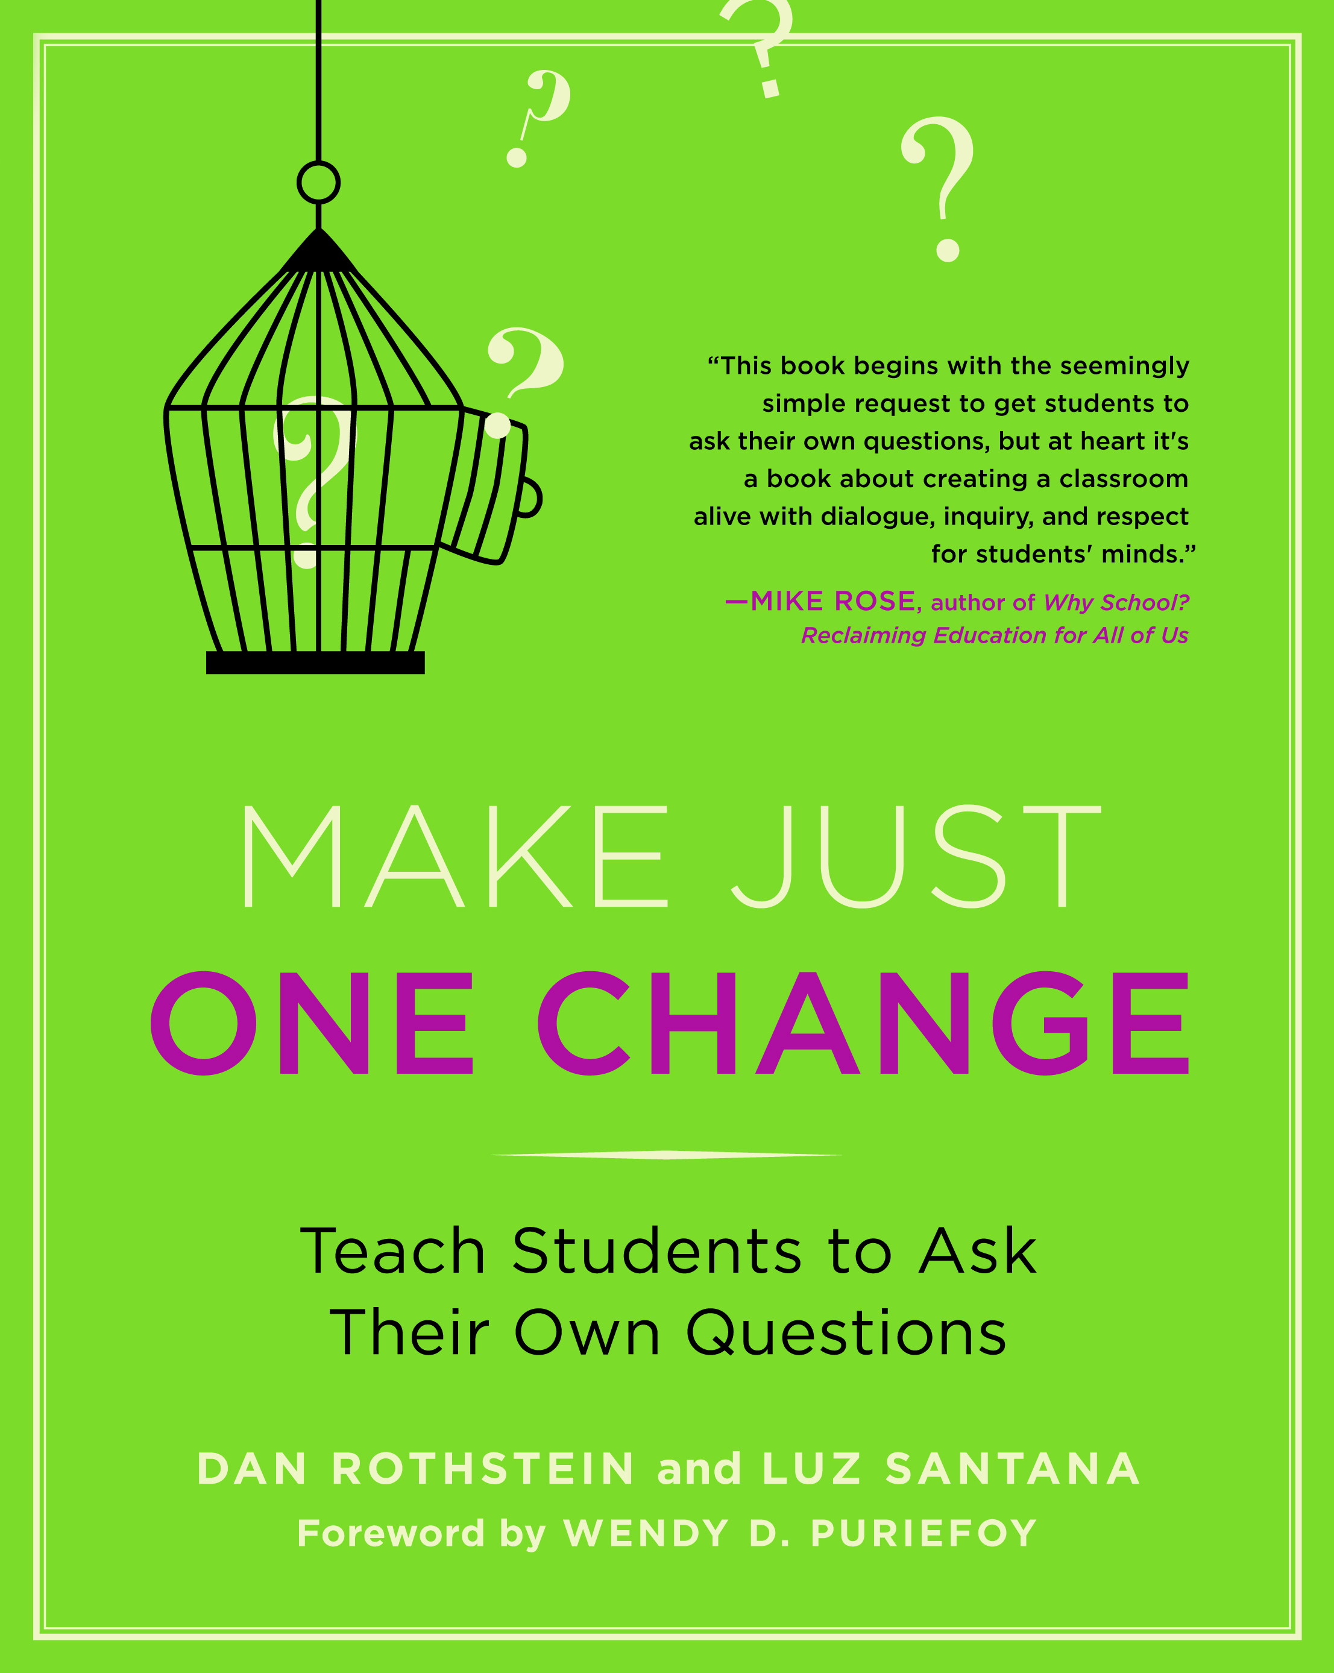

…to the norm

Slide 30
But, the problem begins long before college...
What happens when students learn how to ask their own questions?

Slide 31
Student Reflections

Slide 32
Student Reflections
“The QFT really teaches a way of thinking so students can be thinking critically every time they read, trying to connect the concepts and deciding whether to take facts and information at face value or to dig a little deeper.”
- Student, Brandeis University

Slide 33
Student Reflections
“I learned that by doing the question exploration it can help you not be stuck when you do not understand the material.”
- Student, Mt. San Antonio College

Slide 34
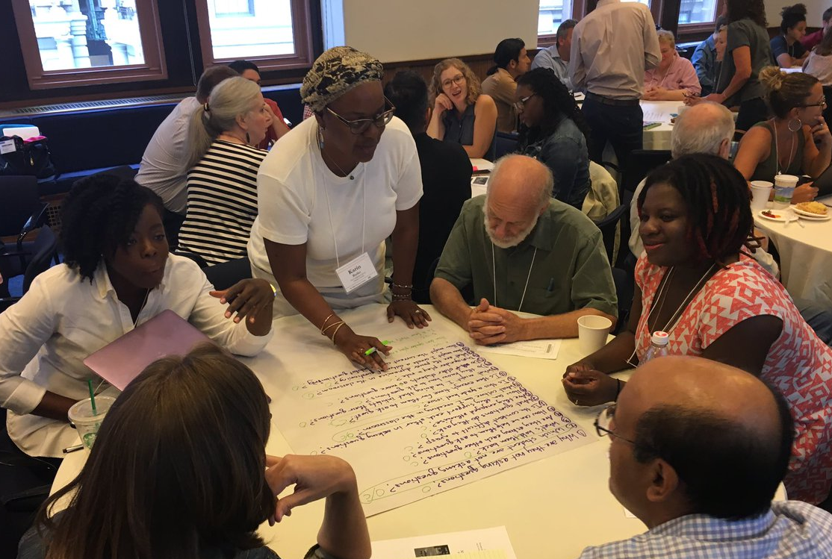
An Experience in the Question Formulation Technique

Slide 35
The Question Formulation Technique (QFT)
A strategy educators can use to teach students how to:
  formulate their own questions
  work with and improve their questions
  prioritize questions
  strategize on how to use questions
  reflect on their questions and the process
  use their questions to drive learning

Slide 36
Rules for Producing Questions
1. Ask as many questions as you can
2. Do not stop to answer, judge, or discuss
3. Write down every question exactly as stated
4. Change any statements into questions

Slide 37
Produce Questions
Ask questions
Follow the rules
      Ask as many questions as you can
      Do not stop to answer, judge, or discuss
      Write down every question exactly as it was stated
      Change any statements into questions
Number the questions as you produce them

Slide 38
Question Focus
Some STEM students are not asking questions.
Please remember to follow the rules and to number your questions.
You may want to write the Question Focus at the top of your paper.

Slide 39
Question Focus
Some STEM students are not asking questions of societal import.
Please remember to follow the rules and to number your questions.
You may want to write the Question Focus at the top of your paper.

Slide 40
Categorize Questions: Closed/Open
Definitions:
  Closed-ended questions can be answered with a “yes” or “no” or with a one-word answer.
  Open-ended questions require an explanation and cannot be answered with a “yes,” “no,” or with one word.
Directions:
Label your closed-ended questions with a “C” and your open-ended questions with an “O.”

Slide 41
Discuss Advantages & Disadvantages
Closed-ended questions
Advantages
Disadvantages

Slide 42
Discuss Advantages & Disadvantages
Open-ended questions
Advantages
Disadvantages

Slide 43
Work with Closed and Open-ended Questions
Take one closed-ended question and change it into an open-ended question.
Take one open-ended question and change it into a closed-ended question.
Add your new questions to the bottom of your list of questions.
Closed
Open
Open
Closed
Notes:
Please be sure to number your new questions—they are new questions and so they should be the next two numbers in your list of questions.

Slide 44
Prioritize Questions
Review your list of questions:
  Choose your two most important questions.
  While prioritizing, keep in mind the Question Focus: Some STEM students are not asking questions of societal import.
After prioritizing consider:
  Why did you choose those two questions?
  Where are your priority questions in the sequence of your entire list of questions?

Slide 45
Create an Action Plan
In order to answer your priority questions:
What do you need to know? Information
What do you need to do? Tasks
Information | Tasks

Slide 46
Share
Your priority questions and their numbers in your original sequence
Rationale for choosing priority questions

Slide 47
Reflect
What did you learn?
How did you learn it?

Slide 48
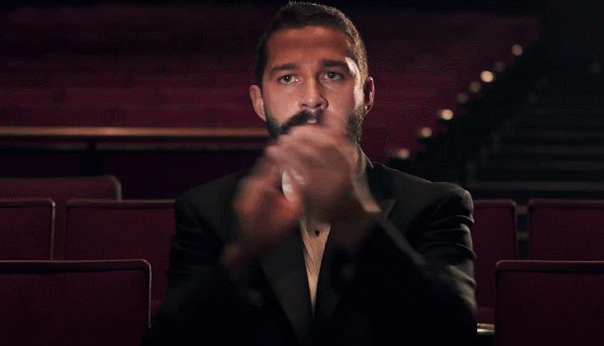
A Round of Applause

Slide 49

Unpacking the QFT

Slide 50
The Question Formulation Technique (QFT)
A strategy educators can use to teach students how to:
  formulate their own questions
  work with and improve their questions
  prioritize questions
  strategize on how to use questions
  reflect on their questions and the process
  use their questions to drive learning

Slide 51
Three thinking abilities, one strategy.

Slide 52
Thinking in many different directions
Divergent
Thinking

Slide 53
Narrowing down, focusing
Convergent
Thinking

Slide 54
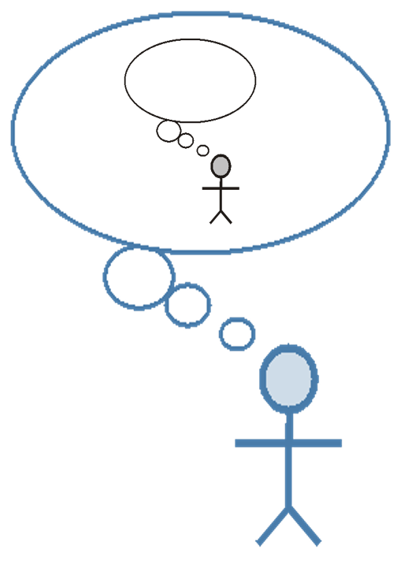
Thinking about thinking
Metacognition

Slide 55
Consistent Outcomes
Greater knowledge
Greater ownership
Greater intellectual rigor
Greater curiosity

Slide 56
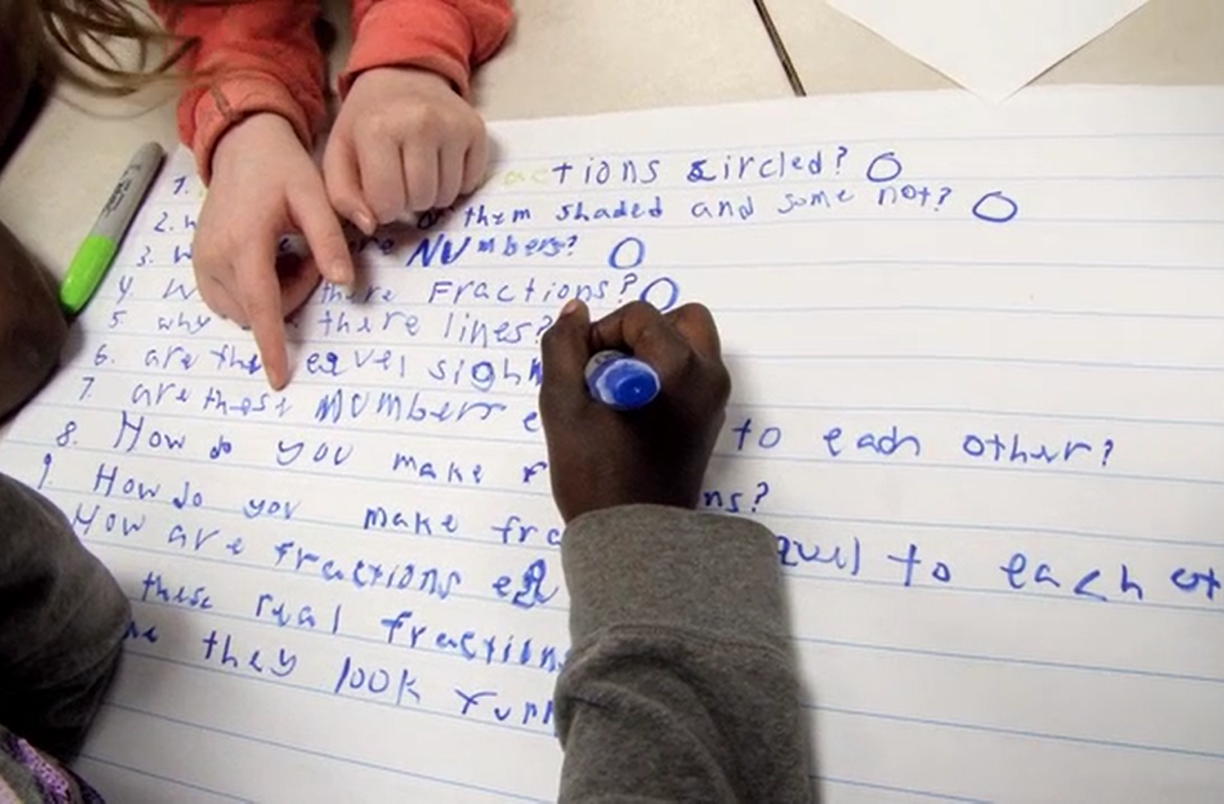
Examples of the QFT in the Classroom
Notes:
What does it look like when students learn to ask their own questions?

Slide 57
Classroom Example: Interdisciplinary
Ellen Gammell, Fitchburg, MA
Topic: Bioethics and nonfiction (The Immortal Life of Henrietta Lacks)
Purpose: To prepare students for a debate
Notes:
They were learning about cell biology/ DNA/ bioethics in biology

Slide 58
Question Focus
Debate Resolve:
Doctors should be able to do what they want with human tissue after the patient gives consent for removal of the tissue.

Slide 59
Students’ Questions
Are our bodies truly our property?
How much consent?
How much information should a patient receive in order for them to give informed consent?
Consent for removal or consent for research?
Should the patient be paid?
How should patients be paid? What for?
What counts as tissue?
Consent for removal of tissue or other body parts?
How about animals?
Are owners in charge of their pet’s tissue?
Are parents in charge of their kids’ tissue?
Can kids give informed consent?
Do gives give their parents consent?
How about teeth?
Do teeth count as bone donations?
What percent of compensation should patients receive?
How have tissue ownership laws changed over the years?
Is there a law?
Do doctors owns the tissue after patients give consent?
Should patients be able to perform their own research?
Do doctors come up with the idea? (A focus)
Do doctors need consent for tissue that doesn't belong to humans?
Can patients take back consent once they find out what the doctors are doing with their tissue?
Notes:
On the left, a team against the debate resolve. On the right, the team for the debate resolve

Slide 60
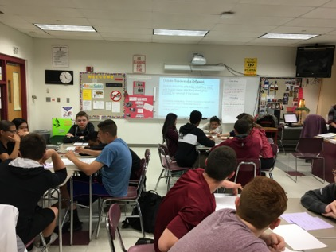
Next Steps
In teams, students researched their priority questions
Students prepared their debate arguments and rebuttals, using research
Students practiced public speaking and rhetorical skills

Slide 61
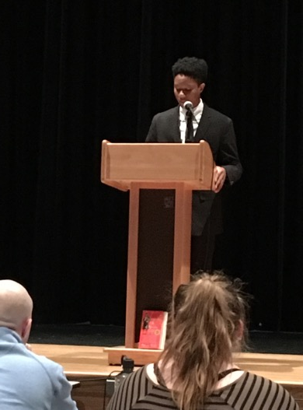
Next Steps
The 3 Judges: administrators, teachers and a former student
The Audience: students, parents, teachers, school & district leaders

Slide 62
Classroom Example: College English
Tina Romanelli, PhD, Raleigh North Carolina
Purpose: To foster a more democratic classroom environment
Notes:
Dr. Tina Romanelli is the Director of the Learning Center and an Instructor of English at Meredith College. Meredith College is a small, women’s liberal arts college in Raleigh, NC. When Dr. Romanelli first started working at Meredith College a few years ago, she found that many of the women in her courses would take at face value some of the decisions being made.
For example, in her past experience at other schools and institutions of higher education her students would question whether a quiz was necessary, whether a question on a test was fair, or whether assignments should be reframed to better meet their learning objectives. Her experience at Meredith College was that many students, she found, were raised in environments that squelched, rather than encouraged, their capacity to question authority. As a result, students did not necessarily perceive her classroom as the democratic, co-constructed space that Dr. Romanelli sought to foster.
To help students develop for themselves the ability to participate in the decision-making process in the classroom and take more ownership over their learning, Dr. Romanelli believed that she needed to teach them how to ask questions. The QFT, she shared, is one of the most effective, simple ways to begin teaching the skill of question formulation to college students. She used it in two classrooms so far, once with rousing success and once with mixed results. Despite differences between those two classrooms, there has been one critical shared outcome she is observing: young women in her classroom are getting more comfortable and confident in their ability and their need to ask questions in the classroom.

Slide 63
Emerging Findings on Our Research

Slide 64
A List of Things Stuart Firestein
Learned in Graduate School
Questions are more important than facts.
Answers or facts are temporary; data, hypotheses (models) are provisional.
Failure happens… a lot.
Patience is a requirement; there is no substitute for time.
Occasionally you get lucky—hopefully you recognize it.
Things don’t happen in the linear or narrative way that you read about in papers or textbooks.
The smooth “Arc of Discovery” is a myth; science stumbles along.
If there is free food, get there early.

Slide 65
Background on the Research
Students from Brandeis University, University Massachusetts, Lowell, and Northeastern University participated in a voluntary, hour-long experience in the Question Formulation Technique (QFT) for research. A questionnaire was administered before and after the hour-long experience to investigate changes in students’ self-reported perceptions and beliefs on question formulation.
Paired-sample two-tailed t-tests were conducted to compare doctoral students’ agreement that they have strategies to support their question formulation skills, beliefs on question formulation behavior, and confidence in question formulation before and after going through an hour-long QFT for research experience.
Notes:
Students from Brandeis University (n = 6), University Massachusetts, Lowell (n = 31), and Northeastern University (n = 48) participated in a voluntary, hour-long experience in the Question Formulation Technique (QFT) for research. A questionnaire was administered before and after the hour-long experience to investigate changes in students’ self-reported perceptions and beliefs on question formulation.
Paired-sample two-tailed t-tests were conducted to compare doctoral students’ agreement that they have strategies to support their question formulation skills, beliefs on question formulation behavior, and confidence in question formulation before and after going through an hour-long QFT for research experience.

Slide 66
Agreement on having strategies
In considering what research questions…
to pursue, I have specific strategies that allow me to generate good questions.***
to investigate, I have specific strategies that allow me to prioritize which questions are the best to pursue.***
***p < .001

Slide 67
In considering what research questions to pursue, I have specific strategies that allow me to generate good questions.

Slide 68
Beliefs about question formulation behavior
Once I have a set of questions before me, I believe that it is worthwhile to take the time to revise and improve them.***
I am able to efficiently formulate research questions.***
***p < .001

Slide 69
I am able to efficiently formulate research questions.

Slide 70
Confidence in question formulation skills
I am confident in my ability to formulate quality research questions.***
In developing research questions, I believe that my skills are at a high level.***
It is easy to formulate quality research questions.***
***p < .001

Slide 71
I am confident in my ability to formulate quality research questions.

Slide 72
What did you notice about the quality of your questions?
“Improved the quality, testability, and impact.”
“Improved the quality and the quantity [of my questions.]”
“It made them more specific and allowed me to pick the best from among several similar questions.”
“Reworking my questions made my questions better and more complex.”
“Improved the quality of the question but more importantly led to new questions.”

Slide 73
Other Results
94.8% of doctoral students believe the QFT for research helped them generate quality research questions. (n = 77)
96.1% of doctoral students reported that they plan to use this process in the future. (n = 77)

Slide 74
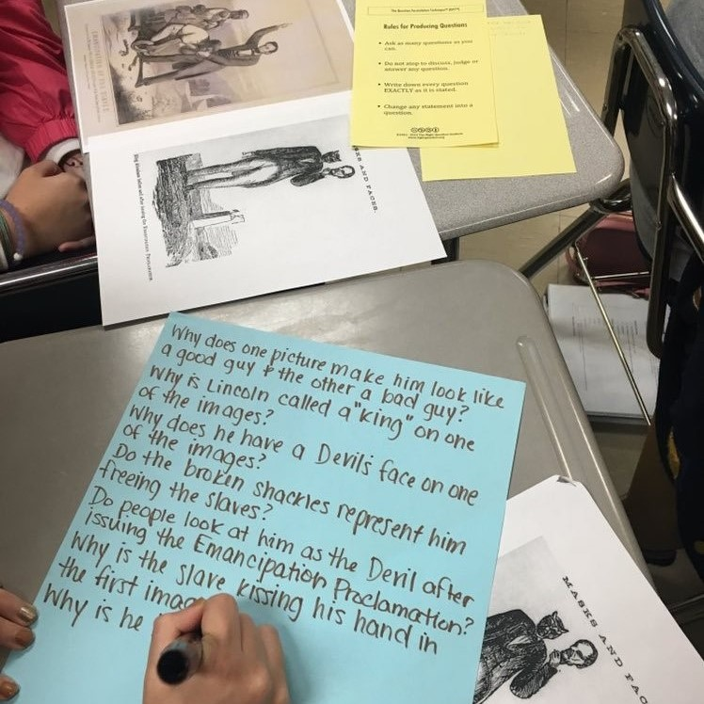
Question Formulation in the 21st Century

Slide 75

In the Age of Google
“How should you respond when you get powerful new tools for finding answers?
Think of harder questions.”
– Clive Thompson
Journalist and Technology Blogger

Slide 76
The Skill of Question Formulation
For reframing the perception of ignorance: not a weakness, but an opportunity
For arriving at better answers (and more questions)
For increasing engagement and ownership
For a little more joy in a very demanding profession
And…

Slide 77
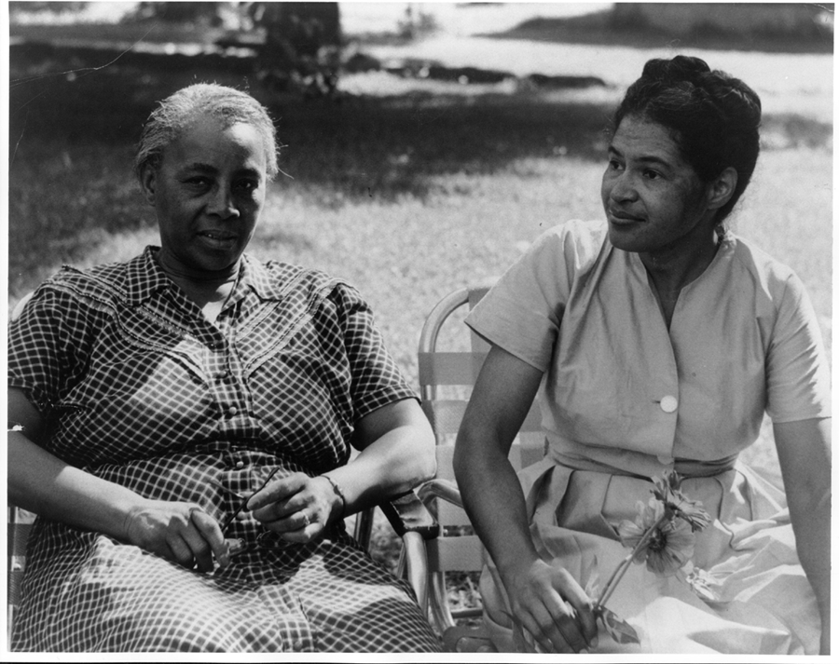
Democracy & Questions
Image Courtesy of Highlander Research and Education Center
Notes:
We have learned a lot from people with limited education, far from power, who were parents in a low-income Massachusetts city. They
were not participating in their children’s education because “they did not even know what questions to ask.” These parents were the
individuals who first named the problem and made the critical insight into the importance of questions for thinking, learning, and
participating. We have worked on this problem for nearly 30 years since.
Yet, we are not the first people to say question formulation is critical. We see our work connecting back to the work of someone who
you probably have never heard of but is one of the greatest educators of the 20th century.
Septima Clark was a civil rights activist and an African American educator who worked alongside Rosa Parks. After having her
teaching license revoked after decades or teaching service for her activism with a civil rights organization (NAACP), Clark, with her
cousin Bernice Robinson, established citizenship schools in South Carolina. Clark began working with low people with low literacy, first
to make sure they could vote and were not cheated out of wages, but as a part of a larger effort for people to become more effective
participants in democracy.
She said, “we need to be taught to study rather than to believe, to inquire rather than to affirm.” Clark saw inquiry and questioning as a
foundational part of learning, civic participation, and advocacy. By honing this fundamental skill one is able to advance research, think
and learn in new ways, and also to integrate this skill democratic habit of mind into their daily life.
Septima Clark, seated center, and her cousin Bernice Robinson standing to the right.
21

Slide 78
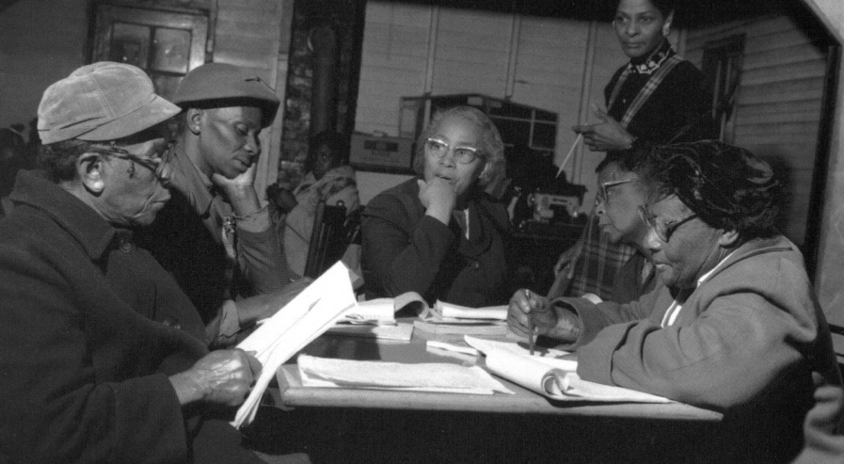
Democracy & Questions
“We need to be taught to study rather than to believe, to inquire rather than to affirm.”
- Septima Clark
See Chapter 6 on Septima Clark in Freedom Road: Adult Education of African Americans (Peterson, 1996).
Notes:
We have learned a lot from people with limited education, far from power, who were parents in a low-income Massachusetts city. They
were not participating in their children’s education because “they did not even know what questions to ask.” These parents were the
individuals who first named the problem and made the critical insight into the importance of questions for thinking, learning, and
participating. We have worked on this problem for nearly 30 years since.
Yet, we are not the first people to say question formulation is critical. We see our work connecting back to the work of someone who
you probably have never heard of but is one of the greatest educators of the 20th century.
Septima Clark was a civil rights activist and an African American educator who worked alongside Rosa Parks. After having her
teaching license revoked after decades or teaching service for her activism with a civil rights organization (NAACP), Clark, with her
cousin Bernice Robinson, established citizenship schools in South Carolina. Clark began working with low people with low literacy, first
to make sure they could vote and were not cheated out of wages, but as a part of a larger effort for people to become more effective
participants in democracy.
She said, “we need to be taught to study rather than to believe, to inquire rather than to affirm.” Clark saw inquiry and questioning as a
foundational part of learning, civic participation, and advocacy. By honing this fundamental skill one is able to advance research, think
and learn in new ways, and also to integrate this skill democratic habit of mind into their daily life.
Septima Clark, seated center, and her cousin Bernice Robinson standing to the right.
21

Slide 79
Reflection & Q&A

Slide 80
Closing Reflections
What did you learn?
How can you use what you learned?
An “a-ha moment” or a meaningful take away from your experience today.
Notes:
To use during discussion usually

Slide 81

Access Free Resources
Visit to find resources from today’s experience:
rightquestion.org/events
You can also find
Easy-to-use templates and downloadable resources
Classroom examples, articles, and blogs
Instructional videos
We offer materials through a Creative Commons License and we encourage you to make use of and/or share all resources.
Please reference the Right Question Institute and rightquestion.org as the source on any materials you use/share.

Slide 82
Thank you.
Now, some time for your questions.
We are eager to connect with you and explore how we can support your work:
Andrew.Minigan@rightquestion.org
Katy.Connolly@rightquestion.org
Register to access free resources over at: www.rightquestion.org

