Slide 1
Build Consensus & Facilitate Effective Decision-Making with the Right Question Strategy
Andrew P. Minigan
Director of Strategy, Education Program
The Right Question Institute

Slide 2
Who is in the room?

Slide 3
Acknowledgments
We are deeply grateful to The National Science Foundation, The Library of Congress, and The Hummingbird Fund for their generous support of the Right Question Institute’s work in education.
I would like to thank the RQI board of directors, and my colleagues Katy Connolly, Tomoko Ouchi, and Sarah Westbrook for all they do to make possible our work in education.
And, I would like to thank Dr. Eliza Reilly for all of her work in making possible this conference.

Slide 4
Access Free Resources
Visit to find resources from today’s experience:
rightquestion.org/events
You can also find
Easy-to-use templates and downloadable resources
Examples, articles, and blogs
Instructional videos

Slide 5
We Tweet
Share your thinking and learning from today:
@AndrewRQI
@RightQuestion
#QFT

Slide 6
Overview
Overview of the Right Question Strategy (RQS)
An experience in the RQS
Unpacking the RQS
Examples of the RQS
Applying the RQS to your work
Reflection & Q&A

Slide 7
Overview of the Right Question Strategy

Slide 8
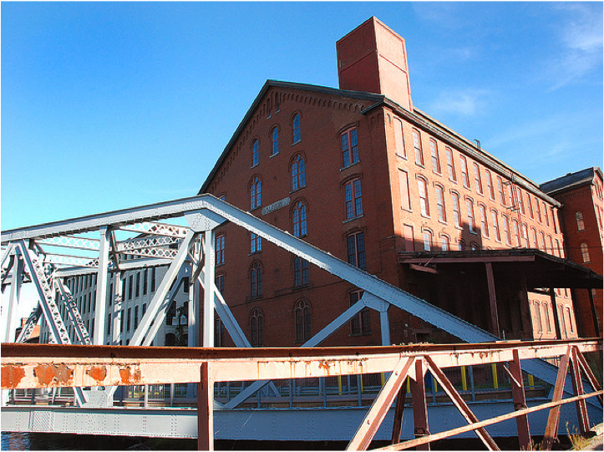
Honoring the Original Source: Parents in Lawrence, MA 1990
“We don’t go to the school because we don’t even know what to ask.”

Slide 9
The Right Question Strategy
One strategy, two techniques:
The Question Formulation Technique (QFT)
The Voice in Decisions Technique

Slide 10
The Question Formulation Technique
A technique to teach individuals how to:
formulate their own questions
work with and improve their questions
prioritize questions
strategize on how to use questions
reflect on their questions and the process
Notes:
In this strategy, the QFT will be used as a tool for consensus building

Slide 11
The Voice in Decisions Technique
A technique to teach individuals how to:
identify decisions using a set of criteria
participate more effectively in the decision-making process
When decisions are made, individuals should consider questions on:
reason: the basis for a decision
process: the steps and actions taken, people involved, information used in making the decision
role: the part you or others play in the decision-making process
Notes:
This offers a technique when a decision is being made.

Slide 12
Definition of a Decision
The selection of one option from among two or more options.
Notes:
Let’s review the working definition of a decision.

Slide 13
We Make Decisions Every Day
Consider the reasons, the process, and the role you played in getting dressed this morning.
Notes:
More specifically, let’s look at the clothing options you had. What are some specific items you chose from? (E.G. shorts/sneakers/boots)
In choosing what to wear, why did you choose what you are wearing? (Reason)
If participants talk about process during reason, mention that we’ll get there.
What did you do to inform that decision? What steps did you take to make that decision? (Process) E.G. checked the temperature.
And in thinking about the role—it seems as though everyone here was the sole decision-maker. But that isn’t always the case, and in other instances it is important to know the reasons, processes, and roles in the decision-making process. So, let’s continue to look at decisions.

Slide 14
What are examples of decisions in this statement?
New courses will be added to increase student success and cuts will be made to other student support programs next year.
Notes:
Let’s think about this decision. What decisions are embedded?
Scope of the changes
Purpose
Timeline
And the impact areas

Slide 15
The value of asking questions when introducing a change
When you introduce a change the questions are going to be asked anyways, but you may not hear them.

Slide 16
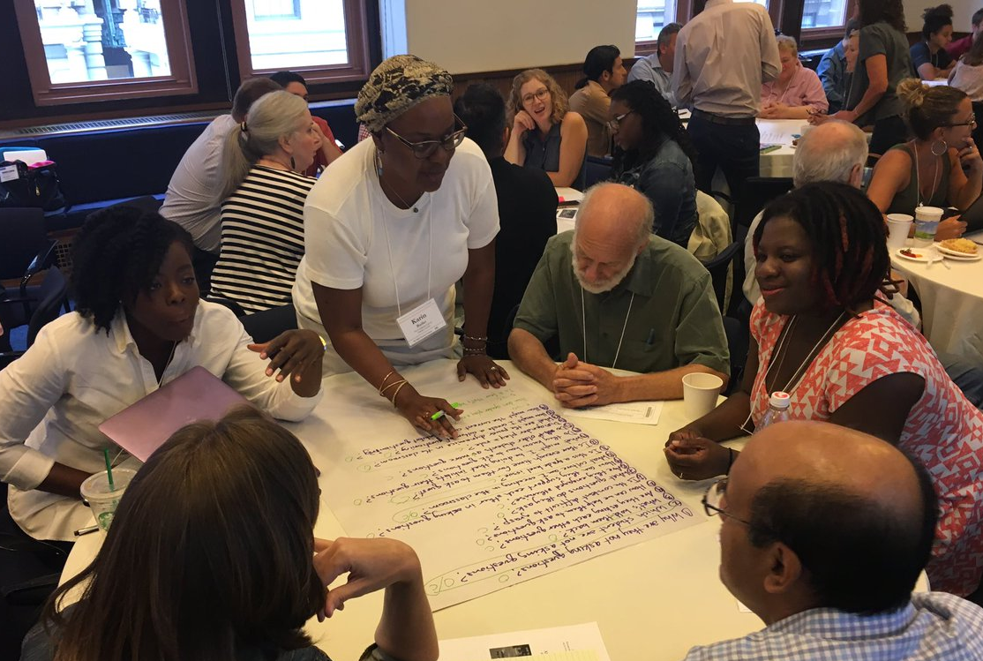
An Experience in the Right Question Strategy

Slide 17
Rules for Producing Questions
1. Ask as many questions as you can
2. Do not stop to answer, judge, or discuss
3. Write down every question exactly as stated
4. Change any statements into questions

Slide 18
Produce Questions
Ask questions
Follow the rules
Ask as many questions as you can
Do not stop to answer, judge, or discuss
Write down every question exactly as it was stated
Change any statements into questions
Number the questions as you produce them

Slide 19
Question Focus
Instructional practices will be changed next year in order to promote inclusion.
Please remember to follow the rules and to number your questions.
You may want to write the Question Focus at the top of your paper.

Slide 20
Categorize Questions: Closed/Open
Definitions:
Closed-ended questions can be answered with a “yes” or “no” or with a one-word answer.
Open-ended questions require an explanation and cannot be answered with a “yes,” “no,” or with one word.
Directions:
Label your closed-ended questions with a “C” and your open-ended questions with an “O.”

Slide 21
Discuss Advantages & Disadvantages
Closed-ended questions
Advantages
Disadvantages

Slide 22
Discuss Advantages & Disadvantages
Open-ended questions
Advantages
Disadvantages

Slide 23
Work with Closed and Open-ended Questions
Take one closed-ended question and change it into an open-ended question.
Take one open-ended question and change it into a closed-ended question.
Add your new questions to the bottom of your list of questions.
Closed
Open
Open
Closed
Notes:
Please be sure to number your new questions—they are new questions and so they should be the next two numbers in your list of questions.

Slide 24
Prioritize Questions
Review your list of questions:
Choose your three questions you would like answered first.
While prioritizing, keep in mind the Question Focus: Instructional practices will be changed next year in order to promote inclusion.
After prioritizing consider:
Why did you choose those three questions?
Where are your priority questions in the sequence of your entire list of questions?

Slide 25
Identify Questions about Decisions
Using the Voice in Decisions Technique, we will review your list of questions and identify questions on:
reason: the basis for a decision
process: the steps and actions taken, people involved, information used in making the decision
role: the part you or others play in the decision-making process

Slide 26
Identify Questions: Reason
Reason: the basis for a decision
Directions:
Identify one question about a reason by marking it with “reason.”
Ask a question about a reason if you do not have one.
Notes:
If you don’t find a question quickly, come up with a new question on reason

Slide 27
Identify Questions: Process
Process: the steps and actions taken, people involved, information used in making the decision
Directions:
Identify one question about a process by marking it with “process.”
Ask a question about a process if you do not have one.

Slide 28
Identify Questions: Role
Role: the part you or others play in the decision-making process
Directions:
Identify one question about your role in the decision by marking it with “role.”
Ask a question about your role if you do not have one.

Slide 29
Share
Your three priority questions and their numbers in your original sequence
Rationale for choosing priority questions
Your questions on:
Reason
Process
Role

Slide 30
Reflect
What did you learn?
How did you learn it?

Slide 31
Unpacking the Right Question Strategy

Slide 32
The Right Question Strategy
Two core techniques:
The Question Formulation Technique (QFT)
The Voice in Decisions Technique
Together, a strategy for more inclusive, equitable, collaborative decision-making and problem-solving.

Slide 33
The Question Formulation Technique
A technique to:
formulate your own questions
work with and improve questions
prioritize questions
strategize on how to use questions
reflect on your questions and the process

Slide 34
Three thinking abilities, one strategy.

Slide 35
Thinking in many different directions
Divergent
Thinking

Slide 36
Narrowing down, focusing
Convergent
Thinking

Slide 37
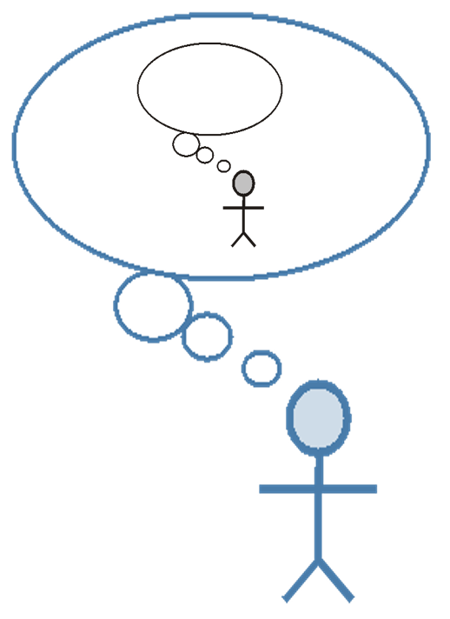
Thinking about thinking
Metacognition

Slide 38
The Voice in Decisions Technique
A technique to:
identify decisions
define key elements in decision-making, including reason, process, and role
identify questions on reason, process, and role

Slide 39
Accountable Decision-Making
In a democracy, we should expect and require that all decisions are guided by the following criteria:
Legitimacy: the decisions are based on policies, standards, or rules that are fairly applied.
Transparency: the process used to make the decision is visible to all.
Opportunities for participation: There is a role in the decision-making process for individual(s) affected by the decision.
Notes:
These principles can be used as criteria for accountable decision-making in a democracy.

Slide 40
Decision-Making and Democratic Principles
Reason Legitimacy
Process Transparency
Role Opportunities for
participation
Notes:
Reason corresponds with legitimacy etc. Our work was to simplify the terminology and create a strategy that helps people think on these democratic principles in ways related to their decisions.

Slide 41
Examples of the Right Question Strategy

Slide 42
“Using the Right Question Strategy to elicit questions about school improvement initiatives and other factors related to organizational change may promote trust and collaboration by giving stakeholders the opportunity to voice their ideas in a safe, non-threatening way.”
– Naomi Ludwig
District Data Coordinator

Slide 43
“I learned that introducing a subject through the Right Question Strategy allows individuals to get inside of a subject and to have much more buy-in not only to the what of the topic but to get into the why and how. I am excited by the call to action that this process began, and I feel we will all learn more as part of this process.”
– Sandy Seufert
Curriculum Specialist

Slide 44
Decision-Making Example
Nat Vaughn, Medfield, MA
Context: A school-wide faculty meeting
Purpose: To build consensus on creating a school-wide homework policy
Notes:
Eager to have staff ask questions

Slide 45
Question Focus
Homework practices are inconsistent at our school.
Homework practices vary at our school.

Slide 46
Practitioner Reflection
“The conversations that took place resulting from the process were rich, meaningful, and productive. The simple process provided a nonjudgmental structure to address a significant issue in our school, and led us to a position of recognizing and embracing a need for change.”

Slide 47
Decision-Making Example
Gerry Briscoe, SEERC – Alaska’s Educational Resource Center, Juneau, AK
Context: Grant advisory board planning and strategizing session
Purpose: To help all stakeholders decide next steps as part of a grant with the Alaska Department of Education Advisory Board

Slide 48
Question Focus
Culturally responsive pedagogy and marginalized students.

Slide 49
Next Steps
Groups from the advisory board included the Alaska State Department of Education, Alaska Native organizations, teachers, and leaders in the school districts.
Began to answer prioritized questions in the next session by applying them to different stakeholder groups:
Teachers
Principals
District leaders
School board members
Parents
Students

Slide 50
Outcomes
Grant evaluator asked advisory board to rate the effectiveness of this strategy on a scale from 1-5. The average was 4.44.
Comment from a board member: “Great strategy! Includes all participants and reinforces understandings and challenges with an aim towards solutions.”

Slide 51
The Value of Focusing on Decisions & Asking Questions
For fostering a more inclusive decision-making process and eliciting different perspectives
For better understanding concerns of different stakeholders
For generating buy-in and reaching consensus in a change process
And…

Slide 52
Democracy & Questions
“We need to be taught to study rather than to believe, to inquire rather than to affirm.”
- Septima Clark
See Chapter 6 on Septima Clark in Freedom Road: Adult Education of African Americans (Peterson, 1996).
Notes:
We have learned a lot from people with limited education, far from power, who were parents in a low-income Massachusetts city. They
were not participating in their children’s education because “they did not even know what questions to ask.” These parents were the
individuals who first named the problem and made the critical insight into the importance of questions for thinking, learning, and
participating. We have worked on this problem for nearly 30 years since.
Yet, we are not the first people to say question formulation is critical. We see our work connecting back to the work of someone who
you probably have never heard of but is one of the greatest educators of the 20th century.
Septima Clark was a civil rights activist and an African American educator who worked alongside Rosa Parks. After having her
teaching license revoked after decades or teaching service for her activism with a civil rights organization (NAACP), Clark, with her
cousin Bernice Robinson, established citizenship schools in South Carolina. Clark began working with low people with low literacy, first
to make sure they could vote and were not cheated out of wages, but as a part of a larger effort for people to become more effective
participants in democracy.
She said, “we need to be taught to study rather than to believe, to inquire rather than to affirm.” Clark saw inquiry and questioning as a
foundational part of learning, civic participation, and advocacy. By honing this fundamental skill one is able to advance research, think
and learn in new ways, and also to integrate this skill democratic habit of mind into their daily life.
Septima Clark, seated center, and her cousin Bernice Robinson standing to the right.
21

Slide 53
Reflect
Where and how will you use what you have learned today?
Specific situations? Issues? Initiatives?
What part of the Right Question Strategy would you like to use?
How does asking questions about decisions connect to:
Equity & inclusivity
Getting buy-in for change
Notes:
Need to have a decision in the Qfocus
User decides how to use it.
Sometimes QFT only, sometimes you’ll want to go through this entire strategy

Slide 54
Thank you. Now, some time for your questions. We are eager to connect with you and explore how we can support your work: Andrew.Minigan@rightquestion.org Katy.Connolly@rightquestion.org Register to access free resources over at: www.rightquestion.org

