Slide 1
Pulling it All Together: A Role for Educators in Creating a New Theory of Learning Based on Students' Questions
Dan Rothstein
Co- Director, The Right Question Institute, Cambridge, MA
New Hampshire Learning Initiative
2019 Powerful Learning Conference
Bow High School, Bow, NH, July 11, 2019

Slide 2
We’re Tweeting…
@RightQuestion
@RothsteinDan
#QFT

Slide 3
Agenda
Active Learning Experience
Question Formulation Theory of Learning
Supporting Teachers in Making Shift in Practices
Reflection
Questions and Discussion

Slide 4
Active Learning Experience
Ask and write down questions
Write down thoughts that come to you through the process of asking questions
Notes:
Asking questions and thoughts that come to you
You will be asking questions
You will be writing down your questions
You will be writing what you are thinking of through the process of asking questions
Rules
Produce questions

Slide 5
Rules for Producing Questions
1. Ask as many questions as you can
2. Do not stop to answer, judge, or discuss
3. Write down every question exactly as stated
4. Change any statements into questions

Slide 6
Produce Questions
Ask Questions
Follow the Rules
Ask as many questions as you can.
Do not stop to answer, judge, or discuss.
Write down every question exactly as it was stated.
Change any statements into questions.
Number the Questions

Slide 7
Lynne M. Bland
Curriculum Specialist for Secondary History and Social Science,
Chesterfield County Public Schools,
Midlothian, VA
Source of pictures: https://www.virginiahistory.org/collections-and-resources/virginia-history-explorer/civil-rights-movement-virginia/equal-access

Slide 10
1961 Richmond VA, Civil Rights Protest

Slide 11
Change Questions
Take one closed-ended question and change it into an open-ended question.
Take one open-ended question and change it into a closed-ended question.
Closed
Open
Open
Closed

Slide 12
Prioritize Questions
Review your list of questions
Choose the three questions you consider most important.
After prioritizing consider…
Why did you choose those three questions?
Where are your priority questions in the sequence of your entire list of questions?

Slide 13
Reflect
What did you learn?

Slide 14
Share
Priority questions
Thoughts

Slide 15
Agenda
Active Learning Experience
Question Formulation Theory of Learning
Supporting Teachers in Making Shift in Practices
Role of Educators
Questions and Discussion

Slide 16
Question Formulation Theory of Learning
Your questions shape how you learn and what you learn.
Questions change the information you seek
Questions change the information you get
Questions can deepen your understanding of what you currently know and what you don’t know
Questions can lead to predictions
Questions can challenge predictions and assumptions
Questions can shape your learning agenda
Questions not asked…affect what you do and don’t learn
Notes:
How do your questions change what you are thinking about and what you are learning (google question would be: how do your questions change what information you are seeking)
Info vs. thinking about and learning
Google as it now operates, emphasis in on obtaining info
We are thinking about thinking and learning - how do you deepend the ability to think and to learn.
How is that different from the ability to obtain information
Link between info presented to you and the kind of questions you ask
QF Theory of Learning: that your questions change:
what you are thinking about
How you learn
What info you seek
What you understand
How you prioritize your info search
All together, your questions shape your learning
There are many approaches to defining and describing and measuring learning. We are not aiming to replace them, but we are adding to them. We are adding perhaps the most ancient technology available for learning; the ability to ask one’s own questions
RQI’s contribution that is new and unique is that the question as a catalyst for learning is both universally recognized and woefully undervalued/ underestimated for its potency. Or maybe, better to say the ability to produce, improve and strategize on the use of one’s own questions…

Slide 17
© The Right Question institute

Slide 18
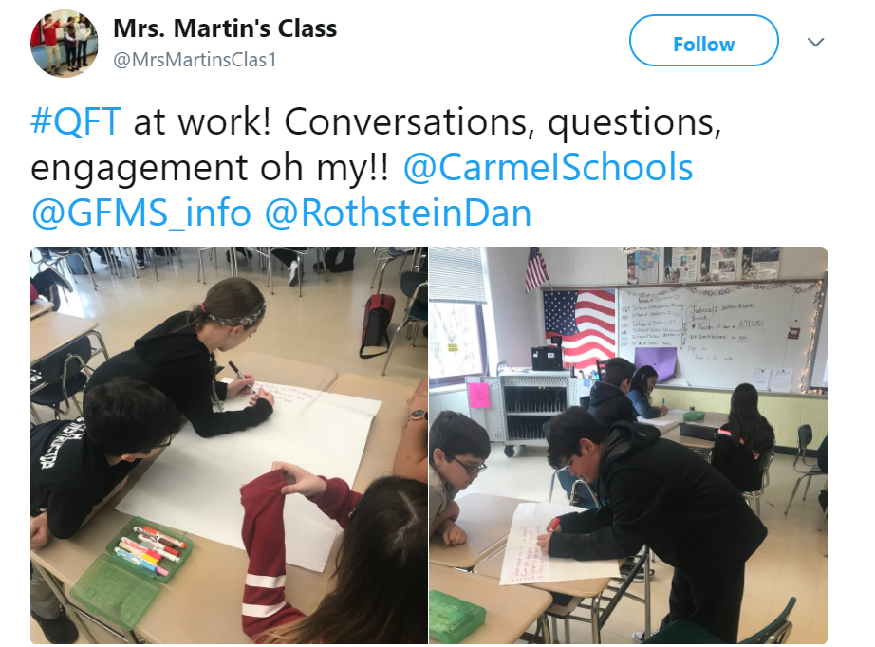
https://twitter.com/MrsMartinsClas1/status/964215453907390464

Slide 19
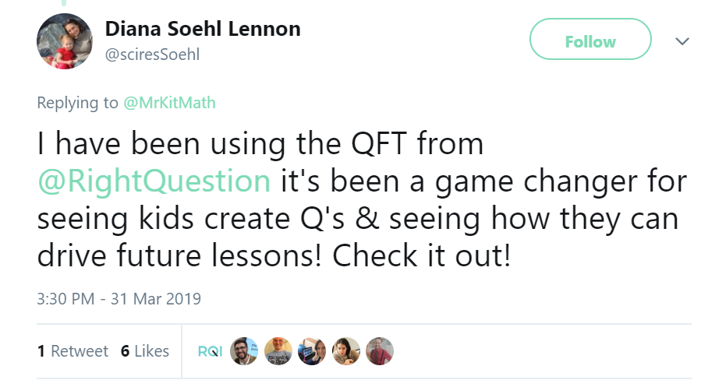
https://twitter.com/sciresSoehl/status/1112482364775636992

Slide 20
Supporting Teachers in Making the Shift in Practices
Notes:
Conflict with what teachers are trained and accustomed to.
“perception of
best teachers are the ones who get the students to think”

Slide 21
Cognitive Shift in Teaching
From asking questions of students
To designing a focus for students’ questions
Notes:
From asking questions of students to designing a focus for students’ questions
Cognitive task and Intellectual labor to plan
Setting learning goals and QFocus design - Can be learned by all teachers
Shift in practice / Behavioral change
Conflict with what teachers are trained and accustomed
(comment)“Perception of best teachers are the ones who get the students to think”

Slide 22
Obstacles
Sacred Cows
Notes:
http://www.flickr.com/photos/14866456@N00/2400376222/sizes/m/in/photolist-4E7ydW-5ZWZ6Q-7szB2F-8aRgqq-cdHD9b-bWkNpz-cdGZ3y-5e8c4q-5e3RMD-o8prV-5ArSwy-5AnAAP-6Myvf-db2rs6-81FoCF-6PijP8-7Nsonu-7EQHbR-cdGosb-cdG8Jq-bWm95x-cdGwU7-cdJTPQ-cdGfyC-cdFNVE-bWjDpB-cdGPWC-cdKH1u-bWmsXX-bWj3oB-cdK2LG-bWnoHz-bWo6rX-cdJ8Zo-bWneNV-5uB9Yt-eBCWoH-4W6hNQ-4XRWVP-2z5JUx-dbbCXU-dbhCdf-7JFhKc-6LZCdu-6PykKk-zzi7z-7U8FyF-beYMzt-cJYpef-4Ab29g-8y25GC/

Slide 23
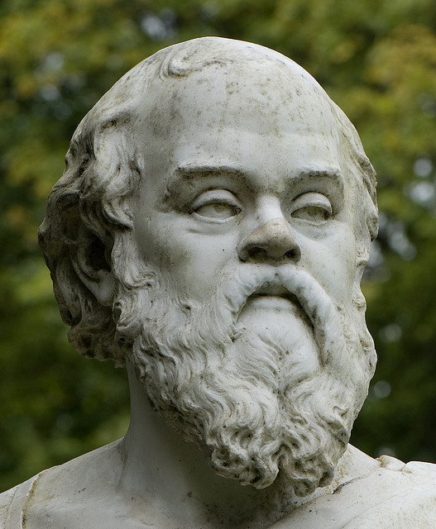

Slide 24
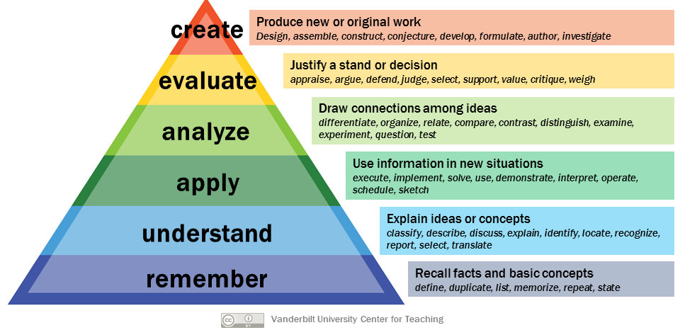
Notes:
http://www.celt.iastate.edu/teaching/effective-teaching-practices/revised-blooms-taxonomy/
http://www.celt.iastate.edu/wp-content/uploads/2015/09/RevisedBloomsHandout-1.pdf
A group of cognitive psychologists, curriculum theorists and instructional researchers, and testing and assessment specialists published in 2001 a revision of Bloom’s Taxonomy with the title A Taxonomy for Teaching, Learning, and Assessment. This title draws attention away from the somewhat static notion of “educational objectives” (in Bloom’s original title) and points to a more dynamic conception of classification.
The authors of the revised taxonomy underscore this dynamism, using verbs and gerunds to label their categories and subcategories (rather than the nouns of the original taxonomy). These “action words” describe the cognitive processes by which thinkers encounter and work with knowledge.
A statement of a learning objective contains a verb (an action) and an object (usually a noun).
The verb generally refers to [actions associated with] the intended cognitive process.
The object generally describes the knowledge students are expected to acquire or construct. (Anderson and Krathwohl, 2001, pp. 4–5)
The cognitive process dimension represents a continuum of increasing cognitive complexity—from remember to create. Anderson and Krathwohl identify 19 specific cognitive processes that further clarify the bounds of the six categories (Table 1).

Slide 25
Challenges in Making the Shift in Practice
Affective and behavioral changes
From:
Helping too much
Being judgmental (+/-)
Providing information
To: Neutral facilitator of learning
Notes:
When teachers make that shift:
What teachers are trained and accustomed
What is required to teach students to ask questions
Teaching contents- teaching how to learn/ Raising individuals as independent learners

Slide 26
When Teachers Make the Shift
Students become more self-directed learners
Students think better
Teachers derive great joy from observing students owning the learning
Notes:
Maybe, we can say that teachers job - make students think is the same, and it happens easier when students are working with their own questions
(comment)“Perception of best teachers are the ones who get the students to think”
For moving from ignorance to knowledge
For arriving at better answers
For increasing engagement and ownership
For demonstrating inquiry in the classroom
For a little more joy in a very demanding profession
And…

Slide 27
Agenda
Active Learning Experience
Question Formulation Theory of Learning
Supporting Teachers in Making Shift in Practices
Role of Educators
Questions and Discussion

Slide 28
Role of Educators
Discuss
How will a question formulation theory of learning help you as an educator?
Notes:
Conflict with what teachers are trained and accustomed to.
“perception of
best teachers are the ones who get the students to think”

Slide 29
Questions and Discussion

Slide 30
Session Evaluation
Please spend 2 minutes leaving some feedback. We value your thoughts.
Thank you!

