Slide 1
Social Studies Examples

Slide 2
Classroom Example: Middle School
Teacher: Megan Harvell, Boston, MA
Topic: American History –The Civil War
Purpose: Pre-reading activity to engage students in the unit and to build primary source reading & interpretation skills

Slide 3
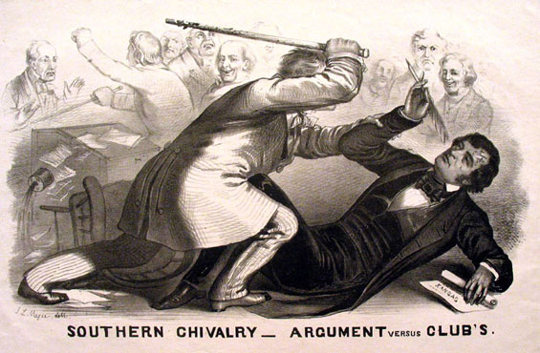
Question Focus
Image by John L. Magee, 1856

Slide 4
Student Questions
Why are you taking a pen?
Why are they in court?
Who hit who first?
Who died?
Why are they smiling?
Why are they fighting?
Are they fighting?
Are they part of the government?
Where were they?
Who are they?
Were they signing anything?
Who else was there?
Why are you hitting him?
Why didn’t they call 911?
Was this related to slavery?
Why is he hitting him with a bat?

Slide 5
Classroom Example: 8th Grade
Teacher: Joshua Beer, Lempster, NH
Topic: American History, Imperialism unit
Purpose: To conclude unit and use student questions to create a summative assessment

Slide 6
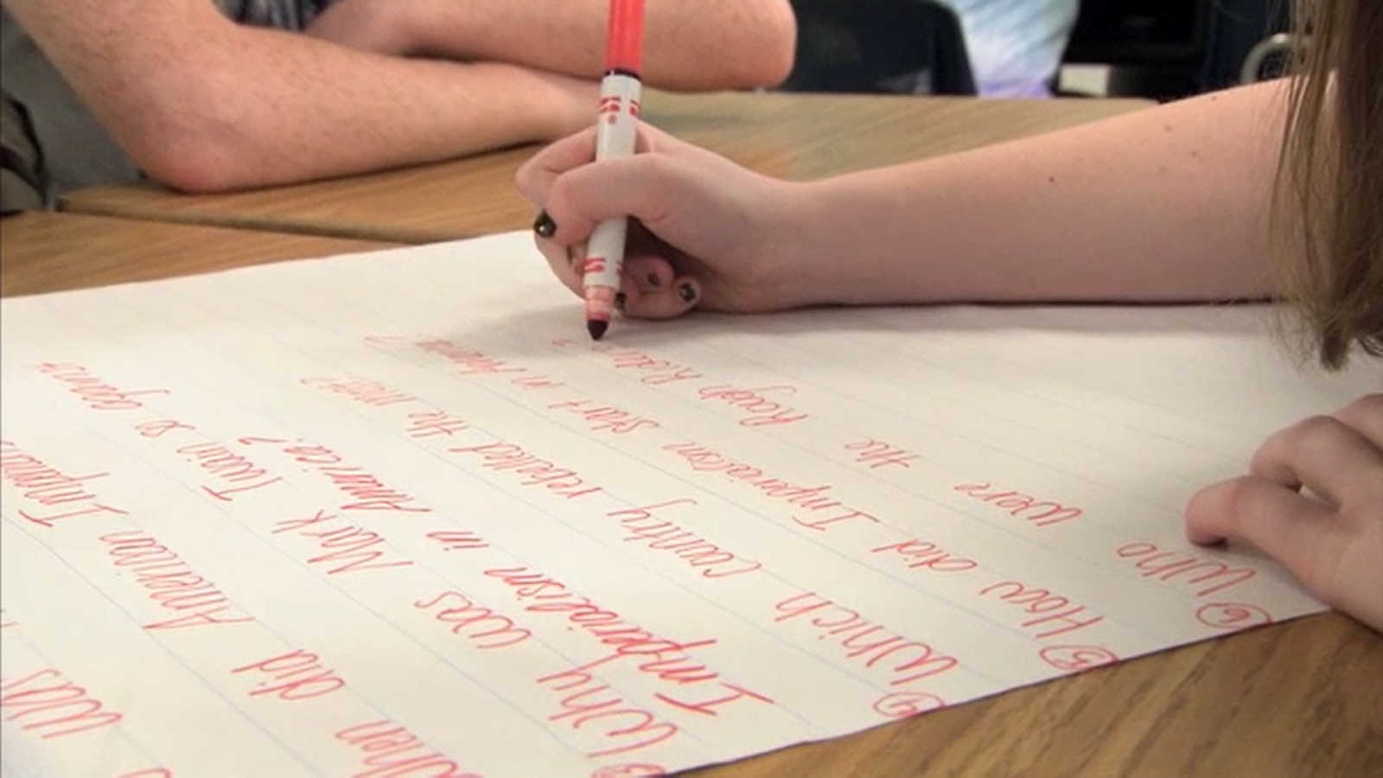
The Question Formulation Technique (QFT) in Action
https://www.youtube.com/watch?v=lfXEf0nG51I

Slide 7
Question Focus:
Questions that should be asked about American Imperialism at the turn of the 20th century

Slide 8
Prioritization Instructions
Choose 3 questions you think are most important for understanding American Imperialism at the turn of the 20th century

Slide 9
Selected Student Questions
1. Why did the United States want to annex Hawaii?
2. Why did the Hawaiian natives and queen Liloukalani not want the United States to annex Hawaii?
5. How was Alfred Thayer Mahan’s book influential towards imperialism?
6. What was Alfred Thayer Mahan’s stance on imperialism?
7. Why is it so important for America to have overseas bases?
8. What started the Spanish-American war?
9. Why was Spain mistreating Cubans & Phillipinos?
10. How did the Spanish-American war affect America?
6→12. Why did Alfred Thayer Mahan have the stance that he did on imperialism?
5→13. Did Alfred Thayer Mahan’s book influence imperialism?

Slide 10
Next Steps with Student Questions
Teacher collected questions and created final unit test.
9 of the 10 questions on the test were student-generated.

Slide 11
Classroom Example: High School
Teacher: Connie Williams, Petaluma, CA
Topic: Debate Team
Purpose: To anticipate the information necessary to research before a debate

Slide 12
Question Focus
Resolved that the United States screen immigrants for extremist ideological views.

Slide 13
Student Questions
What are extremist views?
How are we screening now?
What kinds of extremist views are there?
What about homegrown extremist views?
How might we screen immigrants differently?
What would happen if we didn’t let anyone in anymore?
Don’t we already have a good system?
Why are we re-building something that isn’t broken?
How do we know if it’s broken or not?

Slide 14
Next Steps with Student Questions:
Students created questions for the evaluation of the sources they were using:
Who wrote this?
For what purpose was this written?
How do they want me to feel?
How do they want me to act?
What are the sources of their numbers, charts, or other evidence?
Can we trace them back to their creator?… and then question the purpose and authority of those numbers also.

Slide 15
Classroom Example: 11th Grade U.S. History
Teacher: Kelly Grotrian, East Brunswick, NJ
Topic: The End of World War II
Purpose: To prepare for a debate about whether the United States was justified in dropping the atomic bomb.

Slide 16
Question Focus
http://www.loc.gov/pictures/item/98506956/

Slide 17
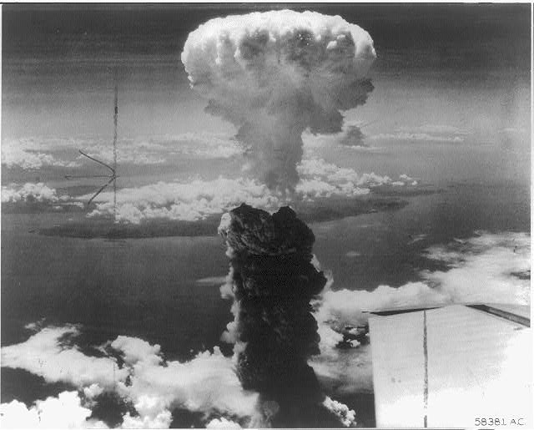
Students’ Questions
What is this?
Who did this?
How did this affect people?
What were the environmental & economic implications of dropping the bomb?
How many people were hurt?
Is that a plane wing in the bottom right?
Did the people in that plane drop the bomb?
Did the people dropping the bomb know what they were doing?
Did they make the bomb?
Who was responsible for dropping the bomb?
What led to this event?
What happened as a result of dropping the bomb?
Where was the bomb dropped?
Had people been given warning?
How long did it take to notice effects of the bomb?
When did this happen (at what point in the war)?
How many lives were lost as a result?

Slide 18
Classroom Example:
High School
Teacher: Isabel Morales, Los Angeles, CA
Topic: Social Justice
Purpose: Engage students in thinking about systemic injustice at the start of a multi-disciplinary unit

Slide 19
Question Focus
“The disciplinary policies of our society perpetuate injustice.”

Slide 20
Student Questions
Why are student of color targeted the most?
Do teachers nationwide take notice of these stats?
How can teachers develop better & effective disciplinary policies?
Why do people see the stats & data as a coincidence?
What does a kid learn about the system once in jail?
What do people believe expulsion will teach the students?
Does going to jury have a long-term effect on younger students about education?
When will it get better?
What are some ways to improve behavior?
What type of training will teachers go through that’ll bring justice to classrooms?
Why is there a law?
Shouldn’t school police officers be trained like teachers?
What is considered a criminal offense in school?
Isn’t it the teacher’s job to keep the students “in line”?
How should disruption in class be handled?
Shouldn’t school officers be punished as well?
What is the difference between a school officer and a regular police officer?
How come there aren’t any policies keeping students out of prison?

Slide 21
Student Reflections
“Asking questions is important because it opens up discussions and debate about issues.”
- Leslie S., 12th grader
“Asking questions is a step in creating change.”
- Jonathan S., 11th grader
“Questions can help focus on a problem and think of solutions.”
- Jason S., 11th grader

Slide 22
Additional History Resources & Examples
http://rightquestion.org/blog/my-qft-journey-putting-students-minds-into-motion-with-their-questions/
Texas social studies teacher, James Brewster, reflects on the large scale cultural changes in his classroom after a year with the QFT and offers several specific lessons, using political cartoons as QFocus prompts.

