Slide 1
Firing Student Curiosity in the Library with the Question Formulation Technique
Sarah Westbrook
Director of Professional Learning
The Right Question Institute, Cambridge, MA

Slide 2
Acknowledgments
We are deeply grateful to The Hummingbird Fund and to the Right Question Institute board of directors for their support of our work.
Thank you also to Tess Henderson, Esther Honda, Brad Williston, and Michelle Yamamoto for bringing The Right Question Institute to San Francisco and for all their work behind the scenes.

Slide 3
Welcome
"There is no learning without having to pose a question."
- Richard Feynman
Nobel Laureate, Physics, 1965

Slide 4
Who is in the room?

Slide 5
Community Building
We shall not cease from exploration
And the end of all our exploring
Will be to arrive where we started
And know the place
For the first time.
-T.S. Eliot

Slide 6
Today’s Agenda
Welcome & Community Building
Why Spend Time on Teaching Question Formulation?
Collaborative Learning with the Question Formulation Technique (QFT)
Exploring Student Work & Classroom Applications
-- Break --
Moving into Practice: Discussion and Planning
Closing Reflections & Evaluations

Slide 7
To Access Today’s Materials:
https://rightquestion.org/events/
Join our Educator Network for:
Templates you can use tomorrow in class
Classroom examples
Instructional videos
Opportunities to connect with other educators
Notes:
*You can also find this link at your tables

Slide 8
We’re Tweeting…
@RightQuestion
@SarahRQI
#QFT

Slide 9
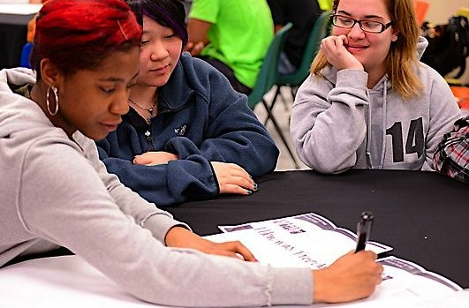
Why spend time teaching the skill of question formulation?

Slide 10
Honoring the Original Source: Parents in Lawrence, Massachusetts, 1990
“We don’t go to the school because we don’t even know what to ask.”

Slide 11
"There is no learning without having to pose a question."
- Richard Feynman
Nobel Laureate, Physics, 1965

Slide 12
“We must teach students how to think in questions, how to manage ignorance.”
– Stuart Firestein
Former chair, Department of Biology,
Columbia University

Slide 13
College Presidents on What College Students Should Learn
“The primary skills should be analytical skills of interpretation and inquiry. In other words, know how to frame a question.”
- Leon Botstein, President of Bard College
“…the best we can do for students is have them ask the right questions.”
- Nancy Cantor, Former Chancellor of University of Illinois
The New York Times, August 4, 2002

Slide 14
Yet, only 27% of graduates believe college taught them how to ask their own questions
Alison Head, Project Information Literacy at University of Washington, 2016

Slide 15
Basic Skill Attainment Over Time
Sources:
http://nces.ed.gov/nationsreportcard/pdf/main2009/2011455.pdf
http://nces.ed.gov/nationsreportcard/pubs/main2007/2008468.asp#section1
Data on question-asking based on parent and teacher feedback

Slide 16
Basic Skill Attainment Over Time
Sources:
http://nces.ed.gov/nationsreportcard/pdf/main2009/2011455.pdf
http://nces.ed.gov/nationsreportcard/pubs/main2007/2008468.asp#section1
Data on question-asking based on parent and teacher feedback

Slide 17
We can work together on changing the direction of that slope

Slide 18
We Are Not Alone
Educators in more than 1 million classrooms worldwide

Slide 19
Now, Educators Lead the Work
The Right Question Institute offers materials through a Creative Commons License and we encourage you to make use of and/or share this resource. Please reference the Right Question Institute and rightquestion.org as the source on any materials you use.

Slide 20
What happens when students do learn to ask their own questions?

Slide 21
Research Confirms the Importance of Student Questioning
Self-questioning (metacognitive strategy):
Student formulation of their own questions is one of the most effective metacognitive strategies
Engaging in pre-lesson self-questioning improved students rate of learning by nearly 50% (Hattie, p.193)
John Hattie
Visible Learning: A Synthesis of Over 800
meta-Analyses Relating to Achievement, 2008
Notes:
UC Davis Research Linking Curiosity to Memory (UC Davis) 2014
The Fullerton Longitudinal Study (FLS), a 30-plus year study of the development of giftedness across various points in time conducted by Adele and Allen Gottfried of California State University ”This finding has strong implications for the development of STEM considering that curiosity is a fundamental predictor of the aspiration to become a scientist.”
S. von Stumm, B. Hell, T. Chamorro-Premuzic. The Hungry Mind: Intellectual Curiosity Is the Third Pillar of Academic Performance. Perspectives on Psychological Science, 2011 meta-analysis shows They found that curiosity did, indeed, influence academic performance. In fact, it had quite a large effect, about the same as conscientiousness. When put together, conscientiousness and curiosity had as big an effect on performance as intelligence.

Slide 22
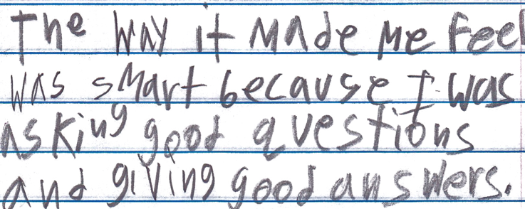
Student Reflection
“The way it made me feel was smart because I was asking good questions and giving good answers.”
-Boston 9th grade summer school student

Slide 23
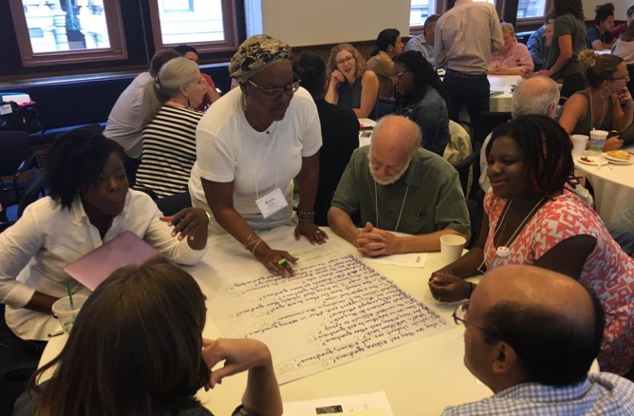
Collaborative Learning with the Question Formulation Technique (QFT)

Slide 24
The Question Formulation Technique (QFT)
A step-by-step strategy in which people:
Produce their own questions
Transform & Improve their questions
Strategize on how to use their questions
Reflect on what they have learned and how they learned it

Slide 25
Rules for Producing Questions
1. Ask as many questions as you can
2. Do not stop to answer, judge, or discuss
3. Write down every question exactly as stated
4. Change any statements into questions

Slide 26
Produce Questions
Ask Questions
Follow the Rules
Ask as many questions as you can.
Do not stop to answer, judge, or discuss.
Write down every question exactly as it was stated.
Change any statements into questions.
Number the Questions

Slide 27
Question Focus
Some students are not asking questions.
→Please write this statement at the top of your paper.
→Remember: Number the questions. Follow the rules.

Slide 28
Categorize Questions: Closed/ Open
Definitions:
Closed-ended questions can be answered with a “yes” or “no” or with a one-word answer.
Open-ended questions require
more explanation.
Directions: Identify your questions as closed-ended or open-ended by marking them with a “C” or an “O.”

Slide 29
Discussion
Closed-ended Questions
Advantages
Disadvantages

Slide 30
Discussion
Open-ended Questions
Advantages
Disadvantages

Slide 31
Transform Questions
Take one closed-ended question and change it into an open-ended question.
Take one open-ended question and change it into a closed-ended question.
Closed
Open
Open
Closed

Slide 32
Prioritize Questions
Review your list of questions
Choose the three questions you consider most important.
While prioritizing, think about your Question Focus: Some students are not asking questions.
After prioritizing consider…
Why did you choose those three questions?
Where are your priority questions in the sequence of your entire list of questions?

Slide 33
Strategize and Action Plan
From priority questions to action plan…
In order to answer your priority questions:
What do you need to know? Information
What do you need to do? Tasks

Slide 34
Strategize and Action Plan
In order to answer your priority questions:
What do you need to know? Information
What do you need to do? Tasks
Information | Tasks

Slide 35
Share
Questions you changed from open/closed
Your three priority questions and their numbers in your original sequence
Rationale for choosing priority questions
Next steps from your action plan

Slide 36
Reflect
What did you learn?
How did you learn it?
What do you understand differently now about some students not asking questions?

Slide 37
A Look Inside the Process

Slide 38
The QFT, on one slide…
Ask as many questions as you can
Do not stop to discuss, judge or answer
Record exactly as stated
Change statements into questions
Question Focus
Produce Your Questions
Follow the rules
Number your questions
Transform Your Questions
Categorize questions as Closed or Open-ended
Change questions from one type to another
Prioritize Your Questions
Share & Discuss Next Steps
Reflect
Closed-Ended:
Answered with “yes,” “no” or one word
Open-Ended: Require longer explanation

Slide 39
Curiosity and Rigor
Three thinking abilities
with one process

Slide 40
Thinking in many different directions
Divergent
Thinking

Slide 41
Narrowing Down, Focusing
Convergent
Thinking

Slide 42
Thinking about Thinking
Metacognition

Slide 43
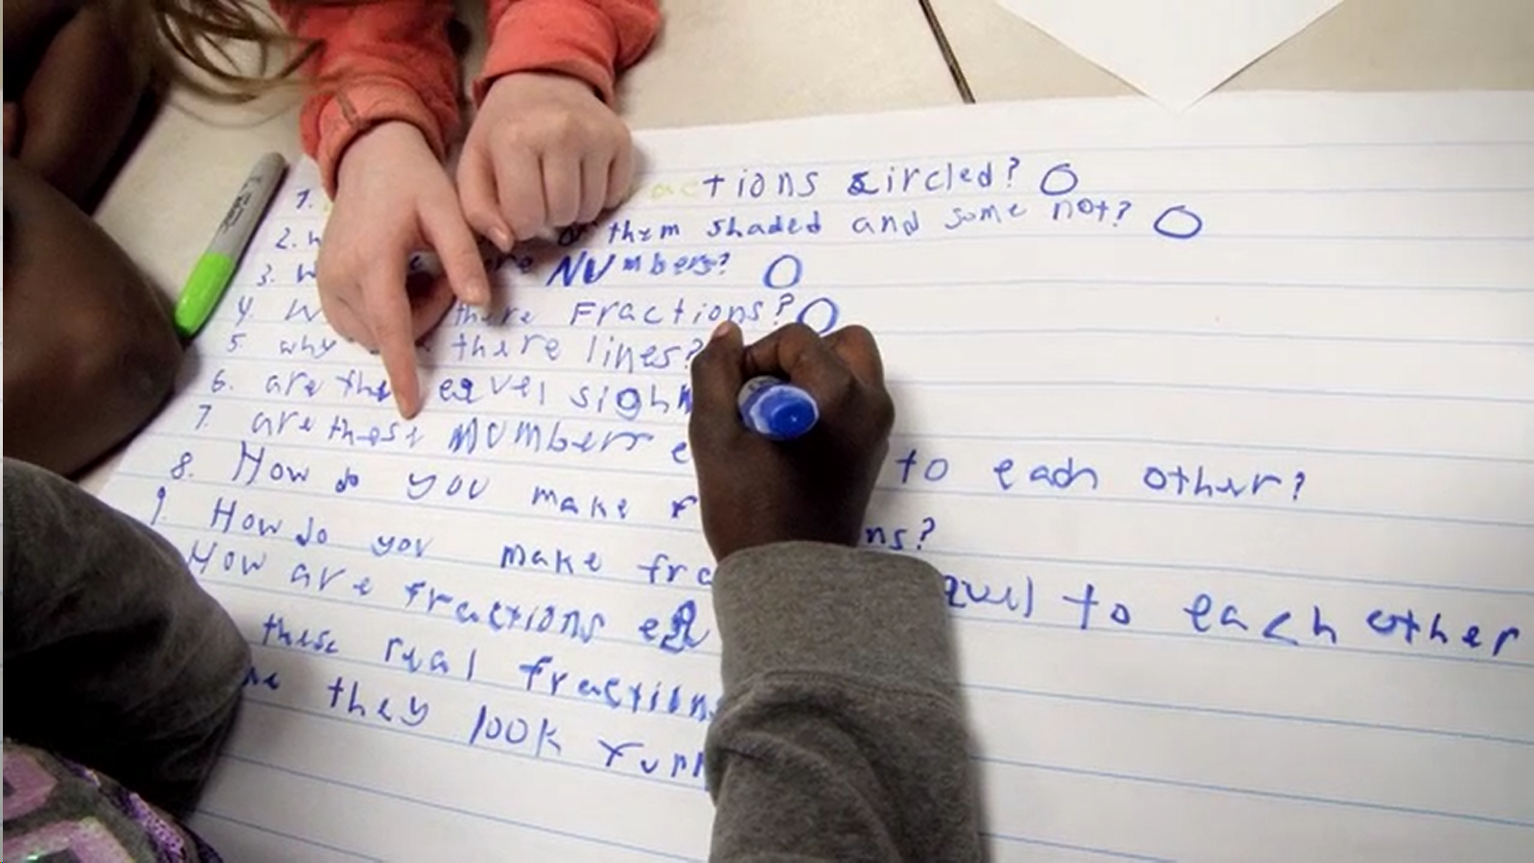
Exploring Classroom Examples

Slide 44
Classroom Example: Kindergarten
Teacher: Jennifer Shaffer, Walkersville, MD
Topic: Non-fiction literacy
Purpose: To engage students prior to reading a nonfiction text about alligators

Slide 45
Question Focus
Photograph by Nuwan Samaranayake, 2013

Slide 46
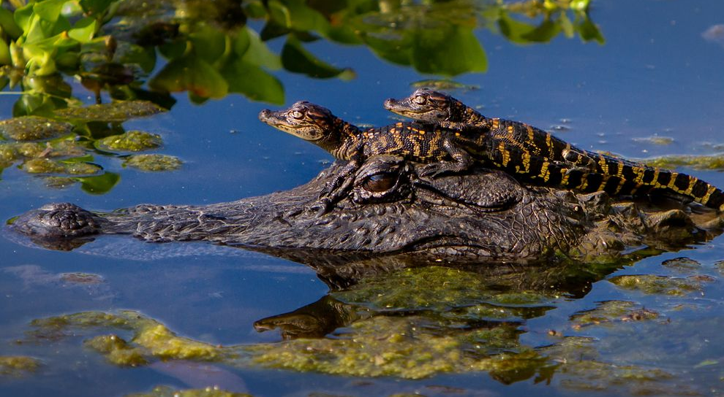
Student Questions
Is the alligator camouflaged?
Why do the babies have stripes?
Are those baby crocodiles?
Is it a mom or dad crocodile?
What is the green stuff?
Why are they in the water so low?
Where are they going?
Why are the baby alligator’s eyes white and the mom’s black?
Why are baby alligators on top of the momma alligator?
Why does momma or daddy have bumps on them?

Slide 47
Classroom Example: 4th Grade
Teacher: Deirdre Brotherson, Hooksett, NH
Topic: Math unit on variables
Purpose: To engage students at the start of a unit on variables and assess their current skill level

Slide 48
Question Focus
24 = ☺ + ☺ + ☺

Slide 49
Student Questions
Why is the 24 first?
What do the smiley faces mean?
Why are there 3 smiley faces?
How am I suppose to figure this out?
Is the answer 12?
Can I put any number for a smiley face?
Do three faces mean something?
Do the numbers have to be the same because the smiley faces are the same?
What numbers will work here?
Does it mean 24 is a really happy number?
Can we replace each smiley face with an 8?
Do any other numbers work?
Can we do this for any number?
Does it always have to be smiley faces?
Do we always have to use three things?

Slide 50
Next Steps with Student Questions
Questions were hung around the room.
Students checked off questions as they were answered during the rest of the unit.
At the end of the unit, students analyzed their original list of questions and discussed what they learned and what they still wanted to know.

Slide 51
Classroom Example:
Middle School
Teacher: Teresa Diaz, Teacher-Librarian, San Antonio, TX
Topic: Edible Insects Research Project
Purpose: To generate research questions about entomophagy (the practice of eating insects) as a solution to world hunger
Notes:
GT - English

Slide 52
Question Focus
6th Grade:
The nutritional/health impacts of edible insects as a part of a regular, balanced diet
Notes:
6th: Nutrition Focus
7th: For/Against; Social/Cultural Attitudes Focus
8th: Sustainability/Ecological Focus

Slide 53
Question Focus
7th Grade:
Changing our social/cultural perceptions of insects as disgusting creatures into an edible, real food source

Slide 54
Question Focus
8th Grade:
“By 2050, there will be more than 9 billion people on the planet. The United Nations estimates that to feed everyone, sustainable food production will have to increase by 70 percent, and bugs will need to be a critical source of protein.”
Source:
Banigan, Melissa. “At Bug-Eating Festival, Kids Crunch Down On The Food Of The Future.” NPR, NPR, 14 Sept. 2017, www.npr.org/sections/thesalt/2017/09/14/550188017/at-bug-eating-festival-kids-crunch-down-on-the-food-of-the-future.

Slide 55
Selected Student Questions
How can we change our perception of bugs?
Will it be harder to convince kids or adults to eat bugs?
What happens if we refuse to eat bugs?
Will bugs become the new burger?
How many bugs will we need to get our daily food intake?
Could eating bugs damage other animals in the ecosystem?
What health problems can some insects cause?
Will bugs be able to keep us going or will we lack certain nutrients?
If a bug eats healthy, is it healthy to eat?
How will the earth sustain 9 billion people?
How did the U.N. arrive at this conclusion?
Will we be prepared for 2050?
Can bugs solve world hunger?
Notes:
Full list of questions:
How can we change our perception of bugs?
How many bugs will we need to get our daily food intake?
Could eating bugs damage other animals in the ecosystem?
Is eating bugs even the best option?
If we change ways to cook the bugs, would it produce more protein?
If a bug eats healthy, is it healthy to eat?
What will be the impact on the world by switching to bugs?
Would vegans be willing to eat insects, too?
What health problems can some insects cause?
Are there any other health benefits besides protein in bugs?
Can bugs solve world hunger?
How will the earth sustain 9 billion people?
How did the U.N. arrive at this conclusion?
Will bugs become the new burger?
What happens if we refuse to eat bugs?
Will bugs be able to keep us going or will we lack certain nutrients?
What other food production would have to increase?
Would this cause more people to go vegan or vegetarian?
Will we be prepared for 2050?
If we start using bugs as a critical source of protein, will we still use other meats as main protein sources as much as we do today?

Slide 56
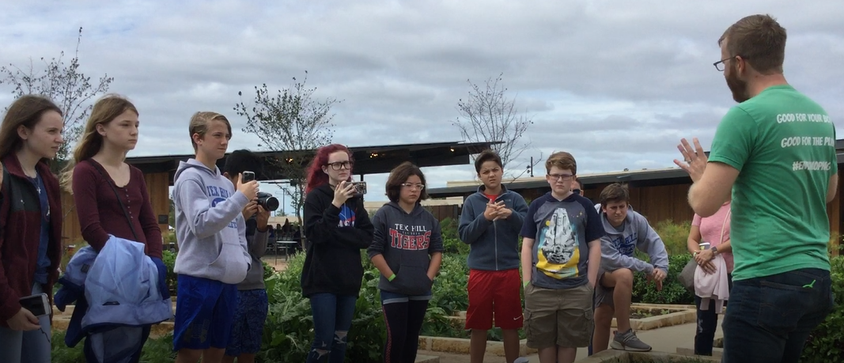
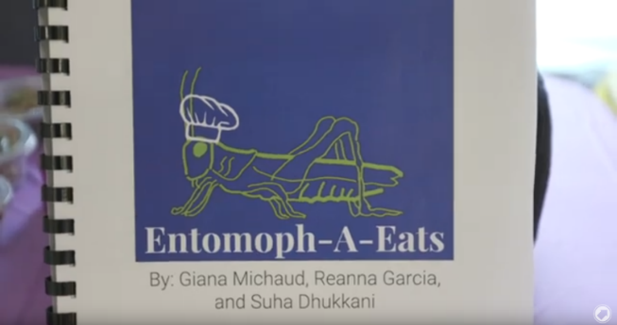
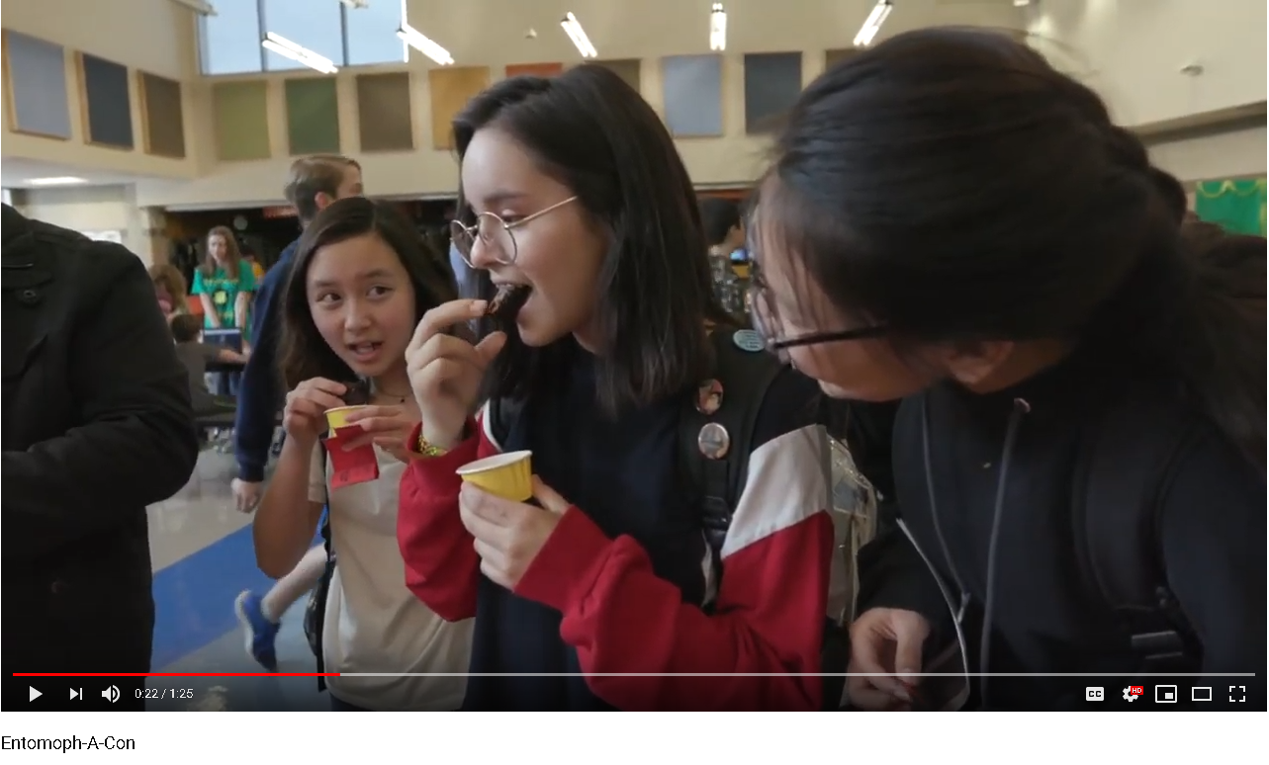
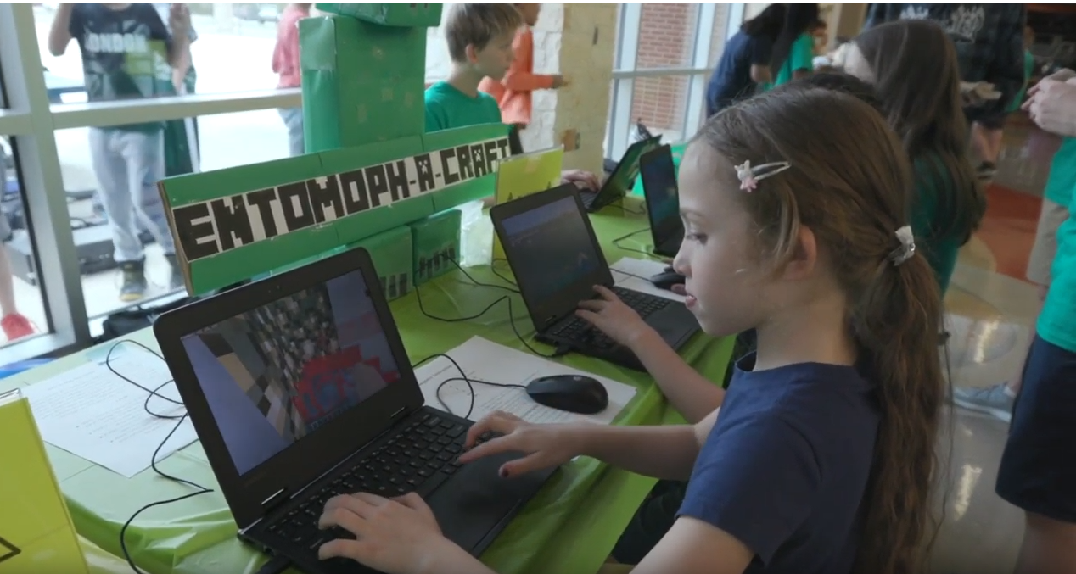
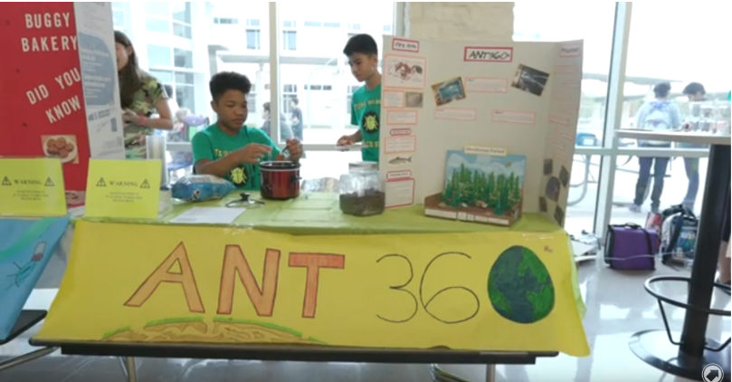
Next Steps with Student Questions
Recipe books
Field Research & Interviewing Experts
Food made with insects
Games
Info booths
Notes:
1. Mini Search Challenge: to identify 3 reliable sources that could answer their groups’ priority question
2. As grade-level teams, they crowd-sourced their sources, did further field research, and created a variety of individual projects
3. They shared with the community at ENTOMOPH-A-CON! with the goal of bringing the idea of eating insects into the mainstream

Slide 57
Classroom Example: High School
Teacher: Connie Williams, Teacher-Librarian, Petaluma, CA
Topic: Finding and assessing reliable sources
Purpose: To help the debate team prepare ahead of a debate about immigration

Slide 58
Question Focus
Questions we should be able to ask and answer of a reliable source

Slide 59
Student Questions & Next Steps
Students created a list they could use to evaluate sources in the future, as well as for the debate:
Who wrote this? How much authority do they have to be writing about this?
For what purpose was this written?
How do they want me to feel?
How do they want me to act?
What are the sources of their numbers, charts, or other evidence?
Can we trace them back to their creator?
What is the purpose of the numbers/data being presented?

Slide 60
Classroom Example: 11th Grade
Teacher: Isabel Morales, Los Angeles, CA
Topic: Social Justice
Purpose: Engage students in thinking about systemic injustice ahead of several fiction and nonfiction texts in the semester

Slide 61
Question Focus
“The disciplinary policies of our society perpetuate injustice.”

Slide 62
Student Questions
Why are student of color targeted the most?
How do disciplinary policies target specific racial groups?
Do teachers nationwide take notice of these stats?
How can teachers develop better & effective disciplinary policies?
Why do people see the stats & data as a coincidence?
What does a kid learn about the system once in jail?
What do people believe expulsion will teach the students?
Does going to juvie have a long-term effect on younger students?
When will it get better?
What are some ways to improve behavior?
What type of training will teachers go through that’ll bring justice to classrooms?
Shouldn’t school police officers be trained like teachers?
What is considered a criminal offense in school?
Isn’t it the teacher’s job to keep the students “in line”?
How should disruption in class be handled?
How come there aren’t any policies keeping students out of prison?

Slide 63
Next Steps with Student Questions
Students decided to research statistics and poll students and teachers.
Students met with the school administration to ask questions and address their concerns.
School principal founded a student advisory council, which many students joined, to give students a voice in new policies.

Slide 64
Student Reflections
“Asking questions is a step in creating change.”
- Jonathan S., 11th grade
“I learned how reluctant students are to ask questions. In our society school environment, we shame asking questions. It felt good to openly ask.”
- Leslie, 11th grade

Slide 65
The QFT in Action in Boston, MA

Slide 66
Why is the skill of question formulation so important now?

Slide 67
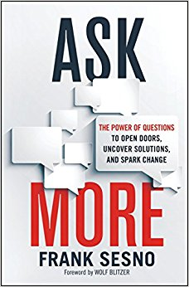
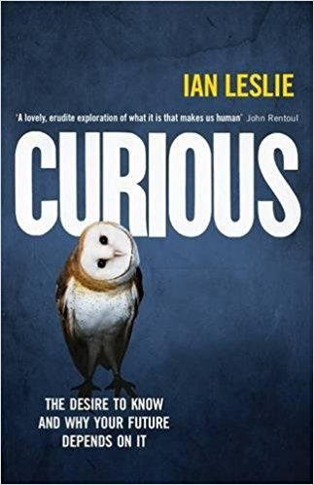

Slide 68
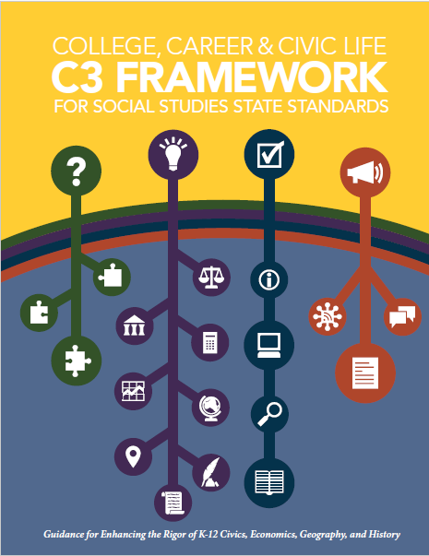
National Standards & Frameworks
Learners display curiosity by “Formulating questions about a personal interest or a curricular topic.”
Learners gather information by “Systematically questioning and assessing the validity and accuracy of information.”
Notes:
https://standards.aasl.org/wp-content/uploads/2017/11/AASL-Standards-Framework-for-Learners-pamphlet.pdf

Slide 69
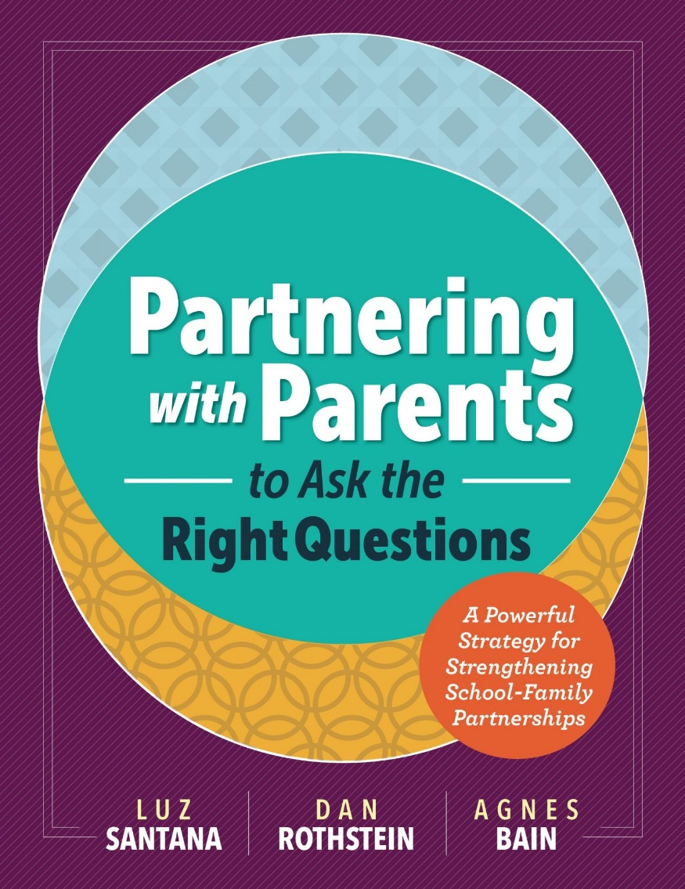
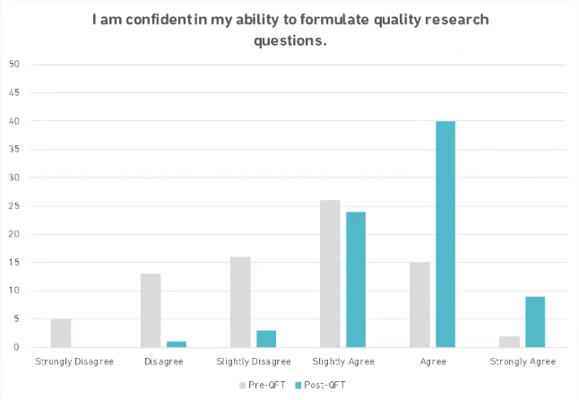
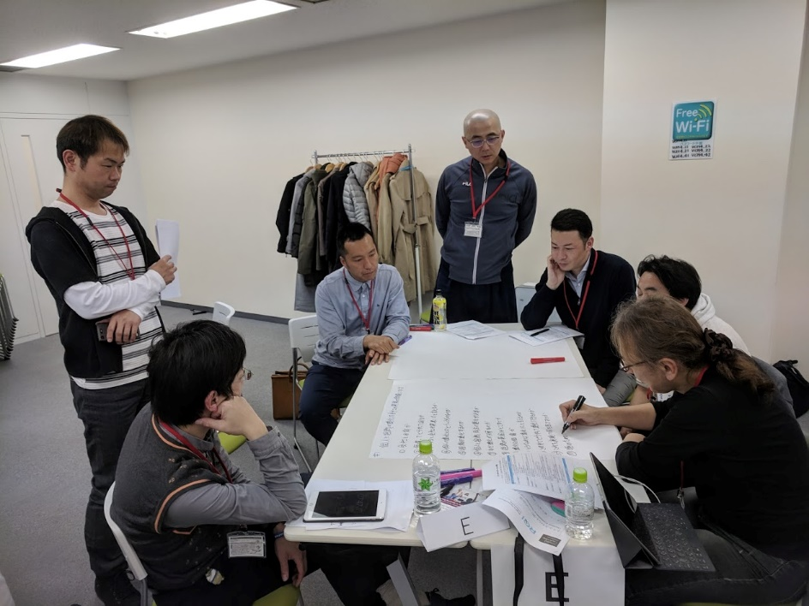
The Universal Relevance of Questioning
Building stronger relationships between parents, communities and our schools and social institutions
One result from an NSF-funded study on how an adaptation of the QFT affected doctoral students’ ability to formulate research questions.
In Tokyo, Japan, executives and innovators use the QFT to discuss culture change in their workplaces

Slide 70
In the Age of Google
“How should you respond when you get powerful new tools for finding answers?
Think of harder questions.”
– Clive Thompson
Journalist and Technology Blogger

Slide 71
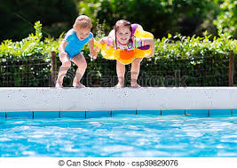
The Role of Libraries
“In the nonstop tsunami of global information, librarians provide us with floaties and teach us to swim.”
–Linton Weeks,
Washington Post & NPR contributor

Slide 72
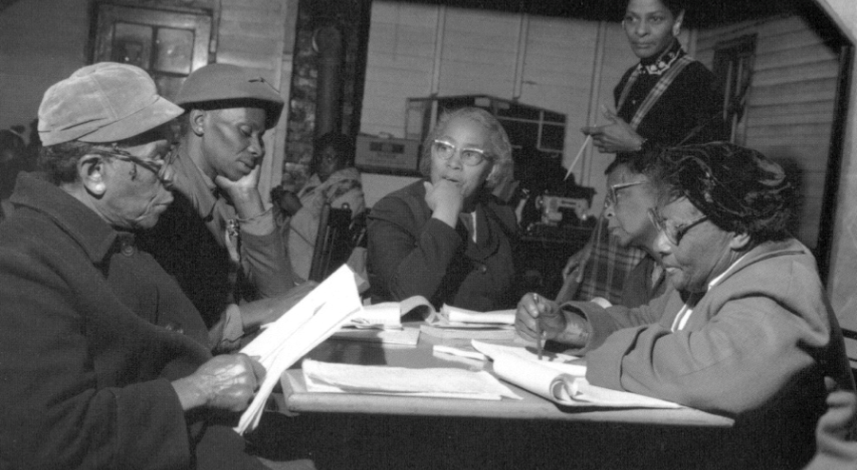
Questions and Democracy
“We need to be taught to study rather than to believe, to inquire rather than to affirm.”
– Septima Clark
Chapter 6 on Septima Clark in Freedom Road: Adult Education of African Americans (Peterson, 1996)

Slide 73
Today’s Agenda
Welcome & Community Building
Why Spend Time on Teaching Question Formulation?
Collaborative Learning with the Question Formulation Technique (QFT)
Exploring Student Work & Classroom Applications
-- Break --
Moving into Practice: Discussion and Planning
Closing Reflections & Evaluations

Slide 74
2 Keys to Beginning to Plan a Lesson with the QFT
Starting at the End
QFocus Design

Slide 75
Various Teaching Purposes
Engagement
Knowledge acquisition
Formative assessment
Summative assessment
Peer review
Skill development
Notes:
Put a space after each bullet.

Slide 76
Next Steps?
Pop Quiz or Reading Check
Debate Prep
Paper topic
Lab work & Experiments
Exit ticket or ”Do Now”
Hang on walls,
Check Off as Answered
Research
Projects
Test Prep
Homework
Class discussion prompts
And sometimes…
Nothing!
Presentations
Student Choice Projects
Socratic Seminar Prompts
Interview an Expert
Make Your Own Final Test
Journal Prompt
Guest speakers
Close Reading Protocol
Year-long or Unit-long Essential Questions
Tailoring Instruction
Service Action Projects
Notes:
Ok to change your mind once you see what you get; but try to be transparent with students, show them how/why their questions matter (rather than one off activity)

Slide 77
Classroom Example: High School
Teacher: Connie Williams, Teacher-Librarian, Petaluma, CA
Topic: Finding and assessing reliable sources
Purpose: To help the debate team prepare ahead of a debate about immigration

Slide 78
Question Focus
Questions we should be able to ask and answer of a reliable source

Slide 79
Student Questions & Next Steps
Students created a list they could use to evaluate sources in the future, as well as for the debate:
Who wrote this? How much authority do they have to be writing about this?
For what purpose was this written?
How do they want me to feel?
How do they want me to act?
What are the sources of their numbers, charts, or other evidence?
Can we trace them back to their creator?
What is the purpose of the numbers/data being presented?

Slide 80
2 Keys to Beginning to Plan a Lesson with the QFT
Starting at the End
QFocus Design

Slide 81
Question Focus (QFocus): A stimulus or prompt for student questions
A phrase or quotation
An image or video
A podcast or speech
A hands-on experience or experiment
An equation or data set
The QFocus is not a question!

Slide 82
Designing a Question Focus
An effective QFocus is:
Directly tied to lesson’s main idea
Simple…but not too simple
Interesting or provocative to students…but not biased or leading

Slide 83
Initial Question Focus
Notes:
Topic: Albert Camus’s The Plague
Purpose: Pre-reading engagement and prediction of central themes going into the text

Slide 84
Revised Question Focus
The city fathers were aware that the decaying bodies of these rodents were making people sick. (page 28)

Slide 85
Initial Question Focus: “People, Animals, and Friends”
Do people exist?
Where do people live?
Why do animals live in the zoo?
Why do people go to the pool?
Why are friends fun?
Why do animals bite?
Why do people go to school?
Do people, animals, and friends play together?
Do animals make friends?
Why do I need friends?
Why do people want to be friends with animals?
Why are people making friends with animals?
Why do people, animal, and friends live in different countries?
Where did my dog and friend go?
Can my friend pet our new dog?
Why do I have eyes?
How do people smell?
Can animals speak?
Can people fly?
Where is my bunny? What happened?

Slide 86
Revising the Question Focus
“People, Animals, and Friends”
Your idea here!
Notes:
My ideas:
I wonder what they would ask about, for ex, "humans need animal friends" or "animals are very important friends to humans" or "friendship between people and animals"? Maybe even more provocative: "To survive, people need animal friends." This is where Dan and I sometimes go back and forth; adults/teens can sometimes benefit from a more open-ended, vague phrase; sometimes kids need more "hooks," more of a complete thought to guide their thinking.
Here's another thought. Say you kept the same Q-Focus and all the same questions--could you get kids, through prioritization, to your goal? (If you didn’t want to do the QFT all over again) What if the prioritization instructions were, "out of all our class questions, pick the 3 questions that you think would help us learn about friendships between pets and humans." Bingo—right back on track, no extra time, still honors their process.

Slide 87
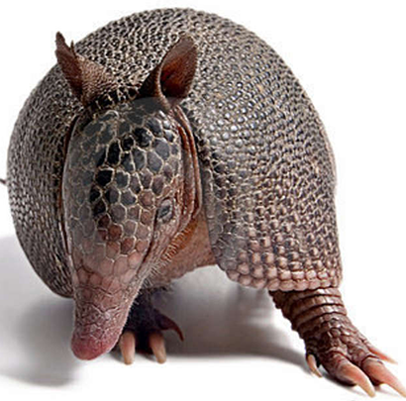
The one quality all excellent QFT designers share?
Thick Skin.
Notes:
Practice makes…more comfortable anyway.

Slide 88
2 Options for Moving into Practice

Slide 89
Option 1: Design a QFocus
Work through the QFocus Design Tool to create your own QFocus. (It’s ok if it is a bit rough.)
Write your QFocus on a post-it note.
Trade with a partner.
Generate questions about your partner’s QFocus.
Trade back and use their questions to guide revision of your QFocus.

Slide 90
Option 2: Read & Discuss
Read: “Rebranding School Libraries with the QFT.” Hard copy or online at: http://bit.ly/Brickeyblog
Then, discuss with a partner:
What ideas in this article resonated with you?
Your thoughts on the role of questioning, curiosity, and inquiry in the library
How might you use QFT in your work?
Be prepared to share your thoughts.
Time permitting, choose another article to read.

Slide 91
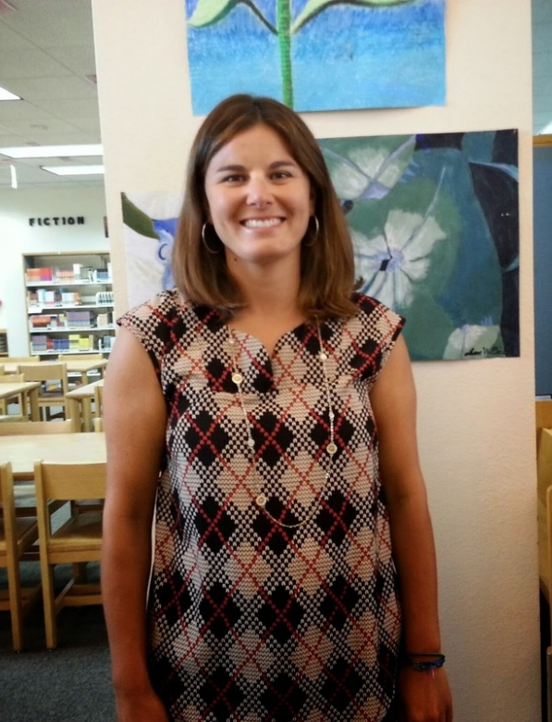
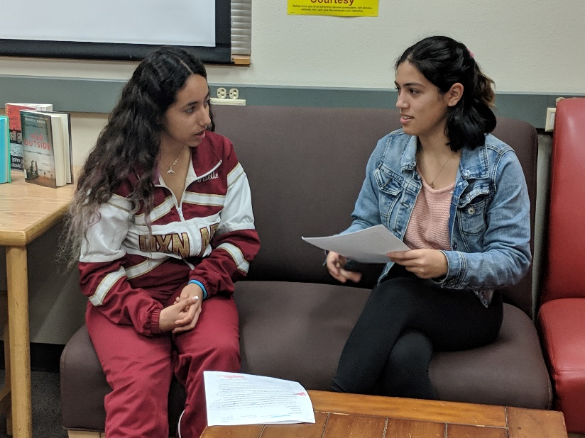
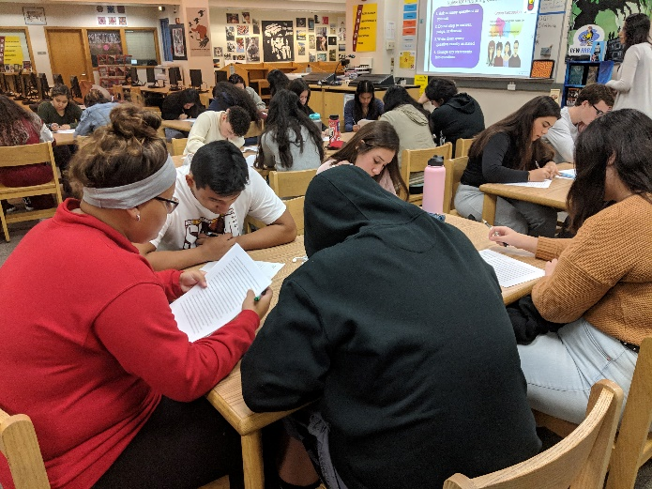
About the Author: Jennifer Brickey
Jennifer Brickey is the Teacher-Librarian at Oxnard High School and the 2019 Oxnard High School and Oxnard Union High School District teacher of the year. Jennifer has transformed the OHS Library into a cultural hub for the school where students pursue their passions, interests, and curiosities.
Notes:
And will be visiting SFUSD in the fall!

Slide 92
Discuss
What did you learn?
An “a-ha moment” or a take away from your experience today
What questions do you now have?

Slide 93
Today’s Agenda
Welcome & Community Building
Why Spend Time on Teaching Question Formulation?
Collaborative Learning with the Question Formulation Technique (QFT)
Exploring Student Work & Classroom Applications
-- Break --
Moving into Practice: Discussion and Planning
Closing Reflections & Evaluations

Slide 94
A Final Thought on Questions, Democracy, and the Unique Role of School Libraries

Slide 95
Questions and Democracy
“We need to be taught to study rather than to believe, to inquire rather than to affirm.”
– Septima Clark
Chapter 6 on Septima Clark in Freedom Road: Adult Education of African Americans (Peterson, 1996)

Slide 96
The Library as a Democratic Site
“The truth is libraries are raucous clubhouses for free speech, controversy and community.”
- Paula Poundstone, Comedian
“To be a librarian is not to be neutral, or passive, or waiting for a question. It is to be a radical positive change agent within your community.”
- R. David Lankes, Director of the University of South Carolina School of Library and Information Science

Slide 97
Thank you! Have a great year!

Slide 98
To Access Today’s Materials:
http://rightquestion.org/events/
Join our Educator Network for:
Templates you can use tomorrow in class
Classroom examples
Instructional videos
Opportunities to connect with other educators

Slide 99
Further Reading & Resources
How Questioning Can Drive Arguments, Productive Debate, and Information Literacy https://www.ebsco.com/blog/article/how-questioning-can-drive-arguments-productive-debate-information-literacy
More from Jennifer Brickey:
Remixing the Question Formulation Technique: Four Explorations ://rightquestion.org/resources/remixing-the-question-formulation-technique-four-explorations-and-revelations/
More from Connie Williams:
What if My Students’ Questions Go Off the Rails? https://rightquestion.org/resources/students-questions-off-the-rails/
My Ah-Ha Moments with the Question Formulation Technique https://rightquestion.org/resources/ah-ha-moments-with-the-qft/
Using the QFT in the Professional Development of Librarians
https://rightquestion.org/resources/qft-professional-development-librarians/

Slide 100
To Learn Even More
https://rightquestion.org/events/teaching-students-to-ask-their-own-questions-best-practices-in-the-question-formulation-technique-3/
Check out our 3-week online course hosted by the Harvard Graduate School of Education

Slide 101
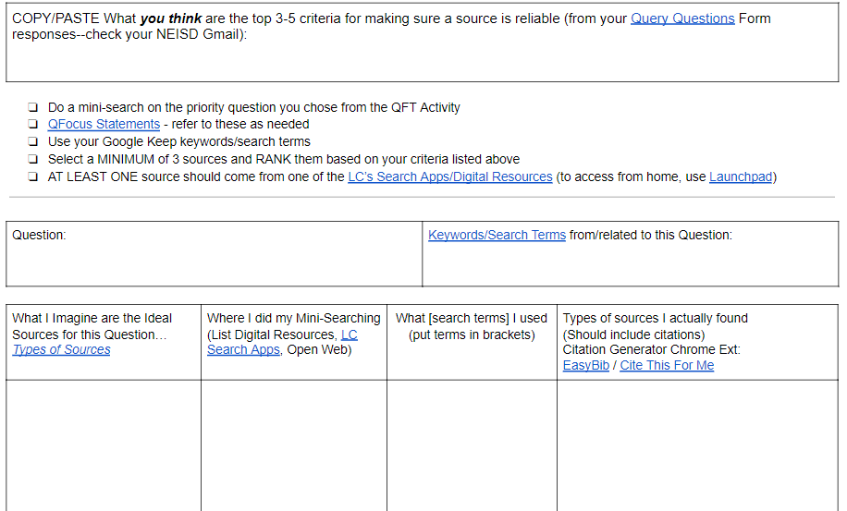
Teresa Diaz’s Mini Search Challenge
Mini Search Challenge Google Doc
Notes:
1. Mini Search Challenge: to identify 3 reliable sources that could answer their groups’ priority question
2. As grade-level teams, they crowd-sourced their sources, did further field research, and created a variety of individual projects
3. They shared with the community at ENTOMOPH-A-CON! with the goal of bringing the idea of eating insects into the mainstream

Slide 102
Classroom Example: 12th Grade
Teacher: Daniel Fouts, Des Plaines, IL
Topic: 12th Grade AP Government unit on the American presidency at moments of crisis
Purpose: To engage students at the start of the unit and to help students select a topic for an independent project

Slide 103
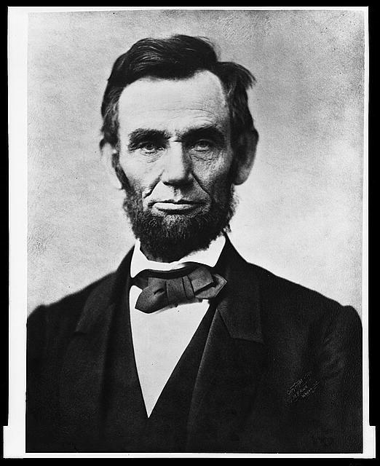
Question Focus
“Nearly all men can handle adversity; but if you really want to test a man’s character, give him power.”
https://www.loc.gov/pictures/item/96522529/

Slide 104
Student Questions
How does power challenge one’s morality?
Should everyone have some type of power?
Does power make people corrupt?
What if the person who is qualified for power doesn’t attain it?
How is a man’s power tested?
What is considered power?
What defines good character?
How can we ensure that the good men get the power?
What kind of man can handle adversity?
What can power tell us about a man’s character?
How can power be obtained by adversity?
Why are some people affected by power differently?
If adversity supposedly makes you stronger, does that mean that power makes you weaker?

Slide 105
Next Steps with Student Questions
Each student selected l question from the class list to work on throughout the unit
Students answered their question using research and knowledge from the unit in a two-page reflection paper
Students shared their reflections in a class discussion on the final day of the unit

