Slide 1
The Power of Student Questions to Spark Inquiry & Drive Learning
Sarah Westbrook
Director of Professional Learning
The Right Question Institute, Cambridge, MA

Slide 2
Welcome

Slide 3
Acknowledgments
We are deeply grateful to The Hummingbird Fund and to the Right Question Institute board of directors for their support of our work.
Thank you also to Kendall Boninti and Nicole Hart for bringing The Right Question Institute to Cambridge Rindge and Latin and for all their work behind the scenes.

Slide 4
Who is in the room?

Slide 5
Today’s Agenda
Welcome
Why Spend Time on Teaching Question Formulation?
Collaborative Learning with the Question Formulation Technique (QFT)
Exploring Student Work & Classroom Applications
Discussion and Reflection

Slide 6
To Access Today’s Materials:
https://rightquestion.org/events/
Join our Educator Network for:
Templates you can use tomorrow in class
Classroom examples
Instructional videos
Opportunities to connect with other educators

Slide 7
We’re Tweeting…
@RightQuestion
@SarahRQI
#QFT

Slide 8
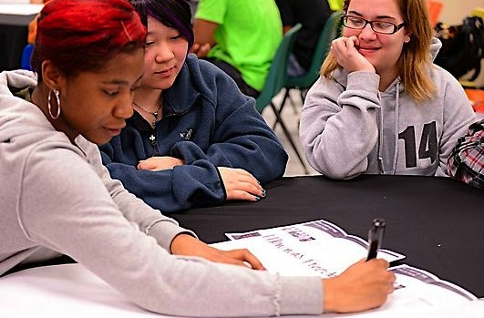
Why spend time teaching the skill of question formulation?

Slide 9
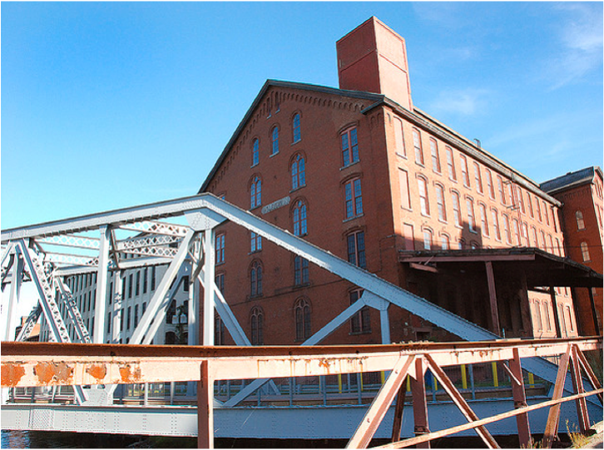
Honoring the Original Source: Parents in Lawrence, Massachusetts, 1990
“We don’t go to the school because we don’t even know what to ask.”

Slide 10
"There is no learning without having to pose a question."
- Richard Feynman
Nobel Laureate, Physics, 1965

Slide 11
“We must teach students how to think in questions, how to manage ignorance.”
– Stuart Firestein
Former chair, Department of Biology,
Columbia University

Slide 12
College Presidents on What College Students Should Learn
“The primary skills should be analytical skills of interpretation and inquiry. In other words, know how to frame a question.”
- Leon Botstein, President of Bard College
“…the best we can do for students is have them ask the right questions.”
- Nancy Cantor, Former Chancellor of University of Illinois
The New York Times, August 4, 2002

Slide 13
Yet, only 27% of graduates believe college taught them how to ask their own questions
Alison Head, Project Information Literacy at University of Washington, 2016

Slide 14
Basic Skill Attainment Over Time
Sources:
http://nces.ed.gov/nationsreportcard/pdf/main2009/2011455.pdf
http://nces.ed.gov/nationsreportcard/pubs/main2007/2008468.asp#section1
Data on question-asking based on parent and teacher feedback

Slide 15
Basic Skill Attainment Over Time
Sources:
http://nces.ed.gov/nationsreportcard/pdf/main2009/2011455.pdf
http://nces.ed.gov/nationsreportcard/pubs/main2007/2008468.asp#section1
Data on question-asking based on parent and teacher feedback

Slide 16
We can work together on changing the direction of that slope

Slide 17
We Are Not Alone
Educators in more than 1 million classrooms worldwide

Slide 18
Now, Educators Lead the Work
The Right Question Institute offers materials through a Creative Commons License. You are welcome to use, adapt, and share our materials for noncommercial use, as long as you include the following reference:
“Source: The Right Question Institute (RQI). The Question Formulation Technique (QFT) was created by RQI. Visit rightquestion.org for more information and free resources.”

Slide 19
What happens when students do learn to ask their own questions?

Slide 20
Research Confirms the Importance of Student Questioning
Self-questioning (metacognitive strategy):
Student formulation of their own questions is one of the most effective metacognitive strategies
Engaging in pre-lesson self-questioning improved students rate of learning by nearly 50% (Hattie, p.193)
John Hattie
Visible Learning: A Synthesis of Over 800
meta-Analyses Relating to Achievement, 2008
Notes:
UC Davis Research Linking Curiosity to Memory (UC Davis) 2014
The Fullerton Longitudinal Study (FLS), a 30-plus year study of the development of giftedness across various points in time conducted by Adele and Allen Gottfried of California State University ”This finding has strong implications for the development of STEM considering that curiosity is a fundamental predictor of the aspiration to become a scientist.”
S. von Stumm, B. Hell, T. Chamorro-Premuzic. The Hungry Mind: Intellectual Curiosity Is the Third Pillar of Academic Performance. Perspectives on Psychological Science, 2011 meta-analysis shows They found that curiosity did, indeed, influence academic performance. In fact, it had quite a large effect, about the same as conscientiousness. When put together, conscientiousness and curiosity had as big an effect on performance as intelligence.

Slide 21
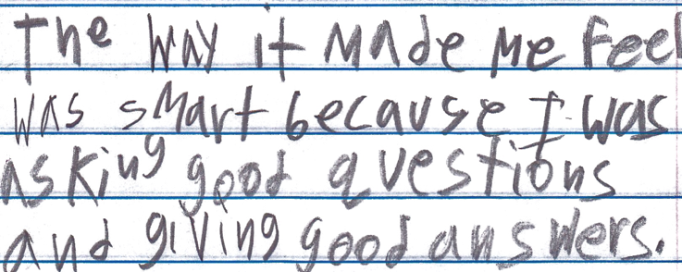
Student Reflection
“The way it made me feel was smart because I was asking good questions and giving good answers.”
-9th grade summer school student, Boston, MA

Slide 22
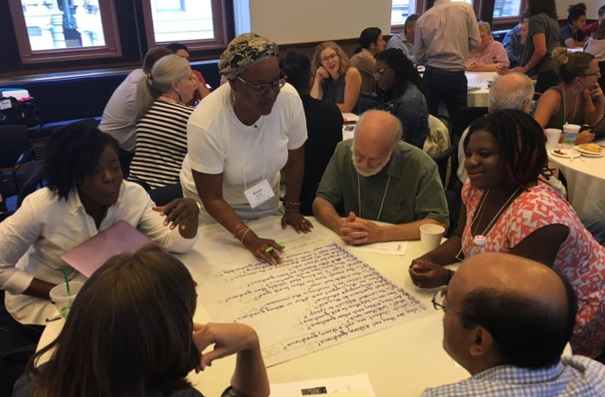
Collaborative Learning with the Question Formulation Technique (QFT)

Slide 23
The Question Formulation Technique (QFT)
A step-by-step strategy in which people:
Produce their own questions
Transform & Improve their questions
Strategize on how to use their questions
Reflect on what they have learned and how they learned it

Slide 24
Rules for Producing Questions
1. Ask as many questions as you can
2. Do not stop to answer, judge, or discuss
3. Write down every question exactly as stated
4. Change any statements into questions

Slide 25
Produce Questions
Ask Questions
Follow the Rules
Ask as many questions as you can.
Do not stop to answer, judge, or discuss.
Write down every question exactly as it was stated.
Change any statements into questions.
Number the Questions

Slide 26
Question Focus
Authentic, student-driven learning at CRLS
→Please write this statement at the top of your paper.
→Remember: Number the questions. Follow the rules.

Slide 27
Categorize Questions: Closed/Open
Definitions:
Closed-ended questions can be answered with a “yes” or “no” or with a one-word answer.
Open-ended questions require
more explanation.
Directions: Identify your questions as closed-ended or open-ended by marking them with a “C” or an “O.”

Slide 28
Discussion
Closed-ended Questions
Advantages
Disadvantages

Slide 29
Discussion
Open-ended Questions
Advantages
Disadvantages

Slide 30
Transform Questions
Take one closed-ended question and change it into an open-ended question.
Take one open-ended question and change it into a closed-ended question.
Closed
Open
Open
Closed

Slide 31
Prioritize Questions
Review your list of questions
Choose the three questions you consider most important.
While prioritizing, think about your Question Focus: Authentic, student-driven learning at CRLS.
After prioritizing consider…
Why did you choose those three questions?
Where are your priority questions in the sequence of your entire list of questions?

Slide 32
Strategize and Action Plan
From priority questions to action plan…
In order to answer your priority questions:
What do you need to know? Information
What do you need to do? Tasks

Slide 33
Strategize and Action Plan
In order to answer your priority questions:
What do you need to know? Information
What do you need to do? Tasks
Information | Tasks

Slide 34
Share
Your three priority questions and their numbers in your original sequence
Rationale for choosing priority questions
Your action plan

Slide 35
Reflect
What did you learn?
What did you notice about the way the process was facilitated?
How did the facilitation affect your learning experience? How might this style of facilitation impact student learning?

Slide 36
Four Principles of Facilitation
Monitor student adherence to the process
Do not give examples
Do not get pulled into group discussion
Acknowledge all contributions equally

Slide 37
A Look Inside the Process

Slide 38
The QFT, on one slide…
Ask as many questions as you can
Do not stop to discuss, judge or answer
Record exactly as stated
Change statements into questions
Question Focus
Produce Your Questions
Follow the rules
Number your questions
Transform Your Questions
Categorize questions as Closed or Open-ended
Change questions from one type to another
Prioritize Your Questions
Share & Discuss Next Steps
Reflect
Closed-Ended:
Answered with “yes,” “no” or one word
Open-Ended: Require longer explanation

Slide 39
Curiosity and Rigor
Three thinking abilities
with one process

Slide 40
Thinking in many different directions
Divergent
Thinking

Slide 41
Narrowing Down, Focusing
Convergent
Thinking

Slide 42
Thinking about Thinking
Metacognition

Slide 43
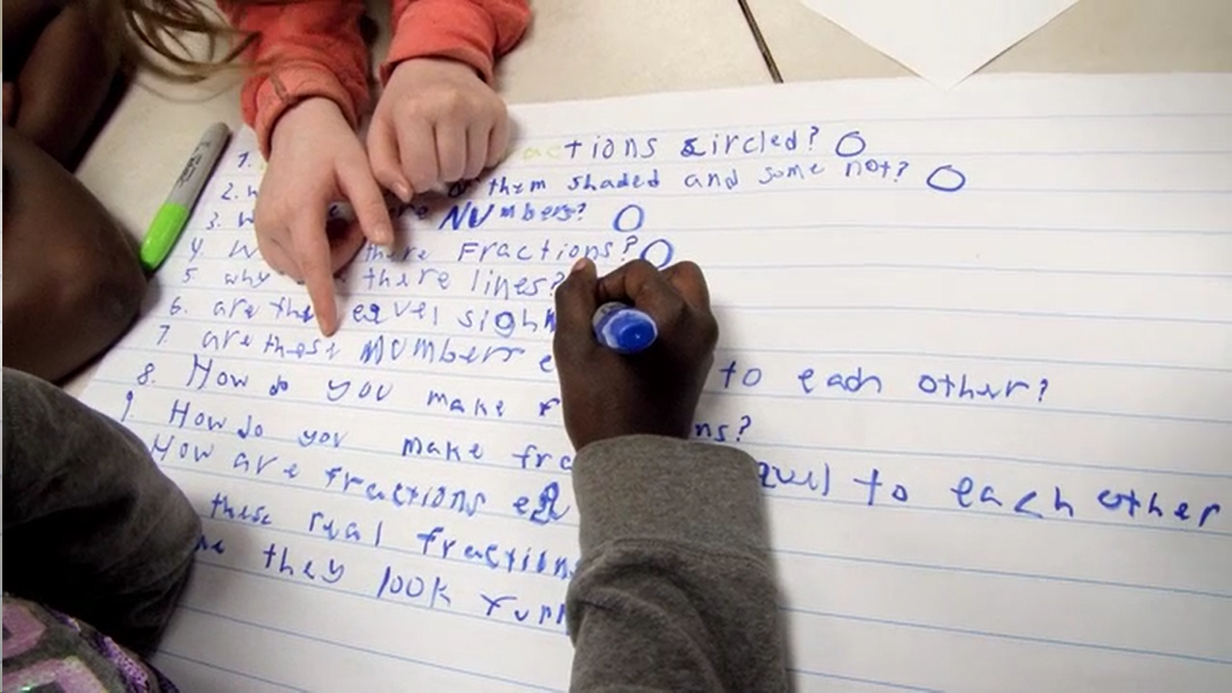
Exploring Classroom Examples

Slide 44
Classroom Example: 9th Grade
Teacher: Ellen Gammel, Fitchburg, MA
Topic: An interdisciplinary unit on bioethics and a nonfiction text, The Immortal Life of Henrietta Lacks
Purpose (2x in the unit):
To engage students at the beginning of the unit
To help students prepare for a debate at the end of the unit
Notes:
While students read the text in English class, they will simultaneously learn about cell biology, bioethics, and DNA in their Biology class.

Slide 45
Question Focus Start of the Unit (& after reading the first few pages of the book)

Slide 46
Selected Students Questions
Why her?
Why does it matter that she’s black?
Why did they call her Helen Lane?
What was her personality like?
Why were her cells the best for research?
Was her story forgotten/ignored because she was black?
How come nobody knew anything about her?
Do you think she would be happy with what people have done with her cells?
Why did the author have a photo of HeLa on their wall?
What do you think the biggest problem that her cells solved was?
Why is this one of the most important things that has happened to medicine in the last 100 years?

Slide 47
Next Steps with Student Questions
Posters remained on the classroom walls during the unit so that students could revisit their questions, answer them, or add more to the lists.
Questions also led to a rich follow up discussion on Day 2 of the intro lesson in which students discussed how one might use a specific type of question, what a question's purpose might be, and in what order they might ask the questions.

Slide 48
Question Focus End of the Unit
Debate Resolve:
Doctors should be able to do what they want with human tissue after the patient gives consent for removal of the tissue.

Slide 49
Student Questions
A Team Against Debate Resolve:
A Team For Debate Resolve:
Are our bodies truly our property?
How much consent?
How much information should a patient receive in order for them to give informed consent?
Consent for removal or consent for research?
Should the patient be paid?
How should patients be paid? What for?
What counts as tissue?
Consent for removal of tissue or other body parts?
How about animals?
Are owners in charge of their pet’s tissue?
Are parents in charge of their kids’ tissue?
Can kids give informed consent?
Do gives give their parents consent?
How about teeth?
Do teeth count as bone donations?
What percent of compensation should patients receive?
How have tissue ownership laws changed over the years?
Is there a law?
Do doctors owns the tissue after patients give consent?
Should patients be able to perform their own research?
Do doctors come up with the idea? (A focus)
Do doctors need consent for tissue that doesn't belong to humans?
Can patients take back consent once they find out what the doctors are doing with their tissue?

Slide 50
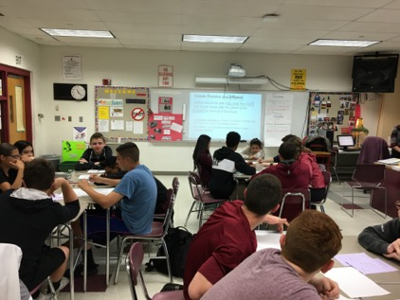
Next Steps
In teams, students researched their priority questions
Students prepared their debate arguments and rebuttals, using research
Students practiced public speaking and rhetorical skills

Slide 51
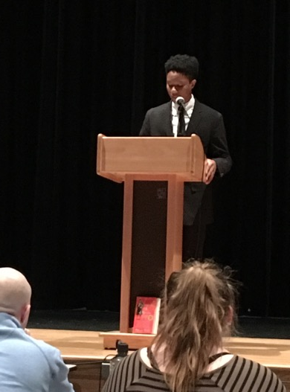
Next Steps: the Debate
The 3 Judges: administrators, teachers and a former student
The Audience: students, parents, teachers, school & district leaders

Slide 52
Classroom Example: 10th Grade
Teacher: Sara Stephenson, Woodstock, Ontario
Topic: Semester-long student-led inquiry project to create a sustainable colony on Mars
Purpose: To launch the project and create research questions. Students learn curriculum through the lens of solving problems in their mission.

Slide 53
Question Focus #1
Your task is to set up a self sustaining colony here

Slide 54
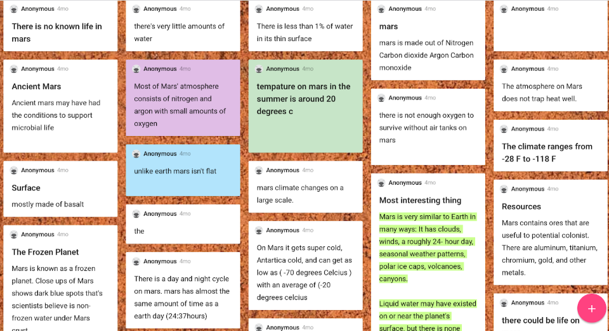
Next Steps with Students’ Questions
Using the questions they developed, students researched what the environment of Mars is like, added answers to Padlet, and consolidated their research in a collaborative google slide deck

Slide 55
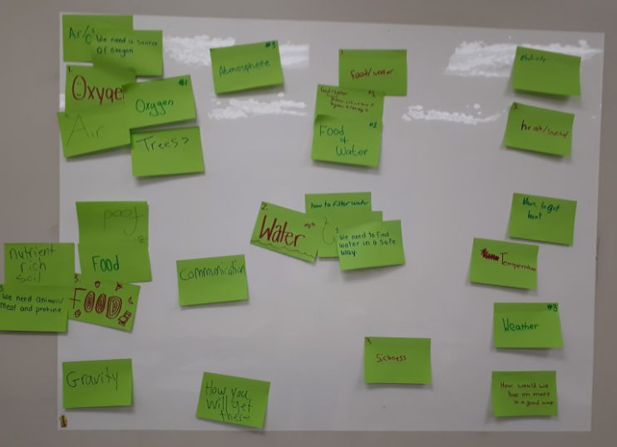
Next Steps with Students’ Questions
Students brainstormed and created a list of what they would need to live on Mars
They created videos defending which of the items they would need to work on first
They had a vote on the videos and ended up with oxygen
Then, they conducted a second QFT.

Slide 56
Question Focus #2
Mars consists of 0.146% oxygen gas.
Notes:
Need to know where this came from

Slide 57
Student Questions
How much carbon dioxide can a human take?
How much oxygen do you need to live?
How long will it take to change the Mars atmosphere?
How do we have oxygen on earth?
Will you die if there’s too much oxygen?
How can we change carbon dioxide into oxygen?
Where is the oxygen source on Mars?
Can we create oxygen on Mars?
How can we make oxygen? Nuclear fusion?
Can oxygen freeze?
How can we collect oxygen?
Will oxygen affect minerals/chemicals on the planet?
Can other organisms survive with low oxygen levels?
How can we tell when there is oxygen?
Can we reuse and sustain the oxygen we have already?
Can we adapt to a different gas besides oxygen?

Slide 58
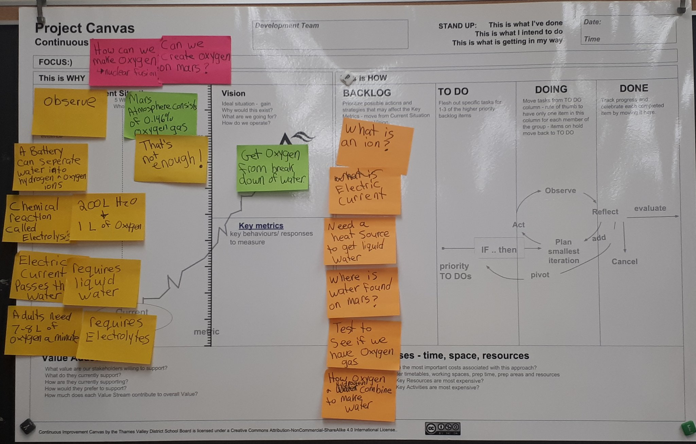
Next Steps with Students’ Questions
Students research priority questions (in yellow); they learn that there is not enough oxygen to sustain life, and that it would be impossible to bring oxygen to Mars.
They discover two ways to create oxygen: photosynthesis or the breakdown of water (electrolysis).
They choose to work on getting oxygen by breaking down water, and conduct a third QFT.

Slide 59
Question Focus #3
The breakdown of water to get oxygen.

Slide 60
Selected Student Questions
Where is water found on Mars?
How will we know oxygen is from electrolysis?
How do oxygen and hydrogen combine to make water?
What is an ion?
What is the difference between hydrogen and oxygen?

Slide 61
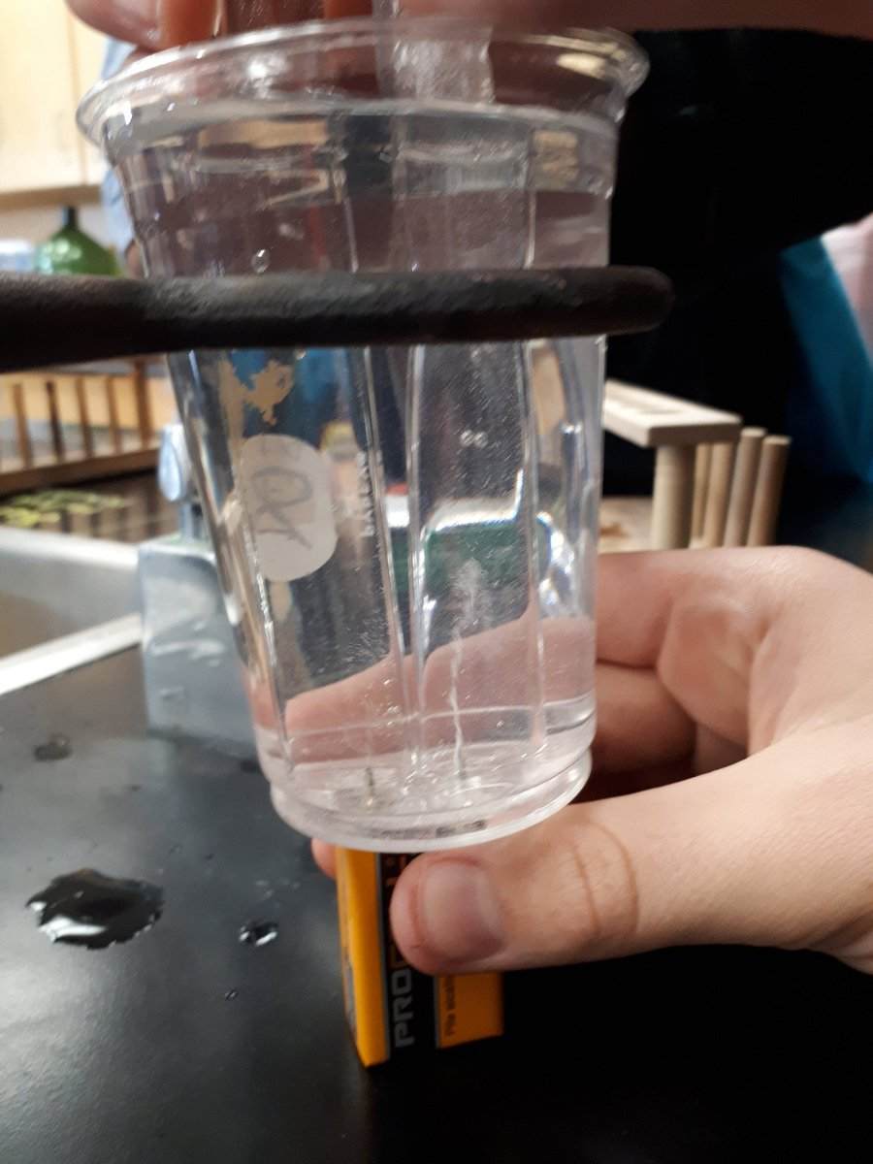
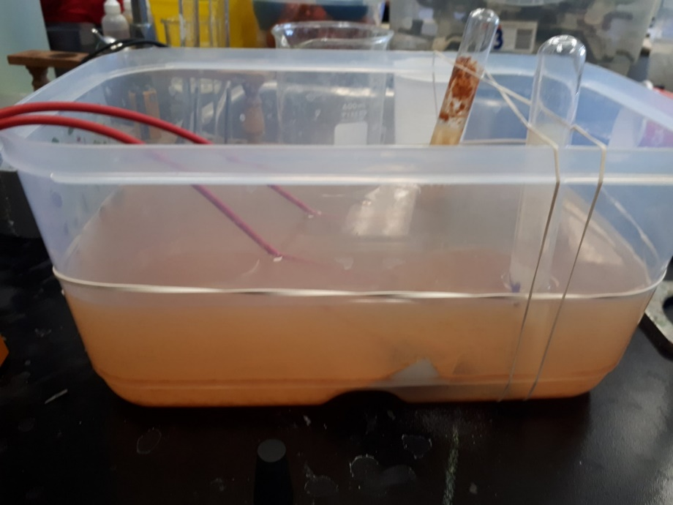
Next Steps with Students’ Questions
Students figure out how to do electrolysis through online research, collaboration, and experimental trial and error
They learn concepts as they need them. For example, when oxidation started happening during their electrolysis, they learned about physical vs. chemical changes

Slide 62
Next Steps with Students’ Questions
Students continued to conduct investigations towards creating a livable amount of oxygen on Mars, including how to extract water from Martian soil for use in electrolysis
Their final projects included:
Growing a radish plant in Mars dirt inside a sealed beaker
Designing and building a Greenhouse and Water Purification Facility on Mars using MindcraftEdu

Slide 63
Why is the skill of question formulation so important now?

Slide 64
In the Age of Google
“How should you respond when you get powerful new tools for finding answers?
Think of harder questions.”
– Clive Thompson
Journalist and Technology Blogger

Slide 65
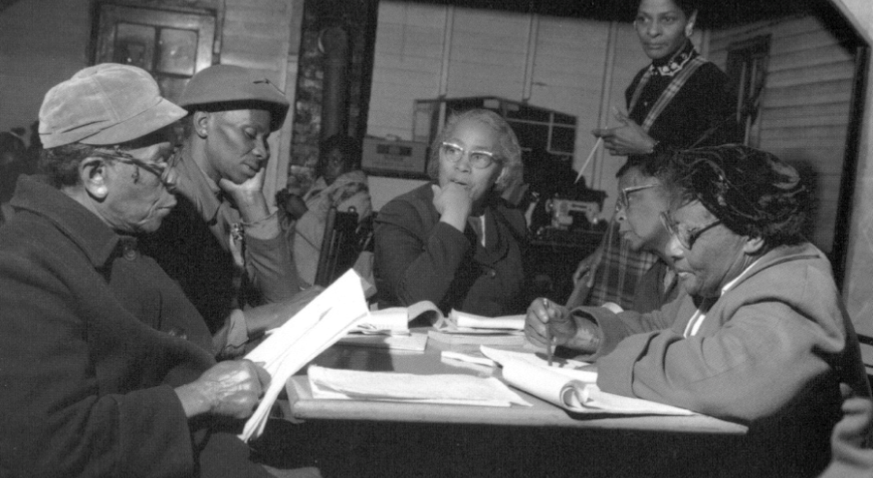
Questions and Democracy
“We need to be taught to study rather than to believe, to inquire rather than to affirm.”
– Septima Clark
Chapter 6 on Septima Clark in Freedom Road: Adult Education of African Americans (Peterson, 1996)

Slide 66
Today’s Agenda
Welcome
Why Spend Time on Teaching Question Formulation?
Collaborative Learning with the Question Formulation Technique (QFT)
Exploring Student Work & Classroom Applications
Discussion and Reflection

Slide 67
Discuss
How do you see applying the QFT to your work?
An “a-ha moment” or a take away from your experience today
What questions do you now have?

Slide 68
Thank You!

Slide 69
To Access Today’s Materials:
http://rightquestion.org/events/
Join our Educator Network for:
Templates you can use tomorrow in class
Classroom examples
Instructional videos
Opportunities to connect with other educators

Slide 70
Educators Lead the Work
The Right Question Institute offers materials through a Creative Commons License. You are welcome to use, adapt, and share our materials for noncommercial use, as long as you include the following reference:
“Source: The Right Question Institute (RQI). The Question Formulation Technique (QFT) was created by RQI. Visit rightquestion.org for more information and free resources.”

Slide 71
To Learn Even More
https://rightquestion.org/events/teaching-students-to-ask-their-own-questions-best-practices-in-the-question-formulation-technique-3/
Check out our 3-week online course hosted by the Harvard Graduate School of Education, starting October 21, 2019.

