Slide 1
Fostering Inquisitive, Equitable Learning by Teaching College Students
How to Formulate Question
Andrew P. Minigan
Director of Strategy, Education Program
The Right Question Institute

Slide 2
Who is in the room?

Slide 3
Acknowledgments
We are deeply grateful to The National Science Foundation, The Library of Congress, and The Hummingbird Fund for their generous support of the Right Question Institute’s work in education.
I would like to thank the RQI board of directors, and my colleagues Katy Connolly, Tomoko Ouchi, and Sarah Westbrook for all they do to make possible our work in education.
And, I would like to thank Dr. Reema Zeineldin, Erin Reardon, and Dr. Madhavan Narayanan for all of their work in making today’s experience possible.

Slide 4
Access Free Resources
Visit to find resources from today’s experience:
rightquestion.org/events
You can also find
Easy-to-use templates and downloadable resources
Classroom examples, articles, and blogs
Instructional videos

Slide 5
We Tweet
Share your thinking and learning from today:
@AndrewRQI
@RightQuestion
#QFT

Slide 6
Overview
Questions & learning
An experience in the Question Formulation Technique (QFT)
Unpacking the QFT
Examples of the QFT in the classroom
Question formulation in the 21st century
Lesson planning and exploring resources
Reflection & Q&A

Slide 7
Questions & Learning

Slide 8

Honoring the Original Source:
Parents in Lawrence, MA 1990
“We don’t go to the school because we don’t even know what to ask.”

Slide 9













The Right Question Institute

Slide 10
“There is no learning without having to pose a question.”
– Richard Feynman
Nobel Laureate, Physicist

Slide 11
“The study of biology is about asking good questions about life and figuring out clever ways to find the answers.”
– Amy Gladfelter
Associate Professor, University of North Carolina

Slide 12
“There can be no thinking without questioning—no purposeful study of the past, nor any serious planning
for the future.”
– David Hackett Fischer
University Professor Emeritus of History, Brandeis University

Slide 13
“In mathematics, the art of posing a question must be held of higher value than solving it.”
– George Cantor
Creator of Set Theory (1867)

Slide 14

“We must teach students how to think in questions, how to manage ignorance.”
– Stuart Firestein
Professor, Department of Biology, Columbia University

Slide 15
College Presidents on
What College Students Should Learn
“The primary skills should be analytical skills of interpretation and inquiry. In other words, know how to frame a question.”
- Leon Botstein, President of Bard College
“…the best we can do for students is have them ask the right questions.”
- Nancy Cantor, Chancellor of University of Illinois
The New York Times, August 4, 2002

Slide 16
19th Century Public Intellectuals on
College Students’ Skills
Someone with a college education, “is able to converse…is able to listen…can ask a question pertinently.”
Aoun, 2017

Slide 17
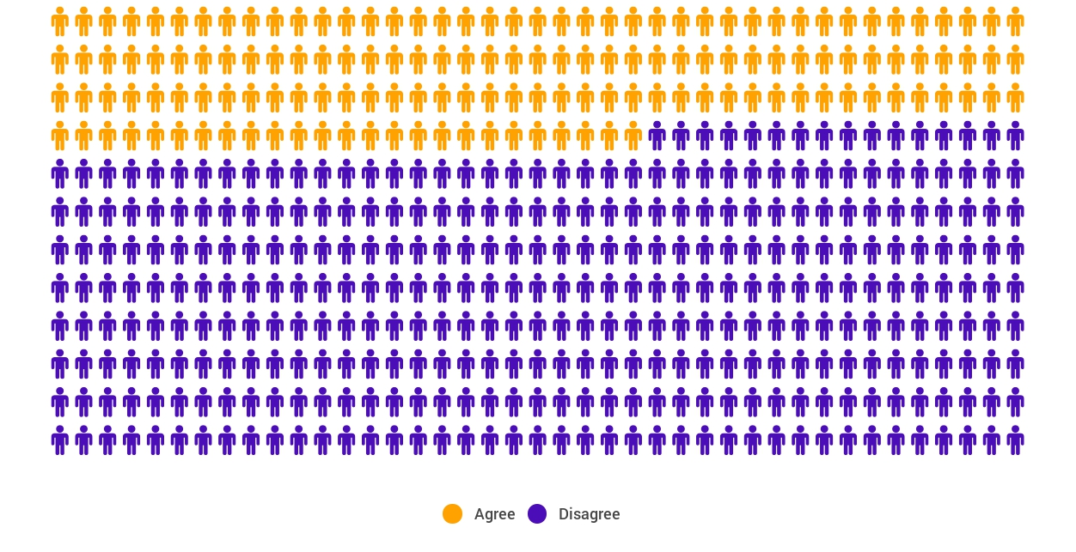
Yet, Only 27% of Graduates Believe College Taught Them How to Ask Their Own Questions
Alison Head
Project Information Literacy
at University of Washington, 2016

Slide 18
But, the problem begins long before college...
But, the problem begins long before college…

Slide 19
Age Four: “The true age of inquisitiveness”
James Sully dubbed age four, “the true age of inquisitiveness when question after question is fired off with wondrous rapidity and pertinacity.”
Young children ask 10,000 questions per year before they begin formal schooling.
Sully, 1896
Harris, 2012

Slide 20
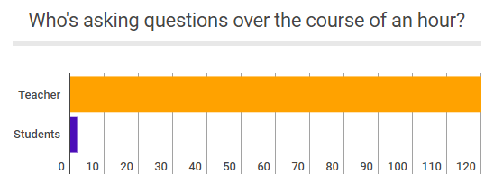
Question Formulation by Adolescence
Dillon, 1988, p. 199

Slide 21
Educators Recognize the Problem
Teachers report that getting students to ask questions feels like, “pulling teeth.”
Students ask less than 1/5th the questions educators estimated would be elicited and deemed desirable.
Susskind, 1979

Slide 22
First Year Students’ Engagement
Students engage in behaviors consistent with their high school behaviors.
Students who reported frequently asking questions in high school also reported doing the same in their first year of college.
Students who tended to not ask questions in high school tended to not do so during their first year at college.
National Survey of Student Engagement, 2008

Slide 23
How can teaching students to ask questions go from a feeling of “pulling teeth” to a feeling of excitement for both teachers and learners?

Slide 24
Moving from the exception…
In a 1912 study Romiett Stevens observed: “an unusual lesson because twenty-five of the thirty-four questions were asked by the pupils… The result was that the lesson developed an impetus born of real interest. I mention it because this lesson was unique in the series of one hundred.”
The question as a measure of efficiency in instruction: A critical study of classroom practice. Columbia University Contributions to Education, No. 48

Slide 25


…to the norm

Slide 26
But, the problem begins long before college...
What happens when students learn how to ask their own questions?

Slide 27
Question Formulation &
Metacognitive Learning
Student question formulation is one of the most effective metacognitive strategies
Engaging in pre-lesson self-questioning improved students rate of learning by nearly 50% (p.193)
John Hattie
Visible Learning: A Synthesis of Over 800
meta-Analyses Relating to Achievement, 2008

Slide 28
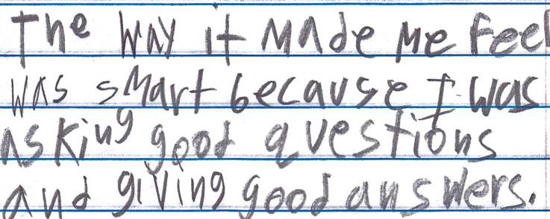
Student Reflections
“The way it made me feel was smart because I was asking good questions and giving good answers.”
- 9th Grader, Boston, MA

Slide 29
Student Reflections
“The QFT really teaches a way of thinking so students can be thinking critically every time they read, trying to connect the concepts and deciding whether to take facts and information at face value or to dig a little deeper.”
- Student, Brandeis University

Slide 30
Student Reflections
“I learned that by doing the question exploration it can help you not be stuck when you do not understand the material.”
- Student, Mt. San Antonio College

Slide 31
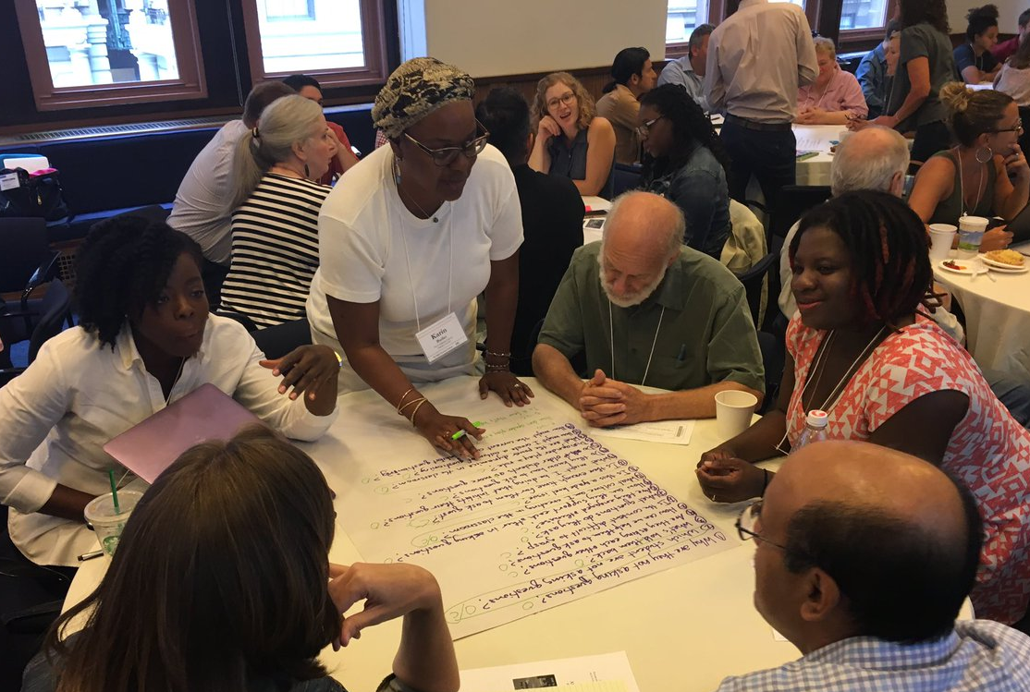
An Experience in the Question Formulation Technique

Slide 32
The Question Formulation Technique (QFT)
A strategy educators can use to teach students how to:
  formulate their own questions
  work with and improve their questions
  prioritize questions
  strategize on how to use questions
  reflect on their questions and the process
  use their questions to drive learning

Slide 33
Rules for Producing Questions
1. Ask as many questions as you can
2. Do not stop to answer, judge, or discuss
3. Write down every question exactly as stated
4. Change any statements into questions

Slide 34
Produce Questions
Ask questions
Follow the rules
      Ask as many questions as you can
      Do not stop to answer, judge, or discuss
      Write down every question exactly as it was stated
      Change any statements into questions
Number the questions as you produce them

Slide 35
Question Focus
Some students are not asking questions.
Please remember to follow the rules and to number your questions.
You may want to write the Question Focus at the top of your paper.

Slide 36
Categorize Questions: Closed/Open
Definitions:
  Closed-ended questions can be answered with a “yes” or “no” or with a one-word answer.
  Open-ended questions require an explanation and cannot be answered with a “yes,” “no,” or with one word.
Directions:
Label your closed-ended questions with a “C” and your open-ended questions with an “O.”

Slide 37
Discuss Advantages & Disadvantages
Closed-ended questions
Advantages
Disadvantages

Slide 38
Discuss Advantages & Disadvantages
Open-ended questions
Advantages
Disadvantages

Slide 39
Work with Closed and Open-ended Questions
Take one closed-ended question and change it into an open-ended question.
Take one open-ended question and change it into a closed-ended question.
Add your new questions to the bottom of your list of questions.
Closed
Open
Open
Closed
Notes:
Please be sure to number your new questions—they are new questions and so they should be the next two numbers in your list of questions.

Slide 40
Prioritize Questions
Review your list of questions:
  Choose your three most important questions.
  While prioritizing, keep in mind the Question Focus: Some students are not asking questions.
After prioritizing consider:
  Why did you choose those three questions?
  Where are your priority questions in the sequence of your entire list of questions?

Slide 41
Create an Action Plan
In order to answer your priority questions:
What do you need to know? Information
What do you need to do? Tasks
Information | Tasks

Slide 42
Share
Questions you changed from open/closed
Your three priority questions and their numbers in your original sequence
Rationale for choosing priority questions
Next steps

Slide 43
Reflect
What did you learn?
How did you learn it?

Slide 44
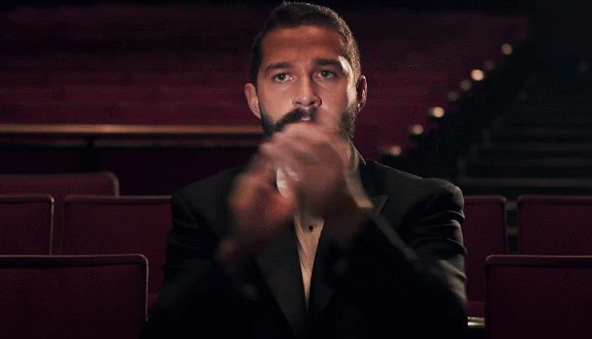
A Round of Applause

Slide 45

Unpacking the QFT

Slide 46
The Question Formulation Technique (QFT)
A strategy educators can use to teach students how to:
  formulate their own questions
  work with and improve their questions
  prioritize questions
  strategize on how to use questions
  reflect on their questions and the process
  use their questions to drive learning

Slide 47
Three thinking abilities, one strategy.

Slide 48
Thinking in many different directions
Divergent
Thinking

Slide 49
Narrowing down, focusing
Convergent
Thinking

Slide 50
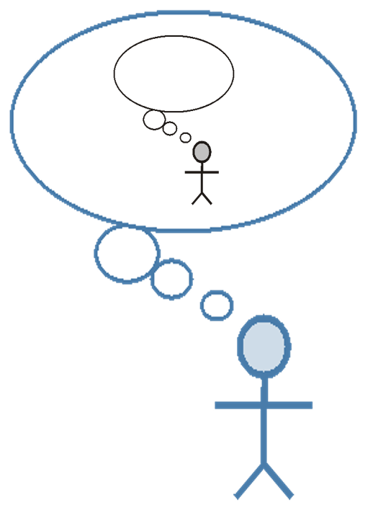
Thinking about thinking
Metacognition

Slide 51
Consistent Outcomes
Greater knowledge
Greater ownership
Greater intellectual rigor
Greater curiosity

Slide 52
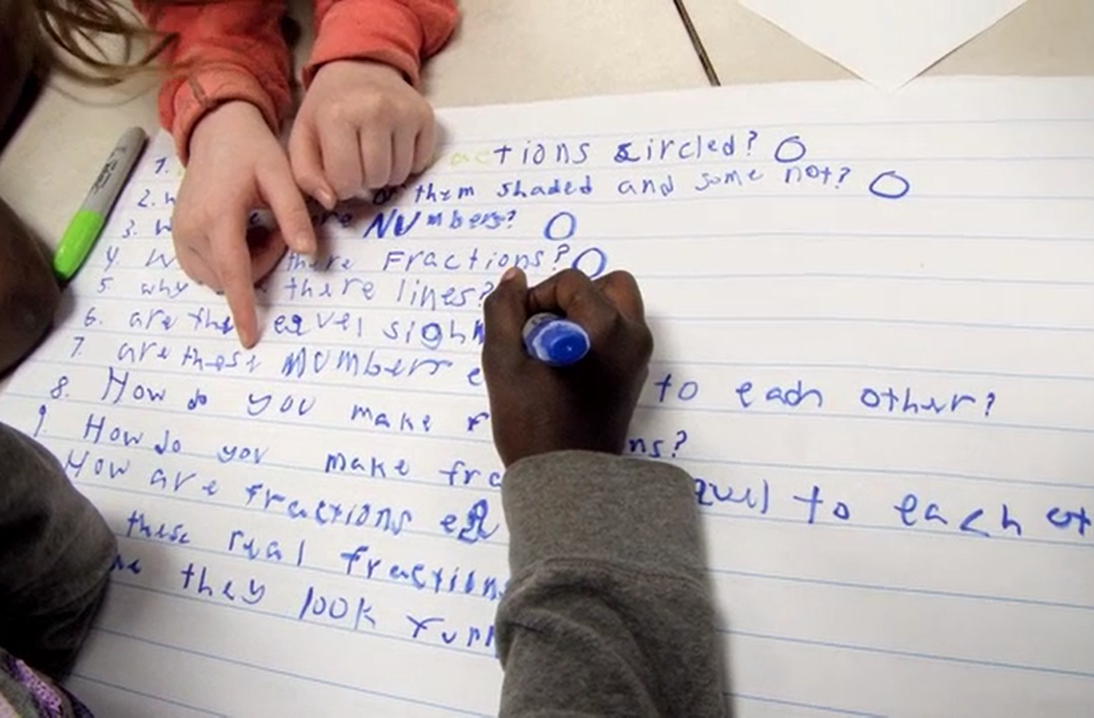
Examples of the QFT in the Classroom
Notes:
What does it look like when students learn to ask their own questions?

Slide 53
Classroom Example: High School English
Notes:
https://vimeo.com/116974103

Slide 54
What did you notice?
Notes:
Showed a video
Framed – pay attention to what the students are doing and what teacher is doing and I’ll ask after
Take a few comments.
A lot of what you’re naming is what we see time and time again that works really well—through observations with this teacher and teachers across the country, we’ve distilled down to four principles to guide facilitation
Stand up and find one new person not at their table to discuss the principles. On the back of the lesson planning workbook.
What would be challenging but why would it be important.
Find someone new.

Slide 55
Classroom Example: Writing Fundamentals
Sun Ezzell, Professor of English, Mt. San Antonio College
Topic: Grades
Purpose:
Students use their questions to spark discussion on the article & write a response to article.
Students consider whether they should switch from letter grade to pass/no pass.

Slide 56
Question Foci
the case against grades (for students who read the article)
or
grades (for students who did not read)

Slide 57
Students’ Questions
Why are students intimidated against grades?
Is the grading process needed?
How does the grading system affect students?
Why do we have a grading system?
Does the grading system need improvement?
Why is it challenging to get good grades?
Why do students think school is challenging?
Why do students focus more on grading than learning?
Does the grading system help students in life?
What are your thoughts on our grading system?
Do students focus more on grading than learning?

Slide 58
Next Steps
After the activity, some students decided to switch from letter grades to pass/no pass
Led to discussion about feedback and how they can use/ share feedback for learning.
Professor Ezzell gained insight into student thinking

Slide 59
Student Reflections
“I discovered that by asking questions about the article it was easier to understand the article and the meaning behind it.”
“The [QFT] was an amazing group activity...I loved that no one was excluded...”
“I learned I can come up with questions very quickly which is good because it means thinking and creativity is improving and growing.”
“When we come up with our own questions, we think more deeply.”

Slide 60
Classroom Example: College Biology
Rachel Woodruff, Ph.D. Assistant Professor of Biology, Brandeis University
Topic: Molecular Biology
Purpose: To build students’ research skills and prepare them to develop their own proposal later in the semester

Slide 61
Question Focus
Students were assigned a complex molecular biology article
Ask as many questions as you can about the reading

Slide 62
Next Steps
Students generate questions about a complex article on their own
Students discuss the key attributes of a good biological research question and compare to other types of questions
Students form groups and improve their questions based on these attributes

Slide 63
Classroom Example: College English
Tina Romanelli, PhD, Raleigh North Carolina
Purpose: To foster a more democratic classroom environment
Notes:
Dr. Tina Romanelli is the Director of the Learning Center and an Instructor of English at Meredith College. Meredith College is a small, women’s liberal arts college in Raleigh, NC. When Dr. Romanelli first started working at Meredith College a few years ago, she found that many of the women in her courses would take at face value some of the decisions being made.
For example, in her past experience at other schools and institutions of higher education her students would question whether a quiz was necessary, whether a question on a test was fair, or whether assignments should be reframed to better meet their learning objectives. Her experience at Meredith College was that many students, she found, were raised in environments that squelched, rather than encouraged, their capacity to question authority. As a result, students did not necessarily perceive her classroom as the democratic, co-constructed space that Dr. Romanelli sought to foster.
To help students develop for themselves the ability to participate in the decision-making process in the classroom and take more ownership over their learning, Dr. Romanelli believed that she needed to teach them how to ask questions. The QFT, she shared, is one of the most effective, simple ways to begin teaching the skill of question formulation to college students. She used it in two classrooms so far, once with rousing success and once with mixed results. Despite differences between those two classrooms, there has been one critical shared outcome she is observing: young women in her classroom are getting more comfortable and confident in their ability and their need to ask questions in the classroom.

Slide 64
Classroom Example: College Biology
Emily Westover, Ph.D., Brandeis University
Topic: Post-Exam Review
Purpose: To assess what students did not understand about the content. They performed poorly on a particular question on an exam.

Slide 65
Question Focus
Ask as many questions as you can about [the exam question]

Slide 66
Educator Reflections
Students were thinking more deeply about the exam question
Professor Westover was able to gather insight into why they may have had difficulty with the exam question

Slide 67
Classroom Example: Business Marketing
Kelly La Venture, Ed.D., Bemidji State University
Topic: Marketing Analytics
Purpose: To prepare for a guest speaker on a topic students identified as important for their learning and career interests

Slide 68
Question Focus
Marketing Analytics
Notes:
Before the QFocus: She asked: “What related to specific topics of interest. do you want to learn more about before you graduate and will help you to elevate your project?” and then adds lessons or brings in a guest speaker based on what they respond. They said, “analytics and Google analytics.”

Slide 69
Students’ Questions
What are marketing analytics?
How do you use them?
What are analytics?
Why are they important?
How can you use them?
What are their benefits?
What are their weaknesses?
Why should I use them?
Who should be using them?
When should you use them?
How can I use marketing analytics to benefit my company?
How often should a company use marketing analytics to their benefit?
What is the best way to use marketing analytics?
Is there a time and place to use marketing analytics?
How can I use social media and marketing analytics together?
With marketing analytics how can I analyze my competition?

Slide 70
Educator Reflections
“Not only were students highly engaged in the QFT process the whole 90 minute class period, but student after student, not just the same students, asked question after question of the guest speaker and didn’t move from their seats when class was over – they stayed about 15 more minutes to keep asking questions.”
“I had a ‘holy cow’ moment. We did the QFT last Tuesday, then on Thursday we had the guest speaker, and this week the students approached me unsolicited to share how much they liked the QFT and asked to do it again.”

Slide 71
Student Reflections
“The QFT can help us develop deeper questions.”
“Changing one word in the question can change the entire question.”
“We have more/better questions the longer we thought about it.”
“How to change closed questions to open.”

Slide 72
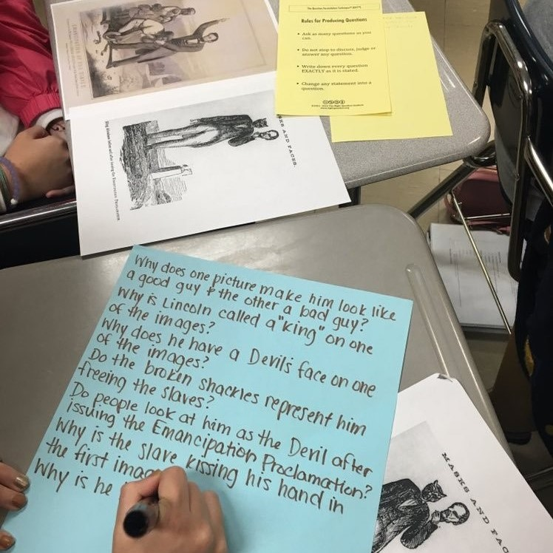
Question Formulation in the 21st Century

Slide 73

In the Age of Google
“How should you respond when you get powerful new tools for finding answers?
Think of harder questions.”
– Clive Thompson
Journalist and Technology Blogger

Slide 74
The Skill of Question Formulation
For reframing the perception of ignorance: not a weakness, but an opportunity
For arriving at better answers (and more questions)
For increasing engagement and ownership
For a little more joy in a very demanding profession
And…

Slide 75
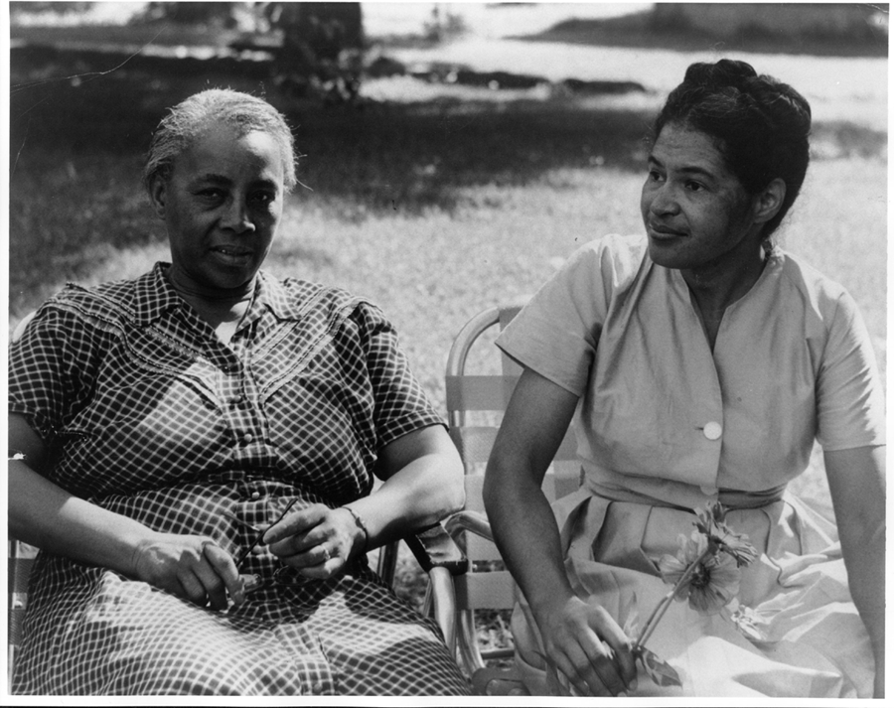
Democracy & Questions
Image Courtesy of Highlander Research and Education Center
Notes:
We have learned a lot from people with limited education, far from power, who were parents in a low-income Massachusetts city. They
were not participating in their children’s education because “they did not even know what questions to ask.” These parents were the
individuals who first named the problem and made the critical insight into the importance of questions for thinking, learning, and
participating. We have worked on this problem for nearly 30 years since.
Yet, we are not the first people to say question formulation is critical. We see our work connecting back to the work of someone who
you probably have never heard of but is one of the greatest educators of the 20th century.
Septima Clark was a civil rights activist and an African American educator who worked alongside Rosa Parks. After having her
teaching license revoked after decades or teaching service for her activism with a civil rights organization (NAACP), Clark, with her
cousin Bernice Robinson, established citizenship schools in South Carolina. Clark began working with low people with low literacy, first
to make sure they could vote and were not cheated out of wages, but as a part of a larger effort for people to become more effective
participants in democracy.
She said, “we need to be taught to study rather than to believe, to inquire rather than to affirm.” Clark saw inquiry and questioning as a
foundational part of learning, civic participation, and advocacy. By honing this fundamental skill one is able to advance research, think
and learn in new ways, and also to integrate this skill democratic habit of mind into their daily life.
Septima Clark, seated center, and her cousin Bernice Robinson standing to the right.
21

Slide 76
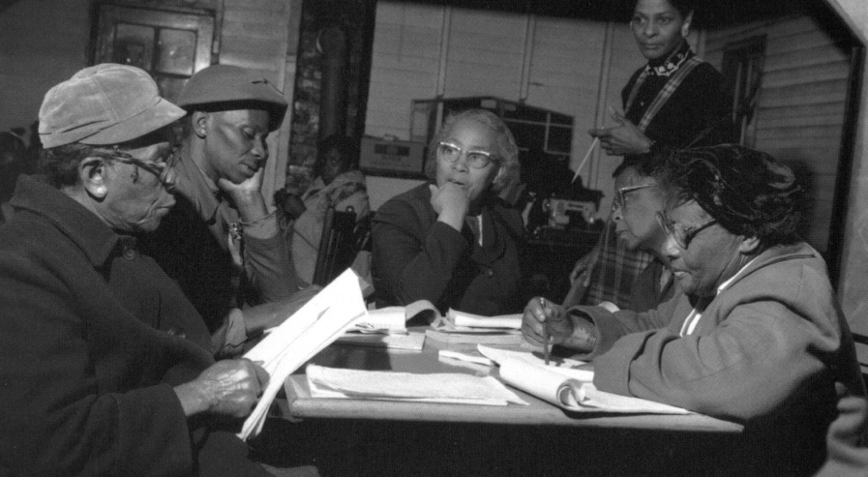
Democracy & Questions
“We need to be taught to study rather than to believe, to inquire rather than to affirm.”
- Septima Clark
See Chapter 6 on Septima Clark in Freedom Road: Adult Education of African Americans (Peterson, 1996).
Notes:
We have learned a lot from people with limited education, far from power, who were parents in a low-income Massachusetts city. They
were not participating in their children’s education because “they did not even know what questions to ask.” These parents were the
individuals who first named the problem and made the critical insight into the importance of questions for thinking, learning, and
participating. We have worked on this problem for nearly 30 years since.
Yet, we are not the first people to say question formulation is critical. We see our work connecting back to the work of someone who
you probably have never heard of but is one of the greatest educators of the 20th century.
Septima Clark was a civil rights activist and an African American educator who worked alongside Rosa Parks. After having her
teaching license revoked after decades or teaching service for her activism with a civil rights organization (NAACP), Clark, with her
cousin Bernice Robinson, established citizenship schools in South Carolina. Clark began working with low people with low literacy, first
to make sure they could vote and were not cheated out of wages, but as a part of a larger effort for people to become more effective
participants in democracy.
She said, “we need to be taught to study rather than to believe, to inquire rather than to affirm.” Clark saw inquiry and questioning as a
foundational part of learning, civic participation, and advocacy. By honing this fundamental skill one is able to advance research, think
and learn in new ways, and also to integrate this skill democratic habit of mind into their daily life.
Septima Clark, seated center, and her cousin Bernice Robinson standing to the right.
21

Slide 77
Integrating the Question Formulation Technique In Ways that Best Support Your Work
Andrew P. Minigan
Director of Strategy, Education Program
The Right Question Institute

Slide 78
Overview
Questions & learning
An experience in the Question Formulation Technique
Unpacking the QFT
Examples of the QFT in the classroom
Question formulation in the 21st century
Lesson planning and exploring resources
Reflection & Q&A

Slide 79
Two Keys to Planning a Lesson with the QFT
Starting at the End
QFocus Design

Slide 80


Not a detour, a shortcut
Notes:
For example…Deirdre didn’t have to do a couple of the lessons she was planning, bc kids were further along than she thought and had figured out a couple things already! A formative assessment that quickly, effectively actually shows what kids are thinking? The QFT

Slide 81
Various Teaching Purposes
  Engagement
  Knowledge acquisition
  Formative assessment
  Summative assessment
  Peer review
  Skill development
Notes:
Put a space after each bullet.

Slide 82
Next Steps
Literature Review
Facilitate Group Collaboration
Class Discussion
Experiments
Exam Prep
Reading Check
Research
Projects
Lab work
Presentations
Tailor Instruction
Paper Topic
Student Choice Projects
Guest Speaker
Service Action Projects
Homework Prompt
Notes:
Kelly brings in a guest speaker every semester. She knew she wanted to improve the way students engage with the topic ahead of time and the speaker during their visit.

Slide 83
Two Keys to Planning a Lesson with the QFT
Starting at the End
QFocus Design

Slide 84
Question Focus (QFocus):
A focus or prompt for student questions
A phrase or quotation
An article
A topic for students to explore further
An image or video
A podcast or speech
A hands-on experience or experiment
An equation or data set
The QFocus is not a question!

Slide 85
Designing a Question Focus
An effective QFocus should be
Directly tied to lesson’s main idea
Simple… but not too simple
Interesting or provocative to students… but not biased or leading

Slide 86
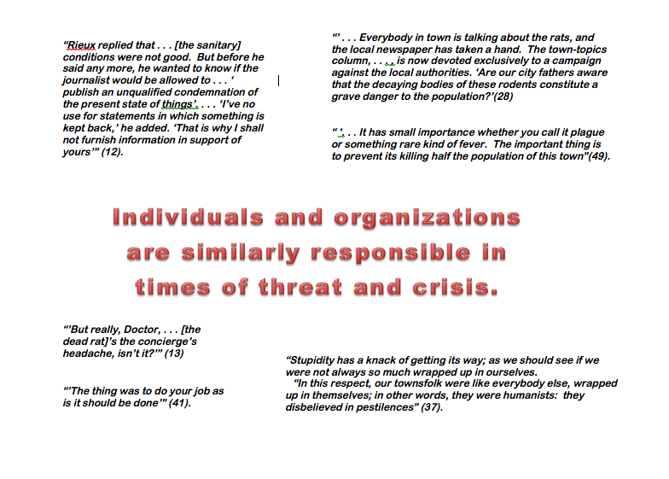
Initial Question Focus
Notes:
Topic: Albert Camus’s The Plague
Purpose: Pre-reading engagement and prediction of central themes going into the text

Slide 87
Revised Question Focus
The city fathers were aware that the decaying bodies of these rodents were making people sick. (p. 28)

Slide 88
Initial Question Focus:
“People, Animals, and Friends”
Do people exist?
Where do people live?
Why do animals live in the zoo?
Why do people go to the pool?
Why are friends fun?
Why do animals bite?
Why do people go to school?
Do people, animals, and friends play together?
Do animals make friends?
Why do I need friends?
Why do people want to be friends with animals?
Why are people making friends with animals?
Why do people, animal, and friends live in different countries?
Where did my dog and friend go?
Can my friend pet our new dog?
Why do I have eyes?
How do people smell?
Can animals speak?
Can people fly?
Where is my bunny? What happened?
Notes:
Let’s look at one more example of a Qfocus that needed some revision. This is from an elementary classroom in Hawaii.
The initial Qfocus was the phrase “people, animals, and friends,” and the teacher was engaging students at the start of a unit on “How can a pet be an important friend?”
Apart from noticing how adorable question #20 is, you may have noticed:
First (In orange), Most of the kids picked one of the three nouns (people, animals, OR friends) and zeroed in on it, asking questions that didn’t consider it in relationship to the other words in the prompt. These lines appear in purple. To me, this indicates that most kids just didn’t have enough direction, guidance from the Qfocus. They needed more hooks to go on, or maybe an image.
Second (Blue) : there is really good information here about what students care about and are interested in, in questions about their own pets and their own friends, which may be helpful to the teacher going forward or in re-designing a Qfocus
Third and finally (IN purple): some students are really thinking about the relationship b/w the 3 things listed and trying to connect the 3, so even in a batch of questions that are kind of off topic/not what the teacher expected, she could still have used #11 or #12 in her next steps.

Slide 89
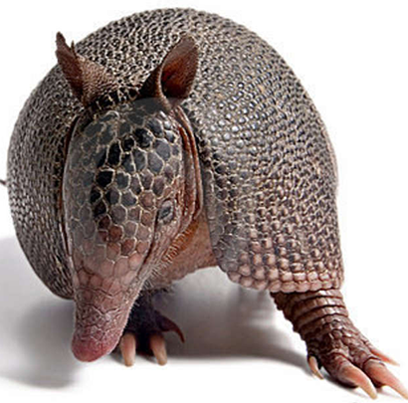
The one quality all excellent QFT designers share?
The key ingredient to QFocus design?
Thick Skin.
Notes:
Practice makes…more comfortable anyway.

Slide 90
Putting it into practice.

Slide 91
Self-Organized Work & Planning Time
Work on the lesson planning workbook
Try creating your own QFocus

Slide 92
Overview
Questions & learning
An experience in the Question Formulation Technique
Unpacking the QFT
Examples of the QFT in the classroom
Question formulation in the 21st century
Lesson planning and exploring resources
Reflection & Q&A

Slide 93
Reflection & Q&A

Slide 94
Closing Reflections
What did you learn?
How can you use what you learned?
An “a-ha moment” or a meaningful take away from your experience today.
Notes:
To use during discussion usually

Slide 95

Access Free Resources
Visit to find resources from today’s experience:
rightquestion.org/events
You can also find
Easy-to-use templates and downloadable resources
Classroom examples, articles, and blogs
Instructional videos
We offer materials through a Creative Commons License and we encourage you to make use of and/or share all resources.
Please reference the Right Question Institute and rightquestion.org as the source on any materials you use/share.

Slide 96
Thank you.
Now, some time for your questions.
We are eager to connect with you and explore how we can support your work:
Andrew.Minigan@rightquestion.org
Katy.Connolly@rightquestion.org
Register to access free resources over at: www.rightquestion.org

Slide 97
Wanted: QFocus Guinea Pigs
Who is willing to share the QFocus you were working on?

