Slide 1
The Power of Student Questions to Spark Inquiry
Sarah Westbrook Jennifer Brickey
Director of Professional Learning Teacher-Librarian
Cambridge, MA Oxnard, CA

Slide 2
Acknowledgments
We are deeply grateful to The Hummingbird Fund and to the Right Question Institute board of directors for their support of our work.
Thank you also to Esther Honda and Brad Williston for bringing The Right Question Institute to San Francisco and for all their work behind the scenes.

Slide 3
Who is in the room?

Slide 4
Community Building
I remember
the first day,
how I looked down,
hoping you wouldn’t see
me,
and when I glanced up,
I saw your smile
shining like a soft light
from deep inside you.
“I’m listening,” you encourage us.
“Come on!
Join our conversation,
let us hear your neon certainties,
thorny doubts, tangled angers,”
but for weeks I hid inside.
I read and reread your notes
praising
my writing,
and you whispered,
“We need you
and your stories
and questions
that like a fresh path
will take us to new vistas.”
Slowly, your faith grew
into my courage
and for you—
instead of handing you
note or apple or flowers—
I raised my hand.
-Pat Mora

Slide 5
Today’s Agenda
Welcome & Community Building
Why Spend Time on Teaching Question Formulation?
Collaborative Learning with the Question Formulation Technique (QFT)
Exploring Student Work & Classroom Applications
The Art & the Science of the QFT: A Deep Dive into Planning and Facilitation
Ideas for Further Partnership & Collaboration
Lunch
Collaboration and Planning Time

Slide 6
To Access Today’s Materials:
https://rightquestion.org/events/
Join our Educator Network for:
Templates you can use tomorrow in class
Classroom examples
Instructional videos
Opportunities to connect with other educators

Slide 7
We’re Tweeting…
@RightQuestion
@Mrs_Brickey
@SarahRQI
#QFT

Slide 8
Why spend time teaching the skill of question formulation?

Slide 9
Honoring the Original Source: Parents in Lawrence, Massachusetts, 1990
“We don’t go to the school because we don’t even know what to ask.”

Slide 10
"There is no learning without having to pose a question."
- Richard Feynman
Nobel Laureate, Physics, 1965

Slide 11
“We must teach students how to think in questions, how to manage ignorance.”
– Stuart Firestein
Former chair, Department of Biology,
Columbia University

Slide 12
College Presidents on What College Students Should Learn
“The primary skills should be analytical skills of interpretation and inquiry. In other words, know how to frame a question.”
- Leon Botstein, President of Bard College
“…the best we can do for students is have them ask the right questions.”
- Nancy Cantor, Former Chancellor of University of Illinois
The New York Times, August 4, 2002

Slide 13
Yet, only 27% of graduates believe college taught them how to ask their own questions
Alison Head, Project Information Literacy at University of Washington, 2016

Slide 14
Basic Skill Attainment Over Time
Sources:
http://nces.ed.gov/nationsreportcard/pdf/main2009/2011455.pdf
http://nces.ed.gov/nationsreportcard/pubs/main2007/2008468.asp#section1
Data on question-asking based on parent and teacher feedback

Slide 15
Basic Skill Attainment Over Time
Sources:
http://nces.ed.gov/nationsreportcard/pdf/main2009/2011455.pdf
http://nces.ed.gov/nationsreportcard/pubs/main2007/2008468.asp#section1
Data on question-asking based on parent and teacher feedback

Slide 16
We can work together on changing the direction of that slope

Slide 17
We Are Not Alone
Educators in more than 1 million classrooms worldwide

Slide 18
Now, Educators Lead the Work
The Right Question Institute offers materials through a Creative Commons License. You are welcome to use, adapt, and share our materials for noncommercial use, as long as you include the following reference:
“Source: The Right Question Institute (RQI). The Question Formulation Technique (QFT) was created by RQI. Visit rightquestion.org for more information and free resources.”

Slide 19
What happens when students do learn to ask their own questions?

Slide 20
Research Confirms the Importance of Student Questioning
Self-questioning (metacognitive strategy):
Student formulation of their own questions is one of the most effective metacognitive strategies
Engaging in pre-lesson self-questioning improved students rate of learning by nearly 50% (Hattie, p.193)
John Hattie
Visible Learning: A Synthesis of Over 800
meta-Analyses Relating to Achievement, 2008
Notes:
UC Davis Research Linking Curiosity to Memory (UC Davis) 2014
The Fullerton Longitudinal Study (FLS), a 30-plus year study of the development of giftedness across various points in time conducted by Adele and Allen Gottfried of California State University ”This finding has strong implications for the development of STEM considering that curiosity is a fundamental predictor of the aspiration to become a scientist.”
S. von Stumm, B. Hell, T. Chamorro-Premuzic. The Hungry Mind: Intellectual Curiosity Is the Third Pillar of Academic Performance. Perspectives on Psychological Science, 2011 meta-analysis shows They found that curiosity did, indeed, influence academic performance. In fact, it had quite a large effect, about the same as conscientiousness. When put together, conscientiousness and curiosity had as big an effect on performance as intelligence.

Slide 21
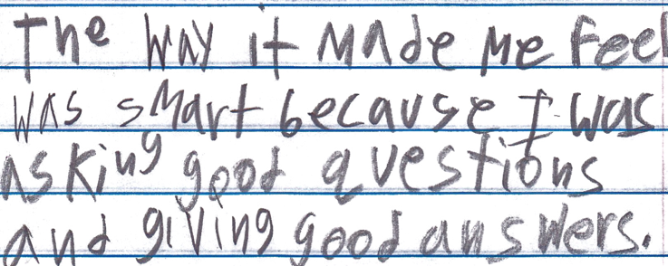
Student Reflection
“The way it made me feel was smart because I was asking good questions and giving good answers.”
-9th grade summer school student, Boston, MA

Slide 22
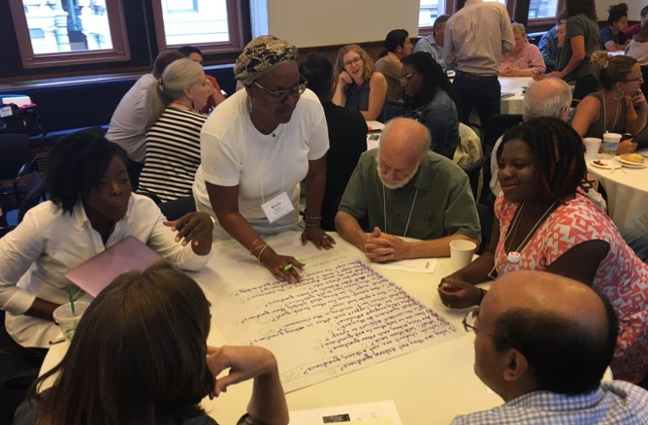
Collaborative Learning with the Question Formulation Technique (QFT)

Slide 23
The Question Formulation Technique (QFT)
A step-by-step strategy in which people:
Produce their own questions
Transform & Improve their questions
Strategize on how to use their questions
Reflect on what they have learned and how they learned it

Slide 24
Rules for Producing Questions
1. Ask as many questions as you can
2. Do not stop to answer, judge, or discuss
3. Write down every question exactly as stated
4. Change any statements into questions

Slide 25
Produce Questions
Ask Questions
Follow the Rules
Ask as many questions as you can.
Do not stop to answer, judge, or discuss.
Write down every question exactly as it was stated.
Change any statements into questions.
Number the Questions

Slide 26
Question Focus #1: Image #1
→Remember: Number the questions. Follow the rules.

Slide 27
Question Focus #2: Full Image
→Remember: Number the questions. Follow the rules.
Notes:
Title: Savagery to “civilization” drawn by Joseph Keppler. Published by Puck Publishing Corporation, 1914. Find it in the Library of Congress Prints and Photographs Division.

Slide 28
Categorize Questions: Closed/Open
Definitions:
Closed-ended questions can be answered with a “yes” or “no” or with a one-word answer.
Open-ended questions require
more explanation.

Slide 29
Discussion
Closed-ended Questions
Advantages
Disadvantages

Slide 30
Discussion
Open-ended Questions
Advantages
Disadvantages

Slide 31
Transform Questions
Take one closed-ended question and change it into an open-ended question.
Take one open-ended question and change it into a closed-ended question.
Closed
Open
Open
Closed

Slide 32
Prioritize Questions
Choose the three questions you are most curious about.
After prioritizing discuss…
Why did you choose those three questions?
Where are your priority questions in the sequence of your entire list(s) of questions?
Select (or write new) one question that you feel best captions this primary source.

Slide 33
Share
Your three priority questions and their placement in your original sequence
Rationale for selecting priority questions
Your caption

Slide 34
Reflect
What did you learn?
How did you feel about asking questions?
How might you use this in your own work?
Notes:
Learning about a primary source through questions compare to other approaches to primary sources

Slide 35
A Look Inside the Process

Slide 36
The QFT, on one slide…
Ask as many questions as you can
Do not stop to discuss, judge or answer
Record exactly as stated
Change statements into questions
Question Focus
Produce Your Questions
Follow the rules
Number your questions
Transform Your Questions
Categorize questions as Closed or Open-ended
Change questions from one type to another
Prioritize Your Questions
Discuss Next Steps or Action Plan
Share & Discuss
Reflect
Closed-Ended:
Answered with “yes,” “no” or one word
Open-Ended: Require longer explanation

Slide 37
Curiosity and Rigor
Three thinking abilities
with one process

Slide 38
Thinking in many different directions
Divergent
Thinking

Slide 39
Narrowing Down, Focusing
Convergent
Thinking

Slide 40
Thinking about Thinking
Metacognition

Slide 41
Exploring Classroom Examples

Slide 42
Finding the Scale that Works for You
Start here!
Large scale, weeks- long civic action project or PBL unit
5 minute
“Do Now”
One-day class discussion
A multi-day research process
15 minute brainstorm before guest speaker arrives
Student- designed lab investigation
Students generate unit-long essential questions that are answered over course of unit
Notes:
Thinking both about “dosage” – frequency with which you are using QFT
And intensity of commitment to following through on the students’ questions

Slide 43
Library Example: High School
Teacher: Connie Williams, Petaluma, CA
Topic: the Holocaust
Purpose: To prepare students for a guest speaker (and fill 20 minutes of ‘dead air time’ due to a timing snafu!)
Time frame: 20 minutes

Slide 44
Question Focus
The Holocaust is with us today.

Slide 45
Student Questions
Was the Holocaust the worst genocide in history?
How many lives were taken?
Did the Holocaust spur more bigotry and racism?
How did our speaker escape?
Could it happen again?
Could this happen in America?
What were the people like?
What were the Nazi’s like?
What was her life like after the Holocaust?
Does she feel the Holocaust is really over?
What is the prompt again?
Is the Holocaust over?
When did it end?
Why did it end?
Is Hitler dead?
Who is Hitler?
What is anti-Semitism?
Was the Holocaust responsible for Eisenhower’s build up of a military industrial complex?
How does the Holocaust being over change how we are today?
How would we be affected if the Holocaust didn’t end?

Slide 46
Classroom Example: 11th Grade
Teacher: Isabel Morales, Los Angeles, CA
Topic: Social Justice
Purpose: Engage students in thinking about systemic injustice ahead of several fiction and nonfiction texts in the semester
Time frame: 1 class period on the QFT, several subsequent classes on answering questions

Slide 47
Question Focus
“The disciplinary policies of our society perpetuate injustice.”

Slide 48
Student Questions
Why are student of color targeted the most?
How do disciplinary policies target specific racial groups?
Do teachers nationwide take notice of these stats?
How can teachers develop better & effective disciplinary policies?
Why do people see the stats & data as a coincidence?
What does a kid learn about the system once in jail?
What do people believe expulsion will teach the students?
Does going to juvie have a long-term effect on younger students about education?
When will it get better?
What are some ways to improve behavior?
What type of training will teachers go through that’ll bring justice to classrooms?
Shouldn’t school police officers be trained like teachers?
What is considered a criminal offense in school?
Isn’t it the teacher’s job to keep the students “in line”?
How should disruption in class be handled?
How come there aren’t any policies keeping students out of prison?

Slide 49
Next Steps with Student Questions
Students decided to research statistics and poll students and teachers.
Students met with the school administration to ask questions and address their concerns.
School principal founded a student advisory council, which many students joined, to give students a voice in new policies.

Slide 50
Why is the skill of question formulation so important now?

Slide 51
In the Age of Google
“How should you respond when you get powerful new tools for finding answers?
Think of harder questions.”
– Clive Thompson
Journalist and Technology Blogger

Slide 52
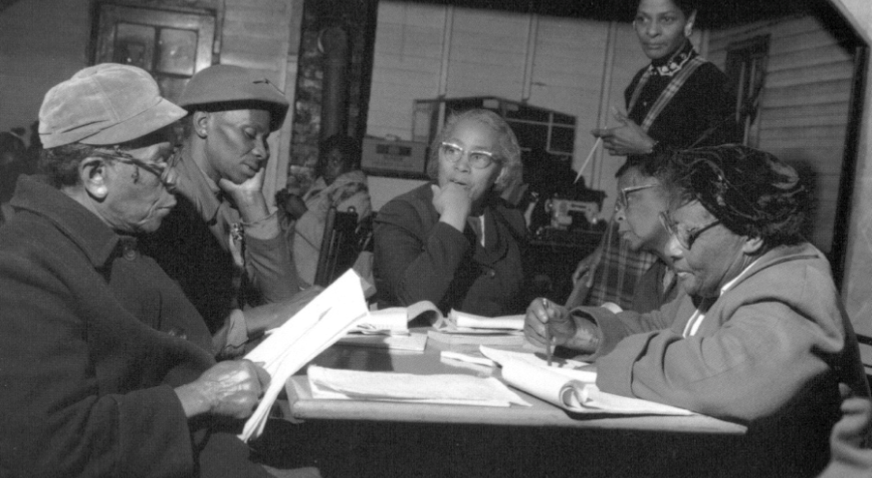
Questions and Democracy
“We need to be taught to study rather than to believe, to inquire rather than to affirm.”
– Septima Clark
Chapter 6 on Septima Clark in Freedom Road: Adult Education of African Americans (Peterson, 1996)

Slide 53
Examples of the QFT in Practice at Oxnard High School Library and Beyond

Slide 54
Quick Write
Think about…
Describe the people you serve including their academic and personal needs, wants, and interests. Add any information about their background, struggles, or triumphs.
Your Students: Who do you serve?
Your Role: What are you expected to do?
Your Goals: When you work with students, what do you hope to achieve?

Slide 55
WHY
QUESTIONING ?
Notes:
Jenn

Slide 56
A Library Lesson Aims...
To promote student voice (including sharing), choice, and self-advocacy.
To use strategies that are both rigorous and equitable.
To include a curation, creation and/or reflection component.
Notes:
For creation, be sure to include using mentor texts as a guide.

Slide 57
QFT in the Library
Student voice and Expression
Self-Advocacy
Academic and Personal Courage and Confidence
Student-Driven Learning
Skeptical consumers of Information
Your Students: Who do you serve?
Your Role: What are expected to do?
Your Goals: When you work with students, what do you hope to achieve?

Slide 58
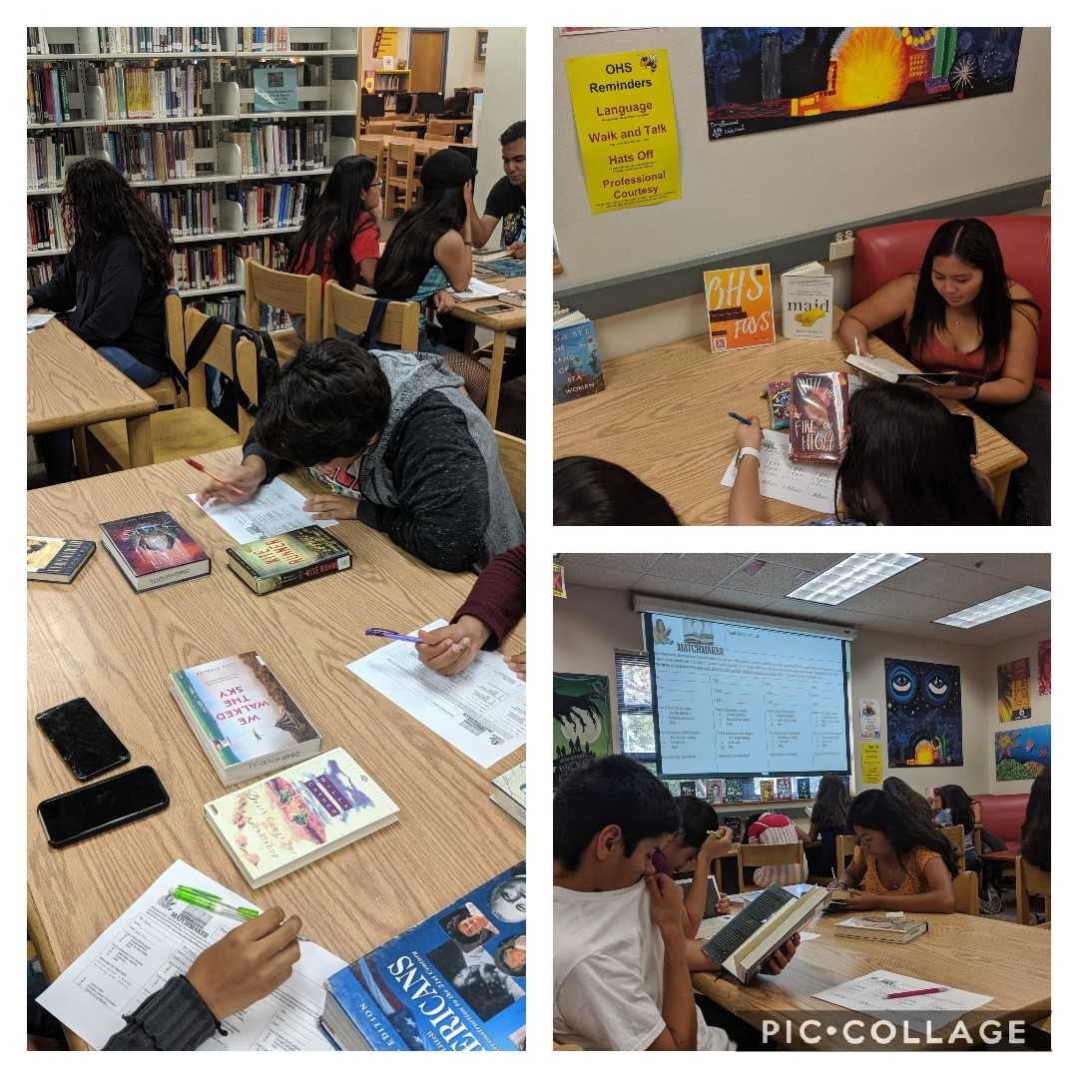
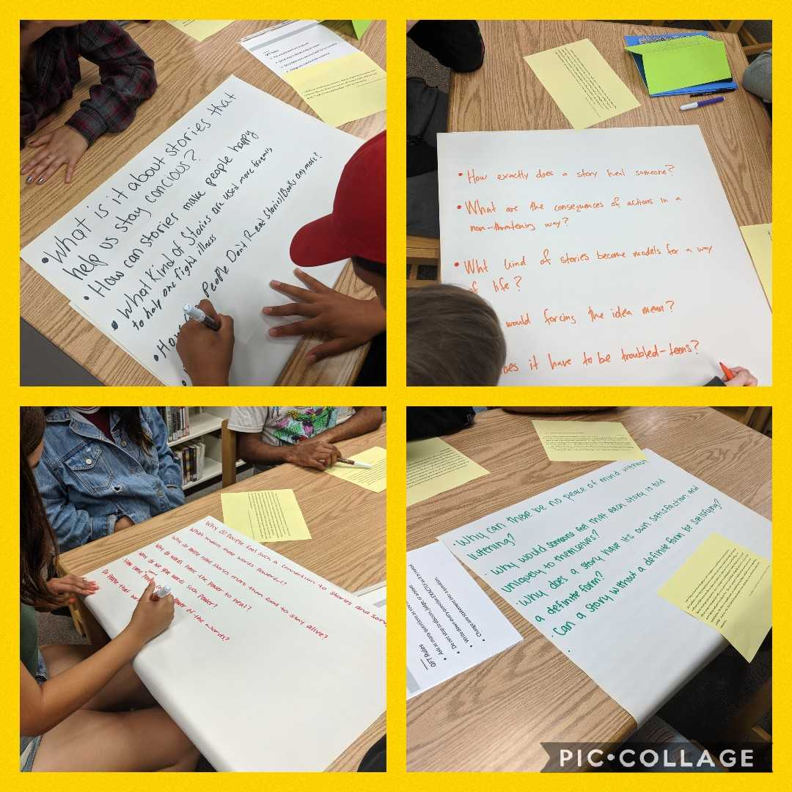
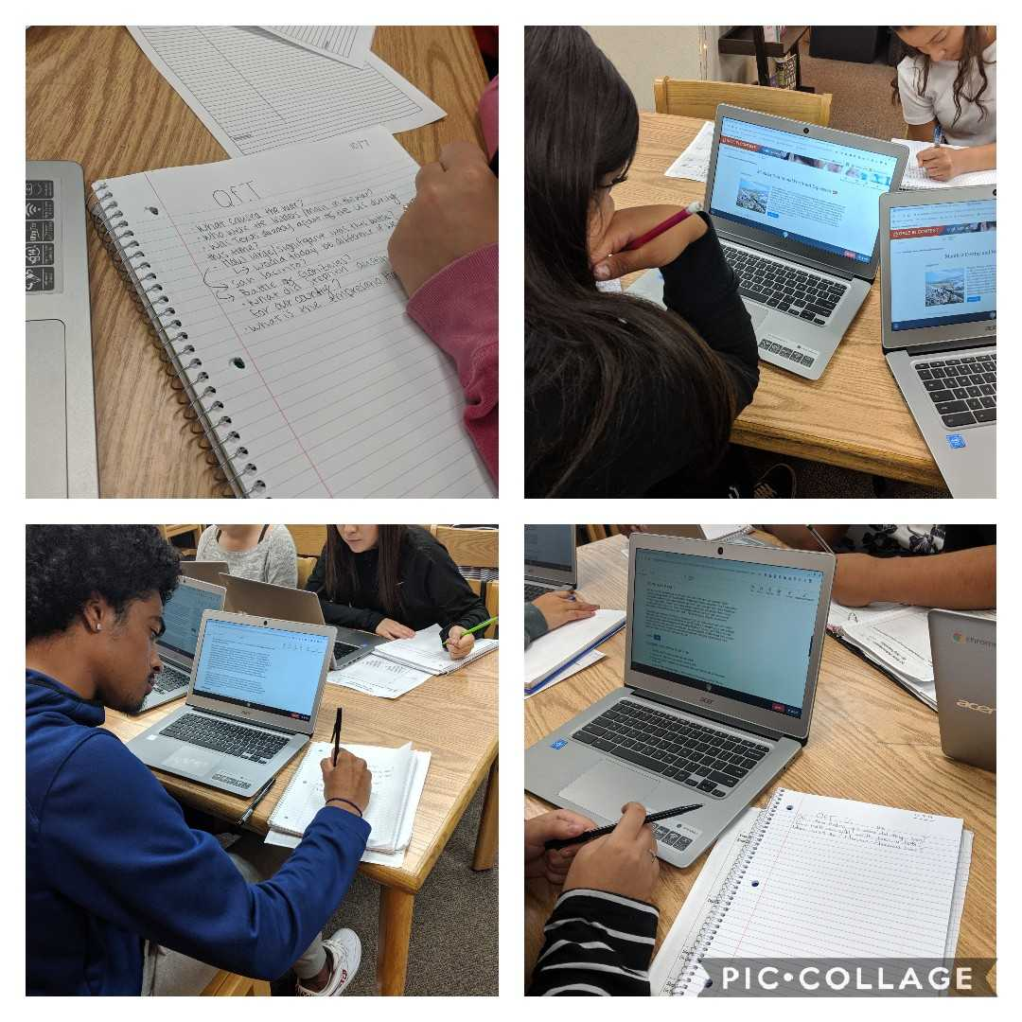
Lessons in Action

Slide 59
Today’s Agenda
Welcome & Community Building
Why Spend Time on Teaching Question Formulation?
Collaborative Learning with the Question Formulation Technique (QFT)
Exploring Student Work & Classroom Applications
The Art & the Science of the QFT: A Deep Dive into Planning and Facilitation
Starting to Design a Lesson with the QFT
Ideas for Further Partnership & Collaboration
Lunch
Collaboration and Planning Time
Notes:
Break at 10 am

Slide 60
An Art and a Science: Best Practices in QFT Planning, Design, and Facilitation

Slide 61
QFT: An Art and a Science
The Science:
The QFT is a rigorous protocol, with specific steps and sequence, that produces consistent results
The QFT
Present a Question Focus
Produce questions following the 4 rules
Improve questions
Prioritize questions
Discuss next steps
Reflect

Slide 62
QFT: An Art and a Science
The Art:
You should tailor the QFT process to the specific content and people you are working with.
Tailor the QFT through:
Planning how to use student questions
Question Focus design
Prioritization instructions
Reflection questions
Facilitation

Slide 63
Five Areas Related to the Art of the QFT
Facilitation
Starting at the End
QFocus Design
Prioritization Instructions
Reflection Questions

Slide 64
Classroom Example: High School
Teacher: Ling-Se Chesnakas, Boston, MA
Topic: The Brief Wondrous Life of Oscar Wao by Junot Diaz
Purpose: To help students generate questions for a Socratic Seminar at the end of the unit

Slide 65
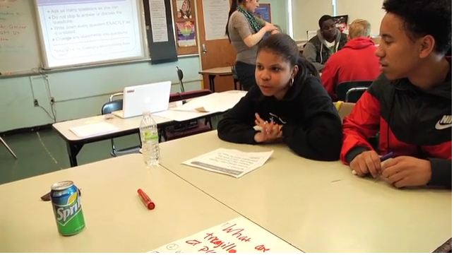
The QFT in Action in Boston, MA
rightquestion.org/rqi-resources/videos/

Slide 66
Four Principles of Facilitation
Monitor student adherence to the process
Do not give examples
Do not get pulled into group discussion
Acknowledge all contributions equally
Discuss: What could be challenging about each principle? What might be important about each?

Slide 67
Other Facilitation Decisions
Grouping
Timing
Scaffolds
Technology Integration
Norms and language around questioning (outside of the QFT process)

Slide 68
Five Areas Related to the Art of the QFT
Facilitation
Starting at the End
QFocus Design
Prioritization Instructions
Reflection Questions

Slide 69
Various Teaching Purposes
Engagement
Research
Formative assessment
Summative assessment
Peer review
Skill development
Problem-solving
Is the QFT the right tool for your objective?
How will you make use of the questions students ask?

Slide 70
Next Steps?
Pop Quiz or Reading Check
Debate Prep
Paper topic
Lab work & Experiments
Exit ticket or ”Do Now”
Hang on walls,
Check Off as Answered
Research
Projects
Test Prep
Presentations
Homework
Class discussion prompts
And sometimes…
Nothing!
Student Choice Projects
Socratic Seminar Prompts
Interview an Expert
Make Your Own Final Test
Journal Prompt
Guest speakers
Close Reading Protocol
Year-long or Unit-long Essential Questions
Tailoring Instruction
Service Action Projects
Notes:
Ok to change your mind once you see what you get; but try to be transparent with students, show them how/why their questions matter (rather than one off activity)

Slide 71
Five Areas Related to the Art of the QFT
Facilitation
Starting at the End
QFocus Design
Prioritization Instructions
Reflection Questions

Slide 72
Question Focus (QFocus): A stimulus or prompt for student questions
A phrase or quotation
An image or video
A primary source
A podcast or speech
A hands-on experience or experiment
An equation or data set
The QFocus is not a question!

Slide 73
Designing a Question Focus
An effective QFocus is:
Directly tied to lesson’s main idea or objective
Simple…but not too simple
Interesting or provocative to students…but not biased or leading

Slide 74
Initial Question Focus

Slide 75
Revised Question Focus
“How you behave online is how your are in real life. That’s you. There’s no separation. You are a person who says those kind of things.”
– Mitch Gerads

Slide 76
Initial Question Focus
“There are books in every library that MUST be banned.”
Your idea here!

Slide 77
Putting it into Practice: QFocus Testing
Work through the lesson planning workbook through page 5 (through QFocus design).
Then, write your working QFocus on an index card. It’s ok if it is still a bit rough.
Ask a partner to generate a few questions about your QFocus.(with minimal context)
Debrief with your partner and revise as needed.

Slide 78
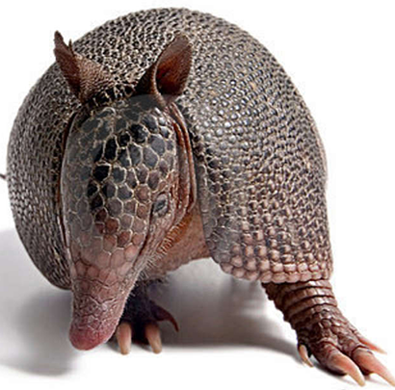
The one quality all excellent QFT designers share?
Thick Skin.
Notes:
Practice makes…more comfortable anyway.

Slide 79
Five Areas Related to the Art of the QFT
Facilitation
Starting at the End
QFocus Design
Prioritization Instructions
Reflection Questions

Slide 80
Prioritization Instructions
Teaching & Learning Goals and Plans for Student Questions
QFocus
Prioritization Instructions

Slide 81
Tailoring the Prioritization Instructions
Choose three questions…
General Instructions:
that you consider most important
that you are most curious about
Specific Purposes:
that you need to research further
to help you solve the problem
that you need to answer first
that a scientist studying the earth might ask
that will help you understand the text
that require analyzing data
that are not “Googleable” and may be difficult to answer
that you think will best open up dialogue
that you consider “outside the box”
that would best help us learn about (topic or QFocus)
that best align with today’s objective
Notes:
SARAH- address troubleshooting with prioritization

Slide 82
Use Prioritization to Troubleshoot
QFocus:
“History, despite its wrenching pain, cannot be unlived, but if faced with courage, need not be lived again.”
– Maya Angelou
Solution: “Prioritize 3 questions you feel best lend themselves to a yearlong exploration of history.”

Slide 83
Five Areas Related to the Art of the QFT
Facilitation
Starting at the End
QFocus Design
Prioritization Instructions
Reflection Questions

Slide 84
Tailoring Reflection Questions
QFT Process
Content Specific
What did you learn about asking questions?
How did you learn it?
What did you notice about the order/sequence of questions?
How can you use what you learned about asking questions?
How do you feel about asking questions?
How has your thinking changed since last time we did the QFT?
What did you learn about the (content)?
What do you understand differently now about [topic]?
How did your questions help you think about…
key concept
specific assignment
overarching topic
theme in the unit
your teaching practice
a challenge in our school

Slide 85
One Last Thought about Reflection
“Reflection is the piece that keeps me coming back the next day…
The most profound reflections are almost always from the students who perhaps seemed disengaged in class. Quiet students often do a great deal of their thinking in the written reflection.”
-Ling-Se Chesnakas, Boston Public Schools

Slide 86
The Science of the QFT: a protocol
The Art of the QFT: You
Notes:
The key role of the teacher and YOU ARE sTILL In CONTROL:
Behind the scenes as lesson planner
Facilitate process according to the steps of the QFT and the five facilitation principles
Use student questions as part of next steps

Slide 87
Five Areas Related to the Art of the QFT
Facilitation
Starting at the End
QFocus Design
Prioritization Instructions
Reflection Questions
* A bonus thought on open and closed-ended questions!

Slide 88
Closed and Open-Ended Questions in Action
Explore real-world examples of questions
Youtube.com/watch?v=uElpm9dbBAY
https://www.theguardian.com/politics/2018/may/29/gavin-williamson-cut-off-by-tv-interviewer-for-dodging-questions
Takeaways:
It isn’t about labeling “o” versus “c;” but rather, the practice of being flexible in your thinking and intentional with your language.
The “right” question is whatever question you need for the situation you are in

Slide 89
Today’s Agenda
Welcome & Community Building
Why Spend Time on Teaching Question Formulation?
Collaborative Learning with the Question Formulation Technique (QFT)
Exploring Student Work & Classroom Applications
The Art & the Science of the QFT: A Deep Dive into Planning and Facilitation
Ideas for Further Partnership & Collaboration
Lunch
Collaboration and Planning Time

Slide 90
Building QFT Partnerships

Slide 91
What your Teacher Librarian can do for you
Collaboration Menu
The Works: Collaboratively plan and co-teach a unit or lesson with the Teacher Librarian.
Curate to Create: Help students evaluate and gather resources - such as articles, images, and videos - in order to create something new.
Brainstorm Banter: Bounce ideas with the TL to get a neutral, judgment-free perspective.
Tackling Tech: Experimenting with new tech? The TL and/or library science students can assist with getting your class started.
Readers’ Advisory: Bring your class into the library to browse the stacks, get book suggestions, and kick back and read.
Active Reading: Work with the TL on reading strategies and techniques to help your students gain depth of knowledge and understanding.
Writing Reps: Teaching writing can be tricky. Your TL also has an English credential and can help with the writing process.
Dive into Inquiry: Explore curiosities and teach students to ask their own questions (QFT).
Classroom Cameo: Don’t need a full period of instruction? The TL can swing by your classroom to introduce resources, databases, or tech tools.
Passion Pursuit: Tap into students’ passions by exploring their interests. Translate those passions into a product such as a Screencast, TED Talk, or other creative outlet.
Power Hour: Let the TL assist you with a period-long lesson such as: the web evaluation, BreakoutEDU, Collaborative Slides, Flip the Library, databases, thesis throwdown, and more.
CIHS
Kimberly Tahsuda
OHS
Jennifer Brickey
RMHS
Margery Ricards

Slide 92
Building Partnerships
Start with your friends
Invite teachers to observe you
Seek out new teacher orientation and mentoring programs
Offer online resources and online learning and collaboration spaces
Present at school and district PD
Share with Instructional Coaches, Tech Coaches, Learning Design Coaches, TOSAs, etc.
Connect with District directors
Get administrators on board
Brag about all the cool things you do

Slide 93
Today’s Agenda
Welcome & Community Building
Why Spend Time on Teaching Question Formulation?
Collaborative Learning with the Question Formulation Technique (QFT)
Exploring Student Work & Classroom Applications
The Art & the Science of the QFT: A Deep Dive into Planning and Facilitation
Ideas for Further Partnership & Collaboration
Lunch
Collaboration and Planning Time

Slide 94
Today’s Agenda
Welcome & Community Building
Why Spend Time on Teaching Question Formulation?
Collaborative Learning with the Question Formulation Technique (QFT)
Exploring Student Work & Classroom Applications
The Art & the Science of the QFT: A Deep Dive into Planning and Facilitation
Ideas for Further Partnership & Collaboration
Lunch
Collaboration and Planning Time

Slide 95
Discuss
An idea your going to borrow (or steal!)
An “a-ha moment” or a take away from your experience today
What questions do you now have?

Slide 96
Thank You!

Slide 97
To Access Today’s Materials:
http://rightquestion.org/events/
Join our Educator Network for:
Templates you can use tomorrow in class
Classroom examples
Instructional videos
Many easy-to-use lesson ideas and tips

Slide 98
Educators Lead the Work
The Right Question Institute offers materials through a Creative Commons License. You are welcome to use, adapt, and share our materials for noncommercial use, as long as you include the following reference:
“Source: The Right Question Institute (RQI). The Question Formulation Technique (QFT) was created by RQI. Visit rightquestion.org for more information and free resources.”

Slide 99
QFT Small Group Worksheet
QFT Resources prepared by J. Brickey and K. Tahsuda
QFocus Ideas prepared by J. Brickey and K. Tahsuda
TL Collaboration Menu
Corippo, J. & Hepbern, M. (2018) EduProtocol field guide. David Purgess Consulting, Inc.
Jenn’s Further QFT
Resources

Slide 100
Further Reading & Resources
How Questioning Can Drive Arguments, Productive Debate, and Information Literacy https://www.ebsco.com/blog/article/how-questioning-can-drive-arguments-productive-debate-information-literacy
More from Jennifer Brickey:
Remixing the Question Formulation Technique: Four Explorations ://rightquestion.org/resources/remixing-the-question-formulation-technique-four-explorations-and-revelations/
More from Connie Williams:
What if My Students’ Questions Go Off the Rails? https://rightquestion.org/resources/students-questions-off-the-rails/
My Ah-Ha Moments with the Question Formulation Technique https://rightquestion.org/resources/ah-ha-moments-with-the-qft/
Using the QFT in the Professional Development of Librarians
https://rightquestion.org/resources/qft-professional-development-librarians/

Slide 101
To Learn Even More
https://rightquestion.org/events/teaching-students-to-ask-their-own-questions-best-practices-in-the-question-formulation-technique-3/
Check out our 3-week online course hosted by the Harvard Graduate School of Education, which runs every October and April.

