Slide 1
Why Vote? A New Tool for Reaching One Million More Voters
Luz Santana, Co-Director
Naomi Campbell, Microdemocracy Program Director
Siyi Chu, Project Coordinator

Slide 2
In this webinar we will explore:
A new model for engaging non voters
A nonpartisan, simple, and powerful tool to help people make the connection between the services that are important to them and voting
How people on the front lines of services in low-income communities can play a role in getting more people to vote

Slide 3
Agenda
Logistics
About the work of the Right Question Institute
Exploring the Right Question Voter Engagement Strategy
Components of the Strategy and why it works
Applying the Strategy
Q & A
Evaluation
Notes:
Our agenda for today:
This is an interactive webinar – meaning that we will try to engage you to complete a series of easy to do activities you will be sharing with each other.
Housekeeping –
I will give you a brief overview of the Right Question Strategy and its origins
We will do an exercise on the Voter engagement tool
We will look at why the process works
We will think about situations in which we can use it
Will have some closing words and assignments
And, lastly there will be an opportunity for asking questions of us

Slide 4
An Interactive Webinar

Slide 5
Let’s see who’s here!
Please share in the chat box:
Your name
Your state
Why did you decide to participate in this webinar?
Make sure you are sending the message to everyone!

Slide 6
After the Webinar
Fill out evaluation
Download free resource: https://tinyurl.com/y3c2nezt
Look out for email announcements
Register for our network and stay in touch

Slide 7
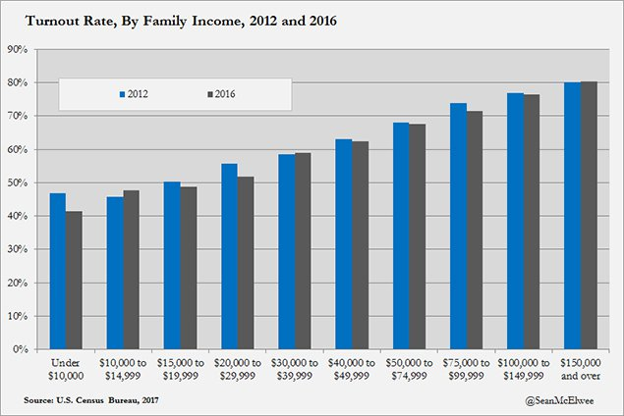
The Problem

Slide 8
This webinar introduces you to a resource that can be used to engage people in low income communities.

Slide 9
RQI’s Story
Honoring the original source: Parents in Lawrence, Massachusetts, 1990
“We don’t go to the school because we don’t even know what to ask.”

Slide 10
RQI’s Story
But then we learned that parents:
needed to be able to formulate their own questions in all situations.
were most effective when they asked questions about decisions.
applied the same skills in different settings.

Slide 11
RQI’s Story
Over the years we have distilled what is essential to effectively build the skill of question formulation
RQI’s expertise is in educational design across many fields

Slide 12
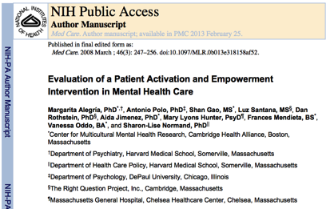
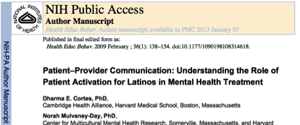

Slide 13
What is the Right Question Voter Engagement Strategy?

Slide 14
Right Question Voter Engagement Strategy
A simple, 5-step process that allows people to name for themselves the value of voting
It helps develop a sense of urgency to participate in decisions that affect them
It is a pathway for taking action
It is a non-partisan strategy that encourages all people to vote, but it does not encourage people to vote for a specific candidate

Slide 15
Exploring the Strategy

Slide 16
Which 3 services are most important to people with whom you work?
EXAMPLES OF GOVERNMENT SERVICES
HOUSING Section 8 Public Housing Homeless Services | INCOME / SUPPORT Welfare Food Stamps Social Security / SSI Earned Income Tax Credit | HEALTHCARE Medicaid Medicare Disability Services
SCHOOLS Free Lunch Program Special Education | JOBS Job Training Unemployment | COURTS Family Housing Small Claims
CHILDREN Head Start WIC Child Care Vouchers | ADULT EDUCATION GED Adult Diploma | NEIGHBORHOODS Street Lights Parks Bus / Subway

Slide 17
The Role of Elected Officials
Elected officials make decisions that affect these services
By voting, people you work with can have a say in who is making these decisions

Slide 18
Making the Connection
Why would it be important for people to see for themselves the connection between services they receive and decisions elected officials make?

Slide 19
Questions about Voting
?
If the people you work with do see the connection…
What questions do you think they might have about actually voting?
Ask as many questions as you can.

Slide 20
Reflecting on the Experience
You looked at the problem of low voting rates in low income communities
You looked at government services that affect people’s lives
You reflected on the connection between services people receive and decisions elected officials make
You asked questions about voting
What thoughts do you have?

Slide 21
Introducing the “Why Vote?” Tool

Slide 22
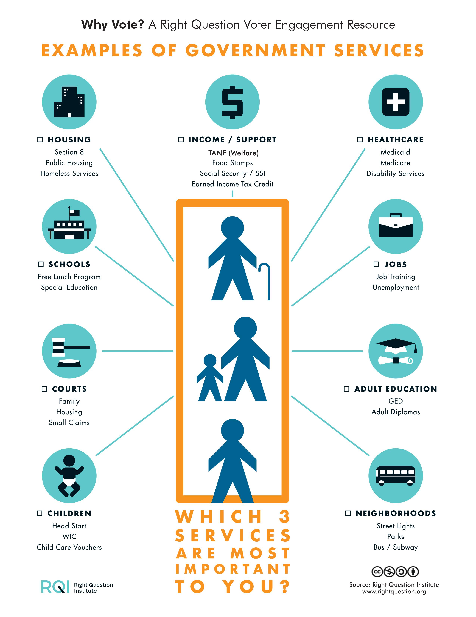
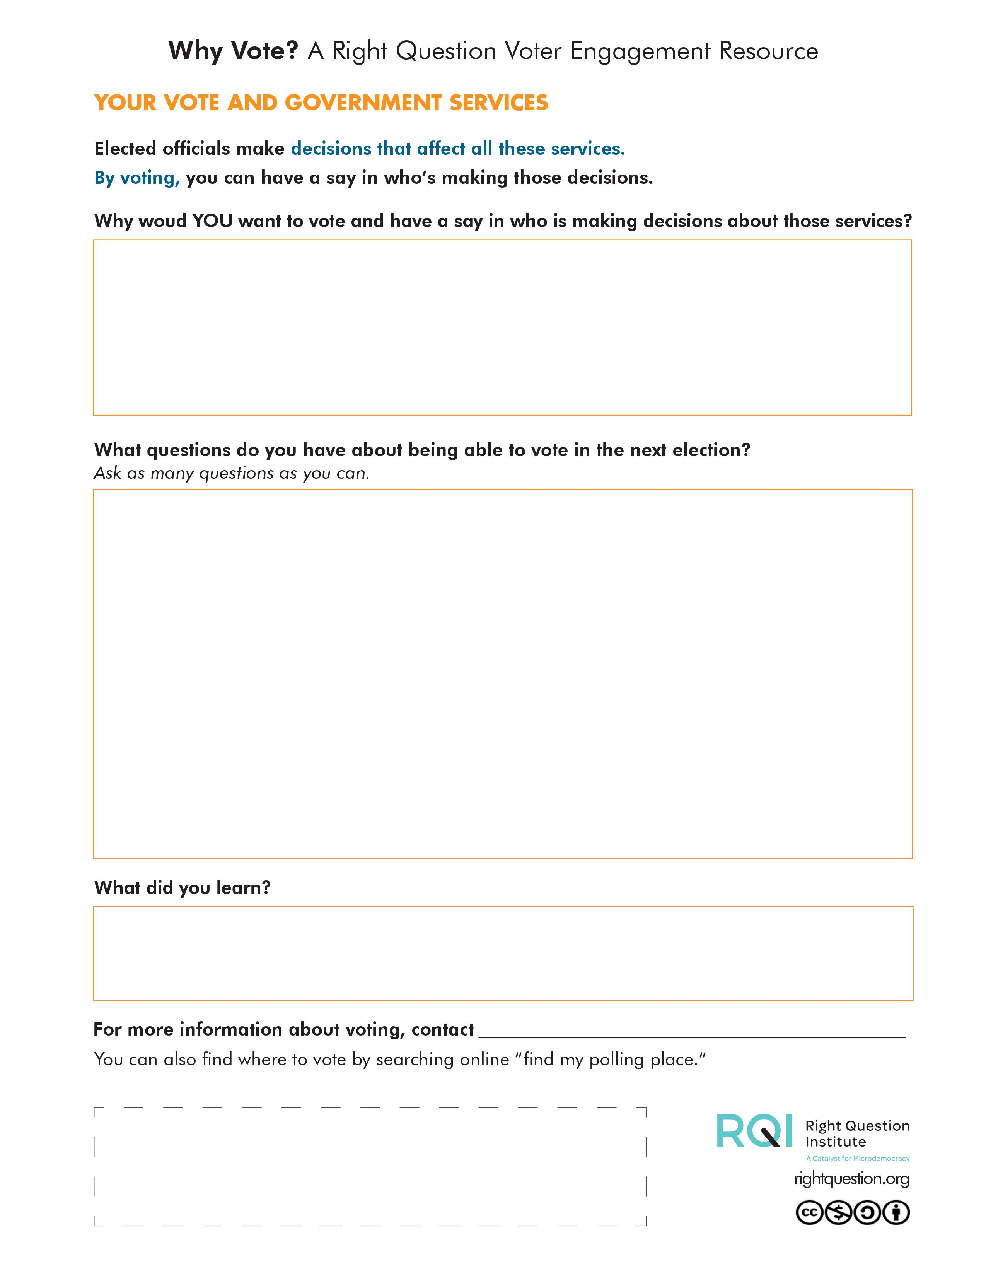

Slide 23
The “Why Vote?” Tool
Creates a sense of urgency to vote
Simple
Packed with thinking power
Vector art credit to Vecteezy, Freeiconspng, and Freepik

Slide 24
The “Why Vote?” Tool
Based on a 2004 voter engagement pilot project in Arizona and New Hampshire that led to:
93% of the participants feeling more prepared to vote
87% affirming they are much more likely to vote after the workshop

Slide 25
Unpacking the Resource
Page 1:
Reviewing the range of services
Prioritizing the services that are most important to them

Slide 26
Unpacking the Resource
Page 2

Slide 27
Unpacking the Resource
Become aware of decisions elected officials make

Slide 28
Unpacking the Resource
Think about reasons for voting

Slide 29
Unpacking the Resource
Ask questions about being able to vote

Slide 30
Unpacking the Resource
Reflect

Slide 31
Unpacking the Resource
Connect to additional voting resources

Slide 32
In Summary:
We are offering a resource that is simple but can have powerful/transformational results:
Cognitive changes: knowing the connection between services and decisions elected officials make
Affective changes: naming what they feel is most important
Behavioral changes: thinking about the benefits of a certain action

Slide 33
Outcomes
What do you like about what we just did?
“Sharpen my thinking. Be aware”
It was really a eye-opener about voting.

Slide 34
Outcomes
How do you feel about voting now?
“I have never vote. I feel really strong about voting now. It would make a different.”
“It made me feel that voting is very important so your voice can be heard.”
“I think is really important do the right of vote, and I will vote for the next presidential election. “

Slide 35
Outcomes
How do you feel about voting now?
“Strongly”

Slide 36
What is different about the Strategy?
A complementary strategy that can be integrated into existing efforts
Focuses on having people name the value of voting as opposed to being told what to do or think
Leverages hundreds of direct service agencies around the country

Slide 37
The Role of People on the Front Lines

Slide 38
Let’s think about potential ways you can make it part of your work

Slide 39
Using the Resource
Use the “Why Vote?” tool as a step-by-step process to help people make connections between services they receive and voting.
Use the “Why Vote?” tool as an activity at the opening of a meeting to build community and set a learning agenda.

Slide 40
Teaching Tips
We recommend that you lead people through the step-by-step process.
One cardinal rule: you are presenting this to them, you are not telling them what they should be thinking, doing, or asking.
If you are going to give information related to voting (polling place, registration, etc.), do it after guiding the participant(s) through all the steps of the process.

Slide 41
Reflection
What are your thoughts on the “Why Vote?” tool?

Slide 42
A Few Closing Words

Slide 43
See Chapter 6 on Septima Clark in Freedom Road: Adult Education of African Americans (Peterson, 1996).
“We need to be taught to study rather than to believe, to inquire rather than to affirm.”
- Septima Clark

Slide 44
Next Steps
Partner with us to reach one million new voters!
Put the resource into the hands of as many as people as possible
Share information with others
Sign up for our instructional webinar
Let us know your suggestions, feedback, and questions
You can reach us at:
Siyi.Chu@rightquestion.org
Luz@rightquestion.org
Naomi.Campbell@rightquestion.org

Slide 45
Additional Materials
On our website, you can find this resource as well as other resources for voter engagement:
https://rightquestion.org/resources/field/voter-engagement/download/

Slide 46
Free Resources
The Right Question Institute offers many of our materials through a Creative Commons License and we encourage you to make use of and/or share this resource.
This resource may be reproduced or adapted, for noncommercial purposes, as long as it includes this reference: “Source: The Right Question Institute - www.rightquestion.org

Slide 47
Complete Evaluation
https://forms.gle/CJfoFM9SB1NrYH3fA

Slide 48
Thank you. Now, some time for your questions. We are eager to connect with you and explore how we can support your work: Siyi.Chu@rightquestion.org Naomi.campbell@rightquestion.org Luz@rightquestion.org Register to access free resources at: www.rightquestion.org

