Slide 1
Make Your Job Easier: Teach Students to Ask Questions
Ashley Melville
Social Studies Professional Learning Specialist, Cobb County School District, Marietta, GA
Trudy Delhey
Social Studies Supervisor
Cobb County School District,
Marietta, GA
Sarah Westbrook
Director of Professional Learning
The Right Question Institute,
Cambridge, MA
+

Slide 2
We’re Tweeting…
@AshleyHMelville
@TrudyDelhey
@RightQuestion
#QFT
Notes:
Dan

Slide 3
Who is in the room?

Slide 4
To Access Today’s Materials:
https://rightquestion.org/events/
Join our Educator Network for:
Templates you can use tomorrow in class
Classroom examples
Instructional videos
Opportunities to connect with other educators

Slide 5
Using & Sharing RQI’s Resources
The Right Question Institute offers materials through a Creative Commons License. You are welcome to use, adapt, and share our materials for noncommercial use, as long as you include the following reference:
“Source: The Right Question Institute (RQI). The Question Formulation Technique (QFT) was created by RQI. Visit rightquestion.org for more information and free resources.”
Notes:
Dan

Slide 6
There is no such thing as
the “right question”.

Slide 7
Everyone needs to find
the “right question”.
to ask for themselves.

Slide 8
Why spend time teaching the skill of question formulation?
Notes:
Dan

Slide 9
"There is no learning without having to pose a question."
- Richard Feynman
Nobel Laureate, Physics, 1965
Notes:
Dan

Slide 10
Strong critical thinking is often grounded in the questions we ask.
BUT
The skill of question asking is
rarely deliberately taught in school.

Slide 11
Yet, only 27% of graduates believe college taught them how to ask their own questions
Alison Head, Project Information Literacy at University of Washington, 2016
Notes:
Dan

Slide 12
The problem begins
long before college...
Notes:
Dan

Slide 13
Basic Skill Attainment Over Time
Sources:
http://nces.ed.gov/nationsreportcard/pdf/main2009/2011455.pdf
http://nces.ed.gov/nationsreportcard/pubs/main2007/2008468.asp#section1
Data on question-asking based on parent and teacher feedback

Slide 14
Basic Skill Attainment Over Time
Sources:
http://nces.ed.gov/nationsreportcard/pdf/main2009/2011455.pdf
http://nces.ed.gov/nationsreportcard/pubs/main2007/2008468.asp#section1
Data on question-asking based on parent and teacher feedback

Slide 15
Educators Recognize the Problem
Teachers report that getting students to ask questions feels like, “pulling teeth.”
Students ask less than 1/5th the questions educators estimated would be elicited and deemed desirable.*
* Susskind, E. (1979), Encouraging teachers to encourage children's curiosity: A pivotal competence. Journal of Clinical Child Psychology, 8 (2), pp.101-106.

Slide 16
Evidence of Value When it is Taught

Slide 17
TEACHING QUESTIONING SKILLS
By deliberately teaching questioning skills, we will be facilitating a process that will help students develop a mental muscle necessary for
deeper learning
creativity
innovation
analysis
problem solving

Slide 18
Research on the Importance of Student Questioning
Self-questioning (metacognitive strategy):
Student formulation of their own questions is one of the most effective metacognitive strategies
Engaging in pre-lesson self-questioning improved students rate of learning by nearly 50% (Hattie, p.193)
John Hattie
Visible Learning: A Synthesis of Over 800 meta-Analyses Relating to Achievement, 2008

Slide 19
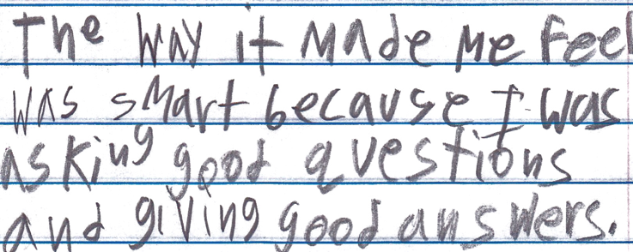
Student Reflection
“The way it made me feel was smart because I was asking good questions and giving good answers.”
-Boston 9th grade summer school student

Slide 20
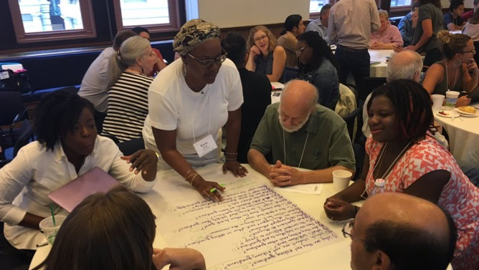
Collaborative Learning with the Question Formulation Technique (QFT)

Slide 21
The Question Formulation Technique (QFT)
A step-by-step strategy in which people:
Produce their own questions
Transform & Improve their questions
Strategize on how to use their questions
Reflect on what they have learned and how they learned it
Notes:
Ashley

Slide 22
Rules for Producing Questions
1. Ask as many questions as you can
2. Do not stop to answer, judge, or discuss
3. Write down every question exactly as stated
4. Change any statements into questions
Which rules might be hard to follow? Why?
Notes:
Ashley

Slide 23
Produce Questions
Ask Questions
Follow the Rules
Ask as many questions as you can.
Do not stop to answer, judge, or discuss.
Write down every question exactly as it was stated.
Change any statements into questions.
Number the Questions
Notes:
Ashley

Slide 24
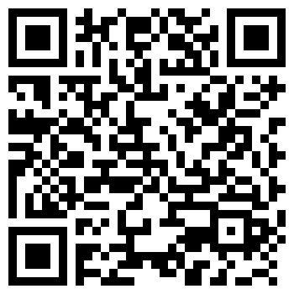
Question Focus
http://bit.ly/qfoci
Pick ONE QFocus to generate questions
with your group
Notes:
Ashley

Slide 25
Give me your tired, your poor, your huddled masses wanting to breathe free . . .

Slide 27
The Cherokee learned to read and write using Sequoyah’s symbols.

Slide 28
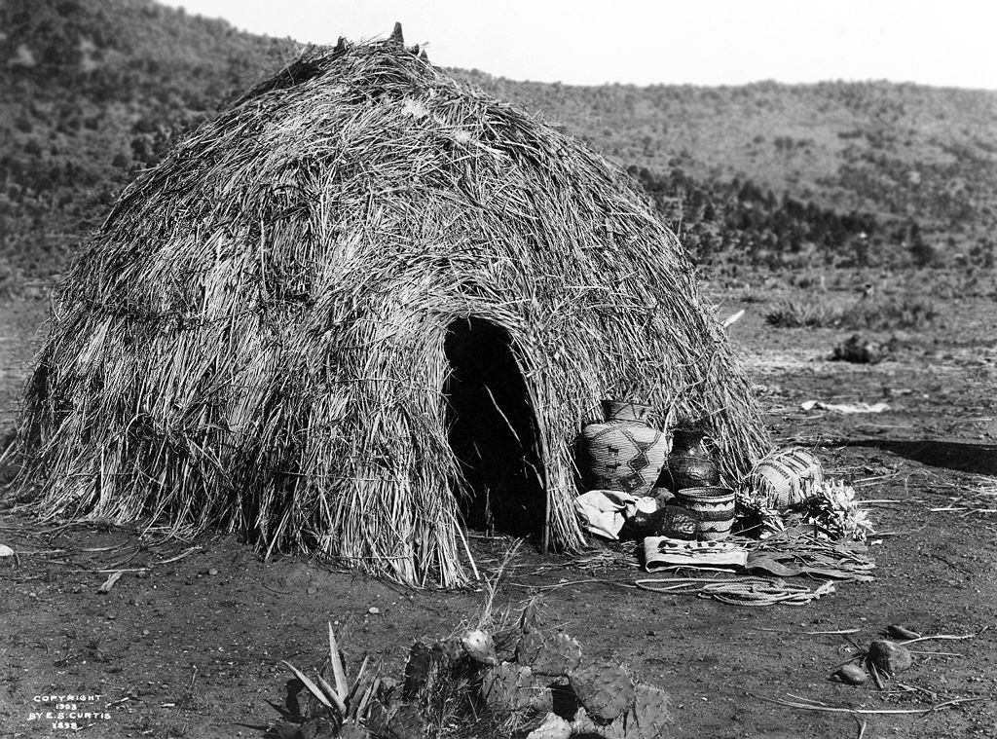
Notes:
https://upload.wikimedia.org/wikipedia/commons/thumb/5/54/Apache_Wickiup,_Edward_Curtis,_1903.jpg/1024px-Apache_Wickiup,_Edward_Curtis,_1903.jpg
https://www.loc.gov/pictures/item/90710167/
https://en.wikipedia.org/wiki/File:Apache_Wickiup,_Edward_Curtis,_1903.jpg

Slide 29
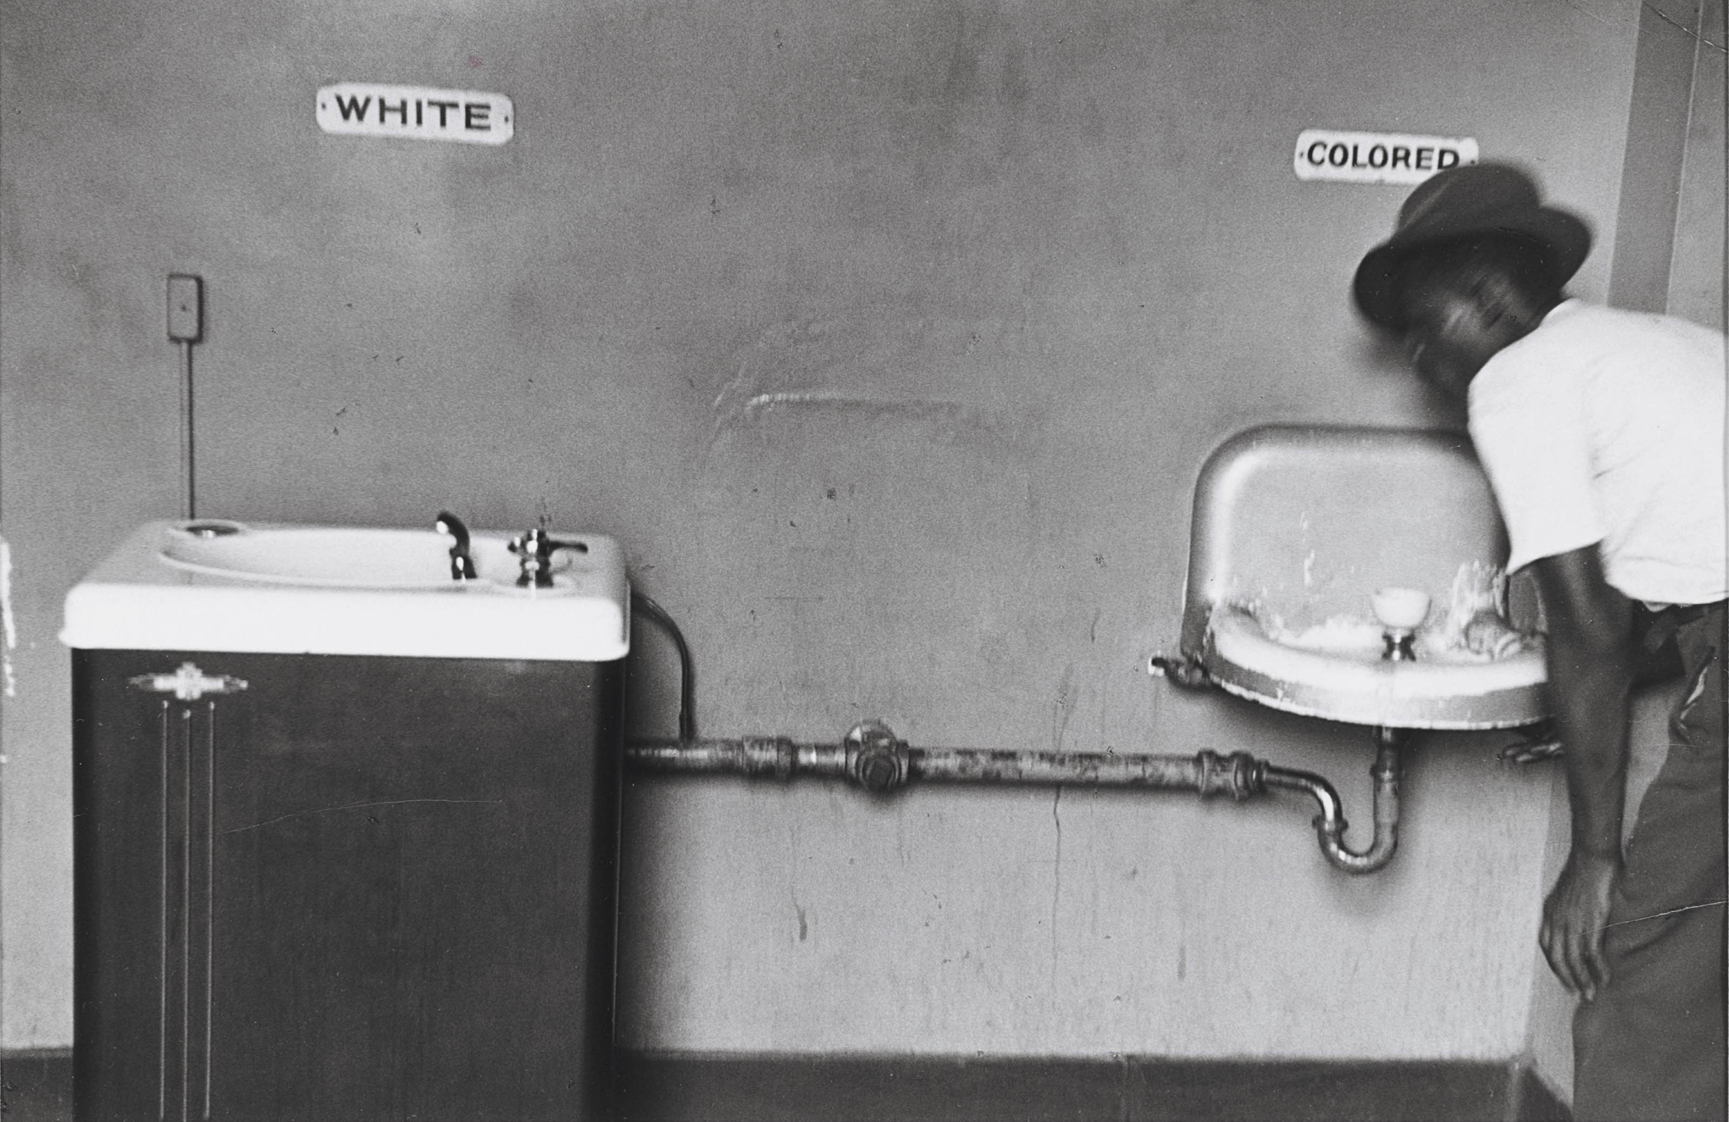
Jim Crow laws, the laws that separated the South
Notes:
ELLIOTT ERWITT (B. 1928)
Segregated Water Fountains, North Carolina, 1950
https://www.christies.com/lotfinder/Lot/elliott-erwitt-b-1928-segregated-water-5544674-details.aspx

Slide 30
Injustice anywhere is a threat to justice everywhere. We are caught in an inescapable network of mutuality, tied in a single garment of destiny. Whatever affects one directly, affects all indirectly.
Martin Luther King, Jr.
Letter from a Birmingham Jail
April 16, 1963

Slide 31
East Germany, 1989
Notes:
East German students sit on the Berlin Wall at the Brandenburg Gate in front of border guards in November 1989.
https://radio.wosu.org/post/leonard-bernstein-marked-fall-berlin-wall-ode-freedom#stream/0

Slide 32
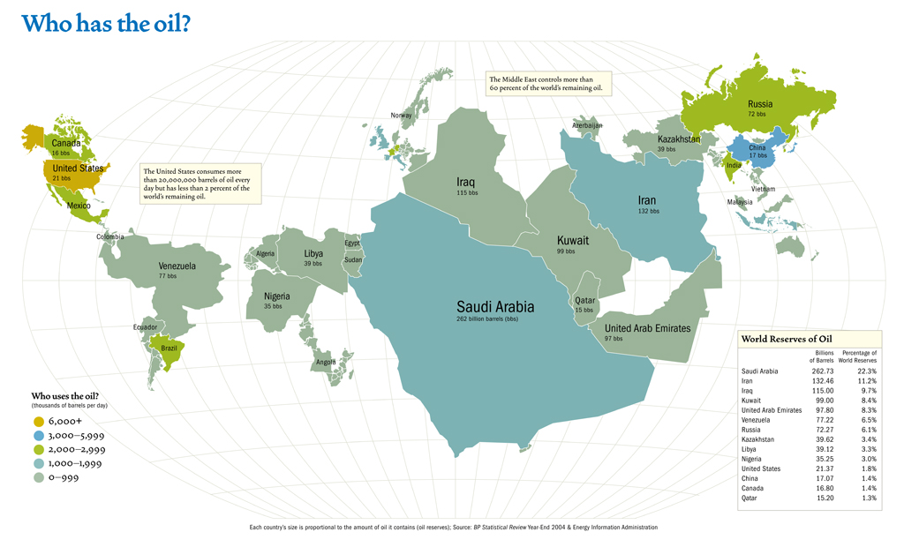
http://blogs.harvard.edu/mesh/2007/12/who_has_oil/

Slide 33
“ . . . the policy of the General Government toward the red man is not only liberal, but generous. He is unwilling to submit to the laws of the States and mingle with their population. To save him from this alternative, or perhaps utter annihilation, the General Government kindly offers him a new home, and proposes to pay the whole expense of his removal and settlement.”
- U.S President Andrew Jackson in his Second Annual Message (1830)
Notes:
http://blogs.harvard.edu/mesh/files/2007/12/oilmap.jpg

Slide 34
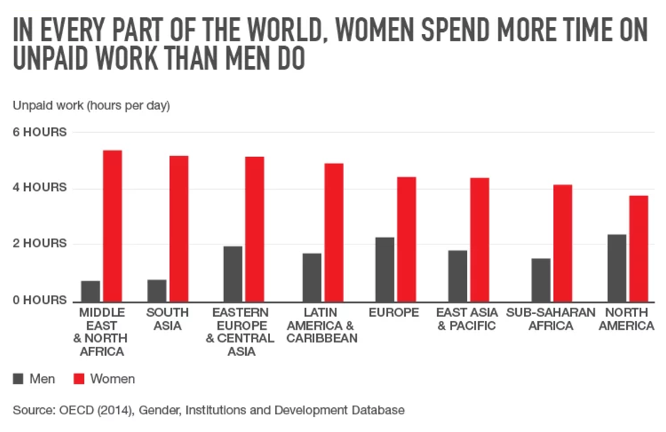
Notes:
Fortune: “Women Do Twice As Much Unpaid Work As Men—Here's Why That's Not Okay” - http://fortune.com/2016/02/23/melinda-gates-women-unpaid-work/
STANDARD: SSWG2 Evaluate how the physical and human characteristics of places and regions are connected to human identities and cultures. d. Examine the impact of cultural beliefs on gender roles and perceptions of race and ethnicity as they vary from one region to another (e.g., the caste system, apartheid, and legal rights for women).

Slide 35
Notes:
SSCG6: Analyze the meaning and importance of each of the rights guaranteed under the Bill of Rights and how each is secured

Slide 36
Categorize Questions: Closed/ Open
Definitions:
Closed-ended questions can be answered with a “yes” or “no” or with a one-word answer.
Open-ended questions require
more explanation.
Directions: Identify your questions as closed-ended or open-ended by marking them with a “C” or an “O.”
Notes:
Ashley

Slide 37
Discussion
Closed-ended Questions
Advantages
Disadvantages
Notes:
Ashley

Slide 38
Discussion
Open-ended Questions
Advantages
Disadvantages
Notes:
Ashley

Slide 39
Transform Questions
Take one closed-ended question and change it into an open-ended question.
Take one open-ended question and change it into a closed-ended question.
Closed
Open
Open
Closed

Slide 40
Prioritize Questions
Review your list of questions
Choose the three questions you consider most important.
While prioritizing, think about your Question Focus: Some students are not asking questions.
After prioritizing consider…
Why did you choose those three questions?
Where are your priority questions in the sequence of your entire list of questions?
Notes:
Ashley

Slide 41
Strategize and Action Plan
From priority questions to action plan…
In order to answer your priority questions:
What do you need to know? Information
What do you need to do? Tasks
Notes:
Ashley

Slide 42
Strategize and Action Plan
In order to answer your priority questions:
What do you need to know? Information
What do you need to do? Tasks
Information | Tasks
Notes:
Ashley

Slide 43
Share
Questions you changed from open/closed
Your three priority questions and their numbers in your original sequence
Rationale for choosing priority questions
Next steps from your action plan
Notes:
Ashley

Slide 44
Reflect
What did you learn?
How did you learn it?
How will you use what you’ve learned?
Notes:
Ashley

Slide 45
A Look Inside the Process
Notes:
Dan

Slide 46
The QFT, on one slide…
Ask as many questions as you can
Do not stop to discuss, judge or answer
Record exactly as stated
Change statements into questions
Question Focus
Produce Your Questions
Follow the rules
Number your questions
Transform Your Questions
Categorize questions as Closed or Open-ended
Change questions from one type to another
Prioritize Your Questions
Share & Discuss Next Steps
Reflect
Closed-Ended:
Answered with “yes,” “no” or one word
Open-Ended: Require longer explanation
Notes:
Dan

Slide 47
Curiosity and Rigor
Three thinking abilities
with one process
Notes:
Dan

Slide 48
Thinking in many different directions
Divergent
Thinking

Slide 49
Narrowing Down, Focusing
Convergent
Thinking

Slide 50
Thinking about Thinking
Metacognition

Slide 51
This is great! . . . What can I take out?
At what point is the QFT no longer the QFT?

Slide 53
RQI’s Question Formulation Technique
Make Just One Change pg. 20 Table 1.1
Steps | Teacher Role | Student Role | Student Thinking Abilities
QFocus | Set goal for use of the QFT and develop a Qfocus | N/A | Divergent
Rules | Introduce Rules for Producing Questions; facilitate discussions | Discuss challenges in using the rules | Metacognitive
Produce | Give instruction to start process | Work in small groups to ask questions related to the QFocus | Divergent
Improving | Facilitate discussion about open- and closed-ended questions. | Discuss advantages and disadvantages of open- and closed-ended questions; practice changing questions from one type to another | Metacognitive & Convergent
Prioritizing | Provide instructions on how to prioritize the questions. Monitor and support student prioritization. | Discuss, compare, assess, and prioritize questions. Select three priority questions and explain choices. | Convergent
Next Steps | Provide direction for using the questions. | Use the questions for purposes set by the teacher. | Convergent
Reflection | Facilitate the reflection process. | Discuss what was learned, how it was learned, and what they now know or feel differently about it. | Metacognitive & Convergent

Slide 54
Changes that result from use of the Rules for Producing Questions
Make Just One Change pg. 44, Tabel 3.1
Rule | What does it accomplish?
1. Ask as many questions as you can | Gives license to ask
2. Do not stop to discuss, judge, or answer any questions | Create safe space and protection
3. Write down every question exactly as it is stated. | Levels the playing field so all question and voices are respected.
4. Change any statement in a question | Insists on the discipline of phrasing, asking, and thinking in questions, not statements

Slide 55
Four Principles of Facilitation
Monitor student adherence to the process
Do not give examples
Do not get pulled into group discussion
Acknowledge all contributions equally
What could be challenging about each principle? What might be important about each?
Notes:
James

Slide 56
Why Use the QFT? Student Changes
Notes:
Dan

Slide 57
Detour or Shortcut?

Slide 58
Behavioral Changes
Students self-regulate more effectively.
Students collaborate and listen to each other’s questions.
Students negotiate and work on reaching consensus about group decisions.
Students become more self-aware and build positive relationships (SEL goals).
Source - Make Just One Change: Teach Students to Ask their Own Questions, Rothstein & Santana 2014

Slide 59
Affective Changes
Students feel more confident.
Students express greater interest and are more curious.
Students demonstrate a greater sense of urgency and responsibility to “get the answers.”
Source - Make Just One Change: Teach Students to Ask their Own Questions, Rothstein & Santana 2014

Slide 60
www.rightquestion.org
Check out our 3-week online course hosted by the Harvard Graduate School of Education (Starting April and October)

Slide 61
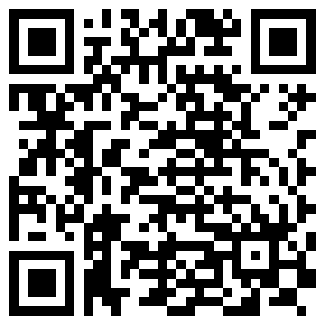
Putting it into Practice
https://rightquestion.org/resources/lesson-planning-workbook/

Slide 62
To Access Today’s Materials:
http://rightquestion.org/events/
Join our Educator Network for:
Templates you can use tomorrow in class
Classroom examples
Instructional videos
Opportunities to connect with other educators
Notes:
Dan

Slide 63
Using & Sharing RQI’s Resources
The Right Question Institute offers materials through a Creative Commons License. You are welcome to use, adapt, and share our materials for noncommercial use, as long as you include the following reference:
“Source: The Right Question Institute (RQI). The Question Formulation Technique (QFT) was created by RQI. Visit rightquestion.org for more information and free resources.”
Notes:
Dan

