Slide 1
Encouraging Agency through Questioning and Inquiry
Kim Sergent
Social Studies Instructional Specialist/QFT Lead
Kentucky Valley Educational Cooperative
Hazard, KY Kimberly.sergent@letcher.kyschools.us @kserge7
Sarah Westbrook
Director of Professional Learning
The Right Question Institute
Cambridge, MA
Sarah.westbrook@rightquestion.org
@SarahRQI

Slide 2
Acknowledgments
We are deeply grateful to The Hummingbird Fund and to the Right Question Institute board of directors for the work they do to support our sharing of the Question Formulation Technique (QFT).
We would also like to acknowledge the tremendous contributions of thousands of educators currently using the QFT, sharing it with students and colleagues, and continuously teaching us. Without their ingenuity and generosity, this work would not be possible. We are grateful to Katy Connolly at RQI, for all their work helping make this session possible.

Slide 3
Welcome
We shall not cease from exploration
And the end of all our exploring
Will be to arrive where we started
And know the place
For the first time.
-T.S. Eliot

Slide 4
Who is in the room?

Slide 5
What is your role?
If you are a teacher, choose the
If you are a PD Coordinator or Instructional Supervisor, or Instructional coach, choose the
If you are a principal or administrator, choose the
OR Choose multiple dots that best identify your role(s).

Slide 6
Today’s Agenda
Collaborative Learning with the Question Formulation Technique (QFT)
Sharing our Model
Planning How You Might Use the QFT
Reflection & Evaluation

Slide 7
To Access Today’s Materials:
http://rightquestion.org/events/
Join our Educator Network for:
Templates you can use tomorrow in class
Classroom Examples
Instructional Videos
Forums and Discussions with other Educators

Slide 8
We’re Tweeting…
@kserge7
@RightQuestion
@SarahRQI
#QFT

Slide 9
Honoring the Original Source: Parents in Lawrence, Massachusetts, 1990
“We don’t go to the school because we don’t even know what to ask.”

Slide 10
"There is no learning without having to pose a question."
- Richard Feynman
Nobel Laureate, Physics, 1965

Slide 11
We Are Not Alone
In over 1 million classrooms worldwide

Slide 12
Now, Educators Lead the Work
The Right Question Institute offers materials through a Creative Commons License. You are welcome to use, adapt, and share our materials for noncommercial use, as long as you include the following reference:
“Source: The Right Question Institute (RQI). The Question Formulation Technique (QFT) was created by RQI. Visit rightquestion.org for more information and free resources.”

Slide 13
What happens when students do learn to ask their own questions?

Slide 14
Research Confirms the Importance of Student Questioning
Self-questioning (metacognitive strategy):
Student formulation of their own questions is one of the most effective metacognitive strategies
Engaging in pre-lesson self-questioning improved students’ rate of learning by nearly 50% (Hattie, p.193)
John Hattie
Visible Learning: A Synthesis of Over 800
meta-Analyses Relating to Achievement, 2008
Notes:
UC Davis Research Linking Curiosity to Memory (UC Davis) 2014
The Fullerton Longitudinal Study (FLS), a 30-plus year study of the development of giftedness across various points in time conducted by Adele and Allen Gottfried of California State University ”This finding has strong implications for the development of STEM considering that curiosity is a fundamental predictor of the aspiration to become a scientist.”
S. von Stumm, B. Hell, T. Chamorro-Premuzic. The Hungry Mind: Intellectual Curiosity Is the Third Pillar of Academic Performance. Perspectives on Psychological Science, 2011 meta-analysis shows They found that curiosity did, indeed, influence academic performance. In fact, it had quite a large effect, about the same as conscientiousness. When put together, conscientiousness and curiosity had as big an effect on performance as intelligence.

Slide 15
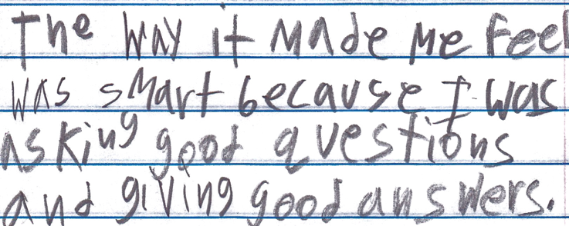
Student Reflection
“The way it made me feel was smart because I was asking good questions and giving good answers.”
-Boston 9th grade summer school student

Slide 16
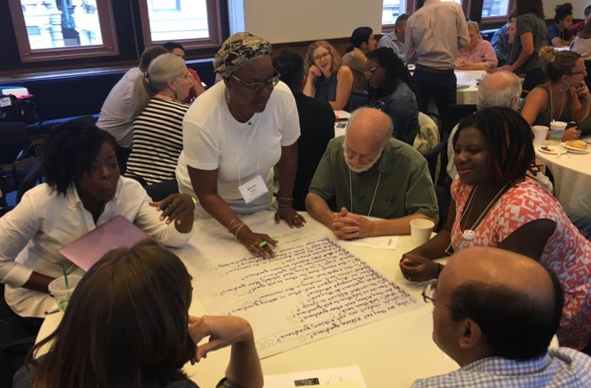
Collaborative Learning with the Question Formulation Technique (QFT)

Slide 17
The Question Formulation Technique (QFT)
Individuals learn to:
Produce their own questions
Improve their questions
Strategize on how to use their questions
Reflect on what they have learned and how they learned it

Slide 18
Rules for Producing Questions
1. Ask as many questions as you can
2. Do not stop to answer, judge, or discuss
3. Write down every question exactly as stated
4. Change any statements into questions

Slide 19
Producing Questions
Ask Questions
Follow the Rules
Ask as many questions as you can.
Do not stop to answer, judge, or discuss.
Write down every question exactly as it was stated.
Change any statements into questions.
Number the Questions

Slide 20
Question Focus:
Your group leader will have your team’s Qfocus.

Slide 21
Categorizing Questions: Closed/ Open
Definitions:
Closed-ended questions can be answered with a “yes” or “no” or with a one-word answer.
Open-ended questions require
more explanation.
Directions: Identify your questions as closed-ended or open-ended by marking them with a “C” or an “O.”

Slide 22
Discussion
Closed-ended Questions
Advantages
Disadvantages

Slide 23
Discussion
Open-ended Questions
Advantages
Disadvantages

Slide 24
Improving Questions
Take one closed-ended question and change it into an open-ended question.
Take one open-ended question and change it into a closed-ended question.
Add these questions to your list, keeping the original questions.
Closed
Open
Open
Closed
Notes:
Luz: Read Slide. 1 ½ Minutes. Pause & Time. DO NOT ASK THEM TO SHARE.
* Winston: Add the gif to this slide to go along with the final animation

Slide 25
Strategize: Prioritizing Questions
Review your list of questions
Choose the three questions you’re interested to continue working on today with your group.
While prioritizing, think about your Question Focus
After prioritizing consider…
Why did you choose those three questions?
Where are your priority questions in the sequence of your entire list of questions?

Slide 26
Strategize: Next Steps
From priority questions to action plan
In order to answer your priority questions:
What do you need to know? Information
What do you need to do? Tasks

Slide 27
Next Steps: Action Plan
In order to answer your priority questions:
What do you need to know? Information
What do you need to do? Tasks
Information | Tasks

Slide 28
4 Different QFocus Prompts in 1 Room
Engaging, student-driven learning
Engaging, teacher-driven professional learning
Scaling and sustaining teacher-driven professional learning
Scaling and sustaining inquiry-based practice

Slide 29
Share
Walk around the room and read what other groups produced.
Look for similarities in their questions.

Slide 30
Reflection
What did you learn?
How did you learn it?
What do you understand differently now about the impact of using questions to engage the voice of your students AND teachers?
How did having 4 different QFocus prompts in 1 room impact your thinking?

Slide 31
A Look Inside the Process

Slide 32
The QFT, on one slide…
Question Focus
Produce Your Questions
Follow the rules
Number your questions
Improve Your Questions
Categorize questions as Closed or Open-ended
Change questions from one type to another
Prioritize Your Questions
Share & Discuss Next Steps
Reflect
Ask as many questions as you can
Do not stop to discuss, judge or answer
Record exactly as stated
Change statements into questions
Closed-Ended:
Answered with “yes,” “no” or one word
Open-Ended: Require longer explanation

Slide 33
Curiosity and Rigor
Three thinking abilities
with one process

Slide 34
Thinking in many different directions
DIVERGENT THINKING

Slide 35
Narrowing Down, Focusing
CONVERGENT
THINKING
Notes:
n

Slide 36
Thinking about Thinking
Metacognition

Slide 37
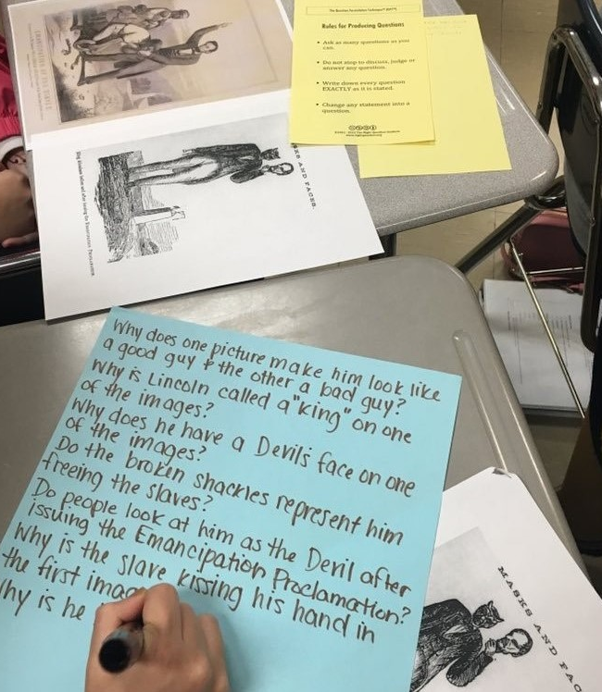
The KVEC Model: Agency in Professional Learning

Slide 38
Who is KVEC?
Rural Educational Cooperative
Serving 22 School Districts in 19 Counties

Slide 39
Why QFT?
Domain 3: Instruction
3b – Questioning & Discussion
In addition to the characteristics of accomplished:
Students initiate higher-order questions.
Students extend the discussion, enriching it.
Students invite comments from their classmates during discussion.

Slide 40
KVEC Model
Three phases:
Cadre
Modeling/Coaching
Personalized Professional Learning
Fall 2016 to the Present
Centered on Student Voice and Teacher Agency

Slide 41
QFT Cadre Fall 2016
Intent: Saturation of the strategy
Support teachers work within Domain 3, esp. 3b
Network created to train teachers in districts
Create support materials
Met July through November 2016
Positives: Urgency in momentum
Changes: More time to develop the “coach within”

Slide 42
Instructional Change does not happen overnight
Process
Practice
Refinement
The Coach Within

Slide 43
Allowing students to approach texts with their own questions created a shift in focus within my classroom and increased student responsibility for learning. I was happy to share QFT with my colleagues in school wide professional learning sessions. I continue to support my colleagues in implementing this effective instructional strategy. Rebecca King, High School English/Language Arts

Slide 44
Modeling/Coaching 2017-Present
Based on Gradual Release Model:
“I do, We do, You do”
Immediate support for teachers as they see it happen with their students
Coaching the components in real time:
Question Focus, Facilitation, Using the Questions
Positives: Can identify factors impacting student agency
Changes: Developing the coaches takes time

Slide 45
I have found the QFT to be an excellent tool to engage my students in their own learning. They are more focused on learning. Their questions allow me as a teacher to assess prior knowledge they may have about a subject, understand their needs and still cover content I need them to know. Students are more invested in their learning and continually amaze me with their questions. Shana Trimble, 5th grade Social Studies

Slide 49
Personalized Professional Learning Arriving in 2020
Webinars: Introduction
Webcasts: Regional teachers demonstrating planning,
teaching, reflecting in the strategy
Microcredential: Demonstrating competency within the QFT
Positives: Keeps the teacher connected to the classroom as they practice the strategy/real time, collaborating with PLC/PLN to plan and reflect, opportunities to share learning, strengthening staff/teacher network

Slide 50
Reflection
Individually, reflect and plan within these question:
What did you learn today that you want to apply?
How will you address the challenges you anticipate within your action plan?
Now, go find a pair to share!

Slide 51
What are your takeaways today?

Slide 52
Stay in Touch & Join Our Community
RQI’s Free Online Educator Network:
rightquestion.org/join/
Twitter: @RightQuestion #QFT
Thinking about using the QFT with primary sources? Join our community group on the TPS Teacher’s Network for tips and lesson ideas.

Slide 53
To Access Today’s Materials:
http://rightquestion.org/events/
Join our Educator Network for:
Templates you can use tomorrow in class
Classroom Examples
Instructional Videos
Forums and Discussions with other Educators

Slide 54
Now, Educators Lead the Work
The Right Question Institute offers materials through a Creative Commons License. You are welcome to use, adapt, and share our materials for noncommercial use, as long as you include the following reference:
“Source: The Right Question Institute (RQI). The Question Formulation Technique (QFT) was created by RQI. Visit rightquestion.org for more information and free resources.”

