Slide 1
Facilitating Primary Source Learning with Students’ Questions
Sarah Westbrook
Andrew Minigan
The Right Question Institute
Cambridge, MA
Ann Canning Teaching with Primary Sources (TPS) Eastern Region
Waynesburg, PA

Slide 2
NCHE Conference Sponsors

Slide 3
NCHE Door Prizes
One Door Prize Ticket for Every Session Evaluation Completed!
Door Prizes Include:
Registration, Flight and Hotel for the 2021 NCHE Conference,
Ancestry DNA Kit,
Kindle Fire,
Assorted Books and Gift Baskets,
Memberships to World Explorer, Fold3.com, Newspapers.com and Sutori,
Other Exciting Items!
Winners will be picked each day and notified after the conference.
Good Luck!!

Slide 4
Humanities in Class Education Programs build bridges between the scholarly world and the working classroom, addressing both classic and contemporary aspects of the humanities.
Spring Online Courses start May 26
Beyond February: Hip Hop and the African American Experience Summer Institute registration now open
Humanities in Class Digital Library launches in early June, featuring OER content and instructional resources from over thirty humanities organizations, including NCHE.
www.nationalhumanitiescenter.org
Notes:
4

Slide 5
Facilitating Primary Source Learning with Students’ Questions
Sarah Westbrook
Andrew Minigan
The Right Question Institute
Cambridge, MA
Ann Canning Teaching with Primary Sources (TPS) Eastern Region
Waynesburg, PA
Access today’s materials at https://rightquestion.org/events/

Slide 6
There are 2 icons you will see in this session:
This means that you should be thinking or working on the task assigned
This means get ready to use your chat box to share some of your work

Slide 7
Who is in the room?
Notes:
Introduce yourself with your first name and where you’re joining us from. And take the poll!
POLL QUESTIONS
How well do you know The Question Formulation Technique (QFT)? (choose 1)
Not at all
A little
Fairly well
Very well
Have you used the Question Formulation Technique (QFT) before? (choose 1)
Yes
No
Unsure
What are you hoping to learn during the webinar today? (Choose all that apply)
Strategies to get students asking more and better questions
Learn more about the Question Formulation Technique (QFT) and how it works
Learn more about specific NGSS classroom applications of the Question Formulation Technique
Tips for best or optimal use of the Question Formulation Technique (QFT)
Learn more about NGSS
Which aspects of NGSS are you fairly familiar with? (Check all the apply)
Investigation of Phenomena
NGSS Storylines
Driving Question Board

Slide 8
Today’s Agenda
Why Spend Time on Teaching the Skill of Question Formulation?
Collaborative Learning with the Question Formulation Technique (QFT)
Explore Real Classroom Examples & Applications
Why is Question Formulation Important Now?
Q&A

Slide 9
We’re Tweeting…
@RightQuestion
@SarahRQI
@AndrewRQI
#QFT

Slide 10
Access Today’s Materials and All of Our Free Resources
https://rightquestion.org/events/
Classroom Examples
Instructional Videos
Planning Tools & Templates

Slide 11
Use and Share These Resources
The Right Question Institute offers materials through a Creative Commons License. You are welcome to use, adapt, and share our materials for noncommercial use, as long as you include the following reference:
“Source: The Right Question Institute (RQI). The Question Formulation Technique (QFT) was created by RQI. Visit rightquestion.org for more information and free resources.”

Slide 12
Why spend time teaching the skill of question formulation?

Slide 13
Honoring the Original Source: Parents in Lawrence, Massachusetts, 1990
“We don’t go to the school because we don’t even know what to ask.”

Slide 14
"There is no learning without having to pose a question."
- Richard Feynman
Nobel Laureate, Physics, 1965

Slide 15
“We must teach students how to think in questions, how to manage ignorance.”
– Stuart Firestein
Former chair, Department of Biology,
Columbia University

Slide 16
College Presidents on What College Students Should Learn
“The primary skills should be analytical skills of interpretation and inquiry. In other words, know how to frame a question.”
- Leon Botstein, President of Bard College
“…the best we can do for students is have them ask the right questions.”
- Nancy Cantor, Former Chancellor of University of Illinois
The New York Times, August 4, 2002

Slide 17
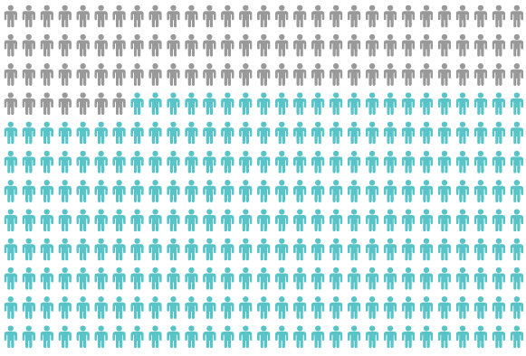
Yet, Only 27% of Graduates Believe College Taught Them How to Ask Their Own Questions
Alison Head, Project Information Literacy at University of Washington, 2016

Slide 18
But, the problem begins long before college…

Slide 19
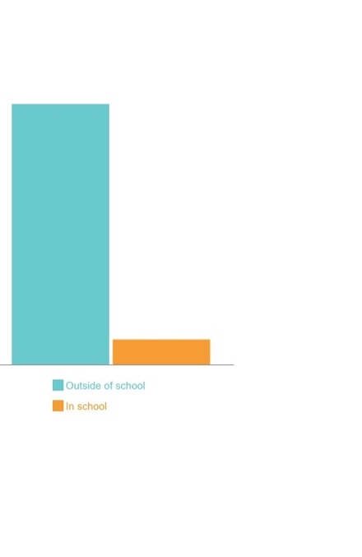
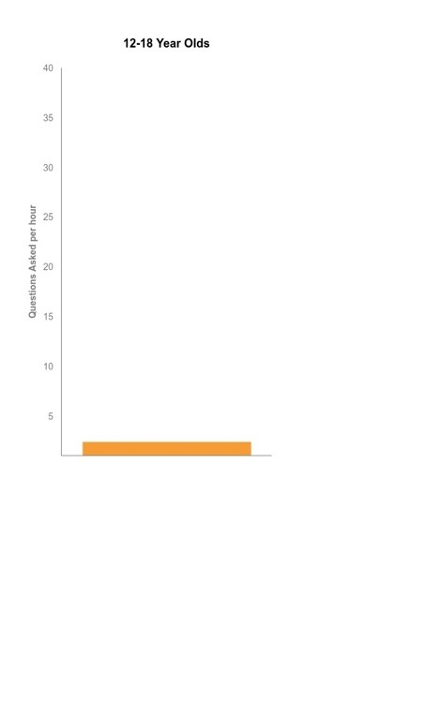
Question Asking Declines with Age
Tizard, B., Hughes, M., Carmichael, H., & Pinkerton, G. (1983).
Dillon, J. T. (1988).
Notes:
First Graph:
Tizard, B., Hughes, M., Carmichael, H., & Pinkerton, G. (1983). Children’s questions and adults’ answers. Journal of Child Psychology and Psychiatry, 24, 269-281.
Girls (mean age 3 years 11 months) from working class and middle class families asked 24 and 29 questions per hour at home, respectively. At school, these same girls asked on average 1.4 and 3.7 questions per hour (working and middle class, respectively)
Need to look into the article to see what age at school.
Second
Differences in question asking by income:
Tizard, B., Hughes, M., Carmichael, H., & Pinkerton, G. (1983). Children’s questions and
adults’ answers. Journal of Child Psychology and Psychiatry, 24, 269-281.
This research study examines two groups of children, one from middle class families and one from working class families, to explore socioeconomic status differences in question-asking behavior at home and at school.

Slide 20
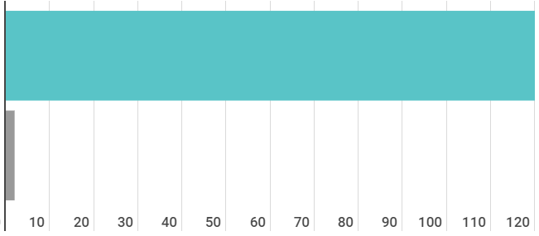
Question Asking in School
Who’s asking questions over the course of an hour?
Educators
Students
Dillon, 1988, p. 199

Slide 21
We can work together on changing these dynamics

Slide 22
We Are Not Alone
More than 1 million classrooms worldwide

Slide 23
What happens when students do learn to ask their own questions?

Slide 24
Research Confirms the Importance of Questioning
Self-questioning (metacognitive strategy):
Student formulation of their own questions is one of the most effective metacognitive strategies
Engaging in pre-lesson self-questioning improved students rate of learning by nearly 50% (Hattie, p.193)
John Hattie
Visible Learning: A Synthesis of Over 800
meta-Analyses Relating to Achievement, 2008
Notes:
UC Davis Research Linking Curiosity to Memory (UC Davis) 2014
The Fullerton Longitudinal Study (FLS), a 30-plus year study of the development of giftedness across various points in time conducted by Adele and Allen Gottfried of California State University ”This finding has strong implications for the development of STEM considering that curiosity is a fundamental predictor of the aspiration to become a scientist.”
S. von Stumm, B. Hell, T. Chamorro-Premuzic. The Hungry Mind: Intellectual Curiosity Is the Third Pillar of Academic Performance. Perspectives on Psychological Science, 2011 meta-analysis shows They found that curiosity did, indeed, influence academic performance. In fact, it had quite a large effect, about the same as conscientiousness. When put together, conscientiousness and curiosity had as big an effect on performance as intelligence.

Slide 25
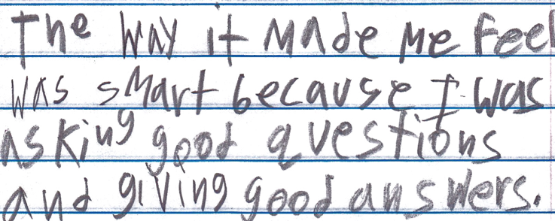
Student Reflection
“The way it made me feel was smart because I was asking good questions and giving good answers.”
-Boston 9th grade summer school student

Slide 26
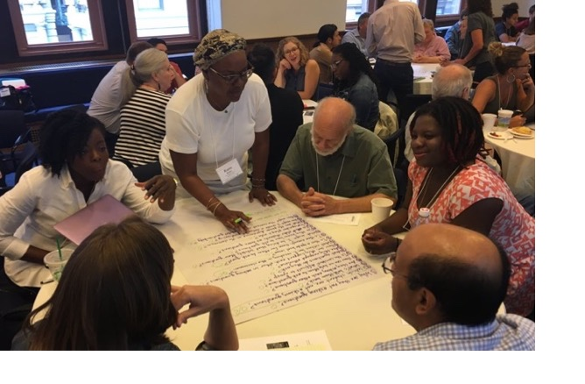
Collaborative Primary Source Learning with the Question Formulation Technique (QFT)
Notes:
Now we’re going to work together on the problem of students not asking questions, by using the Question Formulation Technique.
The next 20 minutes or so will be highly participatory and of course we’re going to be putting you to work. You may want to get some paper or pull up a blank document on your computer screen now. And remember, watch out for the chat box icon. I will tell you when you need to type into it.
The timing may be a little quick, so don’t worry if you haven’t completed every step; we’re more giving you a taste of the whole process. The rest of this course will go far more in depth on each piece.” we will be moving you quickly through an experience to demonstrate how we go through the process, but will be rushing to make sure there is time for your questions at the end." This is giving you a taste

Slide 27
The Question Formulation Technique (QFT)
Individuals learn to:
Produce their own questions
Improve their questions
Strategize on how to use their questions
Reflect on what they have learned and how they learned it

Slide 28
Rules for Producing Questions
1. Ask as many questions as you can
2. Do not stop to answer, judge, or discuss
3. Write down every question exactly as stated
4. Change any statements into questions
Notes:
NOTE THAT THEY ARE Working ALONE rather than in a group: Say something about not judging YOURSELF or changing your wording as it comes out
Think about what will be difficult to follow for you. Pause.
DO NOT ASK THEM TO SHARE!!!
Usually, people say that it is difficult not to stop to answer and judge.

Slide 29
Produce Questions
Ask Questions
Follow the Rules
Ask as many questions as you can.
Do not stop to answer, judge, or discuss.
Write down every question exactly as it was stated.
Change any statements into questions.
Number the Questions

Slide 30
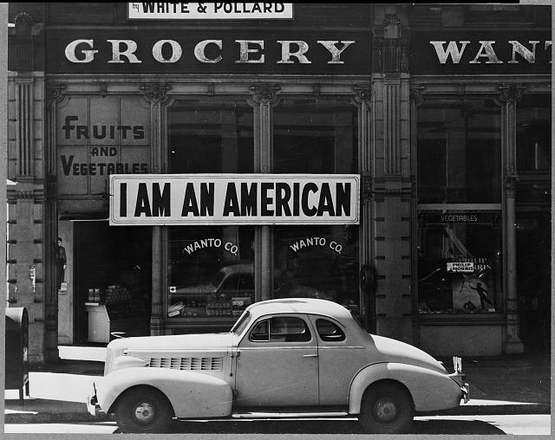
Question Focus
→Take 1 minute to silently observe the image.
→Now, ask questions. Number the questions. Follow the rules.
A store owned by the Matsuda family in Oakland, CA, March, 1942
Retrieved from:
https://www.loc.gov/pictures/item/2004665381/
Notes:
Take a minute to just observe
give directions and pause/time. 3 Min. Give HALFWAY WARNING.
MAKE SURE TO WRITE THEM DOWN BECAUSE YOU NEED THEM FOR ALL THE NEXT STEPS.
Put the 4 rules in the chat box.

Slide 31
Categorize Questions: Closed/Open
Definitions:
Closed-ended questions can be answered with a “yes” or “no” or with a one-word answer.
Open-ended questions require
more explanation.
Directions: Identify your questions as closed-ended or open-ended by marking them with a “C” or an “O.”
Notes:
Read slide. Pause/time. 11/2 Minutes. DO NOT ASK THEM TO SHARE.

Slide 32
Discuss
Closed-ended Questions
Advantages
Disadvantages
Notes:
Give your directions.
Sarah: TYPE a RESPONSE in the chat box now.
SARAH read some questions.
Disadvantages.

Slide 33
Discuss
Open-ended Questions
Advantages
Disadvantages
Notes:
Give the directions.
TYPE a RESPONSE in the chat box now.
Read some questions.
Disadvantages
The point here is that the closed ended questions are equally useful as open-ended!!!

Slide 34
Improve Questions
Take one closed-ended question and change it into an open-ended question.
Take one open-ended question and change it into a closed-ended question.
Closed
Open
Open
Closed
Notes:
Read Slide. 1 ½ Minutes. Pause & Time. DO NOT ASK THEM TO SHARE.

Slide 35
Prioritize Questions
Review your list of questions
Choose three questions that you are most curious to discuss and think about further.
While prioritizing, think about your Question Focus, the image of the storefront.
Then, think about why you chose those questions.
After prioritizing, use the chat box to share ONE of your priority questions.
Notes:
Read the slide. Pause and Time. 1 ½ min.
“Share just ONE of your priority questions.”
You should type in the chat box now.

Slide 36
Action Plan
Moving from priority questions into action steps.
In order to answer your priority questions:
What do you need to know? Information
What do you need to do? Tasks
Write down a couple ideas you have.
Notes:
Read the slide. Pause & Time. 2 minutes to write a couple notes. DO NOT ASK TO SHARE
Tasks can include investigations.
Remember to confine yourself to what we could reasonably do with the materials in our classroom.

Slide 37
Share
Using the Chat Box, please share:
One idea you had from your action plan
- and -
The numbers of your three priority questions in your original sequence (For ex: “2, 4, 7 out of 8 total”)

Slide 38
Reflect
What did you learn?
How did you learn it?
After reflecting, use the chat box to share your response to ONE of the questions above.

Slide 39
Possible Extensions with Library of Congress Resources (thanks, Ann!)
https://blogs.loc.gov/picturethis/2015/02/day-of-remembrance-photographs-of-japanese-american-internment-during-world-war-ii/ blog post that links resources throughout Library collections
http://www.loc.gov/teachers/classroommaterials/primarysourcesets/internment/ A primary source set on Japanese American internment with detailed teacher’s guide
https://www.loc.gov/collections/ansel-adams-manzanar/about-this-collection/ The full Ansel Adams collection of photographs taken at Manzanar relocation center
https://www.loc.gov/teachers/classroommaterials/presentationsandactivities/presentations/immigration/japanese3.html
http://www.loc.gov/teachers/classroommaterials/primarysourcesets/veterans/struggles.html
Women Come To the Front - Dorothea Lange: https://www.loc.gov/exhibits/wcf/wcf0013.html
Japanese-American Internment Camp Newspapers, 1942 to 1946: https://www.loc.gov/collections/japanese-american-internment-camp-newspapers/about-this-collection/

Slide 40
A Look Inside the Process

Slide 41
The QFT, on one slide…
Ask as many questions as you can
Do not stop to discuss, judge or answer
Record exactly as stated
Change statements into questions
Question Focus
Produce Your Questions
Follow the rules
Number your questions
Improve Your Questions
Categorize questions as Closed or Open-ended
Change questions from one type to another
Strategize
Prioritize your questions
Action plan or discuss next steps
Share
Reflect
Closed-Ended:
Answered with “yes,” “no” or one word
Open-Ended: Require longer explanation
Source: The Right Question Institute rightquestion.org
Notes:
Note the changes we made to PRIORITIZATION – could have done “the 3 questions that lend themselves to research” or “3 questions that would help us learn more about Japanese American Internment”
It is NOT just a question brainstorming process
Say something about the LARGER POINT of the PROCESS—it is about changing the way that school is played

Slide 42
Three thinking abilities
with one process

Slide 43
Thinking in many different directions
Divergent
Thinking

Slide 44
Narrowing Down, Focusing
Convergent
Thinking

Slide 45
Thinking about Thinking
Metacognition

Slide 46
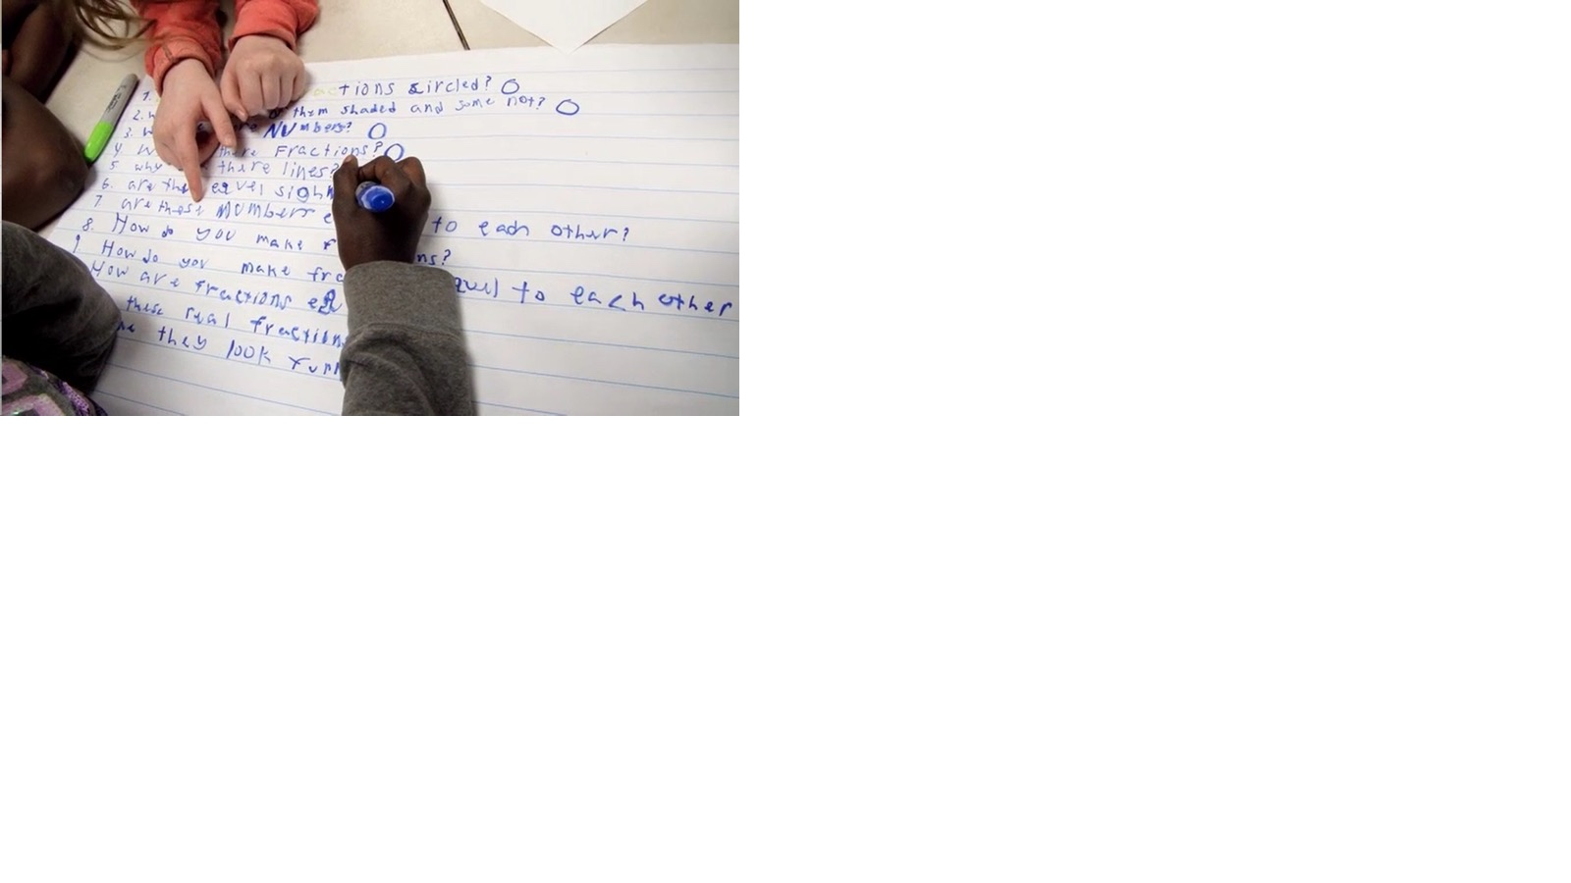
Exploring Classroom Examples

Slide 47
Classroom Example: High School
Teacher: Kelly Grotrian, East Brunswick, NJ
Topic: 11th Grade U.S. History
Purpose: To conclude a unit on World War II and lead into an informed debate about US use of atomic weapons

Slide 48
Question Focus
http://www.loc.gov/pictures/item/98506956/

Slide 49
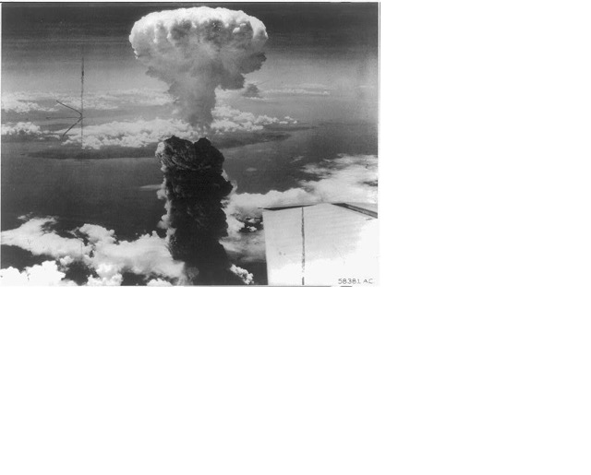
Student Questions
What is this?
Who did this?
How did this affect people?
What were the environmental & economic implications of dropping the bomb?
How many people were hurt?
Is that a plane wing in the bottom right?
Did the people in that plane drop the bomb?
Did the people dropping the bomb know what they were doing?
Did they make the bomb?
Who was responsible for dropping the bomb?
What led to this event?
What happened as a result of dropping the bomb?
Where was the bomb dropped?
Had people been given warning?
How long did it take to notice effects of the bomb?
When did this happen (at what point in the war)?
How many lives were lost as a result?

Slide 50
Next Steps:
Students chose priority questions to respond to in a homework assignment that night
Homework and subsequent lessons lead into a debate about whether the United States was justified in dropping the atomic bomb

Slide 51
Classroom Example: Professional Learning
Teacher: Ann Canning, TPS Eastern Region
Topic: Primary Sources
Purpose: Introducing the QFT to preservice teachers as an approach to analyzing primary sources as part of the TPS Basics Online Course

Slide 52
TPS BASICS Overview: http://bit.ly/TPSbasicsOverview
Register Here: http://bit.ly/TPSbasicsRegistration

Slide 53
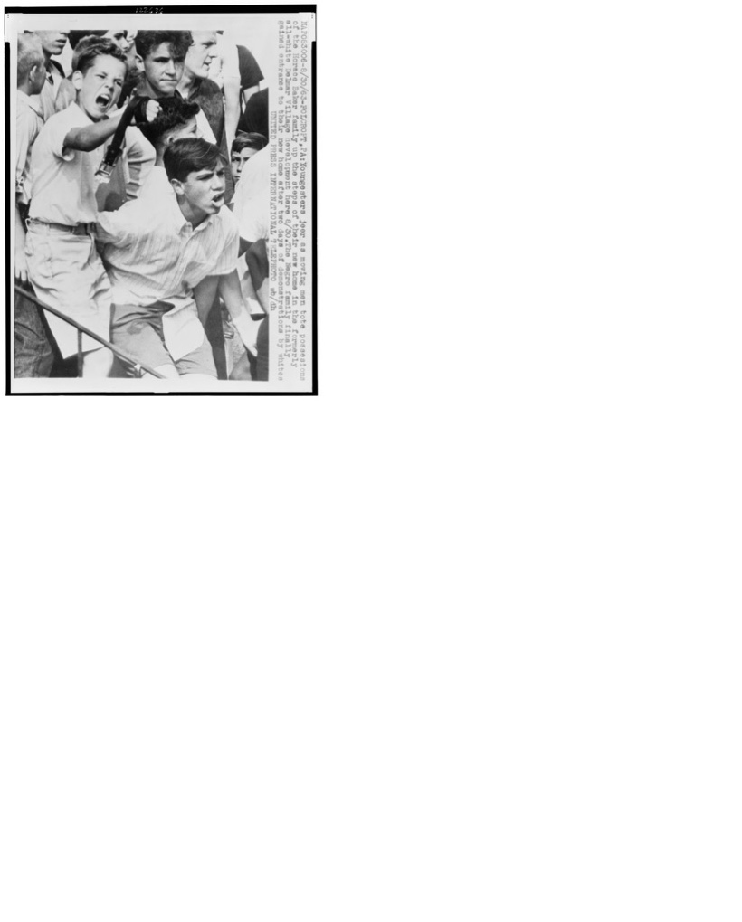
TPS BASICS Tutorial #11
Write About It
What do you understand differently now about students learning to ask their own questions?
Name a primary source from the Library of Congress that would work as a QFocus (Question Focus) either at the beginning of a lesson or at the end. State the title and the URL for the primary source.
Explain why you think the selected primary source would work as a QFocus..
Watch It…..Questions are the Engines of Intellect: How to Stimulate Student Curiosity and Questions with Dan Rothstein and Andrew Minigan
Read It …..Questions, Frameworks, and Classrooms by John Lee, Kathy Swan, SG Grant, Dan Rothstein and Luz Santana
Notes:
Carla Valquez, Virginia Tech, 2018. "What caught my attention was the fact that this photograph was taken in Pennsylvania, a northern state. I would use this source to get rid of the misconception that "Jim Crow" did not happen in the North. Overall, this source would be a great visual representation of the Jim Crow Era to spark student generated questions, especially because there are young kids their age reacting to integration."

Slide 54
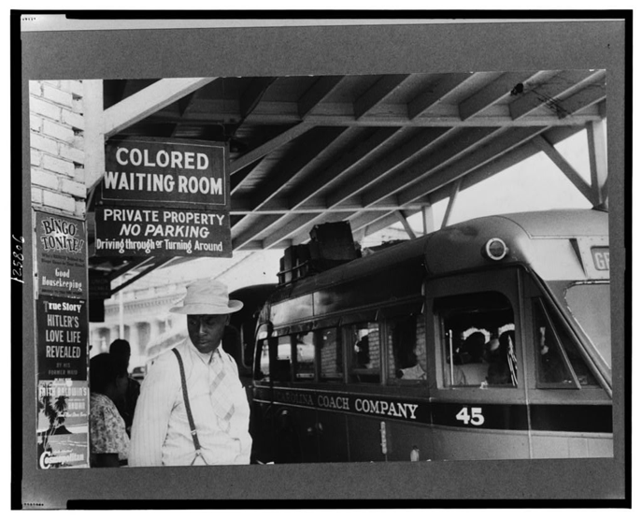
“I think this photograph would be great for a QFocus to introduce Jim Crow South and segregation. This would allow me to see what the students are drawn to and notice, what they are curious about, and possible knowledge (or answers) that they already have about the topic. There are also posters on the wall about Hitler, modes of transportation that define the time period, etc. that could grab the students' attention.”
Allie Hoffman, Virginia Tech 2018
At the bus station in Durham, North Carolina,1940. May. Retrieved from the Library of Congress, https://www.loc.gov/item/2017747598/

Slide 55
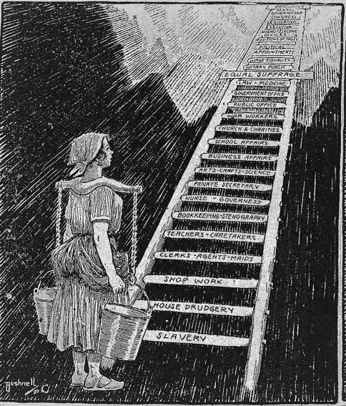
“Additionally, I had never thought about having students categorize their questions into Open and Closed. Not only does this show students that there is a place for each question, but it makes students analyze and question their questions. One source I can think of to use as a QFocus is the photograph of the woman climbing up the ladder after gaining woman's suffrage. I'd use this when beginning a unit on women's literature. Questions about gender roles, women, men, sexism, and all sorts of things could begin a very important discussion about the unit itself. It would also set students up in a specific mindset before reading texts.” Ashton Lineberry, Virginia Tech 2018.
The sky is now her limit / Bushnell 20. , 1920. Retrieved from the Library of Congress, https://www.loc.gov/item/2002716769/ .

Slide 56
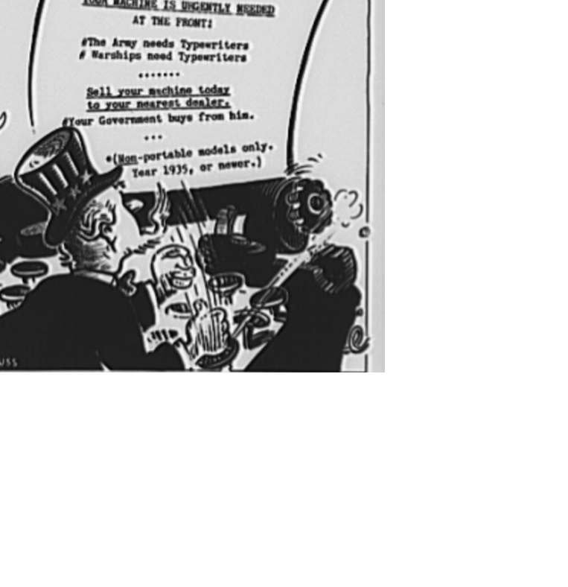
“I am interested in getting the eighth graders to think about and question the persuasive messages found in texts directed at children. This particular image is kind of mind-blowing, and will generate curiosity. My students recently studied the Dr. Seuss's book The Lorax. We talked about the powerful environmental message in The Lorax. I would love to continue working with my students by giving them some of Dr. Seuss' political comics like this one and asking them to use the QFT described in this TPS module.” Bobbie Jo Chase, Virginia Tech 2018.
Forty-Two Keys to Victory. Retrieved from the Library of Congress, https://www.loc.gov/item/2017691953/ .
Notes:
Forty-two keys to victory. One of America's foremost cartoonists comes through with a poster for the Office of War Information's (OWI) typewriter campaign as Dr. Seuss's typin' and Uncle Sam sounds the call for your typewriter
Now is the time for 600,000 GOOD TYPEWRITERS
To come to the Aid of their Country.
YOUR MACHINE IS URGENTLY NEEDED AT THE FRONT
#THE ARMY NEEDS TYPEWRITERS
#WARSHIPS NEED TYPEWRITERS
SELL YOUR MACHINE TODAY TO YOUR NEAREST DEALER.
YOUR GOVERNMENT BUYS FROM HIM.
NON-PORTABLE MODELS ONLY
YEAR 1935 OR NEWER!

Slide 57
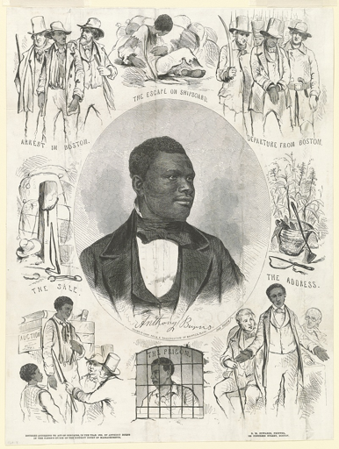
“I like this document because it tells the story of one man, which makes it easier to relate to, but it really addresses the larger issues of antebellum slavery and sectional tensions. I could see using this QFocus as the hook at the beginning of a lesson. I really loved this tutorial. Coming up with compelling questions is one of my areas of weakness, so I love the idea of having the students come up with the questions. I actually tried this in my class last week, and the questions they came up with were MUCH better than the ones I had been thinking of. I also love the QFT routine because I think the students are more invested in discovering the answers when they've come up with the questions.”
Jenni Gallagher, Virginia Tech 2019.
Andrews, J. (ca. 1855) Anthony Burns / Retrieved from the Library of Congress, https://www.loc.gov/item/2003689280/ .

Slide 58
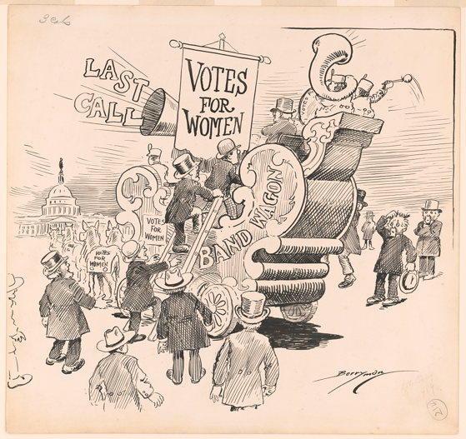
“When thinking about the QFT, I first thought of political cartoons. I think they are a great way to get students interested and asking questions. There are usually so many layers involved in just a singular cartoon. It gets all kinds of students involved,ranging from struggling ones to thriving students. When dissecting a political cartoon, it can be done during any point in the unit but I would likely use it at the beginning to open up a unit and spark interest.”
Jackie McGuiness, Virginia Tech 2019
Votes for Women Bandwagon. Washington D.C, 1918. [Jan] [Photograph] Retrieved from the Library of Congress, https://www.loc.gov/item/2016679510/ .

Slide 59
Why is the skill of question formulation so important now?

Slide 60
In the Age of Google
“How should you respond when you get powerful new tools for finding answers?
Think of harder questions.”
– Clive Thompson
Journalist and Technology Blogger

Slide 61
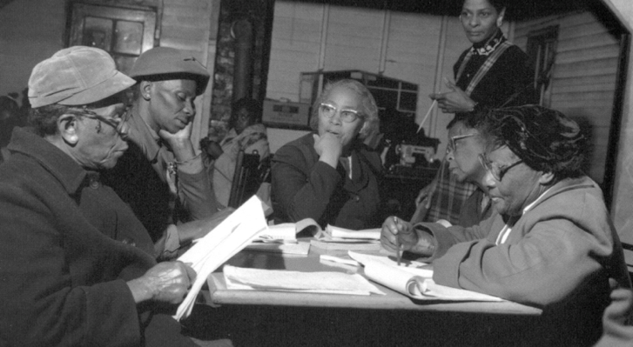
Questions and Democracy
“We need to be taught to study rather than to believe, to inquire rather than to affirm.”
– Septima Clark
Chapter 6 on Septima Clark in Freedom Road: Adult Education of African Americans (Peterson, 1996)

Slide 62
What are your questions for us?
Notes:
4:45

Slide 63
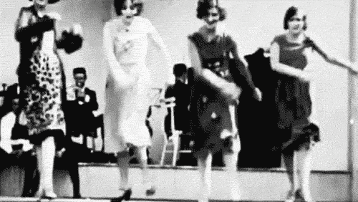
Thank you! Enjoy!

Slide 64
Using & Sharing RQI’s Resources
The Right Question Institute offers materials through a Creative Commons License. You are welcome to use, adapt, and share our materials for noncommercial use, as long as you include the following reference:
“Source: The Right Question Institute (RQI). The Question Formulation Technique (QFT) was created by RQI. Visit rightquestion.org for more information and free resources.”
Access today’s materials (and more!): http://rightquestion.org/events/

Slide 65
To Learn Even More
https://www.gse.harvard.edu/ppe/program/teaching-students-ask-their-own-questions-best-practices-question-formulation-technique
Check out our 3-week online course hosted by the Harvard Graduate School of Education, starting April 13, 2020.

