Slide 1
Introduction to the Question Formulation Technique (QFT) for Primary Source Learning
Hosted by the Library of Congress Teaching with Primary Sources Program
Sarah Westbrook
Director of Professional Learning
The Right Question Institute
Cambridge, MA
Andrew Minigan
Director of Strategy

Slide 2

There are 2 icons you will see in this session:
This means that you should be thinking or working on the task assigned
This means get ready to use your chat box to share some of your work

Slide 3

Who is in the room?
(Not this room, but rather our virtual version of the Library of Congress!)
Highsmith, C. M., photographer. Reading Room at the Library of Congress's historic Thomas Jefferson Building, Washington, D.C. United States Washington D.C, None. [Between 1980 and 2006] [Photograph] Retrieved from the Library of Congress, https://www.loc.gov/item/2011635726/.

Slide 4
Today’s Agenda
Why Spend Time on Teaching the Skill of Question Formulation?
Collaborative Learning with the Question Formulation Technique (QFT)
Explore Real Classroom Examples & Applications
Why is Question Formulation Important Now?
Q&A

Slide 5

We’re Tweeting…
@RightQuestion
@AndrewRQI
@SarahRQI
#QFT

Slide 6



Access Today’s Materials and All of Our Free Resources
https://rightquestion.org/events/
Classroom Examples
Instructional Videos
Planning Tools & Templates

Slide 7

Use and Share These Resources
The Right Question Institute offers materials through a Creative Commons License. You are welcome to use, adapt, and share our materials for noncommercial use, as long as you include the following reference:
“Source: The Right Question Institute (RQI). The Question Formulation Technique (QFT) was created by RQI. Visit rightquestion.org for more information and free resources.”

Slide 8
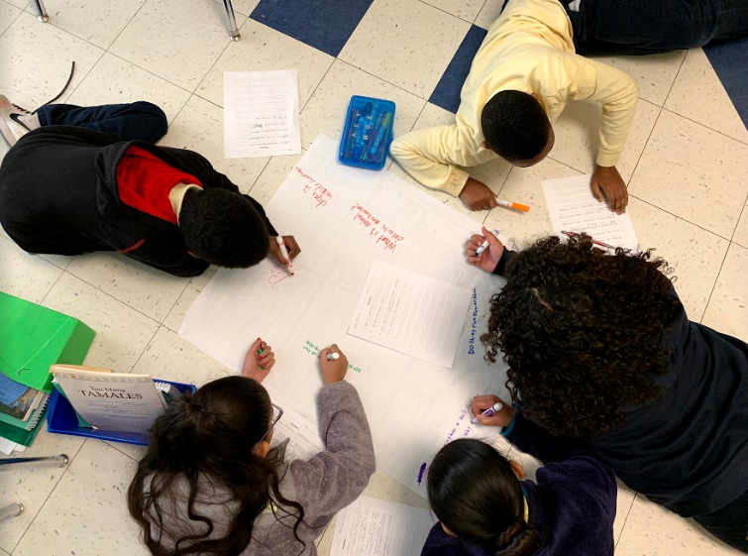
Why spend time teaching the skill of question formulation?

Slide 9

Honoring the Original Source:
Parents in Lawrence, MA 1990
“We don’t go to the school because we don’t even know what to ask.”

Slide 10
“There can be no thinking without questioning—no purposeful study of the past, nor any serious planning for the future.”
– David Hackett Fischer
University Professor Emeritus of History, Brandeis University

Slide 11
“Libraries allow children to ask questions about the world and find the answers. And the wonderful thing is that once a child learns to use a library, the doors to learning are always open.”
– Laura Bush
Educator & Former First Lady of the United States

Slide 12

“We must teach students how to think in questions, how to manage ignorance.”
– Stuart Firestein
Former chair, Department of Biology,
Columbia University

Slide 13
College Presidents on
What College Students Should Learn
“We are here to ask questions—questions about one another and about the world around us. We are at Yale to nurture a culture of curiosity.”
    Peter Salovey, President of Yale University
  https://president.yale.edu/speeches-writings/speeches/culture-curiosity
“…the best we can do for students is have them ask the right questions.”
- Nancy Cantor, Former Chancellor of University of Illinois
The New York Times, August 4, 2002

Slide 14
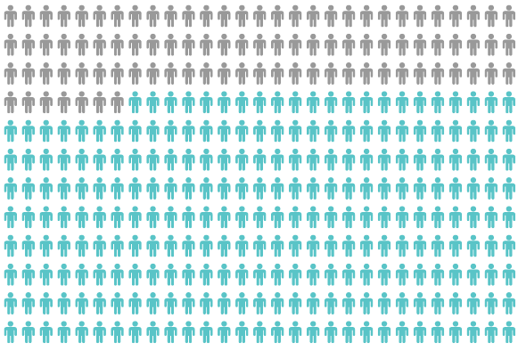
Yet, Only 27% of Graduates Believe College Taught Them How to Ask Their Own Questions
Alison Head, Project Information Literacy at University of Washington, 2016

Slide 15
But, the problem begins long before college…

Slide 16
Age Four: “The true age of inquisitiveness”
James Sully dubbed age four, “the true age of inquisitiveness when question after question is fired off with wondrous rapidity and pertinacity.”
Young children ask 10,000 questions per year before they begin formal schooling.
Sully, 1896
Harris, 2012

Slide 17
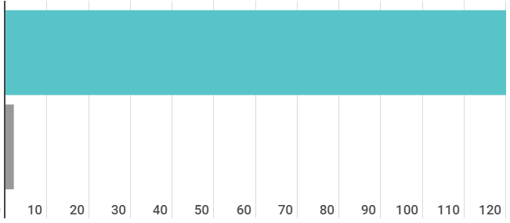
Question Asking by Adolescence
Who’s asking questions over the course of an hour?
Educators
Students
Dillon, 1988, p. 199

Slide 18
Educators Recognize the Problem
Teachers report that getting students to ask questions feels like, “pulling teeth.”
Students ask less than 1/5th the questions educators estimated would be elicited and deemed desirable.
Susskind, 1979

Slide 19
How can teaching students to ask questions go from a feeling of “pulling teeth” to a feeling of excitement for both teachers and learners?

Slide 20
Moving from the exception…
The question as a measure of efficiency in instruction: A critical study of classroom practice. Columbia University Contributions to Education, No. 48
In a 1912 study Romiett Stevens observed: “an unusual lesson because twenty-five of the thirty-four questions were asked by the pupils… The result was that the lesson developed an impetus born of real interest. I mention it because this lesson was unique in the series of one hundred.”

Slide 21


To the Norm
More than 1 million classrooms worldwide

Slide 22
What happens when students do learn to ask their own questions?

Slide 23
Research Confirms the Importance of Questioning
Self-questioning (metacognitive strategy):
Student formulation of their own questions is one of the most effective metacognitive strategies
Engaging in pre-lesson self-questioning improved students rate of learning by nearly 50% (Hattie, p.193)
John Hattie
Visible Learning: A Synthesis of Over 800
meta-Analyses Relating to Achievement, 2008
Notes:
UC Davis Research Linking Curiosity to Memory (UC Davis) 2014
The Fullerton Longitudinal Study (FLS), a 30-plus year study of the development of giftedness across various points in time conducted by Adele and Allen Gottfried of California State University ”This finding has strong implications for the development of STEM considering that curiosity is a fundamental predictor of the aspiration to become a scientist.”
S. von Stumm, B. Hell, T. Chamorro-Premuzic. The Hungry Mind: Intellectual Curiosity Is the Third Pillar of Academic Performance. Perspectives on Psychological Science, 2011 meta-analysis shows They found that curiosity did, indeed, influence academic performance. In fact, it had quite a large effect, about the same as conscientiousness. When put together, conscientiousness and curiosity had as big an effect on performance as intelligence.

Slide 24
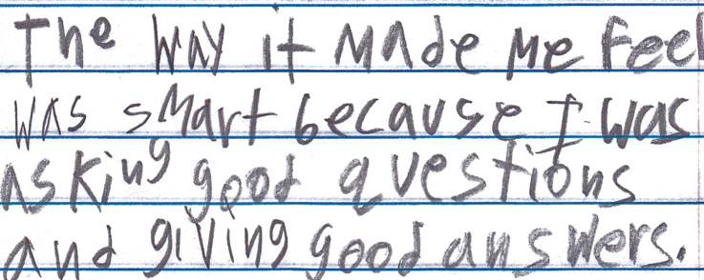
Student Reflection
“The way it made me feel was smart because I was asking good questions and giving good answers.”
-Boston 9th grade summer school student

Slide 25
Student Reflection
“The QFT really teaches a way of thinking so students can be thinking critically every time they read, trying to connect the concepts and deciding whether to take facts and information at face value or to dig a little deeper.”
- Student, Brandeis University

Slide 26
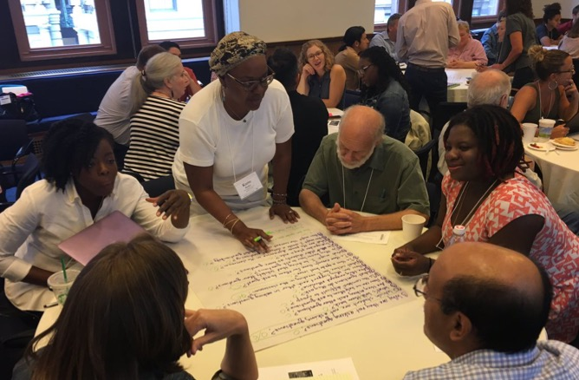
Collaborative Primary Source Learning with the Question Formulation Technique (QFT)
Notes:
Now we’re going to work together on the problem of students not asking questions, by using the Question Formulation Technique.
The next 20 minutes or so will be highly participatory and of course we’re going to be putting you to work. You may want to get some paper or pull up a blank document on your computer screen now. And remember, watch out for the chat box icon. I will tell you when you need to type into it.
The timing may be a little quick, so don’t worry if you haven’t completed every step; we’re more giving you a taste of the whole process. The rest of this course will go far more in depth on each piece.” we will be moving you quickly through an experience to demonstrate how we go through the process, but will be rushing to make sure there is time for your questions at the end." This is giving you a taste

Slide 27
The Question Formulation Technique (QFT)
  Individuals learn to:
  Produce their own questions
  Improve their questions
  Strategize on how to use their questions
  Reflect on what they have learned and how they learned it

Slide 28
Rules for Producing Questions
1. Ask as many questions as you can
2. Do not stop to answer, judge, or discuss
3. Write down every question exactly as stated
4. Change any statements into questions
Notes:
NOTE THAT THEY ARE Working ALONE rather than in a group: Say something about not judging YOURSELF or changing your wording as it comes out
Think about what will be difficult to follow for you. Pause.
DO NOT ASK THEM TO SHARE!!!
Usually, people say that it is difficult not to stop to answer and judge.

Slide 29
Produce Questions
Ask Questions
Follow the Rules
      Ask as many questions as you can.
      Do not stop to answer, judge, or discuss.
      Write down every question exactly as it was stated.
      Change any statements into questions.
Number the Questions

Slide 30
Question Focus
Some students are not asking questions about primary sources.
→Ask questions. Number the questions. Follow the rules.
Notes:
Take a minute to just observe
give directions and pause/time. 3 Min. Give HALFWAY WARNING.
MAKE SURE TO WRITE THEM DOWN BECAUSE YOU NEED THEM FOR ALL THE NEXT STEPS.
Put the 4 rules in the chat box.

Slide 31
Categorize Questions: Closed/Open
Definitions:
  Closed-ended questions can be answered with a “yes” or “no” or with a one-word answer.
  Open-ended questions require
  more explanation.
Directions: Identify your questions as closed-ended or open-ended by marking them with a “C” or an “O.”
Notes:
Read slide. Pause/time. 11/2 Minutes. DO NOT ASK THEM TO SHARE.

Slide 32
Discuss
Closed-ended Questions
Advantages
Disadvantages

Slide 33
Discuss
Open-ended Questions
Advantages
Disadvantages
Notes:
The point here is that the closed ended questions are equally useful as open-ended!!!

Slide 34
Improve Questions
Take one closed-ended question and change it into an open-ended question.
Take one open-ended question and change it into a closed-ended question.
Closed
Open
Open
Closed
Notes:
Read Slide. 1 ½ Minutes. Pause & Time. DO NOT ASK THEM TO SHARE.

Slide 35
Prioritize Questions
Review your list of questions
  Choose three questions that you are most curious to discuss and think about further.
  While prioritizing, think about your Question Focus, Some students are not asking questions about primary sources.
  Then, think about why you chose those questions.
After prioritizing, use the chat box to share ONE of your priority questions.
Notes:
Read the slide. Pause and Time. 1 ½ min.
“Share just ONE of your priority questions.”
You should type in the chat box now.

Slide 36
Action Plan
Moving from priority questions into action steps.
In order to answer your priority questions:
    What do you need to know? Information
    What do you need to do? Tasks
Write down a couple ideas you have.
Notes:
Read the slide. Pause & Time. 2 minutes to write a couple notes. DO NOT ASK TO SHARE
Tasks can include investigations.
Remember to confine yourself to what we could reasonably do with the materials in our classroom.

Slide 37
Share
Using the Chat Box, please share:
One idea you had from your action plan
                - and -
The numbers of your three priority questions in your original sequence (For ex: “2, 4, 7 out of 8 total”)

Slide 38
Reflect
What did you learn?
How did you learn it?
After reflecting, use the chat box to share your response to ONE of the questions above.

Slide 39

A Look Inside the Process

Slide 40
The QFT, on one slide…
Ask as many questions as you can
Do not stop to discuss, judge or answer
Record exactly as stated
Change statements into questions
Question Focus
Produce Your Questions
    Follow the rules
    Number your questions
Improve Your Questions
    Categorize questions as Closed or Open-ended
    Change questions from one type to another
Strategize
    Prioritize your questions
    Action plan or discuss next steps
    Share
Reflect
Closed-Ended:
Answered with “yes,” “no” or one word
Open-Ended: Require longer explanation
Source: The Right Question Institute rightquestion.org

Slide 41
  Three thinking abilities
  with one process

Slide 42
Thinking in many different directions
Divergent
Thinking

Slide 43
Narrowing Down, Focusing
Convergent
Thinking

Slide 44

Thinking about Thinking
Metacognition

Slide 45
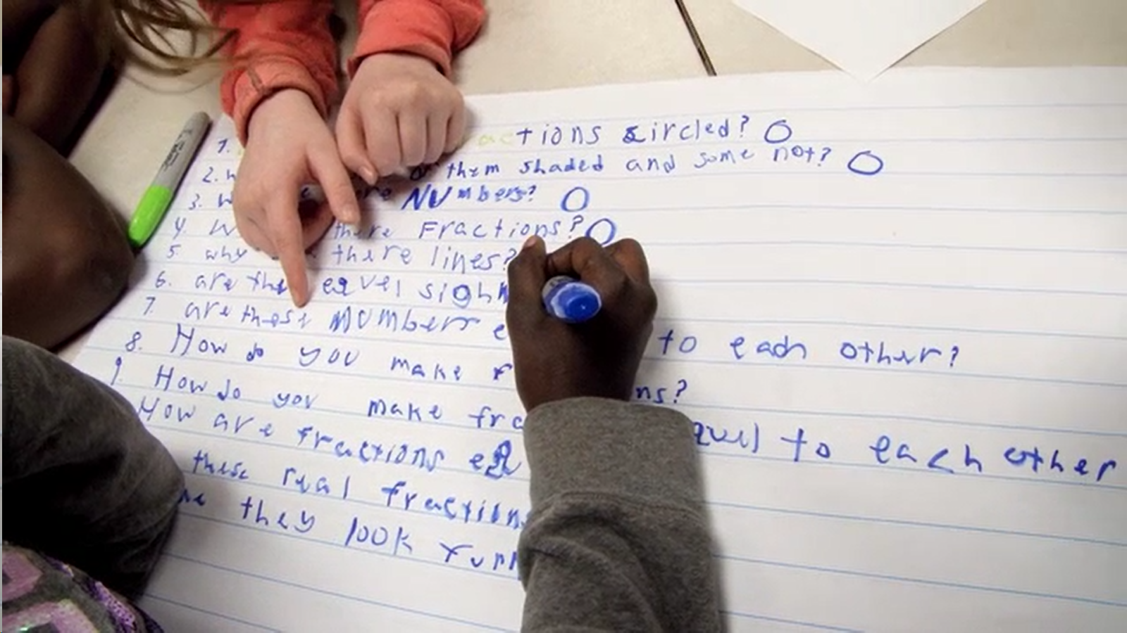
Exploring Classroom Examples

Slide 46
Classroom Example:
High School
Teacher: Kelly Grotrian, East Brunswick, NJ
Topic: 11th Grade U.S. History
Purpose: To conclude a unit on World War II and lead into an informed debate about US use of atomic weapons

Slide 47
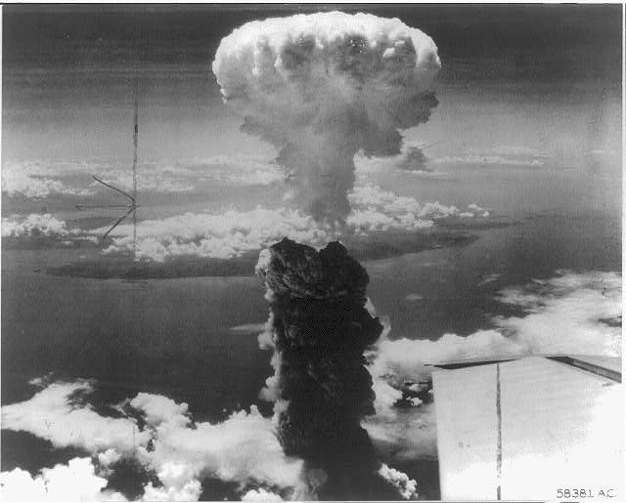
Question Focus
http://www.loc.gov/pictures/item/98506956/

Slide 48
Student Questions
What is this?
Who did this?
How did this affect people?
What were the environmental & economic implications of dropping the bomb?
How many people were hurt?
Is that a plane wing in the bottom right?
Did the people in that plane drop the bomb?
Did the people dropping the bomb know what they were doing?
Did they make the bomb?
Who was responsible for dropping the bomb?
What led to this event?
What happened as a result of dropping the bomb?
Where was the bomb dropped?
Had people been given warning?
How long did it take to notice effects of the bomb?
When did this happen (at what point in the war)?
How many lives were lost as a result?

Slide 49
Next Steps:
Students chose priority questions to respond to in a homework assignment that night
Homework and subsequent lessons lead into a debate about whether the United States was justified in dropping the atomic bomb

Slide 50

Virtual Classroom Example:
4th Grade Social Studies
Teacher: Alyssa Park, Gardnerville, NV
Topic: The Hoover Dam
Purpose: To analyze a primary source and launch a mini-inquiry – using Google Forms!

Slide 51
Question Focus
Library of Congress: https://www.loc.gov/resource/cph.3b07810/
Notes:
She told them: draw on what you know of these two texts

Slide 52
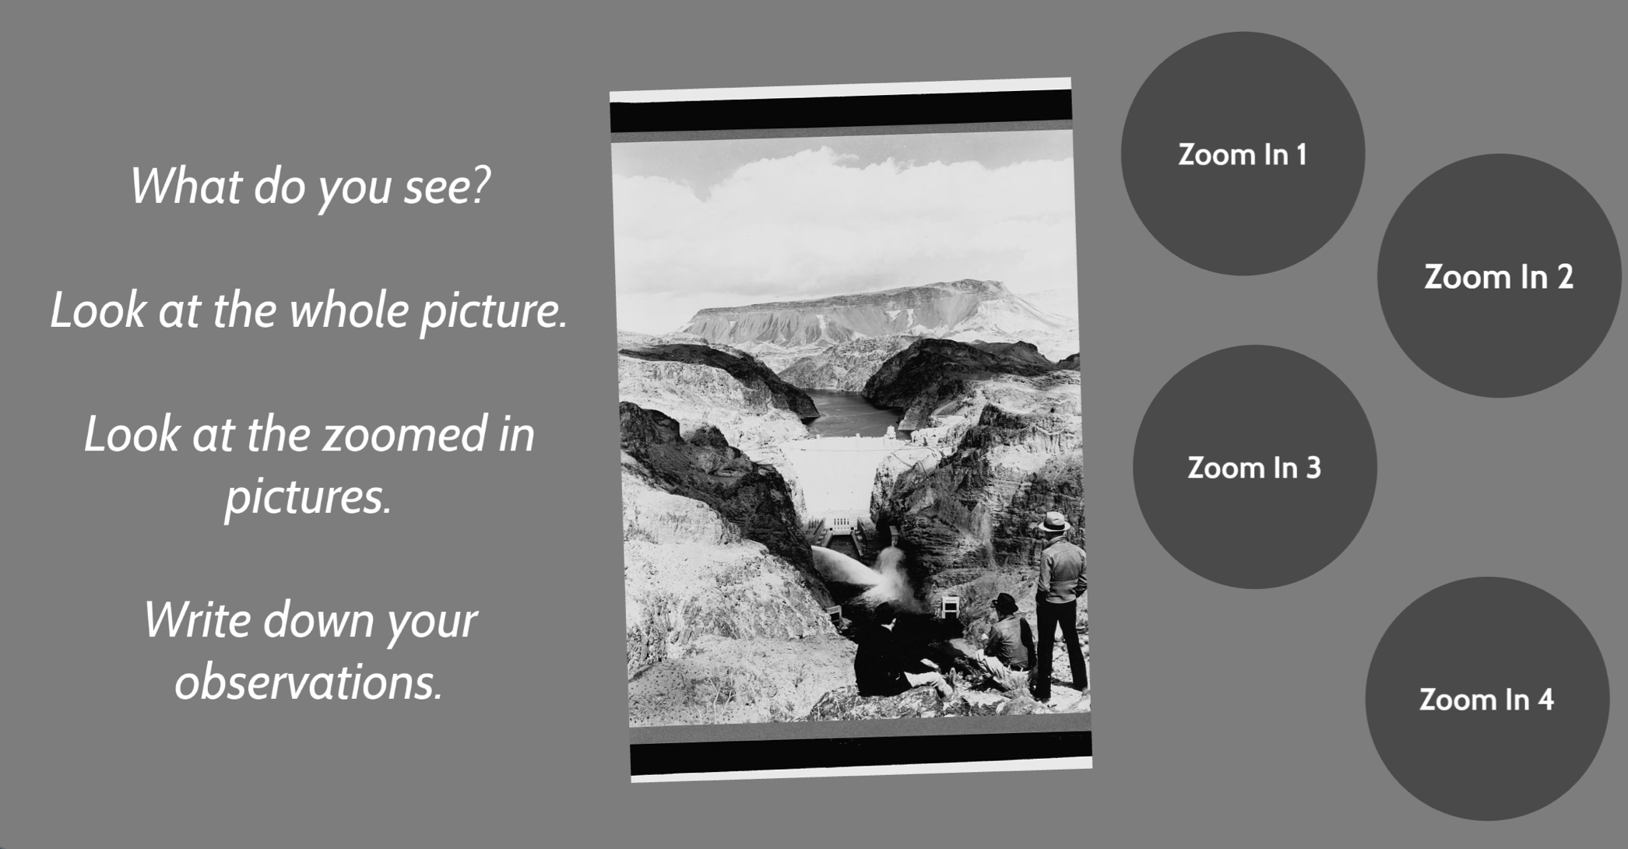
Question Focus…using Prezi!
Library of Congress: https://www.loc.gov/resource/cph.3b07810/
Notes:
She told them: draw on what you know of these two texts

Slide 53
Student Questions
1.Where is this?
2.Why is there a river?
3. Is it a desert?
4. Is it near the grand canyon?
5.When was this picture taken?
6.How did they take the picture?
7.Was it in the 1900's?
8.Where does the road lead to?
9.What is the road called?
10. Is the sculpture (or whatever it is) in the middle of the road a rock?
11.Where is the building located?
12.Do people live in that building?
13. Is it a work place?
14.Is there water at the bottom of the building?
15.Is the road from the last picture lead to the building?
16.How did they build that building?
17.How do people get to the top to the bottom?
18.Is the water falling from the rocks a waterfall?
19.Can people visit the building?
20.How does the water get there?

Slide 54
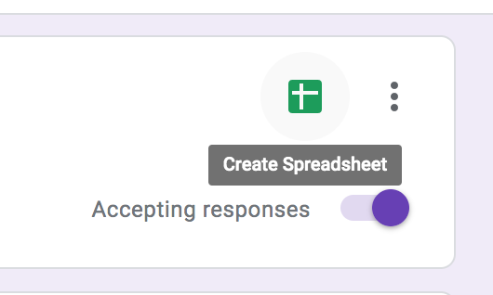
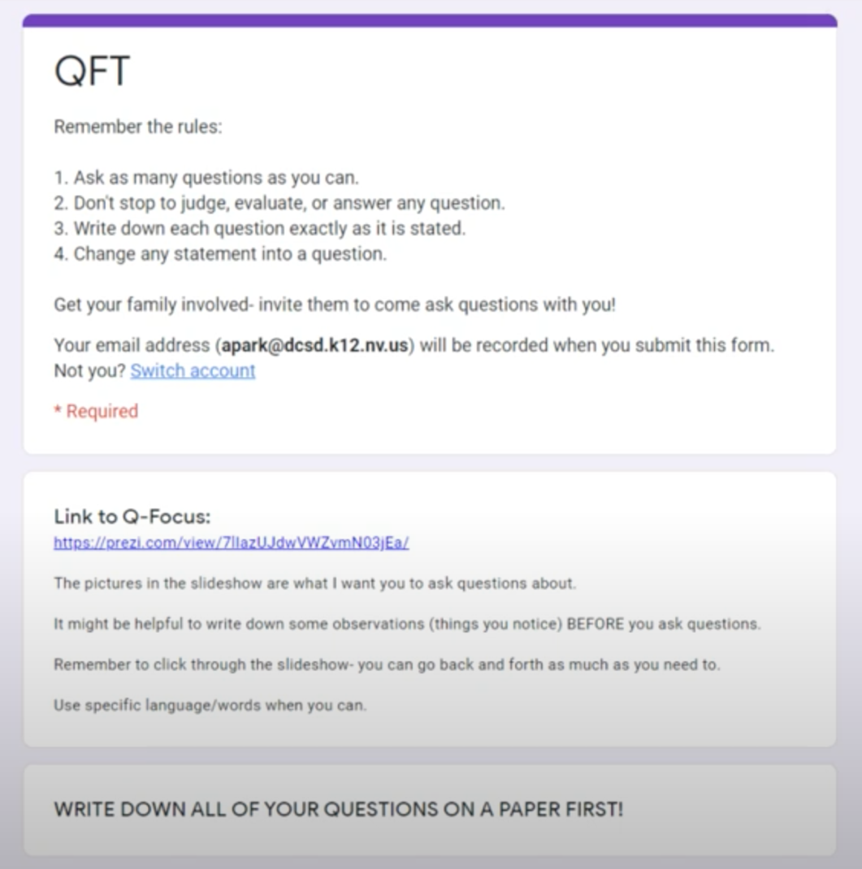
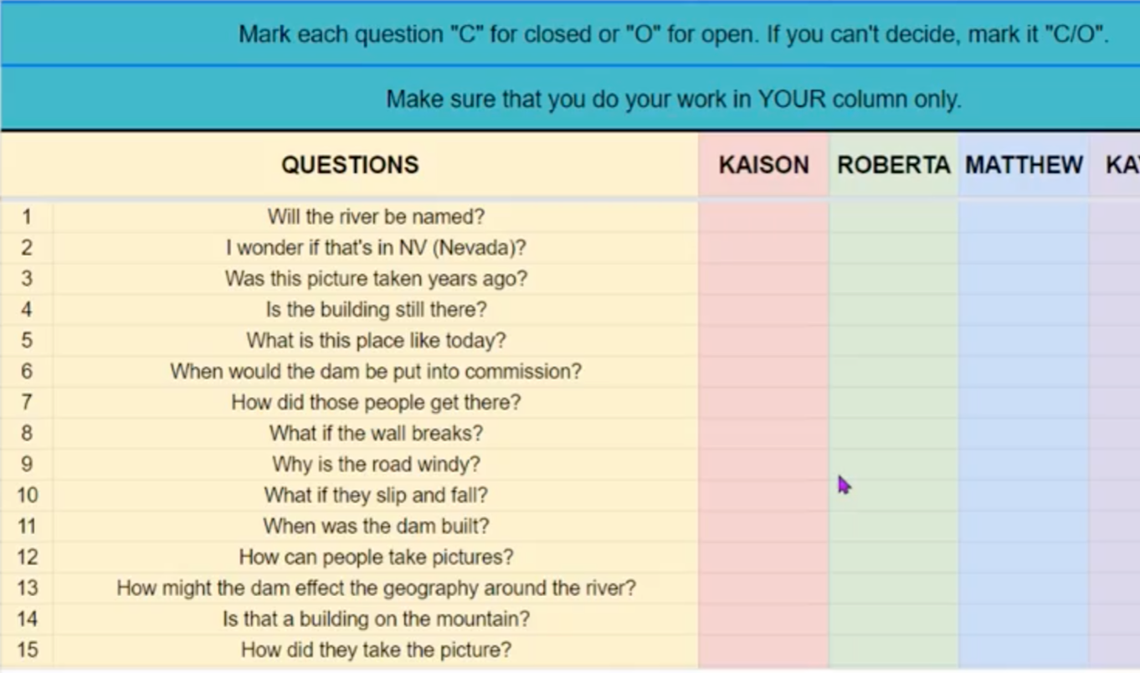
Student Questions…using Google Forms!
Students entered their questions in a google form, which populated a google sheet they could use to categorize their questions as open and closed.
Notes:
She made hers fancy and collaborative, but you don’t have to necessarily do that

Slide 55
Next Steps
Days 1-3 | Using google forms and google sheets
Ask & Improve Questions
Day 4
Gather Basic Information
Students picked 3 closed-ended questions to answer
Read from a collection of 4th grade, Hoover Dam books on Epic!
Shared answers in a collaborative google slide deck
Day 5
Prioritize Questions (Again!)
Pick from the whole class list: 3 questions you would need to answer to write a historical fiction story on the Hoover Dam.
Days 6 & 7
Further Research
They will spend time looking through a “playlist” of resources categorized by the major themes – how dams work, life during the great depression, etc. and answer their second set of priority questions.

Slide 56
Virtual Professional Learning Example
Topic: Japanese American Internment primary sources
Purpose: A live webinar introducing educators to using the QFT with primary sources during distance learning using Padlet.

Slide 57
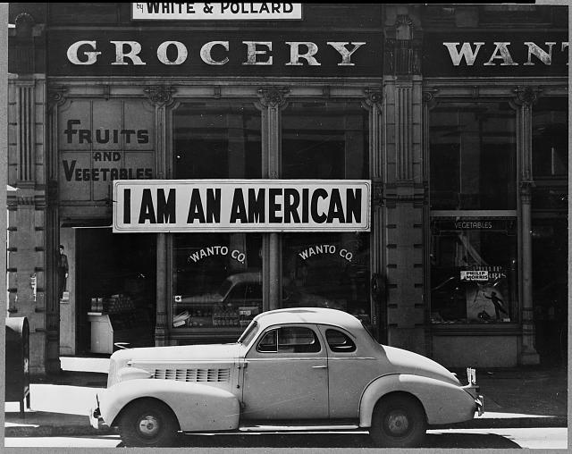
Question Focus
Lange, Dorothea. (1942) Oakland, CA, Mar. 1942.
A large sign reading "I am an American" placed in the window of a store on December 8, the day after Pearl Harbor. The store was closed following orders to persons of Japanese descent to evacuate from certain West Coast areas.
[Photograph] Retrieved from the Library of Congress, https://www.loc.gov/pictures/resource/cph.3a24566/.

Slide 58
Selected Questions
Are there other images that Lange took in Oakland on that day?
Did Dorothea Lange happen upon this site or was she prompted to go there and take the photo?
How did photography change or influence public opinion about Japanese Americans?
Why do they need to claim they are American?
What makes someone American?
Has anything changed in our reactions to “foreigners” or has it just shifted slightly?
Does ”Americanness” need to be performed in some way to be valid?
What happened to the store owner after this photo was taken?
Who is the "I?”
How significant is the car?
What message is the store owner trying to relay to the community by posting the sign?
How did other business owners in the area react to this action?
What may the shop owner fear if it prompted them to hang that sign in the aftermath of Pearl Harbor?
Did the owners already experience some negative reactions, or was this in anticipation?
Was it done out of patriotism or fear?
Did all Japanese Americans relocate? What were the consequences of resistance?

Slide 59

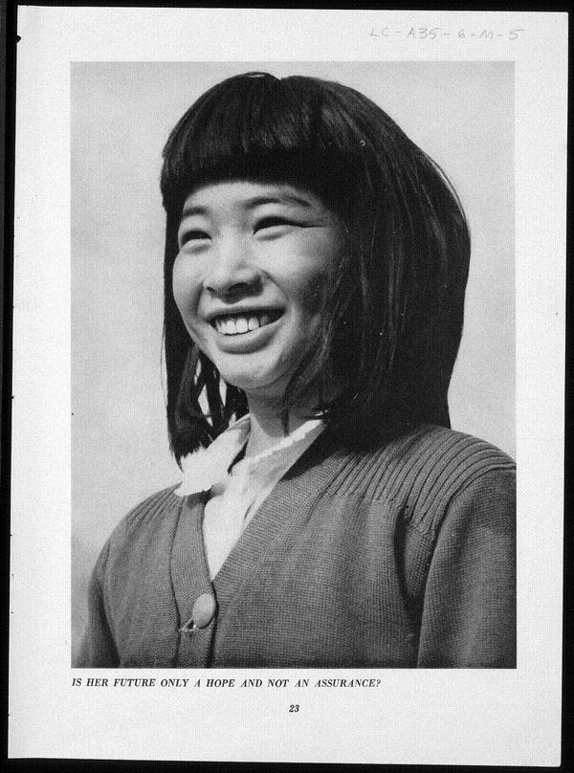
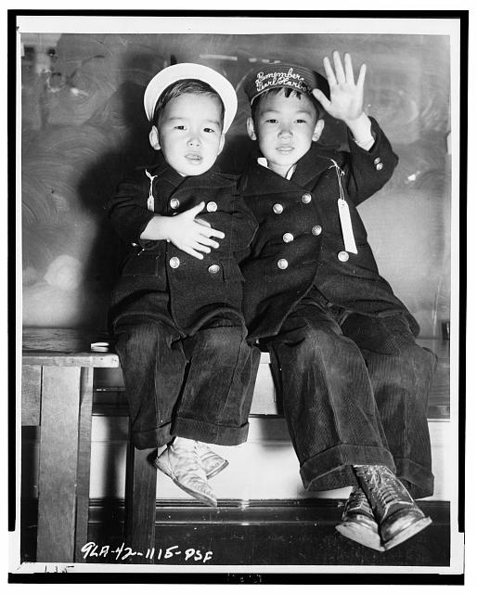
What do I do with the questions students produce?
Students can look for answers to their priority questions (and generate new questions) through researching Library of Congress collections of Japanese American Internment primary sources:
  http://www.loc.gov/teachers/classroommaterials/primarysourcesets/internment/ A primary source set on Japanese American internment with teacher’s guide
  Women Come To the Front - Dorothea Lange: https://www.loc.gov/exhibits/wcf/wcf0013.html
  https://blogs.loc.gov/picturethis/2015/02/day-of-remembrance-photographs-of-japanese-american-internment-during-world-war-ii/ blog post that links resources throughout Library collections
Lead students through primary source analysis using the TPS “Observe – Reflect – Wonder” tool, starting with their priority questions. Then, see what questions remain, or what new ones have been generated.

Slide 60
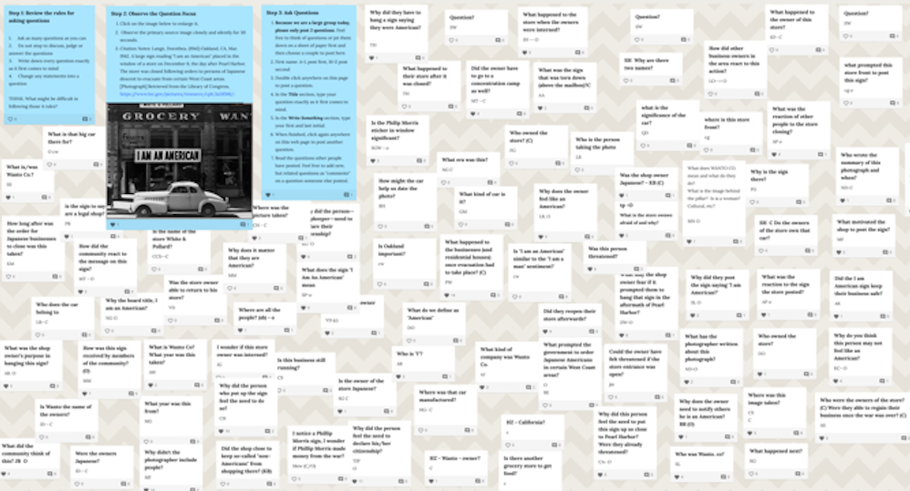
Make Your Own Padlet
Access the QFT Padlet Template Here:
https://padlet.com/sarahwestbrook1/QFT2
Access a quick guide to using Padlet:
https://rightquestion.org/remote-learning-resources/

Slide 61
Why is the skill of question formulation so important now?

Slide 62

In the Age of Google
“How should you respond when you get powerful new tools for finding answers?
Think of harder questions.”
– Clive Thompson
Journalist and Technology Blogger

Slide 63
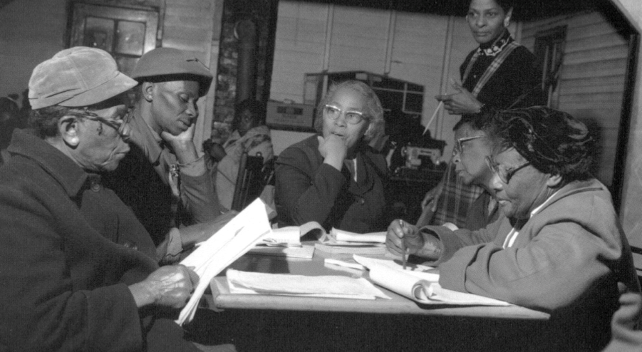
Questions and Democracy
“We need to be taught to study rather than to believe, to inquire rather than to affirm.”
– Septima Clark
Chapter 6 on Septima Clark in Freedom Road: Adult Education of African Americans (Peterson, 1996)

Slide 64
What are your questions for us?
Notes:
4:45

Slide 65
Before You Go
Please take our survey
https://www.surveymonkey.com/r/2020_LOC_Webinar
Certificates for Live Participation Only
Email kmcg@loc.gov

Slide 66
Thank you! Enjoy!

Slide 67
Using & Sharing RQI’s Resources
The Right Question Institute offers materials through a Creative Commons License. You are welcome to use, adapt, and share our materials for noncommercial use, as long as you include the following reference:
“Source: The Right Question Institute (RQI). The Question Formulation Technique (QFT) was created by RQI. Visit rightquestion.org for more information and free resources.”
Access today’s materials (and more!): http://rightquestion.org/events/

