Slide 1
Building People’s Self-Advocacy Skills in Times of Crisis: An Introduction to the Right Question Strategy
Luz Santana, Co-Director Naomi Campbell, Legal Program Director
May 6, 2020
www.rightquestion.org

Slide 2
Overview
Introduction & Housekeeping
About the Right Question Institute
An Experience in the Right Question Strategy
Exploring an Application of the Strategy: Self-Advocacy Tool
Further Applications of the Strategy
Q&A
Closing & Next Steps

Slide 3
Free Resources
The Right Question Institute offers many of our resources and methodology through a Creative Commons License and we encourage you to make use of and/or share this resource. Please reference the Right Question Institute as the source when using our resources or methods.
Source: www.rightquestion.org

Slide 4
An Interactive Webinar
Time:
Time’s up!
3 s

Slide 5
An Interactive Webinar
d

Slide 6
Let’s see who’s here!
Please share in the chat box:
Your name
State or country
Your job title
Make sure you are sending the message to everyone! Click “All panelists and attendees”

Slide 7
After the Webinar
？
Fill out evaluation
Download free resources at www.rightquestion.org
Get support to use the strategy
Look out for emails and stay in touch!

Slide 8
The Right Question Strategy directly builds people’s capacity to:
Ask better questions
Participate more effectively in decisions

Slide 9
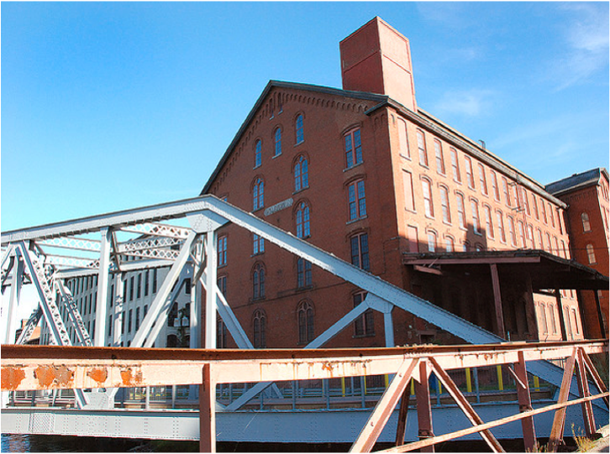
Honoring the original source: Parents in Lawrence, Massachusetts, 1990
“We don’t go to the school because we don’t even know what to ask.”

Slide 10
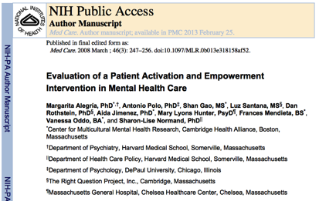

Slide 11
Build the foundation
Teach people how to:
ask their own questions
focus effectively on decisions

Slide 12
Three changes as outcomes
KNOW
FEEL
DO

Slide 13
“What ever it takes to get the information I need.”
Session participant in a homeless shelter
in Louisville, Kentucky

Slide 14
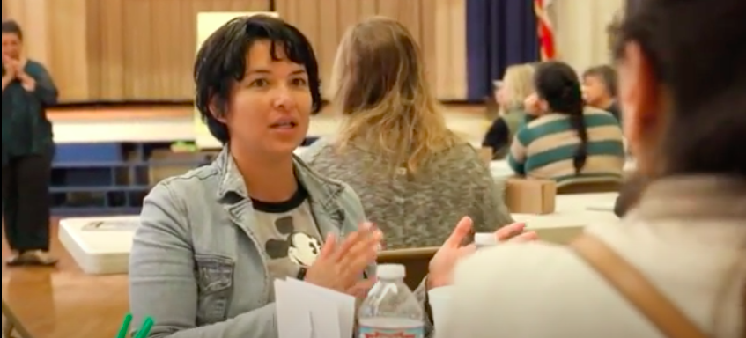
An experience in the Right Question Strategy

Slide 15
A simple definition
A decision is the selection of one option from among two or more options.

Slide 16
We make decisions every day
Consider the REASONS, the PROCESS, and the ROLE you played in getting breakfast this morning.

Slide 17
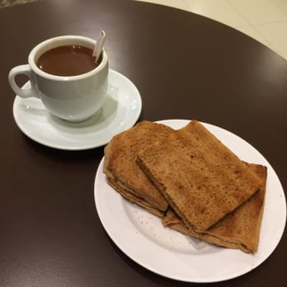
A decision you made today
Options:

Slide 18
Deciding what to have for breakfast
Think about:
Your reasons for making the decision
The steps you took, or process
Your role in the process

Slide 19
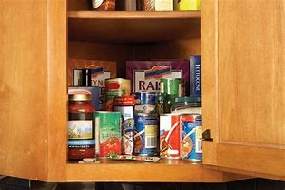
Deciding what to eat for breakfast: Reason
Food available
at home
Breakfast you had the previous day

Slide 20
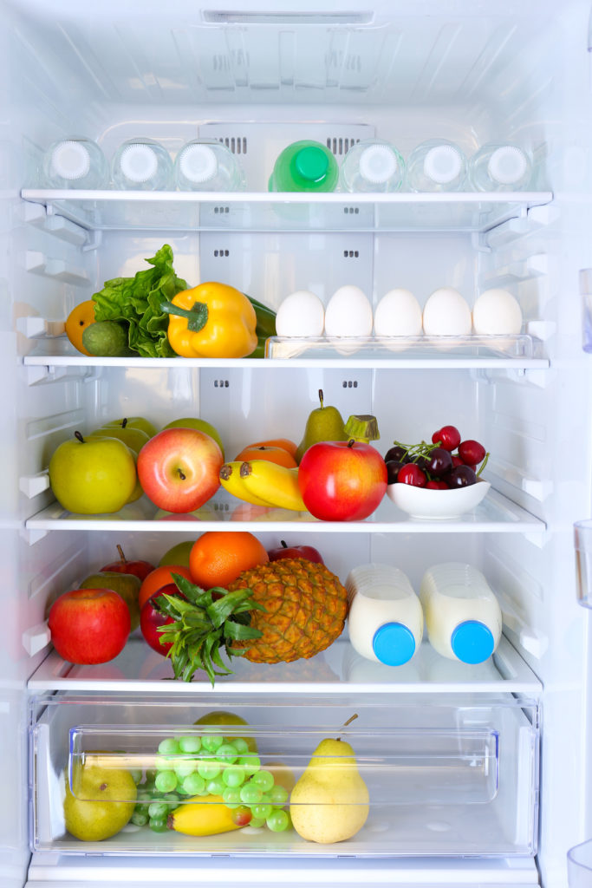
Deciding what to eat for breakfast: Process
Checked in the refrigerator and cabinet
Thought about what you ate the previous day

Slide 21
Deciding what to eat for breakfast: Role
Decision maker
Gave your opinion

Slide 22
When decisions are made it is important to focus on:
The OPTIONS
REASONS - the basis for a decision.
PROCESS - the steps and actions taken, people involved, and information used in making the decision.
ROLE - the part you play/ the part the people affected by the decision play in the decision-making process.

Slide 23
Examples of services
Family outreach
Remote learning tools (i.e. Chromebook)
Reentry program
Community engagement
Mental health services
Special needs programs
Adult education
Rental/mortgage assistance
Other

Slide 24
Rules for Producing Questions
ASK AS MANY QUESTIONS AS YOU CAN
DO NOT STOP TO ANSWER, JUDGE OR DISCUSS
WRITE DOWN EVERY QUESTION EXACTLY AS IT COMES TO MIND
CHANGE ANY STATEMENTS INTO QUESTIONS
What might be difficult about following these rules?

Slide 25
Question Focus
You have asked for services for your child and you were denied.
(Health, educational, therapy, free lunch/SNAP, etc.)
Notes:
Present the Question Focus. Say: Here is the topic, or “Question Focus,” you will ask questions about.

Slide 26
You have asked for services for your child and you were denied.
QFocus:
Ask questions.
Follow the rules.
Ask as many questions as you can.
Do not stop to answer, judge, or discuss.
Write down every question exactly as stated
Change any statements into questions.
Time:
Time’s up!
3 min

Slide 27
Categorizing Questions: Closed/Open
Closed-ended questions can be answered with a “yes” or “no” or with a one-word answer.
Open-ended questions require more explanation.
Identify your questions as closed-ended or open-ended by marking them with a “C” or an “O.”

Slide 28
Closed- and Open-Ended Questions
Closed-ended questions
Advantages

Slide 29
Closed- and Open-Ended Questions
Closed-ended questions
Disadvantages

Slide 30
Closed- and Open-Ended Questions
Open-ended questions
Advantages

Slide 31
Closed- and Open-Ended Questions
Open-ended questions
Disadvantages

Slide 32
Improving Questions
Change one closed-ended question so it becomes open-ended.
Change one open-ended question so it becomes closed-ended.
Closed
Open
Open
Closed

Slide 33
Prioritizing Questions
Review your list of questions
Choose three questions you want to explore further. For example, the question you consider most important.
While prioritizing, think about your Question Focus:
You have asked for services for your child and you were denied.
Time:
Time’s up!
90 sec

Slide 34
Find one question that will help you learn about the REASON(S) for the decision
The basis
Policies
Standards, regulations
Ask a new question if you don’t have one

Slide 35
Find one question that will help you learn about the PROCESS for making the decision
Information used
Steps taken; meetings
held; protocols used;
place; time
People involved
Ask a new question if you don’t have one

Slide 36
Find one question that will help you learn about your ROLE/the ROLE of the people affected by the decision
What you/the people affected can do to influence the decision
What is expected of you/the people affected in this decision
Ask a new question if you don’t have one

Slide 37
Share
One question about the reasons
One question about process
One question about role

Slide 38
Reflection
Think about one of these two questions:
What did you notice about your thinking as you went through the process?
How can the people you work with benefit from asking questions about decisions—questions about reason, process, and their role in the decision?

Slide 39
The Right Question Strategy
Decision: Choosing one option from among two or more
Define “Decision”
Identify Decisions
Define Key Elements in Decision Making
Reason(s): the basis for a decision
Process: the steps and actions taken, people and information involved
Role: the part people affected by the decision play in the process
Produce Your Questions
Follow the rules
Number your questions
Identify Questions about
Reason, Process, and Role
6) Optional Other Steps
7) Reflect
Ask as many questions as you can
Do not stop to discuss, judge or answer
Record exactly as stated
Change statements into questions

Slide 40
Three criteria for accountable decision-making that correspond to key democratic principles
Reason
Process
Role
Legitimacy
Transparency
Opportunities for participation

Slide 41
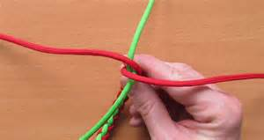
Integration opportunities
Name one situation in which the people you work with should be asking questions about decisions

Slide 42
Examples of Decisions
Covid-19
Working remotely
Children studying from home
Usage of masks
Government stimulus
Other decisions
Child is referred for an evaluation
Doctor is changing your medication
Instructional practices are being changed
Criteria to qualify for benefits is being reviewed
Notes:
Let’s think about whether to keep it focus on the current situation And also to expand beyond it

Slide 43
RQI Self-Advocacy Tool for the COVID-19 Crisis
A specific application of the Right Question Strategy
A tool to share with the people you work with

Slide 44
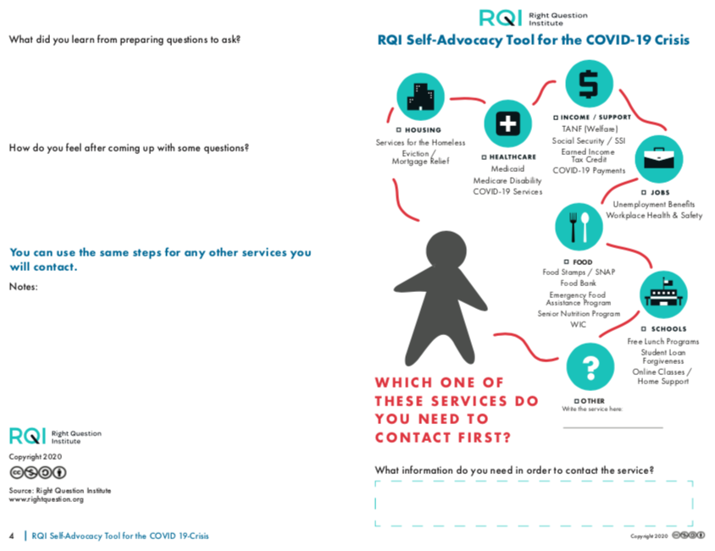

Slide 45
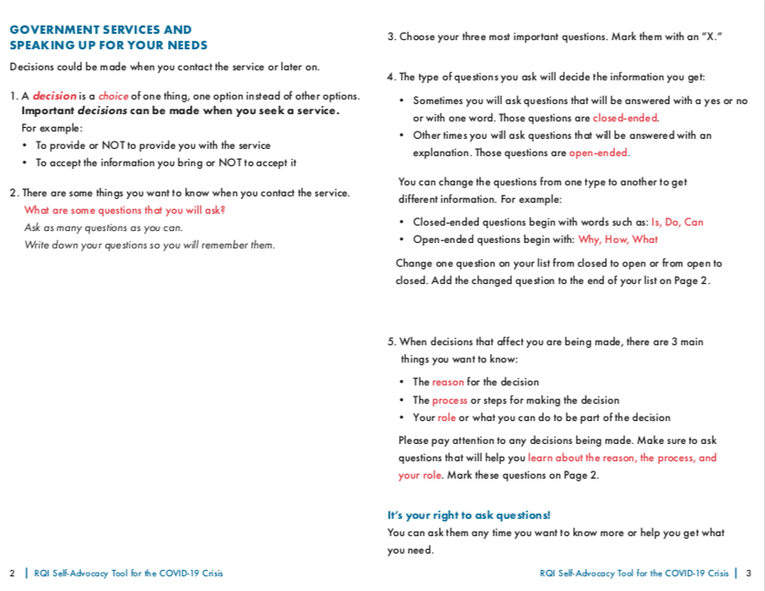

Slide 46
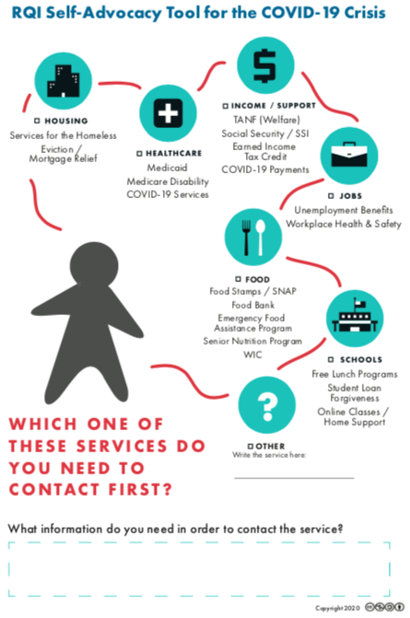

Slide 50
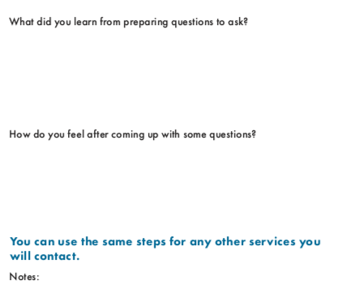

Slide 51
RQI Self Advocacy Tool https://rightquestion.org/events/free-webinar-increasing-peoples-effectiveness-when-advocating-for-their-own-needs/
Also found at https://rightquestion.org/tools-for-self-advocacy-in-times-of-crisis
Event> Free Webinar: Building People’s Self-Advocacy Skills in Times of Crisis

Slide 52
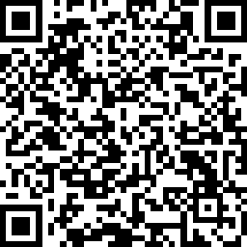
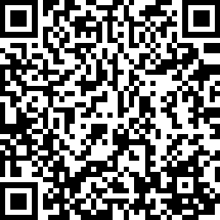
RQI Self-Advocacy Tool: Online Versions
https://cutt.ly/RQI-Self-Advocacy-Online-Tool
https://cutt.ly/RQI-Self-Advocacy-Tool-Type-in
Smartphone and computer icons made by Freepik from www.flaticon.com
Notes:
Smartphone and computer icons made by Freepik from www.flaticon.com
Icons made by <a href="https://www.flaticon.com/authors/freepik" title="Freepik">Freepik</a> from <a href="https://www.flaticon.com/" title="Flaticon"> www.flaticon.com</a>

Slide 53
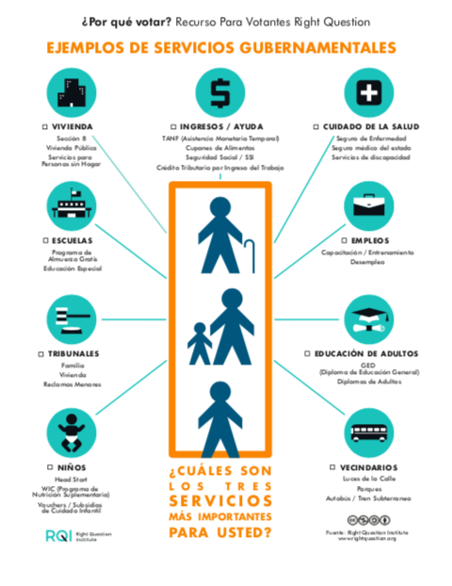
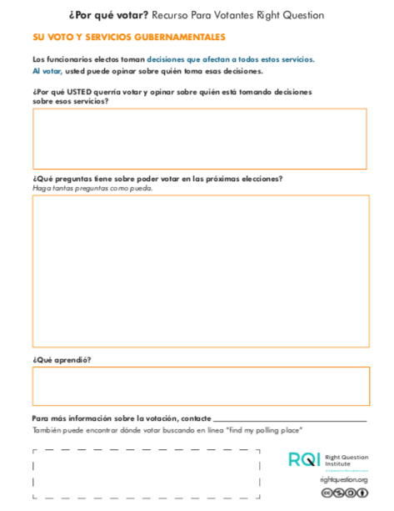
The “Why Vote?” Tool

Slide 54
rightquestion.org/legal

Slide 55
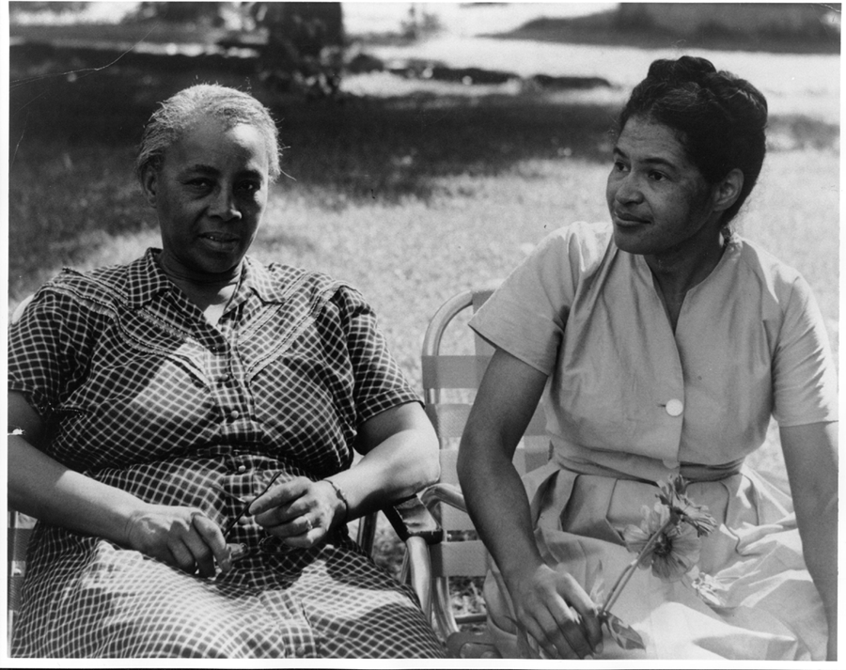
Individual Skills and Democracy
Image Courtesy of Highlander Research and Education Center

Slide 56
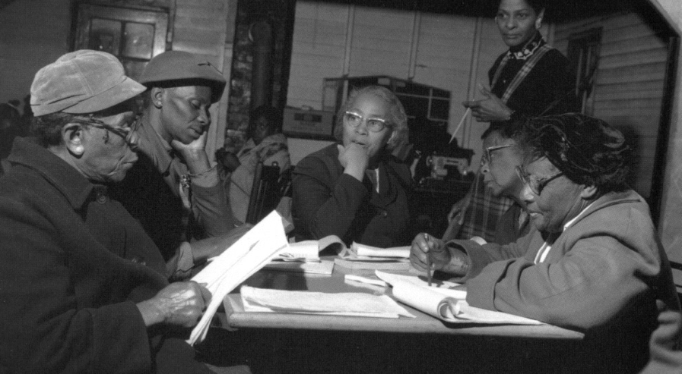
“We need to be taught to study rather than to believe, to inquire rather than to affirm.” - Septima Clark
See Chapter 6 on Septima Clark in Freedom Road: Adult Education of African Americans (Peterson, 1996).

Slide 57
Next Steps
Complete evaluation:
tinyurl.com/rqiwebinar
Look for an email with:
A sign-up for office hours on May 13th at 3:00 p.m. ET. We will offer technical assistance and support in using RQI’s resources, including the Self-Advocacy Tool.
A recording of this webinar
Other resources, including links to videos and resources in Spanish and English, and an online tool

Slide 58
Now, some time for your questions. Evaluation at tinyurl.com/rqiwebinar We are eager to connect with you and explore how we can support your work: naomi.campbell@rightquestion.org luz@rightquestion.org Register to access free resources at: www.rightquestion.org
Thank you!

