Slide 1
Let’s Chat: Taking the Question Formulation Technique (QFT) Online with EdTech Tools
Sarah Westbrook
Katy Connolly
The Right Question Institute
Cambridge, MA
Laura Israelsen
Michelle Pearson
Two Geeky Teachers
TPS Western Region, CO
Jay Sorensen
Oxnard Union High School District, CA

Slide 2
We’re Tweeting…
@RightQuestion #QFT
@TPSMSUDenver
@2GeekyTeachers
@MrSorensen805
@Tchpreservation
@LIsraelsen

Slide 3
Who is in the room?
Please introduce yourself!
Post your first name and where you are joining from in the chat box now.

Slide 4
Acknowledgements
Notes:
Kile, Keith, Peggy, Mary, Michelle, Laura, Jay, Katy, Ann Canning

Slide 5
Today’s Agenda
What is the Question Formulation Technique (QFT) and why use it?
Collaborative Learning with the QFT and Padlet
Virtual learning resources from The Right Question Institute
- Break -
Collaborative Learning with Googledocs
EdTech Tools and Resources to Pair with the QFT
Q&A and Open Discussion
Reflection with Flipgrid

Slide 6
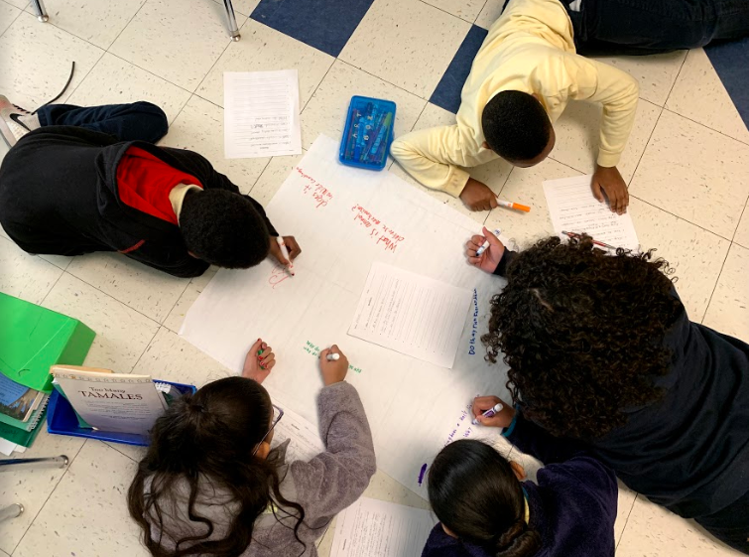
What is the Question Formulation Technique and why use it?

Slide 7
"There is no learning without having to pose a question."
- Richard Feynman
Nobel Laureate, Physics, 1965

Slide 8
Honoring the Original Source: Parents in Lawrence, Massachusetts, 1990
“We don’t go to the school because we don’t even know what to ask.”

Slide 9
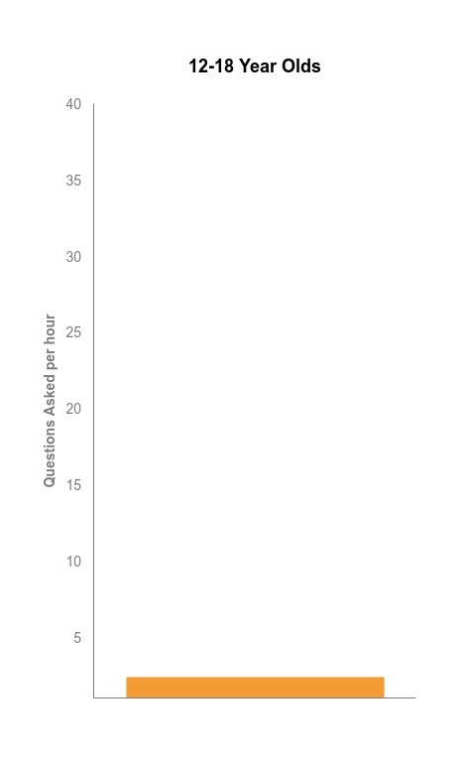
Question Asking Declines with Age
Tizard, B., Hughes, M., Carmichael, H., & Pinkerton, G. (1983).
Dillon, J. T. (1988).
Notes:
First Graph:
Tizard, B., Hughes, M., Carmichael, H., & Pinkerton, G. (1983). Children’s questions and adults’ answers. Journal of Child Psychology and Psychiatry, 24, 269-281.
Girls (mean age 3 years 11 months) from working class and middle class families asked 24 and 29 questions per hour at home, respectively. At school, these same girls asked on average 1.4 and 3.7 questions per hour (working and middle class, respectively)
Need to look into the article to see what age at school.
Second
Differences in question asking by income:
Tizard, B., Hughes, M., Carmichael, H., & Pinkerton, G. (1983). Children’s questions and
adults’ answers. Journal of Child Psychology and Psychiatry, 24, 269-281.
This research study examines two groups of children, one from middle class families and one from working class families, to explore socioeconomic status differences in question-asking behavior at home and at school.

Slide 10
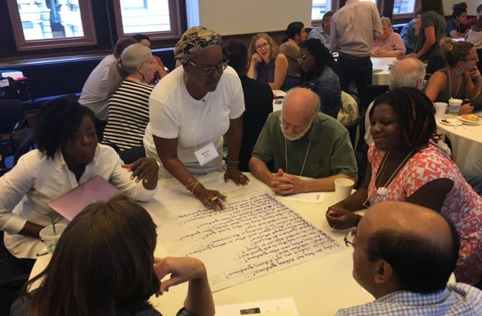
Collaborative Primary Source Learning with the QFT and Padlet

Slide 11
The Question Formulation Technique (QFT)
Individuals learn to:
Produce their own questions
Improve their questions
Strategize on how to use their questions
Reflect on what they have learned and how they learned it

Slide 12
The QFT, on one slide…
Ask as many questions as you can
Do not stop to discuss, judge or answer
Record exactly as stated
Change statements into questions
Question Focus
Produce Your Questions
Follow the rules
Number your questions
Improve Your Questions
Categorize questions as Closed or Open-ended
Change questions from one type to another
Strategize
Prioritize your questions
Action plan or discuss next steps
Share
Reflect
Closed-Ended:
Answered with “yes,” “no” or one word
Open-Ended: Require longer explanation
Source: The Right Question Institute rightquestion.org

Slide 13
Let’s Learn by Doing
Access the QFT Padlet Activity Here:
Group 1: First name starts A – G (Jay moderating)
https://padlet.com/sarahwestbrook1/QFTGroup1
Group 2: First name starts H – P (Laura moderating)
https://padlet.com/sarahwestbrook1/QFTGroup2
Group 3: First name starts Q – Z (Michelle moderating)
https://padlet.com/sarahwestbrook1/QFTGroup3
Feel free to take and use this Padlet activity as a template. Simply log in or create a free Padlet account and click the “Remake” button at the top right corner of the template.

Slide 14
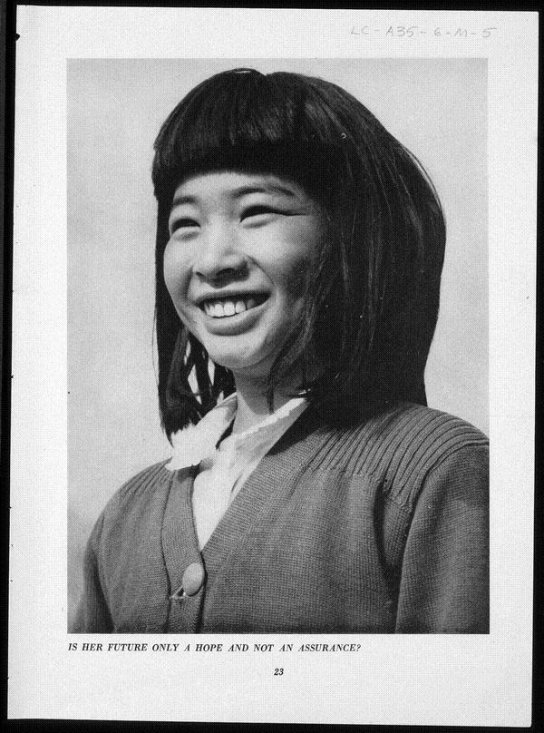
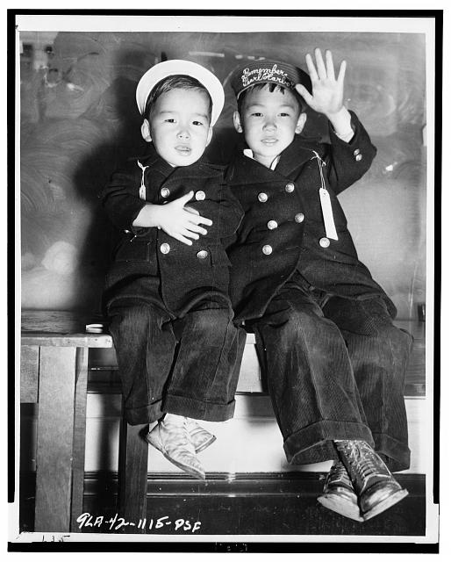
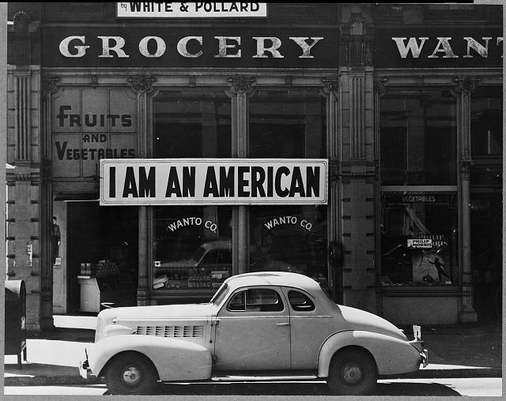
What do I do with the questions students produce?
Students can look for answers to their priority questions (and generate new questions) through researching Library of Congress collections of Japanese American Internment primary sources:
http://www.loc.gov/teachers/classroommaterials/primarysourcesets/internment/ A primary source set on Japanese American internment with teacher’s guide
Women Come To the Front - Dorothea Lange: https://www.loc.gov/exhibits/wcf/wcf0013.html
https://blogs.loc.gov/picturethis/2015/02/day-of-remembrance-photographs-of-japanese-american-internment-during-world-war-ii/ blog post that links resources throughout Library collections
Lead students through primary source analysis and discussion using the TPS “Observe – Reflect – Wonder” tool, starting with their priority questions. See if students can draw inferences that answer their own questions, based on observations. Then see what questions remain, or what new ones have been generated.
Assign a reading, video, or recorded lecture. Ask students to write a response to one of their questions that was answered.

Slide 15
What are your questions for us?
Notes:
4:45

Slide 16
Access All of RQI’s Free QFT Resources
https://rightquestion.org/education/resources
Classroom Examples
Instructional Videos
Planning Tools & Templates
We’re adding new virtual learning templates and guides every day!

Slide 17
Use and Share the QFT
The Right Question Institute offers The Question Formulation Technique and related materials through a Creative Commons License. You are welcome to use, adapt, and share our strategies or materials for noncommercial use, as long as you include the following reference:
“Source: The Right Question Institute (RQI). The Question Formulation Technique (QFT) was created by RQI. Visit rightquestion.org for more information and free resources.”

Slide 18
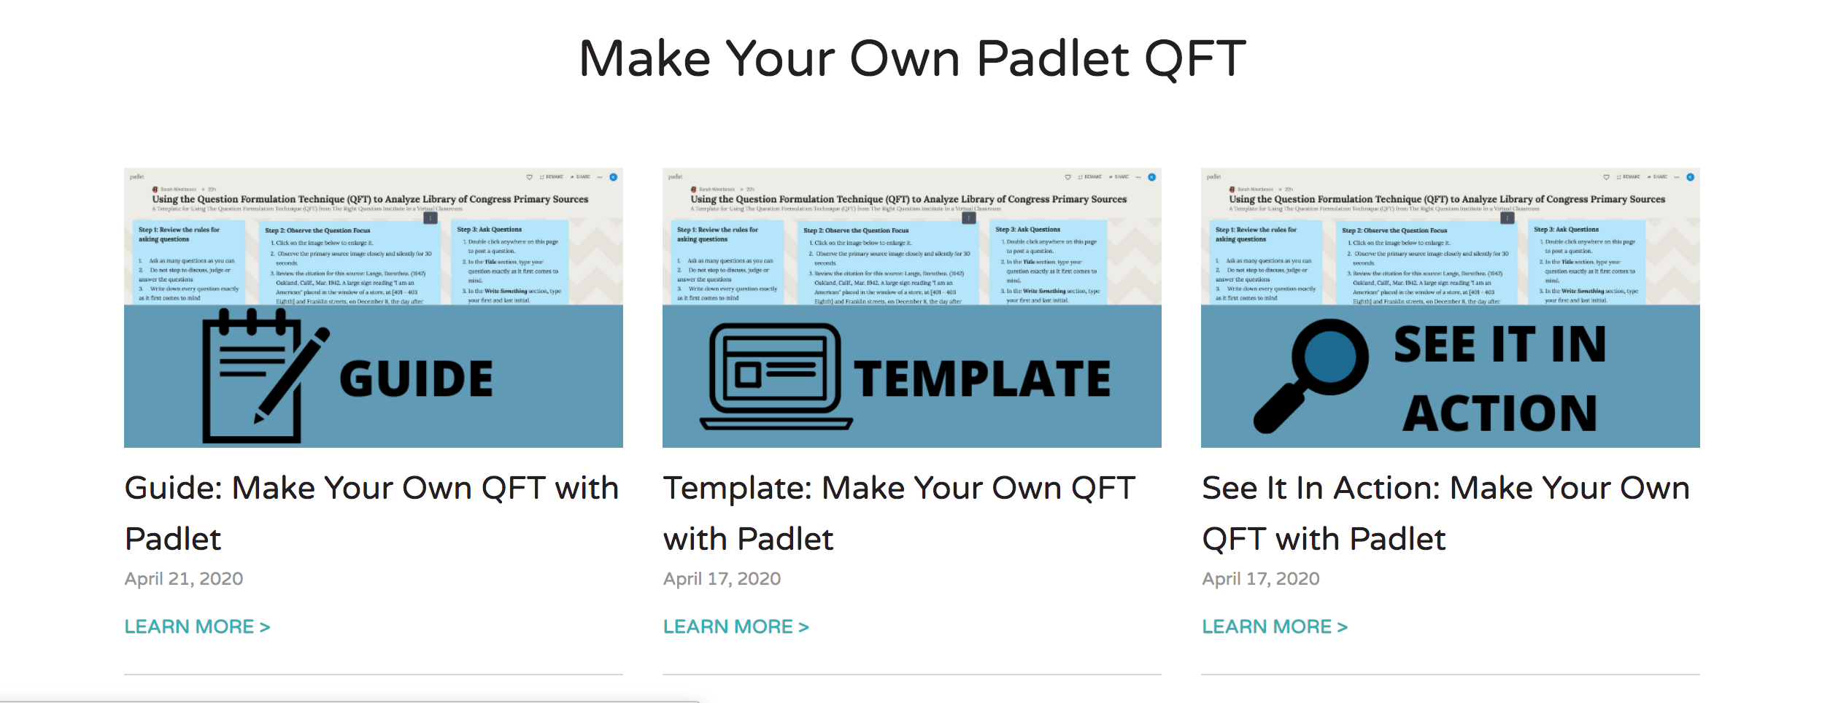
Virtual Learning Toolkits
Notes:
If you liked the padlet activity and would like to try it out with students, the rightquestion.org website has everything you need to make it for yourself, including the template we used today which you can “remake” for yourself”, two screencast video guides on how to create your own with some ideas for how you might adapt it for students, and a webinar recording of a padlet QFT playing out in real time. We have a toolkit for google forms as well and continue to develop and add new tools every day.

Slide 19
To Make Your Own Virtual QFT
Go To:
https://rightquestion.org/remote-learning-resources/
Make an account at rightquestion.org if you don’t already have one:
https://rightquestion.org/register/
Download templates, guides, and examples for free.

Slide 20
Watch Webinars Like This One
Find Upcoming and Recorded Webinars at: https://rightquestion.org/events/

Slide 21
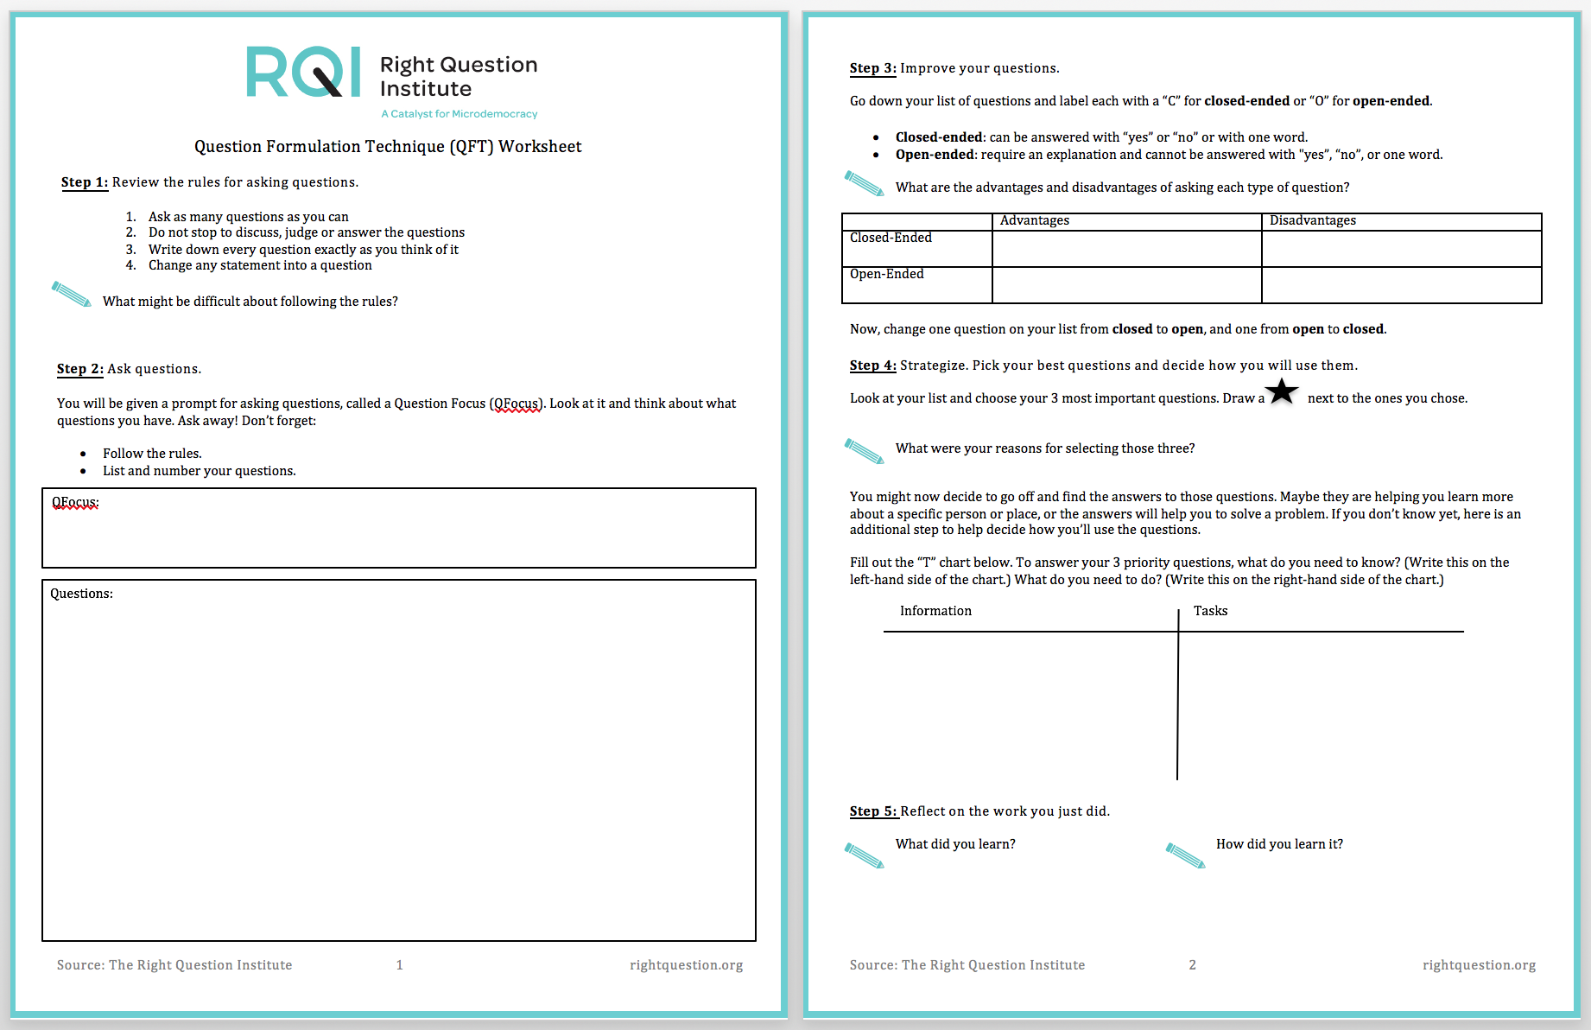
Facilitate an “Off-Line” Remote QFT
Find a printable student worksheet and teacher guide at:
https://rightquestion.org/resources/question-formulation-technique-outline/

Slide 22
Today’s Agenda
What is the Question Formulation Technique (QFT) and why use it?
Collaborative Learning with the QFT and Padlet
Virtual learning resources from The Right Question Institute
- Break -
Collaborative Learning with Googledocs
EdTech Tools and Resources to Pair with the QFT
Q&A and Open Discussion
Reflection with Flipgrid

