Slide 1
Introduction to the Question Formulation Technique (QFT) for Virtual Learning
Hosted by the Maine Department of Education
Sarah Westbrook
Director of Professional Learning
The Right Question Institute
Cambridge, MA
Shane Gower
Maranacook Community High School, Readfield, ME

Slide 2
Who is in the room?
Please introduce yourself in the chat box now!

Slide 3
Today’s Agenda
Why Spend Time on Teaching the Skill of Question Formulation?
Collaborative Learning with the Question Formulation Technique (QFT)
Explore Real Classroom Examples & Applications
Why is Question Formulation Important Now?
Q&A

Slide 4

We’re Tweeting…
@RightQuestion
@SarahRQI
@MrShaneGower
#QFT

Slide 5



Access Today’s Materials and All of Our Free Resources
https://rightquestion.org/events/
Classroom Examples
Instructional Videos
Planning Tools & Templates

Slide 6

Use and Share These Resources
The Right Question Institute offers materials through a Creative Commons License. You are welcome to use, adapt, and share our materials for noncommercial use, as long as you include the following reference:
“Source: The Right Question Institute (RQI). The Question Formulation Technique (QFT) was created by RQI. Visit rightquestion.org for more information and free resources.”

Slide 7
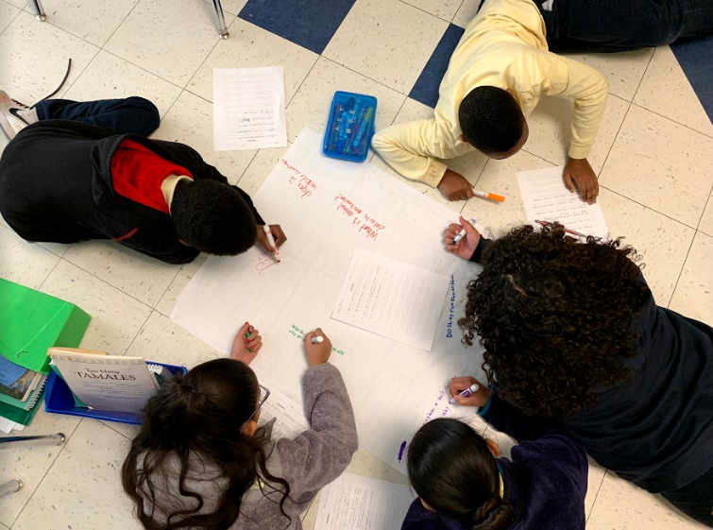
Why spend time teaching the skill of question formulation?

Slide 8

Honoring the Original Source:
Parents in Lawrence, MA 1990
“We don’t go to the school because we don’t even know what to ask.”

Slide 9
“There can be no thinking without questioning—no purposeful study of the past, nor any serious planning for the future.”
– David Hackett Fischer
University Professor Emeritus of History, Brandeis University

Slide 10

“We must teach students how to think in questions, how to manage ignorance.”
– Stuart Firestein
Former chair, Department of Biology,
Columbia University

Slide 11
College Presidents on
What College Students Should Learn
“We are here to ask questions—questions about one another and about the world around us. We are at Yale to nurture a culture of curiosity.”
    Peter Salovey, President of Yale University
  https://president.yale.edu/speeches-writings/speeches/culture-curiosity
“…the best we can do for students is have them ask the right questions.”
- Nancy Cantor, Former Chancellor of University of Illinois
The New York Times, August 4, 2002

Slide 12
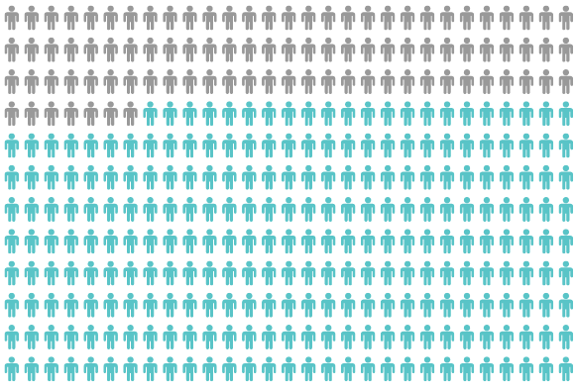
Yet, Only 27% of Graduates Believe College Taught Them How to Ask Their Own Questions
Alison Head, Project Information Literacy at University of Washington, 2016

Slide 13
But, the problem begins long before college…

Slide 14
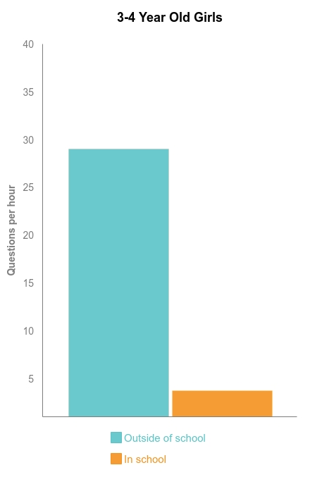
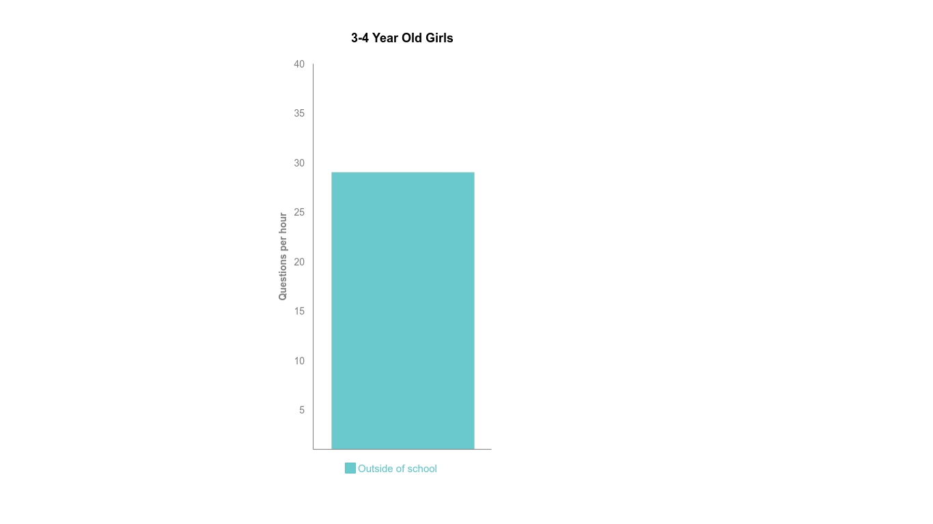
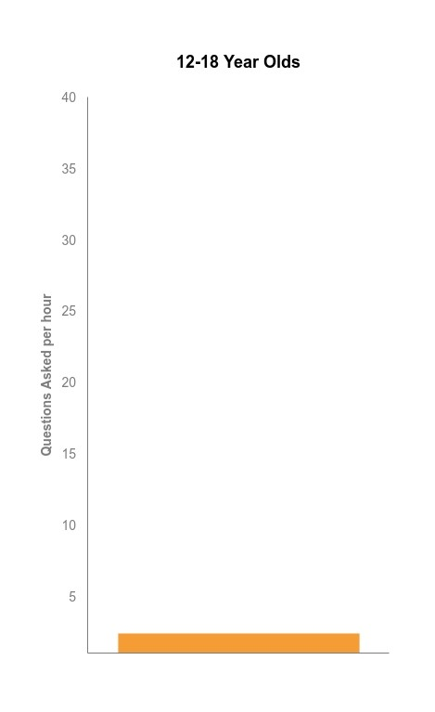


Question Asking Declines with Age
Tizard, B., Hughes, M., Carmichael, H., & Pinkerton, G. (1983).
Dillon, J. T. (1988).
Notes:
First Graph:
Tizard, B., Hughes, M., Carmichael, H., & Pinkerton, G. (1983). Children’s questions and adults’ answers. Journal of Child Psychology and Psychiatry, 24, 269-281.
Girls (mean age 3 years 11 months) from working class and middle class families asked 24 and 29 questions per hour at home, respectively. At school, these same girls asked on average 1.4 and 3.7 questions per hour (working and middle class, respectively)
Need to look into the article to see what age at school.
Second
Differences in question asking by income:
Tizard, B., Hughes, M., Carmichael, H., & Pinkerton, G. (1983). Children’s questions and
adults’ answers. Journal of Child Psychology and Psychiatry, 24, 269-281.
This research study examines two groups of children, one from middle class families and one from working class families, to explore socioeconomic status differences in question-asking behavior at home and at school.

Slide 15
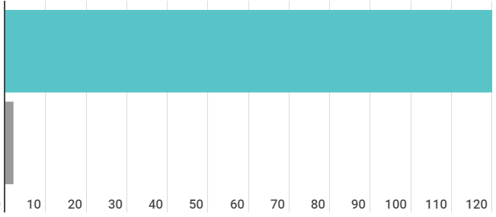
Question Asking by Adolescence
Who’s asking questions over the course of an hour?
Educators
Students
Dillon, 1988, p. 199

Slide 16
We can work together on changing these dynamics

Slide 17






We Are Not Alone
More than 1 million classrooms worldwide

Slide 18
What happens when students do learn to ask their own questions?

Slide 19
Research Confirms the Importance of Questioning
Self-questioning (metacognitive strategy):
Student formulation of their own questions is one of the most effective metacognitive strategies
Engaging in pre-lesson self-questioning improved students rate of learning by nearly 50% (Hattie, p.193)
John Hattie
Visible Learning: A Synthesis of Over 800
meta-Analyses Relating to Achievement, 2008
Notes:
UC Davis Research Linking Curiosity to Memory (UC Davis) 2014
The Fullerton Longitudinal Study (FLS), a 30-plus year study of the development of giftedness across various points in time conducted by Adele and Allen Gottfried of California State University ”This finding has strong implications for the development of STEM considering that curiosity is a fundamental predictor of the aspiration to become a scientist.”
S. von Stumm, B. Hell, T. Chamorro-Premuzic. The Hungry Mind: Intellectual Curiosity Is the Third Pillar of Academic Performance. Perspectives on Psychological Science, 2011 meta-analysis shows They found that curiosity did, indeed, influence academic performance. In fact, it had quite a large effect, about the same as conscientiousness. When put together, conscientiousness and curiosity had as big an effect on performance as intelligence.

Slide 20
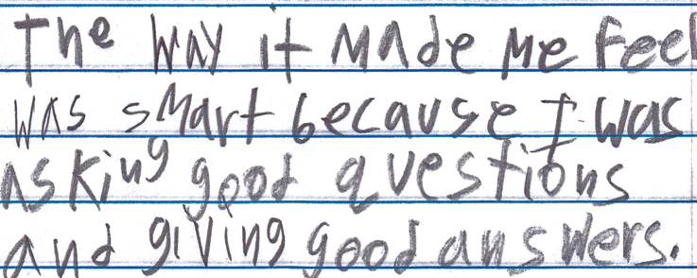
Student Reflection
“The way it made me feel was smart because I was asking good questions and giving good answers.”
-Boston 9th grade summer school student

Slide 21
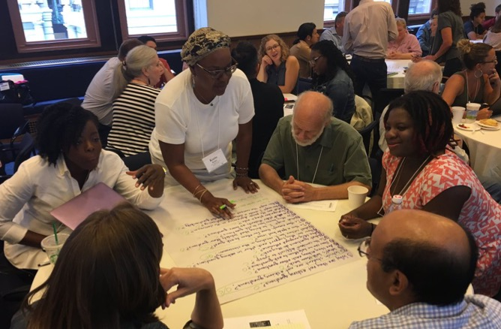
Collaborative Learning with the Question Formulation Technique (QFT)
Notes:
Now we’re going to work together on the problem of students not asking questions, by using the Question Formulation Technique.
The next 20 minutes or so will be highly participatory and of course we’re going to be putting you to work. You may want to get some paper or pull up a blank document on your computer screen now. And remember, watch out for the chat box icon. I will tell you when you need to type into it.
The timing may be a little quick, so don’t worry if you haven’t completed every step; we’re more giving you a taste of the whole process. The rest of this course will go far more in depth on each piece.” we will be moving you quickly through an experience to demonstrate how we go through the process, but will be rushing to make sure there is time for your questions at the end." This is giving you a taste

Slide 22
The Question Formulation Technique (QFT)
  Individuals learn to:
  Produce their own questions
  Improve their questions
  Strategize on how to use their questions
  Reflect on what they have learned and how they learned it

Slide 23
Rules for Producing Questions
1. Ask as many questions as you can
2. Do not stop to answer, judge, or discuss
3. Write down every question exactly as stated
4. Change any statements into questions
Notes:
NOTE THAT THEY ARE Working ALONE rather than in a group: Say something about not judging YOURSELF or changing your wording as it comes out
Think about what will be difficult to follow for you. Pause.
DO NOT ASK THEM TO SHARE!!!
Usually, people say that it is difficult not to stop to answer and judge.

Slide 24
Let’s Learn by Doing
Access the QFT Padlet Activity Here:
  https://padlet.com/sarahwestbrook1/Maine
Feel free to take and use this Padlet activity as a template. Simply log in or create a free Padlet account and click the “Remake” button at the top right corner of the template. Be sure to select “copy posts” before clicking “submit.”

Slide 25
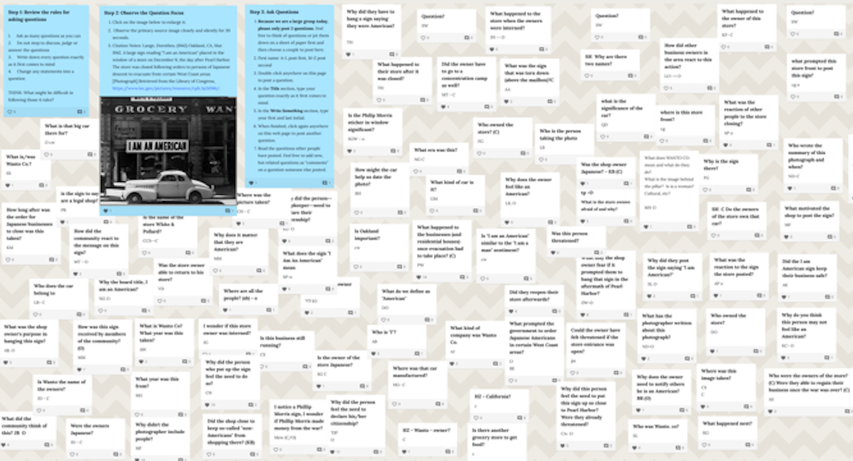
Make Your Own Padlet
Access the QFT Padlet Template Here:
https://padlet.com/sarahwestbrook1/QFT2
Access a quick guide to using Padlet:
https://rightquestion.org/remote-learning-resources/

Slide 26

A Look Inside the Process

Slide 27
The QFT, on one slide…
Ask as many questions as you can
Do not stop to discuss, judge or answer
Record exactly as stated
Change statements into questions
Question Focus
Produce Your Questions
    Follow the rules
    Number your questions
Improve Your Questions
    Categorize questions as Closed or Open-ended
    Change questions from one type to another
Strategize
    Prioritize your questions
    Action plan or discuss next steps
    Share
Reflect
Closed-Ended:
Answered with “yes,” “no” or one word
Open-Ended: Require longer explanation
Source: The Right Question Institute rightquestion.org

Slide 28
  Three thinking abilities
  with one process

Slide 29
Thinking in many different directions
Divergent
Thinking

Slide 30
Narrowing Down, Focusing
Convergent
Thinking

Slide 31

Thinking about Thinking
Metacognition

Slide 32
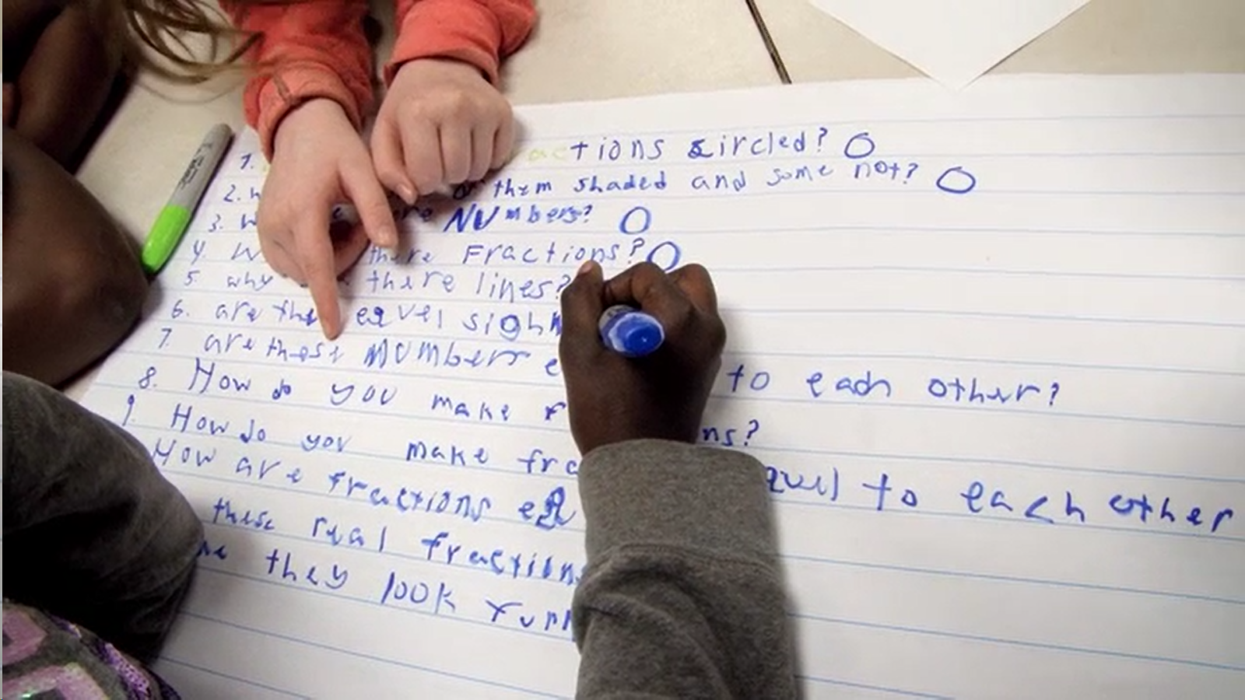
Exploring Classroom Examples

Slide 33
Classroom Example: High School
Teacher: Shane Gower, Readfield, ME
Topic: 11th Grade US History unit on the World Wars
Purpose: Primary source analysis

Slide 34
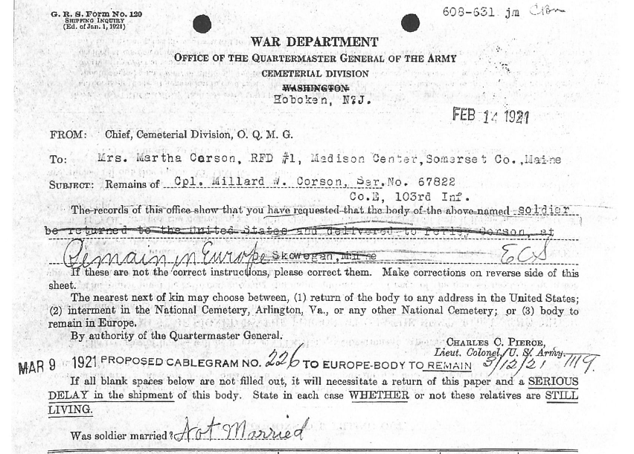
Question Focus
Source: Millard Corson World War I Burial Case File; Correspondence, Reports, Telegrams, Applications and Other Papers relating to Burials of Service Personnel, Records of the Quartermaster General’s Office, 1915-1935, Record Group 92; National Archives and Records Administration - St. Louis.

Slide 35
Before the QFT
Before asking questions, students did an initial analysis using the “HAPP(Y)” framework:
  H- Historical Context
  A- Audience (intended)
  P- Point of View
  P- Purpose
  Y- Why should we care?
Students made notes on each category after watching videos and looking at documents.

Slide 36
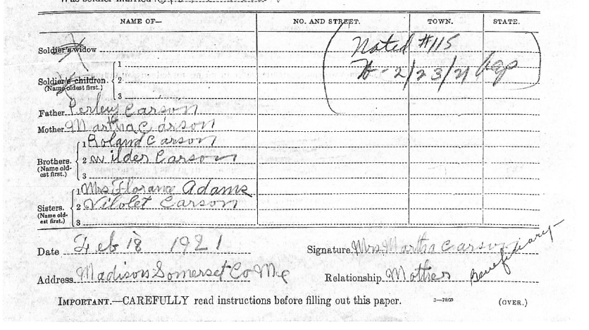

Slide 37
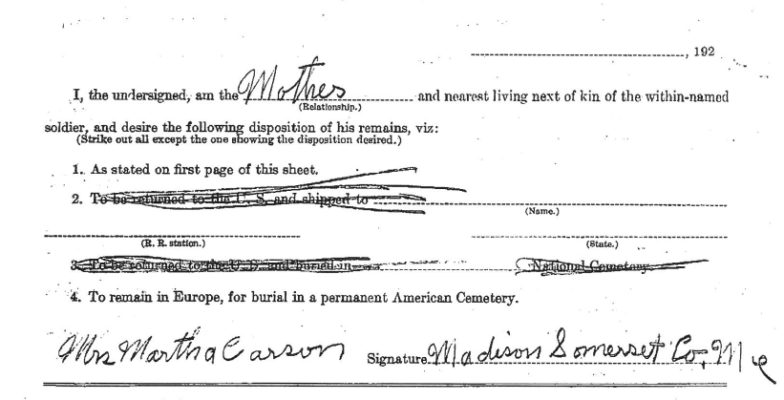

Slide 38
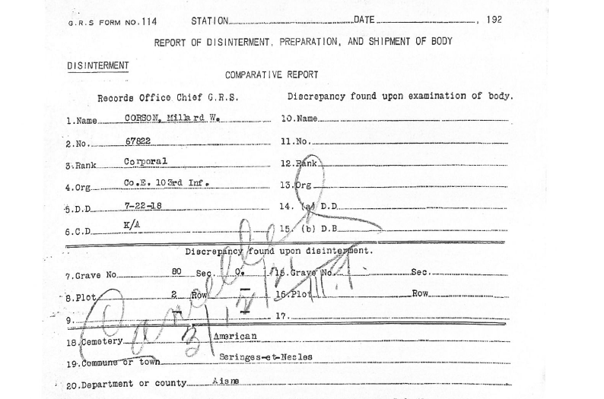

Slide 39
Selected Student Questions
Why did his mother change her mind?
How did his mother decide where he would be buried?
What influenced people’s decisions on where to bury their loved ones?
Why did the US Government give families this choice?
Why was he buried in this particular town in France?
Why was this decision made 3 years after his death and how did that affect the decision?

Slide 40
Next Steps with Student Questions
Students created a slideshow with the question they selected, their answer, and any sources used.
  Slide show can be shared with the original student who asked the question
  Slide show can be presented to the class
In a class discussion, students considered:
  What happens when people fight over power?
  What do these questions and answers tell us about the First World War?
  What did we learn about life in Maine at the time?
  What did we learn about sacrifice?
  How can we acknowledge and commemorate the sacrifice of Millard Corson?

Slide 41

Virtual Classroom Example:
4th Grade Social Studies
Teacher: Alyssa Park, Gardnerville, NV
Topic: The Hoover Dam
Purpose: To analyze a primary source and launch a mini-inquiry – using Google Forms!

Slide 42
Question Focus
Library of Congress: https://www.loc.gov/resource/cph.3b07810/
Notes:
She told them: draw on what you know of these two texts

Slide 43
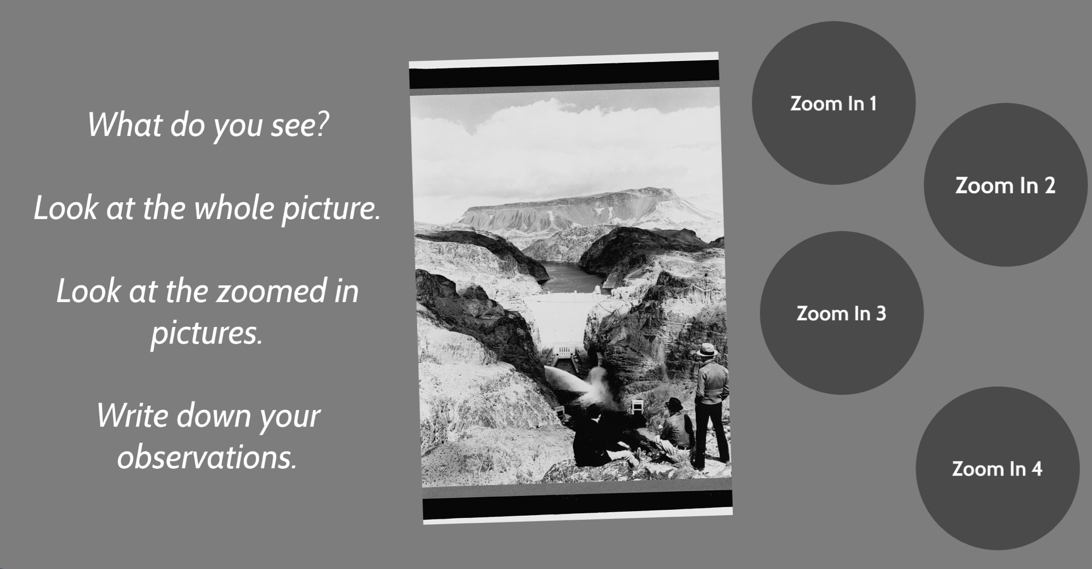
Question Focus…using Prezi!
Library of Congress: https://www.loc.gov/resource/cph.3b07810/
Notes:
She told them: draw on what you know of these two texts

Slide 44
Student Questions
1.Where is this?
2.Why is there a river?
3. Is it a desert?
4. Is it near the grand canyon?
5.When was this picture taken?
6.How did they take the picture?
7.Was it in the 1900's?
8.Where does the road lead to?
9.What is the road called?
10. Is the sculpture (or whatever it is) in the middle of the road a rock?
11.Where is the building located?
12.Do people live in that building?
13. Is it a work place?
14.Is there water at the bottom of the building?
16.How did they build that building?
17.How do people get to the top to the bottom?
18.Is the water falling from the rocks a waterfall?
19.Can people visit the building?
20.How does the water get there?

Slide 45
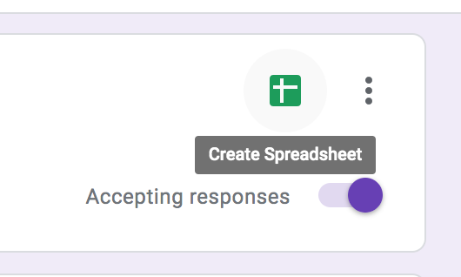
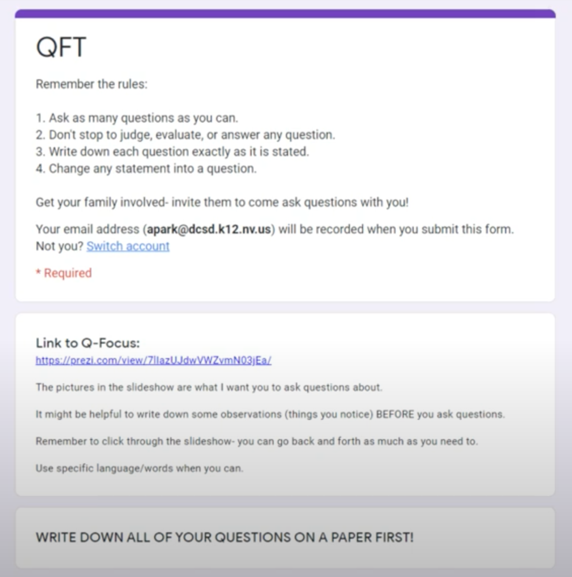
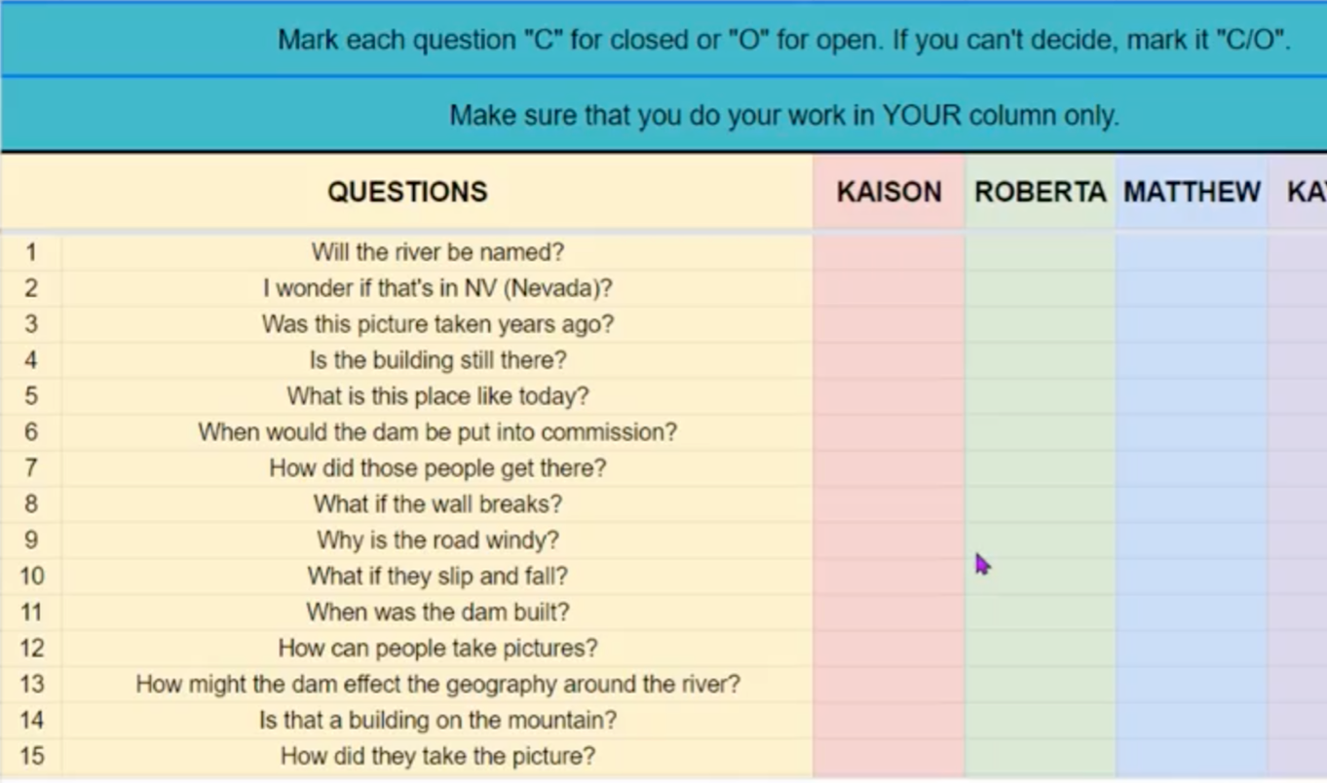
Student Questions…using Google Forms!
Students entered their questions in a google form, which populated a google sheet they could use to categorize their questions as open and closed.
Notes:
She made hers fancy and collaborative, but you don’t have to necessarily do that

Slide 46
Next Steps
Days 1-3 | Using google forms and google sheets
Ask & Improve Questions
Day 4
Gather Basic Information
Students picked 3 closed-ended questions to answer
Read from a collection of 4th grade, Hoover Dam books on Epic!
Shared answers in a collaborative google slide deck
Day 5
Prioritize Questions (Again!)
Pick from the whole class list: 3 questions you would need to answer to write a historical fiction story on the Hoover Dam.
Days 6 & 7
Further Research
They will spend time looking through a “playlist” of resources categorized by the major themes – how dams work, life during the great depression, etc. and answer their second set of priority questions.

Slide 47
Classroom Example: 12th Grade
Teacher: Daniel Fouts, Des Plaines, IL
Topic: 12th Grade AP Government unit on the American presidency at moments of crisis
Purpose: To engage students at the start of the unit and to help students select a topic for an independent project

Slide 48
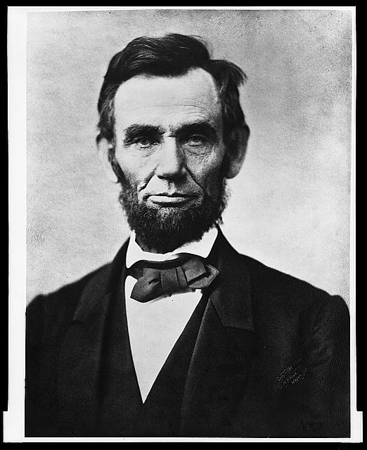
Question Focus
“Nearly all men can handle adversity; but if you really want to test a man’s character, give him power.”
https://www.loc.gov/pictures/item/96522529/

Slide 49
Student Questions
How does power challenge one’s morality?
Should everyone have some type of power?
Does power make people corrupt?
What if the person who is qualified for power doesn’t attain it?
How is a man’s power tested?
What is considered power?
What defines good character?
How can we ensure that the good men get the power?
What kind of man can handle adversity?
What can power tell us about a man’s character?
How can power be obtained by adversity?
Why are some people affected by power differently?
If adversity supposedly makes you stronger, does that mean that power makes you weaker?

Slide 50
Next Steps with Student Questions
Each student selected l question from the class list to work on throughout the unit
Students answered their question using research and knowledge from the unit in a two-page reflection paper
Students shared their reflections in a class discussion on the final day of the unit

Slide 51
The QFT Can Be Used… at Various Points in a Unit for Many Different Purposes
BEGINNING
MIDDLE
END
Engagement
Pre-reading
Formative assessment
Skill development
Discussion
Lab
Guest speaker
Peer feedback
Close Reading
Primary source analysis
Test prep
Final paper topics
Independent research
Summative assessment

Slide 52
Many Possible Uses for Student Questions
Debate Prep
Find Additional Primary Sources
Lab work & Experiments
Exit ticket
”Do Now”
Projects
Hang on walls,
Check Off as Answered
Research
Pop Quiz or Reading Check
Inquiry
Test Prep
Homework
Class discussion prompts
Presentations
Student Choice Projects
Interview an Expert
Socratic Seminar Prompts
Make Your Own Final Test
Journal Prompt
Guest speakers
Paper topic
Blogging or Tweeting
Close Reading Protocol
Year-long or Unit-long Essential Questions
Tailoring Instruction
Service Action Projects

Slide 53
Why is the skill of question formulation so important now?

Slide 54

In the Age of Google
“How should you respond when you get powerful new tools for finding answers?
Think of harder questions.”
– Clive Thompson
Journalist and Technology Blogger

Slide 55
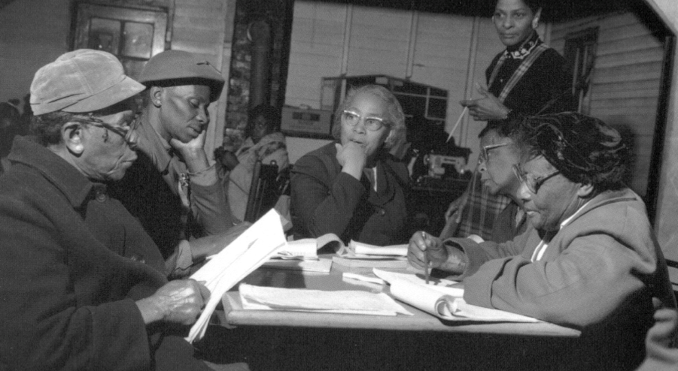
Questions and Democracy
“We need to be taught to study rather than to believe, to inquire rather than to affirm.”
– Septima Clark
Chapter 6 on Septima Clark in Freedom Road: Adult Education of African Americans (Peterson, 1996)

Slide 56
What are your questions for us?
Notes:
4:45

Slide 57
Thank you! Enjoy!

Slide 58
Using & Sharing RQI’s Resources
The Right Question Institute offers materials through a Creative Commons License. You are welcome to use, adapt, and share our materials for noncommercial use, as long as you include the following reference:
“Source: The Right Question Institute (RQI). The Question Formulation Technique (QFT) was created by RQI. Visit rightquestion.org for more information and free resources.”
Access today’s materials (and more!): http://rightquestion.org/events/

